Slide 1


The Impact of Caring Responsibilities on Maria’s Lifespan Development
Evaluating Bowlby’s Attachment Theory
Maria’s case study
Attachment and development
Nature and nurture
My person-centred support plan
In-text citations
(Bowlby, 1988)

Slide 2

Strengths
1. Explains emotional impact of loss
2. Evidence-based
3. Widely used
4. Useful in practice
Limitations
1. Focuses mainly on early childhood
2. Limited consideration of culture
3. Doesn’t explain every outcome
4. Less emphasis on biology
(Bowlby, 1988)

Slide 3
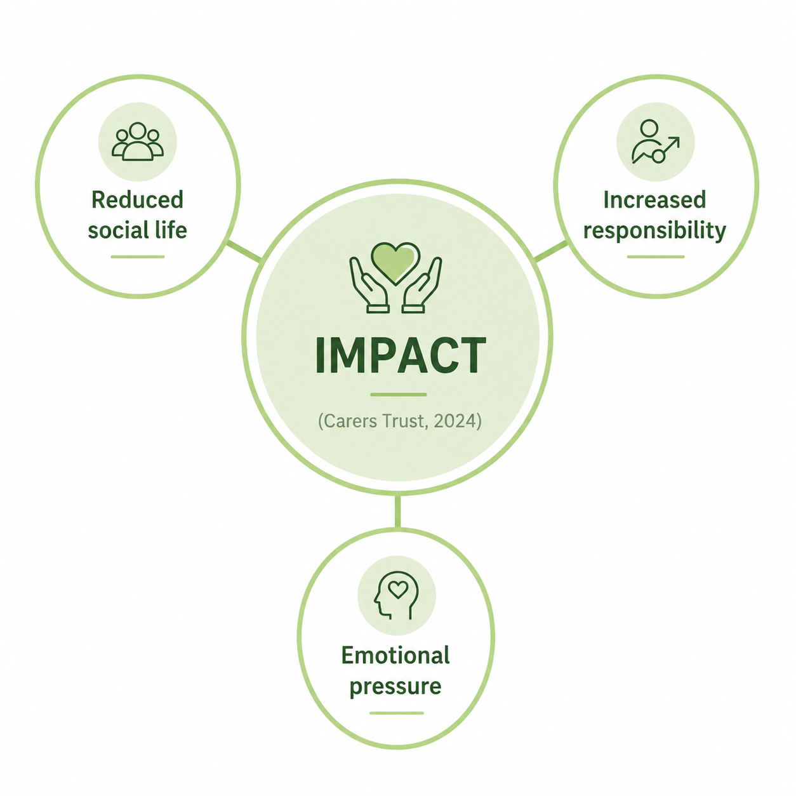
Maria
Young Carer
16 years old
Father died five years ago
Primary young carer
Supports mother daily
Caring responsibilities include:
cooking
cleaning
shopping
administration
Mother experiences mobility difficulties, memory problems and low mood.

Slide 4
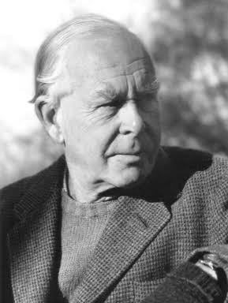
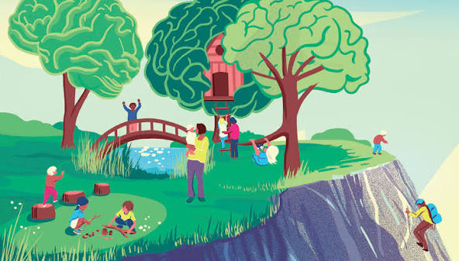
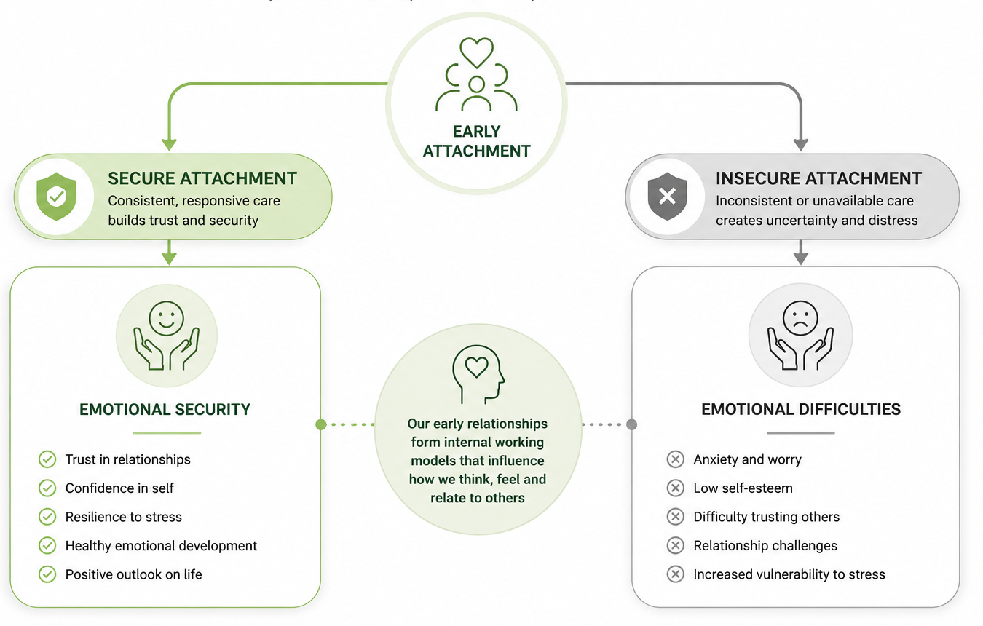
John Bowlby
Attachment Theory
(Bowlby, 1969; Bowlby, 1988)
Key concepts
Secure attachment
Insecure attachment
Internal Working Model
Loss and separation
Emotional security
Bereavement may influence later emotional development.

Slide 5

Possible Affects
Emotional
Grief
Anxiety
Stress
Guilt
Social
Isolation
Reduced friendships
Educational
Fatigue
Reduced concentration
Psychological
Parentification
Increased responsibility
Bowlby’s theory illustrates how Maria’s experiences could impact her development across various domains: emotionally, she may face ongoing grief, anxiety, and guilt; socially, her caregiving duties might limit her time with friends, leading to isolation; educationally, these responsibilities could cause fatigue and decreased concentration; psychologically, she has undergone parentification, taking on adult roles, which may affect her future relationships and emotional wellbeing.
(Ainsworth et al., 1978; Howe, 2011)

Slide 6
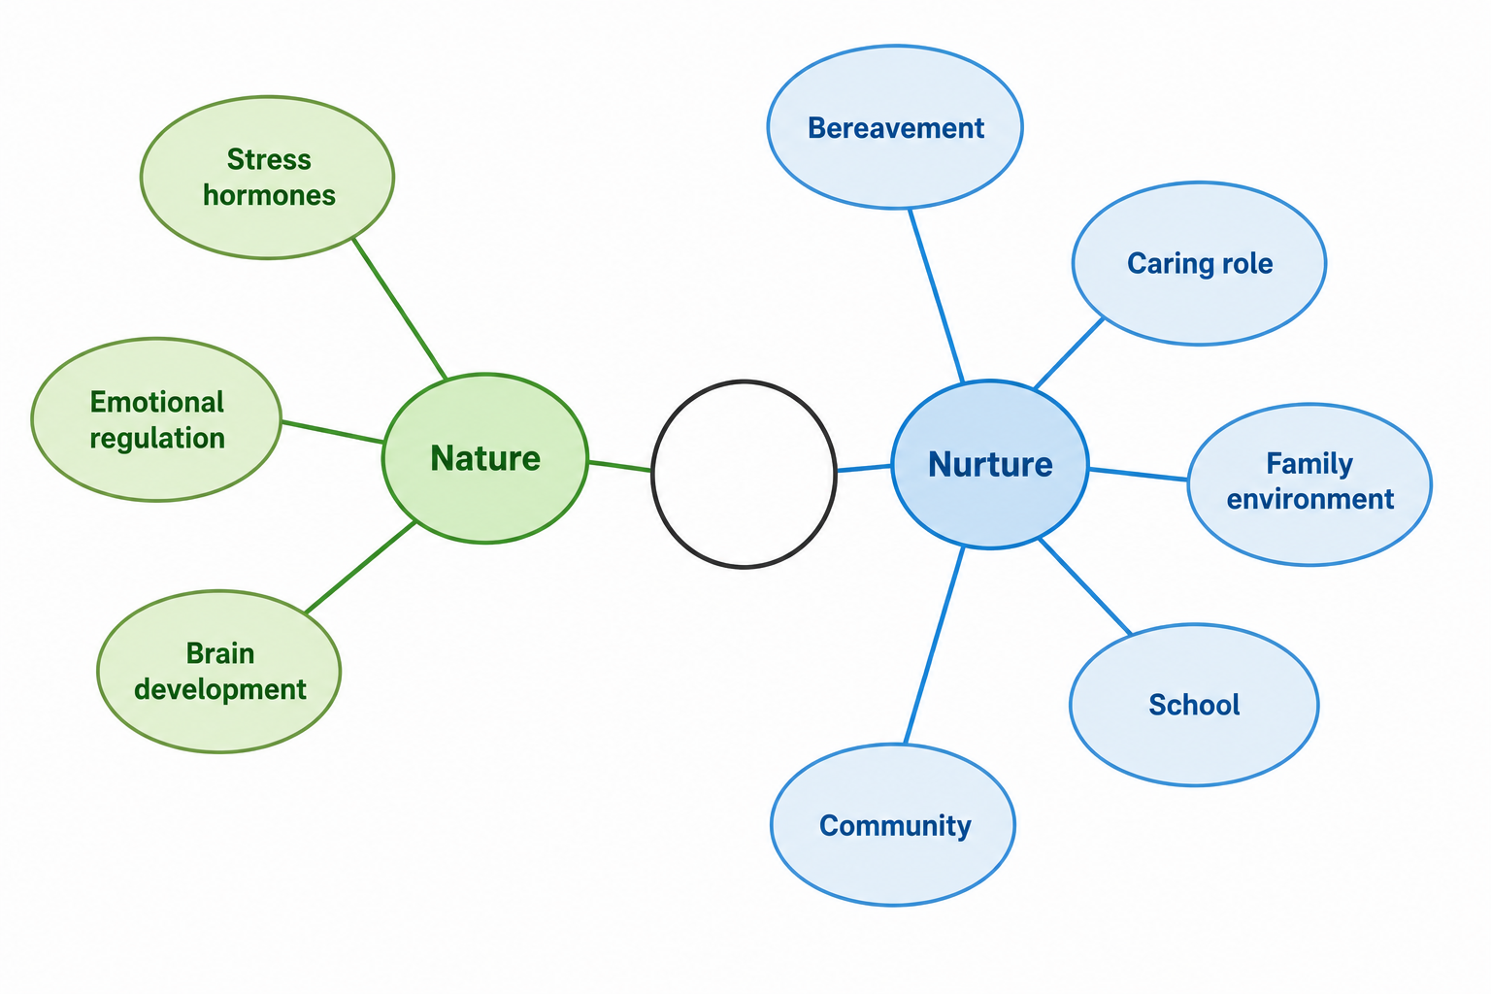

Bowlby's attachment theory and Bronfenbrenner's Ecological Systems Theory highlight that Maria's development is influenced by both biological factors, such as chronic stress affecting emotional regulation, and environmental factors, including her bereavement, caring responsibilities, school environment, and support networks, emphasizing that development results from the interaction of these influences rather than a single factor.
Bronfenbrenner shows how multiple environments influence development.
(Bronfenbrenner, 1979)

Slide 7

Recommendation
I would recommend:
✔ Young Carers Service
✔ Bereavement counselling
✔ School wellbeing support
✔ Social worker assessment
✔ Family support worker
✔ Respite care
✔ Peer support groups
✔ Emotional resilience programme
🤝
❤️
🏫
👨‍👩‍👧
🌱
I would refer Maria to a Young Carers Service for practical support and to reduce isolation, recommend bereavement counselling for processing her father’s loss, involve school wellbeing services for educational support, conduct a social worker assessment to identify unmet family needs, arrange respite care for breaks from her responsibilities, and suggest peer support groups and emotional resilience programmes to build confidence and foster secure relationships, aligning with Bowlby’s theory.

Slide 8
In conclusion
Maria has experienced significant challenges.
Bowlby’s theory explains many emotional effects.
Bronfenbrenner broadens understanding.
Early intervention improves outcomes.
Person-centred support promotes resilience.

Slide 9


Reference
Ainsworth, M.D.S. Et al. (1978). Patterns of Attachment.
Berk, L.E. (2023). Development Through the Lifespan.
Bowlby, J. (1969). Attachment and Loss: Volume 1.
Bowlby, J. (1988). A Secure Base.
Cox, A. (2019). Helping Your Child with Worry and Anxiety.
Howe, D. (2011). Attachment Across the Lifecourse.
NICE. (latest guidance).
Carers Trust. (latest report).
Williams, L.V. (1983). Teaching for the Two-Sided Mind.
YoungMinds. (latest report).

