Slide 1
Independent Project
40 credits
Semester 2 + 3

Slide 2
Brief overview of module
Topic identified in Industrial-Based Research module
Overseen by supervisor
Culmination of your degree – in the case of Apprentice students, usually work-related
Must have a practical element due to our British Computer Society accreditation ie something you can demonstrate at the end (can’t be just research)

Slide 3
Title of project
Most students will already have a Project Title/plan from work done in the Industrial-Based Research module
Most DDA students do a project with their employer.
If an employer-based project is not possible, please discuss with me.

Slide 4
Assessment points
15% Interim Viva – w/c 20th April (10-15 min presentation)
55% Report – Friday 24th July 3pm (approx. 10,000 words)
10% Exhibition poster + materials – Monday 27th July 3pm
20% Final Viva + demo – August 31st/Sept 1st (15-20 min presentation)

Slide 5
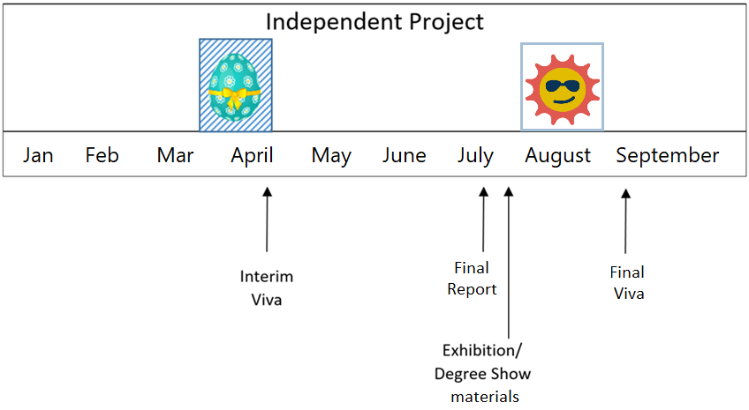
Summary of assessment
(Poster)

Slide 6
Supervisor’s role
Students work independently with the supervisor to oversee
(20 minutes/week)
The supervisor’s role is to use their experience to guide you, make suggestions, make sure you meet deadlines.
It is not the job of the supervisor to do your project! ☺
It is not the job of the supervisor to give you weekly tasks

Slide 7
Check with employer re demo
Some DDA students from previous cohorts had problems with demo of project at the end.

Slide 8
Structure of project
Introduction
Literature Review
Research Methodology
Implementation
Results/Discussion
Conclusion/Future Work
Personal Reflection
Detail about all of the above is available in the Project Handbook (on Moodle)

Slide 9
Moodle
Moodle – can we all see the module(s)? ACCA6020
There are several versions of this module on Moodle:
Ours is labelled: “DDA Students (Sem 2/3 2026)”
Project Handbook
Ethics form (if required)

