Slide 1

Chronic Obstructive Pulmonary Disease (COPD): Diagnosis, Assessment, Management and Personalised Care in the UK
Module: Community Care and Management of Longer-term Conditions
Module Code: LCHS7003
Student Name: SAYED AMAAN
Student ID: 2541476
Lecturer Name: MUHAMMED KHAN

Slide 2
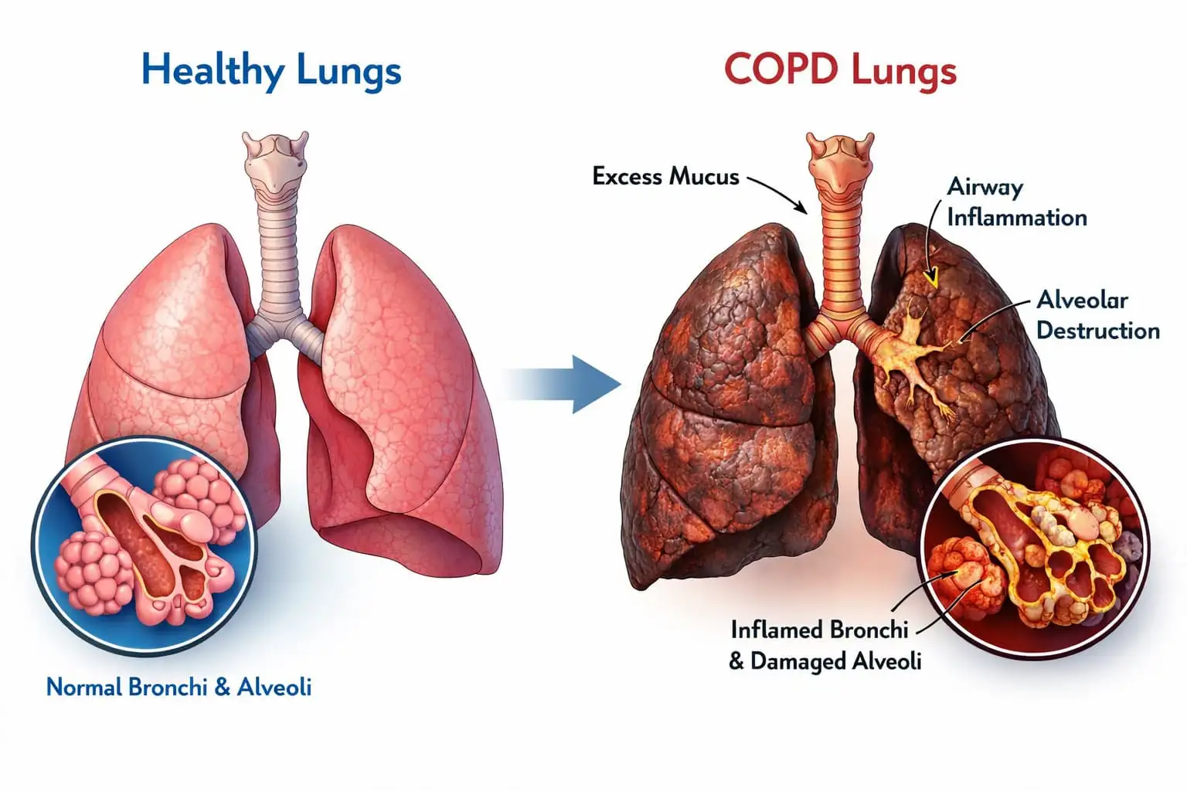
Introduction
COPD is a preventable, treatable and progressive chronic respiratory disease, which is defined by chronic airflow limitation (Stolz et al., 2022).
It has serious impact on physical health, mental health, and quality of life (Martins et al., 2024).
Well-managed care is multi-disciplinary, evidence-based and person-centred (Moloney et al., 2026).
This presentation will critically assess the current guidance on the diagnosis, management, prevention and individual COPD self-management in the UK.
Notes:
COPD is a significant health problem. Respiratory nurses have an important role in early diagnosis, in optimising treatment, educational activities and in providing holistic and personalised care to maximize long term patient outcomes.

Slide 3
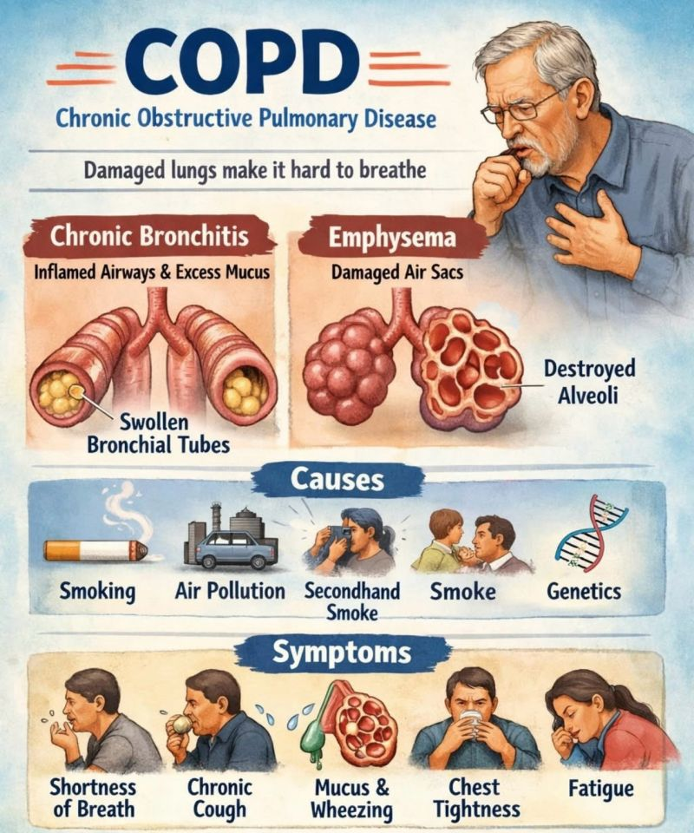
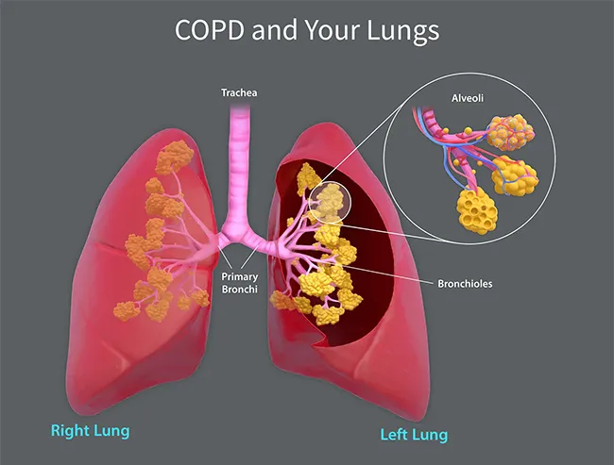
Overview of COPD
COPD includes chronic bronchitis and emphysema, causing irreversible airflow obstruction and chronic inflammation (Xu et al. 2024).
Symptoms include cough, sputum production, dyspnea, wheezing and fatigue (Jo, 2022).
Despite this, the biggest cause is cigarette smoking, although occupational dust and biomass smoke, and air pollution also play a role (Ortiz-Quintero et al., 2022; Dutta et al., 2024).
Non-smokers are more susceptible due to Genetic factors, especially Alpha-1 Antitrypsin Deficiency (Tubío-Pérez et al., 2022).
Notes:
COPD is caused by a long-term exposure to particles over many years. Persistent inflammation damages lung tissue, resulting in airflow limitation, declining respiratory function and increased exacerbation risk.

Slide 4
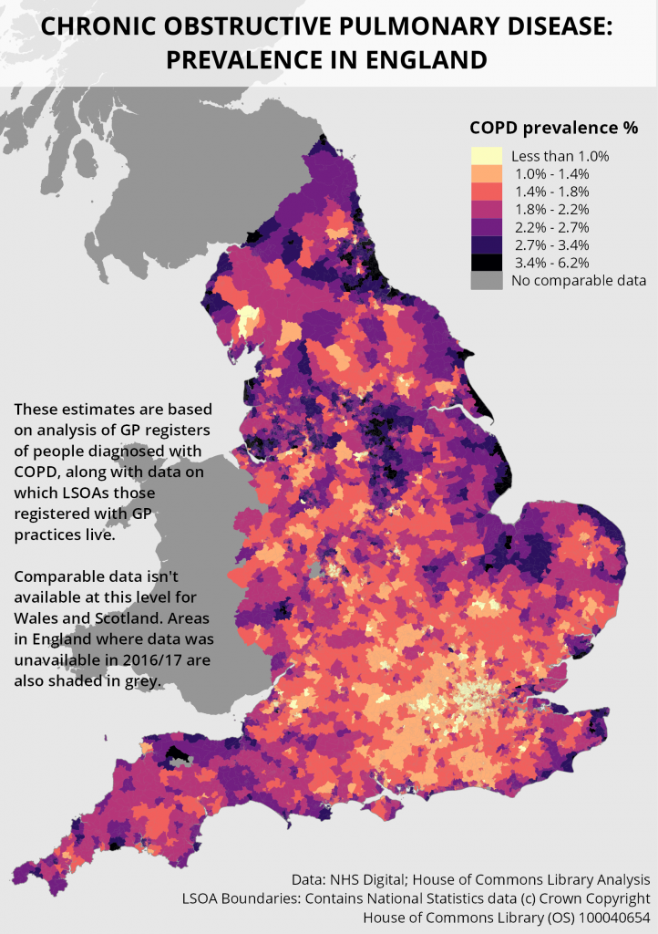
Prevalence of COPD
In the UK, 1.4 million people have the condition COPD, many of whom are undiagnosed (Asthma and Lung UK, 2022).
World Wide, COPD affects more than 390 million people worldwide, and is one of the top causes of death (WHO, 2026).
Diseases are more prevalent in older people and in individuals who smoke and who live at polluted sites (Adeloy et al., 2022).
There are significant inequalities in COPD incidence in ethically deprived communities throughout the UK, which are driven by health inequalities (Barker et al., 2024, Williams et al., 2022).
Notes:
COPD is an increasing worldwide health problem. Earlier detection, smoking cessation programmes and mitigation of the environment continue to be key interventions to limit disease prevalence and mortality.

Slide 5
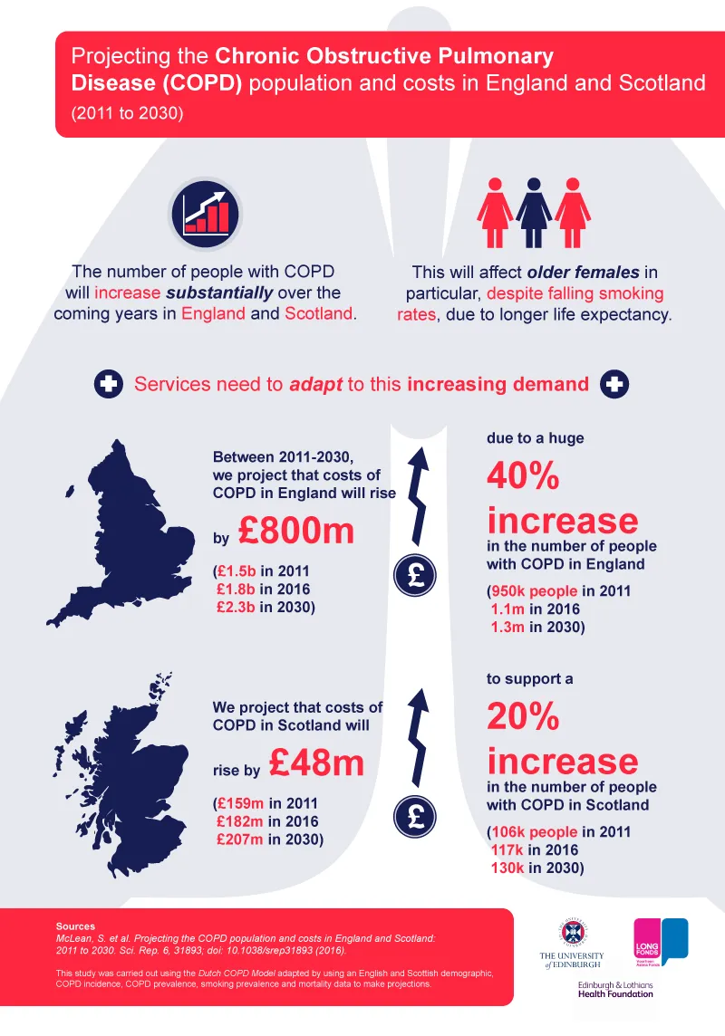
Economic, Physical, Psychological and Social Burden
Hospital admissions, medications and long-term care are some of the key ways that COPD makes a significant contribution to NHS spending (Sansbury et al, 2022).
Patients have diminished exercise tolerance, disability and impairment in their independence (Magunagoikoetxea-Comins et al. 2025).
Anxiety and depression frequently tend to co-occur, negatively impacting disease management (Siraj, 2025).
Emotional, financial and physical burdens involved in providing long term care (LTC) can be experienced by family caregivers (Gholami et al., 2025).
Notes:
The consequences of COPD are not just respiratory! Management should include psychological wellbeing, family support/socio-economic problems as well as the medical management.

Slide 6
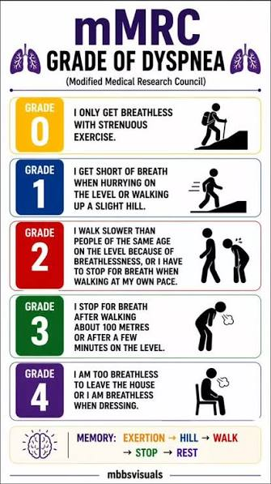
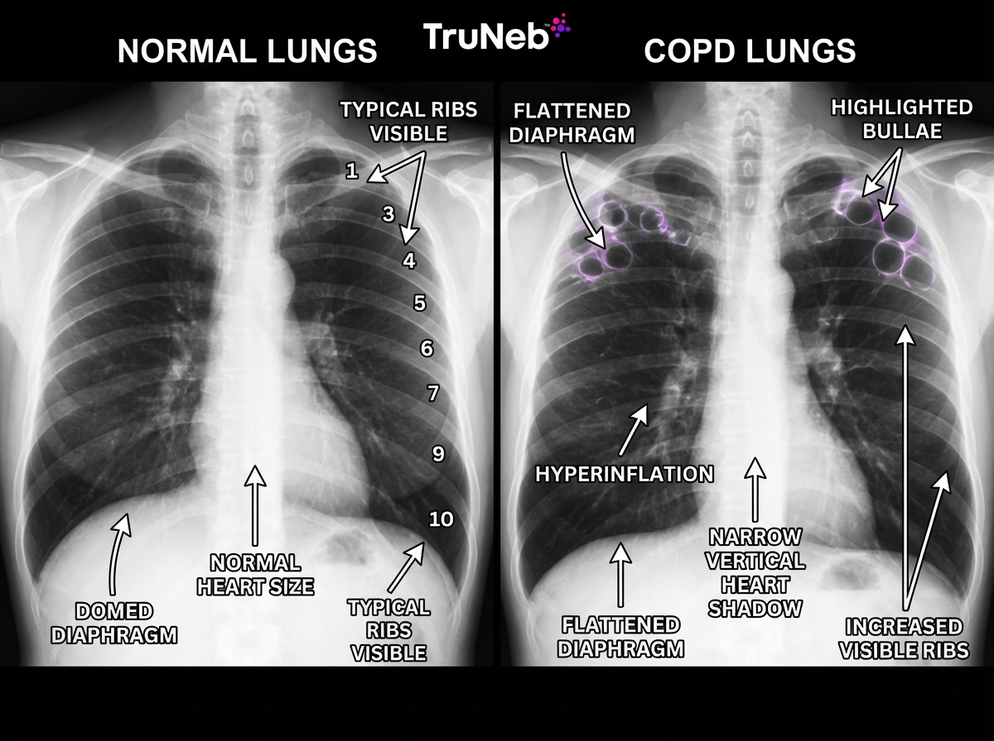
Diagnosis and Initial Assessment
Diagnosis is reached with clinical history, PE and post bronchodilator spirometry showing ongoing airflow limitation (Haynes et al., 2023; Kim and Han, 2025).
Spirometry, symptom assessment and exacerbation history is recommended by NICE NG115 to accurately diagnose (Nice.org.uk, 2018)
CAT score, MRC Dyspnoea Scale and exacerbation frequency should be included in COPD severity (Ma et al., 2026; ERTAN YAZAR et al., 2022) .
Assessment includes smoking history, oxygen saturation, BMI, imaging and screening for comorbidities (Kahnert et al., 2023).
Notes:
Diagnosis is essential for proper treatment. When treatment is personalized, comprehensive assessment will determine the disease level, symptom burden, and related health conditions.

Slide 7
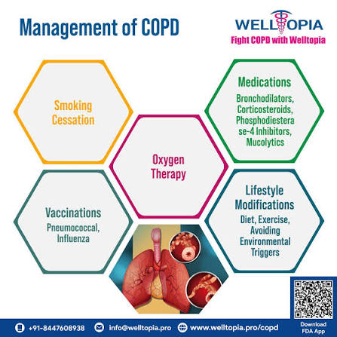
Disease Management as per UK Guidance
Smoking cessation, inhaled therapies, pulmonary rehabilitation and vaccination are recommended in the NICE NG115 (Shrikrishna et al., 2025).
The GOLD strategy advocates for individualised pharmacological treatment according to symptoms and the risk of exacerbation (Samajdar et al., 2025).
Multidisciplinary care (with respiratory nurses, physiotherapists, pharmacists and GPs) has a positive impact on outcomes (Leemans et al., 2023).
ICS facilitate COPD care coordination and evidence-based, patient-centred COPD management (Pagano et al., 2023).
Notes:
Medication is not the only form of management. Multidisciplinary care that is well-coordinated and adherence to evidence-based guidelines decrease exacerbation rates, increases lung function and improve patient quality of life.

Slide 8
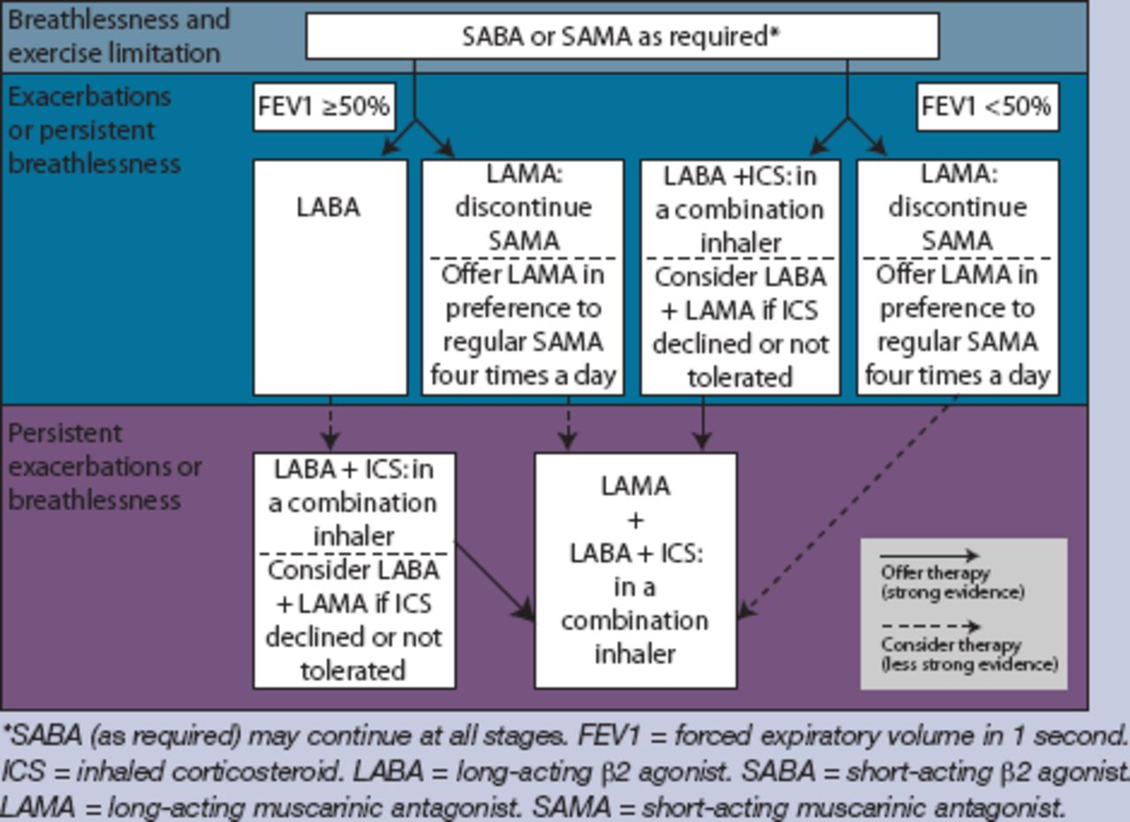
Treatment Available in the UK
Symptom control should still be treated with bronchodilators (LAMA, LABA) as the first line of treatment (Miravitlles et al., 2022).
Inhaled corticosteroids are recommended for some people with frequent exacerbations and eosinophilia (Oishi et al., 2023).
Pulmonary Rehabilitation has a significant effect on exercise capacity, breathlessness and health related quality of life (Huang et al., 2024).
Severe COPD patients who meet certain criteria benefit from long-term oxygen therapy and non-invasive ventilation and lung volume reduction (Volpi et al., 2022).
Notes:
Treatment should be tailored to support the treatment of the specific individual based on their symptoms, exacerbation history and clinical assessment. Non-Pharmacological interventions play a significant role, too, in enhancing patient outcomes.

Slide 9
Comorbidities and Prevention
Common comorbidities are related to cardiovascular disease, diabetes, osteoporosis, anxiety disorders and depression, as well as lung cancer (Siraj, 2025; Xiang and Luo, 2024).
Quitting smoking is the most effective strategy for stopping COPD from getting worse (Pashutina et al., 2022).
Influenza, pneumococcal and COVID-19 vaccines prevent respiratory issues (Dunne et al., 2023; Tsanani et al., 2025).
Primary prevention involves occupational health measures, reduction of pollution and educational efforts (Minov, 2022).
Notes:
Treatment of comorbid conditions in patients with COPD has a beneficial impact on survival and quality of life. In order to prevent, a combination of behavioural, environmental and health care strategies are needed throughout the disease trajectory.

Slide 10
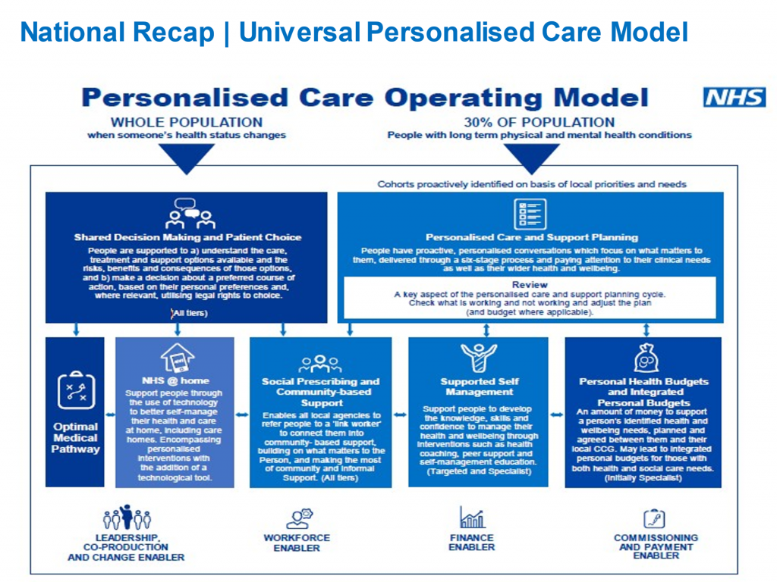
Co-productive Care, Personalised Care and Self-management
Teaming up in co-productive care means that you must engage in shared decision making, respect, empathy and effective communication with other professionals as well as patients.
Key elements of NHS Comprehensive Model of Personalised Care include shared decisions, personalised care planning, supported self-management, social prescribing, personalised budgets and patient activation (Cravo et al., 2022).
Digital health technologies improve symptom monitoring and self-management (Verma et al., 2023).
Research shows that personalised care helps to lower hospitalisations and to empower patients and promote adherence to treatment.
Notes:
Advanced communication, leadership and collaborative skills are needed by respiratory nurses. Personalised care enables patients to take control of their care, enhance their self-management and facilitate long-term sustainable COPD management.

Slide 11
Conclusion
COPD continues to be the number one common chronic illness impacting the health of the nation with significant healthcare economic and public health implications.
Early diagnosis, guidance around the management and multi-disciplinary approach to the care of patients enhances outcomes.
Selfmanagement and personalised care should form the basis of long-term management of COPD.
Prospective practice should incorporate the new evidence, digital innovation, and public health prevention practices.
Notes:
COPD management is a multi-faceted, evidence-based and individualised approach. The primary role of respiratory nurses in driving improvements is through education, collaborative practice and long-term support to individuals.

Slide 12
Reference List
Adeloye, D., Song, P., Zhu, Y., Campbell, H., Sheikh, A. and Rudan, I., 2022. Global, regional, and national prevalence of, and risk factors for, chronic obstructive pulmonary disease (COPD) in 2019: a systematic review and modelling analysis. The Lancet Respiratory Medicine, 10(5), pp.447-458. https://www.thelancet.com/pdfs/journals/lanres/PIIS2213-2600(21)00511-7.pdf
Asthma and Lung UK (2022). COPD in the UK: Delayed diagnosis and unequal care. [online] Asthmaandlung.org.uk. Available at: https://www.asthmaandlung.org.uk/sites/default/files/2023-03/delayed-diagnosis-unequal-care-executive-summary.pdf.
Barker, E., Pocock, J., Moss, J., Hex, N., Rankin, J. and Hudson, R., 2024. The relationship between prescription rates of oral corticosteroids for respiratory diseases and deprivation in England. Npj Primary Care Respiratory Medicine, 34(1), p.3. https://www.nature.com/articles/s41533-024-00362-1.pdf
Cravo, A., Attar, D., Freeman, D., Holmes, S., Ip, L. and Singh, S.J., 2022. The importance of self-management in the context of personalized care in COPD. International Journal of Chronic Obstructive Pulmonary Disease, pp.231-243. https://www.tandfonline.com/doi/pdf/10.2147/copd.s343108
Dunne, E.M., Nunes, M.C., Slack, M.P., Theilacker, C. and Gessner, B.D., 2023. Effects of pneumococcal conjugate vaccines on reducing the risk of respiratory disease associated with coronavirus infection. Pneumonia, 15(1), p.10. https://link.springer.com/content/pdf/10.1186/s41479-023-00112-w.pdf
Dutta, J., Singh, S., Greeshma, M.V., Mahesh, P.A. and Mabalirajan, U., 2024. Diagnostic challenges and pathogenetic differences in biomass-smoke-induced versus tobacco-smoke-induced COPD: a comparative review. Diagnostics, 14(19), p.2154. https://www.mdpi.com/2075-4418/14/19/2154
ERTAN YAZAR, E., Niksarlioglu, E.Y., Yigitbas, B. and Bayraktaroglu, M., 2022. How to utilize CAT and mMRC scores to assess symptom status of patients with COPD in clinical practice?. Medeniyet Medical Journal, 37(2), p.173. https://pdf.journalagent.com/medeniyet/pdfs/MEDJ_37_2_173_179.pdf
Gholami, S., Chinonyerem, D., Cooper, E.J. and Kuwornu, J.P., 2025. Understanding the unmet Needs, Experiences, and perspectives of COPD caregivers: A scoping review. COPD: Journal of Chronic Obstructive Pulmonary Disease, 22(1), p.2481260. https://www.tandfonline.com/doi/pdf/10.1080/15412555.2025.2481260

Slide 13
Reference List
Haynes, J.M., Kaminsky, D.A. and Ruppel, G.L., 2023. The role of pulmonary function testing in the diagnosis and management of COPD. Respiratory Care, 68(7), pp.889-913. https://pmc.ncbi.nlm.nih.gov/articles/PMC10289615/pdf/zrk889.pdf
Huang, C.Y., Hsieh, M.S., Hsieh, P.C., Wu, Y.K., Yang, M.C., Huang, S.Y., Tzeng, I.S. and Lan, C.C., 2024. Pulmonary rehabilitation improves exercise capacity, health-related quality of life, and cardiopulmonary function in patients with non-small cell lung cancer. BMC cancer, 24(1), p.211. https://link.springer.com/content/pdf/10.1186/s12885-024-11977-5.pdf
Jo, Y.S., 2022. Long-term outcome of chronic obstructive pulmonary disease: a review. Tuberculosis and Respiratory Diseases, 85(4), p.289. https://pmc.ncbi.nlm.nih.gov/articles/PMC9537656/pdf/trd-2022-0074.pdf
Kahnert, K., Jörres, R.A., Behr, J. and Welte, T., 2023. The diagnosis and treatment of COPD and its comorbidities. Deutsches Ärzteblatt International, 120(25), p.434. https://pmc.ncbi.nlm.nih.gov/articles/PMC10478768/pdf/Dtsch_Arztebl_Int-120_434.pdf
Kim, S.H. and Han, M.K., 2025. Challenges and the future of pulmonary function testing in Chronic Obstructive Pulmonary Disease (COPD): toward earlier diagnosis of COPD. Tuberculosis and respiratory diseases, 88(3), p.413. https://pmc.ncbi.nlm.nih.gov/articles/PMC12235289/
Leemans, G., Vissers, D., Ides, K. and Van Royen, P., 2023. Perspectives and attitudes of general practitioners towards pharmacological and non-pharmacological COPD management in a Belgian primary care setting: a qualitative study. International journal of chronic obstructive pulmonary disease, pp.2105-2115. https://www.tandfonline.com/doi/pdf/10.2147/COPD.S423279%4010.1080/tfocoll.2024.0.issue-DCOP_self_management
Ma, H., Yan, M., Liu, J. and Zhu, C., 2026. Feasibility of cystatin C as a biomarker for AECOPD severity: a cross-sectional study integrating CAT score, mMRC grade, and GOLD stage. Frontiers in Medicine, 13, p.1804455. https://www.frontiersin.org/journals/medicine/articles/10.3389/fmed.2026.1804455/pdf
Magunagoikoetxea-Comins, G., Jiménez-García, M.E., Pérez-Ferreiro, M. and Fernandez-Pardo, T.E., 2025. Effects on exercise tolerance and functional outcomes of eccentric versus concentric aerobic exercise in people with COPD: a systematic review and meta-analysis. International Journal of Chronic Obstructive Pulmonary Disease, pp.4061-4078. https://www.tandfonline.com/doi/pdf/10.2147/COPD.S558167

Slide 14
Reference List
Martins, S.M., Adams, R., Rodrigues, E.M., Stelmach, R., Adab, P., Chi, C., Cheng, K.K., Cooper, B.G., Correia-de-Sousa, J., Dickens, A.P. and Enocson, A., 2024. Living with COPD and its psychological effects on participating in community-based physical activity in Brazil: a qualitative study. Findings from the Breathe Well group. NPJ primary care respiratory medicine, 34(1), p.33. https://www.nature.com/articles/s41533-024-00386-7.pdf
Minov, J., 2022. Occupational chronic obstructive pulmonary disorder: prevalence and prevention. Expert Review of Respiratory Medicine, 16(4), pp.429-436. https://www.researchgate.net/profile/Jordan-Minov/publication/356547054_Occupational_chronic_obstructive_pulmonary_disorder_prevalence_and_prevention/links/625e81ac4173a21a0d1df186/Occupational-chronic-obstructive-pulmonary-disorder-prevalence-and-prevention.pdf
Miravitlles, M., Kawayama, T. and Dreher, M. (2022). LABA/LAMA as First-Line Therapy for COPD: A Summary of the Evidence and Guideline Recommendations. Journal of Clinical Medicine, [online] 11(22), p.6623. https://pmc.ncbi.nlm.nih.gov/articles/PMC9692772/
Moloney, C., Beccaria, G. and Mullens, A.B., 2026. Beyond Triage: The Critical Role of Emergency Nurses in COPD Assessment and Management—Insights from Patients and Staff. Nursing Reports, 16(4), p.136. https://www.mdpi.com/2039-4403/16/4/136
Nice.org.uk. (2018). Recommendations | Chronic obstructive pulmonary disease in over 16s: diagnosis and management | Guidance | NICE. [online] Available at: https://www.nice.org.uk/guidance/ng115/chapter/recommendations [Accessed 5 Aug. 2026].
Oishi, K., Matsunaga, K., Yamamoto, T., Matsuda, K., Murata, Y. and Hirano, T. (2023). Practical Recommendations for a Selection of Inhaled Corticosteroids in COPD: A Composite ICO Chart. Biomolecules, [online] 13(2), p.213. https://pmc.ncbi.nlm.nih.gov/articles/PMC9953425/
Ortiz-Quintero, B., Martínez-Espinosa, I. and Pérez-Padilla, R., 2022. Mechanisms of lung damage and development of COPD due to household biomass-smoke exposure: inflammation, oxidative stress, MicroRNAs, and gene polymorphisms. Cells, 12(1), p.67. https://www.mdpi.com/2073-4409/12/1/67
Pagano, L., Dennis, S., Wootton, S., Chan, A.S., Zwar, N., Mahadev, S., Pallavicini, D. and McKeough, Z., 2023. The effects of an innovative GP-physiotherapist partnership in improving COPD management in primary care. BMC Primary Care, 24(1), p.142. https://link.springer.com/content/pdf/10.1186/s12875-023-02097-3.pdf

Slide 15
Reference List
Pashutina, Y., Kotz, D. and Kastaun, S., 2022. Attempts to quit smoking, use of smoking cessation methods, and associated characteristics among COPD patients. NPJ Primary Care Respiratory Medicine, 32(1), p.50. https://www.nature.com/articles/s41533-022-00316-5.pdf
Samajdar, S.S., Chatterjee, R., Pal, J., Chatterjee, N., Haldar, I. and Tiwaskar, M., 2025. Expanding the diagnostic horizon in COPD: insights from GOLD 2025 on early detection and comprehensive assessment. J Assoc Physicians India, 73, p.70. https://www.researchgate.net/profile/Rupak-Chatterjee-2/publication/397193376_Expanding_the_Diagnostic_Horizon_in_COPD_Insights_from_GOLD_2025_on_Early_Detection_and_Comprehensive_Assessment/links/690859659708d52f2da48db7/Expanding-the-Diagnostic-Horizon-in-COPD-Insights-from-GOLD-2025-on-Early-Detection-and-Comprehensive-Assessment.pdf
Sansbury, L.B., Lipson, D.A., Bains, C., Anley, G.A., Rothnie, K.J. and Ismaila, A.S., 2022. Disease burden and healthcare utilization among patients with chronic obstructive pulmonary disease (COPD) in England. International journal of chronic obstructive pulmonary disease, pp.415-426. https://www.tandfonline.com/doi/pdf/10.2147/copd.s336158
Shrikrishna, D., Steer, J., Bostock, B., Dickinson, S.W., Piwko, A., Ramalingam, S., Saggu, R., Stonham, C.A., Storey, R.F., Taylor, C.J. and Thakkar, R., 2025. Chronic obstructive pulmonary disease and the management of cardiopulmonary risk in the UK: A systematic literature review and modified Delphi study. International Journal of Chronic Obstructive Pulmonary Disease, pp.2073-2090. https://www.tandfonline.com/doi/pdf/10.2147/COPD.S523865
Siraj, R.A., 2025. COPD and comorbid mental health: addressing anxiety, and depression, and their clinical management. Medicina, 61(8), p.1426. https://www.mdpi.com/1648-9144/61/8/1426
Stolz, D., Mkorombindo, T., Schumann, D.M., Agusti, A., Ash, S.Y., Bafadhel, M., Bai, C., Chalmers, J.D., Criner, G.J., Dharmage, S.C. and Franssen, F.M., 2022. Towards the elimination of chronic obstructive pulmonary disease: a Lancet Commission. The Lancet, 400(10356), pp.921-972. https://www.sciencedirect.com/science/article/am/pii/S0140673622012739
Tsanani, S.E., Yorav, S., Yaron, S., Razi, T., Yechezkel, M., Arbel, R. and Yamin, D., 2025. Effectiveness of influenza vaccination in preventing severe COPD exacerbations and pneumonia before, during, and after the COVID-19 pandemic: a retrospective cohort study. The Lancet Regional Health–Europe, 53. https://www.thelancet.com/pdfs/journals/lanepe/PIIS2666-7762(25)00099-7.pdf

Slide 16
Reference List
Tubío-Pérez, R.A., Torres-Durán, M., García-Rodríguez, M.E., Candal-Pedreira, C., Rey-Brandariz, J., Pérez-Ríos, M., Barros-Dios, J., Fernández-Villar, A. and Ruano-Raviña, A., 2022. Alpha-1 antitrypsin deficiency and risk of lung cancer in never-smokers: a multicentre case–control study. BMC cancer, 22(1), p.81. https://link.springer.com/content/pdf/10.1186/s12885-022-09190-3.pdf
Verma, A., Behera, A., Kumar, R., Gudi, N., Joshi, A. and Islam, K.M., 2023. Mapping of digital health interventions for the self-management of COPD: A systematic review. Clinical Epidemiology and Global Health, 24, p.101427. https://www.sciencedirect.com/science/article/pii/S2213398423002142 ‌
‌Volpi, V., Volpato, E., Compalati, E., Lebret, M., Russo, G., Sciurello, S., Pappacoda, G., Nicolini, A. and Banfi, P., 2022, October. Efficacy of nasal high-flow oxygen therapy in chronic obstructive pulmonary disease patients in long-term oxygen and nocturnal non-invasive ventilation during exercise training. In Healthcare (Vol. 10, No. 10, p. 2001). MDPI. https://www.mdpi.com/2227-9032/10/10/2001
Williams, P.J., Cumella, A., Philip, K.E.J., Laverty, A.A. and Hopkinson, N.S., 2022. Smoking and socioeconomic factors linked to acute exacerbations of COPD: analysis from an Asthma+ Lung UK survey. BMJ Open Respiratory Research, 9(1), p.e001290. https://bmjopenrespres.bmj.com/content/bmjresp/9/1/e001290.full.pdf
World Health Organization: WHO (2026). Chronic obstructive pulmonary disease (COPD). [online] Who.int. Available at: https://www.who.int/news-room/fact-sheets/detail/chronic-obstructive-pulmonary-disease-(copd) [Accessed 5 Aug. 2026].
Xiang, Y. and Luo, X., 2024. Extrapulmonary comorbidities associated with chronic obstructive pulmonary disease: a review. International journal of chronic obstructive pulmonary disease, pp.567-578. https://www.tandfonline.com/doi/pdf/10.2147/copd.s447739
Xu, J., Zeng, Q., Li, S., Su, Q. and Fan, H., 2024. Inflammation mechanism and research progress of COPD. Frontiers in immunology, 15, p.1404615. https://www.frontiersin.org/journals/immunology/articles/10.3389/fimmu.2024.1404615/pdf

Slide 17


