Slide 1

Managing Conflict
Week 4 – BMSW5101 Developing workplace critical thinking

Slide 2



During this session
Define what organizational conflict can be.
Identify sources of organizational conflict
Explore strategies for dealing with conflict

Slide 3



Organisational Conflict
What is it?
Notes:
Mullins (2005), in chapter 22, identifies that *organisational conflict* is an essential part of improved organisational performance.
The six features of organisational conflict are shown on the next slide.

Slide 4
Organisational Development
Organisational Climate
Organisational Culture
Employee Commitment
Major Topics Associated with Organisational Development (Mullins, 2005, p889)
Management Development
Organisational Conflict
Management of Change
Notes:
Students should be encouraged to view conflict as an integral part of the process of management and development.

Slide 5
Organisational Conflict
Organisational conflict can be defined as:
behaviour intended to obstruct the achievement of another person’s/department’s goals.
Drucker (1989) stated that an organisation should be “without friction” and that a manager should be consider ineffective if there is discord within a workforce as this shows a lack of unity and teamwork.
Do you agree with Drucker?
This view is consider to be a unitary perspective and conflict is seen as dysfunction.
Notes:
Often a healthy organisation is viewed as being one in perfect harmony with no differing opinions and persistent agreement. However,

Slide 6
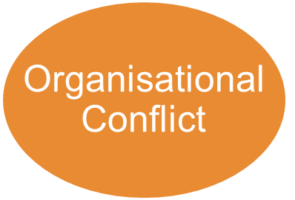
Schmidt (1974) put forward the idea of organisational conflict as having positive and negative points.
Positive
Negative
Some people feel defeated and demeaned.
Better ideas produced
The distance between people is increased.
People forced to search for new approaches
Long-standing problems brought to surface and resolved.
A climate of mistrust and suspicion developed.
Individuals and groups concentrated on own narrow interests
Clarification of individual views.
Stimulation of interests and creativity
Resistance developed rather that teamwork
A chance for people to test their capabilities
An increase in employee turnover.
Notes:
Introduce each positive and negative in turn.
This type of balanced view of conflict, allows us to maintain a critical view on its role.

Slide 7
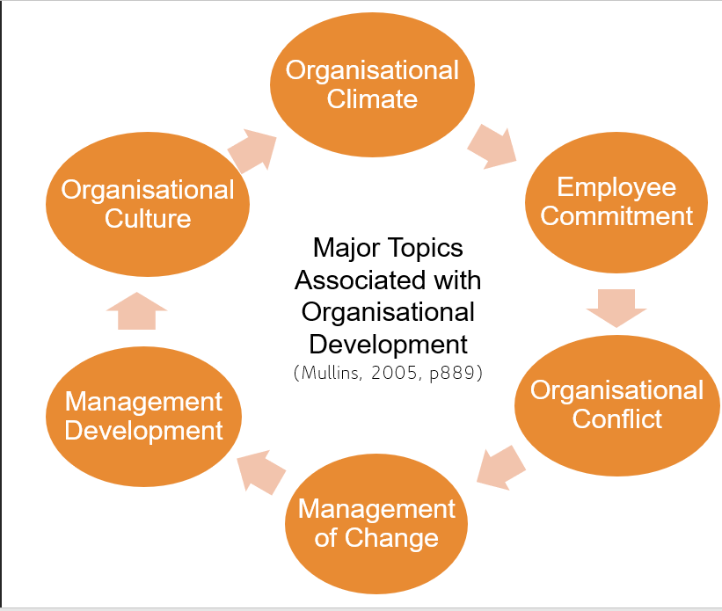
Interactionalist View
The Interactionalist view of conflict is more recent and progressive. It views conflict as a positive force that is an essential ingredient for organisation performance.
A minimal level of conflict aids to prevent apathy and groupthink.
Notes:
Students need again, to view conflict as a predictable and integral part of organisational management.
You may need to define the terms ‘apathy’ and ‘groupthink’.

Slide 8
Source of conflict
Differences in Perception
Limited Resources
Departmentalisation and Specialism
The nature of work activities
Role Conflict
Environmental Change
Notes:
Introduce and discuss in turn.
Differences of Perception – result in different people attaching different meanings to the same stimuli. For example the allocation of additional staff or funds to a department
Limited Resources – Most organisational resources are limited and individuals and departments have to fight for their share, for example at times of the allocation of next years budget or when cutbacks are made. The greater the limitation of resources the greater the potential for conflict. – consider this is today’s economic climate.
Departmentalisation and specialisation – When departments are required to co-operate with each other this is a frequent source of conflict. Differing goals and internal environments are also potential sources of conflict – consider if departments are merged.
The nature of work activities – Where the task of one person is dependent upon the work of others there is potential for conflict, for example if a worker is expected to complete the assembly of a given number of components in a week but the person forwarding the part-assembled components does not supply a sufficient number.
Role conflict – A role is the expected pattern of behaviours associated with members occupying a particular position within the structure of an organisation. However, in reality people often do not behave in the manner people expect within a role, if the responsibilities and remits of two roles (individual or departmental) overlap or are unclear then conflict may occur.
Environmental Change – Changes in an organisations external environment – such as shifts in demand, increased competition, government intervention, new technology or change in social values can cause conflict.

Slide 9



Managing Conflict
There are several ways that managers can attempt to avoid the harmful effects of conflict.
What do you think these strategies might involve?
Notes:
Before moving to the answers, allow students to make there own suggestions.

Slide 10
Managing Conflict
Clarification of goals and objectives
Resource Distribution
Group Activities
Leadership and Management
Organisational Processes
Notes:
This is not an exhaustive list – HRM, development of personal/group skills, socio-technical approach can also be used.
Clarification of goals and objectives – may continually emphasising and clarifying goals and objectives, it will aid to avoid misunderstandings – focus attention on the goals shared between departments to build areas of shared focus.
Resource Distribution – It is not always possible to increase budget without consequence but by making compromised choices budgets and resources can be managed to try and avoid conflict, for example the recruitment of a new role in one department could be delayed so that the budget of a different department could be given more funds.
Group activities – When putting teams together, an informed manager can consider the skillset, experience and personalities involved and manage team membership accordingly. Having over-lapping group members, where a member of staff is on two or more teams offers a ‘linking pin’ to connect and improve communication between teams.
Leadership and management – the style of leadership and management can have a huge affect on the conflict within a workplace, encouraging a collaborative and transparent culture offers opportunity to prevent challenging and potentially disruptive conflict.
Orgaisational Processes – Conflict situations may be reduced by attention to such features as: the nature of the authority structure, work organisations, patterns of communication and sharing of information (transparency), democratic functioning of the org, level of bureaucratic adherence to rules and regulations.

Slide 11
Activity – group task
Mary Kellent is head of marketing at 365FrozenFood, she has been informed that due to changes in the cost of energy the marketing department will have a 25% reduction in its budget for the final quarter of 2022. 12.5% will be allocated to the processing and storage department, and 12.5% will be allocated to the customer services department.
Mary disagrees with the justification of the budget reallocation as she does not see why the customer service department would be affected by the increased in energy costs.
Steve Acton, the head of transport has found out that some departments are having increases in budgets and annoyed that his department has not benefited.
As the Financial Director of 365FrozenFood, how would you approach the conflict that is occurring here? What are the causes and what strategies could be used?
Notes:
Consider printing off this slide for students to discuss in groups.

