Slide 1
Learning in the digital era
Dysgu yn yr oes digidol
Level / Lefel 4
Study Skills / Sgiliau Astudio
Anna Stevenson ac Heddwen Davies

Slide 2



Report Writing / Ysgrifennu Adroddiad

Slide 3
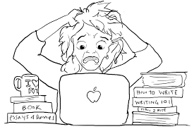
Difference between an essay and a report
Gwahaniaeth rhwng traethawd ag adroddiad
What is the difference?
Beth ydy’r gwahaniaeth?

Slide 4

Report Objectives / Amcanion Adroddiad
Report
A report is a factual and systematic account of what has happened or is happening .
A report usually makes recommendations.
Adroddiad
Mae adroddiad yn gyfrif ffeithiol a systematig am beth sydd wedi digwydd neu am rywbeth sy’n mynd i ddigwydd.
Mae adroddiad, fel arfer, yn rhai argymhellion

Slide 5
Why Write a Report? / Pam Ysgrifennu Adroddiad?
Present specific research-based information.
Gives information concisely and accurately.
Impersonal and objective.
Outlines and discusses clear findings.
Uses a minimum of words.
Standard, rigid structure.
Cyflwyno gwybodaeth seiliedig ar ymchwil
Rhannu gwybodaeth yn gywir ac yn gryno
Amhersonol a gwrthrychol
Trafod canlyniadau
Defnyddiwyd nifer fechan o eiriau
Strwythur cadarn.

Slide 6
Characteristics of a report… / Nodweddion adroddiad
Where an essay is continuous prose, a report is structured very differently. Reports contain the following:
Sub-headings
Bullet points
Graphs
Charts
Tables
Diagrams
Illustrations
Mae traethawd ag adroddiad wedi strwythuro’n wahanol. Mewn adroddiad ceir :
Is-penawdau
Pwyntiau bwled
Graffiau
Siartiau
Byrddau
Deiagramau
Darluniau

Slide 7
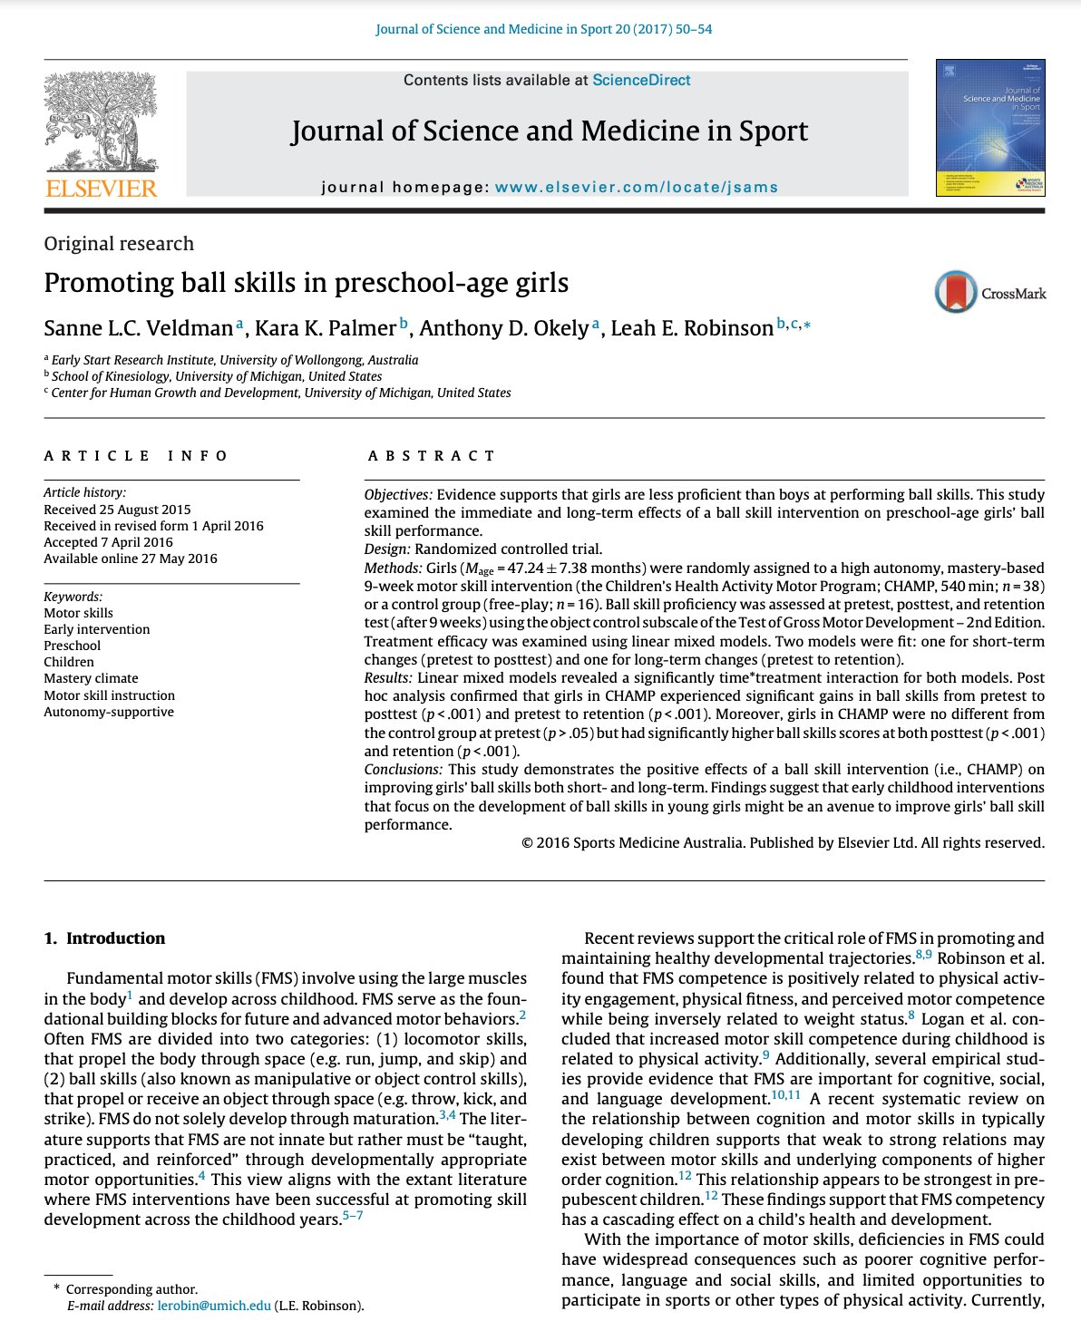
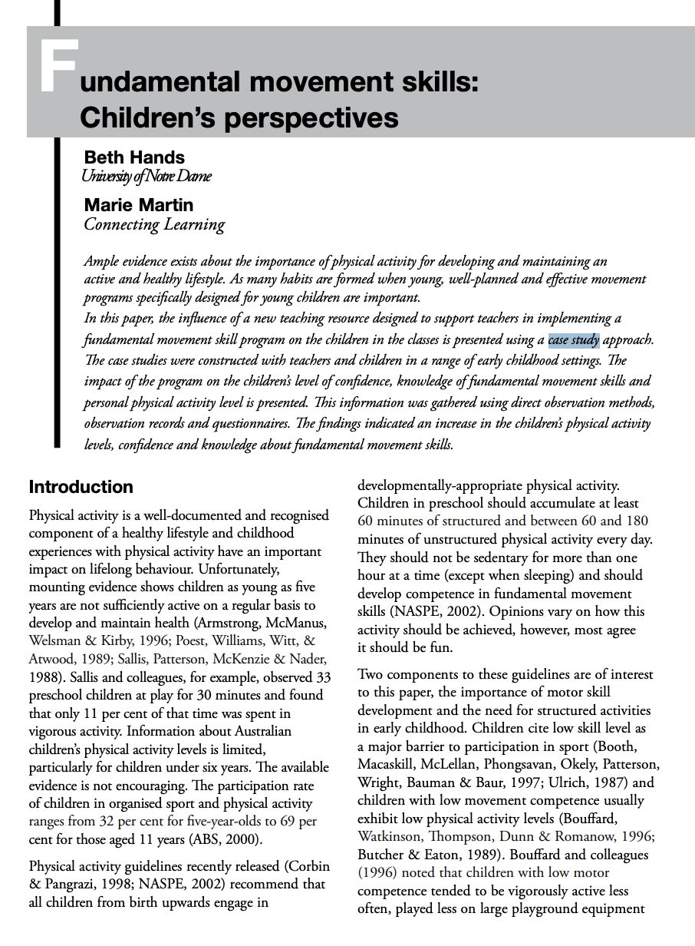
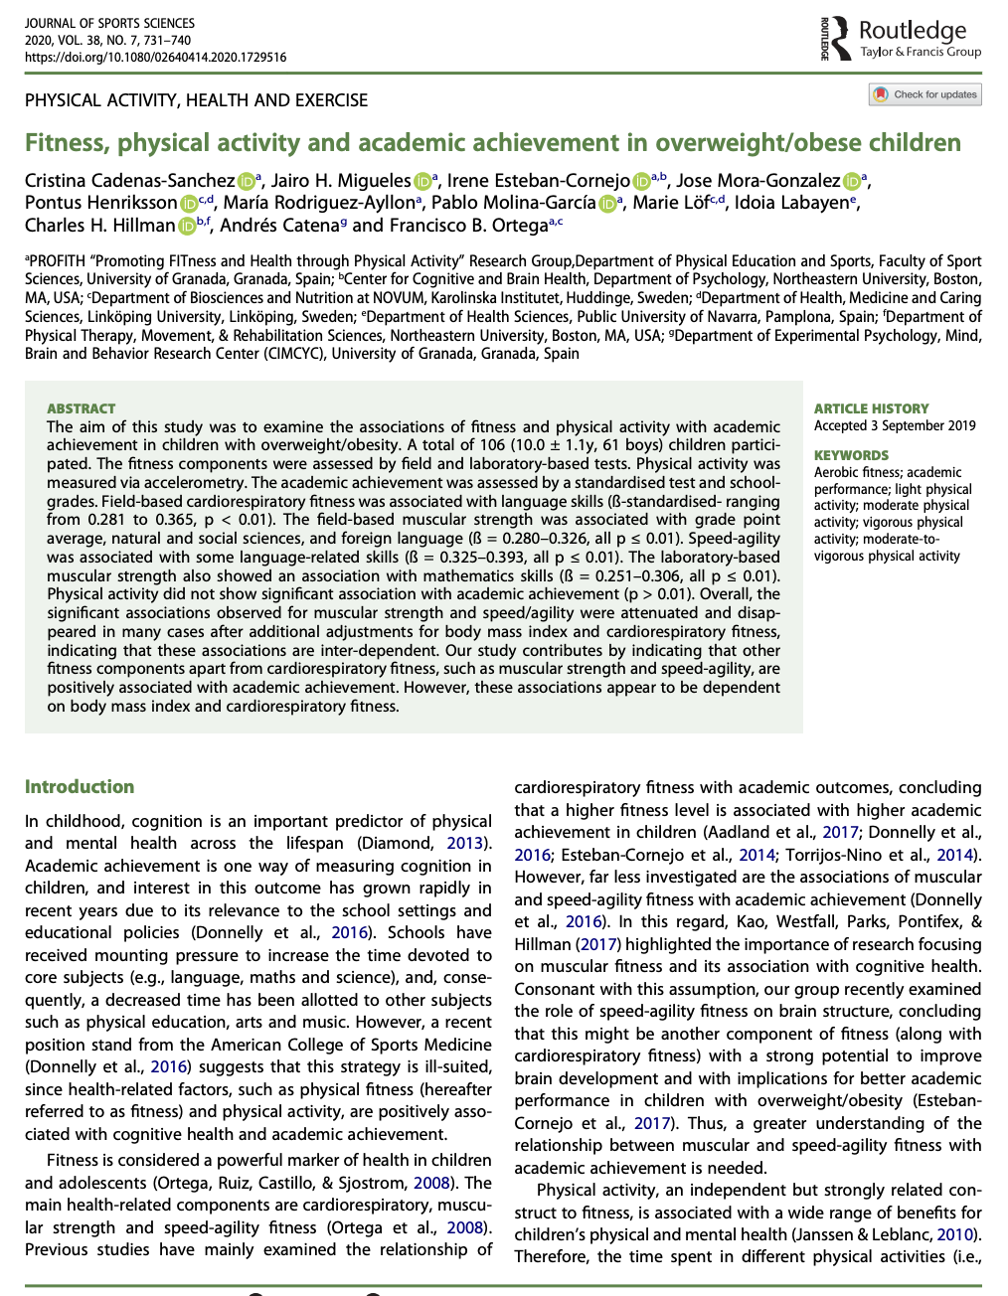
Enghreiffitau o wahanol fathau o adroddiadau
Research Papers
Papurau Ymchwil
Case Studies
Astudiaethau Achos
Lab reports
Adroddiad Labordy

Slide 8
TASK : Gaining information from an 'abstract'
TASG: Cymryd gwybodaeth o ‘abstract’
From an abstract you have found, determine key aspects of the study.
Read the abstract and complete the following table (Table 1.1) to pick out key points.
Table 1.1 Key Points derived from each section of an abstract
Abstract Component Cyd-destun yr Abstract | Key Point / Pwynt allweddol
Introduction/Aims Cyflwyniad/amcanion
Participants / Cyfranogwyr
Methods / Dulliau
Results / Canlyniadau
Discussion/Conclusion Trafodaeth/Casgliad

Slide 9
Structures of abstracts
Title – Clear & Concise, but not too short as to leave the reader uninformed
Participants – As many details as you can regarding participants. Usually presented in 1 or 2 sentences
Methods – The reader should get a good idea of what you have done. Protocols or measurements/
Results – Considered one of the important parts of an abstract – reader wants to know what has been found. Pick out most important findings!
Conclusion - Often a discussion component isn't included – not enough words to discuss results but the conclusion is used to present key findings

Slide 10
Nodweddion abstract
Tips for writing an abstract
Clear language & easy to read (No complex terminology or jargon)
Write in the past tense
Logical flow
Structured

Slide 11

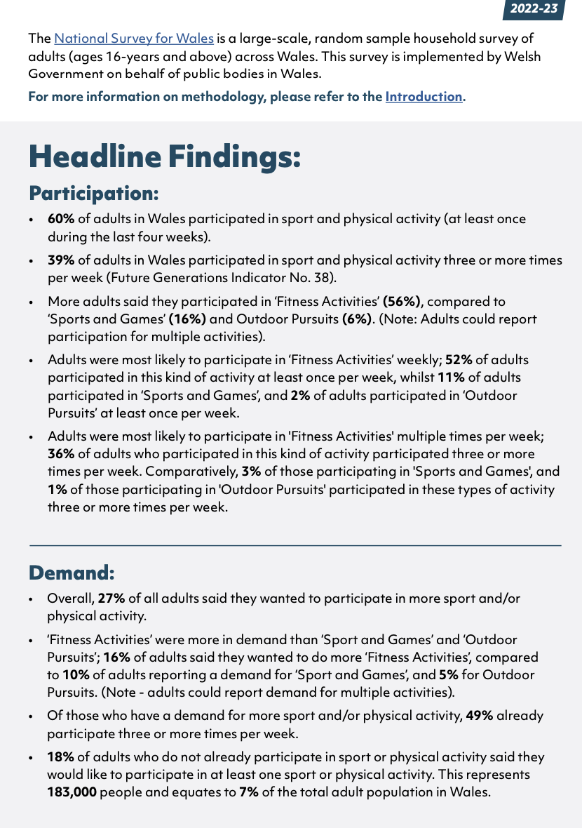
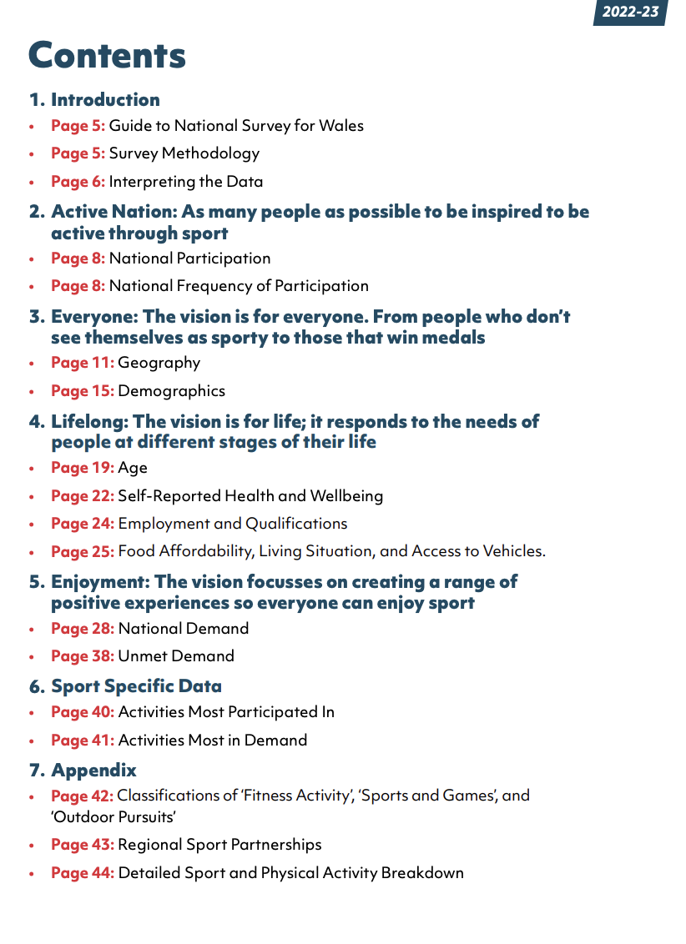
Mae gan Chwaraeon Cymru nifer o rai syml medrwch ddarllen

Slide 12
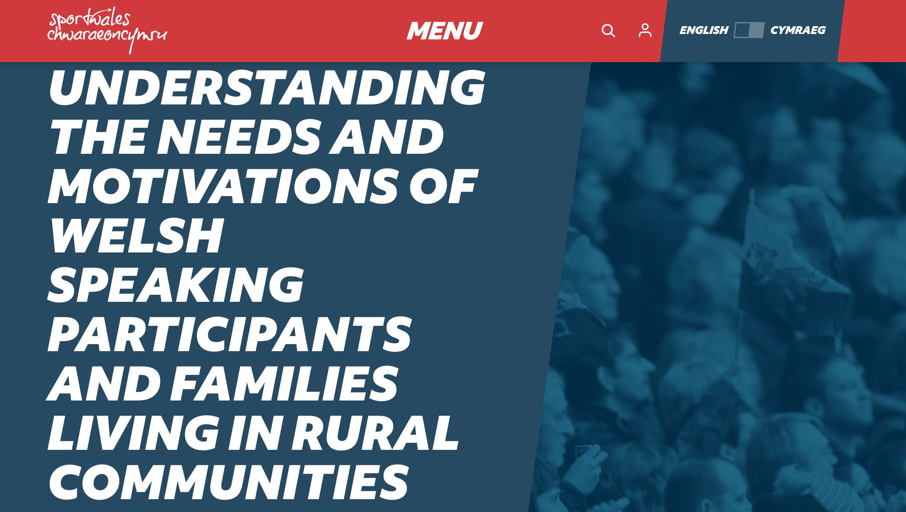
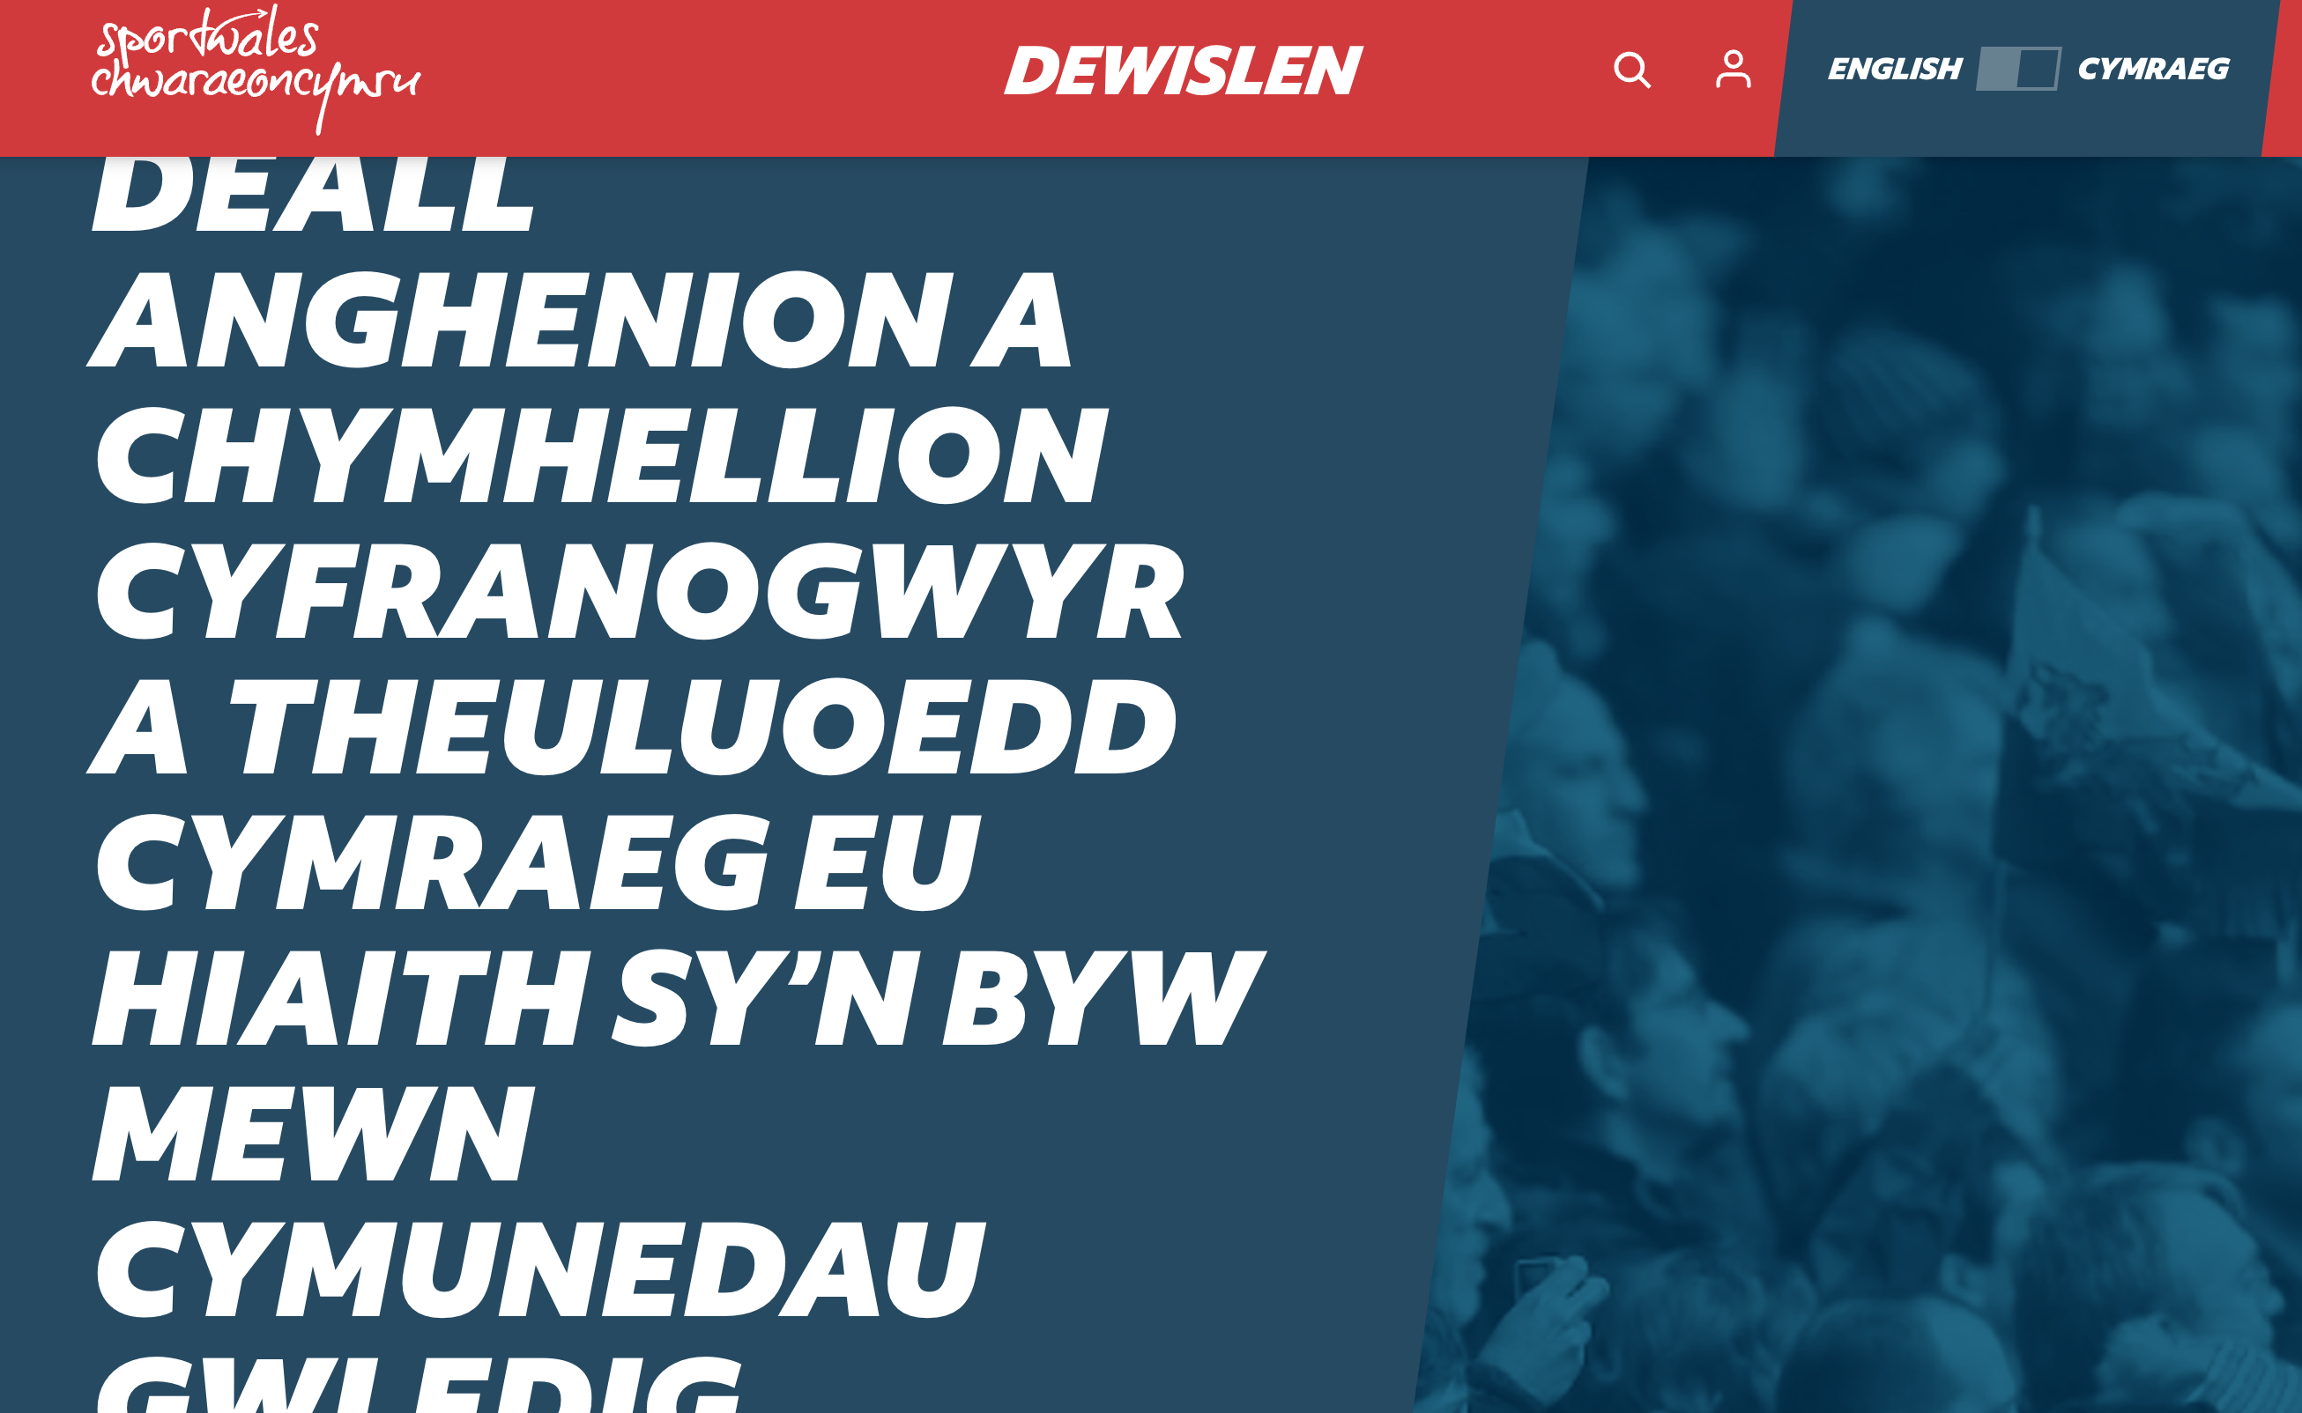
https://www.sport.wales/research-and-insight/understanding-the-needs-and-motivations-of-welsh-speaking-participants-and-families-living-in-rural-communities/

Slide 13

Tasg
Chwiliwch am adroddiad yn eich maes dysgu.
Mewn parau, creuwch boster ar un ochr tudalen A4, sy’n nodi’r nodweddion a strwythur yr adroddiad academaidd. Rhannwch gyda gweddill y dosbarth.
Yna, adrodd nôl i’r dosbarth – pwrpas a chynnwys un rhan o’ch adroddiad rydych wedi darllen. Sut mae’r un rhan yma’n cyfrannu tuag at strwythur yr holl adroddiad?

Slide 14
Task
Find a report in your field of study.
In pairs create a poster one side of A4 paper, that lists the characteristics and structure of an academic report. Share with whole class.
Then, report back to whole class – purpose and content one part of the report that you have read. How does the one part that you've read contribute towards the general overall structure of the whole report?

Slide 15
Check list to Task : Structure of a Report
Rhestr wirio ar gyfer Tasg : Strwythur Adroddiad
Title Page
Contents Page
Executive Summary (or Abstract)
Introduction
Literature review
Methodology
Main Findings/results
Conclusions
Recommendations
Reference List
Appendices
If ever writing a report like this, your module lecturer will explain each section.
Tudalen blaen - teitl
Tudalen cynnwys
Crynodeb
Cyflwyniad
Adolygiad llyfryddiaeth
Methodoleg
Prif Ganlyniadau
Casgliadau
Argymhellion
Rhestr Cyfeirnodi
Atodiadau
Pan yn ysgrifennu adroddiad, bydd eich ddarlithydd yn egluro pob adran.

Slide 16
Characteristics of a report… / Nodweddion adroddiad
Where an essay is continuous prose, a report is structured very differently. Reports contain the following:
Sub-headings
Bullet points
Graphs
Charts
Tables
Diagrams
Illustrations
Mae traethawd ag adroddiad wedi strwythuro’n wahanol. Mewn adroddiad ceir :
Is-penawdau
Pwyntiau bwled
Graffiau
Siartiau
Byrddau
Deiagramau
Darluniau

Slide 17
Tasg : Crynhoi a chyfeirnodi'r ffynhonnell
Chwiliwch am un pwynt allweddol o'r adroddiad
Ysgrifennwch mewn dyfyniad
Ysgrifennwch yr un dyfyniad yn eich geiriau eich hun
Ysgrifennwch fel byddai'r ffynhonnell yn ymddangos yn eich rhestr cyfeirnodi

Slide 18

Task : Summarise & Reference
Find one key piece of information from the report.
Write as a quotation inc. reference
Re-write the quotation but now in your own words … remember what this was called?
Cite this accurately & share with others how
Write the reference as though it was for your reference list

Slide 19
Next Week / Wythnos Nesaf

