Slide 1

Cost Estimation in Engineering Projects
Name: MD Niamat Ullah
Name: MD Niamat Ullah
ID: 2507288

Slide 2

Case Study: Channel Tunnel
Focus: Accuracy & Cost Overruns

Slide 3

Introduction
Cost estimation is crucial in project planning
Many projects exceed budgets
Channel Tunnel as key example
Aim: Identify causes & improvements
Notes:
1. Introduction
Good morning everyone. Today I am going to discuss my work on the accuracy of cost estimation in the management of engineering projects. In this paper, the Channel Tunnel is used as a case study. Cost estimation is a very important part of project planning. Nonetheless, numerous high scale engineering projects do not turn out to be within their budgets. The Channel Tunnel is an obvious illustration to this issue, with the overall cost of the project being significantly greater than anticipated. The goal of this research is to learn why the cost estimation is inaccurate and how project managers can enhance the use of estimation in future engineering projects.

Slide 4




2. Literature Review: Key factors
Project complexity
Data availability
Uncertainty in early stages
External factors (inflation, material prices)
Notes:
The literature review is based on the three essential areas; the factors that influence the accuracy of the cost estimate, the cause of cost overruns and the cost estimation techniques applied in engineering projects.
To begin with, according to According to Ibrahim, and Elshwadfy, (2021), cost estimation accuracy is determined by a number of significant factors. Project complexity is one of the significant ones. Engineering projects are large construction projects that have numerous activities, making it hard to calculate costs precisely. The data availability is another significant factor. To estimate the costs accurately, there has to be trustworthy past data. In case the information is incomplete or not up to date, the estimates might not be accurate. Accuracy of estimation is also influenced by uncertainty. During the initial phase of a project there are numerous unknowns. Consequently, the project managers make assumptions, and this may minimize accuracy. Furthermore, according to Al-Gahtani et al., (2024), cost estimation is also influenced by external factors like inflation and fluctuation in prices of materials.

Slide 5
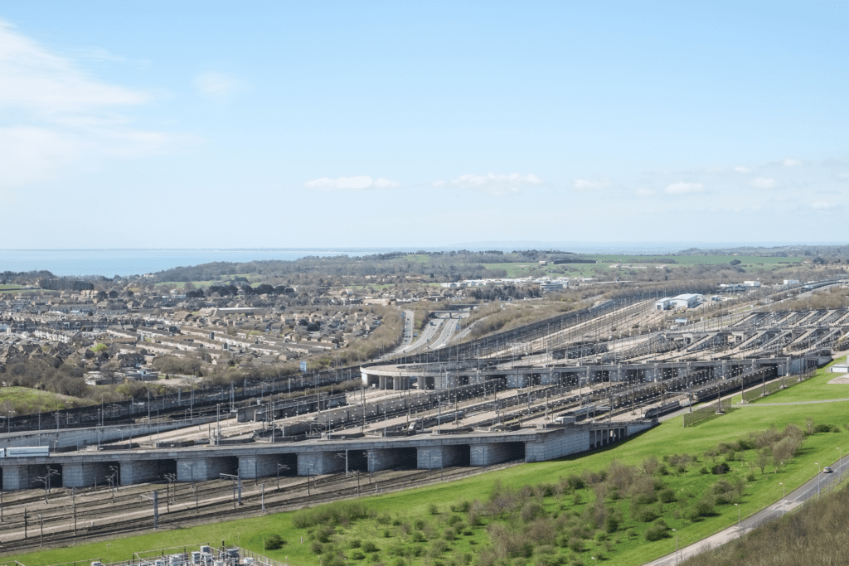



Literature Review: Causes of Cost Overruns
Weak planning & control
Miscommunication
Project delays
Poor initial estimation
Scope changes
Notes:
Secondly, overruns in cost are typical in engineering projects. Durdyev, (2021) has stated that ineffective estimation at the beginning is one of the primary reasons. When the initial budget is not realistic, chances are that the project may be over-budgeted. Another significant cause is scope changes. Gomez-Cabrera et al., (2024) have advised that new requirements can be introduced during the project, and this is going to increase the overall cost. Cost overruns are also due to poor planning and weak project control. Scheduling delays in the project raise labour and material costs. Amini et al., (2023) have stated that miscommunication among the stakeholders may also lead to mistakes and rising costs. Most of these problems were encountered in the Channel Tunnel project and this led to a massive cost overrun.

Slide 6
Literature Review: Estimation Methods
Analogous
Bottom-up
Three-point estimation
Fast
Less accurate
Detailed
Accurate
Handles
Uncertainty
Notes:
Thirdly, different cost estimation methods are used in project management. Analogous estimation is one of the methods, employing similar past project data. The approach is fast but not as precise. The other technique is the parametric estimation, which is based on mathematical models and project data. It is more accurate but relies on accurate data. According to Shen et al., (2025), the bottom-up estimation is a step-by-step approach which estimates the individual activities. It is more accurate but takes more time. Three-point estimation takes into account optimistic, most likely and pessimistic costs. This aids in dealing with uncertainty. Disch, (2024) has noted that both approaches have their merits and shortcomings. The combination of methods can enhance the accuracy of estimation.
Altogether, it can be observed that cost estimation is a complicated procedure as evidenced in the literature. It involves proper planning, correct data, and efficient ways of minimizing mistakes and enhancing successful projects.

Slide 7
Methodology
Research Philosophy - Positivist
Research Approach - Deductive reasoning
Research Methodology - Qualitative case study
Data Collection Sources - Secondary data sources
Analysis Type - Document analysis
Notes:
This study employs a systematic approach to the study of risk identification and mitigation measures. The research is based on the positivist research philosophy. This implies that the study is based on facts and real-life facts. Risk management entails events that can be observed, like failures in the system and project delays (Kohler et al., 2022). Hence, this study is appropriate for a positivist approach. A deductive approach is also used in the research. This method begins with the existing theories on risk management. These theories are then applied to the case study of Heathrow Terminal 5. This assists in testing the applicability of the theories to real-world situations. The deductive methodology offers a definite framework of analysis. A qualitative research method is used in this study. It is aimed at learning about risk management practices in detail. The case study method is used to analyse Heathrow Terminal 5. This approach will enable a thorough comprehension of the project and its difficulties (Wood, 2024). It helps to explore the reasons behind risk management failures. The study uses secondary data sources. They are academic journals, books and project reports. Credible online sources are also employed. Secondary data is used to give a comprehensive detail on the project and issues. Document analysis is used as the main data collection tool. This includes a review of reports and case studies. The information gathered is relevant and analysed to respond to the research questions. On the whole, the methodology guarantees valid and reliable results. It gives a simple procedure for analysing risk management in engineering projects.

Slide 8

Results & Findings
Estimation often inaccurate
Causes: complexity, poor data, uncertainty
Optimism bias in budgeting
Scope changes increase cost
Notes:
4. Results
The research findings are likely to be that cost estimation in engineering projects is inaccurate. The results will tend to indicate that this issue is caused by a number of factors. These are complexity of the project, untrustworthy data and uncertainty during the planning phase. The research could indicate that one of the key problems in cost estimation is optimism bias. Project managers can also estimate costs lower to be approved. This causes impractical budgets and financial issues in the future. Change of scope within the project also is likely to add a lot of costs (Eliasson, 2025).

Slide 9

Recommendations
Improve data accuracy
Use combined estimation methods
Better planning & control
Realistic assumptions
Notes:
In the case of the Channel Tunnel, the results may show that poor forecasting and financial risks contributed to the cost overrun. Engineering work in the project was complicated hence it was not easy to estimate it accurately (Ghartey et al., 2026). The study can also discover that conventional methods of estimations cannot be applied to massive projects. The accuracy can be enhanced with the help of using modern tools and combining various methods. On the whole, the findings are likely to imply that more planning, correct data, and realistic assumptions should be made. To minimise cost overruns, the best way is to improve cost estimation practices in order to make projects a success.

Slide 10
References
Al-Gahtani, K.S. K. S., Alsanabani, N. M., Alsugair, A. M., Aljadhai, S. I., and Alotaibi, H. F. (2024) “Dynamic BIM Adoption Impact on Contract Cost Variance Factors Using PLS-SEM Techniques,” Applied sciences, 14(17), p. 8017. Available at: https://doi.org/10.3390/app14178017.
Amini, S. Rezvani, A., Tabassi, M., and Malek Sadati, S. S. (2023) “Causes of cost overruns in building construction projects in Asian countries; Iran as a case study,” Engineering, construction, and architectural management, 30(7), pp. 2739–2766. Available at: https://doi.org/10.1108/ECAM-05-2021-0445.
Durdyev, S. (2021) “Review of construction journals on causes of project cost overruns,” Engineering, construction, and architectural management, 28(4), pp. 1241–1260. Available at: https://doi.org/10.1108/ECAM-02-2020-0137.
Eliasson, J. (2025) “Cost overruns of infrastructure projects – distributions, causes and remedies,” Transportation research. Part A, Policy and practice, 198. Available at: https://doi.org/10.1016/j.tra.2025.104532.
Ghartey, I. Wahab, A., Enning, S., and Arthur, B. A. (2026) “The role of Quantity Surveyors in mitigating cost overruns: evidence from Ghana’s public infrastructure projects,” International journal of construction management, pp. 1–22. Available at: https://doi.org/10.1080/15623599.2026.2643742.
Gomez-Cabrera, A., Gutierrez-Bucheli, L. and Muñoz, S. (2024) “Causes of time and cost overruns in construction projects: a scoping review,” International journal of construction management, 24(10), pp. 1107–1125. Available at: https://doi.org/10.1080/15623599.2023.2252288.
Ibrahim, A.H. and Elshwadfy, L.M. (2021) “Factors Affecting The Accuracy Of Construction Project Cost Estimation In Egypt,” Jordan Journal of Civil Engineering, 15(3).
Ravn, S. (2023) “Integrating qualitative research methodologies and phenomenology—using dancers’ and athletes’ experiences for phenomenological analysis,” Phenomenology and the cognitive sciences, 22(1), pp. 107–127. Available at: https://doi.org/10.1007/s11097-021-09735-0.
Shen, C. Meng, P., Shen, J., and Sun, G (2025) “A construction cost estimation system based on case-based reasoning and exponential smoothing,” Journal of Building Engineering, 113. Available at: https://doi.org/10.1016/j.jobe.2025.114120.
Wohlin, C. and Runeson, P. (2021) “Guiding the selection of research methodology in industry–academia collaboration in software engineering,” Information and software technology, 140. Available at: https://doi.org/10.1016/j.infsof.2021.106678.

