Slide 1
International Marketing: Principles and Practices
LCMB 7026
WEEK 6

Slide 2
Week Six
International Product Strategies and Brandings

Slide 3
Last Week
We have covered
What the STP strategy is and how international STP differs from domestic STP.
The primary factors used to identify international consumer market segments.
Steps and tactics used to establish positioning in international markets.
Notes:
Business products are marketed to the other businesses, which are the end users.

Slide 4
In today’s session….
After reading and studying this session, you will be able to:
  Understand basic product categories and product dimensions available in domestic and international markets
  Understand how standardisation and adaptation programs combine to achieve greater international marketing effectiveness.
  Understand the role that brand development and management play in international marketing.

Slide 5
Learning Objective 1
Understand basic product categories and product dimensions available in domestic and international markets

Slide 6
Goods versus Services 1 of 2
A good is a physical product sold to and used by an individual, household, or business.
  Durable goods are items that are consumed over time. Televisions and household appliances are durable goods.
  Nondurable goods are consumed more quickly. Toothpaste and food items are nondurable goods. Many nondurable goods are consumed in daily life.
  Businesses sell consumer products to consumers either directly or through a market channel that employs intermediaries. The buyers, or end users, are individual persons or families.
  Business products are marketed to other businesses, which are the end users.

Slide 7
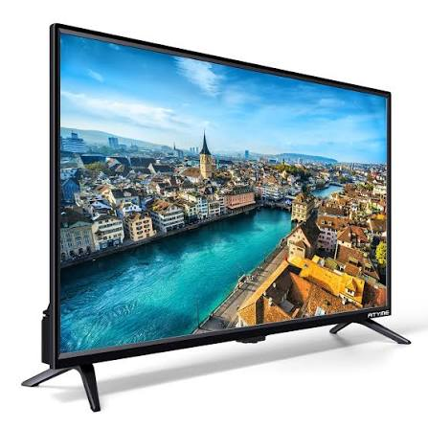




Which one is a durable product?

Slide 8
Goods versus Services 2 of 2
A service is an intangible product that generally centers on an act or performance that delivers value to individuals, households, and businesses.
  Services play a major role in the global economy.

Slide 9
Classifications of Products
Convenience Products
Shopping
Specialty
Unsought/ unwilling to buy

Slide 10
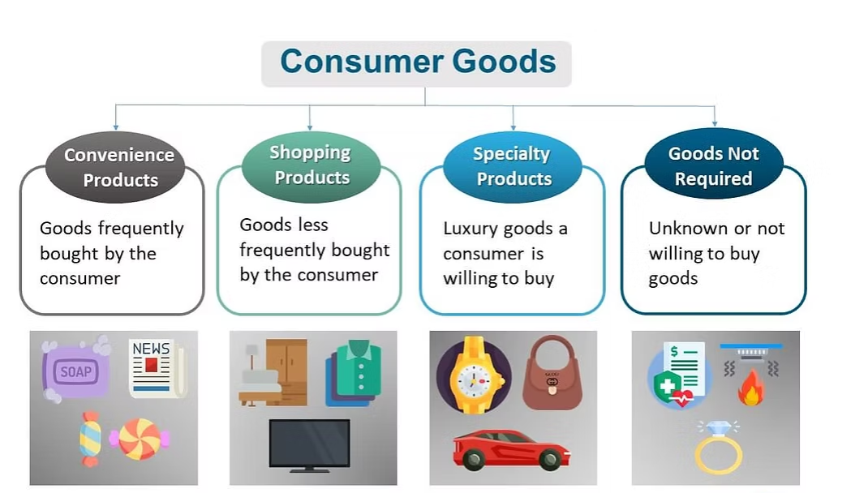

Slide 11
Classifications of Products – Convenience Products
Types of Convenience Products
  Impulse products, or items purchased spontaneously with no preplanning, for the enjoyment that the purchase provides
    This contrasts with unplanned purchases, which are also not planned but provide no pleasure (e.g buying forgotten milk/bread).
  Staples are goods that are used regularly and tend to be replenished often, such as sugar, flour, rice, millet, salt, and soap.

Slide 12
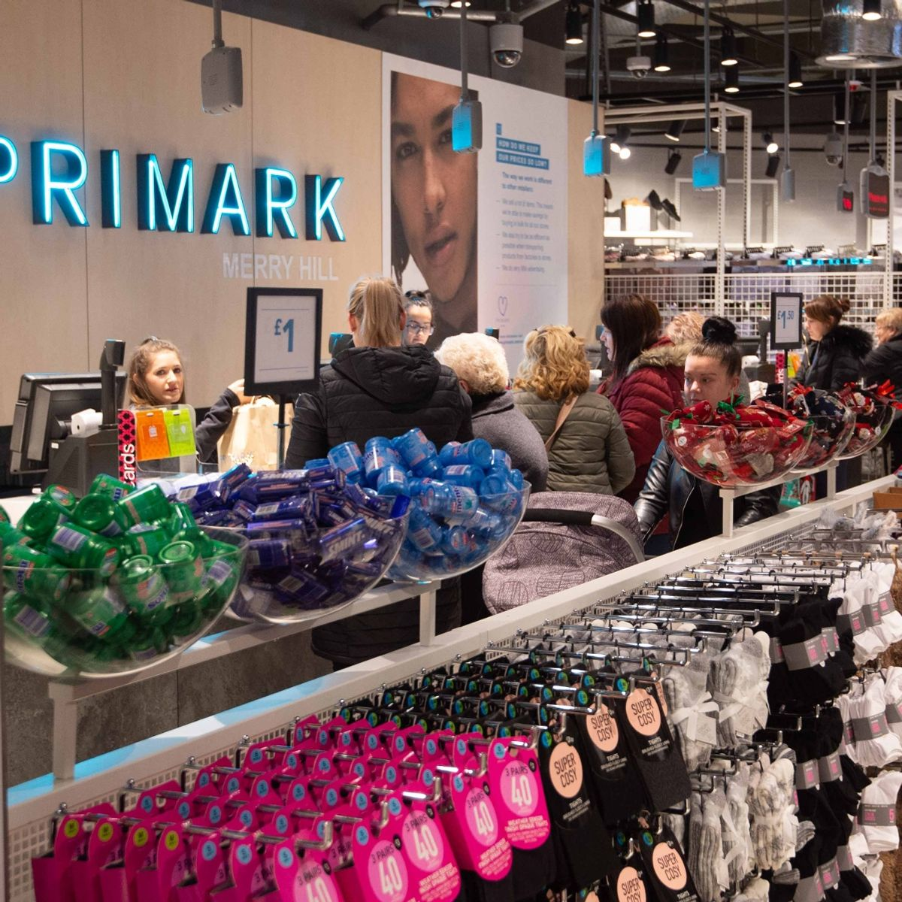
  Impulse products, or items purchased spontaneously at Primark (small stuff near the cashiers).

Slide 13
Classifications of Products – Shopping Products
Features of Shopping Products:
  Consumers expend more effort when searching for and purchasing
  More expensive than convenience products and are purchased less frequently
  Consumers compare several brands and more carefully consider prices.
  Marketers typically employ selective distribution strategies for shopping products, which means retail outlets are chosen for each geographic region.
  International marketers pay close attention to cultural differences for shopping products.

Slide 14
Classifications of Products –Specialty Products
Features of Specialty Products:
  Items that consumers spend much time searching for and will not accept a substitute
  Expensive and are marketed with a significant degree of exclusivity, meaning only select retailers offer the products
  Consumers generally do not consider competing brands, as they usually have chosen one particular alternative and expend effort to purchase the preferred brand.
  Luxuries represent a subcategory of specialty products.

Slide 15
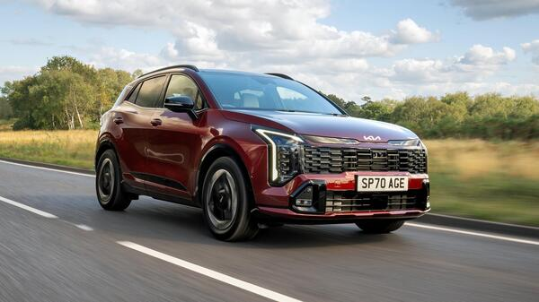
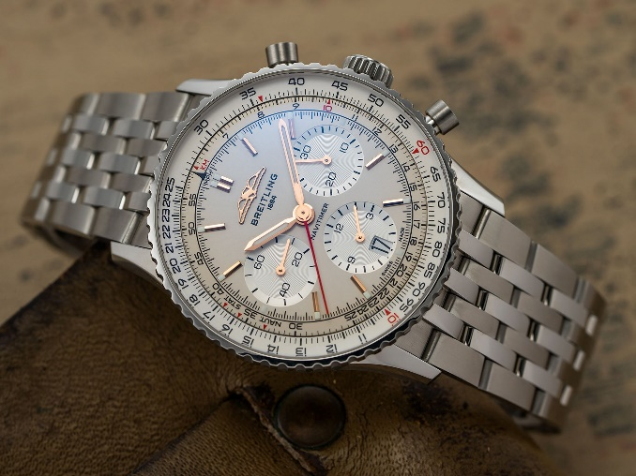


Which one is –Specialty Product?
KIA Sportage
Breitling Navitimer
Apple Watch
Alpha Romeo 33 stradale

Slide 16
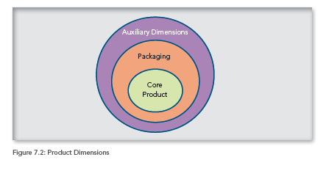
Product Dimensions 1 of 2
The core product
Packaging
Auxiliary

Slide 17
Product Dimensions 2 of 2
The core product satisfies or remedies a basic need.
Packaging includes the elements of the product that communicate the brand name, logo, and trademark and protect the core product.
  Marketers adapt packaging and labels in response to differences in legal systems, local traditions, and cultures.
The auxiliary dimensions include warranties, instructions, company contact information, and the image of the particular brand.
  Shopping products are sometimes differentiated based on auxiliary dimensions.

Slide 18
International Product Mix Management – Product Lines
Product lines are groups of similar products within a particular category.
  The depth of a product line refers to the total number of products in that line. (iPhone 12, 13, 14)
  The width (sometimes called the breadth) of the product mix refers to the total number of product lines that the company offers. (iPhone 12e, iPhone 12pro, etc)
The product mix refers to the total number of products that a firm carries.
e.g., iPhone, iPad, Apple Watch

Slide 19
International Product Mix Management – Packaging 1 of 3
Packaging decisions represent a key aspect of international product marketing.
When exporting or shipping goods, the product’s package protects the item until it safely arrives.
Packaging facilitates the movement of products through the distribution channel—from the factory to the consumer.
Packaging can become an aspect of a brand’s identity, thereby affecting the relationship between the customer and the brand.

Slide 20
International Product Mix Management – Packaging 2 of 3
Visual Elements
  Elements such as shape, colour, font usage, and pictorials help to communicate brand meaning to customers and differentiate the product from the competition.
  Much of the sensory experience of consumers comes from the visual elements, which play an important role in package design.
Informational Elements
  The package transmits vital and legal information regarding the contents of the package and the product.
  Marketers should ensure that the language and metrics used on the package will be suitable for the selected target market.

Slide 21
International Product Mix Management – Packaging 3 of 3
Protective Elements
  To protect the product, international marketers must carefully consider some elements, such as plastic, due to regional restrictions and sustainability issues.
Symbolic Elements
  Package shapes and features that help the consumer recognise the brand
  The symbolic nature of packaging not only appeals to a consumer's inner needs but also helps to convey desired images to others.

Slide 22
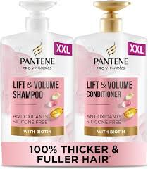
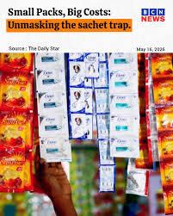

Big packaging
UK, US
Small packaging
India, Indonesia
Refill packaging
Southeast Asia
(Japan, Indonesia)

Slide 23
Pair Activity – 30 Minutes
Discuss how each company’s product lines vary by country or region for the following:
  Honda
  Pantene
  Add some screenshots from the website/internet, by region or country/country, as evidence of similarities and differences in packaging. Add it to PowerPoint

Slide 24
BREAK

Slide 25
Labeling
Labelling helps customers learn about various aspects of the product before purchase.
Legal requirements also drive labelling.
  For labelling in the European Union (EU), the “CE Mark” signifies that a product has met EU health, environmental, and safety requirements.
  In the United States, companies must adhere to the Fair Packaging and Labelling Act.
Labelling standards vary significantly by product type.
  Cigarette manufacturers in the United States must place the Surgeon General’s warning on each pack.

Slide 26
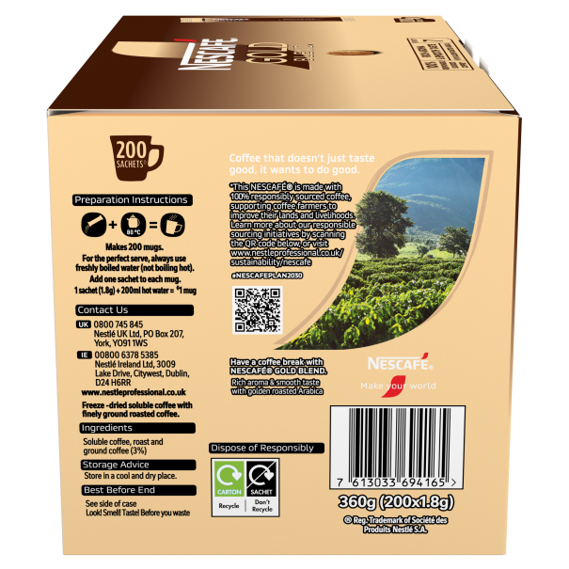
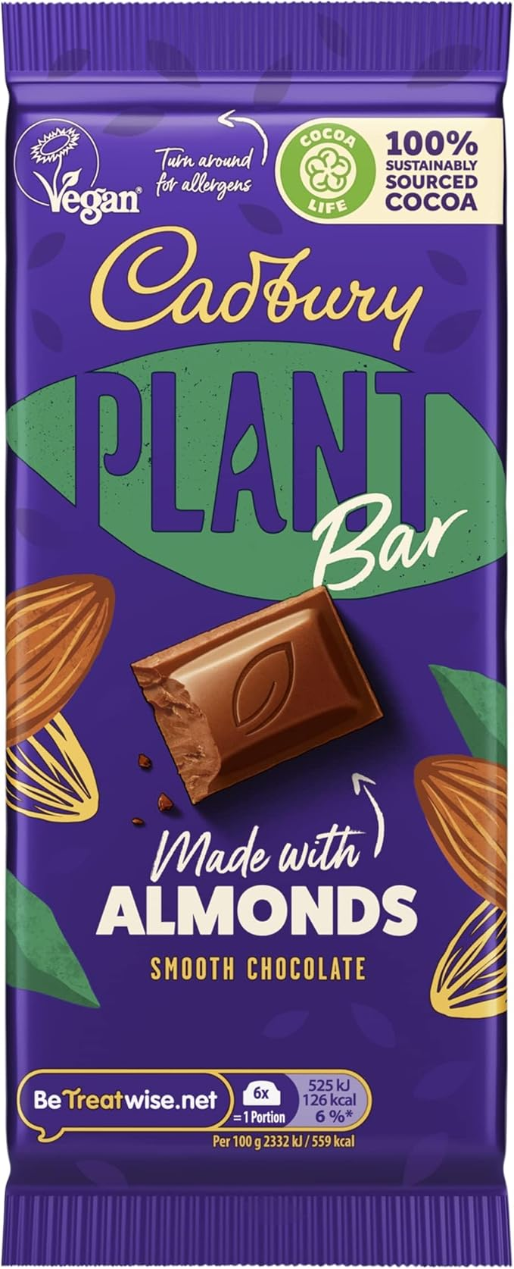

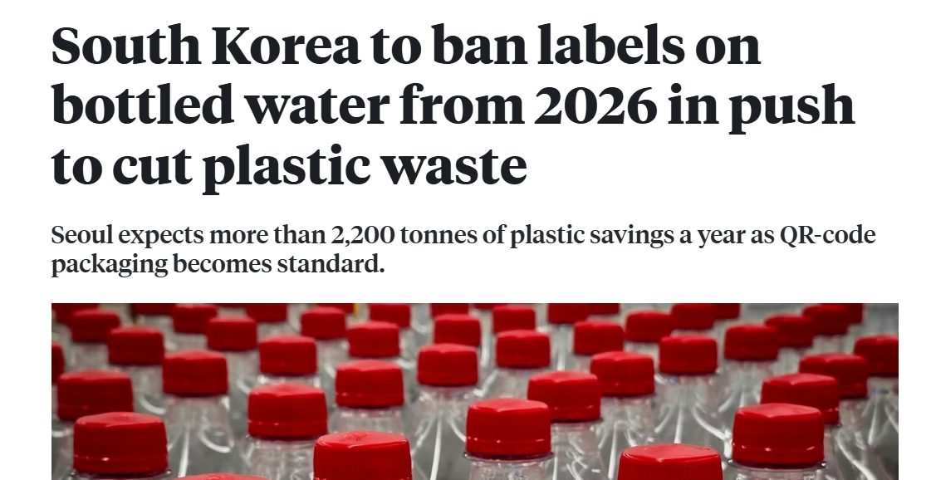

Slide 27
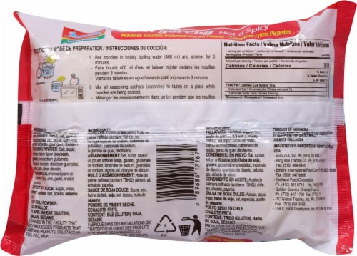
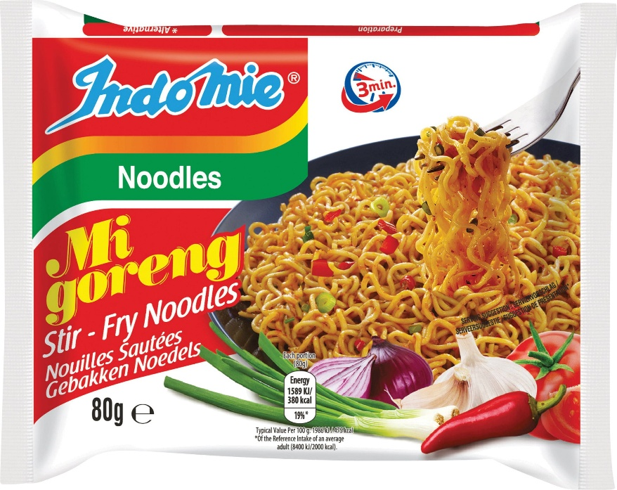
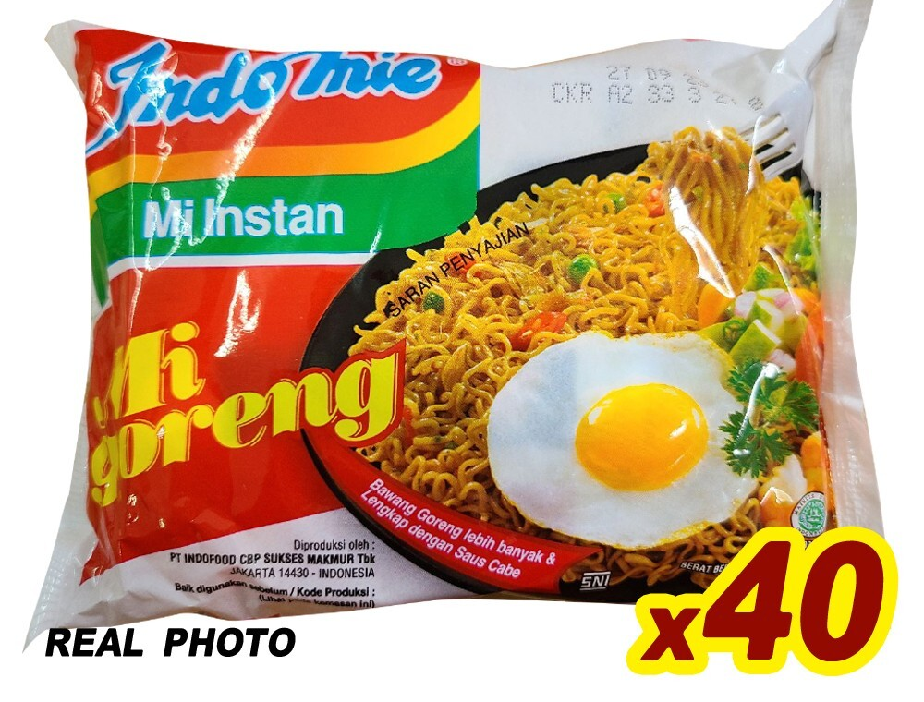
European market
Indonesia & Malaysia market

Slide 28
International Product Quality Standards
Product that meets a quality standard can become a key in international marketing success.
Companies can follow ISO to meet international standard
  The International Organization for Standardization (ISO) provides standards to quality management and assurance (www.iso.org).

Slide 29
Learning Objective 2
How standardisation and adaptation programs combine to achieve greater international marketing effectiveness.

Slide 30
Standardization
Standardization is the process of applying the same marketing mix to all markets. A single production process, brand, and appeal are used.
  While less responsive to consumer needs in a given country, it decreases costs and increases efficiency.
  The company can focus on perfecting a single approach.

Slide 31
Adaptation
Changing of any component of the marketing mix to better meet the needs of a local market is adaptation.
  Changes or adaptations can be as minor as adjusting the information about the product to meet local labeling requirements, or as significant as adding new ingredients or creating unique new brand names.
  Responding to local needs as closely as possible constitutes the primary goal of adaptation.

Slide 32
Adaptation
Adaptation can lead to more satisfied consumers, build brand image, and increase sales.
  Adaptation also incurs costs.
  Changing the marketing mix may require designing an entirely new advertising campaign or developing an expensive new ingredient.

Slide 33
Laws and Adaptation
Laws influence the adaptation of product attributes.
  These laws frequently focus on safety
  In other cases, products that are accepted in one country are forbidden in others.
    In strict Islamic countries, this includes a prohibition on alcohol.

Slide 34
Combining Standardization and Adaptation
Standardization versus adaptation debate
In practice marketers often combine the two approaches.
The default will be standardization because it offers cost savings
Although some degree of adaptation often becomes necessary to generate product demand.

Slide 35
Learning Objective 3
The role that brand development and management play in international marketing.

Slide 36
International Brand Management
A brand is the name, sign, symbol, and/or design that identifies the products of a firm and distinguishes it from the competition.
Key components:
  A brand name is the verbal part of a brand that can be spoken.
  A brandmark is comprised of the nonverbal elements that signify the brand.
  A trademark is a legally protected brand name and a servicemark is a legally protected service name.

Slide 37
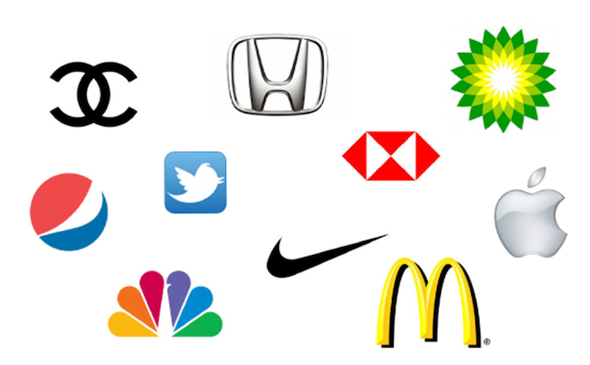
Brandmark quiz

Slide 38


Brand Strategies
A brand extension strategy takes the brand name and adds it to a new product. (e.g. Virgin brand name across various product categories and industries such as airlines, mobile media, and entertainment)
Cobranding is the practice of placing two or more brand names on the same product. (e.g., Walls and Oreo ice cream, Apple watch & Nike)

Slide 39
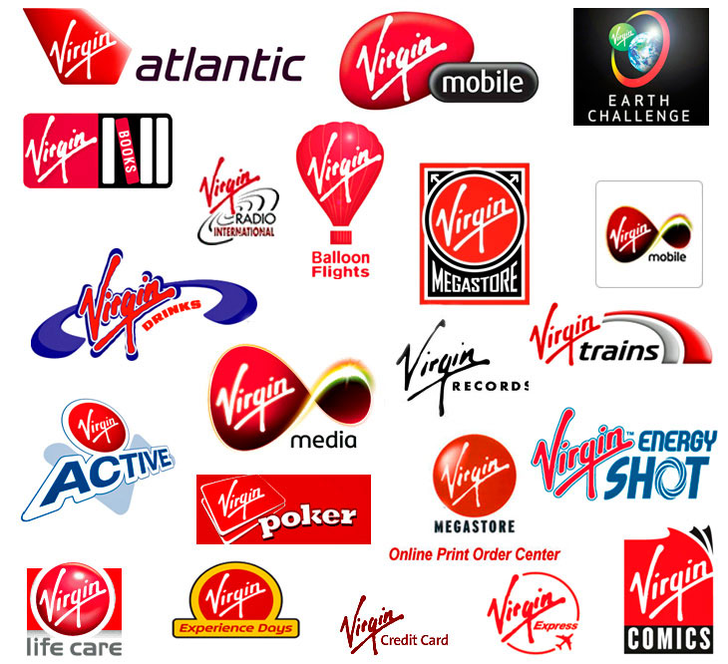
Virgin brand extension

Slide 40
Building Powerful International Brands
BRAND AWARENESS. Results from marketing efforts that place the brand in a consumer’s mind.
BRAND IMAGE. Consumers’ perceptions of the brand. Brand image includes perceptions of brand quality.
How to build Brand Awareness and Brand Image?
  Attention to product quality, excellent customer service, and exceeding consumers' expectations.
  Advertising and promotional efforts can then be used to support the message.

Slide 41
Individual Activity– 15 Minutes
Consider a global product that you recently purchased. What was standardized or adapted? Why did the marketing team make these choices? What was legally required?

Slide 42

Any questions?
Next week we will study
International Pricing Strategies and Promotions

Slide 43
References
Baack, D. G. (2018). International marketing., 2nd edition. London: SAGE Publications.
Czinkota, M.R. (2011) International Marketing. Hampsire: Cengage Learning.
De Búrca, S., Fletcher, R. and Brown, L. (2004) International marketing : an SME perspective. 1st ed. Harlow, England: FT Prentice Hall.
Doole, I. and Lowe, R. (2012) International marketing strategy : analysis, development and implementation. Cengage Learning.
Keegan, W.J. and Green, M.C. (2013) Global marketing. 7th ed., global ed. Boston, Mass. ; London: Pearson.
Ko, E., Kim, E., Taylor, C. R., Kim, K. H., & Kang, I. J. (2007). Cross-national market segmentation in the fashion industry: A study of European, Korean, and US consumers. International Marketing Review, 24(5), 629–651.
Mathur, U. C. (2008). International marketing management : text and cases. SAGE.
Wind, Y., & Douglas, S. P. (1972). International market segmentation. European Journal of Marketing, 6(1), 17–25.

