Slide 1

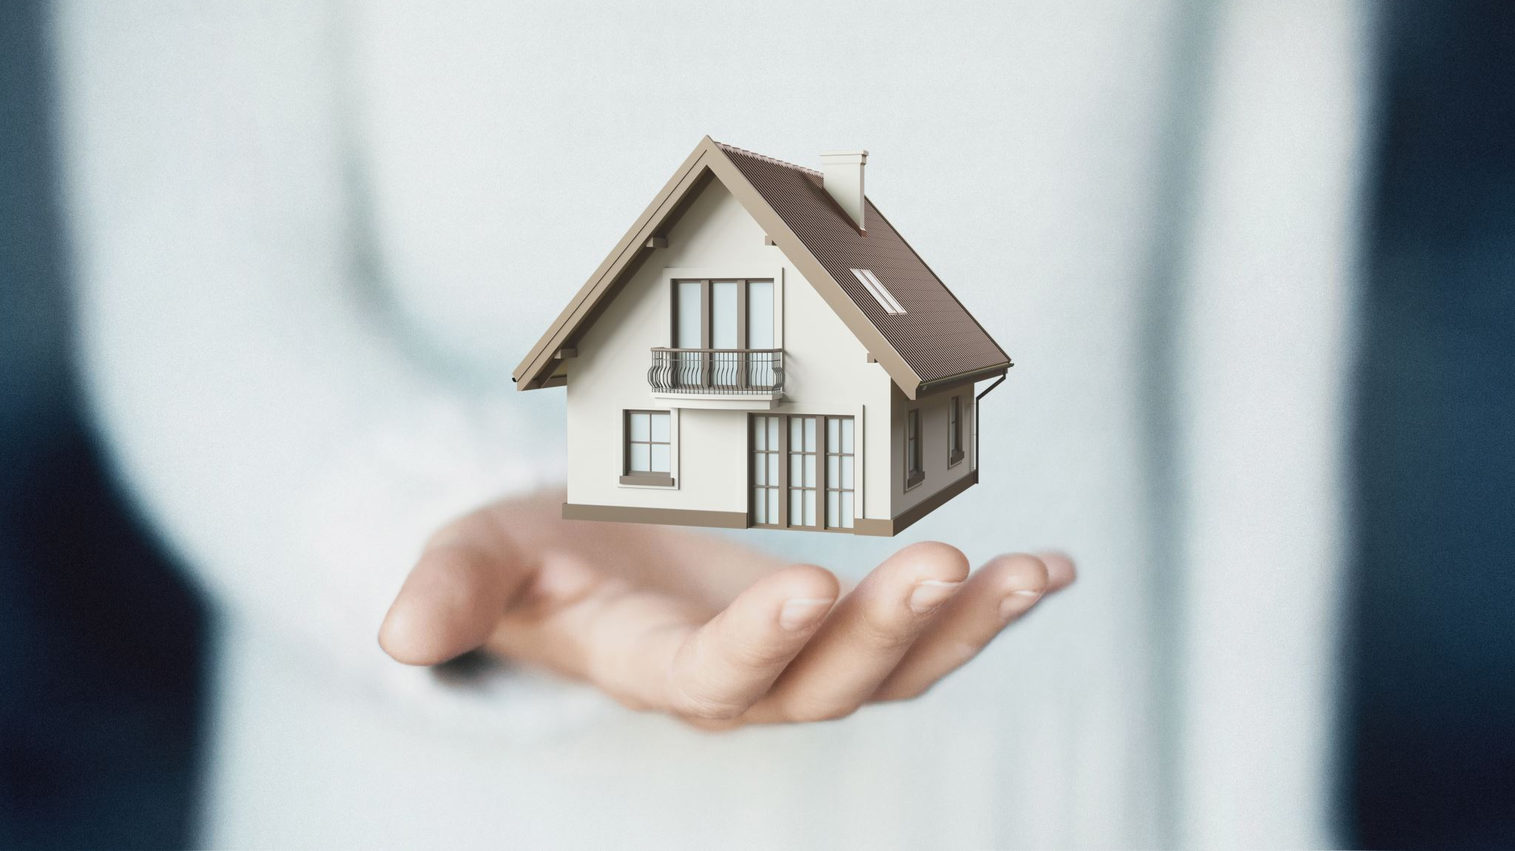
STRATEGIES FOR EFFECTIVE COMMUNICATION IN SELBORNE HOUSE CARE HOME
BMSW4004 EFFECTIVE TEAMWORKING AND COMMUNICATION
HALEMA KHANOM (2117251)
ELAYNE DA CRUZ (2016547)
USMAN UDDIN (2116921)
LECTURER – ABDI RAHMAN

Slide 2
CONTENTS
INTRODUCTION (Elayne Da Cruz)
BENEFITS OF EFFECTIVE COMMUNICATION (Elayne Da Cruz)
THEORIS OF MODELS USED FOR EFFECTIVE COMMUNICATION (Halema Khanom)
BARRIERS THAT EFFECT COMMUNICATION BETWEEN ORGANISATIONS AND EXTERNAL STAKEHOLDERS (Halema Khanom)
THE CHANNELS USED TO IMPROVE COMMUNICATION (Usman Uddin)
CONCLUSION (Usman Uddin)
EVALUATION FORM
REFERENCES

Slide 3
INTRODUCTION
Selborne Care Home is located in Birmingham. It is specially provides care for adults under 65 with learning disabilities, mental health needs and complex support needs. The care home can accommodate up to 15 residents.
In 2019 CQC had inspected the care home and had found that the care home needs improvement in being well led, safe, effective, caring and, responsive. Their findings suggested that the care home lacked adequate training in being well led.
When organisations are not well led this unanimously points towards the communication in the organisation. If information and message is not clearly communicated it can cause barriers and negative outcomes. These negative outcomes have had an effect on the safety and care of residents.
By Elayne Da Cruz

Slide 4
BENEFITS OF EFFECTIVE COMMUNICATION
Communication is vital and must be expressed to get a message or information across. Robbins and Coulter (2017) showed four different function of communication such as control, information, motivation and, emotional expression.
The benefits of effective communication is being able to understand what is trying to be communicated. To understand and acknowledge the information that is expressed, skills such as hearing, listening, reading, understanding the language, recognising and memorising is important.
Effective communication brings trust, better relationships, team building and people skills. This will have a positive impact on the organisations.
Elayne Da Cruz

Slide 5
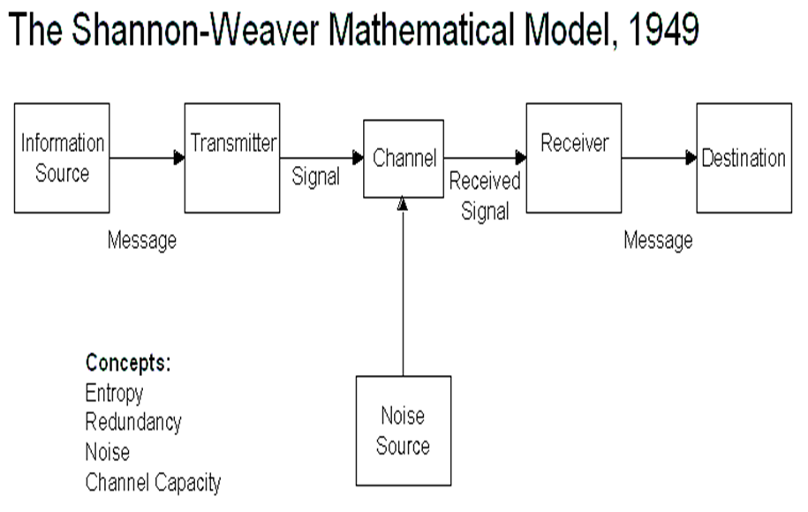
The Shannon-Weaver Model (1949)
Shannon Weaver mathematical model is very effective for communication as it has been used to have a maximum efficiency of using telephone cables and radio waves.
This model is effective for the care home as it lays out the steps clearly to get the best possible outcome.
The information source produces the message
The transmitter encodes the message
The channel is used to pass the message on to the correct receiver
The receiver then decodes the message and passes onto the correct destination
The sixth element can be an interruption and could convey the wrong message.
This model is effective as this can point out the barriers for effective communication
By Halema Khanom

Slide 6
BARRIERS THAT EFFECT COMMUNICATION BETWEEN ORGANISATIONS AND EXTERNAL STAKEHOLDERS
There are six barriers for effective communication and can effect organisations and the external stakeholders. Barriers are when there is a gap or a hurdle in communicating the message and information. There are many barriers that have an adverse on effective communication within organisations and stakeholders.
Filtering – This is when communicating what the other wants to hear. It is being more favourable to get a positive reaction. It also means withholding the correct information.
Emotions – This is when the receiver decodes the message emotionally rather than rationally can effect the way the message was sent. Emotional judgement can have a wrong effect on the communication.
Information overload – When too much information is received it could be impossible to process. This can also happen when someone is medically unfit. This can impact on the final decision on how the information was communicated.
By Halema Khanom

Slide 7
BARRIERS THAT EFFECT COMMUNICATION BETWEEN ORGANISATIONS AND EXTERNAL STAKEHOLDERS
National culture – To be culturally diverse is important as different cultures have different ways of communicating. What might seem rude in some cultures could be the norm for the other, e.g., hand gestures and body language.
Language – Language is important to consider as this is one of the main barriers for communication. English is very common now but people still struggle, one word can mean many different things. Providing a translator is the most effective way to be able to get the correct information across.
Defensiveness – This is when communicating in a way the receiver feels threatened which leads to a negative reaction towards the communication.
By Halema Khanom

Slide 8
WHAT ARE THE CHANNELS USED TO IMPROVE COMMUNICATION
Listening skills: clear communication can begin with active listening. If you just concentrate on how you are showing yourself than the chances will be either you are not listening, or you might be reacting to what the other person is brining to the table. The effective communicator will use different listening styles. An effective communicator will pay close attention to what’s been said and will try hard to make the listeners feel heard and studied.
Empathy: it is something where you must try to understand the feelings of people that are surrounded by you as an effective communicator. It means that you need to understand and relate to other people. Therefore, you need to have a high level of emotional intelligence and showing definitively is an ability to show empathy which will increase the rapport between you and the others eventually will level up your ability to communicate.
Nonverbal communication skills: when it comes to verbal communication the effective communicator dependent on nonverbal cues. You need to be aware of your body language and the tone of your voice which will be developed through messages and presentation skills.
Teamwork: this is can also developed your communication skills. Where you engage actively with your team building and be consistent in collaborating with your teammates is an essential part of building communication skills. The more you build strong relationships and rapport with others in the workplace, the more effectively you’ll be able to communicate with them.
By Usman Uddin

Slide 9
Conclusion
Overall, it is very important to have an effective communication because it leaves all parties involved and feeling accomplished. It can be improved in your day to day life such as by practicing active listening, managing your own emotions, ask for feedback from your teachers from presentation and start practicing public speaking etc. These skills will leave you to become an effective communicator that could be used in any field of your work.
Selborne Care Home needs to build an effective communication internally and externally to be able to improve the quality of the care home overall. Correct communication towards staff will have a positive impact. Also with effective communication with external stakeholders will help the care home in getting the right support to build up the inadequate results
By Usman Uddin

Slide 10
REFERENCES
Robbins, SP. & Coulter MA. (2017) Management, Global Edition Harlow, United Kingdom: Pearson Education Limited. Available from: ProQuest E-book Central. (Accessed: 7 May 2020).

Slide 11
Teamwork Evaluation
Teamwork evaluation | Team responses
Who was in your team? | HALEMA KHANOM USMAN UDDIN ELAYNE DA CRUZ
What were the key strengths of your team? | Able to agree with most decisions
What are the challenges that you overcame as a team? | Being able to meet up due to personal commitments
What would you do differently if you worked as a team? | Organise time to work together effectively

