Slide 1
Brindusa Elena Nechita
1905284
Developing Working Relationships
University of Wales Trinity Saint David
Motivation

Slide 2

Motivation – latin word ‘movere’ which means displacement
Is the sum of all internal and external energies that initiate and direct behaviour towards a goal.
The result is always action by making individuals respond to their internal needs through activities that achieve goals they believe to be rewarding.
Motivation is an important element in determining behaviour, but there are also biological, social, cultural, organisational and psychological nature influences to determine the performance of an employee.

Slide 3
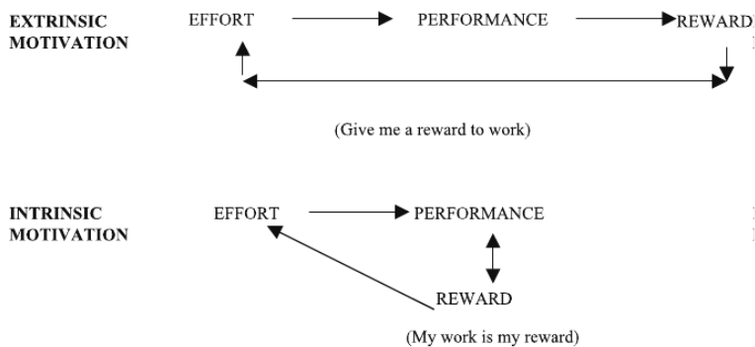
Theories
Maslow (1943)
Fry (2003)
Maslow’s classic depiction of human motivation is based on the hierarchy of the 5 needs each individual has within:
physiological (air, food, water, shelter)
Safety (environmental/emotional safety)
Social (love and affection, friendship, care)
Esteem (internal-self-respect, confidence, freedom and external-recognition, status, admiration)
self-actualisation (the urge to become better in your capabilities, the need of growth)
managementstudyguide.com
Fry classifies the sources of motivation:
Extrinsic: motivated by external factors (salary increase, promotions, company car).
Intrinsic: motivated by personal interest or enjoyment of the activity (personal growth and satisfaction).
Fry (2003) p. 698 – Figure Extrinsic versus intrinsic motivation

Slide 4
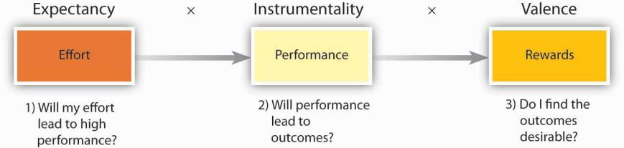
Vroom’s Expectancy Theory (1964)
Is build around 3 basic elements:
Expectation (the relationship between effort and performance)
Instrumentality (the relationship between performance and result)
Valence as the value of result.
Douglas McGregor (1960)
“Man is a wanting animal – as soon as one of his needs is satisfied, another appears in its place. This process is unending. It continues from birth to death.”
Theory X – people in general dislike work and will only work effectively in a controlled work environment, where leaders make decisions and others take orders. X-type workers require to be attracted to produce results and are mostly a minority in organisations.
Y theory – assumes that individuals accept work as an important part of their lives and work to achieve goals and gladly accept responsibility. In type Y organisations, people at lower levels are engaged in decision making and have more responsibility.
www.toolshero.com

Slide 5

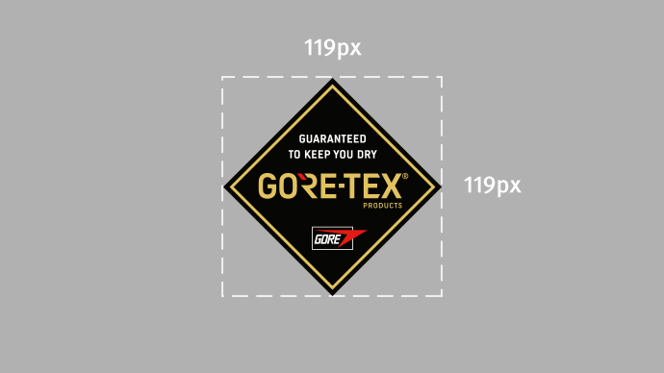
W.L. Gore has a flat organizational structure, without chain of command and formal communication channels. At this time W. L. Gore realised that as his company grew, and he had more employees, efficiency and productivity started to decline. Therefore, he had to change the typical pyramid management that supressed creativity and innovation. During World War II he learned about a new type of organisational structure called the lattice structure which emphasized on communication and cooperation, where individuals are expected to be more self-motivated, and therefore self-managing.
There is no hierarchy, managers or bosses and employees choose themselves a leader they follow. There are temporary groups and each group has a maximum of 150 members, a number that allows you to get to know all the members of the group and have an idea of who is responsible for what, and it is mutual responsibility that motivates the employees. Performance is evaluated collectively, and salary increases and bonuses are determined according to this performance.
Any person is allowed to make decisions as long as they are fair.
Consultation is only required for decisions that could harm the company on a long-term basis.
But even this management structure comes to a point when it starts to decline in effectiveness, and that is when it reaches 200 members because of lack of trust and cooperation between them.
No wonder that every year the company ranks among the best companies and has been working on this model since it was founded in 1958.

Slide 6


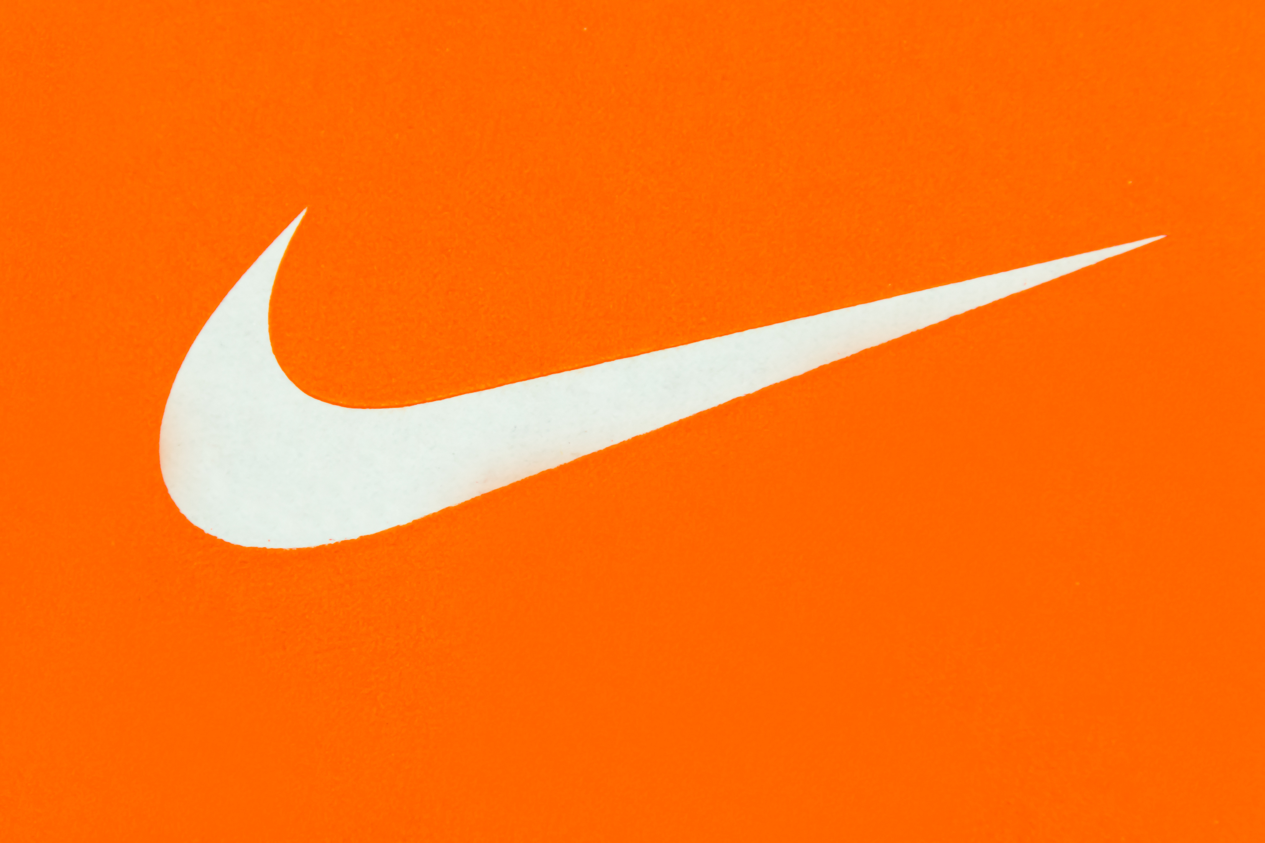
Nike uses the matrix organizational structure, and a big part of its success comes from this structure that is said to be one of the best in the world. A matrix organization means that the company is organized by both product and function and the authority passes vertically as well as horizontally. Nike uses both divisional and functional structures.
The divisional structure is followed on the product basis and ensures that the innovation and development keep happening in all the products that that company is manufacturing. There are functional departments under the Global corporate leadership and team structures in the organization that make sure the policies are implemented throughout the company and in all divisions.
The functional structure comes under the CEO with regional divisions all over the world, are separate from each other and are given autonomy in taking local decisions but preventing them from doing any unethical decisions, a close check is kept.
The matrix organizational structure allows Nike to increase sales and enforce its brand image across the world by providing different goods in different regions in relation with the people’s preferences in those regions, all because of the divisional structure. The divisions according to products helps employees to focus on their product only, making them specialists in their particular field and therefore best for their job. This functional structure enhances the best form of workforce, by using people with the perfect set of skill sets, working with similar individuals in the group, bringing high efficiency and reducing the chances of error.
The matrix structure, as a whole, emphasizes on efficiently employing a single person for more than one job, motivating employees by increasing their incomes.

Slide 7


Motivation methods can be of many kinds - internal, external, material or non-material. Here are some of the approaches that can have a positive impact on motivation: flexibility of working hours, team building, brainstorming sessions, validation of results obtained, transparency, additional salary benefits, transparency, keep regular information about the future of the company, treat each employee separately, contribute to a relaxed atmosphere at work, make small gestures, but with meaning.
Several theories can help managers understand what people need and therefore can manage them better. Employees respond to fairness or unfairness in the work environment and learn from the consequences of their actions. They repeat behaviours that lead to positive results and can be motivated to exert effort when they see that their actions lead to outcomes that gets them the desired reward.
It is very important to find the right organisational structure that works best for a particular company. Using the wrong structure can result in poor communication, poor product development, poor employee efficiency and poor customer service and can be detrimental to a company and could result in lost revenue or even complete failure of the company.

Slide 8
https://portal.gorefabrics.com/cof/en_xx/assets/img/teaser-gtx-products-logo-size.jpg http://motivatingemployees101.weebly.com/uploads/1/4/7/4/14746808/1168405.jpg?602 https://api.time.com/wp-content/uploads/2015/06/nike-logo.jpg
Fry, L. W. (2003) ‘Toward a theory of spiritual leadership’ The Leadership Quarterly, 3rd September. Available at: https://www.researchgate.net/publication/222827010_Toward_a_Theory_of_Spiritual_Leadership (Accessed: 10th October 2020) van Vliet, V. (2016) Douglas McGregor Available at: https://www.toolshero.com/toolsheroes/douglas-mcgregor/ (Accessed: 15th October 2020)
Juneja, P. Available: https://managementstudyguide.com/maslows-hyerarchy-needs-theory.htm (Accessed: 20th Oct 2020)
Sobiya, Nike’s Organizational Structure: Pros & Cons Available at: https://www.advergize.com/business/nikes-organizational-structure-the-pros-cons/ (Accessed: 30th Oct 2020)
Goins, J. (2018) Nike's Flat Organizational Structure, Reviewed by: Michelle Seidel, B.Sc., LL.B., MBA
Updated December 04, 2018 Available at: https://bizfluent.com/facts-6887850-nike-s-flat-organizational-structure.html (Accessed: 20th Oct 2020)
Brooks, I., (2009) Organisational Behaviour. Harlow, England: Prentice Hall/Financial Times

