Slide 1
Review of Database Concepts

Slide 2
Learning Objectives
Difference between Database and Database Management System
Database Components

Slide 3
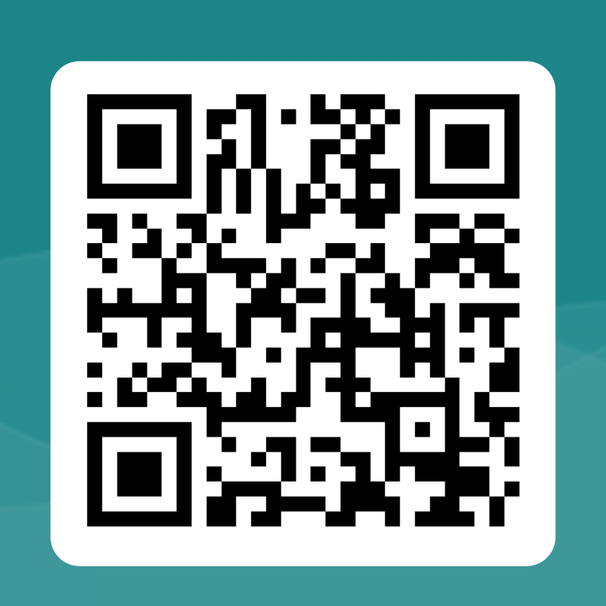
https://forms.office.com/e/T9qT3MQ44r

Slide 4

Database – What is it?
"A set of information held in a computer" - Oxford English Dictionary
“One or more large structured sets of persistent data, usually associated with software to update and query the data” - Free On-Line Dictionary of Computing
A database is a structured collection of data that is organized in a way to make it easily accessible, manageable, and updateable. It is designed to efficiently store, retrieve, and manage vast amounts of information in a systematic and structured manner. Databases are a fundamental part of modern computing and play a critical role in various applications and systems.
Notes:
A clear understanding of what a database is and its various components helps individuals comprehend the concept of data management more effectively.
Knowing different definitions allows you to communicate with others in various fields, such as database administrators, developers, business analysts, and stakeholders, who may have different perspectives on what constitutes a database.

Slide 5


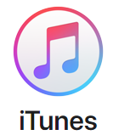







Why Database Management Systems?
Data is used everywhere.
  Personal Data
  Product Data
  Media Data, etc.
It needs to be stored somewhere!
Notes:
Your grocery store, bank, restaurant, online shopping sites, hospital, favorite clothing store and mobile service provider, for instance all use databases to keep track of customer, inventory, employee and accounting information.

Slide 6
Why Database Management Systems?
Data is valuable.
https://informationisbeautiful.net/visualizations/worlds-biggest-data-breaches-hacks/
It needs to be managed - controlled access to it.
Notes:
https://www.informationisbeautiful.net/visualizations/worlds-biggest-data-breaches-hacks/ [accessed: 03-Oct-2023]

Slide 7
Why Database Management Systems?
"Data is the new oil”
Clive Himby British data scientist and entrepreneur
“Data that is loved tends to survive.”
Kurt Bollacker, computer scientist
"Without big data, you are blind and deaf and in the middle of a freeway.“
Geoffrey Moore, a business consultant and author
“If somebody tortures the data enough (open or not), it will confess anything.”
Paolo Magrassi, former vice president, research director, Gartner
Source: Shareable Data Quotes That Will Change How You Think About Data
Notes:
Quote sources: https://www.springboard.com/blog/41-shareable-data-quotes/ [accessed: 02-Oct-2018, 27-Sep-2019]
“Torture the data, and it will confess to anything.”
These quotes remind us of the critical role that databases play in our increasingly data-driven world
Ronald Coase, winner of the Nobel Prize in Economics

Slide 8
Do you think the choice of a database system can significantly impact the success of a software project? Why or why not?
Have you ever wondered about the differences between SQL and NoSQL databases and when to use each one in a project
Have you heard about NewSQL databases and their attempt to combine the best of both SQL and NoSQL worlds? What are your thoughts on this approach?

Slide 9
Distinct types of database management systems
SQL (Structured Query Language) Databases
NoSQL (Not Only SQL) Databases
NewSQL Databases

Slide 10
SQL (Structured Query Language) Databases
-SQL databases are relational databases that use structured query language (SQL) to manage and manipulate data.
-Examples of SQL databases include MySQL, PostgreSQL, Oracle Database, and Microsoft SQL Server.

Slide 11
NoSQL (Not Only SQL) Databases
- NoSQL databases are non-relational databases designed for handling unstructured or semi-structured data.
- NoSQL databases can handle large volumes of data and are suitable for distributed and high-velocity data environments.
- NoSQL databases are particularly popular for web applications and big data projects.
Notes:
used when scalability, flexibility, and fast data access are crucial.

Slide 12
NewSQL Databases:
-NewSQL databases are a relatively recent category of databases that aim to combine the best of both worlds from SQL and NoSQL databases.
- designed to offer the scalability and high availability of NoSQL databases while maintaining ACID (Atomicity, Consistency, Isolation, Durability) compliance.
- used in applications like financial systems and e-commerce platforms.

Slide 13
Do you think the choice of a database system can significantly impact the success of a software project? Why or why not?

Slide 14
Choice of a Database system - Impact
Data model Alignment: - SQL database: relational
Scalability: when expected to handle massive volume of data
- Experience rapid growth
Performance: SQL DB can handle complex queries and transactions
- suitable for applications requiring high data integrity& consistency
Development Speed-
Cost: initial licensing and infrastructure costs, ongoing maintenance and scaling
Notes:
.

Slide 15
Have you ever wondered about the differences between SQL and NoSQL databases and when to use each one in a project?

Slide 16
Differences between SQL and NoSQL databases
SQL Databases:
These are like organized, structured filing cabinets for your data.
They're great when you have a clear plan for your data.
E.g. bank accounts or airline reservations
NoSQL Databases:
These are like flexible, fast-moving drawers for your data.
They're perfect when you have lots of data coming in from all directions.
E.g. Social media apps or big e-commerce websites

Slide 17
Have you heard about NewSQL databases and their attempt to combine the best of both SQL and NoSQL worlds? What are your thoughts on this approach?

Slide 18
NewSQL databases
Example: E-commerce Platform:
Imagine you're building an e-commerce platform, and you want to choose a database system to handle your product catalog, customer orders, and inventory management. Here's how a NewSQL database might come into play:
Data Integrity
Scalability
Transaction Support
Structured Data
SQL Compatibility

Slide 19
Activity
Describe the functionalities of the database components

Slide 20
Summary
Database
DBMS
Database Components
Next session
- Database environment
- Database Languages

