Slide 1
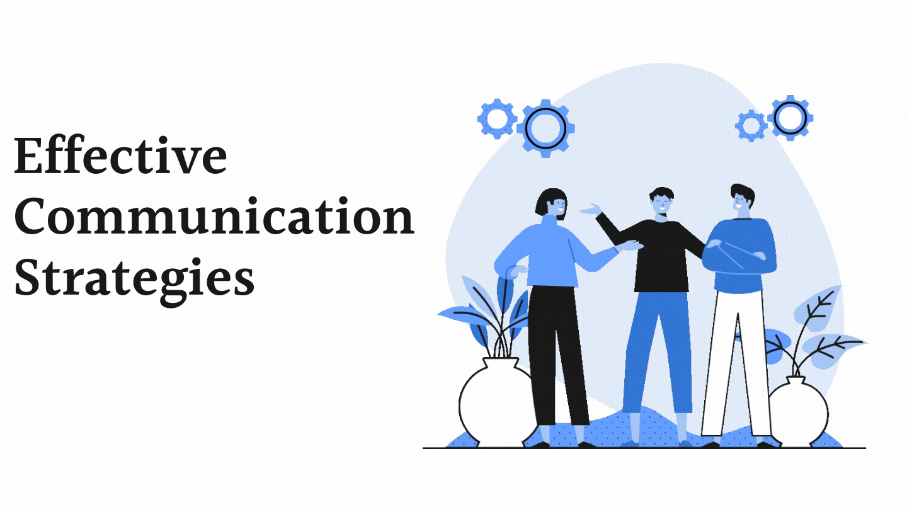
PRESENTATION – STRATEGIES FOR EFFECTIVE COMMUNICATION IN A BUSINESS SETTING
Student number: 1911518
Student name: Eduard Valentin Tischler
Module: BMSW 4002
Lecturer name : Dale Clarke

Slide 2
Table of Contents
Introduction……………………………………………………………………………..Slide 3
How might the firm use the theories related to the models of Communication? …………………Slide 4
Theories relating to group dynamics, team working………………………………………………..Slide 6
The channels of communication that the organisation can use……………………………………..Slide 8
Channels that can be used to improve Communication…………………………..………………..Slide 9
Types of barriers that could prevent effective Communication amid the external stakeholders and
organisation………………………………………………………………………………………..Slide 10
Impact of Effective communication on the business process of the organisation………………..Slide 11
Conclusion……………………………………………………………………………………….Slide 12
Teamwork Evaluation…………………………………………………………………………...Slide 13
References……………………………………………………………………………………….Slide 14

Slide 3
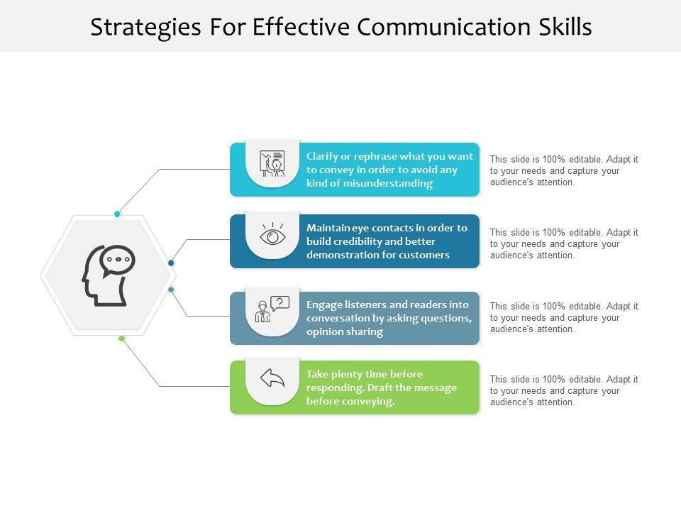
Introduction
Effective Communication in a team helps to develop a common purpose within different team members that could allow team members to reach individual goals.
Understanding the importance of effective communication can be stated that it helps the employees form a sense of friendly environment and strong relationship.
Marks and Spencer is a famous British retailer that keeps its focus on its own labelled business that consists of Clothing and Home, Bank and Service and Food (Home. 2021)
This firm has spontaneously expanded its market across the country and all around the world.
Notes:
The chosen firm has shown its priorities over employee's relationships and improved working interface where Communication plays an effective role. The concerned study will highlight different communication strategies, team building theories that should be taken into consideration by the firm. Moreover, different communication channels, different communication barriers, and the impact of effective communication on the organisation.

Slide 4
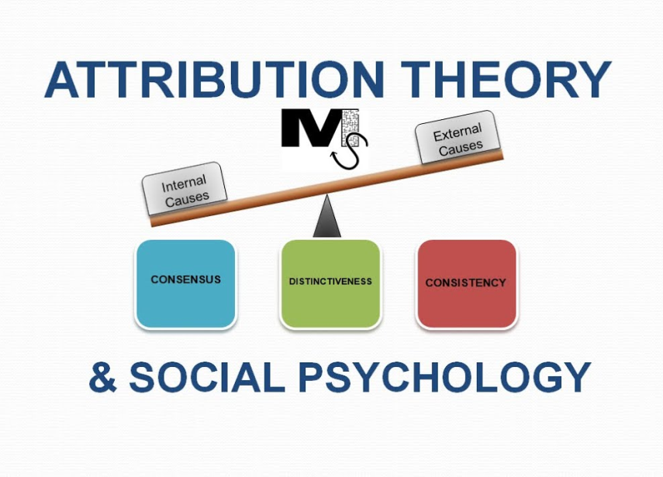
How might the firm use the theories related to the models of Communication?
Several features are coincided within Communication
According to Fraley and Shaver (2021), Attachment Theory is considered as evolutionary psychological and ethological theory
It is mostly concerned with individual relationships among the employees
For instance, M&S always keeps its focus on colleagues, local stakeholders to understand their changing needs (Our Communities. 2021)
Notes:
The above-identified communication theories have enough impact on the business success of M&S.

Slide 5
On the other hand, Attribution Theory depicts effective concern about the ways by which ordinary people could explain the reasons for events and behaviour​
With its implementation in the company, it can be highlighted that M&S always listen to their stakeholders and successfully identify their shared objectives for business with them ​
Communication has played an effective role in M&S​

Slide 6
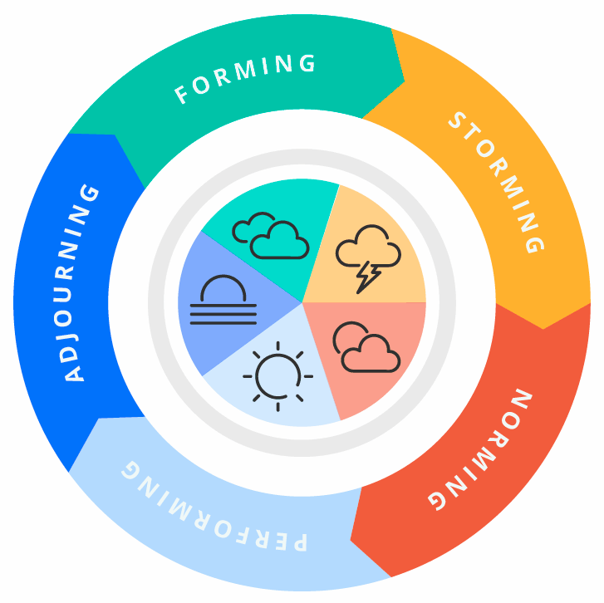
Theories relating to group dynamics, team working
Apart from Communication, there are two more important aspects related to organisational growth: Team Working and Group Dynamics.
As opined by Solomon (2020), Tuckman has first introduced the theory of Group Dynamics.
Tuckman's theory has five stages of group development such as forming, norming, storming, adjoining and performing.
Forming determines the purpose and uncertainties that should be addressed similarly; norming depicts individual differences among members.
Storming determines the highest level of conflict and disagreement among team members and in the phase of performing group attains a sense of cohesiveness.

Slide 7
Adjourning determines the deserving outcome and salaries for the members​
The implementation of this theory in M&S has helped to initiate different groups of stakeholders ​
The famous theory of Team Working is Belbin's Theory​
It states that by the understanding individual roles of the members in a team, one can boost up the strengths and could deal with the weakness​
The company has implemented the theory to integrate team collaboration​
For instance, M&S recognise the individual priorities of the employees and offer them safe and healthy workforce ​
Moreover, by promoting diversity the internal bond among them could be improved by mitigating cultural differences (Our People. 2021)​

Slide 8
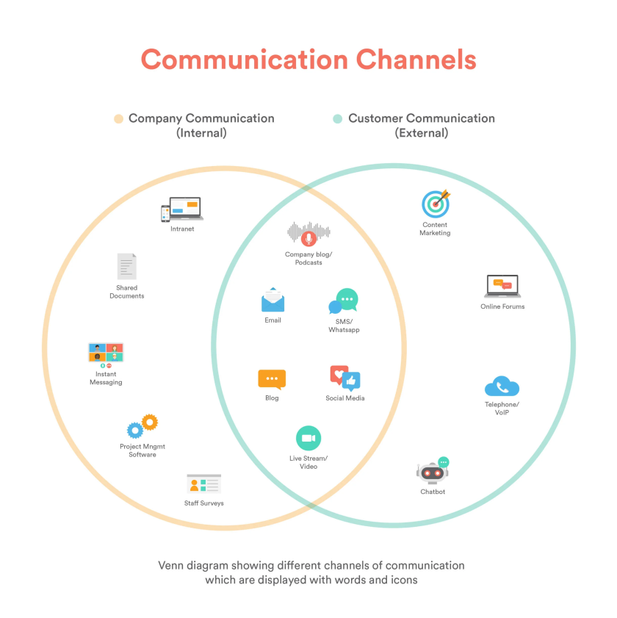
The channels of communication that the organisation can use
There are different types of communication channels that M&S can use
Communication channels can be categorised into three types such as written, verbal and non-verbal
Different individual characteristics make diverse use of different channels
After examining the individual characteristics, it can be stated that verbal and written Communication is effective
For instance, in Marks and Spencer, the primary plan is to make people happy and satisfied in coming to work and to offer a workplace that is free of discrimination
With the help of Verbal Communication, employee relations could be strengthened
Moreover, with the help of professional appreciation through mail or chats, an effective and sophisticated working environment could be generated as well
Notes:
In this phenomenon, employees would be able to respect each other and value others.

Slide 9
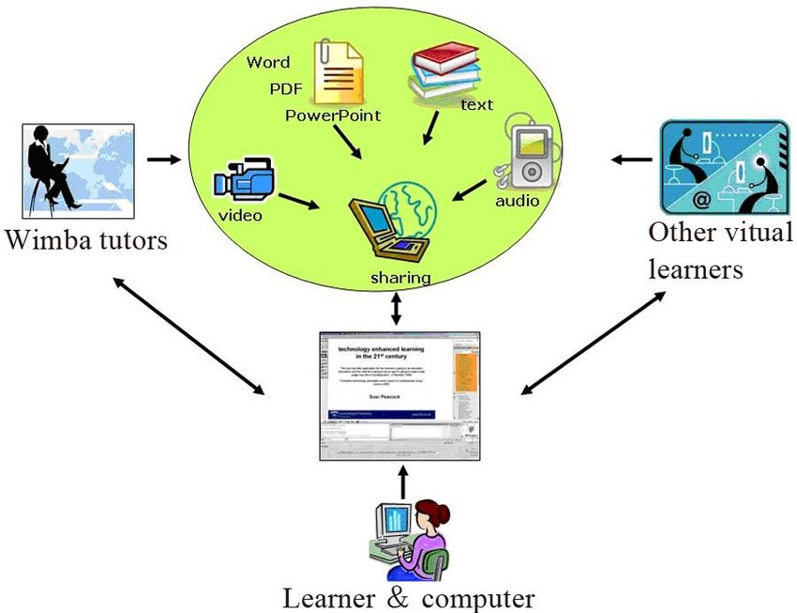
Channels that can be used to improve Communication
Apart from the above identified communication channels the use of Digital Communication Channels can be used to improve the current situation
As opined by Blackburn et al. (2020), Digital channels extend the communication opportunities among employees from face to face conversation to video conferencing
M&S has decided to organise online survey annually to note their changing needs and level of interest in doing their jobs
Notes:
Considering the Pandemic situation through video conferencing, online discussions, meetings, telephonic conversation, and email would be highly effective to have a strong relationship with the workers.

Slide 10
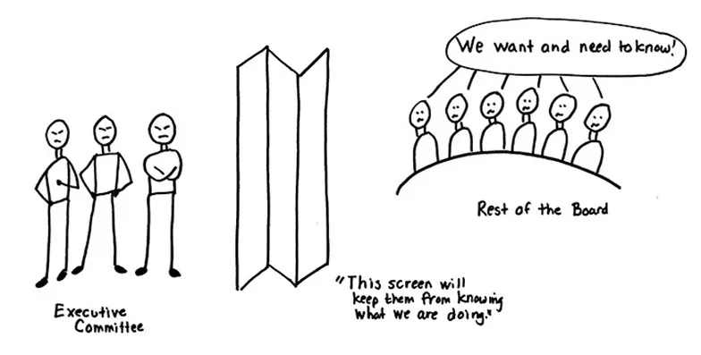
Types of barriers that could prevent effective Communication amid the external stakeholders and organisation
There are different types of barriers that could impact effective Communication
Lack of trust and transparency among the organisation and stakeholders might create issues in having Communication
Internal conflict in the workplace, level of dissatisfaction and disagreement among the members would create difficulties in having strong Communication
M&S has shown the necessity of developing an application that could enable the team members in tracking the distribution of sales and could supervise individual roles (Microsoft Tech Community Resource Center. 2021)

Slide 11
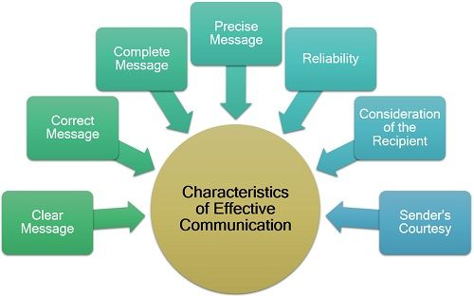
Impact of Effective communication on the business process of the organisation
Effective Communication contributes in the organisational success
By rendering the followed principles of M&S, it has been recognised that a sense of cultural integration is offered to the employees
It helps to build employees satisfaction, engagement and morale within the business interface
Effective Communication helps the workers to understand different terms and conditions of employment
It could drive loyalty and commitment

Slide 12

Conclusion
It can be concluded that Communication reflects teamwork and workplace success
Marks and Spencer has taken its prior role in improving principles of Communication
Workplace diversity and individual relationship with the workers have boost up the growth and development
Different communication strategies and impacts of effective Communication have been discussed above

Slide 13
Teamwork Evaluation | Response
Who was in your team? | Cristina Florina Simion,Delia Miclea
What were the key strengths of your team? | Effective Communication, Teamwork
What were the challenges that you overcame as a team? | Lack of effective decision making process and lack of understanding
What would you do differently if you worked as a team again? | I will improve my decision making skills
How would you rate your team working? Out of 10? | 8

Slide 14
References
Blackburn, S., LaBerge, L., O’Toole, C. and Schneider, J., 2020. Digital strategy in a time of crisis. McKinsey Digital, April, 22.
Fraley, R.C. and Shaver, P.R., 2021. Attachment theory and its place in contemporary personality theory and research.
Home. 2021. Home. [online] Available at: <https://corporate.marksandspencer.com/?intid=gft_company> [Accessed 20 November 2021].
Microsoft Tech Community Resource Center. 2021. Marks & Spencer streamlines companywide communication with Microsoft PowerApps and SharePoint lists - Microsoft Tech Community Resource Center. [online] Available at: <https://resources.techcommunity.microsoft.com/case-studies/marks-spencer-streamlines-companywide-communication-with-microsoft-powerapps-and-sharepoint-lists/> [Accessed 20 November 2021].
Our Communities. 2021. Our Communities. [online] Available at: <https://corporate.marksandspencer.com/sustainability/our-communities> [Accessed 20 November 2021].
Our People. 2021. Our People. [online] Available at: <https://corporate.marksandspencer.com/sustainability/our-people> [Accessed 20 November 2021].
Solomon, D.B., 2020. The Worth of Steady Digital Team Formation Strategy A Case Study of Bruce Tuckman's Model in Software Industry. Advance: Social Sciences & Humanities.

