Slide 1





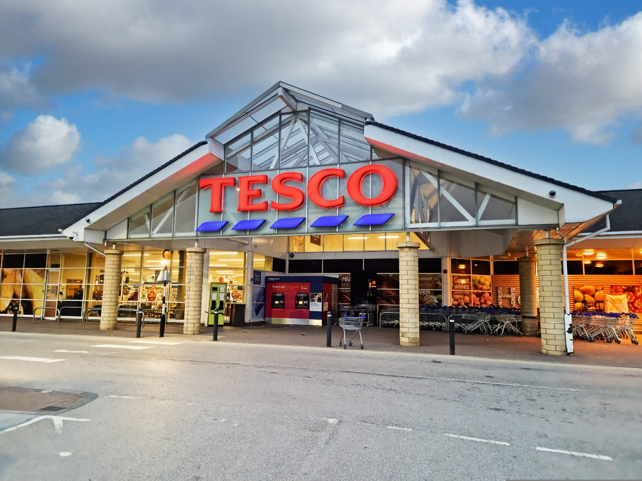
APPLYING FAYOL’S MANAGEMENT FUNCTIONS IN A CONTEMPORARY RETAIL CONTEXT: A CASE STUDY OF TESCO
Presented by:
Florina Petre(2326724)
Elena Raican(2440481)
Shamima Akter Rumi(2223220)

Slide 2



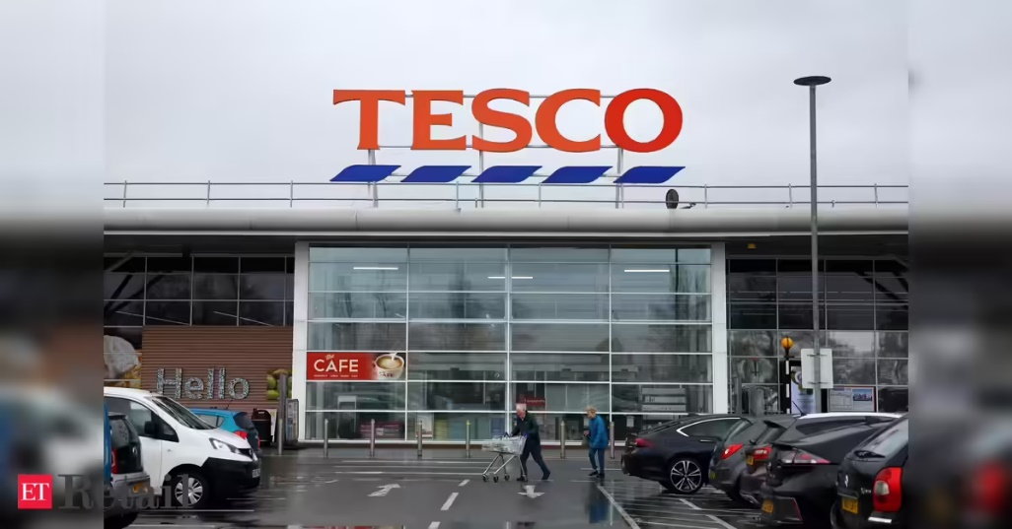
Introduction to Tesco
Tesco is the UK’s largest supermarket chain with over 3,800 stores.
Founded in 1919, it dominates UK grocery retail and operates globally.
Offers groceries, clothing, financial services, and online shopping.
Tesco’s scale makes it an ideal case for analysing managerial functions.
Notes:
The long history, market dominance, and multisector position of Tesco offer the firm a powerful platform on the functions of management as proposed by Henry Fayol. Its managers have to be efficient in planning, organising, commanding, coordinating, and controlling with hundreds of thousands of employees and complicated business to maintain profitability and satisfy changing customer demands. This renders Tesco a topical example of how classical management theory can be applied to contemporary business issues and large-scale retail organisations.

Slide 3
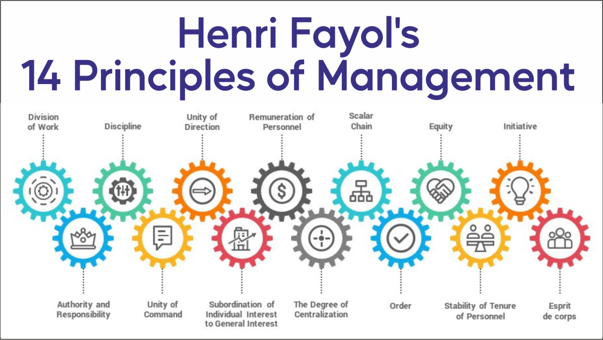
Henry Fayol’s Management Framework
  Fayol proposed five key functions: planning, organising, commanding, coordinating, and controlling.
  These functions outline universal managerial responsibilities (Odeniyi and Abdulsalam, 2025).
  Widely applied across industries to assess leadership effectiveness.
  Provide a foundation for modern management practices at Tesco.
Notes:
The framework by Henry Fayol continues to be pivotal in management studies and practice. Although created in the early 20th century, the functions are applicable to Tesco today. They assist us in systematically assessing the performance of Tesco managers in their tasks and in keeping the organisation competitive, customer-oriented and adaptable in a demanding retailing environment. The functions serve as guiding principles that assist Tesco managers to make decisions, allocate resources, and achieve long-term organisational success effectively.

Slide 4
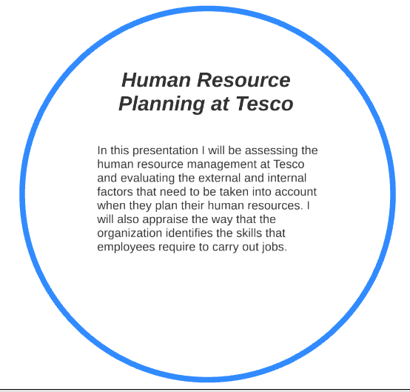
Planning at Tesco
Planning sets objectives, allocates resources, and anticipates challenges.
Tesco managers use demand forecasting to manage inventory (Biliavska and Mykytenko, 2023).
Strategic planning tackles competition from Aldi, Lidl, and Amazon Fresh.
Long-term plans include digital transformation and sustainability goals.
Notes:
At Tesco, competition and changing consumer preferences in the market are a daily challenge that requires effective planning. Demand is predicted by managers to prevent shortages or waste, whereas long-term plans are concerned with sustainability and digitalisation. The rivalry forces necessitate planning of promotions and pricing carefully to enable Tesco to stay customers loyal and profitable.

Slide 5
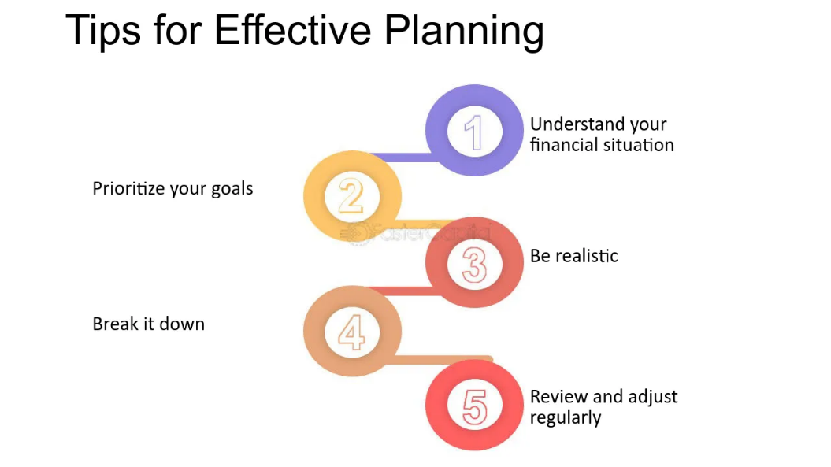
Effectiveness of Planning
  Tesco uses scenario planning to respond to inflation and Brexit effects.
  Investment in e-commerce strengthens long-term competitiveness.
  Clubcard loyalty schemes align short-term promotions with strategy.
  Planning ensures both resilience and customer retention (Stanikzai and Ali, 2024).
Notes:
Tesco planning has proven resilient in addressing unforeseeable external environmental changes such as inflation and supply chain disruptions. Tesco incorporates planning into all activities by connecting long-term digitalisation plans with customer loyalty programs like Clubcard. This enables managers to protect profits and adjust to external shocks. The planning role makes sure that Tesco is competitive, that it achieves sustainable growth, and that it foresees competitors and that it continues to provide constant service and customer satisfaction across markets.

Slide 6
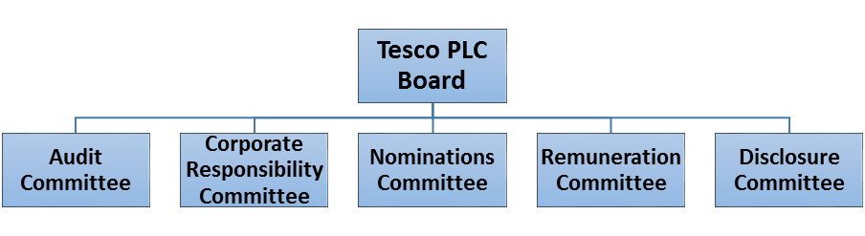
Organising at Tesco
  Organising ensures resources, staff, and systems are structured effectively.
  Tesco operates with hierarchical layers across national, regional, and store levels.
  Departmental divisions (finance, logistics, HR, marketing) enhance efficiency (Manioudis and Meramveliotakis, 2023).
  Managers coordinate between supply chain and sales for smooth operations.
Notes:
Tesco can operate on a scale because of organisation. Managers provide role clarity and inter-departmental communication. The hierarchical system enables accountability and the inter-divisional teamwork ensures the movement of the products between suppliers and stores. This framework allows Tesco to uphold its efficiency even in the face of its expansive operations. Effective organising will also enhance resource maximisation, proper definition of employee duties and the customer facing services will always be in reflection of the reputation of quality and reliability of Tesco in the retail business.

Slide 7
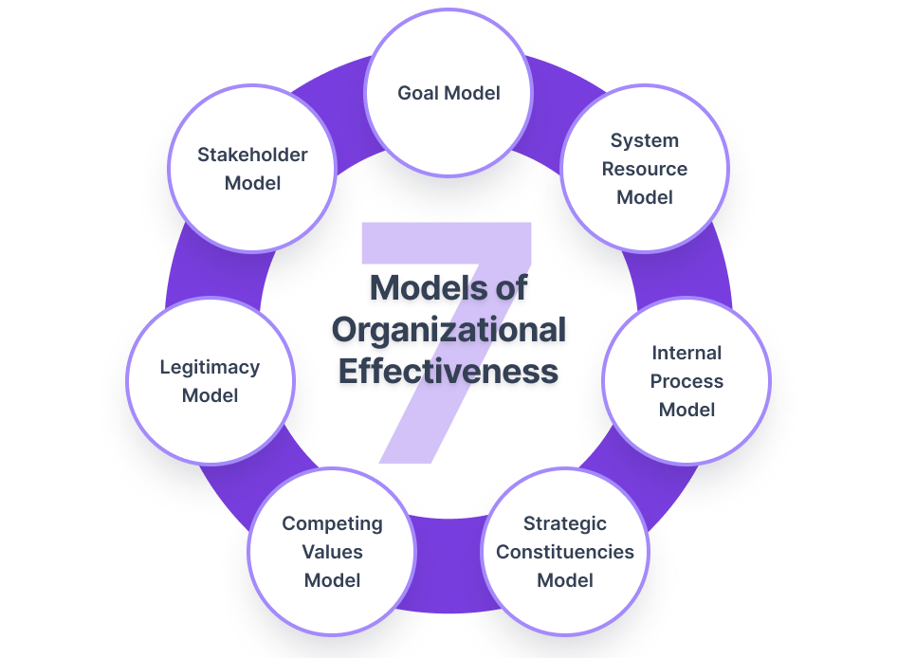
Effectiveness of Organising
  Clear job roles improve employee accountability and performance.
  Supply chain organisation ensures shelves remain stocked daily.
  Effective HR policies promote training and employee engagement (Younis and Mohamed, 2022).
  Organising supports consistency across thousands of Tesco outlets.
Notes:
The organisation activities of Tesco are quite effective in establishing uniformity in its extensive chain of stores. Role definition promotes accountability and service delivery by managers. Besides, availability of goods will be secured with the help of supply chain organisation, and training prospects will be provided to employees with the help of HR activities, which helps Tesco to be committed to involve workers.

Slide 8
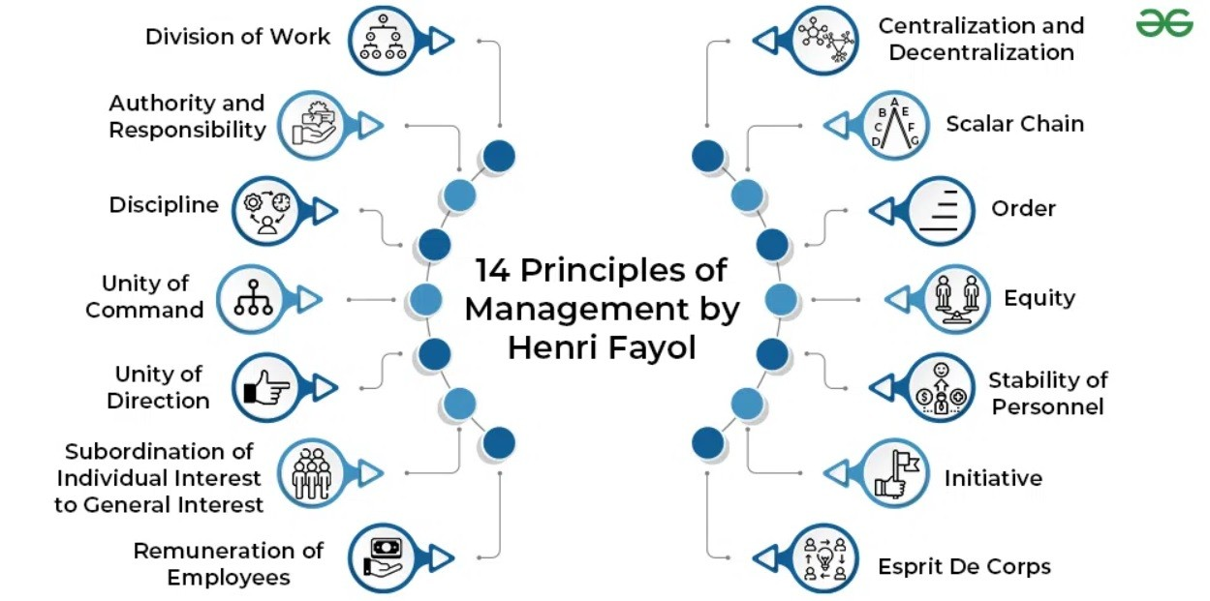
Commanding in Tesco
  Commanding involves directing and leading employees effectively.
  Tesco managers use performance targets to guide staff.
  Leadership ensures motivation, customer service, and teamwork.
  Managers balance operational directives with employee welfare (Hashim et al., 2021).
Notes:
Tesco managers are forced to deal with large teams every day. The targets and expectations are both efficient and staff motivation is high. Leadership is also related to customer service. Being a commander requires balancing the needs of the work force and the wellbeing of personnel members to retain them in shape and happy.

Slide 9
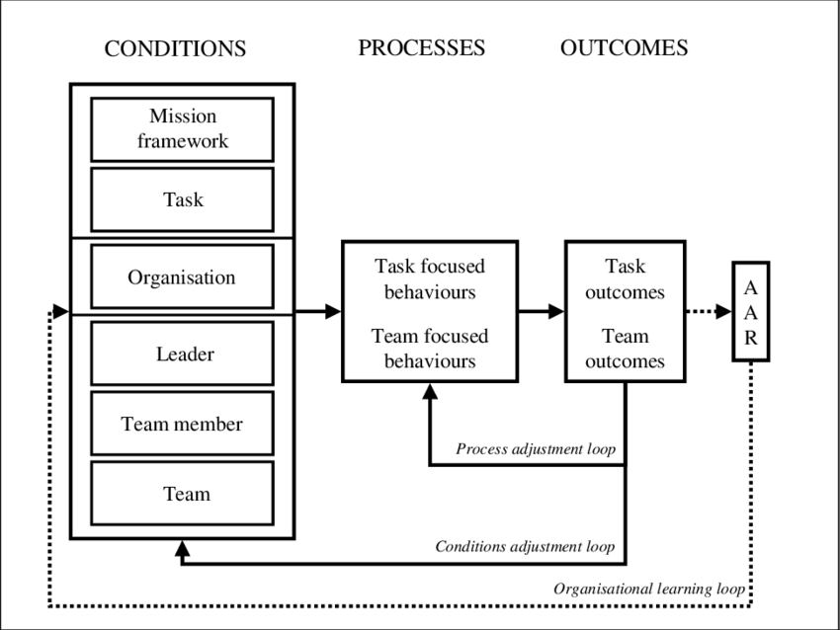
Effectiveness of Commanding
  Tesco adopts participative leadership, encouraging staff input.
  Strong leadership enhances customer service standards.
  Clear communication reduces misunderstandings and delays (Lin and Ma, 2021).
  Motivated employees contribute to higher productivity.
Notes:
Tesco leadership is not an authoritarian leadership style, but a blend of directive and participative leadership. Managers listen actively to employees, improving engagement. Goal communication ensures alignment, and motivation strategies, such as incentives, are necessary to enhance productivity and preserve Tesco reputation of responsible service. This participative type of style helps motivate the boost in engagement, the enhancement of customer service, and the maintenance of the Tesco image as a reliable retailer capable of offering stable value and satisfaction to its customers.

Slide 10
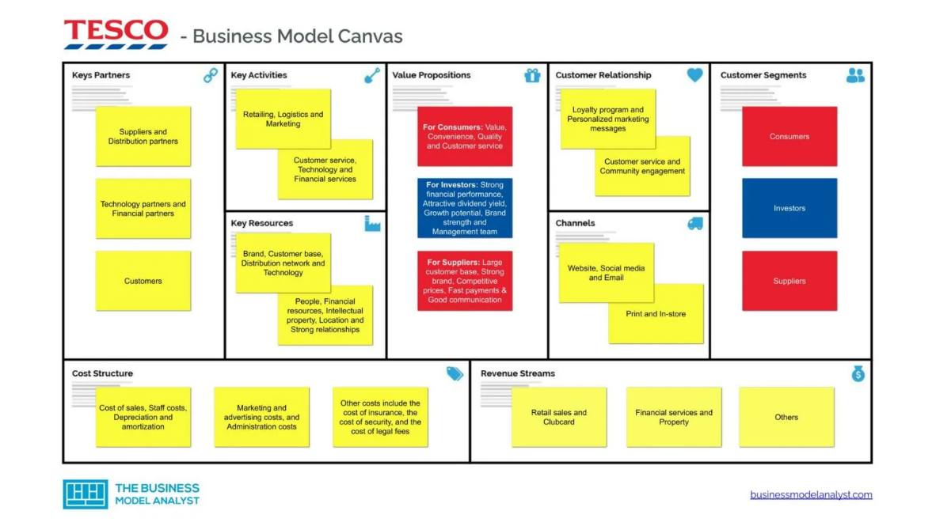
Coordinating at Tesco
  Coordination integrates activities across departments and levels.
  Managers align logistics, supply chain, and sales functions (Sagar, 2024).
  Technology enables real-time coordination of stock and distribution.
  Coordination supports consistent customer experiences nationwide.
Notes:
To coordinate its complicated operations, Tesco uses coordination. Managers should align supply chain operations with sales objectives and ensure the smooth flow of customer requirements. The coordination process has now been made easier and more efficient because of the IT systems in place, enabling Tesco to react quickly to customer demand and market trends. Through coordinating various departments and processes, Tesco can quickly adjust to shifts in demand and ensure consistent client service both in stores and online.

Slide 11
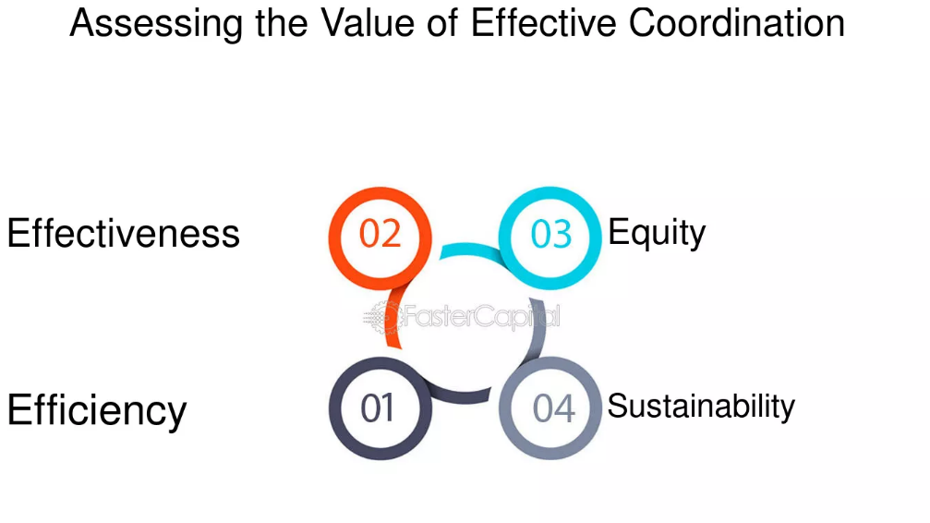
Effectiveness of Coordinating
  Coordination reduces duplication and inefficiencies.
  Real-time stock updates enhance inventory management.
  Cross-functional teamwork strengthens problem-solving.
  Customer service quality improves through effective integration.
Notes:
The Tesco managers ensure that the functions are harmonized to reduce resource and inefficiencies wastages. An example of this is IT systems which provide real-time stock updates thus increasing accuracy. Teamwork will be effective in the problem solving and this will end up positively affecting customer shopping experience in Tesco stores. Such a good co-ordination ensures that customers are assured that they will always have a stock of products and this will create a smooth shopping experience. It also helps Tesco to remain efficient and please clients in a very competitive retail environment.

Slide 12
  Controlling involves monitoring performance against objectives.
  Tesco managers use KPIs like sales growth and customer satisfaction.
  Regular audits and feedback ensure quality compliance.
  Financial controls maintain cost efficiency and profitability (Gupta et al., 2022).
Controlling at Tesco
Notes:
The concept of control is also an important part of Tesco that ensures the attainment of objectives and maintenance of standards. Key indicators that the managers rely on to gauge improvement include sales and customer satisfaction levels. The compliance and cost-efficiency in businesses on a wide scale are also maintained through financial controls and audits..

Slide 13
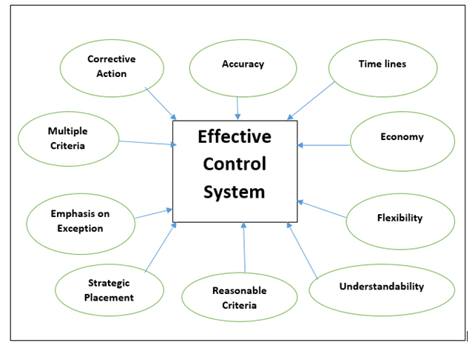
Effectiveness of Controlling
  Continuous monitoring helps Tesco adapt to market changes.
  Clubcard data provides insights into customer behaviour.
  Financial controls safeguard Tesco’s profitability.
  Effective controlling ensures alignment with strategic objectives.
Notes:
Tesco also has really information-oriented control systems that employ the experience of its Clubcard programme to track the preferences of the customers. This data helps the managers to cut down strategies. Tesco can easily become adaptable by implementing financial controls which guard profit and performance checkups. This shows that operational performance of the orients can be handled so as to be customized towards long term objectives.

Slide 14
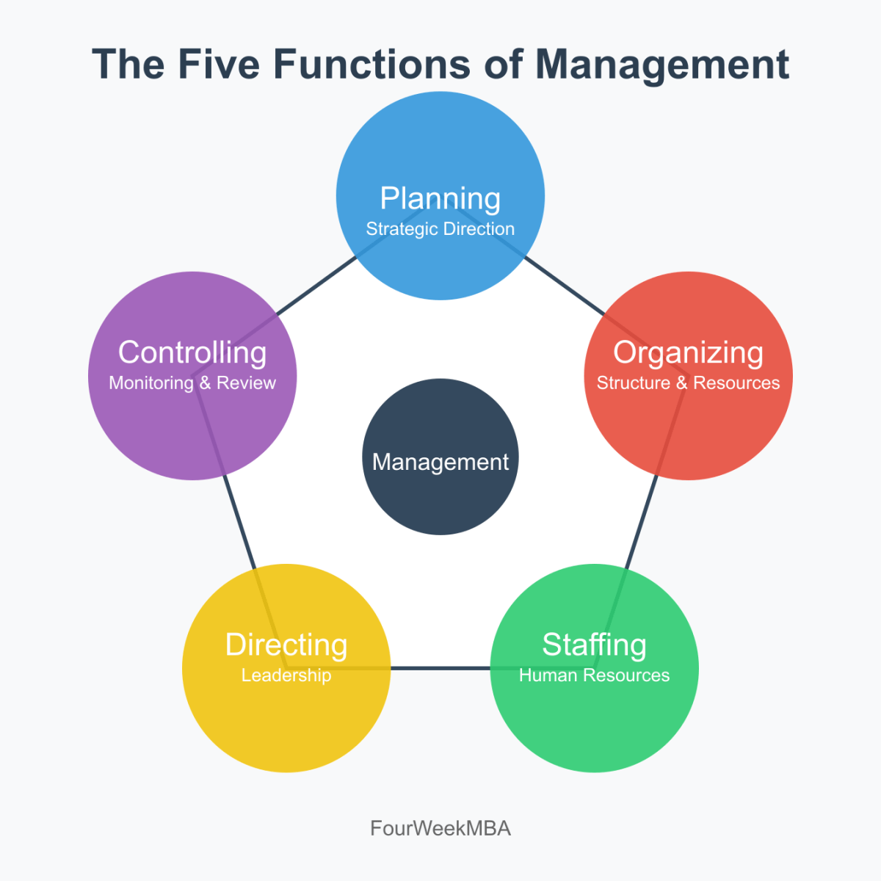
Integration of Fayol’s Functions
  Functions are interdependent and applied simultaneously.
  Planning sets direction, while organising structures delivery.
  Commanding and coordinating guide execution (Santos et al., 2021).
  Controlling ensures goals are achieved effectively.
Notes:
Fayol functions cannot be separated when referring to Tesco. They also depend on one another to make up a complete management process. Planning provides a big picture, organisation has everything laid, command and coordination have everything done and controlling has everything in check. The combination of these functions assures Tesco success. With such a combination, Tesco managers will be successful in the long-term, internal environment of competitiveness and survival in dynamic markets.

Slide 15
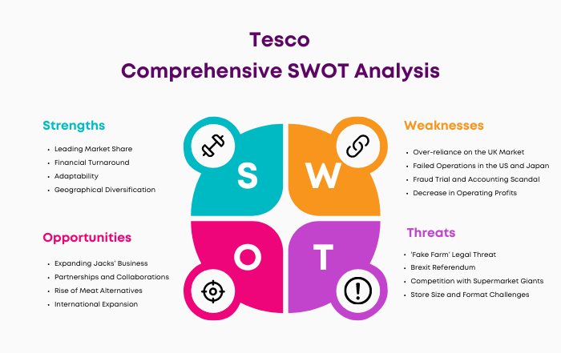
Tesco’s Contemporary Challenges
  Increasing competition from Aldi, Lidl, and Amazon Fresh.
  Rising inflation affects pricing strategies and costs.
  Sustainability pressures demand eco-friendly practices.
  Digital transformation reshapes retail operations.
Notes:
Tesco managers have to grapple with certain current challenges. The cost of inflation is high and retailers and offers are very competitive over the internet. In the meantime, the change in interest to sustainability assumes a change in the supply chains and packaging. The managers should also embrace digital transformation to address the need of online services by the customers. Moreover, it must be digitalized to address the changing needs of the clients regarding online purchases, online delivery services, and green retailing.

Slide 16
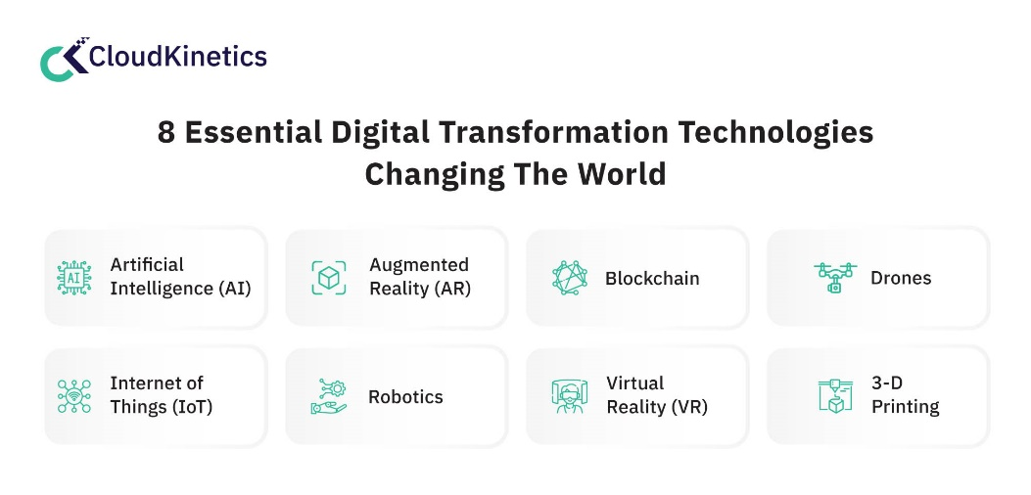
Digitalisation and Technology
  Tesco uses AI and data analytics for forecasting and personalisation.
  Online platforms and delivery services expand customer reach.
  Self-service checkouts improve efficiency and reduce costs (Biliavska and Mykytenko, 2023).
  Technology enhances coordination across supply chains.
Notes:
Digital transformation has been an inseparable element of Tesco strategy. To predict demand and personalize offers, managers increasingly rely on AI, analytics, and online platforms. The introduction of self-service checkout and home delivery services demonstrates the potential of technology to simplify the operations and increase customer convenience. Technology is not only simplifying day-to-day operations but also customer satisfaction, making Tesco a digitally innovative and customer-centred supermarket chain.

Slide 17
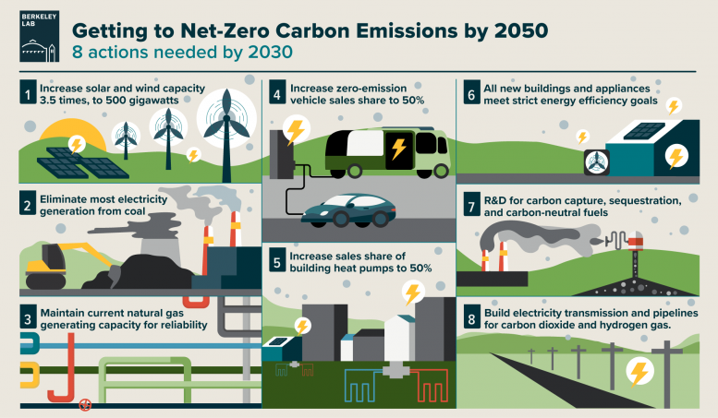
Sustainability Practices
  Tesco aims for net zero carbon by 2050.
  Managers prioritise reducing food waste and plastic usage.
  Sustainable sourcing policies ensure ethical supply chains.
  Customers increasingly expect eco-conscious practices.
Notes:
Sustainability has gained a focus in Tesco operations, and it is directed by managers who endeavor to minimize carbon emissions, waste, and unethical sourcing. The policies adopted by Tesco support international environmental objectives and satisfy the increasing consumer demands of sustainable retailing. It shows how management can adjust functions of Fayol to contemporary priorities. Combining functions of Fayol, Tesco managers strategise sustainably, plan resources effectively, coordinate suppliers, and control progress to ensure that environmental priorities are incorporated into daily business without losing profitability and customer confidence.

Slide 18
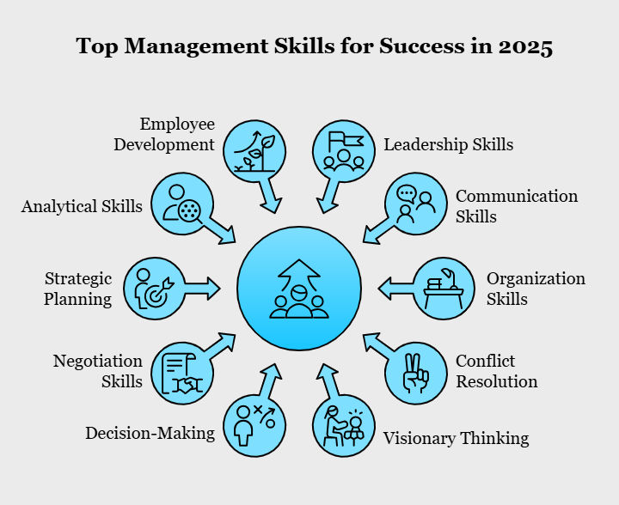
Essential Managerial Skills
  Effective communication and decision-making.
  Digital literacy to leverage data and technology.
  Adaptability in dynamic retail markets (Younis and Mohamed, 2022).
  Ethical leadership to balance profit with responsibility.
Notes:
Today’s Tesco managers need more than classical skills. Communication and decision-making are still essential, yet digital literacy is becoming more important. Changeable retail markets demand adaptability, whereas moral leadership helps Tesco balance profitability with social, employee, and environmental responsibilities.

Slide 19
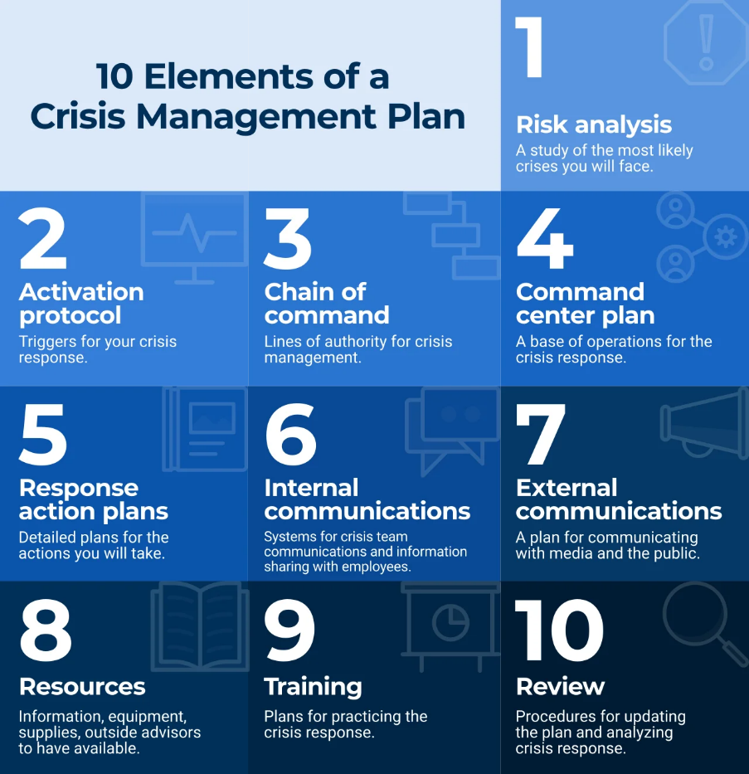
Crisis Management
  Tesco faced supply chain disruptions during COVID-19.
  Managers ensured continuity through rapid response teams.
  Health and safety protocols were prioritised in stores.
  Crisis planning improved long-term resilience (Gupta et al., 2022).
Notes:
The COVID-19 pandemic tested Tesco’s resilience. Managers rapidly adapted by prioritising supply continuity, employee safety, and customer reassurance. These measures demonstrated the value of crisis planning, coordination, and effective controlling. The lessons learned have strengthened Tesco’s capacity to handle future disruptions. Lessons learned from the pandemic strengthened Tesco’s long-term ability to manage future disruptions, proving the importance of adaptable leadership and the practical relevance of Fayol’s functions.

Slide 20
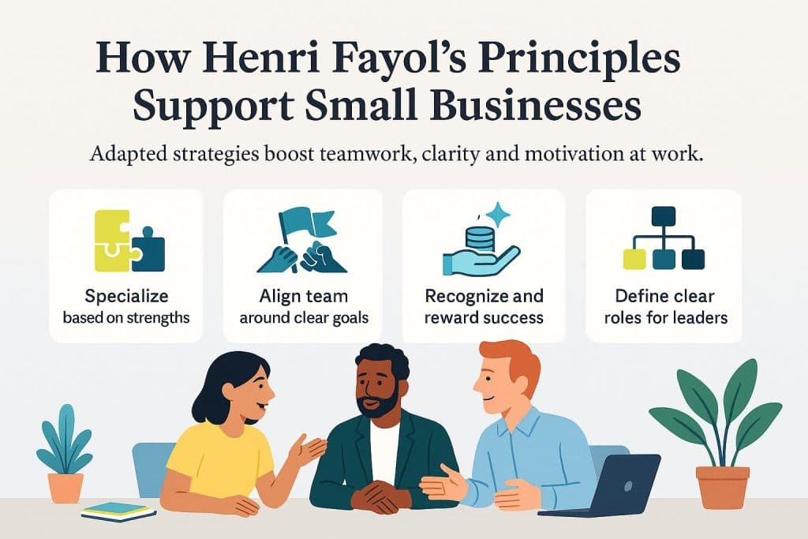
Relevance of Fayol Today
  Fayol’s principles remain a strong foundation.
  Adaptation is needed to address modern challenges.
  Functions guide managers but require flexibility (Sagar, 2024).
  Tesco demonstrates their relevance in contemporary contexts.
Notes:
Fayol ideas were elaborated more than a century ago, and they can be applied to the present world. Tesco demonstrates how these classical functions can be used in the present digitalisation and sustainability setting. They give the pillars to the managers, but are implemented in dynamic way to be competitive.

Slide 21
  Tesco illustrates Fayol’s functions in modern retail.
  Planning, organising, commanding, coordinating, and controlling remain interlinked.
  Managerial effectiveness drives competitiveness and resilience.
  Skills such as adaptability, communication, and digital literacy are essential for the future.
Conclusion
Notes:
In conclusion, Tesco illustrates how the functions of Fayol continue to inform successful management in the contemporary world. Planning, organising, commanding, coordinating, and controlling allow managers to be competitive and resilient. Simultaneously, new skills flexibility, digital fluency and ethical leadership are needed to address current business challenges and maintain Tesco market leadership.

Slide 22
Biliavska, Y. and Mykytenko, N., 2023. Category affinage ent: Industry vs trade. Horizons, 26(1), pp.129-150.
Gupta, A., Alston, L., Needham, C., Robinson, E., Marshall, J., Boelsen-Robinson, T., Blake, M.R., Huggins, C.E. and Peeters, A., 2022. Factors influencing implementation, sustainability and scalability of healthy food retail interventions: a systematic review of reviews. Nutrients, 14(2), p.294.
Hashim, M., Nazam, M., Abrar, M., Hussain, Z., Nazim, M. and Shabbir, R., 2021. Unlocking the sustainable production indicators: a novel tesco based fuzzy AHP approach. Cogent Business & Management, 8(1), p.1870807.
Lin, H.L. and Ma, Y.Y., 2021. A new method of storage management based on ABC classification: A case study in Chinese supermarkets’ distribution center. Sage Open, 11(2), p.21582440211023193.
Manioudis, M. and Meramveliotakis, G., 2023. The historical evolution of the Greek retail trade: A first overview of its organisational-functional and spatial restructuring. Journal of Innovation and Entrepreneurship, 12(1), p.73.
Odeniyi, I.K. and Abdulsalam, M.K., 2025. Periscoping Mosque Management in Police Formations, Southwestern Nigeria, In the Lens of Henry Fayol Management Principles. ANP Journal of Social Science and Humanities, 6(2), pp.26-34.
Sagar, S., 2024. The impact of digital transformation on retail management and consumer behavior. Journal of Business and Management, 26(1), pp.06-14.
Santos, G., Sá, J.C., Félix, M.J., Barreto, L., Carvalho, F., Doiro, M., Zgodavová, K. and Stefanović, M., 2021. New needed quality management skills for quality managers 4.0. Sustainability, 13(11), p.6149.
Stanikzai, I.U. and Ali, H., 2024. The Influence of Social Media Platform Marketing on the Global Reach And Performance of the UK Retail Sector Organisation.” A Case Study on Tesco Plc.
Younis, Z.S. and Mohamed, D.A.A., 2022. The impact of Leadershift on cultural agility policy: The search for effective ways of mindfulness. Journal of Business and Retail Management Research, 17(01).
References

Slide 23

THANK YOU

