Slide 1
ECEY6005/C
Adennill Pardwys: cynaladwyedd yn y blynyddoedd cynnar
Regaining Paradise : sustainability in the early years
Canllawiau Aseiniad
Assignment Guidance

Slide 2
Deillianau Dysgu
Learning Outcomes
gwerthuso’n feirniadol ymagweddau cyfredol at addysg a gofal blynyddoedd cynnar trwy lens cynaliadwyedd;
dadansoddi’n feirniadol y cyd-destunau athronyddol, cymdeithasol-ddiwylliannol, hanesyddol, deddfwriaethol a pholisi o ran cynaliadwyedd a dinasyddiaeth a’u harwyddocâd i gyd-destunau addysg a gofal blynyddoedd cynnar;
adfyfyrio’n feirniadol ar hawliau’r plentyn, rôl yr oedolyn, systemau cymdeithasol-ddiwylliannol-wleidyddol ehangach a’u hymgysylltiad personol o ran addysg blynyddoedd cynnar ar gyfer cynaliadwyedd;
trefnu eu gwybodaeth a’r hyn y maent wedi’i ddysgu drwy ddefnyddio amrywiaeth o adnoddau gwybodaeth, a chyflwyno’u gwaith ar y lefel briodol.
critically analyse current approaches to early years education and care through a sustainability lens;
critically analyse the relevant philosophical, socio-cultural, historic, legislative and policy contexts in relation to sustainability and citizenship and their significance to early years education and care contexts;
critically reflect on the child rights, the adult’s role, wider socio-cultural-political systems and their own personal engagement in relation to early years education for sustainability;
organise knowledge and learning through use of a range of information resources, and present work at the appropriate level.

Slide 3
Y Dasg- 2 ran
The Task- 2 parts
Rhan 1
Rhan 1 –. Tystiolaeth a glir fel rhan o Wobr John Muir.
Gan ddefnyddio canllawiau yn eich darlithoedd mae angen ymgymryd â phrofiad sy'n cefnogi Gwobr John Muir. Cadwch y dystiolaeth a gasglwch, gan gynnwys unrhyw ffotograffau, llyfrau lloffion, storïau, cerddi, gwaith celf, dawns, cân, clipiau fideo neu unrhyw gyfrwng arall, gan ei fod yn cael ei asesu. Gellir rhannu’r dystiolaeth hon ar one-drive neu ar Turnitin neu fel arteffactau ffisegol. Trafodir hyn mewn darlithoedd.
Part 1
Part 1 – Evidence collected as part of John Muir Award
Using guidance in lectures and from the John Muir Trust undertake an experience that supports the John Muir Award. Keep the evidence you collect, including any photographs, scrap books, writing and video clips to support Part 2 of the assignment. The John Muir evidence can be saved onto one drive, or be made accessible on Turnitin or as artefacts. This will be discussed in lectures.

Slide 4
Rhan 2
Rhan 2- Myfyrio a Gwerthuso
Cyflwyniad 20 munud wedi torri lawr fel y ganlyn:
5 munud
Mae angen cyflwyno a myfyrio ar eich profiad yn rhan 1 i ddangos sut y gwnaeth eich cefnogi i ddatblygu eich dealltwriaeth ac ymgysylltiad ymarferol â materion a thrafodaeth cynaliadwyedd
15 munud
Gwerthuso'n feirniadol sut y gallai ymgymryd â phrofiadau fel y rhai yn rhan 1 gefnogi athroniaeth ac egwyddorion addysg plentyndod cynnar ar gyfer cynaliadwyedd. Rhaid i'r adran hon gynnwys tystiolaeth fanwl o'r llenyddiaeth rydych wedi'i darllen, gan gynnwys erthyglau theori, polisi ac ymchwil.
Part 2
Part 2- Reflection and Evaluation
20 minute presentation broken down as below:
5 minutes
Introduce and reflect upon your experience in part 1 to illustrate how it supported you develop your own understanding and practical engagement with sustainability issues and discourse.
15 minutes
Critically evaluate how undertaking experiences such as those in part 1 could support the philosophy and principles of early childhood education for sustainability. This section must include detailed evidence from the literature you have read, including theory, policy and research articles.

Slide 5
Rhan 1 / Part 1
Cwblhewch weithgaredd Gwobr John Muir
Bydd yn cymryd oddeutu 4 diwrnod gwaith (tua 25 awr) i’w gwblhau a chasglu gwybodaeth.
Mae’n cynnwys:-
Darganfod
Archwilio
Gwarchod
Rhannu
Rydym ni eisoes wedi rhoi eich enw ymlaen am y Wobr felly dim ond angen dod o hyd i ardal i’w darganfod, ei harchwilio, gwarchod a rhannu
https://www.johnmuirtrust.org/award
Complete the John Muir Award activity
This must involve.4 work days (or approx. 25 hours) to complete and collect information.
It includes:
Discover
Explore
Conserve
Share
We have already entered you in the Award and thus you only need to find an area to discover, explore conserve, and share
https://www.johnmuirtrust.org/award

Slide 6
Rhan 1 / Part 1
1. Darganfod
Darganfod – ardal naturiol. Gallai hyn fod eich gardd, ardal awyr agored mewn lleoliad, coetir, llwybr rydych yn cerdded neu gwneud ymarfer corff, ……
Ble ydy chi wedi dewis?
Ble ydy’r ardal ar y map?
Pam ydy chi wedi ei ddewis?
2. Archwilio
Dysgwch am yr ardal, Beth sy’n byw yno? Beth sy’n bwysig am yr ardal Gallwch ddefnyddio llyfr lloffion, tynnu ffotograffau, gwaith celf, barddoniaeth, dawns.... Defnyddiwch unrhyw dechneg i ddysgu a chysylltu am y safle ac i gael gwybodaeth i’w rhannu am eich safle.
Discover
Discover – a natural area. This could be your garden, outdoor area in a setting, woodland, a path where you walk or exercise.
Where have you chosen?
Where is the area on a map?
Why did you choose this area?
2. Explore
Explore – find out about the area, What lives there? You can use a scrap book, take photos, art work, poetry, dance…. Use any technique to find out and connect with the site and this will be th information you have to share about your site.

Slide 7
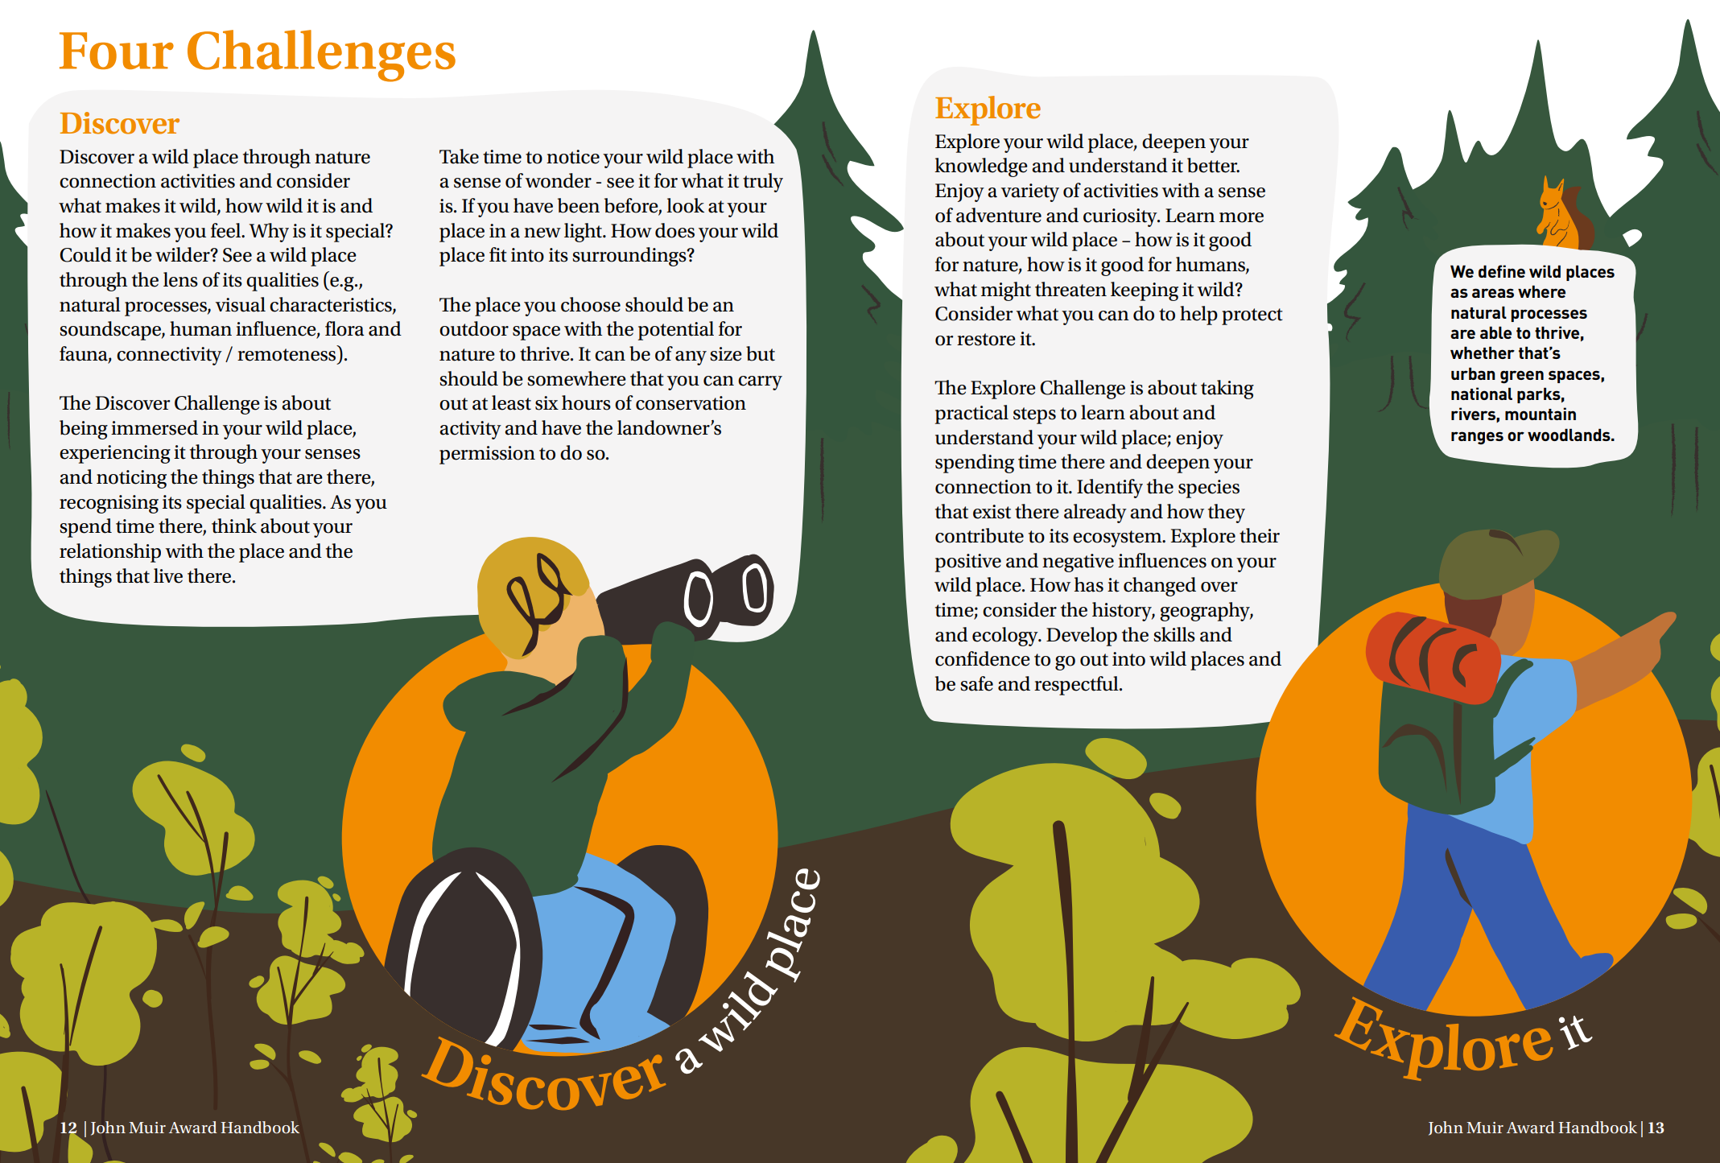

Slide 8
Rhan 1 / Part 1
3. Gwarchod
Gwnewch rywbeth i ofalu am eich safle. Crëwch westy trychfilod o ddarnau o bren, crëwch declynnau i fwydo adar â hadau gan ddefnyddio cyngor gan sefydliad megis yr RSPB, meddwl am ffyrdd i fod yn fwy cynaliadwy.
4. Rhannu - yn Rhan 2 byddwch chi’n rhoi gwybod i’r tiwtoriaid / y grŵp am eich profiad John Muir
Dylech gadw’r wybodaeth hon a’i lanlwytho naill ai ar Turnitin neu OneDrive neu os byddwch chi’n defnyddio llyfrau lloffion dewch â nhw i’ch cyflwyniad yn Rhan 2.
3. Conserve
Do something to look after your site. Create a bug hotel from bits of wood, create bird feeders from seeds using advice from organisation such as RSPB, consider ways you could be more sustainable.
4. Share
In part 2 you will let tutors / the group know about your site.
This information should be saved and either uploaded onto Turnitin or OneDrive or if you use a scrapbook bring it with you to your part 2 presentation.

Slide 9
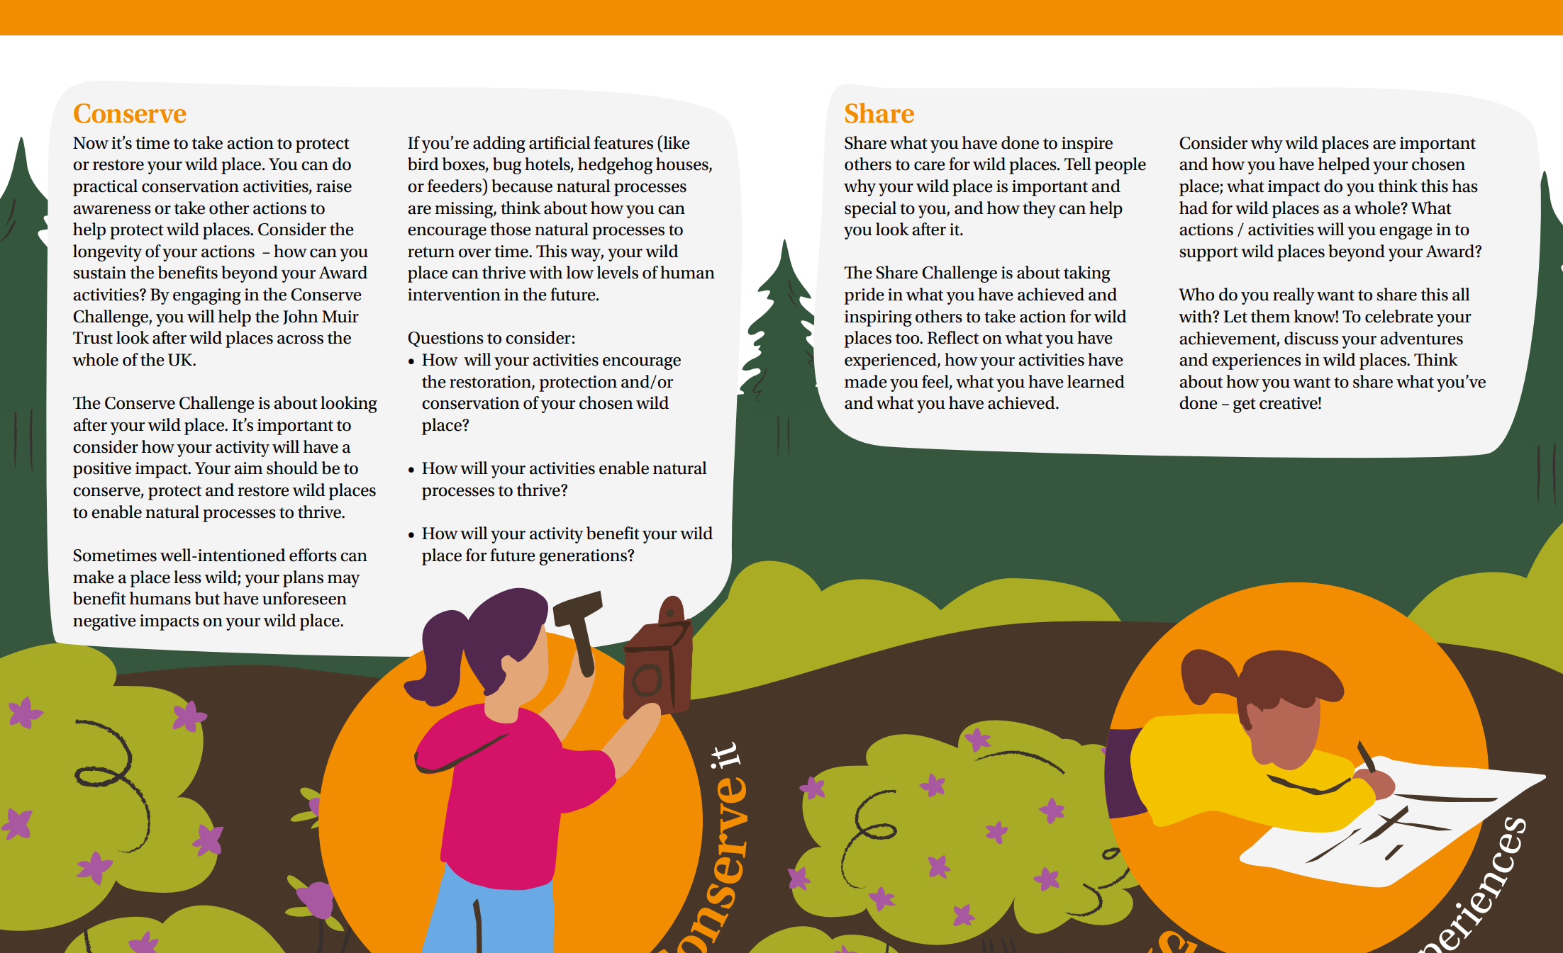

Slide 10
John Muir
Yn ystod darlithoedd bydd angen archwilio John Muir.
Pwy oedd e?
Pam fod e mor bwysig fel cadwraethwr ?
Bydd angen gynnwys ychydig o wybodaeth am John Muir neu cadwraethwr enwog arall ar ddiwedd eich tystiolaeth rhan 1 er mwyn cael y Gwobr John Muir
https://www.johnmuirtrust.org/assets/000/003/906/Resource_Guide_2025_John_Muir__original.pdf?1742215452
During lectures we will also explore John Muir himself
Who was he?
Why is he so important as a conservationist?
You need to include some information on John Muir or another famous conservationist at the end of your part 1 evidence, to gain John Muir Award
https://www.johnmuirtrust.org/assets/000/003/906/Resource_Guide_2025_John_Muir__original.pdf?1742215452

Slide 11
Rhan 2 / Part 2
Pan fyddwch wedi cwblhau Gwobr John Muir:
Lluniwch gyflwyniad 20 munud.
Mae’r rhan yma yn gyflwyniad unigol ar MS Teams.
Fodd bynnag allwn drafod cyflwyno mewn person
5 munud cyntaf
Dylai 5 munud cyntaf y cyflwyniad esbonio i’r gynulleidfa beth wnaethoch fel rhan o wobr John Muir.
Beth gwnaethoch chi ei ddarganfod?
Beth ddysgoch chi?
Sut gwnaethoch chi warchod?
Gallwch chi ddangos ffotograffau, neu ddod ag unrhyw adnoddau i mewn i gefnogi’ch trafodaeth. Mae’r adran hon yn nodi’ch profiad ac yn helpu’r gynulleidfa i ddysgu am y safle o’ch dewis.
Dylai’r adran hon hefyd ganiatáu i chi adfyfyrio ar sut mae’r profiad hwn wedi cefnogi’n ymarferol eich dealltwriaeth eich hun o gynaliadwyedd.
Once you have completed the John Muir Award:
Create a presentation of 20 minutes.
This is an individual presentation on MS Teams. However, we can discuss if you would like to present in person
First 5 minutes
The first 5 minutes of presentation should explain to the audience what you did as part of the John Muir Award.
What did you discover?
What did you find out about?
How did you conserve?
You can show photos, or bring in any resources to support your discussion. This section is noting your experience and helping the audience find about your chosen site.
This section should also allow you to reflect on how this experience has practically supported your own understanding of sustainability.

Slide 12
Rhan 2 / Part 2
15 munud olaf y cyflwyniad yw adran academaidd y gwaith.
Gwerthuso'n feirniadol sut y gallai ymgymryd â phrofiadau fel y rhai yn rhan 1 gefnogi athroniaeth ac egwyddorion addysg plentyndod cynnar ar gyfer cynaliadwyedd. Rhaid i'r adran hon gynnwys tystiolaeth fanwl o'r llenyddiaeth rydych wedi'i darllen, gan gynnwys erthyglau theori, polisi ac ymchwil.
The final 15 minutes of the presentation is the academic section of the work.
Critically evaluate how undertaking experiences such as those in part 1 could support the philosophy and principles of early childhood education for sustainability. This section must include detailed evidence from the literature you have read, including theory, policy and research articles.

Slide 13
Rhan 2 / Part 2
Er enghraifft,
Ydy amcanion profiadiadau wanethoch chi gyflawni, cysylltu â damcaniaeth ac addysgeg y blynyddoedd cynnar, megis ‘dysgu ymarferol’, dysgu yn y ‘sefyllfa go iawn’, dysgu o fewn natur, ailgysylltu gyda’r byd nad sy’n ddynol ac ymdeimald o le. Gallai hyn gysylltu â Froebel, Dewey, Steiner ac eraill.
A roddodd y gweithgaredd amser i feddwl yn greadigol neu adfyfyrio, egwyddorion Addysg ar gyfer Datblygu Cynaliadwy a Dinasyddiaeth Fyd-eang.
A oedd y gweithgaredd yn gysylltiedig â gweithredu ymarferol ac ag unrhyw themâu ADCDF, Deddf Llesiant Cenedlaethau’r Dyfodol neu â Nodau Datblygu Cynaliadwy’r CU.
A oedd unrhyw heriau neu faes y gellir eu beirniadu. Yn nhermau cynaliadwyedd ydy profiadau megis rheini o fewn y John Muir yn anwybyddu rhai o’r nodau dinasyddiaeth gan ganolbwyntio’n fwy ar feysydd amgylcheddol datblygu cynaliadwy?
For example,
Does the John Muir Award’s principles and the experience you undertook as part of John Muir Award link to early years theory and pedagogy, such as ‘hands on learning’, learning in the ‘real situation’, learning in nature, reconnecting with the non-human world, sense of place. This may tie with Froebel, Dewey, Steiner and others.
Did the activity provide time for creative thinking, or reflection which are principles of Education for Sustainable Development and Global Citizenship.
Was the activity linked to practical action and any of the themes of ESDGC, Wellbeing of Future Generations Act or the UN Sustainable Development Goals.
Were there any challenges or areas that could be critiqued. In terms of sustainability do experiences such as those in the John Muir Award ignore some of the citizenship aims and concentrate more on environmental areas of sustainable development?

Slide 14
Deallusrwydd Artiffisial Cynhyrchiol​ (DA)
Generative Artificial Intelligence (AI)​
PRAWF DDARLLEN Ar gyfer yr asesiad hwn, gallwch chi ddefnyddio Deallusrwydd Artiffisial Cynhyrchiol i wirio eich testun/creadigaeth eich hun am wallau gramadegol a chystrawennol, yn cynnwys aralleirio eich gwaith eich hun o fewn safonau penodol.
PROOFREADING For this assessment, you can use Generative AI to check your own text/creation for grammatical and syntactical mistakes, including rephrasing of your own work within specific standards.

Slide 15
1. Sgiliau Ymgysylltu â Llenyddiaeth (10marc)
1. Engagement with Literature (10 marks)
Rhaid i’r cyflwyniad gynnwys cyfeirnodi ar lafar
Mae angen rhestr gyfeiriadau clir a chywir
Rhaid darparu tystiolaeth ar gyfer y gwaith gyda chyfeiriadau o lyfrau, erthyglau cylchgronau a ffynonellau dilys eraill.
Cymerwch amser gan ddefnyddio’r canllaw cyfeirnodi i sicrhau bod y cyfeirnodi’n gywir
Cyflwyno rhestr cyfeirnodi ar Turnitin
The presentation must include oral referencing.
You should have a clear and correct reference list.
The work must be evidenced with references from books, journal articles and other valid sources.
Take time using the reference guide to ensure referencing is accurate
Reference list to be submitted onto Turnitin

Slide 16
2. Sgiliau Gwybodaeth a Dealltwriaeth (20 marc)
2. Knowledge and Understanding Skills (20 marks)
Rhan 1 - Tystiolaeth a gasglwyd fel rhan o Wobr John Muir
Gan ddefnyddio canllawiau yn eich darlithoedd mae angen ymgymryd â phrofiad a Chymdeithas John Muir sy'n cefnogi Gwobr John Muir. Cadwch y dystiolaeth a gasglwch, gan gynnwys unrhyw ffotograffau, llyfrau lloffion, storïau, cerddi, gwaith celf, dawns, cân, clipiau fideo neu unrhyw gyfrwng arall, gan ei fod yn cael ei asesu. Gellir rhannu’r dystiolaeth hon ar one-drive neu ar Turnitin neu fel arteffactau ffisegol. Trafodir hyn mewn darlithoedd.
Part 1 – Evidence collected as part of John Muir Award
Using guidance in lectures and from the John Muir Trust undertake an experience that supports the John Muir Award. Keep the evidence you collect, including any photographs, scrap books, writing and video clips to support Part 2 of the assignment. The John Muir evidence can be saved onto one drive, or be made accessible on Turnitin or as artefacts. This will be discussed in lectures.

Slide 17
3. Sgiliau Gwybyddol a Deallusol (20 marc)
3. Cognitive and Intellectual Skills (20 marks)
Rhan 2- Gwerthusiad (5 munud)
Mae angen cyflwyno a myfyrio ar eich profiad yn rhan 1 i ddangos sut y gwnaeth eich cefnogi i ddatblygu eich dealltwriaeth ac ymgysylltiad ymarferol â materion a thrafodaeth cynaliadwyedd.
Part 2- Evaluation (5 minutes)
Introduce and reflect upon your experience in part 1 to illustrate how it supported you develop your own understanding and practical engagement with sustainability issues and discourse.

Slide 18
4. Sgiliau Cymhwyso Ymarferol (30 marc)
4. Practical Application Skills (30 marks)
Rhan 2- Gwerthusiad (15 munud)
Gwerthuso'n feirniadol sut y gallai ymgymryd â phrofiadau fel y rhai yn rhan 1 gefnogi athroniaeth ac egwyddorion addysg plentyndod cynnar ar gyfer cynaliadwyedd. Rhaid i'r adran hon gynnwys tystiolaeth fanwl o'r llenyddiaeth rydych wedi'i darllen, gan gynnwys erthyglau theori, polisi ac ymchwil.
Part 2- Evaluation (15 minutes)
Critically evaluate how undertaking experiences such as those in part 1 could support the philosophy and principles of early childhood education for sustainability. This section must include detailed evidence from the literature you have read, including theory, policy and research articles.

Slide 19
5. Sgiliau Trosglwyddadwy ar gyfer Bywyd ac Arfer Proffesiynol (20 marc)
5. Transferable Skills for Life and Professional Practice (20 marks)
Ansawdd y cyflwyniad, strwythur a sgiliau trefnu.
Mae’r marciau yma ar gyfer eich sgiliau cyflwyno ar lafar
Strwythur cyffredinol, yn cynnwys rhagarweiniad, diweddglo, is-adrannau synhwyrol.
Amseru’r cyflwyniad – dylai fod yn 10% yn fwy neu’n llai nag 20 munud (18-22 munud)
Quality of presentation, structure and organisation skills.
Marks here are for your oral presentation skills
Overall structure ,including introduction, conclusion, sensible subsections.
Timing of presentation – should be 10% more or less than 20 minutes (18-22 minutes)

Slide 20
Cofiwch / Remember
15 munud olaf y cyflwyniad mae angen cyfeirnodi
Mae engreifftiau o waith John Muir ar Moodle
Os oes llyfr lloffion digidol mae’n haws i lanlwytho fel pdf
Mae Cymedithas John Mur wedi rhannu llawer o adnoddau all helpu chi. https://www.johnmuirtrust.org/award
The final 15 minutes of presentation requires referencing
There are examples of John Muir evidence on Moodle
If you create a digital scrap book easier to upload as pdf
The John Muir Trust has created very useful resources that could help you
https://www.johnmuirtrust.org/award

Slide 21
Amgylchiadau Esgusodol (EC)
Extenuating Circumstances (EC)
Digwyddiadau tu allan o’ch rheolaeth
Gweithred swyddogol
Tystiolaeth
Cwblhau ffurflen ar MY TSD
Cysylltu gyda’r Swyddfa Academaidd
(Hwb@uwtsd.ac.uk)
Events out of your control
Official procedure
Evidence
Complete form on MYTSD
Liaise with Academic Office
(Hwb@uwtsd.ac.uk)

Slide 22
Cyflwyniadau Hwyr
Late Submissions
Cyflwyno o fewn 7 diwrnod gwaith – dim EC – wedi'i gapio ar 40%
Cyflwyno ar ôl 7 diwrnod gwaith – dim EC – ni chaniateir i staff eich asesu
Present within 7 working days – no EC – capped at 40%
Present after 7 working days – no EC – staff not permitted to assess

Slide 23
Cwestiynau am elfen 1?
Questions about Component 1?
Panopto
Llawlyfr modwl
GA36 Assignment form
Nodiadau
Recordiadau
Eich darlithydd
Cydlynydd y modwl
Peidiwch â dibynnu ar eich ffrindiau/cyfoedion
Panopto
Module handbook
GA36 Assignment form
Notes
Recordings
Your lecturer
Module coordinator
Do not rely on friends / peers

Slide 24
Materion TGCh?
ICT issues?
Desg Gymorth TG
ITServiceDesk@uwtsd.ac.uk
0300 500 5055
Moodle
moodle@uwtsd.ac.uk
IT Service Desk
ITServiceDesk@uwtsd.ac.uk
0300 500 5055
Moodle
moodle@uwtsd.ac.uk

Slide 25
Pob lwc
Good luck
Cysylltwch os oes angen cymorth
Get in touch if you need support

