Slide 1


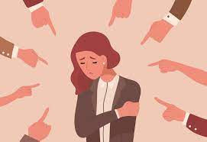
Victimisation, Gender and Race
BMCP5002

Slide 2
Aim:
The aim of this lecture is for students to have a greater knowledge on how victims are targeted due to their race and gender..
Objectives:
  To recognise the difference between diversity and inclusion.
  To recognise the impact that hate crime has on victims.
  To acknowledge how victims have had to fight for rights and equality, due to their race and gender.

Slide 3
Diversity- definitions
Diversity is about what makes each of us unique and includes our backgrounds, personality, life experiences and beliefs, all of the things that make us who we are. It is a combination of our differences that shape our view of the world, our perspective and our approach.
Diversity is also about recognising, respecting and valuing differences based on ethnicity, gender, age, race, religion, disability and sexual orientation.
Cambridge, (2023)

Slide 4

Diversity expands experiences & knowledge
Communication and mutual learning between people of different races, ethnic origins, religious beliefs, and social groups are made easier by diversity.
It encourages us to appreciate all people, not only those who are similar to ourselves. It motivates people to live, adopt a wider perspective, and fit into society.
Notes:
expands worldliness/experiences/knowledge - opening the door to the entire world. For many people we learn more from people who are different from us. For some individuals there might be the first time to really real interaction with people from diverse groups.
Enhances social development - Interacting with people from a variety of groups widens your social circle by expanding the pool of people with whom you can associate and develop relationships and this can be useful when policing in the community.
Successful performance in police role – having a diverse workforce will require sensitivity to human differences. Staff can interact with a variety of individuals and have the ability to relate to people from different cultural backgrounds.
Expands your capacity for viewing problems - encounter problem or issues rather than viewing the world through a single-focus lens, you are able to expand your views and consider multiple options when making decisions.
Enriches the multiple perspectives - you gain a panoramic perspective of the world around you and a more complete view of your place in it. You open up your tunnel vision and that it is not about ‘you’ but others.

Slide 5
Diversity enhances social development.
The more diverse our social group, the more we have to learn. Embracing different cultures can help you to learn new languages, explore new traditions, and gain valuable insights.
Having diversity and inclusion will improve the balance of opinions, views in any setting. A well-balanced world will accept different opinions and reduce fears towards differences.
Notes:
The more diverse a scial group is, the more we learn. We open our specticles, it is not about just us and what we know and belief, we make time to understand and open our eyes to others. Exploring new things like tradition, gain valuable insights, new languages, new opportunities. Diverse and inclusion will improve the balance of opinion, a well-balanced world accepts different valuas opinions and beliefs and reduces fear towards differences, everyone is different therefore, everyone should be treated equally with same respect.

Slide 6
Diversity improves a more successful workforce
Diversity increases employee satisfaction and reduces conflicts between groups, improving collaboration and loyalty. Improve decision making. Diversity fosters innovation and creativity through a greater variety of problem-solving approaches and perspectives.
The decision making process and its overall outcome improves drastically when a diverse workforce is promoted. It's no secret that a team of employees will make relatively better problem-solving decisions than a single employee will.
Notes:
If we have a diverse workfoce, it is better for everyone overall, everyone can benefit, it fosters innovation and creativity, it increases employee satisfaction and reduces conflicts, if people undertand and respect each other and everyone is involved with different approaches and perspectives, there will be better outcomes and better decision making. A team can work together and will make better decisions than one.

Slide 7
Diversity enriches multiple perspectives
When you take an issue or project and present it to people from a wide range of backgrounds, they will all see the issue or project from a different angle, often influenced by their varying experiences. This can bring fresh ideas, as well as a wider range of potential solutions.
Notes:
It opens your eyes to new perspectives solutions and approaches, someone may have a different approach or been through a different experience to you. This can bring fresh ideas, build friendships, bring a whole new range of potential solutions and solve problems. It can encourage others to respect each other listen and understand their views beliefs and opinions.

Slide 8
Inclusion: Definition
Inclusion is to embrace all people irrespective of race, gender, disability, medical or other need. It is about giving equal access and opportunities with the hope of eliminating discrimination and intolerance.
A state of being valued, respected and supported. It's about focusing on the needs of every individual and ensuring the right conditions are in place for each person to achieve their full potential.
Notes:
Inclusion is to accept and embrace everyone regardless of their race gender etc. it is about making sure everyone has equal opportunities and eliminating any discrimination and intolerance. Everyone should be valued and respected, it is about ensuring the right conditions are in place for them to achieve their potential without barriers.

Slide 9
Why is inclusion important?
When people are included, they feel:
  Involved and empowered
  Recognised and respected
  They feel worthy
  Social Acceptance
Having positive interactions with and being valued for who they are - acceptance
Inclusion must be ‘internally motivated’ and stem from embracing the belief that all people have value and the right to belong.

Slide 10
What is the difference between diversity and inclusion?
  Diversity is simply a representation of many different types of people focusing on the differences
  Inclusion is the act of welcoming a person/groups that is included within that environment - where all different kinds of people can thrive and succeed.
  Inclusion is the act of giving equal access to opportunities and resources for people who might otherwise be excluded or marginalised.
  Diversity is what you have. Inclusion is what you do.
    Simply having a diverse workforce is not enough.
    Everyone should be encouraged to fully participate and share equally. Inclusion is the deliberate act of welcoming diversity for everyone to participate and be successful
Notes:
Diversity is there to represent different types of people including those with disabilities, race, religion , gender and sexuality. It’s about the willing to take others' perspectives into account irrelevant if you think it is write or wrong. Letting others' ideas into our lives.
The phrase ‘disabled people’ over the phrase ‘people with disabilities’ those with disabilities may see themselves differently.
Inclusion is the deliberate act of welcoming diversity so that everyone can participate and be successful.

Slide 11
History
1960s
In the 1960s new laws said people of different races must be treated fairly.
1970s
In the 1970s new laws said men and women must be treated equally and get the same pay for the same job.
1990s
In the 1990s new laws said disabled people must be treated fairly.
2004
In 2004 new laws gave lesbian, gay and bisexual people the right to become partners/marriage

Slide 12
Why was new legislation needed?
Stronger laws were needed because the old equality laws did not make equality happen fast enough.
Many women are paid less than men for the same kind of work. Disabled people are a lot more likely to have no job.
People of different races found it harder to get a job
Lesbian and gay people were worried about asking the police for help in case they were treated unfairly.
Government Equalities Office - The Equality Act, made equality real it brought together 9 big equality laws and about 100 smaller laws.
One law makes it easier for all and employers to know what is right or wrong

Slide 13
Equality Act 2010
Introduced in October 2010
Legal framework to protects individuals from discriminatory and unfair treatment. Everyone has equal rights and opportunities
It includes:
Sex Discrimination Act 1975
Race Relations Act 1976
Disability Discrimination Act 1995
Equal Pay Act 1970
Employment Equality (Religion or Belief) Regulations 2003
Employment Equality (Sexual Orientation) Regulations 2003
Employment Equality (Age) Regulations 2003

Slide 14
What are the protected characteristics of the Equality Act 2010?

Slide 15
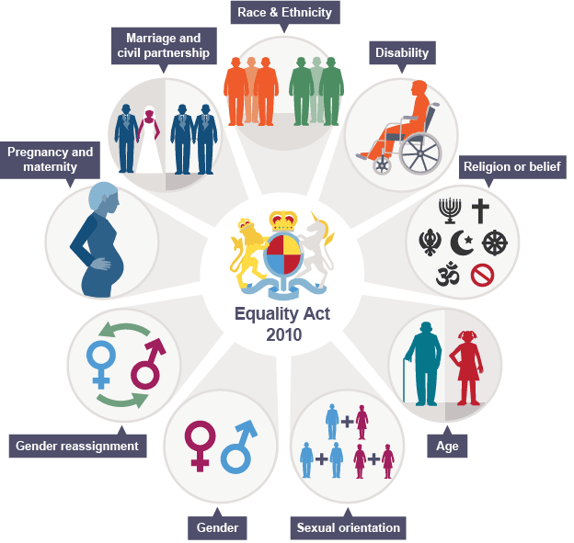
Government Equalities Office and Equality Human Rights Commission, (2015)
Notes:
The Act recognises that people may suffer discrimination and be disadvantaged for many reasons. These groups above are called protected characteristic under the Act. Protected from discrimination.
A person has a disability if they have a physical or mental impairment which had a substantial and long term effect on that persons ability to carryout normal activities, include conditions such as AIDS and cancer.
Refers to group of people defined by their race, colour, nationality include gypsy and traveller communities.
Belief includes religious beliefs including lack of beliefs (atheism). A belief should affect the way you live your life for it to be included under the definition.
The Equality Act came into force 1 October 2010, as a legal framework to protect individuals from discriminatory and unfair treatment
It brings together over 116 separate pieces of legislation into one Act, simplifying and strengthening the law.
The main legislation’s that merged include:
Sex Discrimination Act 1975
Race Relations Act 1976
Disability Discrimination Act 1995
Equal Pay Act 1970
Employment Equality (Religion or Belief) Regulations 2003
Employment Equality (Sexual Orientation) Regulations 2003
Employment Equality (Age) Regulations 2003
Equality Act 2006, Part 2
Equality Act (Sexual Orientation) Regulations 2007
Access to the Act can be found here: https://www.legislation.gov.uk/ukpga/2010/15/contents

Slide 16
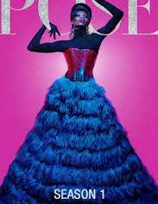
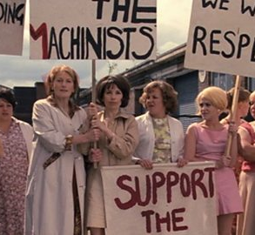
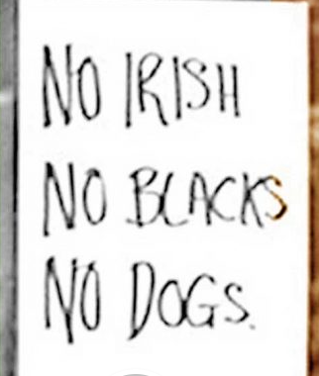

Although films – experienced by real people
Female factory workers at the Ford Dagenham plant – strike action for equal pay
Gay man Andrew Beckett who asks lawyer Joe Miller to help him sue his employers, who fired him after discovering he had AIDS
New York City's ballroom culture, an LGBTQ subculture in the African-Latino cultures
Regular sign UK not to rent rooms out 1950’s onwards

Slide 17
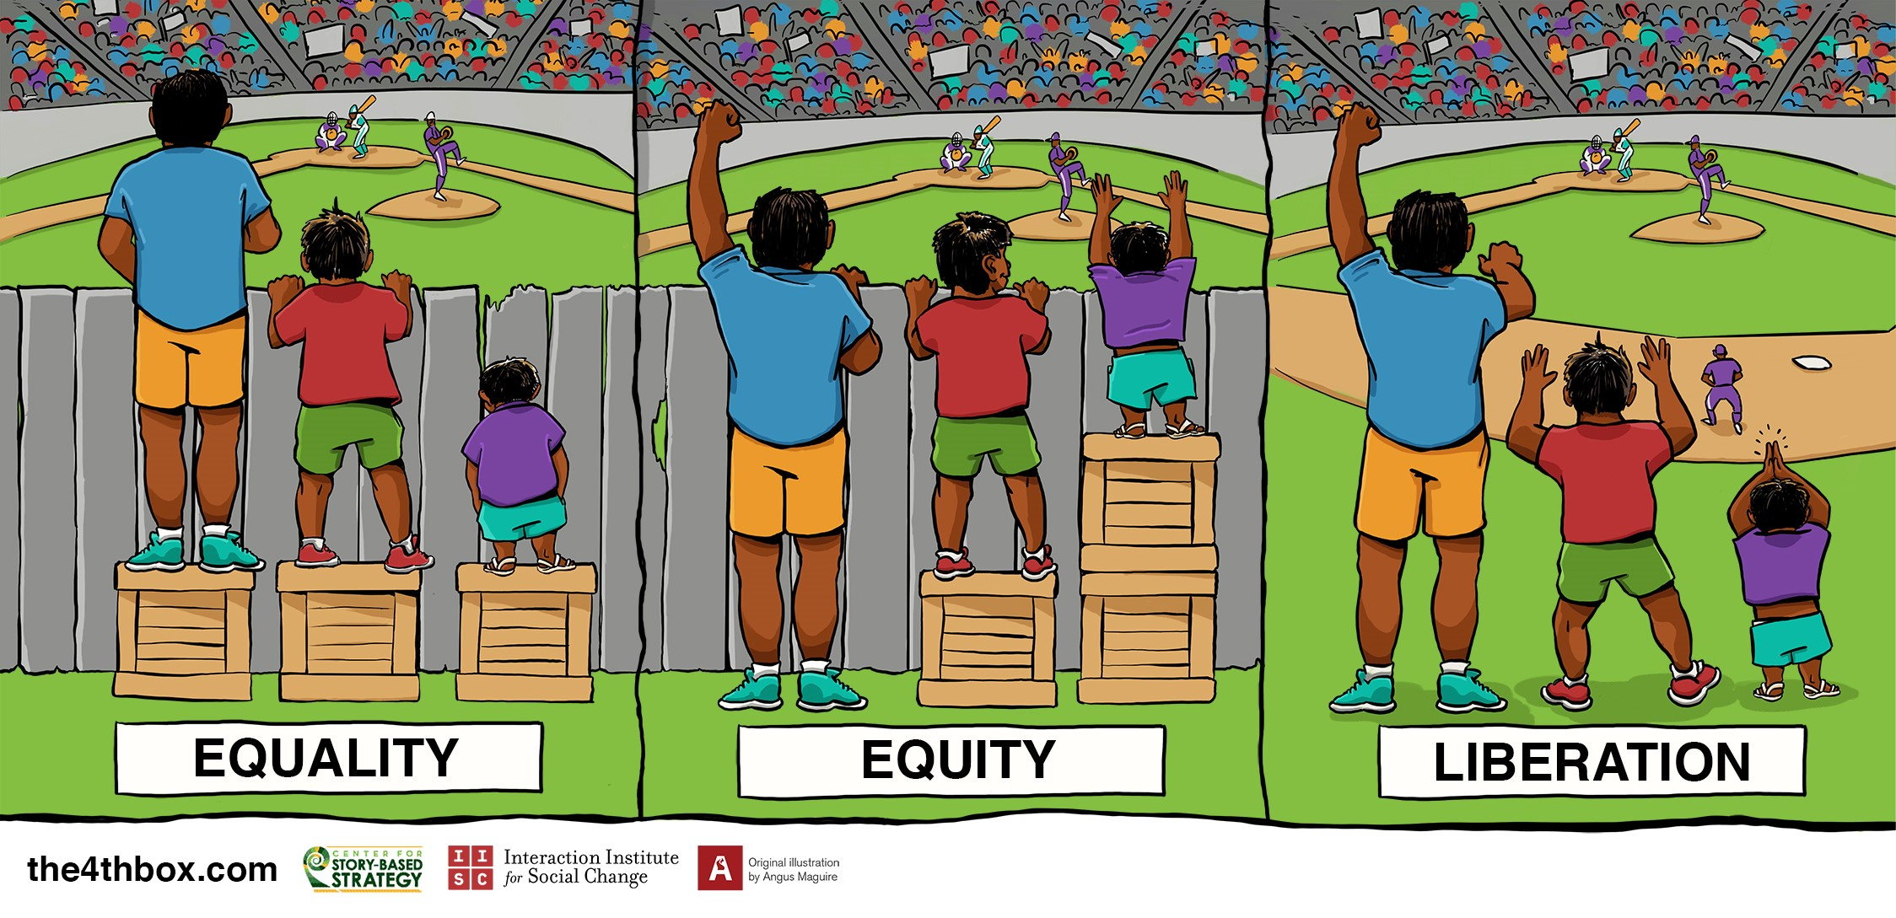
Sowden (2019)
Notes:
Fist image = Equality and this assumed that everyone will benefit from the same support. They are all being treated equally.
But it does not always work for everyone. It is good to know it works but sometimes need additional support.
2nd Image = individuals are given different supports to make it possible for them to have equal access to the game. They are being treated equitably sharing
3rd image = this image, all three can see the game without any supports or accommodations because the cause of the inequity was addressed. The barrier has been removed.

Slide 18

HATE CRIME

Slide 19

HATE - What’s the difference?
Hate Crime
Hate Incident
Hate crimes are criminal offences
Any criminal offence which is perceived by the victim or other’s to be motivated by hostility or prejudice based on a person's race or perceived race; religion or perceived religion; sexual orientation or perceived sexual orientation; disability or perceived disability and any crime motivated by hostility or prejudice against a person who is transgender or perceived to be transgender.
Assault/murder/theft/sexual assault
Hate incidents refer to incidences that are motivated by specific characteristics – No law broken
Any incident which the victim, or anyone else, thinks is based on someone’s prejudice towards them because of their race, religion, sexual orientation, disability or because they are transgender.
Name calling/ social media/complains about smell/noise
Notes:
The definition of ‘Hate Crime’ is defined by ACPO and the CPS and is given on the CPS website as:
‘any criminal offence which is perceived by the victim or any other person, to be motivated by hostility or prejudice based on a person’s race or perceived race; religion or perceived religion; sexual orientation or perceived sexual orientation; disability or perceived disability and any crime motivated by hostility or prejudice against a person who is transgender or perceived to be transgender.’
“Any criminal offence which is perceived by the victim or any other person, to be motivated by hostility or prejudice, based on a person's disability or perceived disability; race or perceived race; or religion or perceived religion; or sexual orientation or perceived sexual orientation or transgender identity or perceived transgender identity”.
Criminal Justice Act 2003 introduced these changes to hate crime after the enquiry into the death of Stephen Lawrance - MPS Institutionally Racist, Sir Macpherson

Slide 20
The law recognises five types of hate crime & incidents - CPS
Race
Religion
Disability
Sexual orientation
Transgender identity
Any crime can be prosecuted as a hate crime if the offender has either:
demonstrated hostility based on race, religion, disability, sexual orientation or transgender identity
Or
been motivated by hostility based on race, religion, disability, sexual orientation or transgender identity
Someone can be a victim of more than one type of hate crime.

Slide 21

Death of Brianna Ghey
11 February 2023
16-year-old transgender girl murdered Scarlett Jenkinson and Eddie Ratcliffe after being lured into a park
Stabbed 28 times, across her head, neck, chest, and back.
Convicted 20th Dec 2023 sentenced 2024 – Jenkinson 22 years / Ratcliffe 20 years before eligible for parole.
Cheshire Police described the killing as a targeted attack, though initially reported that "there is no evidence to suggest that the circumstances surrounding Brianna's death are hate related"
Past text messages - Jenkinson poisoned Brianna = suicidal overdose.
Ratcliff bought a hunting knife
Jenkinson admitted being obsessed with Brianna calling her "really different" and "really pretty“
Ratcliffe also stated over text messages that he wanted "to see if it will scream like a man or a girl"
The court decided the offence was primarily motivated by sadistic tendencies and that hate against transgender people was a secondary motivation of Ratcliffe.
The murder involved a significant degree of brutality and planning.

Slide 22
Legislation
No particular legislation entitle ‘Hate Crime’ - further to extend our current laws.
Public Order Act 1986 –
  Racially or religiously aggravated assaults
  Common assault
  Racially or religiously aggravated criminal damage
  Fear or provocation of violence and intentional harassment, alarm or distress
Crime & Disorder Act 1998 - Racially or religiously aggravated offences
Sections 28 to 32 of the Act create separate offences for crimes that were aggravated by the victim's race or religion or presumed race or religion.
Notes:
A person is guilty of an offence if, with intent to cause a person harassment, alarm or distress, by:
uses threatening, abusive or insulting words or behaviour, or disorderly behaviour, or
displays any writing, sign or other visible representation which is threatening, abusive or insulting

Slide 23
Legislation
Criminal Justice Act 2003 (Sections 145 and 146) treats hate-motivated crimes relating to Gender Identity, Sexual Orientation, and Disability as aggravating features, incurring increased sentences.
Sentencing Act 2020 S.66 – aggravated offence of homophobic, biphobic or transphobic hate crime – courts have to considering the seriousness of an offence, to treat as an aggravating factor that either:
at the time of committing the offence, or immediately before or after doing so, the offender demonstrated hostility towards the victim based upon the sexual orientation (or presumed sexual orientation) of the victim or based upon the victim being (or being presumed to be) transgender; or
the offence was motivated (wholly or partly) by hostility towards persons who are of a particular sexual orientation or who are transgender.

Slide 24
Case
R v Rogers [2007]
On 28 February 2007, the House of Lords ruled that use of the expletive "bloody foreigner" amounted to racial abuse under the Act, and held that the legal definition of "racial group" went beyond colour, race or ethnic origin to include nationality, citizenship and national origin – even if they were not specified in the words used by the offender. Baroness Hale stated that such conduct was not only deeply hurtful, damaging and disrespectful to the victim, but also to the community as a whole "by denying acceptance to members of certain groups not for their own sake but for the sake of something they can do nothing about".

Slide 25
‘Stirring up’
Different ways used:
Threating words or behaviour
Displaying written material
Publishing material
Public performance
Broadcasting threatening images or sounds
Possessing racial material

Slide 26
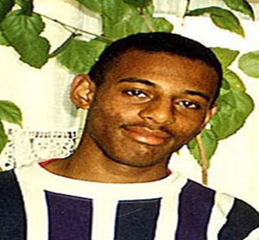
Stephen Lawrence
On 22 April 1993, at the age of just 18, Stephen was murdered in an unprovoked racist attack. He didn’t know his killers and his killers didn’t know him.
After the initial police investigation, five suspects were arrested but not convicted. A public inquiry into the handling of Stephen’s case was held in 1998, leading to the publication of the Macpherson Report, which has been called ‘one of the most important moments in the modern history of criminal justice in Britain’.
It led to profound cultural changes in attitudes to racism, to the law and to police practice. It also paved the way for a greater understanding of discrimination of all forms and new equalities legislation.
Met Police ‘Institutional Racist’ This means that racist attitudes and beliefs were seen as normal in the Metropolitan police, and affected how they investigated Stephen's murder.

Slide 27
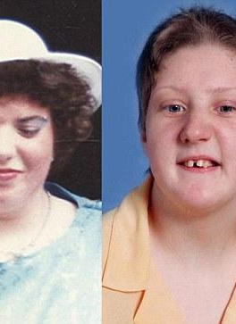
Fiona Pilkington
Fiona Pilkington killed herself and her severely disabled daughter Francesca Hardwick in 2007, after 10 years of torment by local youths.
The Independent Police Complaints Commission (IPCC) carried out an investigation published in May 2011 which concluded that the failure by police officers to identify Fiona Pilkington, her son and daughter as a collective vulnerable family unit was at the core of Leicestershire Constabulary’s failure to implement a cohesive, structured and effective approach to the harassment/anti-social behaviour from which they were suffering.
The report lists 33 recorded incidents between November 1997 and October 2007 when the family had contact with Leicestershire Police. Incidents were often dealt with in isolation and with an unstructured approach which prevented a true picture of the level of harassment suffered by family

Slide 28
Task
Work in groups, find a hate crime case
Why is it a hate crime, what happened, who did it happen to?
Discuss back to class
15 minutes

Slide 29
Hate crime is on the rise in England and Wales
https://www.google.com/search?q=youtube+hate+crime+case&source=lnms&tbm=vid&sa=X&ved=2ahUKEwiioY2Pxbb9AhXNiFwKHXQsA9UQ_AUoAnoECAEQBA&biw=1199&bih=837&dpr=2#fpstate=ive&vld=cid:2c1dfc09,vid:nzRlmvCkbls

Slide 30
How much hate?
Year ending March 2023, there were:
145,214 hate crimes recorded by the police in England and Wales (-5%)
Year before there were155,841 hate crimes
101,906 race hate crimes
8,241 religious hate crimes
24,102 sexual orientation hate crimes, but transgender hate crimes increased by 11%, to 4,732 offences
13,777 disability hate crimes
Notes:
https://www.gov.uk/government/statistics/hate-crime-england-and-wales-2022-to-2023/hate-crime-england-and-wales-2022-to-2023

Slide 31

Race

Slide 32
Race / Ethnicity
BAME individuals are likely to be both victims and suspects of crime.
Likely to live in high crime areas
Want to protect themselves – knives
Distrust police / poor service
Rate Hate Crime Figures - 145,214 race hate crimes to March 2023
Decrease from the following year
https://library.college.police.uk/docs/homeoffice/Experiences-of-young-black-men-as-victims-of-crime.pdf
https://www.theguardian.com/world/race
Notes:
ethnic minority groups also emerged as being most likely to be victims of crime, at 19 per cent compared with 15 per cent of their white counterparts.
Although the proportion of white adults experiencing at least one crime fell from 17 per cent to 15 per cent in the three years to 2016, there was no significant change for ethnic minorities.
higher chances of them falling victims to crime also has to do with the areas in which they live – ethnic minorities are more likely to live in deprived areas where there is more crime taking place.
Police officers from non-white groups were more concentrated in lower ranks
Around one in 10 Army personnel are from an ethnic minority background but the figure falls to just one in 50 for the RAF
https://assets.publishing.service.gov.uk/government/uploads/system/uploads/attachment_data/file/839172/hate-crime-1819-hosb2419.pdf
https://assets.publishing.service.gov.uk/government/uploads/system/uploads/attachment_data/file/849201/race-cjs-2018-infographic.pdf
http://library.college.police.uk/docs/homeoffice/Experiences-of-young-black-men-as-victims-of-crime.pdf

Slide 33
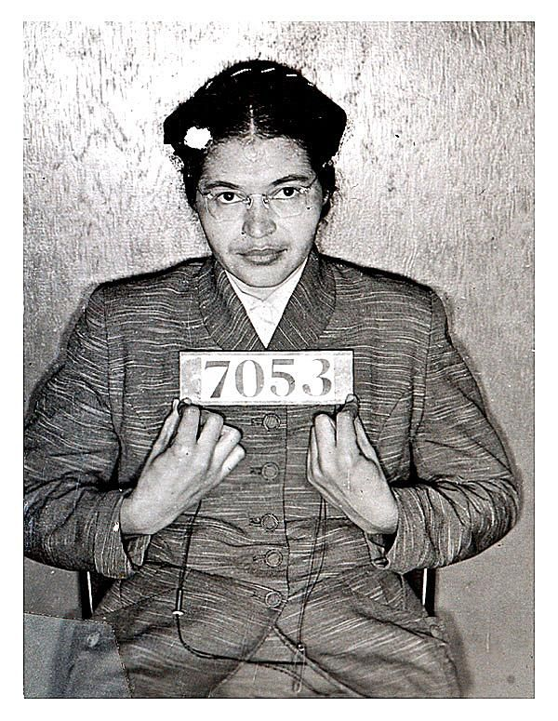
Race
Doctor Who 2018
Ryan Air 2018
https://www.bbc.co.uk/iplayer/episode/b0bpwm2m/doctor-who-series-11-3-rosa
https://www.youtube.com/watch?v=Bq4QqxnWlLg
1955
2018
Notes:
Rosa Louise McCauley Parks was arrested for sitting in a ‘whites’ seat on a bus. This started the civil rights movement Montgomery Bus Boycott.
The Dr Who programme showed Rosa Parks being arrested for sitting in a ‘whites’ seat on a bus. See above slides about her fight for civil rights but the two although 63 years apart show some people attitudes have not changed.
The show is about a time travel wanted to change Parks actions and not have a change in American Civil Rights and segregation.
The United States Congress has called her "the first lady of civil rights" and "the mother of the freedom movement".
A man on a Ryanair plane has been filmed calling a woman sitting in the same row an 'ugly black bastard', and shouting 'don’t talk to me in a foreign language' when she spoke to him in English with a Jamaican accent. The airline, criticised for not removing the abusive passenger, incident was referred to Essex police.
The Ryanair incident various passengers and staff asked David Mesher to desist from his behaviour. Staff ultimately decided that he should remain in his seat rather than being removed from the plane, with Delsie Gayle being asked to move seats instead.
63 years on similar incident.

Slide 34
Religious hate crime
”A group of persons defined by reference to religious belief or lack of religious belief." Identified by clothes, religious symbols
To what extent can police understand & recognise religions faith in their communities?
How do police engage in faith communities and adopt good practices?
  grassroots connection
  building bridges between police and members of communities
  negotiating potentially conflicts
  supporting independent community empowerment
Notes:
Goal is for police to develop the ways in which they understand their local communities in order to enhance an effective and responsive policing service by forming appropriate, positive relations with local religious communities.
https://www.faithandpolicetogether.org.uk/uploads/4/9/5/4/4954631/faith_communities_guide_to_engaging_with_police__03.12.19_.pdf
https://www.interfaith.cam.ac.uk/resources/lecturespapersandspeeches/effectivecommunitypolicing
http://multifaiths.com/pdf/PoliceArmitage07PhD.pdf
http://www.religionandsociety.org.uk/uploads/docs/2009_11/1258555474_Spalek_Summary_Report_2008.pdf

Slide 35
Religious Practices
Female genital mutilation (FGM) is a procedure where the female genitals are deliberately cut, injured or changed
  It's illegal in the UK and is child abuse
Baby tossing - India has been in practise since the past 700 years. Babies in the month of December are tossed from the top of a temple roof to a group of men standing below with a cloth meant to catch the babies. Brings good luck for the community.
Finger amputation – Banned but practiced in Indonesia and in Japan. Portions of one's finger is chopped off by others to mourn for the deceased of member of family.
Clothes
Religious practices – Friday Prayer, Church on Sunday, Lent etc.
Honor killings
Notes:
Class discussion on knowledge of religious practices - from Friday prayers, Giving something up for Lent, vegetarianism, fire walking, wiping yet some practices are wrong.
Baby tossing - India has been in practise since the past 700 years. Babies in the month of December are tossed from the top of a temple roof to a group of men standing below with a cloth meant to catch the babies. Brings good luck for the community.
Finger amputation – Banned but practiced in Indonesia and in Japan. Portions of one's finger is chopped off by others to mourn for the deceased of member of family.
Human Sacrifice - parts of India and Africa where fellow human beings are offered to God to express their gratitude.
Honour killing or shame killing is the murder of a member of a family, due to the belief that the victim has brought shame or dishonour upon the family, or has violated the principles of a community or a religion. https://www.theguardian.com/uk/2011/dec/03/honour-crimes-cases
Female Genital Mutilation (FGM) refers to procedures which intentionally alter, mutilate, or cause injury to the female genital organs for non-medical reasons.
FGM is medically unnecessary and can have serious health consequences, both at the time it is carried out and in later life.
FGM is prevalent in 28 African countries and areas of the Middle and Far East, but it is increasingly practiced in the UK, in communities with larger populations of first-generation immigrants, refugees, and asylum seekers.
FGM is deeply embedded in some communities and is performed for cultural and social reasons. It is usually carried out on girls before they reach puberty, but in some cases it is performed on new-born infants or on women before marriage or pregnancy.
It is often justified by the belief that it is beneficial for the girl or woman, but FGM is an extremely harmful practice which violates basic human rights.
http://sro.sussex.ac.uk/id/eprint/73458/1/__smbhome.uscs.susx.ac.uk_lsu53_Documents_My%20Documents_Leverhulme%20Project_Sussex%20Hate%20Crime%20Project%20Report.pdf
Due to the hidden nature of FGM, it is difficult to estimate how many girls and women it actually affects in the UK and worldwide, but it is generally recognised to be more common than previously thought.
Training for schools, youth workers, social workers and community workers to report potential young girls who may go away to visit family might have had the procedure.
The most significant risk factor for girls and young women is coming from a community where FGM is known to be practised and/or where a mother, sister, or other female family member has been subjected to FGM.
France has been a leading example in this respect, having achieved more than 40 prosecutions since 1979, resulting in the punishment of more than 100 parents and cutters. There is no specific law against FGM in France. Instead perpetrators are prosecuted under general law such as acts involving intended bodily harm, causing permanent infirmity or mutilation.
https://publications.parliament.uk/pa/cm201415/cmselect/cmhaff/201/20105.htm

Slide 36
Honor Killing
The killing of a relative, especially a girl or woman, who is perceived to have brought dishonour or shame on the family.

Slide 37
What is reason for honor killing?
Most often, it involves the murder of a woman or girl by male family members, due to the perpetrators' belief that the victim has brought dishonour or shame upon the family name, reputation or prestige.
2022)

Slide 38
Victim support- honor killings
https://www.google.com/search?sca_esv=15f8c5997f1624f4&rlz=1C1GCEA_enGB1060GB1060&q=honor+killings&tbm=vid&source=lnms&sa=X&ved=2ahUKEwjixvC02b6EAxW-U0EAHde2CfUQ0pQJegQIEBAB&biw=1366&bih=641&dpr=1#fpstate=ive&vld=cid:492c469e,vid:xwqOTXRZR7g,st:0
https://www.google.com/search?sca_esv=15f8c5997f1624f4&rlz=1C1GCEA_enGB1060GB1060&q=honor+killings&tbm=vid&source=lnms&sa=X&ved=2ahUKEwjixvC02b6EAxW-U0EAHde2CfUQ0pQJegQIEBAB&biw=1366&bih=641&dpr=1#fpstate=ive&vld=cid:33c2e39f,vid:FgbCQMw5LOM,st:0

Slide 39

Sexual Orientation

Slide 40
LGBTQ+ Meaning
LGBTQ+ acronym of: lesbian, gay, bisexual, transgender, and queer.
Also seen is LGBTQQIA+ thus a clear representation of: lesbian, gay, bisexual, transgender, queer, questioning, intersex, and asexual people.
The "plus," on the other hand, may be open to some interpretation. The addition of this symbol has come to be extremely important due to its expansive meaning ‘inclusion’.
Fighting for equal rights
Notes:
Just an understanding of what the acronym LGBTQ+ means -
LGBTQQIA+ in recent years the acronym has grown to include those individuals who are questioning their sexuality, Intersex – a person is born with a combination of male and female biological characteristics, Asexual - person who does not desire sex or have sexual feelings.
“plus" stands for love, acceptance, and the embracing of all. In inclusion of ALL!

Slide 41
Declassification & Decriminalisation
Decriminalisation of homosexuality happened as part of the Sexual Offences Act 1967.
  Conditions - age was 21, strict private areas, no filming or photographs
Before this act, men could be sent to jail for being with another man (although lesbians were not subject to the same laws).
Many men were convicted including WWII code-breaker Alan Turing who was charged in 1952 for his relationship with another man.
Also given hormonal treatment to try and ‘cure’ him by reducing his libido.
Notes:
The UK has not always agreed to same sex relationships and up until 1967 it was an illegal act between two men. Decriminalising happen on 27 July 1967, as part of the Sexual Offences Act 1967.
Prior to this it was an offence for men to have an relationship with another man. Queen Victoria believed that such things would not happened between women and it was physical impossibility between women to have sexual relationships thus did not approve making homosexuality of both sexes illegal. The law was only passed for men.
After the Act the age of consent was set at 21 for sex between men, compared with 16 for sex between men and women.
There was also a decision that pandered to the homophobic notion that young men are seduced and corrupted by older men. The punishment for a man over 21 having non-anal sex with a man aged 16-21 was increased from two to five years.
Gay sex remained prosecutable unless it took place in strict privacy, which meant in a person’s own home, behind locked doors and windows, with the curtains drawn and with no other person present in any part of the house. It continued to be a crime if more than two men had sex together or if they were filmed or photographed having sex by another person.
Alan Turing died in 1954 and was pardoned of his offence in 2013.
2000 - A law was changed which allowed gay and bisexual people to be in the armed forces.
2002 - A law was changed to allow gay people (and also unmarried couples) to adopt children.
2003 - The ban on 'promoting' homosexuality in schools (Section 28) was overturned.
2004 - This year marked the start of civil partnerships for gay people. This meant that they had similar rights to people who were married, but civil partnerships are not exactly the same as marriage. Some people did not think it was good enough and that gay people should be allowed to get married.
2008 - It became illegal to encourage homophobic hatred. Last year, more than 7,000 hate crimes were reported against gay men and women in the UK.
2013 - Gay marriage was made legal in England and Wales, and later in Scotland. In Northern Ireland 2020.

Slide 42
Movement for LGBTQ+
Attitudes of same-sex partnerships are ‘not wrong at all’ was 17% 1983 to 68% in 2018.
2019 a drop to 66% marking the first drop since 1987, when the figure stood at 11%.
Why the change?
  More diverse society with different beliefs, from different religions?
https://www.theguardian.com/education/2019/may/21/lgbt-lessons-police-chief-calls-end-birmingham-protests-schools- 11% drop could be due to a more diverse society, in many schools in Birmingham faced protests and children being removed from schools due to the sex education which parents stated the lessons promoted homosexuality.
https://www.youtube.com/watch?v=Zy9FAko75hE
Roth, (2023)
Notes:
Attitudes towards same sex partnerships have changed over the years.
During the 80’s society was changing with lots of influences such as MTV; Sport clothing Nike/Reebok/Adidas; Coke V’s Pepsi.
Change in music styles being different cultures.
Computers being accessible to homes as they were cheaper but no home internet.
People more free and expressed themselves. AIDS Epidemic Arises 1980’s which changed attitudes to same sex partnerships. Many famous people die of AIDS, society ‘scare’ to catch it, TV adverts warning people of the dangers. This impacted on attitudes of acceptance of gay relationships. People are educated and change of attitudes of AIDS being a stereotype gay disease.
Possible reason on why the drop in 2019 could be because of a more diverse society. In 2019 many schools around the Birmingham areas faced protests and children removed from schools due to the sex education which parents stated that the lessons promoted homosexuality.
https://www.theguardian.com/education/2019/may/21/lgbt-lessons-police-chief-calls-end-birmingham-protests-schools

Slide 43

Being Different, Vulnerability & Crime
Different - what does this mean?
Looking different
Speaking a different language
Not conforming to what is right in society
Homeless
ADHD / Autism
What YOU believe in?
Notes:
Students to discuss what does being different mean to them?
People who are different find themselves not to be inclusion
Looking/dressing different examples = Punk, Goth, Emo any difference they can think of
Not conforming – travellers & their communities
Being different and vulnerable =individuals who may be homeless.
People with learning needs how do they process information if you where to see them in the line of duty?
What about language barriers?
https://www.app.college.police.uk/app-content/engagement-and-communication/engaging-with-communities/

Slide 44
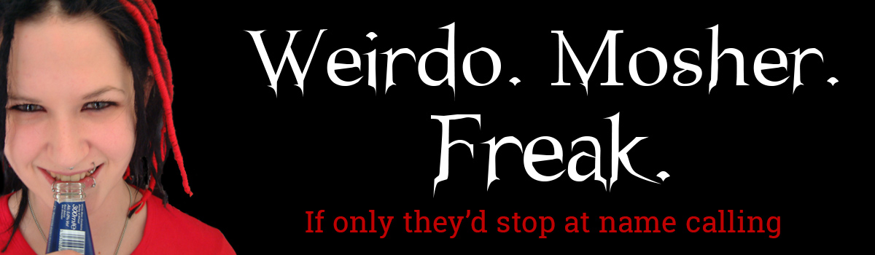
Sophie Lancaster Foundation
Kicked to death for looking different.
Sophie Lancaster Foundation - Family campaign to support young people.
Sophie’s face bore her killers footprint. Her head was used like a football
Thomas, (2022)
Notes:
Sophie’s family wanted something positive to come from losing her. They set up the Sophie Lancaster Foundation which supports young people

Slide 45
Sophie Lancaster
August 24th 2007 Sophie died after being attack
Sophie and Rob dressed in their unique way, expressing their individuality as creative artistic people – Goths/Mosher
A recording was played in court of a 15-year-old telling the emergency services: 'This mosher's just been banged because he's a mosher ... his bird's on the floor as well.'
Anthony Russell QC, said:
'This was a hate crime against completely harmless people who were targeted because their appearance was different.' Sophie Lancaster did not die because of her race, religion or sexuality. She died because she was a Goth.
Thomas, (2022)
Notes:
Both Sophie & boyfriend Rob (who was attacked) both looked ‘different’ as Goths.
Stephen Herbert, 16 and Brendan Harris, 15, committed the offence. They repeatedly stamped upon Sophie’s head as she lay semi-conscious
Their only motive was that the couple were both dressed as Goths.
Det. Supt Mick Gradwell - "The only thing these lads think they have done wrong is to be caught. It was almost as though they were laughing and joking about what they had done".
https://www.theguardian.com/uk/2008/aug/03/ukcrime.sophielancaster

Slide 46
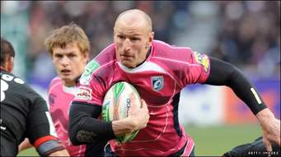
Gareth Thomas
Discussed his sexuality 2009
2019 attacked in a hate crime incident
Being Different?
We discussed where he was targeted for his HIV status
Breaking down the stigma - did the same with Hate crime – I am not going to change – used restorative justice to change offender
Godfrey, (2023)
Notes:
Challenged his sexuality when he ’came out’ but a few years later the media was going to expose his HIV status.
Thus made him release TV programme of him telling family and friends before the papers.
Was worried in being treated ‘different’ and misrepresented and how would family and the public react to this news.
Spoken about "shame" and "fear“ but day after the announcement he completed the Iron Man cheered on by crowds.
Class discussion – why do we feel we need to justify ourselves if we are different?

Slide 47
Language as a Barrier
Consider how diverse our society has become language barriers can be problematic
Misunderstandings and misinterpretations between people
Differences in language can result in frustration, animosity or hostility between parties
Overall refusal to communicate in general depending on the situation.
‘Prison within a Prison’
Community Centered Libraries, (2020)
Notes:
Now living in a diverse society we have an range of languages within the UK. Learning a language can be challenging for many especially adults as much as there are many ESOL (English for Speakers of other Languages) classes these are seeing funding cuts. So those people relying on them may struggle to get to classes.
Consider that there are people who do not speak English or very little English and certainly not enough if one was in trouble or needed help. That is where misunderstandings and misinterpretations can happen.
For those who are victims of crime they may not report the crime due to frustration, being afraid in trying to explaining the facts. Imagine how hard it must be trying to explain you have been attacked in a foreign language?
For those who need to be arrested how much hostility there must be between police and them. For those in prison who’s first Language is not English then they will experience real challenges and experiences in prison and after release. Can also be identified to victims – living the incident over and over with no justice.
http://www.bbk.ac.uk/news/language-barriers-in-the-criminal-justice-system
https://www.bell-foundation.org.uk/research-report/prison-within-prison/

Slide 48
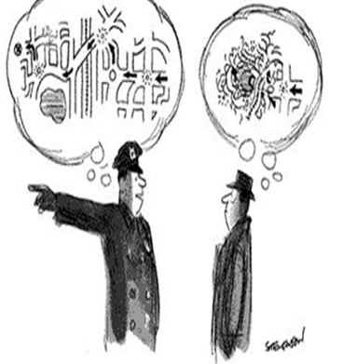
Language
Non verbal.
Speech impediment’s.
Sign Language.
Words mean different things.
Hearing difficulties.
Community Centered Libraries, (2020
Notes:
Communication is a vital day to day sense. When an incident happens if officers are not able to communicate properly it can lead to various misinterpretations and problems.
It is essential to consider everyone's needs. Improved communication allows for better outcomes when it comes to public safety and it encourages and builds stronger relationships between officer, individuals and communities.
The negative impact ranging from distrust, no reporting of crime as an individual living in fear of crime.

Slide 49
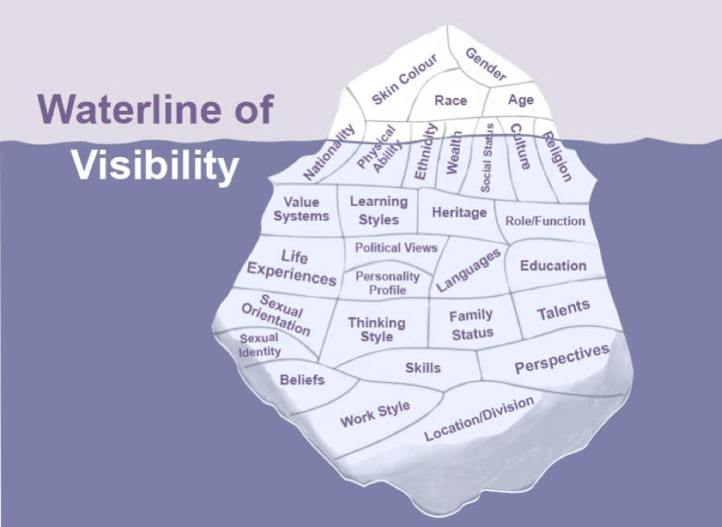
Community Centered Libraries,(2020)
Notes:
Other Barriers - Like most of these Iceberg models it is the hidden element of our differences that can effect a diverse society.
Trying to understand these unseen differences will always be a challenge for many police officers. Our actions & behaviour has to take into account the differences in people.
Inclusion is not just about what we can see it is valuing all our differences including the ‘hidden’ elements.

Slide 50
Why do you think people commit hate crime?
Thrill Seeking – Obvious victim due to features.
Defensive - attackers sees themselves as "defending" their country or religion
Revenge - revenge in response to acts of terrorism or other significant change
Hate – ‘crusader’ for a radical/religious causes, they are on a ‘mission’
Brought up that way?
Notes:
Why hate crime?
Thrills – obvious victims (clothes, hair, race) Maybe perpetrator(s) have a toxic mix of emotions, from anger to fear or under the influence of substances. That "added element“ allows them to commit a hate crime. Often attackers think society doesn't care about the victims.
Defensive attackers sees themselves as "defending" their neighbourhood, their work, their religion or their country. Target specific victims and justify their crimes as necessary to keep threats at bay. Can be triggered by a particular event, such as a political march or a Muslim or black family moving into a new neighbourhood. They think that society will thank them. Brexit triggered defensive attacks.
Revenge - target members of the racial or religious group who they believe committed the original crime - even if the victims had nothing to do with it. perpetrator(s) only want revenge and they will travel to the victims' territory to enact it.
These eye-for-an-eye attacks spike after acts of terrorism 9/11 USA, 7/7 London and Paris attacks in 2015.
The deadliest types of hate crimes. They are committed by people who consider themselves "crusaders," often for a racial or religious cause. Their mission: total war against members of a rival race or religion. They are often linked to groups that share their racist views.
Mission offenders write lengthy manifestos explaining their views, visit websites steeped in hate speech and violent imagery, and travel to target symbolically significant sites while seeking to maximize carnage.
Mission offenders believe that the system is rigged against them, which means that they can justify excessive violence against the innocent.
These hate crimes can look a lot like terrorism, and scholars say mission offenses often overlap both definitions, as in the case of a Muslim man who killed 49 people at a gay nightclub in Orlando 2016. Former President Barack Obama called the massacre both "an act of terror and an act of hate.“ Killer Omar Mateen had been angered few months before by 2 men kissing, stated his father. He also had an interest in ISIS and had been interviewed by FBI over it.

Slide 51
Behaviour
Values
Attitude
Beliefs
Discrimination
Conscious decisions based upon values
Family, Peers, Geography, Religion, Media etc.
Notes:
Theories and concepts linked to an ethical approach:
This slide will look at how as individuals how we develop our beliefs which can effect our behaviours.
The relationship between the beliefs and values relates to our resulting prejudices and behaviour to others.
The diagram (tree) illustrates the influences on us that result in our behaviour. The diagram first outlines the sources of our Beliefs which is learned from family, religion, influences, experiences, education and where we come from.
Although beliefs shape us as we become more independent we might feel that we object or question things and develop our own values.
Values are stable long-lasting ideas about what is important to a person. They become standards by which people order their lives and make their choices.
Attitudes are the mental dispositions people have towards others and the current circumstances before making decisions that result in behaviour. People primarily form their attitudes from underlying values and beliefs.
However, factors which may not have been internalised as beliefs and values can still influence a person’s attitudes at the point of decision-making. Typical influences include the desire to please, political correctness, convenience, peer pressure, and psychological stressors.
When it comes to considering attitudes to others in society our beliefs and values can influence our behaviours.

Slide 52
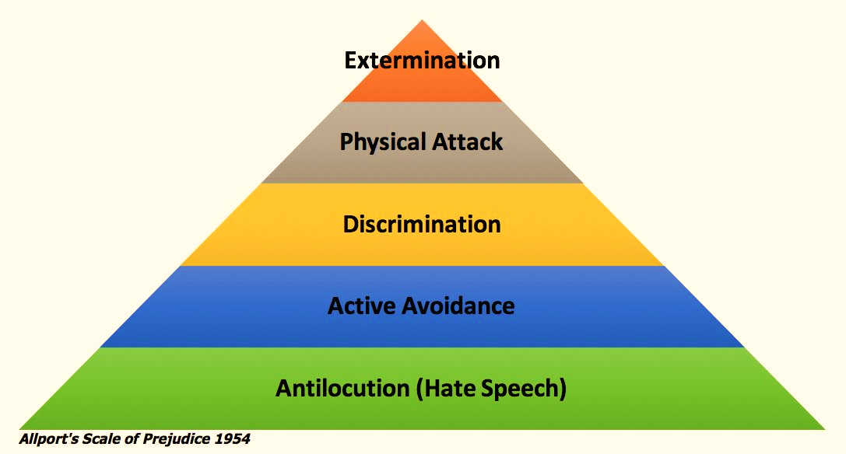
Allport’s Scale
Alport, (2023)
Notes:
Trainer to link in Allport’s scale and the impact hate crime can have on communities.
Allport's Scale is a measure of the manifestation of prejudice in a society. It is also referred to as Allport's Scale of Prejudice. It was devised by psychologist Gordon Allport in 1954.
Allport's Scale of Prejudice goes from 1 to 5.
Antilocution
Antilocution occurs when an in-group freely purports negative images of an out-group. Hate speech is included in this stage. Although antilocution itself may not be harmful, it could set the stage for more severe outlets for prejudice
2. Avoidance:
Members of the in-group actively avoid people in the out-group. No direct harm may be intended, but psychological harm often results through isolation
3. Discrimination
The out-group is discriminated against by denying them opportunities and services, putting prejudice into action. Behaviors have the intention of disadvantaging the out-group by preventing them from achieving goals, getting education or jobs, etc. Examples include Jim Crow laws in the US, the Statute of Kilkenny in British Ireland, Apartheid in South Africa, the Nuremberg Laws in 1930's Germany and antisemitic laws in the Middle East.
4. Physical Attack
The in-group vandalizes, burns, or otherwise destroys out-group property and carries out violent attacks on individuals or groups. Physical harm is done to members of the out-group. Examples include pogroms against Jews in Europe, the lynchings of blacks and Italians in the US, and ongoing violence against Hindus in Pakistan
5. Extermination
The in-group seeks extermination or removal of the out-group. They attempt to eliminate either the entirety or a large fraction of the undesired group of people. Examples include the Cambodian genocide, the Final Solution in Nazi Germany, the Rwandan genocide, the Armenian Genocide, the Genocide of the Hellenes and ethnic cleansing in the Bosnian War
Activities 2 & 3 to follow this slide as per lesson plan

Slide 53
How you can be discriminative against
Direct discrimination - This is when you’re treated less favourably because of a protected characteristic
Indirect discrimination - This is when a service has criteria which have the effect of being discriminatory against a person because of a protected characteristic
NiDirect Government Services,(2023)
Notes:
4 areas that discrimination is again a person/group Direct/indirect/harassment/victimisation

Slide 54
How you can be discriminative against
Harassment - experience behaviour that makes you feel intimidated, humiliated, or degraded, or that creates a hostile environment
Victimisation - Treated unfairly as a result of making a complaint about discrimination or giving evidence when someone else makes a complaint.
NiDirect Government Services,(2023)
Notes:
For more details please read the link: https://www.gov.uk/discrimination-your-rights
Types of discrimination ('protected characteristics')
It is against the law to discriminate against anyone because of:
age
gender reassignment
being married or in a civil partnership
being pregnant or on maternity leave
disability
race including colour, nationality, ethnic or national origin
religion or belief
sex
sexual orientation

Slide 55
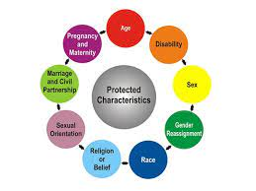
Discrimination- It is against the law under the Equality Act to discriminate anyone with protected characteristics.
Government Equalities Office and Equality Human Rights Commission, (2015)

Slide 56
References:
https://www.cps.gov.uk/crime-info/hate-crime
https://www.google.com/search?q=youtube+hate+crime+case&source=lnms&tbm=vid&sa=X&ved=2ahUKEwiioY2Pxbb9AhXNiFwKHXQsA9UQ_AUoAnoECAEQBA&biw=1199&bih=837&dpr=2#fpstate=ive&vld=cid:2c1dfc09,vid:nzRlmvCkbls
https://stephenlawrenceday.org/stephens-story/
https://www.google.co.uk/books/edition/The_Oxford_Handbook_of_Diversity_
https://www.independent.co.uk/news/long_reads/fiona-pilkington-frankie-pilkington-suicide-learning-disabilities-bullying-hate-crime-a8004526.html
https://www.google.co.uk/books/edition/Understanding_Inclusion
https://www.gov.uk/guidance/equality-act-2010-guidance
https://blogs.tip.duke.edu/teachersworkshop/equity-vs-equality-vs-liberation-first-steps-toward-inclusive-classroom-discussions-with-gifted-youth/
https://www.stophateuk.org/about-hate-crime/religious-discrimination/
https://www.gov.uk/government/statistics/statistics-on-so-called-honour-based-abuse-offences-england-and-wales-2021-to-2022/statistics-on-so-called-honour-based-abuse-offences-england-and-wales-2021-to-2022
https://www.gov.uk/government/statistics/hate-crime-england-and-wales-2021-to-2022/hate-crime-england-and-wales-2021-to-2022
https://www.stonewall.org.uk/list-lgbtq-terms
https://www.parliament.uk/about/living-heritage/transformingsociety/private-lives/relationships/collections1/sexual-offences-act-1967/sexual-offences-act-1967/

Slide 57
References:
https://www.hrw.org/news/2015/01/23/lgbt-moving-towards-equality
http://the-classroom.org.uk/wp-content/uploads/2014/07/Prejudice_And_Allport_Scale.pdf-1.pdf
https://www.theguardian.com/uk-news/2022/apr/13/mother-woman-murdered-dressing-as-goth-dies-suddenly-sophie-sylvia-lancaster-
https://www.nidirect.gov.uk/articles/introduction-discrimination
https://www.theguardian.com/sport/2020/jun/08/gareth-thomas-on-coming-out-as-hiv-positive-it-was-my-right-to-tell-my-family-not-somebody-elses
https://programminglibrarian.org/blog/going-beneath-cultural-iceberg-communicate-your-community
https://www.met.police.uk/advice/advice-and-information/hco/hate-crime/what-is-hate-crime/

