Slide 1

Problem solving and decision-making
(BMSW4004_BIRM)
Serena Bailey -2025320
Lecture: Besty Jose

Slide 2
In this presentation I'm going to be talking about the main outcomes of staff shortages.
Title
Introduction
How big is the problem
Impact of the problem
PESTLE analysis
Fish bone diagram
Scope of the problem

Slide 3


Addressing the problem of staff shortage in Proper Care UK

Slide 4
Introduction
The main problem identified is staff shortages within my business ( Proper Care UK).
Staff shortages have increased over the last couple of years due to a global pandemic (COVID-19). This has affected us with a great deal of backlog of requirements due to loosing many of our staff members.

Slide 5

Scope of the problem
So, the scope of the problem which we are currently dealing with and trying to become in control of our staff shortages.
How wide the problem
Who is impacted problem
And how they are impacted by the problem

Slide 6
How wide is the problem
The problem with staff shortages is currently worldwide.
Due to a nation-wide pandemic (COVID-19) has caused a huge impact on working life. The ever-increasing morbidity and mortality due to COVID-19 is the biggest setback. (Ray,D, Tripathy, S, et al June 2020)
Staff are also having time off for various reasons e.g. travel expense, mental health problem, illness, money, lack of communication

Slide 7

How big is the problem
NHS hospitals and mental health and community providers are currently reporting a shortage of more than 100,000 FTE staff (representing one in eleven posts), severely affecting some key groups. (Proper Care UK 2022)
This statement shows that the problem has massively impacted the health care community.
This is a problem that we won't be able to fix fully but can improve the impact on staff shortages

Slide 8

IMPACT OF THE PROBLEM
Longer patient waiting time
Overworked staff members/ more pressure on staff
Poor quality of service
Health & Safety at risk
Patient waiting list will grow even more

Slide 9
Pestle analysis
Political | Economical | Sociological | Technological | Legal | Environmental
Brexit – less staff Follow rules & regulations Covid-19 Confidential PPE | Overworked Less pay Long wait time Providing staff Providing money | Care workers rules & regulations Behaviour in a working environment Health & safety Mental health | Better communication Latest equipment Mobiles/computer/PC | Data protection Training DBS Confidentiality Copy right Risk assessments | Clean community Health Hygiene Climate change Environmental changes

Slide 10
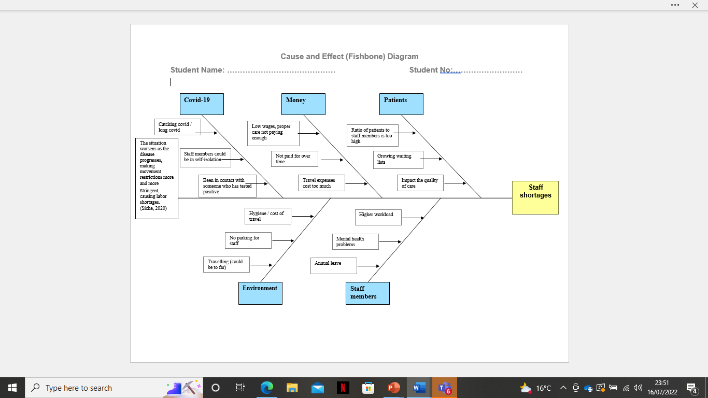

Slide 11
3 solutions
Recruiting of more staff
Meetings for support
Training

Slide 12
Plus | Minus | Interesting
Improvement in safeguarding +5 | Expensive -3 | Easier to do the job
Better quality of care +4 | Less shifts available for current shifts -1 | Bigger team means getting things done
Better teamworking skills +2 | Finding people with the correct training -2 | Work your way up within the company
Staff motivation +1 | Long hours -4 | Meeting new people
More help +3 | Finding staff to train new staff members -1 | More ratio staff then patients
Total = +15 | Total -11 | Total = 4
RECRUITING MORE STAFF

Slide 13
Meetings for support
Plus | Minus | Interesting
Gathering people's thoughts and ideas +4 | Time consuming -3 | Nice to receive feedback
Good team building exercise +3 | Costs for resources -1 | Socializing
Improves communication within the team +5 | Repetitive -5 | Gives everyone a break
Improves morale +2 | Not enough staff to watch patients and attend meetings -2 | Makes you feel like a team
Total = +14 | Total = -11 | Total = 3

Slide 14
Training
Plus | Minus | Interesting
Gaining more knowledge +5 | Getting the staff to provide training -5 | Easier
Finding out the rules and regulations +4 | Cost -3 | Learning while on the job
Workplace becomes more versatile +5 | Everyone being able to attend on the same date -2 | Feeling confident to work within the workplace
Improve training matrix +3 | Waste of medical equipment -2
Total = +17 | Total = -12 | Total = 5

Slide 15

Results
Out of all 3 solutions, staff training was the highest one. This shows that with correct training staff will feel more motivated to do the job and comfortable in coming to work. Without training staff won't feel comfortable and it can make it harder to attend work. This results in training being top of the list.

Slide 16
CONCLUSION
As we know Proper Care Uk has been dealing with a mass drop in staff shortages. I have found some solutions that could solve this problem. The PMIs has resulted in showing how to try and get in control of staff shortages.
In conclusion I think that Proper Care Uk will always deal with staff shortages but can at least get on track with it by using the solutions mainly training to help them pervent problems happening again.

Slide 17
References
RAY,D, TRIPATHY,S, ET AL (2020) can be found: https://www.sciencedirect.com/science/article/pii/S1876201820301945
Addressing the problem at Proper Care Uk - Can be found at: GA36a Level 4 (uwtsd.ac.uk) Accessed date: 15 July 2022
Siche, R. (2020). What is the impact of COVID-19 disease on agriculture? Scientia Agropecuaria, [online] 11(1), pp.3–6. doi:10.17268/sci.agropecu.2020.01.00. Accessed date: 14 July 2022

