Slide 1
Group Project
M5X00400
Sam Melmoth
1809093

Slide 2
Overview
Contents:
Introduction
Design
Planning
Installation
Production

Slide 3
Introduction
Reasons for project
Improve efficiency in production procedure
Ease of use for operators
Increased manufacture of wear plates

Slide 4
Design
Old
Processes are spread out over the department
Movement of components is a waste of time
Components are heavy and hard to move
New
Implementation of single piece flow
All processes will be concentrated in a single cell
Lifting apparatuses will be added to service all stations
Aim to reduce time wastage and unnecessary movement between stations

Slide 5
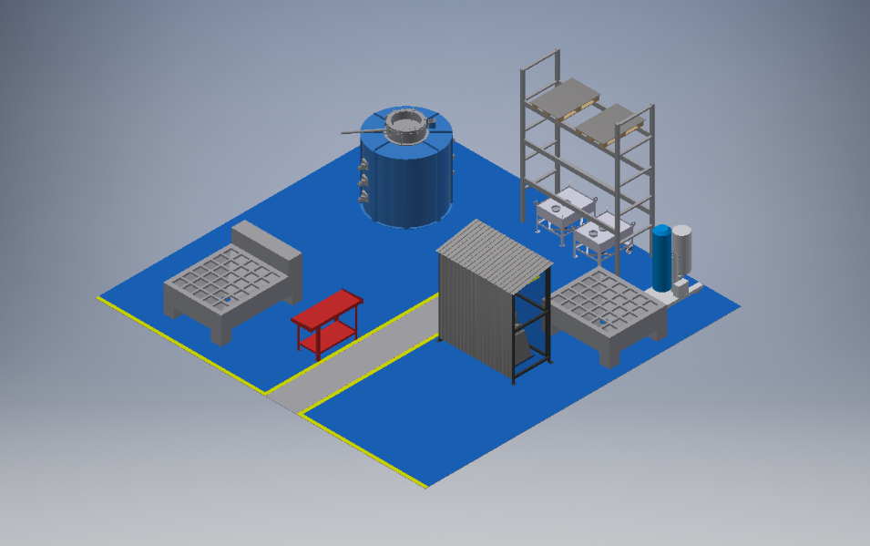
Design

Slide 6
Planning
Planning Techniques
The project was planned out on a Gant chart
Utilized Microsoft projects
The deadline for the project was before the board visit
This allowed us to spread out the contractors so they did not get in each others way

Slide 7
Installation
The installation phase consisted of:
Emptying and cleaning the area
Filling in holes and levelling the floor
Painting the area
Assembling racking for plate and powder storage
Move install and connect the powder mixer
Lower and fix in place an isolation cage over the mixer for safety
The whole installation was completed in a week
No need for down time as the area wasn’t in use for production.

Slide 8
Production
Benefits of new design
Operators no longer have to carry heavy components
All parts for the wear plates are in one cell
Single piece flow reduces waste and this cuts down on process time
Heavier plates can be manufactured now the new lifting equipment is available
A single operator can produce plates with the help of the lifting equipment saving on labor costs

