Slide 1
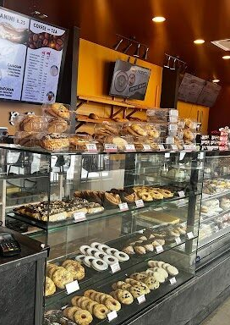
Student Name: Md Saidur Rahaman
Student ID: 2541515
Lecturer’s Name: Yetunde Everard-Igweh
Module Code: LCLM 4004
Module Name: Problem Solving and Decision-Making
Component 1: Basil’s Bakery
This Photo by Unknown Author is licensed under CC BY

Slide 2
Overview of presentation.
Today’s Presentation
Business Background & History
Sales Performance Overview
Key Issues & Challenges Identified
Customer & Market Changes
PESTAL and SWOT Analysis
Root Causes of Sales Decline
Strategic Recommendations
Implementation Plan
Conclusion & Next Steps

Slide 3
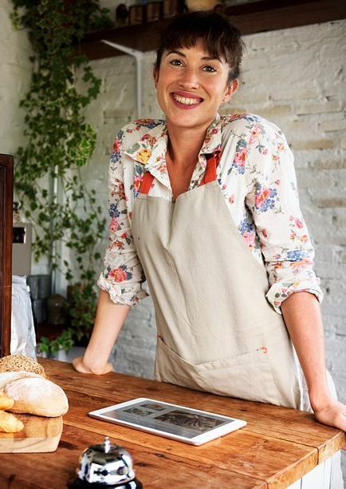
Overview of Basil’s Bakery
Who is Basil’s Bakery?
Independent artisan bakery established in 2015
Located in a retail park in Coventry, UK
Products: Cakes, pastries, bread all using high-quality organic ingredients
Customer base: Local shoppers, retail park staff, nearby office & warehouse workers
Core values: Quality ingredients, great taste, convenient location
Owner: Basil skilled
(Office for National Statistics, 2024)
Key Strengths:
Strong product reputation & loyal customer base
Organic sourcing unique selling point
Established presence since 2015

Slide 4
The problems Basil’s Bakery are facing.
External( Limited control) Internal(Greater control)
Retail park quieter, shops closing No delivery service
Remote work, less daily visitors Pre-order, phone not reliable
Loyal customers lost jobs No online ordering or digital presence
Rising rent, utilities, rates, insurance Organic ingredient costs unpredictable
(Barraza and González, 2019)

Slide 5

Critique of the PESTEL Framework
PESTEL Framework Critique
What it is: A tool to analyse external macro-environmental factors affecting a business
Why use it: Identifies opportunities & threats outside your control
Benefits:
Broad, structured view of external influences
Simple to apply & easy to communicate
Highlights risks before they impact the business
Criticisms:
Can generate too much irrelevant data
Doesn’t rank factors or show interactions between them
Assumes external trends continue unchanged
(Department for Business and Trade, 2025)

Slide 6
PESTEL — Application to Basil’s Bakery
Table
Factor | Key Points
Political | UK government support for local independent businesses, business rates relief schemes, food safety regulations
Economic | Cost-of-living squeeze, higher energy/rent costs, customers cutting premium spending, organic price volatility
Social | Shift to hybrid/remote work, demand for local & organic produce, customers want delivery & pre-ordering
Technological | Low-cost digital ordering platforms available, social media as free marketing, mobile delivery apps
Legal | Food hygiene & labelling laws, employment rules, insurance requirements, health & safety
Environmental | Customers value sustainable/organic sourcing, local supply chains preferred, climate affecting crop yields
(BCC, 2024)

Slide 7
Critique of the Cause and Effect model
Cause-and-Effect Model Critique
What it is: Also called Fishbone/Ishikawa Diagram — visually maps root causes of a problem across categories
Why use it: Moves beyond symptoms to underlying causes; encourages systematic thinking; builds team consensus
Benefits:
Clear visual structure easy to understand
Covers all angles: people, process, resources, environment
Identifies where to focus fixes rather than guessing
Criticisms:
Can become cluttered if too many causes listed
Doesn’t prioritise which causes matter most
Correlation ≠ causation — may show links that aren’t real
Needs good data to be reliable
(References: e.g. Ishikawa 1985; Oakland 2020)

Slide 8
Application and discuss the information provided in your Cause-and-Effect diagram
Methods
Machines
People
No delivery
Not answering phone
Less people
Pre Order
System issue
Lost jobs
Sales decreased by 25%
Bills overheads
Waiting time
Covid
Cost of stock
Not digital
Retail park shop close
Materials
Measurement
Environment
Adapted from: Super series Solving Problems and Making Decisions (2013, page 31)

Slide 9
Summary of Key Findings
Key Findings
Sales loss is structural, not temporary hybrid work & retail park decline mean pre 2020 footfall will not return
Customers still want the products they just can’t access them easily enough (no delivery / unreliable pre-orders)
Costs are outpacing revenue fixed overheads & volatile organic margins squeeze profitability
Owner capacity is the biggest internal bottleneck Basil’s time is tied to baking, limiting service expansion

Slide 10
Reference List:
Reference list
Adapted from: Super series Solving Problem and Making Decisions(2013, page 31)
Barraza, M.F.S. and González, F.G.R. (2019). Cornerstone root causes through the analysis of the Ishikawa diagram, is it possible to find them? International Journal of Quality and Service Sciences, [online] 11(2), pp.302–316. doi:10.1108/ijqss-12-2017-0113.
BCC (2024). BCC quarterly economic survey: Business confidence continues to tick up in Q2 - British chambers of Commerce. [online] British Chambers of Commerce. Available at: https://www.britishchambers.org.uk/news/2024/07/bcc-quarterly-economic-survey-business-confidence-continues-to-tick-up-in-q2/ [Accessed 13 Oct. 2026].
Department for Business and Trade (2025). Longitudinal small business survey 2024: SME employers (businesses with 1 to 249 employees). [online] GOV.UK. Available at: https://www.gov.uk/government/statistics/small-business-survey-2024-businesses-with-employees/longitudinal-small-business-survey-2024-sme-employers-businesses-with-1-to-249-employees [Accessed 13 Oct. 2026].
for, D. (2025). SME digital adoption taskforce: Final report. [online] GOV.UK. Available at: https://www.gov.uk/government/publications/sme-digital-adoption-taskforce-final-report [Accessed 13 Oct. 2026].
Office for National Statistics (2024). Who are the hybrid workers? [online] Ons.gov.uk. Available at: https://www.ons.gov.uk/employmentandlabourmarket/peopleinwork/employmentandemployeetypes/articles/whoarethehybridworkers/2024-11-11 [Accessed 13 Oct. 2026].

Slide 11

Thank you for listening

Slide 12


