Slide 1

Supporting the Well-Being of a Young Carer
Student Name: Huma Ali
Student Number: 2437892
Course Title: Health and Social Care
Module Title: Psychology in Health and Social Care
Module Code: LCHS4010
Lecturer Name: Alice Clayton
Assessment Component 1

Slide 2

Scenario Overview
Jenny is 16 years old
Primary carer for mother for 5 years
Father died
Mother has mobility, memory and low mood difficulties
Image placeholder
(Insert relevant image here)
(young carer context – Department for Education, 2018)

Slide 3
Why Attachment Theory?
Focus on caregiving relationships
Explains emotional impact of loss
Relevant to young carers

Slide 4
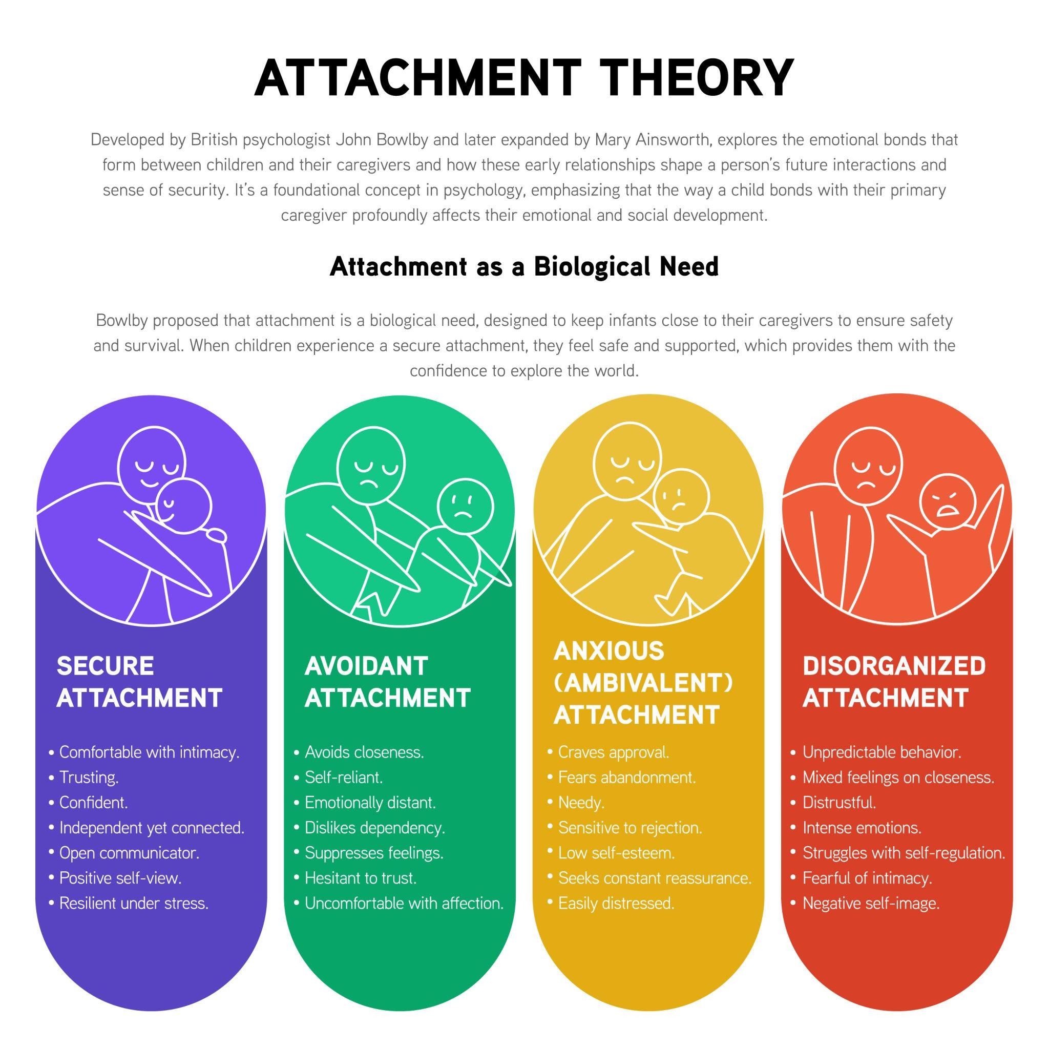
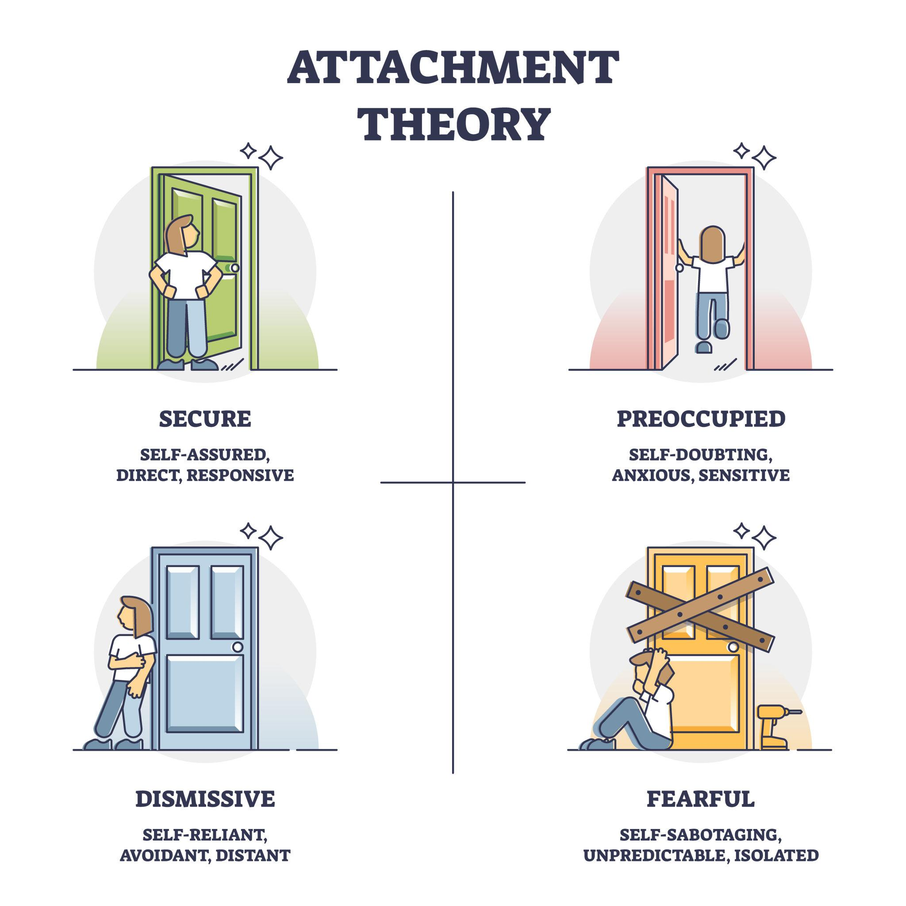
Attachment Theory Overview
Internal working models
Secure vs insecure attachment
Importance during adolescence
(Bowlby, 1988; Cassidy and Shaver, 2016)
Emotional security
Relationships & coping
Internal working model
Caregiver responsivees
(Attachment theory diagram – adapted from Bowlby, 1988)
Image placeholder
(Insert relevant image here)

Slide 5
Historical Impact on Jenny
Grief and loss
Increased anxiety
Reduced peer interaction
Role reversal
(Bowlby, 1988)

Slide 6
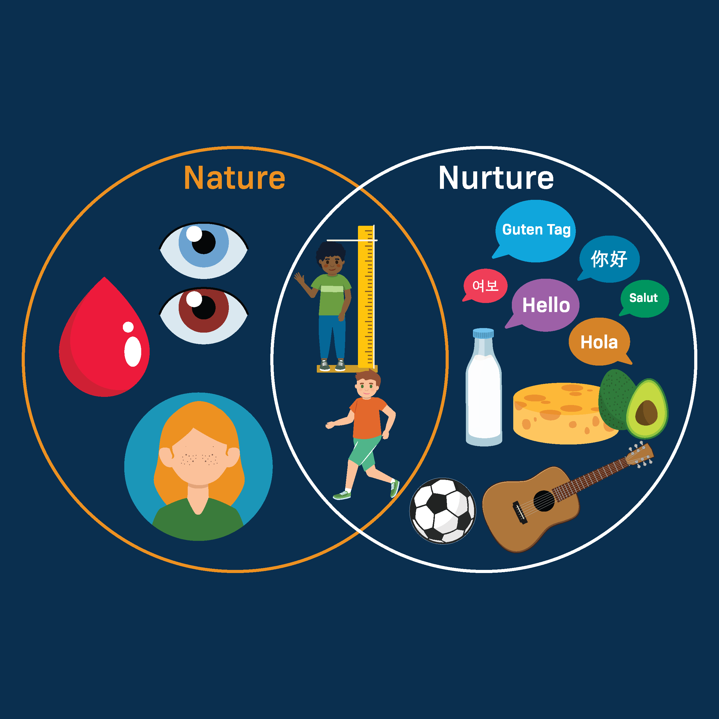
Nature and Nurture
Biological emotional sensitivity
Environmental stressors
Chronic caregiving demands
(Joseph, Becker and Becker, 2009)
Image placeholder
(Insert relevant image here)
(Nature vs nurture – adapted from Steinberg, 2017)

Slide 7
Jenny’s Current Needs
Emotional security
Adult support
Reduced responsibility
Age-appropriate development
(Steinberg, 2017)

Slide 8
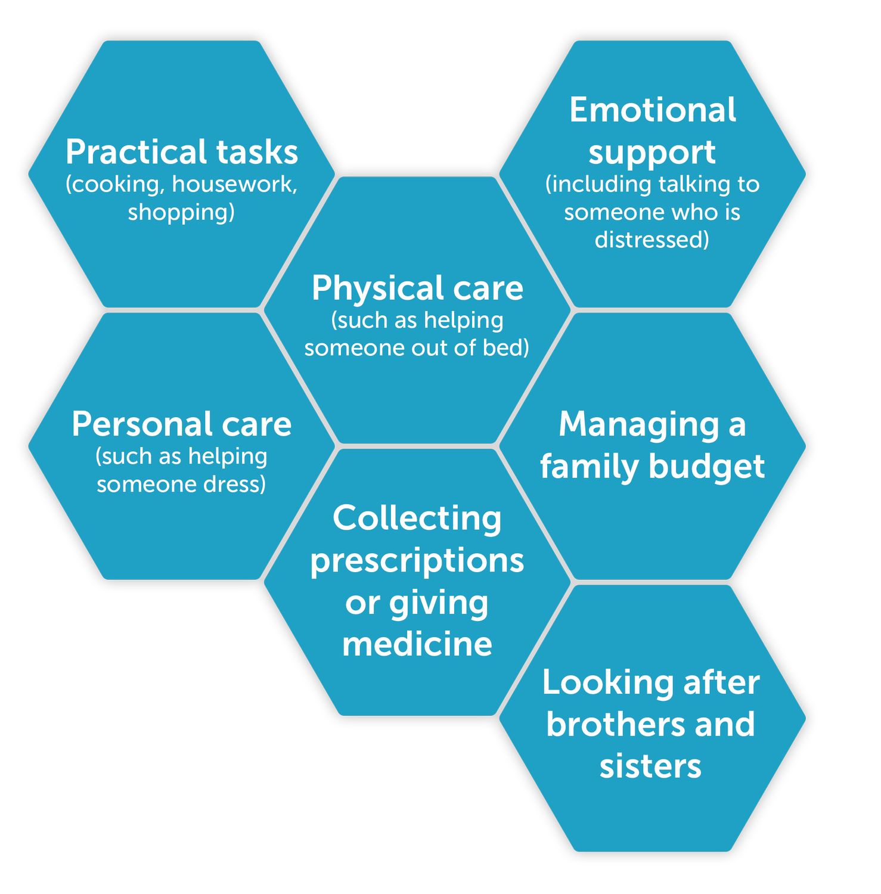
Support Plan
Consistent support worker
Young carers group
Respite care
School support
Counselling
(Department for Education, 2018; NHS England, 2021)
Image placeholder
(Insert relevant image here)
(Support services overview – NHS England, 2021)
Support Worker
Peer Support
Respite Care
Counselling

Slide 9
Critical Evaluation
Strong evidence base
Relevant to social care
Limited focus on resilience
Cultural limitations
(Bowlby, 1988; Early Intervention Foundation, 2020)
Vygotsky highlights the role of social and environmental support in development
(Vygotsky, 1978)

Slide 10
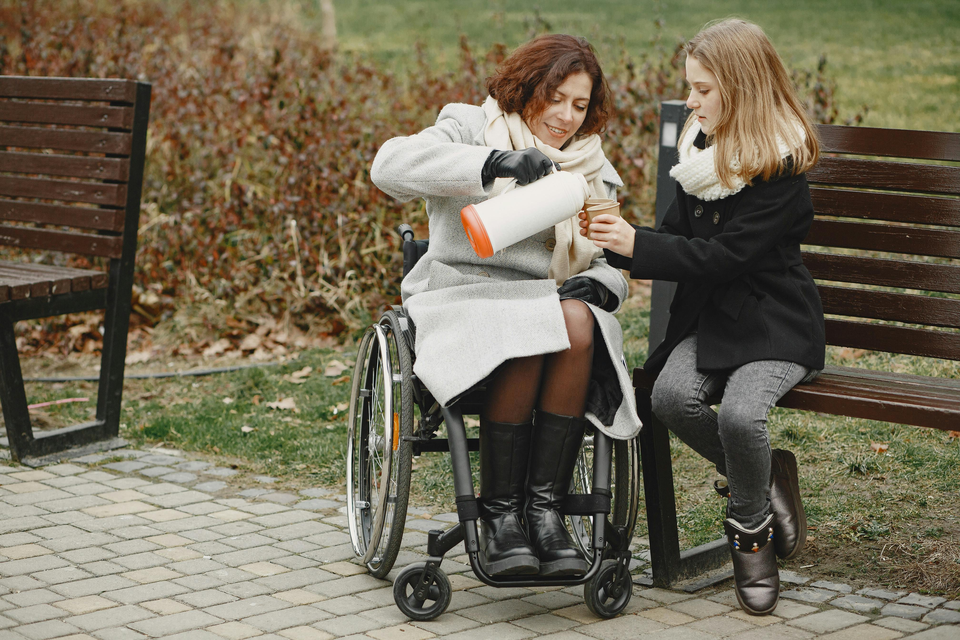

Conclusion
Attachment theory explains impact
Support plan promotes wellbeing
social and environmental support in development.
Vygotsky highlights the role of

Slide 11
References
Ainsworth, M.D.S., Blehar, M.C., Waters, E. and Wall, S. (1978) Patterns of attachment: A psychological study of the strange situation. Hillsdale, NJ: Erlbaum.
Bowlby, J. (1988) A secure base: Parent-child attachment and healthy human development. London: Routledge.
Cassidy, J. and Shaver, P.R. (2016) Handbook of attachment: Theory, research, and clinical applications. 3rd edn. New York: Guilford Press.
Department for Education (2018) Young carers: Guidance for schools and local authorities. London: Department for Education.
Early Intervention Foundation (2020) Attachment and adversity in childhood. London: Early Intervention Foundation.
Joseph, S., Becker, F. and Becker, S. (2009) ‘Young carers and their psychological well-being’, Child & Family Social Work, 14(1), pp. 1–10.
NHS England (2021) Supporting young carers [Online]. Available at: https://www.england.nhs.uk/ (Accessed: 1 February 2026).
Steinberg, L. (2017) Adolescence. 11th edn. New York: McGraw-Hill Education.
Vygotsky, L.S. (1978) Mind in society: The development of higher psychological processes. Cambridge, MA: Harvard University Press.

