Slide 1
ECAD5004/C
Rachel Wallis / Nerys Defis
1/3/2018

Slide 2
Tasg gynhesu / Warm-up task
Gan ddefnyddio’r set o adnoddau sydd ym mlaen yr ystafell dyfeisiwch weithgaredd Dydd Gwyl Dewi ar gyfer dosbarth / grwp o blant.
Y nod yw datblygu rhyw sgil fathemategol mewn ffordd hwyliog.
Nodwch: Pa sgil? Beth yw oed tebygol y plant?
Using the resources at the front of the classroom devise a Saint David’s Day activity for a class / group of children.
The aim is to develop a mathematical skill is a fun way.
Note: What skill? Approximate age of the children?

Slide 3
Dadansoddi Gwaith Plant mewn Mathemateg
Cefnogaeth i’r aseiniad
Analysing Pupils’ Work in Mathematics
Assignment support

Slide 4
Amcanion y sesiwn
Session objectives
Deall y datblygiadau diweddaraf yn y gofynion asesu statudol
Profiad ymarferol o asesu darnau o waith yn deillio o’r esiamplau a gasglwyd ar y PAP
Understand latest developments within statutory assessment requirements
Gain practical experience of levelling pieces of work linked to samples collected on PTE

Slide 5
Meddwl - Paru - Rhannu
Think - Pair - Share
Beth yw’r gofynion ar gyfer asesu ac adrodd o ran mathemateg a rhifedd yn ysgolion cynradd Cymru?
What are the requirements for assessing and reporting mathematics and numeracy in primary schools in Wales?

Slide 6
Asesu Mathemateg a Rhifedd Statudol
Statutory Mathematics and Numeracy Assessment
Asesiad sylfaenol gyda Proffil Cryno y Cyfnod Sylfaen yn ystod 6 wythnos gyntaf plentyn yn y Derbyn
Diwedd Cyfnod Sylfaen (B.2) asesiadau athro yn erbyn deilliannau’r cyfnod sylfaen (Proffil Llawn)
Diwedd CA2 (B.6) asesu yn ôl disgrifiadau lefel y cwricwlwm cenedlaethol
Profion rhesymu a gweithdrefnol blynyddol i blant B.2-6. Rhieni i dderbyn y canlyniadau.
Ysgolion i roi adroddiad ‘naratif’ ar sgiliau rhifedd disgyblion mewn perthynas â’r Ff.Ll.Rh. (h.y. sut maent yn defnyddio rhifedd ar draws y cwricwlwm)
Baseline Assessment using the compact Foundation Phase Profile within a child’s first 6 weeks in Reception
End of Foundation Phase (Y.2) teacher assessments against Foundation Phase Outcomes (Full Profile)
End of key stage 2 (Y.6) teacher assessments against national curriculum level descriptors
Annual procedural and reasoning numeracy tests for children in years 2-6. Parents receive their child’s results
Schools give a ‘narrative’ report on learners’ numeracy skills in relation to the LNF (i.e. How numeracy is used across the curriculum)
Notes:
Gwybodaeth am asesu’r CS ar wefan Llywodraeth Cymru:
http://gov.wales/topics/educationandskills/foundation-phase/foundation-phase-profile/?skip=1&lang=cy
Info on FP assessment on Welsh Government Website:
http://gov.wales/topics/educationandskills/foundation-phase/foundation-phase-profile/?skip=1&lang=en
Fideo Llywodraeth Cymru yn esbonio trefniadau asesu CS a defnyddio’r Proffil:
https://www.youtube.com/watch?v=kwH5xGHAgRU&feature=youtu.be
WG video explaining FP assessment arrangements and use of the Profile
https://www.youtube.com/watch?v=xfWghefLmHo&feature=youtu.be

Slide 7
Cyfnod Sylfaen / Foundation Phase
Cyfrwng Cymraeg / Welsh Medium:
http://learning.gov.wales/resources/collections/foundation-phase?lang=cy
Cyfrwng Saesneg / English Medium:
http://learning.gov.wales/resources/collections/foundation-phase?lang=en

Slide 8
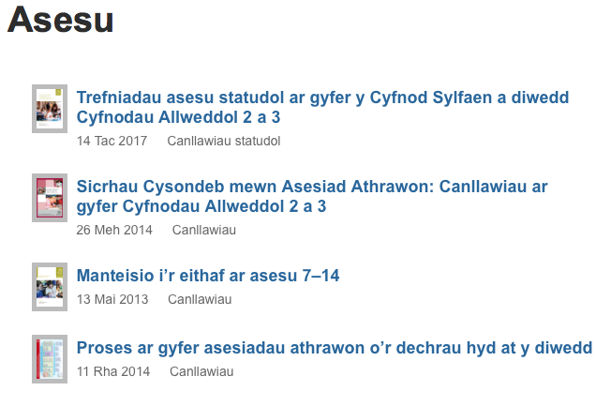
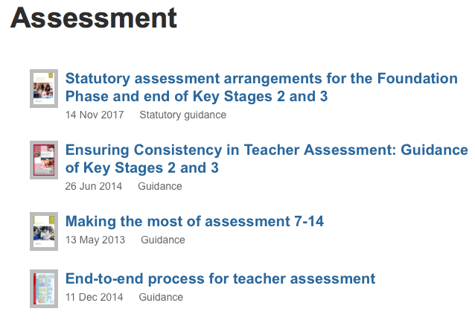
Cyfnod Allweddol 2 / Key Stage 2
Cyfrwng Cymraeg / Welsh Medium:
http://learning.gov.wales/resources/collections/key-stages-2-4?lang=cy#collection-2
Cyfrwng Saesneg / English Medium:
http://learning.gov.wales/resources/collections/key-stages-2-4?lang=en#collection-2

Slide 9
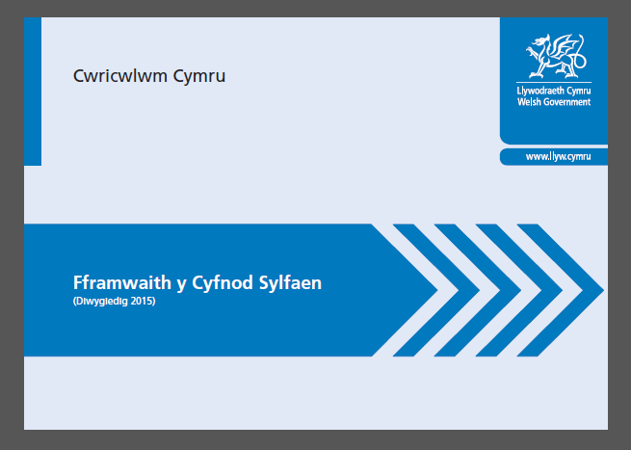
Dogfennau Mathemateg / Mathematics Documents
Cyfrwng Cymraeg / Welsh Medium:
http://learning.gov.wales/resources/collections/foundation-phase?lang=cy
http://learning.gov.wales/resources/collections/key-stages-2-4?lang=cy
Cyfrwng Saesneg / English Medium:
http://learning.gov.wales/resources/collections/foundation-phase?lang=en
http://learning.gov.wales/resources/collections/key-stages-2-4?lang=en

Slide 10
Cytuno / Anghytuno?
Agree / Disagree?

Slide 11
National curriculum outcomes and level descriptions are designed for ‘best-fit’ judgements of learners’ attainment after a significant period of learning and teaching, i.e. normally at the end of each key stage. If schools use them for monitoring and tracking learner progress over shorter intervals of time, care needs to be taken to avoid an inappropriate, narrow focus for assessment information. For example, single pieces of work should not be levelled, although they may provide evidence for characteristics from one or more level descriptions.
p.9, WG (2010) Making the Most of Assessment
http://learning.gov.wales/resources/browse-all/assessment-7-14/?skip=1&lang=en

Slide 12
Mae deilliannau a disgrifiadau lefel y cwricwlwm cenedlaethol wedi’u llunio fel bod modd dod i farn sy’n ’cyd-fynd orau’ am gyrhaeddiad dysgwyr ar ôl cyfnod sylweddol o addysgu a dysgu, h.y. ar ddiwedd pob cyfnod allweddol fel arfer. Os yw ysgolion yn eu defnyddio ar gyfer monitro a thracio cynnydd dysgwyr dros gyfnodau byrrach, mae angen cymryd gofal i osgoi ffocws amhriodol, cul i’r wybodaeth asesu. Er enghraifft, ni ddylid rhoi lefel i ddarnau unigol o waith, er eu bod, o bosibl, yn dangos nodweddion un neu fwy o ddisgrifiadau lefel.
t.9, LlC (2010) Manteisio i’r Eithaf ar Asesu 7-14 http://learning.gov.wales/resources/browse-all/assessment-7-14/?skip=1&lang=cy

Slide 13
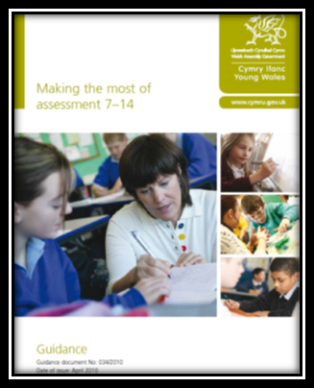
The importance of ‘best-fit’ applies to assessment of all learners. Using ‘best-fit’, all teachers are able to take account of relevant evidence, encompassing transferable skills, as well as knowledge and understanding. School managers should ensure that all teachers understand the concept of ’best-fit’ and apply it consistently.
p.11, WG (2010) Making the Most of Assessment
http://learning.gov.wales/resources/browse-all/assessment-7-14/?skip=1&lang=en

Slide 14
Mae pwysigrwydd ‘cyd-fynd orau’ yn gymwys wrth asesu pob dysgwr. Wrth ddefnyddio ’cyd-fynd orau’ gall athrawon ystyried tystiolaeth berthnasol, sy’n cwmpasu sgiliau trosglwyddadwy yn ogystal â gwybodaeth a dealltwriaeth. Dylai rheolwyr ysgol sicrhau fod pob athro/athrawes yn deall y cysyniad ‘cyd-fynd orau’ ac yn ei ddefnyddio’n gyson.
t.10, LlC (2010) Manteisio i’r Eithaf ar Asesu 7-14
http://learning.gov.wales/resources/browse-all/assessment-7-14/?skip=1&lang=cy

Slide 15
Identifying characteristics of outcomes/levels within work
For the work samples you have brought in:
Identify what characteristics of outcomes/levels may be evident in each piece – be able to provide a short justification for this
Exchange your samples with a partner form within the same key stage – are you in agreement?

Slide 16
Link to your Assignment
Looking at data, such as an outcome or level is one means of analysis.
Within your assignment you are asked to analyse a child’s learning in mathematics and language with recommendations for ensuring progress.
Work again within your pairs to give recommendations for each child i.e. how this child can be supported to make progress

Slide 17
Adnabod Nodweddion Deilliannau/Lefelau o fewn Darnau o Waith
Ar gyfer yr esiamplau o waith sydd gennych o’r PAP:
Ceisiwch adnabod pa ddeilliannau/lefelau sydd wedi eu hamlygu yn y gwaith – dylech fedru cyfiawnhau hyn neu roi rheswm
Gan gydweithio gyda phartner sydd wedi addysgu yn yr un Cyfnod Allweddol, ewch ati i gyfnewid samplau. Ydych chi’n gytun o ran deilliant/lefel?

Slide 18
Cyswllt gyda’r Aseiniad
Mae edrych ar ddata, megis deilliant neu lefel, yn UN dull o ddadansoddi.
O fewn eich aseiniad gofynnir i chi ddadansoddi sut mae plentyn yn dysgu iaith a mathemateg gydag argymhellion ar gyfer sicrhau cynnydd.
Cydweithiwch unwaith eto yn eich parau er mwyn cynnig argymhellion h.y. sut allai’r plentyn gael ei gefnogi er mwyn iddo/i wneud cynnydd.

Slide 19

Cyfle i ddangos eich gwybodaeth am y Gofynion Asesu Statudol
A chance to show your understanding of the Statutory Assessment Requirements!

