Slide 1

Finance Management
ACMA 4017
Tata Steel UK Financial analysis 23-25
February 2025
Darrell Byrne

Slide 2

Agenda
        Context & Overview
        Full Financial Ratio Analysis
        Investor Ratios
        Capital Investment Appraisal Methods
        Working Capital Management Techniques
        Conclusion

Slide 3
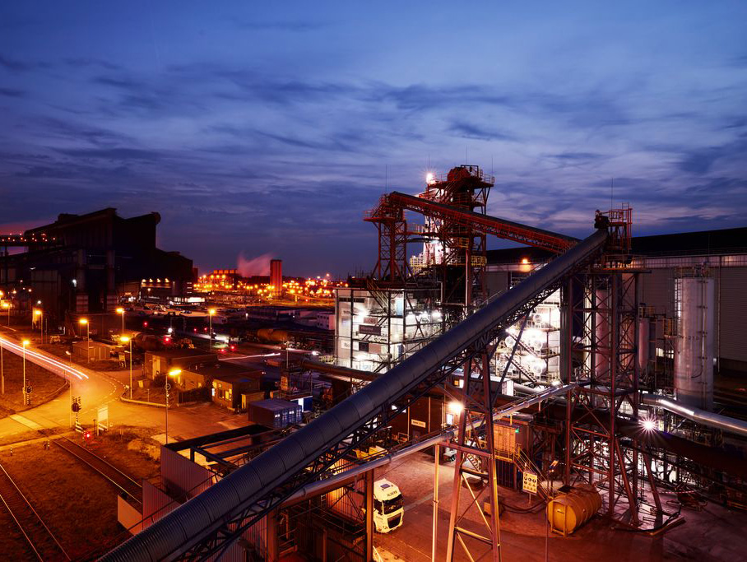
Context & Overview

Slide 4

Executive Summary of Tata Steel UK’s Financial trajectory
FY23 Baseline Performance
FY23 was the final year of integrated blast furnace steelmaking with modest losses and tight liquidity.
DY24 Profitability Decline
FY24 saw a sharp profit decline due to restructuring, impairments, operational changes and weak demand.
FY25 Transition and Stabilisation
FY25 featured a shift to a re-roller model, margin stabilisation, but continued liquidity pressures.
Decarbonisation and Future Outlook
Decarbonisation efforts and Electric Arc Furnace plans promise a lower cost, lower carbon future.
Notes:
Across the three-year period from FY23 to FY25, Tata Steel UK underwent a profound operational and financial transformation driven by structural, macroeconomic and strategic factors.
FY23 marked the final full year of integrated blast furnace steelmaking in the UK, presenting a relatively stable but still loss-making baseline characterised by modest operating losses, tight liquidity and high leverage.
The subsequent year, FY24 represented a dramatic turning point, with results reported as part of the wider Tata Steel Europe Group, demonstrating a steep deterioration in profitability due largely to restructuring expenses, impairment charges linked to Port Talbot heavy end closure, reduced production resulting from operational outages such as the BF6 reline in the Netherlands and weak European steel demand. This combination of cyclical price compression, high energy and carbon costs and structural overhaul resulted in substantial negative margins and record low ROCE.
FY25 saw the UK business operating under a transitional re-roller model following the shutdown of the blast furnaces. While losses persisted, margin stabilisation was evident relative to the FY24 trough. Liquidity remained under pressure despite equity injections, with working capital volatility, reliance on revolving credit facilities and receivables securitisation proving essential for maintaining solvency. Gearing escalated dramatically as accumulated losses led to negative equity. Operationally, the shift away from primary steelmaking sharply reduced the emissions profile, although this was influenced by metric denominator changes.
The three years collectively present a financial narrative dominated by decarbonisation led restructuring, capacity reconfiguration, external market challenges and the anticipation of long-term cost and emissions benefits associated with the planned Electric Arc Furnace investment. Together, these trends frame a business in the midst of a radical transition, navigating short term financial stress whilst laying the groundwork for a lower cost, lower carbon future.

Slide 5
Full Financial Ratio Analysis

Slide 6
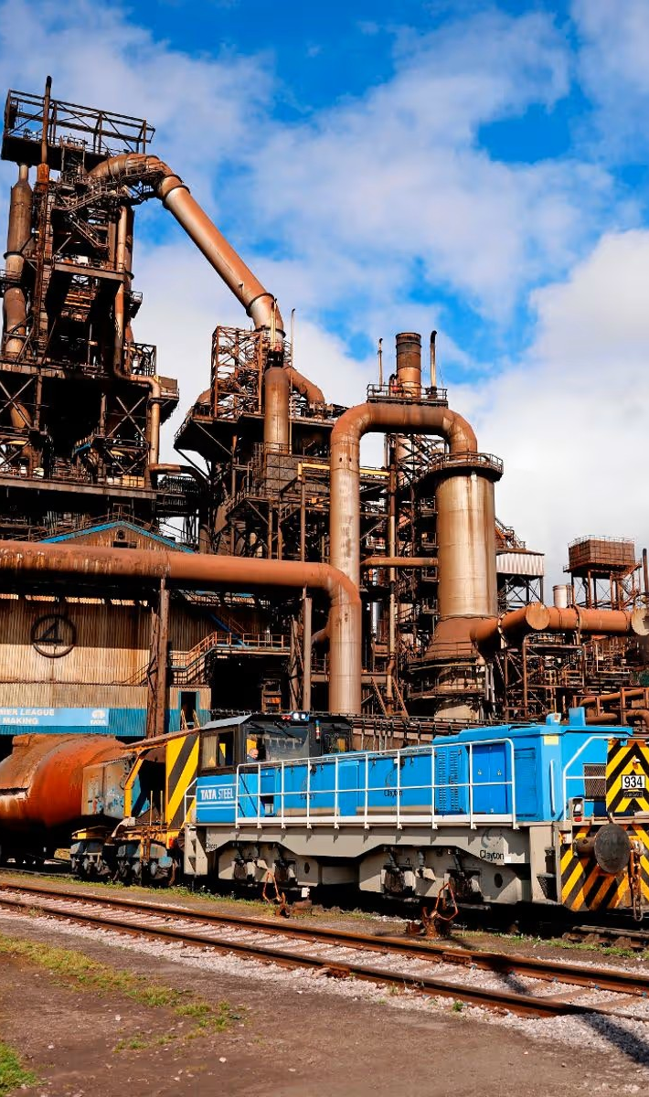
Profitability Ratio Performance Analysis
FY23 Profitability Challenges
FY23 showed negative operating and net margins driven by high raw material costs and inflationary spending pressures.
FY25 Profitability Collapse
FY24 experienced drastic margin drops due to restructuring, impairment charges and demand contraction in steel markets.
FY25 Modest Stabilisation
FY25 margins improved slightly with the transition to a re-roller model but ROCE declined further due to negative equity.
.
Notes:
Profitability ratios across FY23 to FY25 highlight the severity and depth of Tata Steel UK’s financial downturn before showing limited stabilisation.
In FY23, operating margins of -7.1% and net margins of -21.5% reflected pressures from high raw material costs, inflationary maintenance spending and subdued steel spreads.
By FY24, profitability collapsed across the European group, with operating margins plunging to -22.0% and net margins to -25.1%, this was heavily driven by major restructuring and impairment charges associated with the Port Talbot blast furnace closures, extensive loses linked to the BF6 reline outage in the Netherlands and broader demand contraction in European steel markets. High energy and carbon costs also amplified the deterioration.
ROCE followed a similar pattern, deteriorating from -15.2% in FY23 to -47.1% in FY24 due to massive impairment charges and shrinking capital employed efficiency.
In FY25, margins improved modestly as the UK transitioned to a re-roller model relying on imported slab, reducing cost exposure to primary steelmaking inefficiencies. Operating margin improved slightly to -19.2% and net margin to -21.2%. However, ROCE feel further to -86.9% because negative equity amplified the capital base distortion.
Overall, the profitability story is shaped by the interplay of structural transition, one off charges, operational disruptions and macroeconomic fragility, with FY24 representing an extraordinarily low point before partial recalibration in FY25.

Slide 7
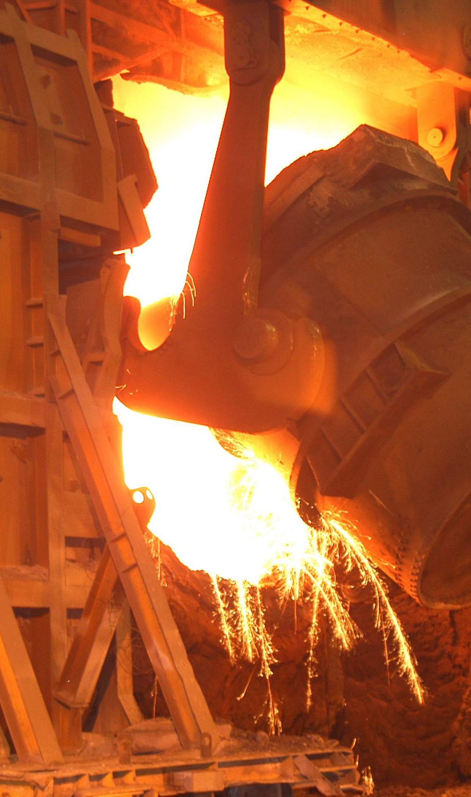
Liquidity Ratio Assessment and Interpretation
Liquidity Shortfall Overview
Liquidity ratios remained below 1.0 from FY23 to FY25, indicating persistent liquidity strains and financing reliance.
FY23 Liquidity Challenges
FY23 current ratio was 0.59, affected by high inventories, low cash and large short-term liabilities.
FY24 Modest Improvement
Liquidity improved to 0.87 in FY24 due to asset growth and liability restructuring but stayed below safe levels..
FY24 decline and Financing Reliance
FY25 liquidity dropped to 0.64, driven by operational losses and heavy use of revolving credit facilities.
Notes:
Liquidity performance over FY23 – FY25 demonstrates consistent shortfall, with current ratios remaining below 1.0 throughout, reflecting significant liquidity strain and reliance on external financing support.
FY23 showed a current ratio of 0.59, reflecting elevated inventories, minimal cash reserves and substantial short-term liabilities. Quick and cash ratios remained particularly weak, demonstrating that the business could not cover immediate liabilities without continuous facility support.
In FY24, liquidity modestly improved to 0.87 due to higher group level current assets and restructuring of short-term liabilities but remained below solvency thresholds. Cash balances remained marginal relative to obligations.
In FY25, the ratio declined again to 0.64, driven by the UK’s transition to the re-roller phase, loss making operations, sustained working capital absorption and heavy utilisation of revolving credit facilities. Receivables securitisation improved headline cash conversion but masked underlying collection dynamics. Overall, liquidity ratios underscore a reliance on continued parent company support, securitisation and government backed financing to ensure business continuity during the transition to Electric Arc Furnace operations.

Slide 8
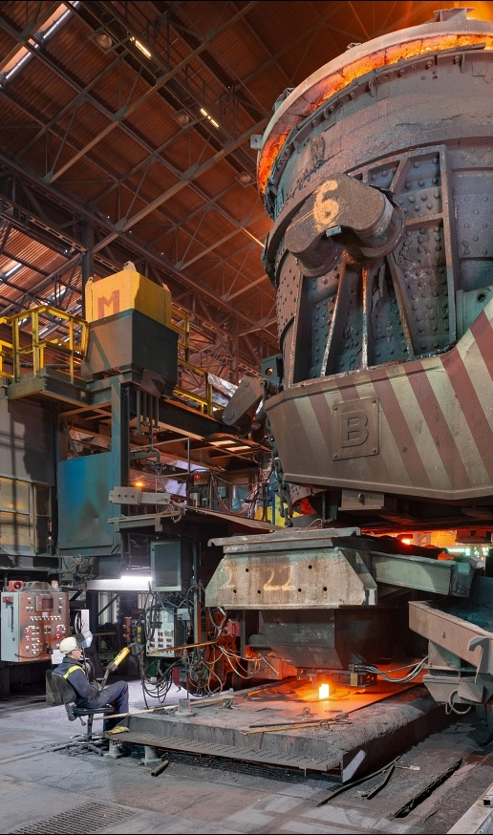
Gearing, Solvency and Capital Structure Dynamics
Escalating Solvency Risks
Gearing ratios reveal growing solvency risks with debt-to-equity rising from 2.81x to 3,01x in FY24.
Negative Interest Coverage
Interest cover sharply declined into negative due to negative EBIT, indicating financial stress by FY24.
Capital Structure Deterioration
By FY25, negative equity caused traditional gearing ratios to be non-meaningful, with debt-to-assets hitting 0.89.
Recovery Dependant on Structural Change
Long-term recovery depends on EAF installation reducing operating costs and improving margins amid restructuring.
Notes:
Gearing ratios across the analysis period reveal escalating solvency risks culminating in severe imbalance by FY25.
In FY23, debt-to-equity stood at 2.81x, with debt representing around 44% of total assets. Net debt remained substantial due to historical investment, working capital requirements and refinancing needs.
By FY24, group level leverage increased further as net debt surged to over £2.6bn, driven by operational losses, restructuring payments and financing needs to maintain liquidity. Debt-to-equity rose to 3.01x, while interest cover fell sharply into negative territory due to negative EBIT.
FY25 marked an inflection point where negative equity produced non-meaningful traditional gearing measures: however, debt-to-assets jumped to 0.89 and net debt remained elevated. The deterioration reflected accumulated losses, asset impairments and the timing mismatch between heavy restructuring outflows and anticipated long-term savings from the decarbonisation strategy.
The solvency analysis demonstrates a business reliant on debt, parent company support and government funding during structural transition, with long-term recovery contingent on EAF installation enabling lower operating costs and improved margins.

Slide 9
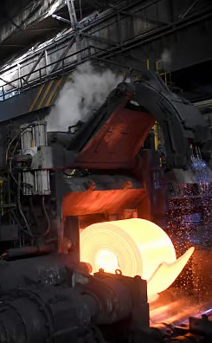
Working Capital Efficiency Ratios
Receivables Management
Receivables days fluctuated due to securitisation programs and group dynamic changes, impacting cash flow timing.
Inventory Levels
Inventory days varied with raw material stocking, production constraints and demand fluctuations affecting stock levels.
Payables Strategy
Extended payables days supported liquidity, with declines reflecting renegotiated supplier terms during restructuring.
Working Capital Impact
Strategic working capital management was key to preserving operational cash flow during restructuring periods..
Notes:
Working capital efficiency varied considerably across the period due to structural, operational and financial policy changes.
FY23 displayed low receivables days of approximately 3.4 days, primarily driven by the company’s receivables securitisation program rather than rapid customer payments. Inventory days were elevated at around 72 days, reflecting raw material stocking practices associated with blast furnace operations. Payables days near 51 signalled extended payment strategies to support liquidity.
In FY24, the group level figures revealed increased inventory days of around 95.5, caused by EU demand slowdown, destocking and production constraints from BF6 outages. Receivables days increased to 14 as group dynamics replaced UK only securitisation dominated patterns. Payables days declined due to renegotiations and changes in supplier terms during restructuring.
By FY25, inventory days returned closer to historical norms, whiles receivables days again fell sharply to around 2 days due to renewed use of securitisation.
The patterns indicate that working capital management served as a critical liquidity tool during the restructuring and transition period, with securitisation, payables management and strategic inventory reduction forming the backbone of operational cashflow preservation.

Slide 10
Investor Ratios

Slide 11

Investor Ratios
Capex Intensity (Capex / Revenue) | FY23 | FY24 | FY25
 | 3.1% | 2.0% | 2.8%
Notes:
Because TSUK is a private entity within Tata Steel Limited, traditional equity market valuation ratios (EPS, P-E, Dividend yield) are not applicable. Instead, capex intensity provides a more meaningful indicator of long-term value creation during the transition to EAF technology. The rising capex intensity in FY25 and the expected step change across FY26>FY28 as the tenova EAF package and site works mobilise, demonstrates strategic investment in future capability rather than short term financial returns.

Slide 12
Capital Investment Appraisal Methods

Slide 13

Capital Investment Appraisal Methods
Net Present Value (NPV) Usage
NPV is applied to major long-term investments, incorporating discounted cash flows for value creation assessment.
Internal Rate of Return
IRR is used for feasibility studies and projects needing clear financial acceptance thresholds amid market volatitlity.
Payback Period for Smaller Projects
Payback period metric measures capital recovery time for smaller operational investments.
Sensitivity and Scenario Analysis
These analyses evaluate risks from steel price volatility, carbon costs and energy market fluctuations.
Notes:
TSUK applies a structured capital investment appraisal framework consistent with Tata Steel Group governance requirements.
The Net Present Value (NPV) technique is used for major long-term investments, including the critical Electric Arc Furnace project, due to its ability to incorporate discounted cash flows and assess long term value creation.
Internal Rate of Return (IRR) is applied to feasibility studies and capital proposals requiring clear thresholds for financial acceptance, particularly in environments characterised by volatile pricing and energy markets. The payback period metric is commonly used for smaller operational projects, providing a simple measure of capital recovery time.
Additionally, sensitivity and scenario analysis play a critical role in TSUK’s appraisal process, given the high exposure to steel price volatility, carbon cost and energy market fluctuations. These appraisal techniques collectively ensure a disciplined allocation of capital, aligning investment decisions with strategic decarbonisation goals and financial risk tolerances.

Slide 14
Working Capital Management Techniques

Slide 15
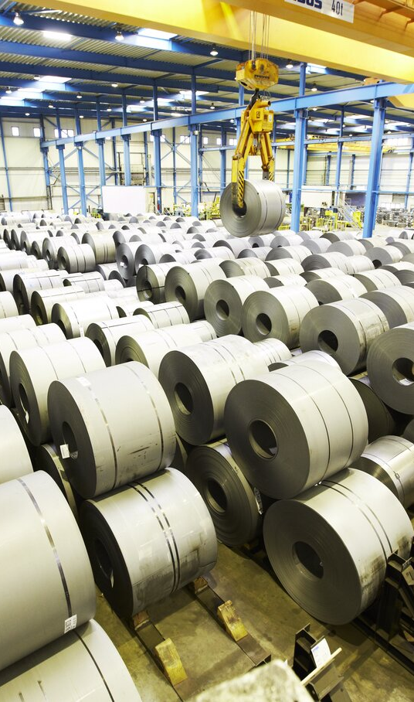
Working Capital Management and Supply Chain Resilience
Liquidity Maximisation
TSUK uses trade receivables securitisation to quickly convert receivables into cash while credit transferring risk.
Supplier Financing Optimisation
Optimising supplier financing by stretching payables and leveraging procurement scale strengthens liquidity.
Inventory Stabilisation
Inventory levels are stabilised during transition to imported materials, ensuring consistent supply amid freight fluctuations.
Efficiency Improvement Program
The ‘Drive to Save’ programme reduces costs and improves procurement efficiency to support supply chain resilience.
Notes:
TSUK maximises liquidity through a non-recourse trade receivables securitisation facility of up to £450 million, enabling rapid conversion of receivables into cash wile transferring credit risk. Supplier financing optimisation, including stretching of payables and leveraging Tata Group procurement scale, further strengthens liquidity.
TSUK also stabilises inventory levels during the shift to imported slab and coil, ensuring consistent input despite fluctuations in global freight markets.
Additionally, the Drive to Save programme enhances efficiency through cost reduction and improved procurement performance. Collectively these mechanisms illustrate how financial techniques can directly support supply chain resilience, innovation and sustainability.

Slide 16
Conclusion

Slide 17
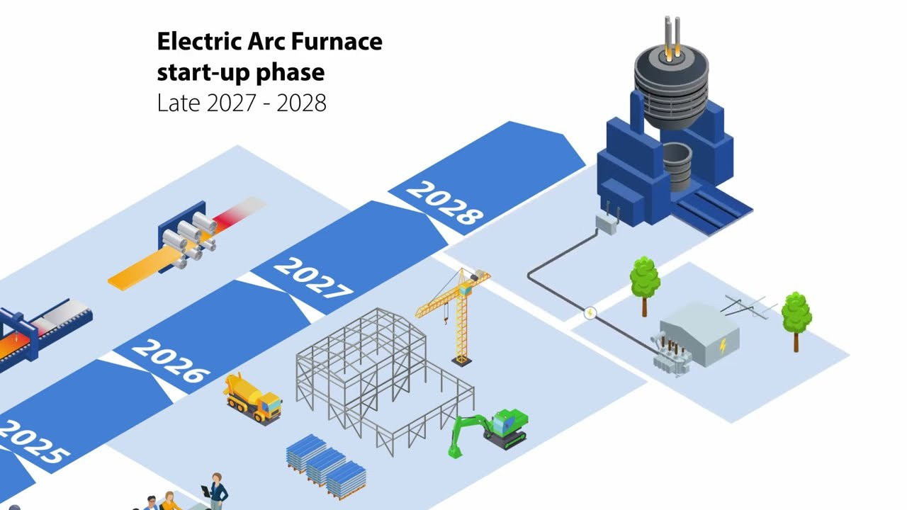
Strategic Summary and Closing Reflections
Legacy Steelmaking Challenges
TSUK’s BOF model faces revenue decline, low utilisation, negative margins and liquidity issues in volatile markets..
Transition to EAF Technology
Switching to EAF technology enables flexibility, decarbonisation and reduces fixed costs in steel production.
Supply Chain Reconfiguration
New supply chain involves imported slabs and scrap feedstock, requiring changes in logistics and inventory management.
Operational Improvements
Enhanced S&OP, dynamic buffer management and digital quality processes strengthen operational performance.
Notes:
Across FY23 to FY25 TSUK’s financial performance demonstrates a clear progression from structural deterioration to early stabilisation., reflecting both challenges of the BOF model and the corrective actions taken during transition.
In FY23, TSUK was still operating a fully integrated blast furnace route, but rising energy and input costs placed pressure on margins and utilisation. Although revenue remained higher than later years, profitability was already negative and working capital metrics such as DIO and CCC signalled strain. TSUK’s cash position was beginning to tighten as liquidity ratios fell below healthy thresholds.
By FY24, financial performance had deteriorated sharply. Revenue contracted further as the heavy end was wound down, utilisation fell and restructuring changes drove margins deeply negative. Liquidity reached its weakest point, with the current ratio dropping to 0.46 and equity turning negative. CCC temporarily improved due to inventory reductions during the wind down. But this was not evidence of operational strength – rather a reflection of forced destocking. TSUK’s cash position was at its most constrained during this year.
In FY25, despite another year of reduced revenue linked to the interim re-roller model, TSUK showed early signs of financial stabilisation. Net losses narrowed significantly as restructuring costs fell away, the equity injection improved balance sheet resilience and working capital discipline reduced operational cash pressure. DIO rose again due to rebuilding buffers for imported slab and coil, but CCC and liquidity were manged more tightly than in FY24. these shifts demonstrate that TSUK has begun strengthening its cash position through both financial restructuring and operational controls.
Looking across the three-year period, the contrast is clear: TSUK moved from structurally loss making, liquidity constrained heavy end operation (FY23/FY24) toward a more stable platform in FY25 supported by capital restructuring and disciplined working capital management.
At the same time the company is laying the groundwork for long term improvement in cash generation through the transition to an Electric Arc Furnace. As the EAF programme accelerates, capex intensity will rise but this investment will fundamentally reshape the cost base – lowering fixed cost exposure, improving flexibility and enabling a more agile supply chain that supports healthier cash in the future.
Ultimately, the period illustrates how TSUK is using both financial restructuring (equity injection, securitisation, tighter liquidity controls) and operational redesign (S&OP integration, dynamic buffers, inbound flow optimisation) to progressively strengthen its cash position while transitioning to a more competitive and sustainable steel model.

Slide 18
Appendix

Slide 19
Key Financial Data
Financial Ratio Summary

Slide 20
Do you have any questions?
        Tata Steel
Department
www.tatasteeleurope.com

