Slide 1
Medical Leadership Programme
2017-2018
Dr. Richard Wheeler
Consultant Cardiologist
Improving the Quality of Emergency Echocardiography and Echo Training for Specialist Registrars at the University Hospital of Wales

Slide 2
Purpose
To achieve >80% cross checking of all emergency scans performed by cardiology registrars at the University Hospital of Wales
A phased introduction ensuring a long term system maintaining quality assurance by June 2018
Establish an enhanced registrar teaching program with supervised echo lists by April 2018

Slide 3
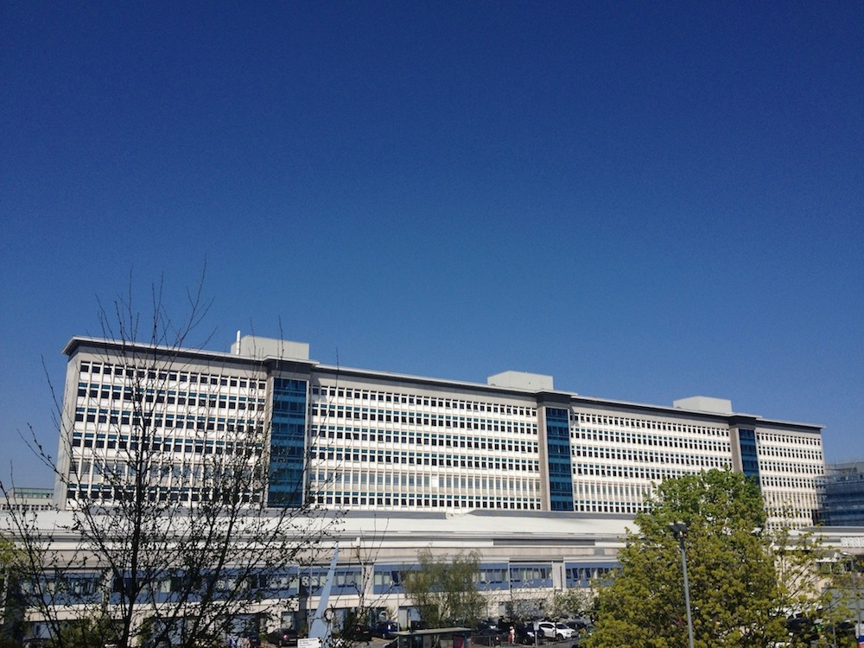
Context
Large Tertiary Cardiac Centre – 1000 beds
750 cardiac surgical operations per year
12 Consultant Cardiologists, 4 Cardiac Surgeons
12 Cardiology Specialist Registrars

Slide 4
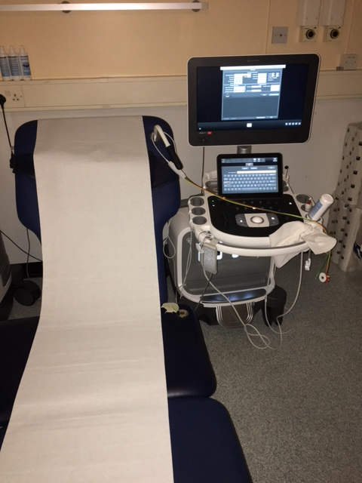
Echocardiography
Ultrasound diagnostic technique
Portable
No ionizing radiation
Applicable to multiple patient groups and diagnoses
Expert acquisition and interpretation are essential

Slide 5
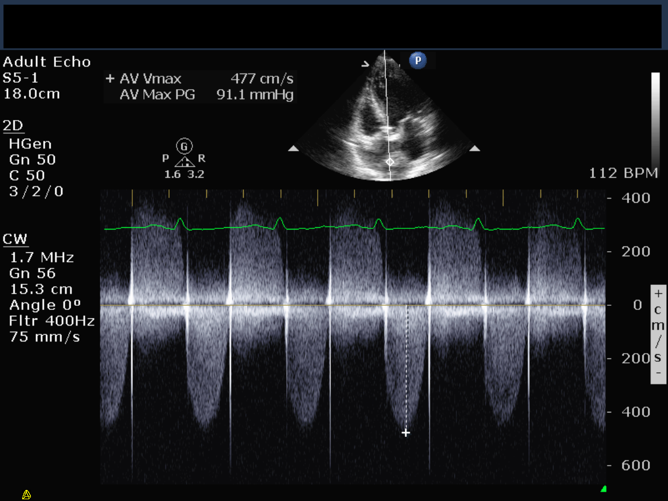
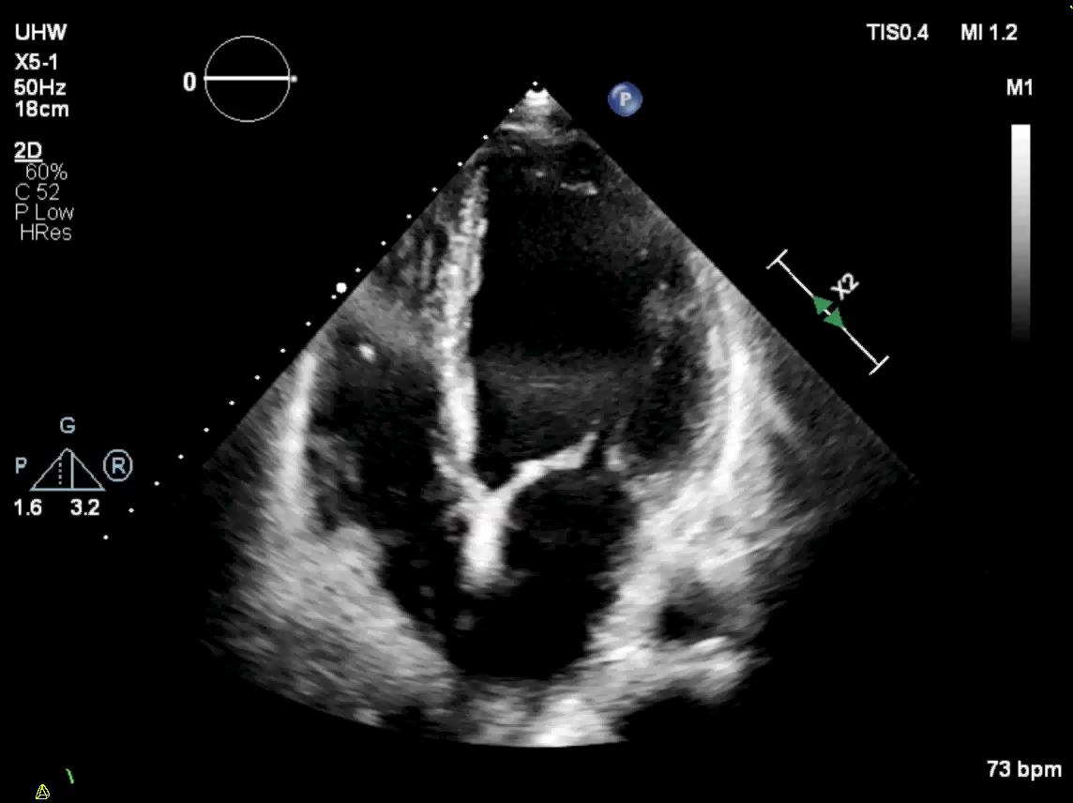
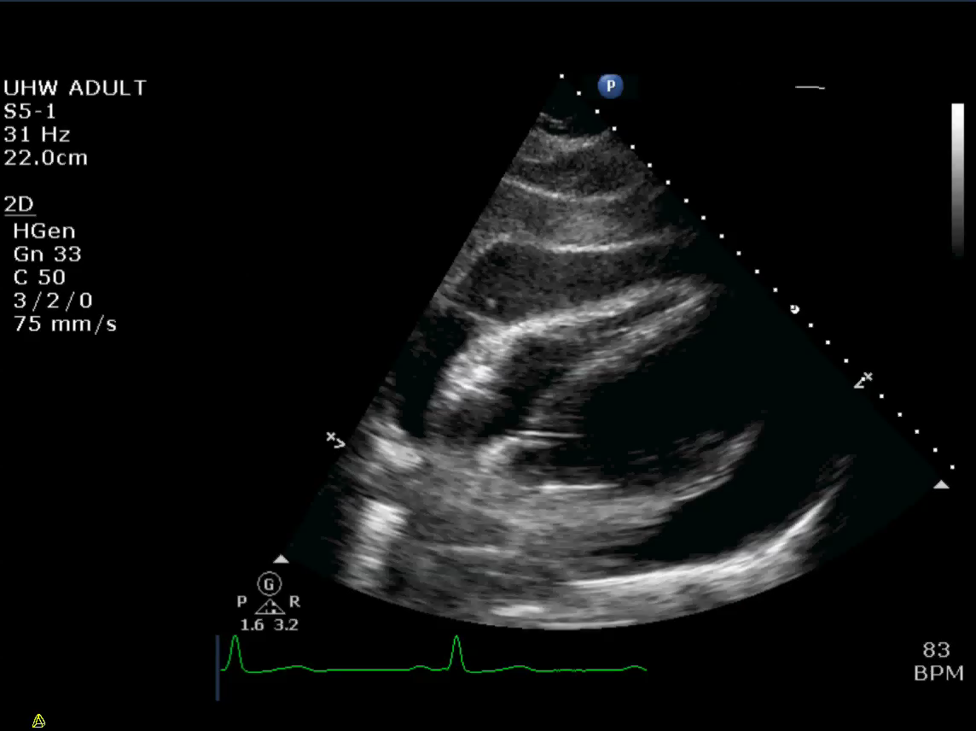
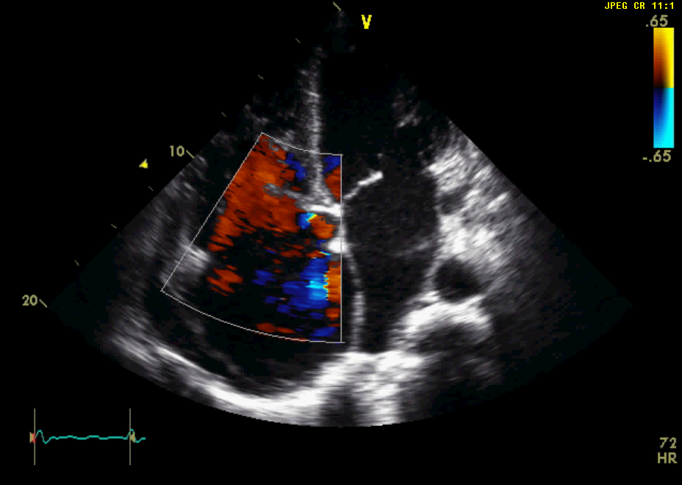

Slide 6
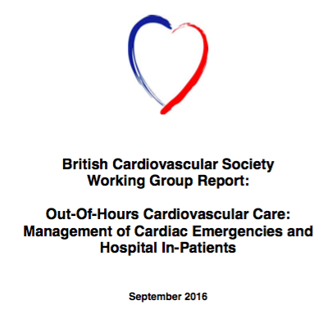
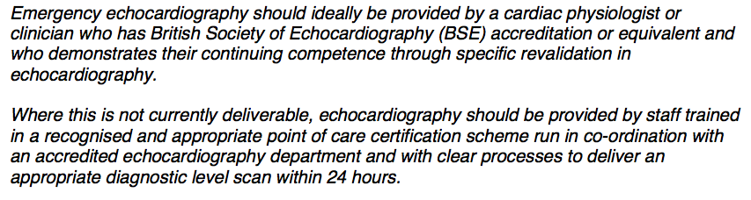
Patient Impact
Large cohort of inpatients who need accurate and early echocardiography
Large number of requests are emergencies occurring day or night
7 day services are a government priority

Slide 7
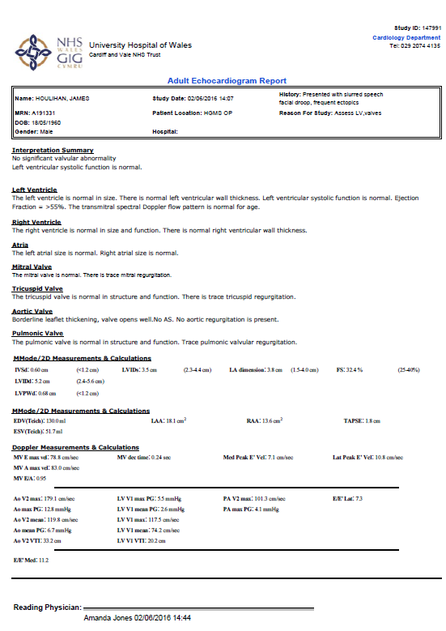
Finalised Report on
Xcelera Database

Slide 8
Key issues
Most routine echocardiography done by well trained cardiac physiologists – accredited
No oncall rota for echocardiography
Majority of urgent/emergency scans delegated to the cardiology registrars
Majority have no accreditation
No active supervision
No routine cross checking of reports

Slide 9
Key issues - continued
Major clinical governance concerns
Major potential clinical risks
Regular adverse feedback regarding the quality of ‘hands on’ echo training
‘Creating a sense of urgency’

Slide 10
Assembling the team
RW
Lead Cardiology Registrar
Management
Consultant Colleagues
Lead Cardiac Physiologist

Slide 11
Driver Diagram
To achieve >80%
cross checked emergency/urgent TTE scans at UHW perfomed by SpRs
Increase the number of finalised TTE scans
on Xcelera
Allocation of cardiac physiologists to review scans
Allocation of Consultants to review scans
Competent trained SpRs
Ensure timely electronic reports on Xcelera
Supervised TTE lists during the working week
Regular teaching meetings

Slide 12
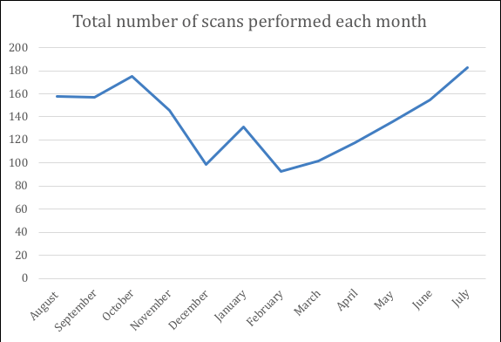
Total number of TTE performed by SpRs from August 2017 – July 2018

Slide 13
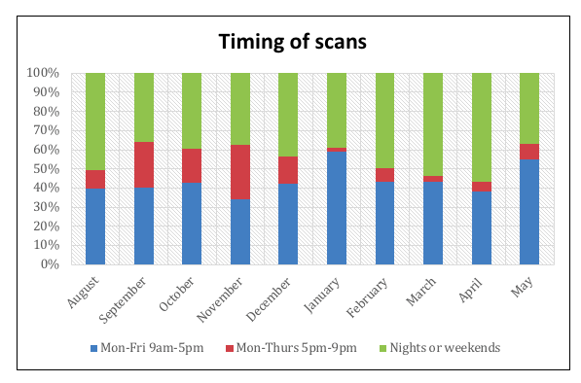
Timing of emergency/urgent scans

Slide 14
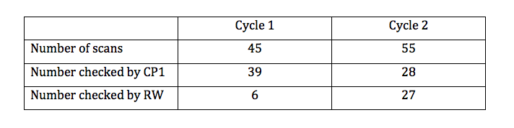
How to introduce a checking system
Cycle 1 – CP1 regular sessions. RW adhoc.
Cycle 2 – CP 1 + RW regular sessions

Slide 15
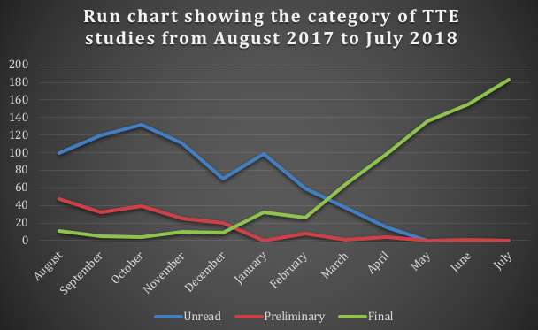

Slide 16
Outcomes
Close to 100% of scans are now checked and are accompanied by an electronic report
Regular supervised scanning lists for registrars in place x3 per week

Slide 17
Problems encountered
Most scans failed to generate a preliminary report
Uncertainty regarding the written report in the notes at the time of the scan
No clinical details, more time consuming
Limited opportunity for direct feedback to trainees
Regular review would allow shorter sessions – less backlog
Is a cross checked report a marker of quality and accuracy ?

Slide 18
Actions going forwards
Always completing an electronic preliminary report straight away
Reporting stations in registrar room
Wireless download of images
Allocated time for lead physiologists and consultants to cross check scans through the week
Regular supervised scanning lists for registrars
Develop the educational/teaching role of senior physiologists
Substudy to look at variance in registrar reports vs cross checked – can we prove the concern re clinical risk

Slide 19
Personal reflections
‘If you do what you always did you get what you always got’ – you have to be proactive
Team interactions – learning to delegate more effectively
‘Benign dictatorship’ – learning to nurture and develop autonomy within the team
Keeping the pressure up – building on the change

Slide 20
Achievements
Cultural shift within the department in relation to the process of emergency echo
Highlighting and reinforcing the importance of exemplary registrar echo teaching
Paving the way for service development with cardiac physiology to develop educational roles

Slide 21
Acknowledgments
Amanda Jones – Senior Cardiac Physiologist
Jason O’Neill – Specialist Registrar Cardiology
Abbas Zaidi – Consultant Cardiologist
Nav Masani – Consultant Cardiologist
Peter O’Callaghan – Clinical Director

