Slide 1
Evidence based policing- week 4
Identifying and analysing evidence
Sadie France
Criminology@uwtsd.ac.uk

Slide 2

Recap the assignment
What is the difference between traditional policing and EBP?
ATLAS
OSARA
Research as an investigation
Critical thinking/ investigative mindset
Scenario's to test our knowledge
Recap from last session

Slide 3
Aims for today's session
Searching for evidence- the 9 pillars
Bias
Problem solving models
Theories of crime
Book in draft sessions!

Slide 4

Searching for existing evidence
What type of research is this known as?
Deploying your search strategy- use keywords!
TASK
Thinking about how you search the internet. You are tasked with finding information on crime prevention in the UK.
A) Write down the number of results if you search using the words crime prevention research.
B) Search again but using the words crime prevention research UK- What happens?
C) Search again using crime prevention research UK Midlands- do the numbers reduce again?
D) Finally, search again this time using "crime prevention research UK". What is the result?

Slide 5
Resource Pillars: catagorising existing research
Over the years EBP research has been conducted and it is not always clear where information and resources are retained.
9 Resource Pillars:-
Government agencies
Academic literature
Law enforcement
Available toolkits
Collaborations
Think tanks
International organisations
Charities and voluntary organisations
Case law

Slide 6

Resource pillars
Access points to these pillars are generally three- fold:-
Online
University library
College of policing (National Police library for serving officers)
The research pillars contain:-
Research and information generated within the UK and relevant to its domestic policing agenda, or research information connected to international law enforcement issues and policy
And
Research information generated outside of the UK, but which is in some way relevant to its domestic policing agenda or to international law enforcement issues and policy.

Slide 7
Being clever with information
TASK
Chose an aspect of policing and then search on the internet to identify any journal article on the topic:-
Open the article and scroll to the end. Have a look at the reference list and familiarise yourself with the literature that the author consulted in order to write the article.
Click on one of the references, and do the same again. You will soon find a host of credible sources for your use.

Slide 8

Managing Information
Is a witness statement always correct?
Is a statement in a book or article always factual/ true?
This is where we employ critical thinking to question the information provided to gain "best evidence".

Slide 9

Group task
You are tasked with a research project of ascertaining whether new drone technology available to police forces replaces the need for Force helicopters. Think about the aspects of drone technology that might be relevant.

Slide 10

What issues may we start to search for?
The technology itself
Any research already conducted regarding the public reaction to using drones.
Any links to the media coverage of drone usage (positive or negative)
The cost of drones versus helicopters
The effectiveness of drone technology versus helicopters
The access to drones within police forces

Slide 11
Researching in this way will guide your reading and your search for information.
This will aid you to easily identify any gaps in knowledge which will aid you to focus on obtaining primary research data to address those gaps.

Slide 12
Tips on keeping on top of the sources of information
Avoid information overload!!
Develop a spreadsheet or table that records the book, author and publishing details plus a free text box for you to note down the pertinent points. This can also be archived for later research!
Always record your sources in alphabetical order according to the authors surname which means you are compiling your resource list as you go along.
Write a brief summation of what you have read either during or immediately after you have finished reading.

Slide 13

Task
Say what you see!
What words come to mind?

Slide 14

Warning
Graphic images !

Slide 15
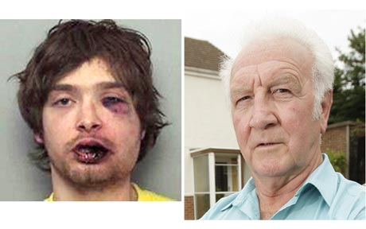

Slide 16
Shout out words that come to your mind

Slide 17


Slide 18


Slide 19


Slide 20


Slide 21

Unconscious bias

Slide 22
What is unconscious bias?
Automatic: Unconscious biases operate automatically, affecting how individuals perceive and react to others without conscious thought or intent.
Involuntary: People may be unaware that they hold these biases, and they can occur even in individuals who consciously reject discriminatory beliefs.
Pervasive: Unconscious biases can influence various aspects of life, including hiring decisions, interactions with colleagues, medical care, law enforcement, and other areas.
Influenced by Stereotypes: These biases are often rooted in stereotypes and preconceived notions about certain groups of people. For example, stereotypes about race, gender, or socioeconomic status can lead to unconscious biases.
Impact on Decision-Making: Unconscious biases can affect decision-making, leading to disparities and unequal treatment in various situations.

Slide 23

Analysing existing evidence
When collecting evidence it is fundamental to maintain integrity and ensure a fair and legal process, including avoiding any bias.
Bias can lead to the misinterpretation of facts, unfair treatment of individuals, and the potential for wrongful convictions

Slide 24

Problem Solving

Slide 25
What is a problem?
A group of incidents occurring in a community that are similar or connected in one or more ways & that are of concern to the public & require a police response

Slide 26
Problem Solving Models
Partnership-Orientated Policing (POPS)
OSARA
PAT (Problem analysis triangle)
PAT (Enhanced)
Routine Activity Theory
Rational Choice Theory

Slide 27

Traditional vs Partnership-Orientated Policing
Pop
Constantly review reports for patterns
• Look for any commonalities that can be addressed
• Look for root cause
• Find solutions to root cause
• Implement solutions
Traditional
• Take a report - officer attends & deals with incident
Take another report - officer attends & deals with incident
• Take yet another report - officer attends & deals with incident
• Random patrols in the hope of finding incident

Slide 28
Partnership-Orientated Problem-Solving
Is a way of thinking that systematically addresses identified problems
It encompasses a set of tools designed to help you understand them
It is about dealing with the conditions that create the problems
It is about identifying who has the expertise to help
It is often about teamwork & leadership

Slide 29

When can POP be used?

Slide 30
Goldstein Theorised …. Partnership-orientated policing (POP)
Underlying conditions create problems
Problems in turn lead to incidents
Many incidents lead to police calls
Incidents appear to be isolated
They can arise from a single common source
Police usually only deal with the symptom of the cause

Slide 31
Key principles of Problem-Oriented Policing include:
Partnerships and Collaboration: POP emphasises collaboration between law enforcement, other government agencies, community organisations, and members of the community. These partnerships help gather diverse perspectives and resources to address complex issues.
Prevention: By addressing the root causes of problems, POP aims to prevent crime and disorder from occurring in the first place. This proactive approach is seen as more effective in the long term than merely reacting to incidents after they occur.
Community Engagement: POP recognises the importance of involving community members in the problem-solving process. Their input helps identify problems, develop solutions, and build trust between police and the community.
Evidence-Based Practices: POP encourages the use of data and research to inform decision-making. Strategies and interventions are developed based on empirical evidence of what works to address specific problems.
Flexibility and Adaptability: Problem-oriented policing acknowledges that each problem and community is unique. As a result, strategies need to be flexible and adaptable to the specific context.
Problem Solving: POP focuses on solving specific problems rather than simply responding to incidents. It encourages police officers to think critically and creatively to develop tailored solutions for each problem.

Slide 32
Barriers to effective Problem-Solving
Failure to recognise the problem
Conceiving the problem too narrowly
Making a hasty choice
Failure to consider all consequences
Failure to consider the feasibility of the solution

Slide 33
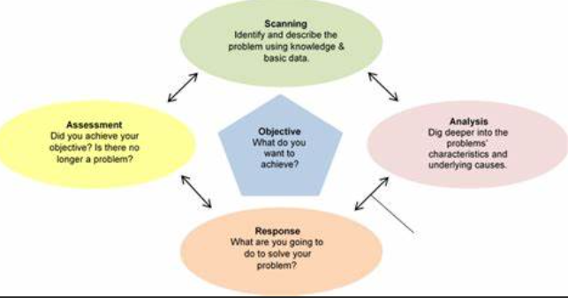
Problem-Solving Models: OSARA
O – Objective S – Scanning A – Analysis R – Response A - Assessment

Slide 34
OSARA Model – Objective
(SMART)
Scanning - Identify problems
Analysis - Understand conditions that cause problems to occur
Response - Develop & implement solutions
Assessment - Determine the impact

Slide 35

SMART
• Specific – target a specific area for improvement.
• Measurable – quantify or at least suggest an indicator of progress.
• Assignable (Achievable) – specify who will do it.
• Realistic – what results can realistically be achieved, given available resources.
• Timely – specify when the results can be achieved

Slide 36
Scanning
Allows incidents to be grouped into clusters or “problems”. These problems comprise similar, related or recurring incidents and are identified from police and partnership data and intelligence and from community information.
The definition of what constitutes a “problem” is deliberately left open as there is an almost endless range of situations where the public may call for help. Incidents may vary in terms of their seriousness, particularly in crime terms, but they are all of concern to the community and many call for a partnership response.
•Problems identified in the scanning phase of the process should not be “one-offs”; they should be problems which have been recurring for some time, certainly over a period of months

Slide 37

Analysis
In this phase, crime reduction practitioners identify the conditions that give rise to a particular problem by examining the characteristics and impact of the problem in greater detail.

Slide 38

Theories that Underpin Problem-Solving
Routine Activity Theory
Repeat (& near repeat) victimisation
Rational Choice Theory
Incident Pattern Theory
Broken Windows
Notes:
Broken-Windows Policing in Action • Broken Windows is not a silver-bullet. You don’t “do” Broken Windows. You act based on community input of disorder, fear, foot patrol, and police discretion. • Broken Windows is problem-solving process of police action. • Broken Windows asks how can police work with the community to reduce fear and create a less criminal environment? “Signal Crime” as a mechanism • The presence of signal crimes [Broken Windows] is more likely to stimulate a decline in levels of social cohesion and collective efficacy by degrading levels of mutual trust and confidence. Signal crimes shape people’s risk perceptions, encouraging higher levels of fear and anxiety. Innes, Martin. 2004. “Signal Crimes and Signal Disorders: Notes on Deviance as Communicative Action.” The British Journal of Sociology. Vol. 55(3) pp. 335-355

Slide 39
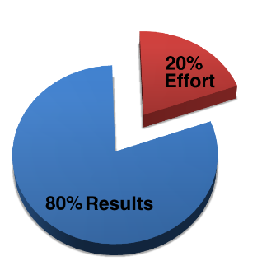
80/20 Rule: The Pareto Principle
This rule argues that typically 80% of unfocussed effort generates only 20% of results
The remaining 80% of results are achieved with only 20% of effort
The Pareto Principle - 80/20 Rule - Do More by Doing Less (animated) - YouTube

Slide 40
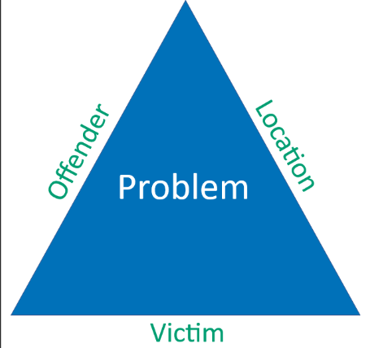
The Problem-Analysis Triangle (PAT)

Slide 41

PAT and SARA Models
Notes:
(28) Problem analysis triangle | Video explainer 7 | Problem solving with the SARA model - YouTube

Slide 42
Task....
Research into Routine Activity Theory (RAT) and answer the following questions:-
What is RAT?
How does RAT explain the occurrence of crime in society?
What is a targeted victim?
What is an opportunistic victim?

Slide 43
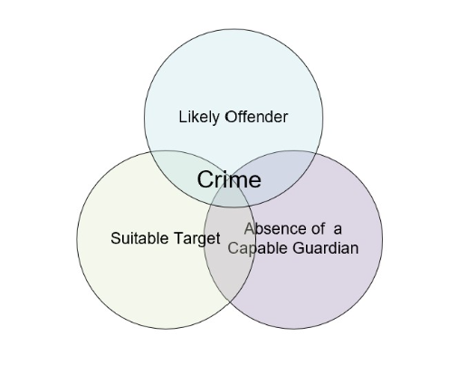
Routine Activity Theory (RAT)
Notes:
The Problem Analysis Triangle is based within the Routine Activity Theory – so lets build upon it.
RAT = WHAT IS OUR RESPONSE? HOW CAN WE REDUCE THE RISK OF THE CRIME(S) OCCURRING? This tool can be used in the Fourth stage of OSARA to identify effective responses. RAT was developed by Marcus Felson, a criminologist who has worked on crime reduction theories for a number of years.
This theory will help you understand why crimes occur by analysing the three elements present when any crime is committed.
RAT is a well known and straightforward explanation that can be used as a practical tool by practitioners in the field. The theory states that in order for a crime to occur 3 things must happen at the same time and in the same place – there is a suitable target, a likely offender and the absence of a capable guardian. •
A SUITABLE TARGET – can be a person, an object, a place. Four things make a target suitable to an offender (click for second box and explain the following):
Value – offender must either value the target for what they may gain from it or value the effect they may have on it. Inertia – how easily can it be removed/moved. Size & weight can affect how suitable it is to the offender. Visibility – how easy is it to see a target will affect how suitable it is. Access – if a potential target is easy to get to, the suitability is increased. •
ABSENCE OF A CAPABLE GUARDIAN – a capable guardian whose presence would discourage a crime from taking place must be absent – examples : police patrols, security guards, Neighbourhood Watch Schemes, door staff, vigilant staff and coworkers, friends and/or neighbours, alarms, CCTV. •
LIKELY OFFENDERS – This is the final element – a crime will only be committed if a likely offender thinks that a target is suitable and a capable guardian is absent. It is their assessment of the situation that determines whether a crime will take place.
To reduce the risk of an offence taking place, you should make sure the 3 elements cannot happen at the same time and in the same place. If you have a potential target but access is denied, the potential offender will be unable to carry out the offence.
Similarly, making sure that there is a capable guardian in place will help to protect the target.
Once you have used RAT to identify which element of a potential crime situation you want to alter to reduce the risk, you can then use the TEN PRINCIPLES OF CRIME PREVENTION to select the exact method. The following principles can be used to be pro-active and therefore prevent crime from occurring in the first instance. Be the “eyes” of the criminal when you look and see the opportunities that can prevent crime and the consequences.

Slide 44
Example of RAT- Burglary
Suitable Target: In this case, the suitable target is a single-family home in the neighbourhood. The homeowners leave for work in the morning, and it's known that the house is vacant during the daytime.
Likely/ Motivated Offender: The likely/ motivated offender could be someone who is looking to steal valuables. They may be familiar with the neighbourhood and the routines of its residents, identifying a potential target of opportunity.
Absence of Capable Guardians: The capable guardians in this context would typically include the homeowners or neighbours who are vigilant and can deter criminal activity. However, in this scenario, the homeowners are at work, and neighbours are not closely monitoring the property.

Slide 45

Targeted victims
Targeted victims are individuals who are specifically chosen or singled out by offenders.
Offenders have a particular victim in mind and actively seek them out.
This may involve premeditated planning and a deliberate focus on a specific individual or group of individuals.

Slide 46

Can you think of any examples?
Stalking
Domestic violence
Hate crimes
Cases where the offender has a personal motive or vendetta against the victim.

Slide 47

Opportunistic victims
Opportunistic victims are victims of crimes of opportunity.
They become victims because they happen to be in the wrong place at the wrong time or because they inadvertently create a favourable opportunity for offenders.
Offenders may not have a specific victim in mind but rather take advantage of the circumstances presented by the victim's routine activities and the absence of capable guardians.

Slide 48

Can you think of any examples?
Property crimes like theft
Burglary
Vandalism
Car theft
Pick pocketing
Shop lifting

Slide 49

Rational Choice Theory

Slide 50
Rational Choice Theory operates on the following key assumptions:
Goal-Oriented Behaviour: Individuals are assumed to have specific goals they want to achieve, whether they are related to financial gain, personal satisfaction, or other objectives.
Weighing Costs and Benefits: People are expected to assess the potential costs and benefits of their actions before making a decision. This includes considering the potential rewards of criminal behaviour as well as the potential risks of getting caught and facing legal consequences.

Slide 51
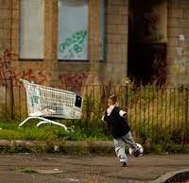
Limited Resources: Individuals are assumed to have limited resources, such as time, money, and energy. As a result, they seek to optimise their choices to achieve their goals efficiently.
Information Processing: Rational actors are believed to gather relevant information and evaluate potential actions based on that information to make informed decisions.
Consistency: Rational Choice Theory assumes that individuals act in a consistent manner, making choices that align with their preferences and goals.

Slide 52
Rational Choice Theory can be applied in several ways:
Crime Prevention Strategies: Law enforcement agencies can design strategies that increase the perceived risks and costs of engaging in criminal activities. For example, visible police presence, security cameras, and effective lighting in high-crime areas can discourage potential criminals by increasing the chances of being caught.
Deterrence Theory: Rational Choice Theory underlies deterrence theory, which suggests that the fear of punishment can deter individuals from engaging in criminal acts. Law enforcement aims to create a credible threat of punishment that outweighs the potential benefits of criminal behaviour.
Situational Crime Prevention: This approach involves altering the environment to make it more difficult for criminals to commit offenses. By increasing the effort required to commit a crime, potential offenders are less likely to proceed.

Slide 53
Target Hardening: This involves implementing security measures that make specific targets less attractive to criminals. For instance, using locks, alarms, and other security measures on homes and vehicles can make them less appealing targets.
Community Policing: Rational Choice Theory also supports community policing efforts, which involve building positive relationships between police and the community. When individuals have more trust in the police and feel connected to their community, they may be more inclined to report criminal activities and cooperate with law enforcement.

Slide 54

Broken window theory
Overall, the Broken Windows Theory has had a significant impact on policing and community development strategies in some areas.
It has led to the adoption of community policing and efforts to address disorder and minor offences in an attempt to create safer and more orderly neighbourhoods.

Slide 55
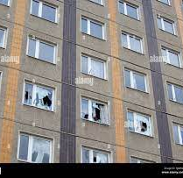
Criminological and social theory that suggests that visible signs of disorder and neglect in an area can lead to an increase in both petty crimes and more serious criminal activities. The theory was first introduced by Wilson and Kelling in a 1982 article titled "Broken Windows: The Police and Neighbourhood Safety."

Slide 56

Key points to Broken Window Theory:-
Visible Signs of Disorder: The theory emphasises the significance of visible signs of disorder in public spaces. For example, if a broken window in a building is not promptly repaired, it sends a message that no one is concerned about the state of the community.
Social Norms and Social Control: The theory suggests that maintaining social norms and social control is essential for preventing crime. When small acts of disorder are left unaddressed, it can undermine the social fabric of a community.

Slide 57

Crime Prevention: By addressing minor signs of disorder and maintaining public order, law enforcement and communities can prevent more serious crimes from occurring. This concept is sometimes referred to as "order maintenance policing."
Community Policing: The Broken Windows Theory encourages community engagement and collaboration with law enforcement to address and prevent signs of disorder and neglect.
Criticism and Controversy: The theory has been both praised and criticised. Critics argue that it can lead to over-policing and harassment of certain communities, as well as potential infringements on civil liberties.

Slide 58
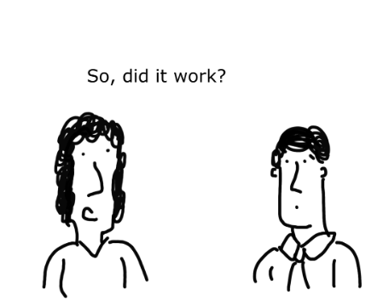
Measuring Effectiveness
Assessment: What’s different?
Did the problem decline?
If so, did the response cause the decline?

Slide 59

Any Questions?

Slide 60

Next week- Draft session
Appointments ONLY

