Slide 1

Working with children in a social care setting
Student name: Ana Persida Corcan
Student id: 2133068
Module code: LCHS4006
Module name: Phycology in HSC
Lecturer name: Joanne Davies

Slide 2
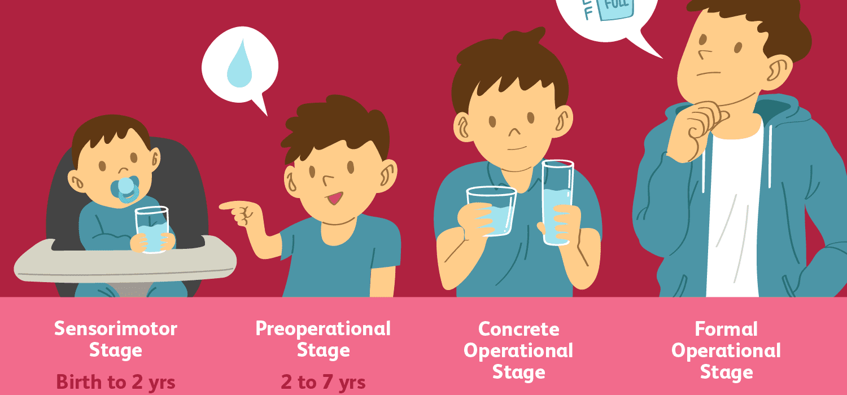
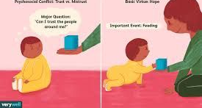
Introduction
This presentation is about two creche activities for children aged 0-2, who lives with their mother in a women's refuge center.
The activities have the purpose to help the children to develop and keep them occupied as their mothers are in their weekly support sessions.
This activities will be linked to the Piaget Theory of development.
Hopefully, children would be able to develop through those activities and gain more confidence, develop new friendships, social and emotional growth, and self-esteem.
This presentation have two creche activities who would be linked to Piaget theory, conclusion and reference list.
Verrywellmind.com

Slide 3

0-2 aged children
0-2 is the age range for the next activities proposed, by using the Piaget theory that” from birth we are involved in the process of learning”. According to Piaget, older children are capable of thoughts that youngest not.
Piaget theory of development had a big impact in understanding of children growth, and there are his 4 stages of cognitive development:
Sensorimotor (aged 0-2 years)
Preoperational ( aged 2-6 years)
Concreate operational (aged 7-12 years)
Formal operational ( aged 12-adult)
Kids are constantly exploring and experimenting as they understand how the world works. Early stage of life, infants are exploring through the sensorimotor, using the primitive skills, that are gifted by birth. Progressing in life, the infant is developing the mind by accessing his motor perception and gain new skills, that would help for the next stage of life.

Slide 4

Proposed activities 1
1.Playing with blocks: Blocks helps children to develop the creativity, develop new friendships, self-esteem and imagination. Is a verry common game that parents and teachers can use it for entertain but the same time educate them and help them to learn new things such as mathematics, science, creativity and more.
Parents and teacher can use this game to stimulate the brain of the infants, and give them the opportunity to discover new ideas, new challenges, and memory skills.

Slide 5

How the theory relate to activity1
The Piaget theory is relating with the 1 activity as children explore through direct sensory (tach, see, smell, hear), playing with blocks enable the imagination and creativity of kids and demonstrate what they are learning across language. It is known as “object permanence” and enable the child to predict and learn even if it takes a while for a baby to do so. According to Piaget object permanence is the most important in sensorimotor stage of development.

Slide 6

Peek-a-boo activity 2
To play this game, is necessary that a person hide behind something and appear suddenly. The baby will laugh or even response, but always the baby would act socked when the person reappears. The infant understanding of the world is very limited, comparing with an older infant who understand the object permanence that the person or object continued to existing even when unseen.

Slide 7
Relating between the activity 2 and the Piaget theory
The peek-a-boo activity is a classic example, of how during this early stage, an infant knowledge from the world is limited to his sensory perception and motor activities. During this stage of development kids take an active role, as they continuously develop the understanding of the world.
Piaget theory is related to this activity, as infants are exploring through the sensorimotor using the skills that they already are born with and develop them progressing to the next stage of development.

Slide 8

conclusion
The activities for children aged 0-2, who lives with their mother in a women refuge Centre, would help them develop and accomplish the sensorimotor stage of cognitive development. Piaget suggest that children progress through a series of four stages of development: sensorimotor( explore through direct sensory: see, hear, smell, touch), preoperational( the child has ability to pretend, can use symbols, words), concreate operational( the child think logically, understanding conversation), and formal operational( think hypothetically).
These stages enclose mental development and gives children the abilities they need as they progress into the next stage of life.
The Piaget theory can be related to these activities ( playing with blooks, and peek-a-boo), because the sensorimotor stage serve an important step in child development and allow the infant to interact and build cognizance of themselves and what is around them.

Slide 9

Reference list:
1. Boyd, (2019), Lifespan development (Bee, Ed.; Eight, Global edition., p. 598p.), Pearson.
2. Gross, R.J. (2015) Psychology : the science of mind and behaviour . Seventh edition. London, [England] :, Hodder Education.
3. Gillibrand, R. (2016) Developmental psychology . Second edition. Harlow, England :, Pearson.
4. Halpenny, A.M. (2013) Introducing Piaget [electronic resource] : A guide for practitioners and students in early years education. Hoboken :, Taylor and Francis.
5. Eysenck, M.W. (2015) Cognitive psychology [electronic resource] : a student’s handbook . 7th ed. Hove :, Psychology P.
6.

