Slide 1
LCLM4006:
Enterprise and Entrepreneurship
Raising Finance
Teaching Team
Fouziya Farheen
Trinh Nguyen Thi Ngoc
Taonga Kaonga Sobere-Snithers
Ejike Udeogu
Chung Lai Johnny Wan

Slide 2
LCLM4006: Enterprise & Entrepreneurship
Recap of previous session….
We
Explored the business environment, industry/sector, and competitors.
Explained and applied the PESTEL analysis

Slide 3
LCLM4006: Enterprise & Entrepreneurship
In today’s session….
We will:
Explore the different finance options for SMEs/Startups
Apply theory to practice by looking at your funding choices.
Work on your Cash Flow for your business idea.

Slide 4
Share your thoughts
What is Funding, and why is it important in business?

Slide 5
LCLM4006: Enterprise & Entrepreneurship
Raising funding
One of the unique talents of entrepreneurs is finding the resources to launch their business ideas.
Funding means… MONEY and it is a resource that plays a crucial part in all entrepreneurial journeys.
Funding refers to the money required to start and run a business. It is a financial investment in a company for product development, manufacturing, expansion, sales and marketing, office spaces, and inventory.
Anyone might have a great business idea but…..without the necessary funding…it will remain a great idea only…….

Slide 6
LCLM4006: Enterprise & Entrepreneurship
Raising funding
Whether it is a small bakery or a large tech company, every business needs money at different stages, and how they get that money can impact their success.
There are many different types of funding/ finance available, especially in the UK.
And entrepreneurs can access these funding options both to start their business ideas or to grow their existing companies.

Slide 7
LCLM4006:
Enterprise and Entrepreneurship
Potential Sources of Business Funding

Slide 8
LCLM4006: Enterprise & Entrepreneurship
Raising funding
Government (national/local) backed loans or grants
Crowdfunding
Business loans (commercial Banks)
Family and friends
Angel investors
Venture capitalists
Personal funding
Bootstrapping

Slide 9
LCLM4006: Enterprise & Entrepreneurship
Government loan/grants
Government (national/local) backed loans or grants
Governments around the world, nationally or locally through the councils provide finance to startups or existing firms in form of loans or grants.
Government backed loans usually have much lower interest rates compare to the loans from commercial banks.
Grants are usually small amounts that startups do not need to pay back.

Slide 10
LCLM4006: Enterprise & Entrepreneurship
Government-Backed Loans and Grants
Start Up Loans:
  The UK government offers unsecured personal loans ranging from £500 to £25,000 to start or grow your business.
  Successful applicants also receive up to 12 months of free mentoring.
  Government Loan Application
Finance and Support for Your Business:
  A comprehensive directory of government-backed financial support, including grants and loans, tailored to various business needs.
  Finance and Support

Slide 11
Group Activity
Split into groups of 3-5, discuss and identify three pros and cons of government loans and grants for SMEs.
Be ready to share your points with the class.

Slide 12
Crowdfunding
LCLM4006: Enterprise & Entrepreneurship
Crowdfunding allows small business owners or startups to sell shares in their companies in exchange for funding.
Through Crowdfunding anyone can make a micro investment in a new business that interests them.
Large numbers of people can invest small, affordable amounts into any existing firm or startup & can raise significant amounts.
Usually through online platforms that charge a fee

Slide 13
Benefits and Drawbacks of Crowdfunding
Benefits | Drawbacks
Access to funding without traditional loans | Highly competitive and crowded platforms
Validates your business through public support | Many platforms operate an all-or-nothing funding model
Builds a loyal community of supporters | Time-consuming to create and manage a campaign
Increase marketing and brand visibility | No guarantee of reaching funding target

Slide 14
Crowdfunding Platforms
LCLM4006: Enterprise & Entrepreneurship
Crowd for Angels:
  A UK-based crowdfunding platform authorized by the Financial Conduct Authority (FCA), offering investment opportunities through shares, bonds, or tokens.
  Crowd-For-Angels
SyndicateRoom:
  An equity-based crowdfunding site that helps startups raise capital from angel investors and venture capitalists.
Crowdfunding-Site

Slide 15
Business loans (Banks)
LCLM4006: Enterprise & Entrepreneurship
Business loans from commercial Banks can be a traditional route of entrepreneurial funding- but it is not always easy- a lot of paperwork.
Can be in a form of unsecured or secured business loans
The latter (secure business loan) will require collateral or a guarantor.

Slide 16
Business Loans from Commercial Banks
LCLM4006: Enterprise & Entrepreneurship
Barclays Business Loans:
  Offers various financing options tailored to business needs.
Lloyds Bank Business Loans:
  Provides a range of business loans with flexible terms.
NatWest Business Loans:
  Features different loan options to support business growth.

Slide 17
Group Activity
In groups of 3-5, search online for at least three advantages and three disadvantages of getting a business loan from commercial banks.
One person from your group will present the findings to the class

Slide 18
Family & Friends
LCLM4006: Enterprise & Entrepreneurship
Funding through family and friends.
Very common way of entrepreneurial funding in developing countries.
Requires strong family connections. It can be difficult to control the family dynamic at a later stage, but is a very straight forward funding option.
Example- Easyjet- Sir Stelios Haji-Ioannou secured a £5 million loan from his father.

Slide 19
Business Angels investors
LCLM4006: Enterprise & Entrepreneurship
Business angels are investors that invests their own money in a small business in exchange for a minority stake (usually between 10% and 25%).
Business angels will not offer only the investment, but also the mentoring and support to grow the business idea.
Business angel investors tend to be entrepreneurs or people with extensive experience in the business world.
Success or growth is not guarantee as a result of the investment offer.

Slide 20
Angels investors Link
LCLM4006: Enterprise & Entrepreneurship
Business angels
UK Business Angels Association (UKBAA):
  The national trade association for angel and early-stage investment, offering resources to connect with potential investors.
Angels Den:
  An online investment platform that connects businesses with angel investors.
  Angel investors | British Business Bank

Slide 21
Venture capitalists
LCLM4006: Enterprise & Entrepreneurship
Venture Capitalists are investors that fund early-stage firms to help them grow.
Similarly, as the business angels they offer advice and strategic mentorship as well as funding.
They VC investment is often time limited as they expect the companies they fund to grow significantly and make a significant return on their investment.
Could raise millions and requires proof of concept.

Slide 22
Venture capitalists Link
LCLM4006: Enterprise & Entrepreneurship
British Private Equity & Venture Capital Association (BVCA):
  Provides information on venture capital firms operating in the UK.

Slide 23
Personal funding
LCLM4006: Enterprise & Entrepreneurship
Personal funding means funding raised by the individual entrepreneur.
Someone could have worked for several years and saved up a sum of money that is invested to their business idea.
Other examples:
Retired individuals can use their retirement funds to start their business ideas.
Individuals that been made redundant can use their redundancy pay to start their business ideas.

Slide 24
Bootstrapping
LCLM4006: Enterprise & Entrepreneurship
Bootstrapping in the startup context refers to
  the process of launching and growing a business without external help or capital.
Bootstrapping.. means operating a company as economically as possible and cutting all unnecessary expenses.
Bootstrapping involves:
  hiring as few employees as possible
  leasing anything you can & being creative
  asking suppliers to allow longer payments terms & in some instances ask customers to pay in advance etc.

Slide 25
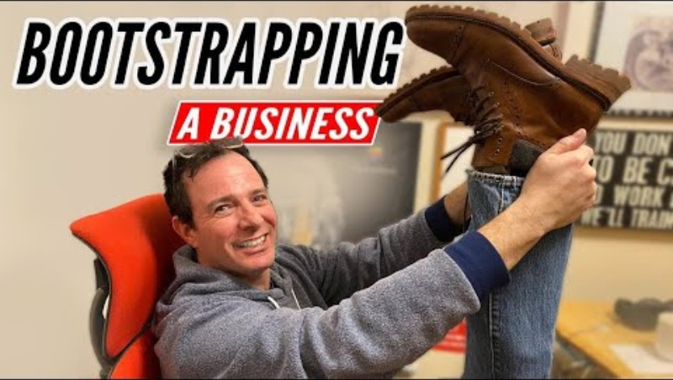
How to Bootstrap a Business

Slide 26
Raising Finance
LCLM4006: Enterprise & Entrepreneurship
Classroom discussion:
Reflecting on the different funding sources we learned, please choose two funding options that you would use to start your own business idea and tell the class why you selected these two.

Slide 27
Is not all about out money!
LCLM4006: Enterprise & Entrepreneurship
Let's look at the 25 UK entrepreneurs that started with very little money:
https://www.thisismoney.co.uk/money/smallbusiness/article-2809685/Top-25-self-entrepreneurs-started-small-sums-money.html
Choose any two entrepreneurs who inspire you and explain why you picked them.

Slide 28
LCLM4006: Enterprise & Entrepreneurship
Entrepreneur case study- GymShark
Let's read about high grow company GymShark- this Young entrepreneur started from his garage!
https://www.thisisnotfinancialadvice.co.uk/p/from-garage-to-global-the-incredible
https://www.benfrancis.com/business/how-i-started-the-uks-fastest-growing-company/

Slide 29
LCLM4006:
Enterprise and Entrepreneurship
Cash Flow

Slide 30
Cash flow
Cash flow in business refers to the amount of cash/money that comes into and out of a company over a particular period of time.
Cash flow helps you to plan and manage your financial resources.
A cash flow forecast gives you insight into the likely future state of your business.
You can make decisions before they become critical.

Slide 31
Cash flow
Cash inflow is the money that comes into a business. It increases the company’s cash balance and helps cover expenses, invest in growth, or save for the future. Example: Customer payments, loans, sales revenue, etc.
A strong cash inflow is essential for a business to survive, grow and succeed.

Slide 32
Cash flow
Cash outflow is the money that a business spends. It flows out of the business to pay various costs and expenses. Examples are operating expenses, loan repayment, taxes and fees, etc.
It reflects how much the business is spending.
Helps track and control business costs.
Must be balanced with cash inflow to running out of money.

Slide 33
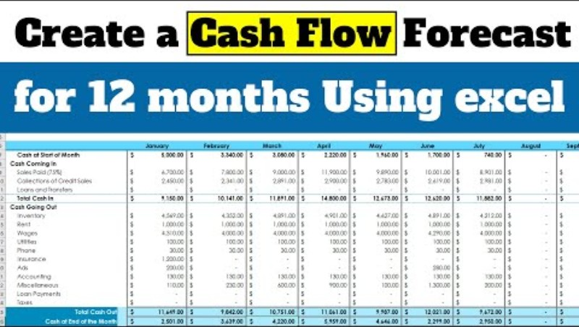
Cash flow

Slide 34
Cash flow
LCLM4006: Enterprise & Entrepreneurship
To be successful entrepreneur you need to be able to control the finance of your company.
You need to specify the amount of funding you are required and specify the funding source/s and why. In addition, outline the main startup expenses expected during the first month of operations.
A Cash Flow template is provided, please check in Moodle.
Use this template and attach it in your assignments.

Slide 35
Cash flow Practical activity 30 minutes
LCLM4006: Enterprise & Entrepreneurship
Let’s explore the Cash flow template from Moodle and try in the next 30 minutes to fill some of the costs or sales figures.

Slide 36

Do you have any ……
LCLM4006: Enterprise & Entrepreneurship

Slide 37
Thank you

Slide 38

Next week…..
We will learn about
Assessment workshop

Slide 39
References
Barrow, Barrow, P., & Brown, R. (2012). The business plan workbook (7th ed.). Kogan Page.
Mariotti, S., & Glackin, C., (2017). Entrepreneurship: Starting and Operating A Small Business, 4th Edition, Pearson.

