Slide 1
BA (Hons) Leadership and Management Skills in the Workplace Managing Projects in the Workplace
Module Code: BMSW5104
Student Name’s:
George Giuliano Mihai - 2027230
Cristian Dumitru -2108821
Dan Dumitru -2025728
Lecturer: Abel Agoba

Slide 2
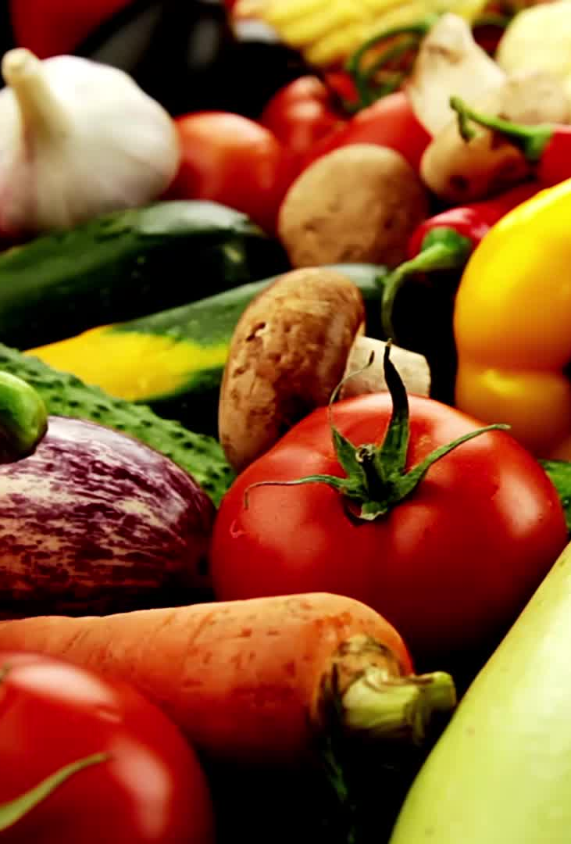
Incredible Vegetables

Slide 3
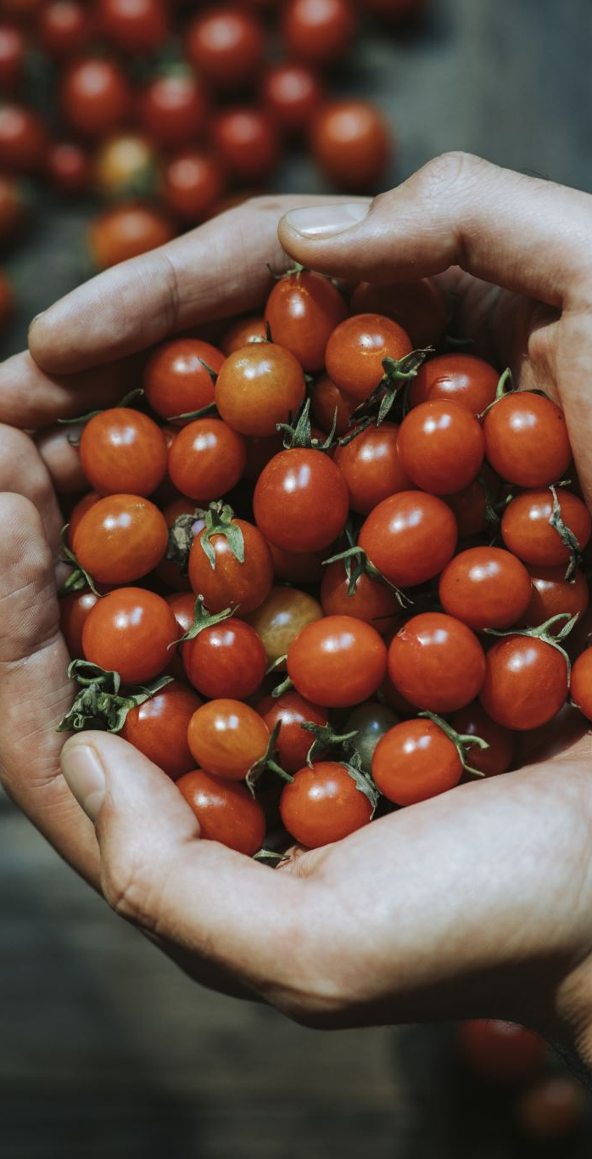
Introduction
Establish a tomato cultivation operation using sustainable and efficient practices.
Maximize yield, quality, and profitability of tomatoes through careful seed selection and propagation.
Focus on growing the most flavorful tomatoes in the UK within the allocated budget and special area.
Challenge norms of vegetable cultivation by sourcing and distributing rare and exotic tomato varieties.
Inspire individuals and communities to explore the world of unusual and fascinating edible plants.
Promote biodiversity and sustainable farming practices in the tomato cultivation process.

Slide 4

Scope of the Project
Establish and operate a company dedicated to tomato cultivation and production.
Select appropriate tomato varieties and implement efficient cultivation practices.
Manage irrigation, fertilization, pest, and disease control to ensure optimal growing conditions.
Implement post-harvest management practices to preserve the quality of the tomatoes.
Develop marketing strategies to effectively promote and sell the tomatoes.
Focus on sustainability and profitability in all aspects of the project.

Slide 5

Stakeholders Analysis for a Company Growing Tomatoes
Farmers and Owners: Maximize crop yield, quality, and financial sustainability.
Employees and Laborers: Fair wages, job security, safe working conditions, and growth opportunities.
Suppliers: Strong business relationships, timely payments, and reliable demand.
Customers: High-quality tomatoes, timely delivery, competitive pricing, and consistent supply.
Local Community: Environmental impact, job creation, and contributions to the local economy.
Regulatory Authorities: Compliance with regulations, permits, and transparent operations.

Slide 6
PESTLE Analysis
Political | Economical | Social | Technological | Legal | Environmental
-Government policies and regulations can impact operations and compliance requirement.
- Economic conditions and trends can affect production costs and consumer purchasing power.
- Consumer preferences and cultural practices can impact market demand and product positioning.
- Technological advancements can enhance productivity and efficiency in tomato cultivation.
- Climate patterns and environmental regulations can affect crop yields and farming practices.
- Compliance with agricultural and food safety regulations is essential for legal operations.

Slide 7
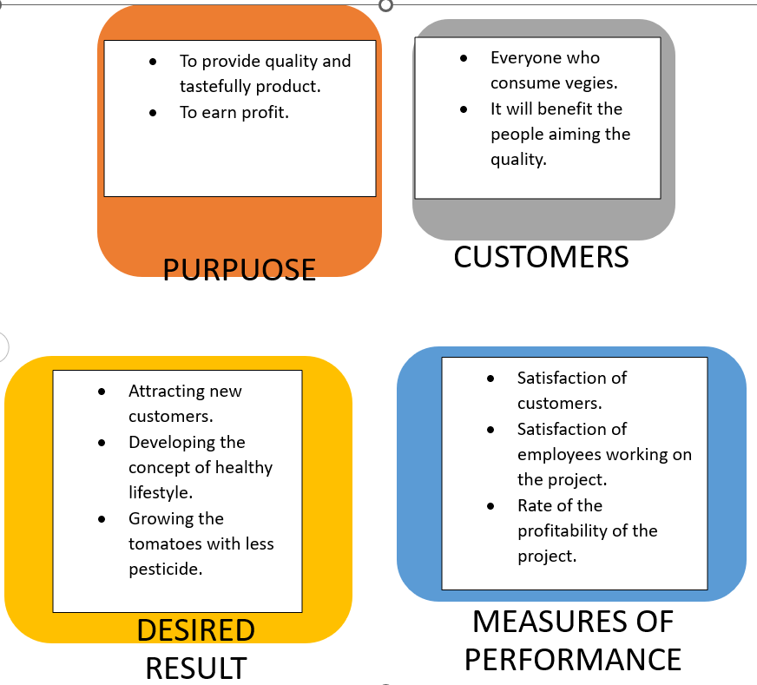
Quad Chart
The Quad chart is a common name for technical documentation that shows the project's goal, target audience, expected outcomes, and success metrics (Kaufman, 2021). However the explaneison is can be seen below, has been made based on the Analysis above PESTLE and STAKEHOLDERS.

Slide 8
Risk Assessment
Market Risk: Fluctuations in tomato prices due to changes in demand, supply, or market conditions.
Environmental Risk: Competition from other tomato growers or substitute products in the market.
Operational Risk: Equipment breakdown or failure, leading to disruptions in farming activities.
Supply Chain Risk: Disruptions in the supply of inputs, such as seeds, fertilizers, pesticides, or packaging materials.
Issues with transportation, logistics, or delays in delivering tomatoes to customers.
Financial Risk: Fluctuations in input costs, such as labor, fertilizers, or fuel prices, impacting production expenses.
Reputation Risk: Negative publicity or product recalls due to food safety incidents or quality issues, leading to damage to the company's reputation and customer loyalty.

Slide 9
Market risk Environmental Risk Operational Risk
Decision making
Supply Chain Risk Financial Risk Reputation Risk
Source: (Zwikael, 2016)

Slide 10

Conclusion
Overall, the project to grow tomatoes aims to deliver high-quality, sustainable, and profitable tomato production. By considering the insights from the stakeholder analysis, PESTLE analysis, quad chart, and risk assessment, the company can make informed decisions and take proactive steps to overcome challenges and achieve its goals.

Slide 11

Thank you
This Photo by Unknown Author is licensed under CC BY-NC-ND

Slide 12
Reference List
Kaufman, G., 2021. Displaying parenthood, (un)doing gender: parental leave, daycare and working-time adjustments in Sweden and the UK. Families, Relationships and Societies, 10(2), pp.213-229.
Zwikael, O., 2016. International journal of project management special issue on “project benefits management”. International Journal of Project Management, 34(4), pp.734-735.
Torres 4, 2020. Risk Assessment for Tomato Fruitworm in Processing Tomato Crop-Egg Location and Sequential Sampling. [Online]
Available at: https://www.mdpi.com/2075-4450/12/1/13
FRUE, K., 2020. PEST Analysis Ultimate Guide: Definition, Template, Examples. [Online]
Available at: https://pestleanalysis.com/pest-analysis/
George., T., 2023. What Is a Fishbone Diagram? | Templates & Examples. [Online]
Available at: https://www.scribbr.co.uk/the-research-process/fishbone-diagrams/

