Slide 1
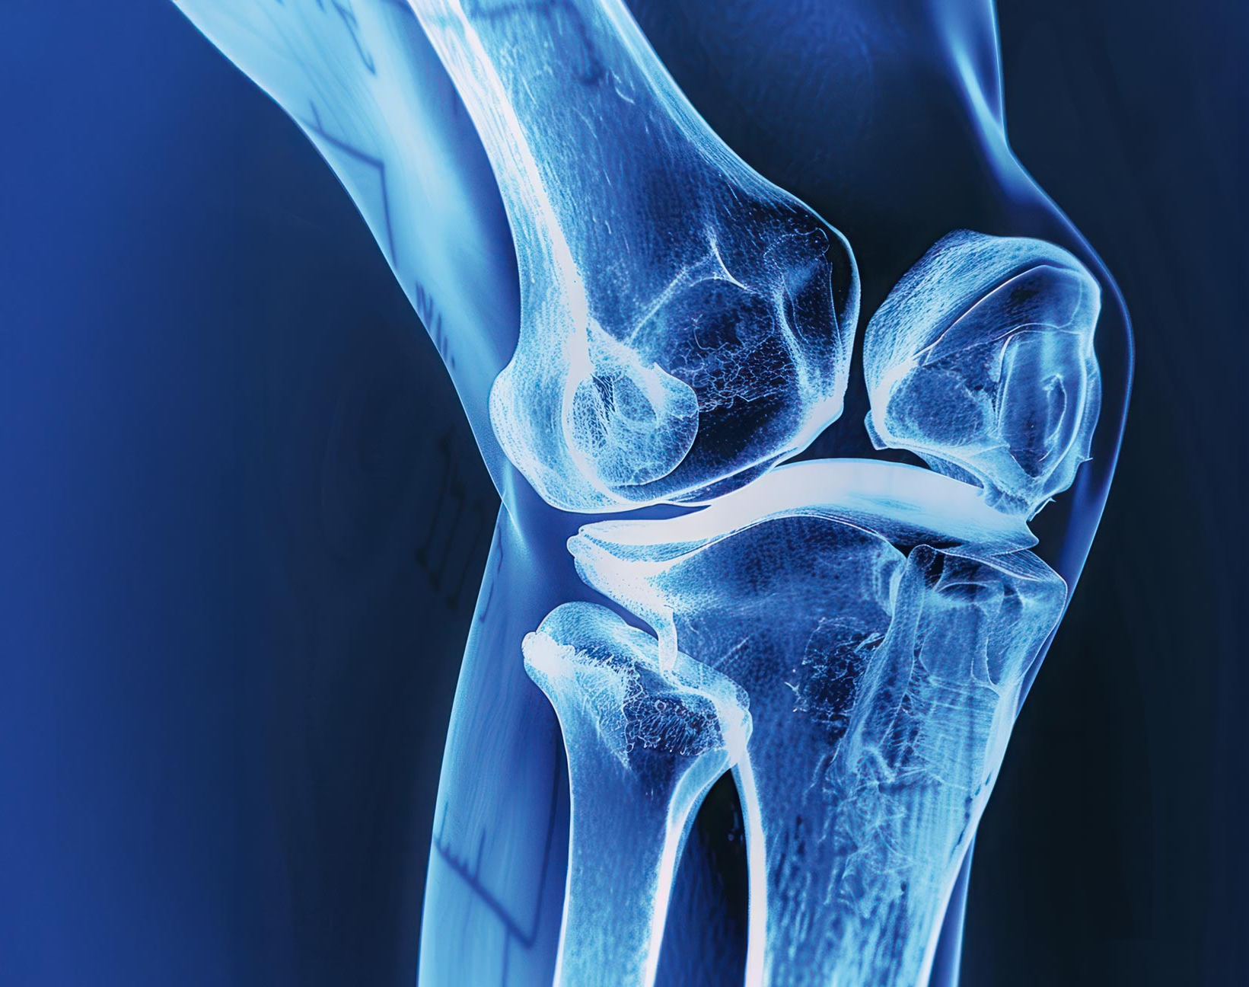

A Care Plan for a Fictional Patient with Knee Osteoarthritis
BMHP5023 COMPONENT 2
Introduction to Physiology
2334944 - Kwadwo Adjei Brempong

Slide 2
The Musculoskeletal System
The musculoskeletal system provides body structure, support, and mobility.
Kenhub (2015) explains that the human body consists of bones, joints, muscles, tendons, ligaments, and cartilage that function together to allow humans to stand, walk, and perform daily tasks.
These structures provide a framework that protects important organs while also allowing for regulated movement of various bodily parts (Healthdirect, 2026).
This presentation focuses on the knee joint, which is typically afflicted by osteoarthritis (GOV.UK, 2012).
Notes:
The musculoskeletal system is the structure that enables the body to stand, move, and maintain stability. It consists of bones, joints, muscles, tendons, ligaments, and cartilage, all of which work together to maintain posture and mobility. Bones and joints protect organs and direct movement, whereas muscles pull on bones via tendons. In this talk, I will use the knee joint as a fundamental illustration of osteoarthritis.

Slide 3
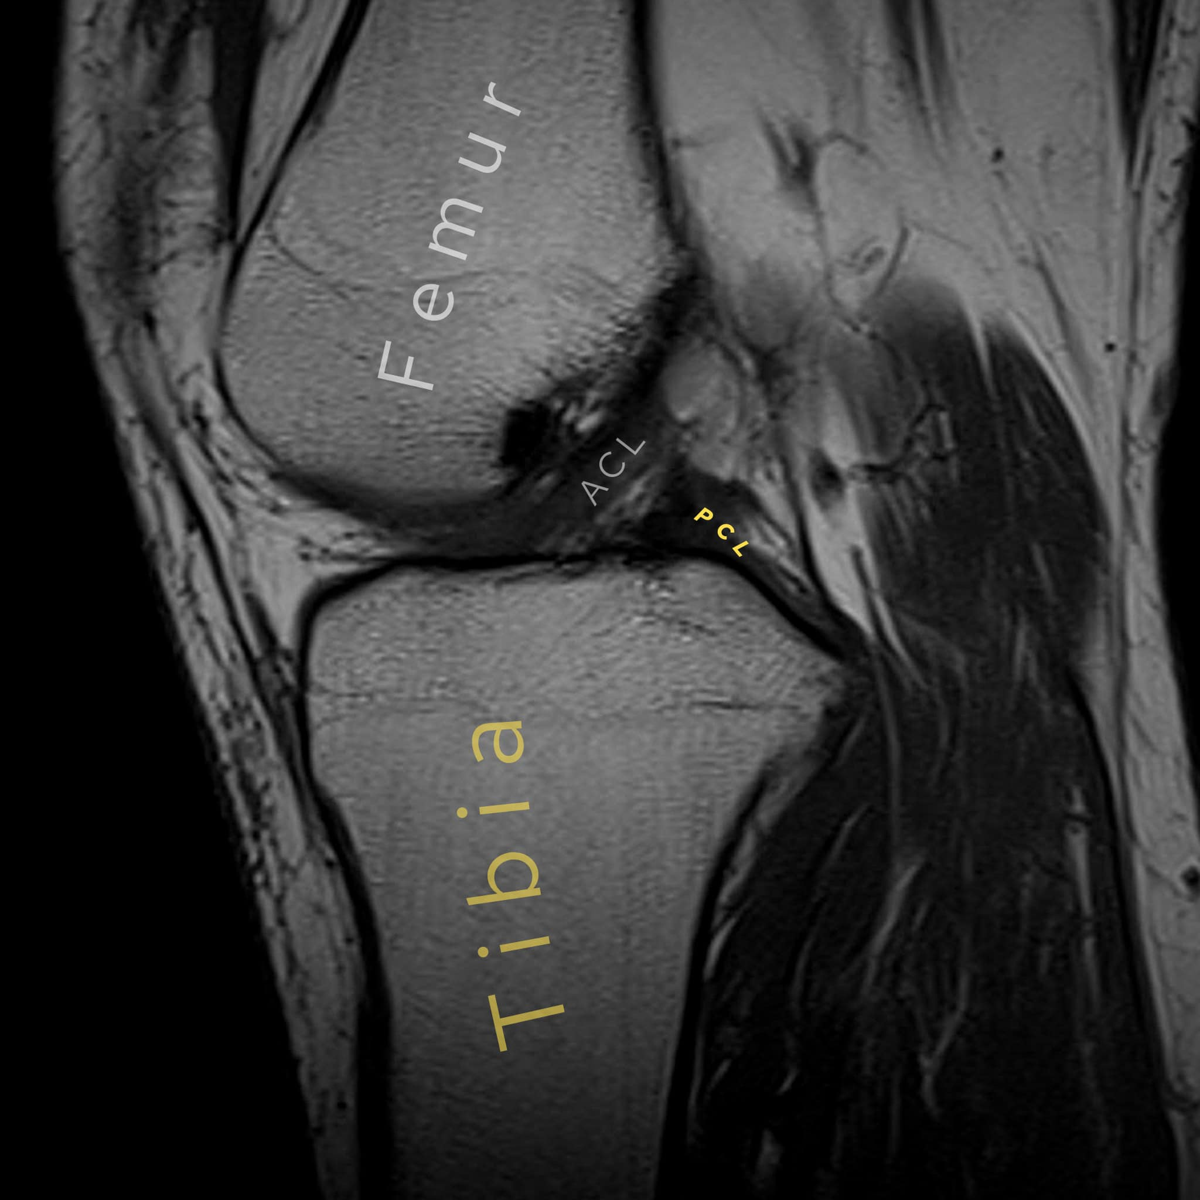
Anatomy of the Knee Joint
The knee is one of the body's biggest joints, connecting the femur (thigh bone) to the tibia (shin bone).
The kneecap (patella) is a tiny bone that lies in front of the joint and helps the thigh muscles straighten the knee.
Smooth articular cartilage covers the ends of the bones, reducing friction and absorbing stress.
Strong ligaments and surrounding muscles support the knee during weight-bearing exercises (Cleveland Clinic, 2023).
Notes:
The knee joint connects the femur, tibia, and patella, making it a crucial weight-bearing hinge joint. When we straighten our legs, the patella increases the leverage of our thigh muscles. Articular cartilage covers the bone ends, providing for smooth mobility and cushioning impact. Walking, standing, and climbing stairs all require the knee joint to be stabilised by ligaments and muscles.

Slide 4
Normal Function of the Knee Joint
The knee is primarily a hinge joint that allows for limb flexion and extension (TeachMeAnatomy, 2025).
Smooth articular cartilage and synovial fluid reduce friction and absorb stress during walking and standing.
The quadriceps and hamstrings work together to stabilise the knee during weight bearing (TeachMeAnatomy, 2025).
Notes:
In a healthy knee, the joint functions as a hinge. It bends and straightens to enable for activities such as walking, sitting, and ascending stairs. Cartilage and synovial fluid make movement smooth and cushioned, lowering friction and impact. Ligaments and thigh muscles support and govern the knee, allowing it to remain stable when loaded with body weight.

Slide 5
Knee Osteoarthritis
The most prevalent kind of arthritis is osteoarthritis, which causes joint pain and stiffness (NHS, 2017).
Knee osteoarthritis occurs when the protecting cartilage in the joint gradually wears away, causing the bones to move less smoothly than they should.
This can cause discomfort, swelling, stiffness, and trouble moving the joint, particularly while walking or climbing stairs (NHS, 2017).
Symptoms might be slight or severe, affecting a person's everyday activities and quality of life.
Notes:
Knee osteoarthritis is a prevalent degenerative joint disorder. It occurs when the protecting cartilage in the knee is destroyed over time. As a result, movements become less fluid and more uncomfortable. Individuals may endure stiffness, oedema, and trouble walking. The disease might limit freedom and interfere with daily tasks such as climbing stairs, shopping, or working.

Slide 6
Impact on Body Functioning and Daily Life
Knee osteoarthritis can cause discomfort, stiffness, and limited mobility, making it difficult for the joint to function normally (NHS 2017).
Walking, climbing stairs, standing for long periods of time, and getting in and out of a chair may all be affected by this ailment.
Ongoing symptoms can limit a person's freedom and make daily tasks more challenging.
In certain circumstances, limited movement might impair sleep, emotions, productivity, and general quality of life (NHS, 2018).
Notes:
Knee osteoarthritis impairs both physical function and daily living. Pain and stiffness can impair normal mobility, particularly while walking, climbing stairs, or standing. As the symptoms worsen, the person may have difficulty maintaining independence and following daily activities. Reduced mobility can have an impact on emotional well-being, sleep, and productivity, demonstrating that osteoarthritis has both physical and social consequences.

Slide 7
Fictional Patient Case Study
Mrs Sarah, 62, lives alone and works part-time as a store assistant.
She has experienced right knee discomfort and stiffness over the past two years, particularly while walking, climbing stairs, and standing for extended durations.
Sarah is overweight and had a knee injury some years ago, which may have raised her risk of osteoarthritis .
She claims that her knee discomfort impairs her movement, confidence, and ability to accomplish everyday tasks independently.
Notes:
Sarah, a 62-year-old lady, has knee osteoarthritis. Her symptoms include chronic discomfort and stiffness, particularly during weight-bearing tasks like walking and standing. Her age, past knee injury, and extra body weight are all potential risk factors. These challenges are currently impacting her independence, confidence, and quality of life at home and at work.

Slide 8
Lifestyle and Risk Factors
Sara's age and past knee injury are significant risk factors that may have influenced the development of knee osteoarthritis.
Her increased body weight puts additional strain on the knee joint, potentially increasing discomfort and reducing physical function.
Reduced activity due to discomfort may also weaken the muscles around the knee, providing less support to the joint.
These elements demonstrate how lifestyle influences the maintenance of the musculoskeletal system and the advancement of arthritis.
Notes:
Sara's story demonstrates how personal and lifestyle variables contribute to knee osteoarthritis. Her age and previous knee injuries enhance her risk, and extra body weight puts additional strain on the joint. As pain worsens, people tend to become less active, which weakens muscles even worse. This results in a vicious cycle of discomfort, restricted movement, and deteriorating joint function.

Slide 9
Evidence-Based Care Plan: Routine and Monitoring
Sara should get a personalised exercise program to enhance strength, mobility, and knee function (NICE, 2022).
Weight management assistance is recommended to reduce strain on the knee joint (NICE, 2022).
Sara should be encouraged to maintain safe daily mobility rather than becoming less active due to discomfort.
Her development should be tracked based on pain levels, mobility, daily activities, and reaction to medication.
Notes:
Sara's care plan should be reasonable and based on current guidelines. The primary goals are exercise, weight management, and pain relief. She should also be urged to keep active within her capabilities, since idleness can weaken the muscles around the knee. Regular monitoring is crucial to see if her symptoms, mobility, and everyday functioning improve over time.

Slide 10
Communication and Multidisciplinary Care
Sara's care should entail open communication and collaborative decision-making with health providers (NICE, 2024).
Her treatment may entail a multidisciplinary team, such as a GP, physiotherapist, and chemist, to manage pain, exercise, and mobility.
Sara should be provided information in an understandable style so that she may manage her health more confidently and participate in her treatment decisions.
Notes:
Sara's care plan relies heavily on effective communication. She deserves to be heard and included in choices regarding treatment and support. A multidisciplinary approach can assist her satisfy her many requirements, such as pain relief, mobility, and self-management. Clear information also helps Sara understand her health and feel more confidence in her ability to manage it on a daily basis.

Slide 11
Ethical and Professional Considerations
Sara's care should always respect her dignity, privacy, and secrecy.
She should have enough knowledge to make informed decisions regarding her care (NICE, 2024).
Person-centred care prioritises Sara's unique needs, preferences, and aspirations.
Notes:
Ethical care entails treating Sara with dignity and respect throughout the treatment procedure. Her privacy and confidentiality must be preserved, and she should be consulted about her treatment options. Using a person-centred approach ensures that care is based not only on clinical data, but also on what Sara values most as an individual.

Slide 12
Conclusion
The knee joint plays a crucial role in the musculoskeletal system, which facilitates mobility, stability, and daily functioning.
Knee osteoarthritis impairs normal joint function by producing pain, stiffness, and limited mobility, compromising independence and quality of life.
Sara's story demonstrates how age, prior injury, and extra body weight all raise the risk of osteoarthritis.
An effective treatment plan includes exercise, weight control, symptom monitoring, clear communication, and person-centred support (NICE, 2022).
Notes:
In conclusion, this lecture demonstrated how the musculoskeletal system supports normal mobility and how knee osteoarthritis may impair it. Sara's story emphasises the importance of risk variables including age, injuries, and weight. Overall, an evidence-based, person-centred care plan is necessary to increase mobility, alleviate pain, and enhance quality of life.

Slide 13
References
Cleveland Clinic (2023) Knee joint: Function & anatomy. Available at: https://my.clevelandclinic.org/health/body/24777-knee-joint (accessed on 5 July 2026).
GOV.UK (2012) Osteoarthritis of the Knee. Available at: https://assets.publishing.service.gov.uk/media/5a7dbf02e5274a5eaea66153/osteoarthritis_knee.pdf (accessed on 5 July 2026).
Healthdirect (2026) Bones, muscles and joints. Available at: https://www.healthdirect.gov.au/bones-muscles-and-joints (accessed on 5 July 2026).
Kenhub (2015) Musculoskeletal system: Anatomy and functions. Available at: https://www.kenhub.com/en/library/anatomy/the-musculoskeletal-system (accessed on 5 July 2026).
NHS (2017) Osteoarthritis. Available at: https://www.nhs.uk/conditions/osteoarthritis/ (accessed on 5 July 2026).
NHS (2018) Living with Osteoarthritis. Available at: https://www.nhs.uk/conditions/osteoarthritis/living-with/ (accessed on 5 July 2026).
NHS England (2024) Musculoskeletal health. Available at: https://www.england.nhs.uk/elective-care/best-practice-solutions/musculoskeletal/ (accessed on 5 July 2026).
NICE (2022) Osteoarthritis in over 16s: diagnosis and management. Available at: https://www.nice.org.uk/guidance/ng226 (accessed on 5 July 2026).
NICE (2022) Management of osteoarthritis. Available at: https://www.nice.org.uk/guidance/ng226/resources/visual-summary-on-the-management-of-osteoarthritis-pdf-11251842157 (accessed on 5 July 2026).
NICE (2024) About shared decision making. Available at: https://www.nice.org.uk/what-nice-does/our-guidance/about-nice-guidelines/about-shared-decision-making (accessed on 5 July 2026).
TeachMeAnatomy (2025) The Knee Joint - Articulations - Movements - Injuries. Available at: https://teachmeanatomy.info/lower-limb/joints/knee-joint/ (accessed on 5 July 2026).

