Slide 1

HPAN5022/6022
Models and Theories of World Order and Economic Development

Slide 2
A fundamental question:
What kind of thing is “development”?
Is it
A distinct and separate post-1945, “Third World” thing?
or
Part of a much longer-term, worldwide set of processes?

Slide 3
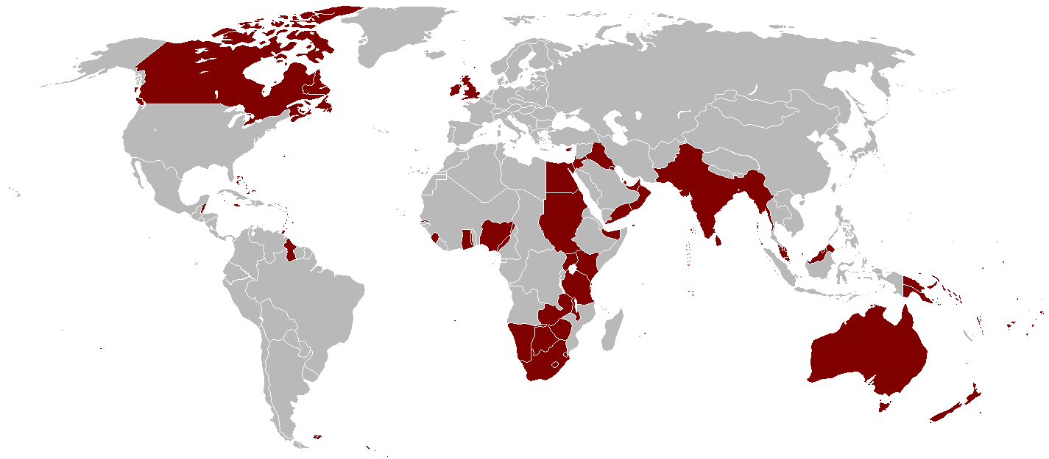
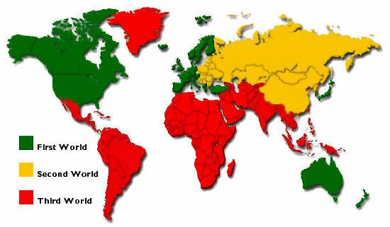
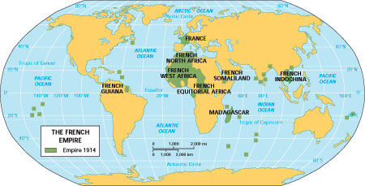
A quick Review:
Colonial and Post-Colonial Worlds

Slide 4
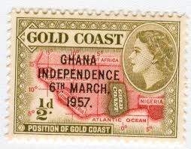

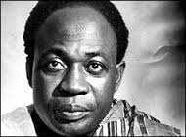

The idea of Neo-Colonialism
“The neo-colonialism of today represents imperialism in its final and perhaps most dangerous stage…In place of colonialism as the main instrument of imperialism we have today neo-colonialism.
The essence of neo-colonialism is that the State which is subject to it is, in theory, independent and has all the outward trappings of international sovereignty. In reality its economic system and thus its political policy is directed from outside.”
Introduction p.ix in Nkrumah, K., 1965. Neo-Colonialism: The Last Stage of Imperialism. London: Heinemann

Slide 5
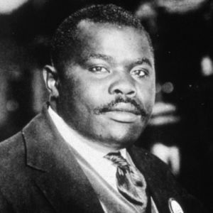
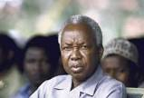
The idea of “Pan-Africanism”:
Afro-American, Caribbean and African thinkers
Henry Sylvester-Williams (1869-1911): Trinidad
WEB Du Bois (1868-1963): USA
Marcus Garvey (1887-1940): USA: The Black Star Line
George Padmore (1903-1959): Trinidad
CLR James (1901-1989): Trinidad
Amy Ashwood Garvey (1897-1969): Jamaica
Jomo Kenyatta (1891-1978): Kenya
Kwame Nkrumah (1909-1972): Gold Coast/Ghana
Chris Braithwaite (1885-1944): Barbados
Aimé Césaire (1913-2008) Marcus Garvey (above)
Frantz Fanon (1925-1961) Julius Nyerere (below)
Julius Nyerere (1922-1999): Tanganyika/Tanzania: Ujamaa
Amilcar Cabral (1924-1973): Guinea-Bissau/Cape Verde
Samora Machel (1933-1986): Mozambique
Agostinho Neto (1922-1979): Angola

Slide 6
Theories of “Development” in the post-colonial epoch
Modernisation Theory: popular in the 1950s-
mid-1960s
Structuralism and Dependency Theory: mid-1960s-1970s
Basic Needs Theory: 1970s
Neo-Classical Counter-Revolution/Neo-Liberalism/The Washington Consensus: 1980s-1990s
Human Development Theory: 1990s
Post-Development Theory: 2000s
Sustainable Development: the latest thing?

Slide 7
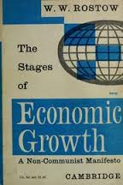
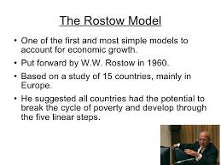
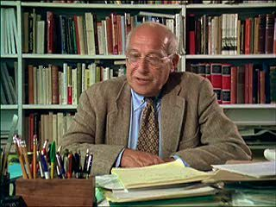
Modernisation Theory
1950s – mid-1960s
Walt Whitman Rostow (1916-2003)

Slide 8
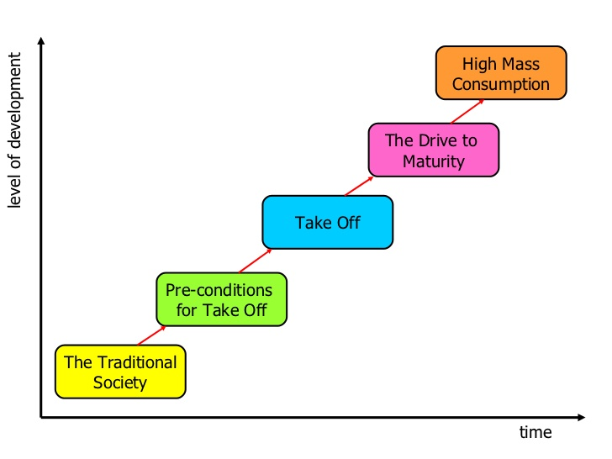
Rostow’s 5-stage model of economic growth

Slide 9
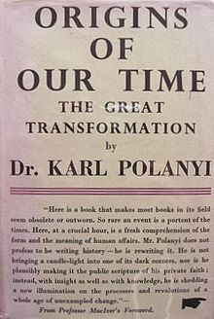
Critique of Rostow’s Theory
An attempt to explain development in an over-arching way (in the footsteps of G F Hegel and Karl Marx - and Karl Polanyi: The Great Transformation, 1944)
“A non-Communist manifesto” – the
subtitle of Rostow’s famous book
Mimicry and repetition, in parallel
with the West: naïve?
Don’t worry: there is a way forward
and it doesn’t involve a revolution!

Slide 10

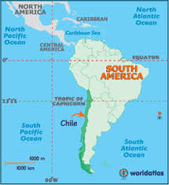
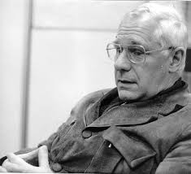
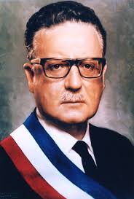
Structuralism and Dependency Theory
Mid-1960s – 1970s
André Gunder Frank (1929-2005)
German-American Economist
Went to Chile in 1962
The Development of Underdevelopment (1966)
Capitalism and Underdevelopment in Latin America (1967)
CD Government of Eduardo Frei 1964-1970
Popular Unity Government, Salvador Allende 1970-73

Slide 11
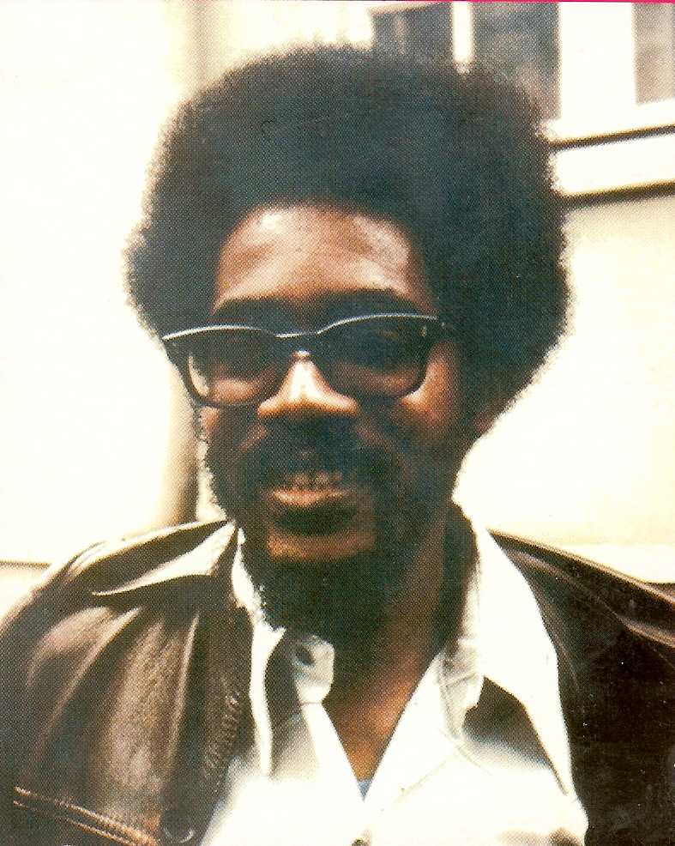
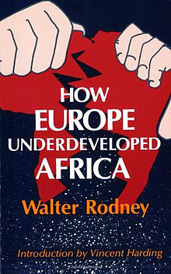
Applying the idea of “Underdevelopment”:
Walter Rodney (1942-1980)
How Europe Underdeveloped Africa (1972)

Slide 12
Structuralism
Dependency Theory: Core and Periphery
Latin American roots
Development and underdevelopment seen as two sides of the same coin
Post-colonial dependence is ensured by the reproduction of socio-economic and political structures at the periphery in accordance with the interest of the centre of power
Main interest of Western monopoly capitalism is to prevent, slow down or control the economic development of underdeveloped countries
So, what structural changes are needed?
Breaking the constraints imposed by the world trade system: tariffs to protect indigenous “infant industry” and promote ISI (Import Substitution Industries*)
More national control over and speed of the transition from rural to urban life
National control and ownership of extractive industry and of foreign trade
(*NB: A strange version of ISI-by-boycott in Rhodesia 1965-1979; and US blockade of Cuba after 1959)

Slide 13
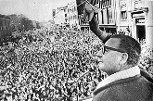
Chile 1964-1973
Eduardo Frei and the failure of Land Reform, 1964-1970
Popular Unity victory in 1970: a coalition of 6 parties: SP, CP, Radical Party, Social-Democrats, MAPU, IC (with MIR outside the coalition)
Destabilisation of the
Chilean Government
Allende and the military
“Covert action”: CIA etc.

Slide 14
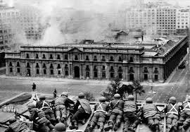

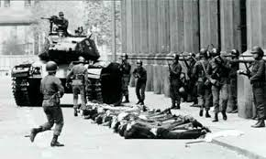
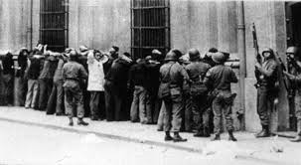
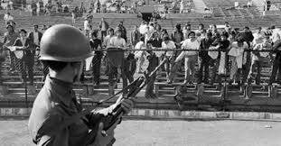
Pinochet’s coup, 11 September 1973
Gunder Frank escaped to Europe after the coup
Lampeter footnote: So did Stafford Beer (1926-2002) a British consultant in management cybernetics. He also sympathized with the stated ideals of Chilean socialism of maintaining Chile's democratic system and the autonomy of workers instead of imposing a USSR-style system of top-down command and control.

Slide 15
The “Basic Needs” approach of the ILO (1970s): Louis Emmerij (b.1934) et al
The basic needs model was introduced by the International Labor Organization in 1976, in reaction to modernization- and structuralism-inspired development approaches, which were not achieving satisfactory results in poverty alleviation and combating inequality in developing countries.
It tried to define an absolute minimum of resources necessary for long-term physical well-being. The poverty line which follows from this, is the amount of income needed to satisfy those basic needs.
Proponents of basic needs have argued that elimination of absolute poverty is a good way to make people active in society so that they can provide labour more easily and act as consumers and savers.
Basic needs theory does not focus on investing in economic growth.
In some ways, it anticipates the Human Development approach
See: Basic Needs and the ILO
http://www.un.org/en/development/desa/policy/wess/wess_bg_papers/bp_wess2010_emmerij.pdf
ODI, 1978:
https://www.odi.org/sites/odi.org.uk/files/odi-assets/publications-opinion-files/6616.pdf

Slide 16
Louis Emmerij (b.1934)
1961: Institut d’Etudes Economiques et Sociales, University of Paris
1962: OECD, Directorate of Scientific Affairs, Paris
1970: ILO, Director, World Employment Programme, Geneva
1976: Rector, Institute of Social Studies, The Hague
1985: President, OECD Development Centre, Paris
1993: Special Advisor to the President (Bill Clinton), Inter-American Development Bank, Washington, D.C.
1999-2010: Co-Director, United Nations Intellectual History Project and Senior Research Fellow, The Graduate Center, City University of New York

Slide 17
Neo-Classical Counter-Revolution/
Neo-Liberalism/The Washington Consensus
1980s - 1990s
A powerful combination
1979: Thatcher’s election victory brings in policies based on monetarism and ideas of the Chicago School: privatisation, rolling back the state
1980: Reagan’s election: Reaganomics
The Washington Consensus and a new tack for the World Bank and IMF

Slide 18
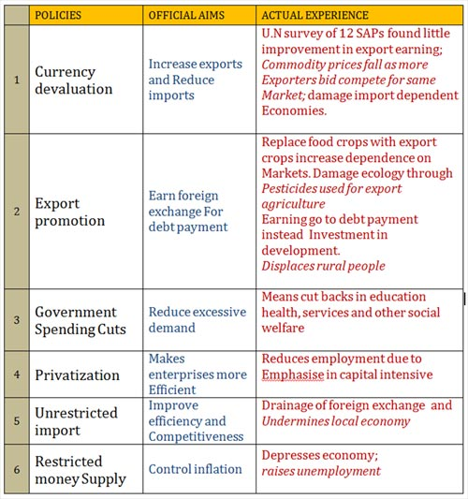
1980s-1990s: Structural Adjustment Programmes (SAPs)
Infographic: http://proutistuniversal.info/

Slide 19

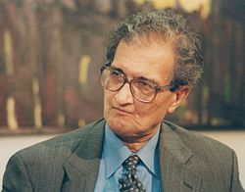


Human Development Theory : 1990s
Amartya Kumar Sen (b. 1933)

Slide 20
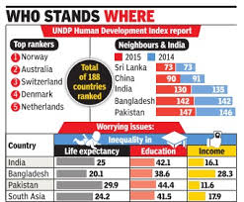
Human Development Index

Slide 21
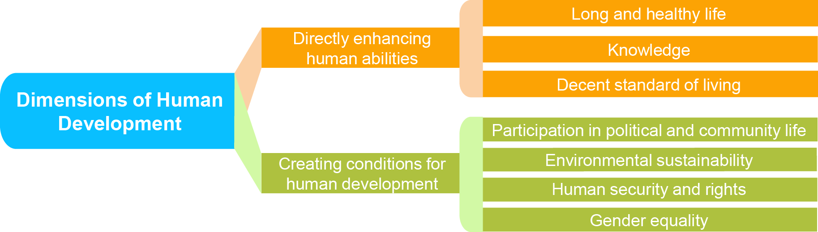
HDI dimensions

Slide 22
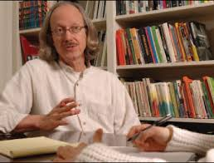
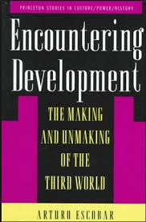
Post-development Theory
2000s
Arturo Escobar (b. 1952)
Colombian-American anthropologist

Slide 23
Post-Development and “Alternative Development”
Post-development theory holds that the whole concept of development is a reflection of Western-Northern hegemony over the rest of the world. Post-development thought arose in the 1980s out of criticisms voiced against development projects and development theory, which justified them.
Influenced by Ivan Illich and other critics of colonialism and postcolonialism, a number of post-development theorists like Arturo Escobar and Gustavo Esteva have challenged the very meaning of development. According to them, the way we understand development is rooted in the earlier colonial discourse that depicts the North as "advanced" and "progressive", and the South as "backward", "degenerate" and "primitive".
They point out that a new way of thinking about development began in 1949 with President Harry Truman's declaration: "The old imperialism—exploitation for foreign profit—has no place in our plans. What we envisage is a program of development based on the concepts of democratic fair dealings.“
While claiming that the "era of development" began at this point, post-development theorists do not suggest that the concept of development was new. What was new was the definition of development in terms of an escape from underdevelopment. Since the latter referred to two-thirds of the world, this meant that most societies were made to see themselves as having fallen into the undignified condition of "underdevelopment", and thus to look outside of their own cultures for salvation.

Slide 24
Some key concepts – and challenges to development “orthodoxy”
The post-development school argue that development was always unjust, never worked, and has clearly failed.
Post-development thought takes inspiration from vernacular societies, the informal sector and “frugal” rather than atavistic/materialistic lifestyles.
It does advocate structural changes. According to Escobar, post-developmental thinking believes that the economy must be based around solidarity and reciprocity; policy must focus on direct democracy; and knowledge systems should be traditional, or at least a hybrid of modern and traditional knowledge.

Slide 25




Other key concepts
Appropriate/Intermediate Technology
Fair Trade
Global Justice

Slide 26
Back to Square One:
What kind of thing is “development”?
Is it
A distinct and separate post-1945, “Third World” thing?
or
Part of a much longer-term, worldwide set of processes?

Slide 27
Sustainable Development in the 21st century: A world-wide issue
Academia, the world of Ideas and the Third World: who and what has really made an impact?
My verdict:
Nkrumah and the concept of Neo-Colonialism?
Gunder Frank and Structuralism?
The IMF, the World Bank and Structural Adjustment?
Amartya Sen and Human Development: the UN General Assembly’s “rank and file”?

Slide 28
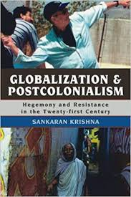
Globalization and Postcolonialism: Hegemony and Resistance in the 21st Century the analysis of Sankaran Krishna
* Smith>Modernization>Globalization
* Marx>Structuralism>Postcolonialism

