Slide 1

Registered Dental Nurse – GDC Registered
Name | SAMAN NAVEED
Student ID | 2519576
Module Code | (LCHS4009_BIRM) Professional development within Health and Social Care

Slide 2
Introduction
I have chosen to pursue a career as a GDC-Registered Dental Nurse within the UK Health and Social Care sector. My ultimate goal is to become fully qualified and registered with the General Dental Council, enabling me to practise as a professional dental nurse.
This career appeals to me because it combines compassionate patient care, clear communication, and working as part of a supportive team. I value the opportunity to develop clinical skills while making a positive difference to people’s oral health and wellbeing. There are also excellent prospects for professional growth and continuing development throughout the role.
A current vacancy for a Dental Nurse at Mid and South Essex NHS Foundation Trust (Rochford, 2025) confirms that there are active opportunities in this field and supports my decision to pursue this career path.

Slide 3

Job Requirements Analysis
A Dental Nurse should have a recognised Dental Nursing qualification, be registered with the GDC and have experience working with patients in a dental or hospital setting. Key skills include chair side support, orthodontic support, infection prevention and control, communication and organisation. Confidentiality and patient centered care, team working and awareness of safeguarding issues are also required as part of the role (Magennis 2024). Further courses in dental radiography and orthodontic nursing can enhance employment prospects. These requirements will support the NHS 6Cs, care, compassion, competence and communication (Hardicre, 2014).

Slide 4
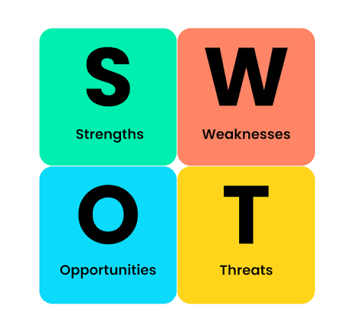
Personal SWOT Analysis
Strengths: My strengths include empathy, communication and organisation, developed through three months of volunteering at a community dental access center and university group work. Volunteering gave me an insight into the need to comfort panicking patients. I also have an awareness of infection control, attention to detail and a commitment to continuous professional development (CPD).
Weaknesses: I have limited experience in orthodontics, radiography and sedation. I also need to boost my confidence with dental IT systems like R4 and Exact.
Opportunities: Skills will be developed during NEBDN training programs, and through UWTSD clinical skills experiences and opportunities for further training and qualification within the NHS in oral health education, radiography and orthodontics.
Competition for NHS dental nursing roles, training expenses, the emotional demands of supporting nervous patients and general pressures on the dental profession could impact my career growth. I will tackle these challenges through ongoing training, experience and ongoing professional development.
SWOT analysis is a technique that is used to identify the internal strengths and weaknesses of an organisation, and the external opportunities and threats, (Pickton & Wright, 1998).

Slide 5
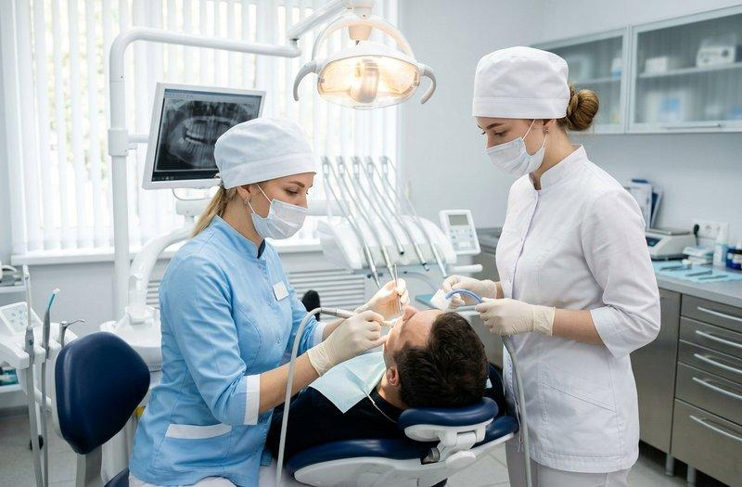
Using Strengths to Overcome Weaknesses
Orthodontic experience: Use my empathy and attention to detail to help patients feels at ease when attending, seek supervised experience and undertake relevant orthodontic training.
Sedation: Be aware of suitable training, supervised experience (if appropriate), and record progress in a CPD portfolio.
Radiography: Identify appropriate training, gain supervised experience (if appropriate), and record progress in a CPD portfolio.
IT and time management include using my organisation and communication skills to practice R4/SOE, to follow checklists and prioritise tasks.
Job competition: Refer to STAR from group work at university and volunteering experiences to show how well I communicated, worked in teams, and provided patient care when compared to the job requirements.
Working with patient anxiety: use my empathy through communication to build trust and provide person-centered care (GDC, 2023).

Slide 6
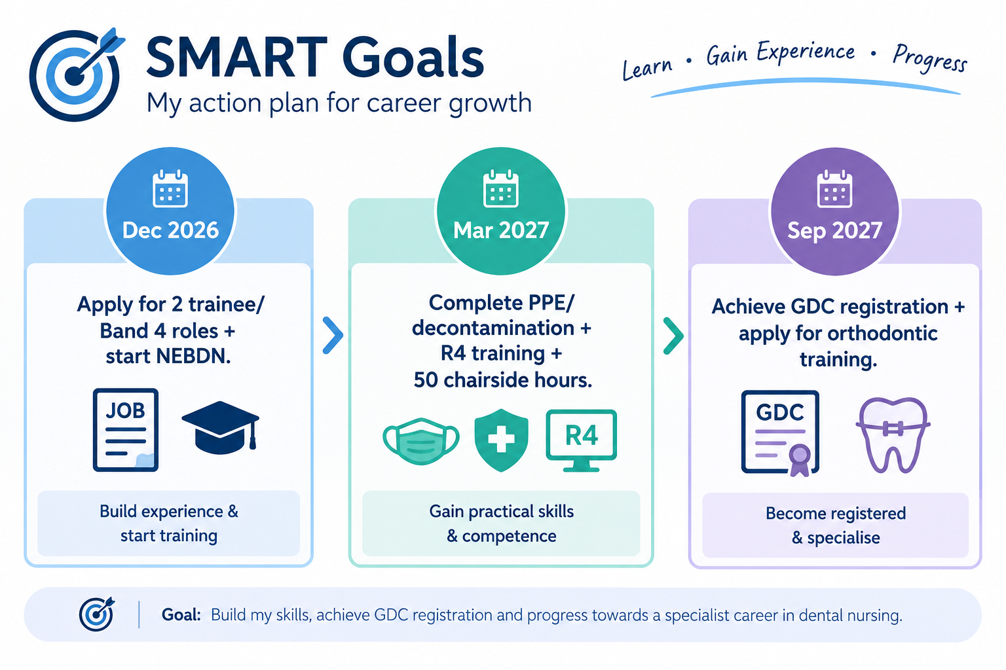
Career Growth: Turning Opportunities into Action
I will use my empathy and communication skills to seek NHS trainee Dental Nurse opportunities and gain supervised practical experience. I will use my organisation and commitment to learning to complete a recognised NEBDN qualification and meet the requirements for GDC registration (GDC, 2023; NEBDN, n.d.). I will seek feedback from supervisors and record my progress through CPD. Upon successful completion of this course, I would like to enhance my employability by gaining specialist skills within orthodontics and radiography and oral health education, as relevant, with the NHS (Mid and South Essex NHS Foundation Trust) in 2026.

Slide 7
Conclusion & Personal Action Plan
Conclusion
My empathy, communication and organisational skills are excellent and are vital to Dental Nursing. I will develop my practical skills by completing my training with recognised NEBDN and supervised experience and continuing professional development (CPD). I want to build relevant skills and enhance my clinical ability to become a qualified Dental Nurse (GDC registered) and develop my career aspirations into NHS Band 4.
12-Month Action Plan
Months 1–3: Research NEBDN courses and entry requirements and apply for appropriate trainee Dental Nurse position.
Months 4- 6: Practical experience under supervision, acquire PPE and decontamination skills, ask for feedback and get it.
Months 7-12: To continue to complete my qualification, maintain CPD, research orthodontic training and apply for appropriate qualified Dental Nurse positions available, months 7-12.

Slide 8
References
Barrow, H., Bartlett, S., Bullock, A. and Cowpe, J., 2023. Are the standards of professionalism expected in dentistry justified? Views of dental professionals and the public: Are the standards of professionalism expected in dentistry justified? Views of dental professionals and the public. British Dental Journal, 234(5), pp.329-333.
General Dental Council (GDC) (2023) Standards for the Dental Team. Available at: https://www.gdc-uk.org/standards-guidance/standards-and-guidance/standards-for-the-dental-team (Accessed: 14 October 2026).
Mid and South Essex NHS Foundation Trust (2026) Dental Nurse – Band 4, Job reference: 390-SUR-SO-8469-A. NHS Jobs. Available at: https://www.nhsjobs.com/job/UK/Essex/Southend_On_Sea/Mid_South_Essex_NHS_Foundation_Trust/Dental/Dental-v8332782 (Accessed: 14 October 2026).
National Examining Board for Dental Nurses (NEBDN) (n.d.) Diploma in Dental Nursing. Available at: https://www.nebdn.org/qualifications/diploma-in-dental-nursing/ (Accessed: 14 October 2026
Pickton, D.W. and Wright, S., 1998. What's swot in strategic analysis?. Strategic change, 7(2), pp.101-109.
Rochford, D., 2025. Working to a full scope of practice in general dental practice. A mixed methods study presenting the results of a British Society of Dental Hygiene and Therapy member survey. International Journal of Dental Hygiene.

