Slide 1

Effective Teamwork and Communication (BMSW4009)
Presentation Topic: Difference Between Groups and Teams
Student Name: Roqia Haji Haidar (2422002)
Lecturer Name: Melanie Squire

Slide 2
Presentation Outline
In this presentation, we will explore the key concepts related to teamwork and communication by covering the following topics
What is Team?
What is a group?
Differences Between Groups and Teams
What Happens When Teamwork Goes Wrong?
Theories on Teamwork and Conflict
Belbin Team Roles Theory
Schramm’s Communication Model (1954)
What Motivational Factors Are Important?
Conclusion
References

Slide 3

What is Team?
Team means people working together to reach the same goal (Perry, 2022).
It’s not just splitting tasks but sharing ideas and skills to do better as a group.

Slide 4

2. What is a Group?
A group is a collection of individuals who come together to share information, ideas, and resources while working toward a common goal. Members interact but primarily act as individuals.
(Thomas, n.d.)

Slide 5
3. Differences Between Groups and Teams
Groups: people working alone on similar tasks, with little connection (Asana Blog, 2025).
Teams: work closely together, share the work, and depend on each other to succeed.

Slide 6

4. What Happens When Teamwork Goes Wrong?
Poorly planned team-building causes fights, stress, and less trust (Sabre, 2023).
Groups often have poor communication and don’t share the same goals (Asana Blog, 2025).
Good leaders help fix these problems.

Slide 7
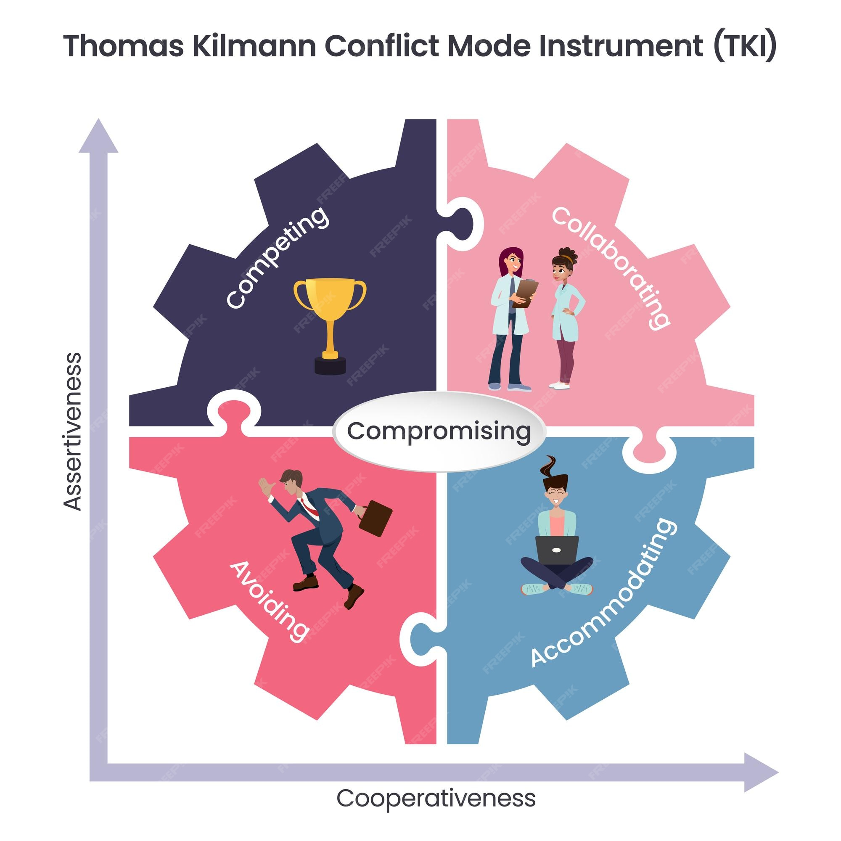
5. Theories on Teamwork and Conflict
Thomas-Kilmann Conflict Mode Instrument (TKI):
  Five conflict styles: competing, collaborating, compromising, avoiding, accommodating.
  Teams work best when they collaborate to solve problems together.

Slide 8
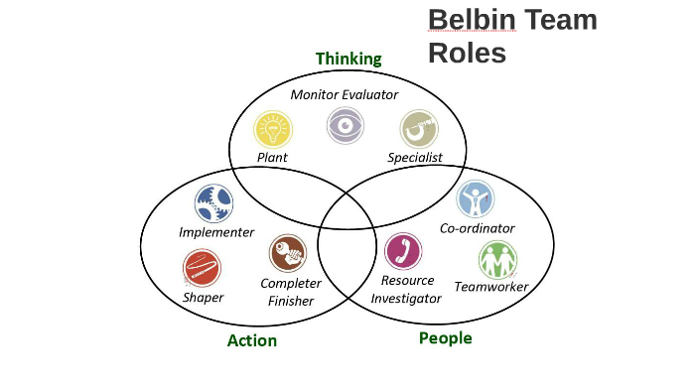
6. Belbin Team Roles Theory:
  Teams have different roles like helpers, thinkers, doers, organizers.
  Knowing these roles helps teams use everyone’s strengths and work better together.

Slide 9
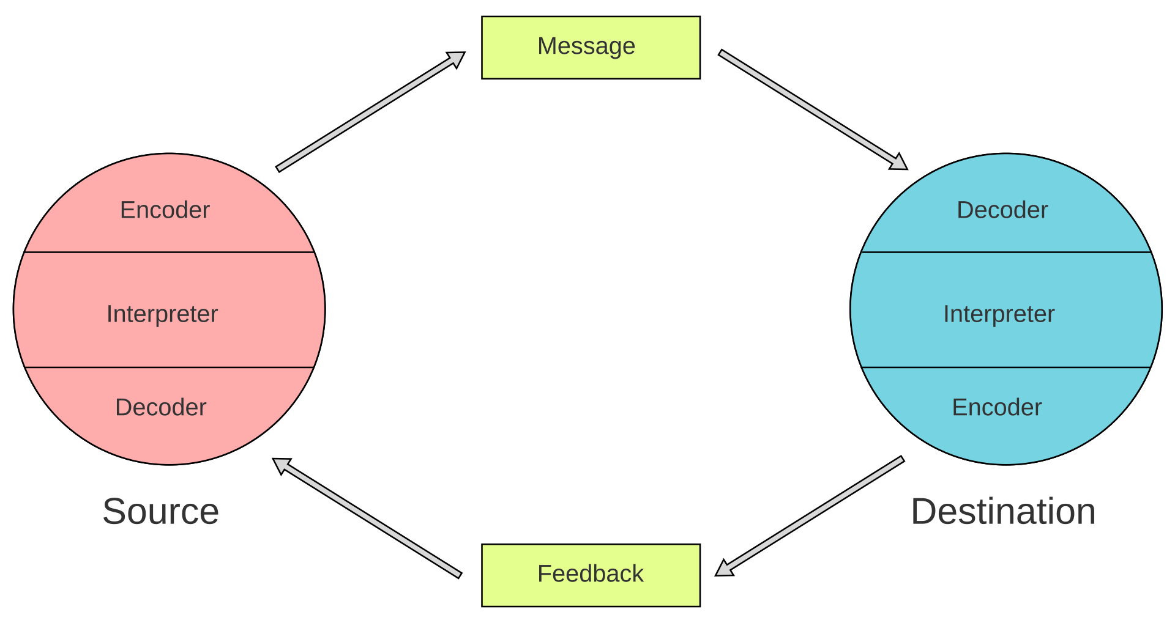
7. Schramm’s Communication Model (1954):
  Communication is a two-way process of sending and receiving messages.
  Feedback and understanding are vital; noise and distractions can disrupt communication.

Slide 10
8. What Motivational Factors Are Important
Motivation comes from rewards and enjoying the work (Young, 2023).
Important factors include trust, a good workplace, chances to grow, work-life balance, and meaningful work (Tenney, n.d.).
Leaders should understand each person’s needs.

Slide 11
9. Conclusion
Teamwork is more than just a group of people (Perry, 2022).
Good teams have clear goals, motivation, good communication, and strong leaders.
Teams do better when people trust and help each other.

Slide 12
10. References
Perry, E. (2022). What Is Teamwork and Why Does It Matter? [online] BetterUp. Available at: https://www.betterup.com/blog/what-is-teamwork.
Young, D. (2023). The power of team motivation. [online] The Predictive Index. Available at: https://www.predictiveindex.com/blog/team-motivation/.
Thomas, J. (n.d.). rumie-learn. [online] Rumie-Learn. Available at: https://learn.rumie.org/jR/bytes/what-is-the-difference-between-a-team-and-a-group.
Team, T.S. (2023). What happens when team building goes wrong? [online] Sabre Team Building. Available at: https://www.sabrehq.com/post/what-happens-when-team-building-goes-wrong.
Tenney, M. (2024). 10 Factors That Influence Employee Motivation. [online] PeopleThriver - We help your people to thrive. Available at: https://peoplethriver.com/what-are-the-factors-that-influence-employee-motivation/.
Asana (2024). Group Vs. Team: What’s the Difference? [online] Asana. Available at: https://asana.com/resources/group-vs-team.
BiteSize Learning (2025). The Thomas-Kilmann Conflict Model, Explained. [online] BiteSize Learning. Available at: https://www.bitesizelearning.co.uk/resources/thomas-kilmann-conflict-model.
Belbin (2025). The nine belbin team roles. [online] Belbin. Available at: https://www.belbin.com/about/belbin-team-roles.
Das, B. (2024). Wilbur Schramm’s Model of Communication: Advantages & Disadvantages. [online] StudyMassCom.com. Available at: https://studymasscom.com/communication/wilbur-schramm-model-of-communication-advantages-disadvantages/.‌

