Slide 1
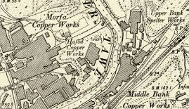
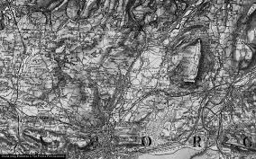
Early Development of the Area
Before Industrialisation took over, the Lower Swansea Valley was originally a rural farm area with many small clusters of population.
Many of the farms in the area including Hafod, Aberdyberthi and Pentre Mawr were in existence before Industrialization occurred.
In the 1700s, the discovery of large mineral deposits in the area might have made it more appealing to several industries by allowing them to enter and operate within the region.
Many buildings such as copperworking facilities were located near rivers in order to have access to transportation and fresh water.
Over time, many large Factory buildings, Furnace buildings and Warehouse Buildings were built where originally this land was used for farming or to hold cattle for Farm use.
Notes:
The geography of Swansea displayed an uncommon melding of mineral wealth and route to the sea. These geographic advantages allowed Swansea to become a global industrial centre.

Slide 2
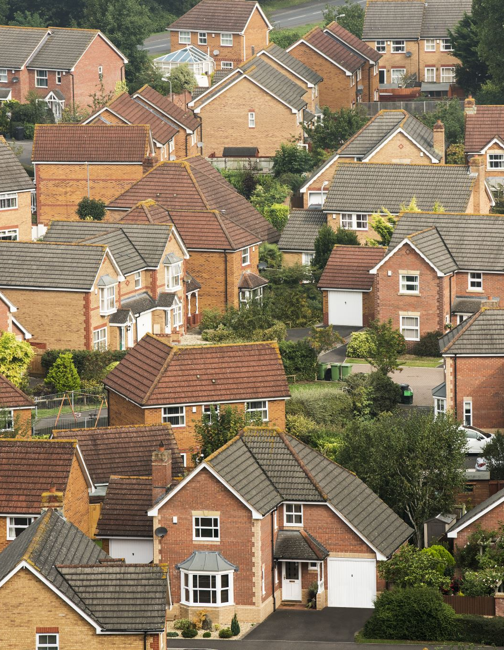
Economic Value
The Swansea Valley became the main location for production of copper due to its large number of natural resources.
The amount of copper produced by Swansea made up a huge part of the world's supply in the 19th century.
Copper was used worldwide, either in buildings or as tools.
As a result, many industrialists (businessmen) decided to invest their money into the copper industry.
As a result of the growth of businesses and suppliers, local businesses also benefitted from increased economic activity.
Notes:
The necessary factors required of entrepreneurs and inventors were key players, while the new technologies ensured that Swansea was leading the way on industrial production and the potentials of global competition.

Slide 3
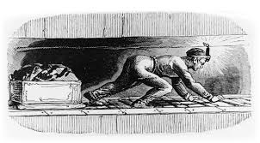
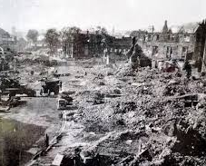
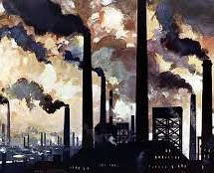
Reduction Of The Copper Industry
Starting in the late 19th century, the copper industry started to decline.
The reduction was caused by larger government production prices outside of the UK and from competitors exporting copper back to Great Britain.
The majority of copperworks closed by the early 20th century.
A few industries chose to diversify into producing steel, tinplate, or other metals.
The copper industry is now only represented by a few industrial facilities that provide historical insight and assist with the preservation of a cultural heritage.
Notes:
While Swansea enjoyed prosperity because of industrialisation, there were also pain for workers endured and violence to the local environment, resulting in consequences that extended for generations.

Slide 4

References
Akgul, G. (2026). The Shadow of the Industrial Revolution in the Mirror of English Fiction: The Tired Soul of the Working Class. In Public Sector Burnout and Wellness: Research and Experiences (pp. 291-320). IGI Global Scientific Publishing.
Baron, K. J. Manufacturing the mill girl: working-class white women’s bodies in New England factory literature, 1830-1860 (Doctoral dissertation, University of Iowa).
Daunton, M. (2021). Swansea Copper: A Global History, by Chris Evans and Louise Miskell.
Evans, C. (2014). A World of copper: introducing Swansea, Globalisation and the Industrial Revolution. The Welsh History Review, 27(1), 85-91.
Evans, C., & Miskell, L. (2020). Swansea copper: A global history. Johns Hopkins University Press.
Evans, C. (2020). Welsh Copper: What, When and Where?. New Perspectives in Welsh Industrial History, 25-44.
Golding, B., & Golding, S. D. (2017). Copper and coal through the ages. In Metals, energy and sustainability: The story of doctor copper and king coal (pp. 37-155). Cham: Springer International Publishing.
Hughes, S. (2008). The characteristics of extractive and smelting landscapes of the Industrial Revolution at Swansea and Blaenavon. Landscape History, 30(1), 21-47.
Hong, S., Candelone, J. P., Soutif, M., & Boutron, C. F. (1996). A reconstruction of changes in copper production and copper emissions to the atmosphere during the past 7000 years. Science of the Total Environment, 188(2-3), 183-193.
Vincent, D. John Sanders, Workers of Their Own Emancipation. Working-Class Leadership and Organisation in the West Riding Textile District, 1829–1839. Breviary Stuff, London 2024. 554 pp. Ill.£ 25.00. International Review of Social History, 1-3.

