Slide 1
BMHP5005
Introduction to Research
Online viva voce examination
Huma Shamas
Fahad Khan

Slide 2
Introduction
My systematic review is about smoking in the united kingdom.
The dangers and effects of smoking.
How smoking effects people’s mental health and physical health.
Smoking or consuming tabaco causes long lasting bad effects on the cardiovascular system.
In severe cases Smoking can cause mouth and lung cancer.
Smoking can increase the risk of infection, effecting the bodies immunity.
This systemic review assesses and evaluates the prevalence of smoking and its effects in the
United Kingdom. Furthermore, this systemic review will help to understand the strategies and
methods to cease tobacco consumption and smoking and promote a healthy lifestyle
Notes:
k

Slide 3
Every year 6million people die yearly because of long term smoking globally.
Physician and psychological healthcare professionals, including psychiatrists and psychologists, many people have seen to quit smoking and tobacco consumption and adopt a healthy lifestyle (Anna-Lena Bartsch, 2016).
The clinical training procedures of the United Kingdom enable doctors and health and social care providers to take wide-ranging tactics and make plans to support people who want to quit or cease smoking (Hughes, 2013)
This systemic review aims to evaluate and assess the frequency of tobacco and cigarette consumption and strategies to counsel people to feel supported to quit smoking and tobacco consumption.

Slide 4
Methodology
This systemic review was stated according to the PRISMA statement, data collection, and information gained from articles. The searched articles were limited between 2012 to 2022. Some articles were taken from PubMed, and others were searched on Google Scholar.
120 articles were selected for this review, 70 were removed.
50 articles were reviewed and studied
8 were shortlisted for review in this report
A PRISMA flow diagram is used to help understand how research papers were selected to review in this report.
The research and articles are limited to the united kingdom, very little globally is stated in this review.

Slide 5
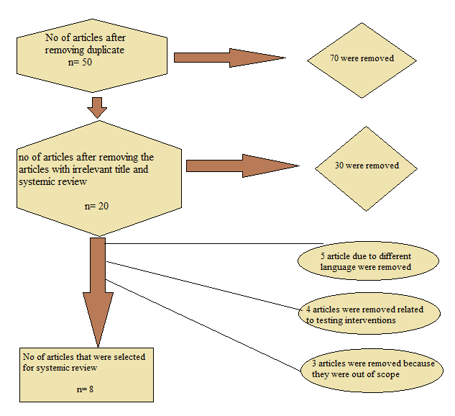

Slide 6
Citation | Subjects | Themes
(Powell, 2013) | Male/Female Age between 40-80 | Asking/ Advice Briefing Changes/ Counseling/ Challenges Documentation
(Pirie, 2013) | 1M women between 24-65 (Survey was conducted from 1996 to 2001, in 2011, the study again started to check who had quit smoking permanently) | Asking/ Advice Briefing Documentation
(Windsor-Shellard, 2017) | Young adults between 18 to 24 | Asking Documentation

Slide 7
Themes of the study
The studies that I have selected are based on the following themes
Documentation
Asking / Advice
Briefing
Asking / Advice
Changes / Counselling / Challenges

Slide 8
Conclusion
In this systematic reiew it is concluded that smoking is bad for your health.
Smoking is assoisated with many diseases, including lung cancer, mouth cancer, kidney cancer, throat cancer, bronchitis, chronic obstructive pulmonary disorder and cardiovascular diseases, hypertension, stroke, heart attack etc.
The reviews of articles showed how smoking is related to people’s physical or mental health. The National Health Services (NHS) in England has worked so much to educate people about the hazards of smoking and tobacco consumption with the help of local authorities and health and social caregivers
Smoking is one of the biggest problems in the united kingdom.
Passive smoking is even worse.
Furthermore, local authorities, with the help of social and healthcare providers and regional organisations, can hold training programmes related to physical and mental fitness and lives sessions to spread awareness among people and encourage them to stay away from smoking or tobacco consumption and help people to stay away from this in their social circles.

