Slide 1
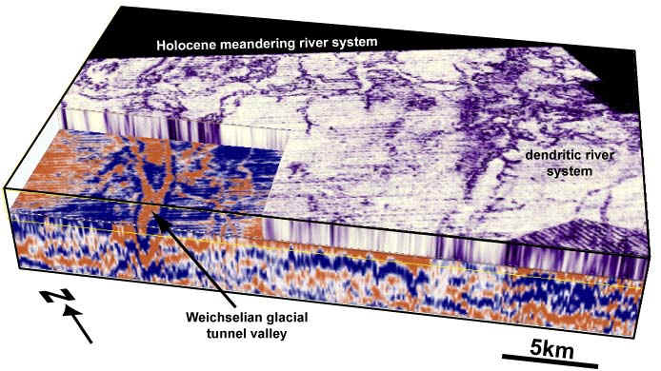
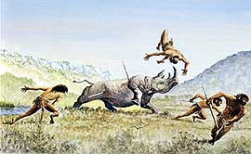
THEMES AND CONCEPTS: RECONSTRUCTING PAST ENVIRONMENTS

Slide 2
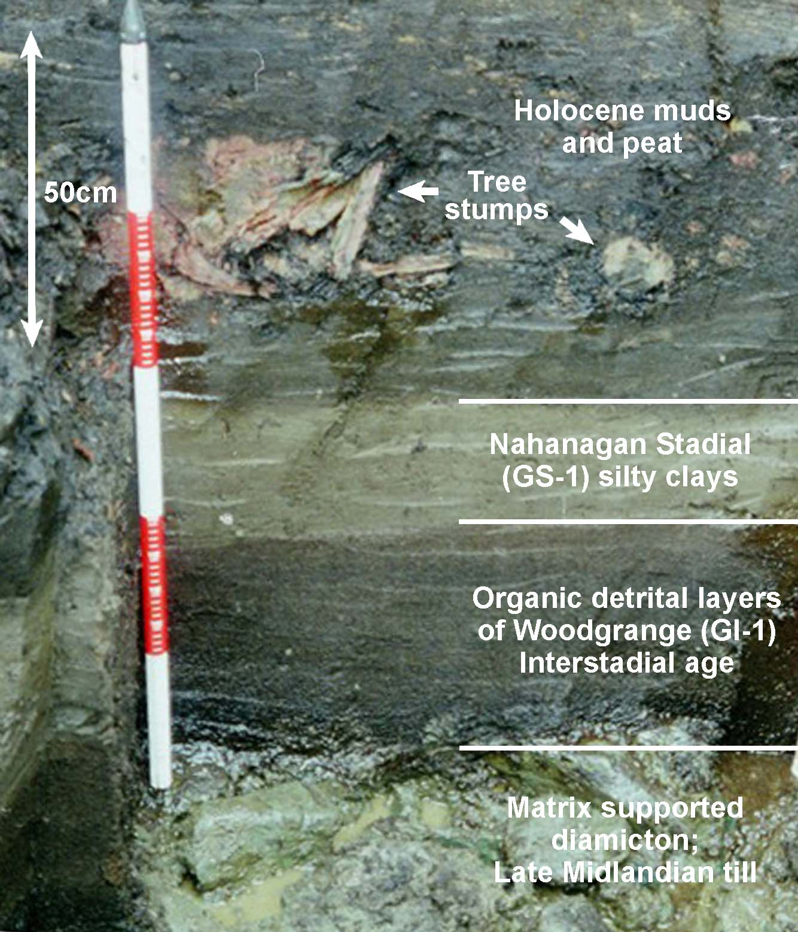
How do we get from this …

Slide 3
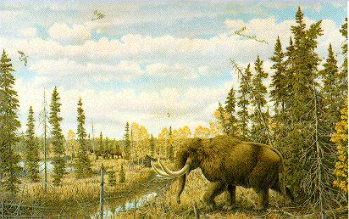
… to this

Slide 4
Why is it important to understand something about the environment and landscape?
Because people live in that environment and it impacts on their way of life.
People rely on the environment to supply them with resources.
Because changes in the environment have the ability to cause major changes to peoples life style.
Because landscape has a recreational importance to people.
Because the landscape has a ‘spiritual’ significance to people.

Slide 5
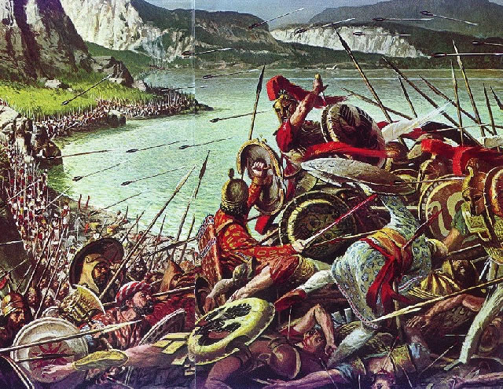
Important to our understanding of human settlement, past events and diet
www.ancientgreekbattles.net

Slide 6
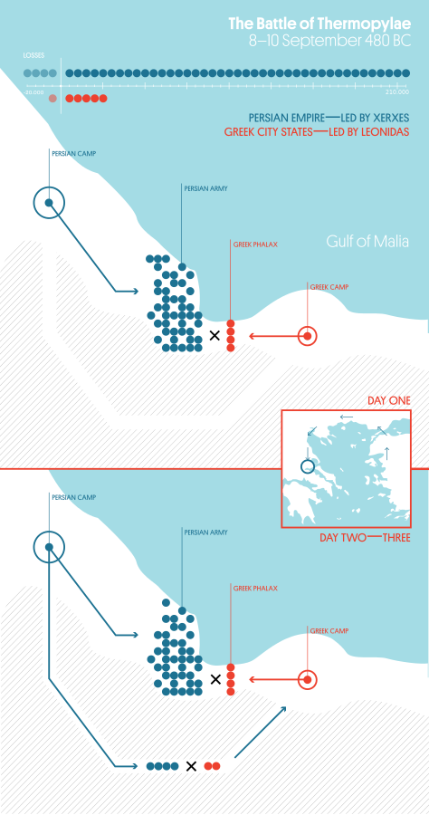
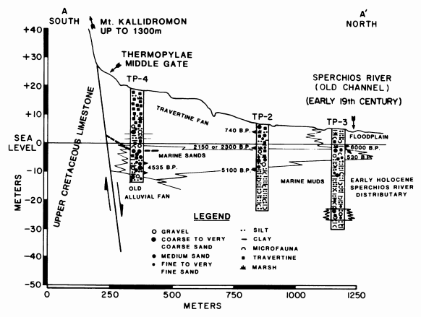
Kraft et al.,1987
"Nicolo arena battleofthermopylae" by This image has been created during "DensityDesign Integrated Course Final Synthesis Studio" at Polytechnic University of Milan, organized by DensityDesign Research Lab. Image is released under CC-BY-SA licence. Attribution goes to "Nicolo Arena, DensityDesign Research Lab". - Own work. Licensed under CC BY-SA 4.0 via Commons - https://commons.wikimedia.org/wiki/File:Nicolo_arena_battleofthermopylae.svg#/media/File:Nicolo_arena_battleofthermopylae.svg

Slide 7
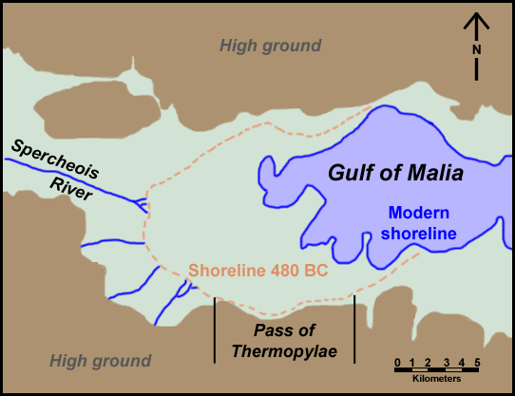
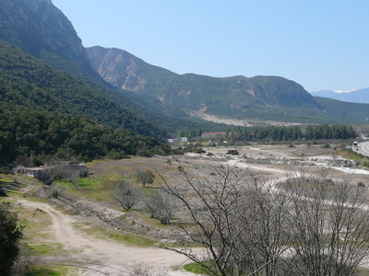
www.touristlink.com

Slide 8
Landscapes of the past are:
Very different
Every changing
Important to our understanding of human settlement and diet
A guide to the future

Slide 9
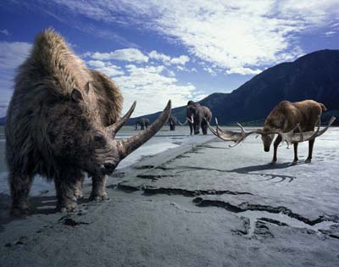
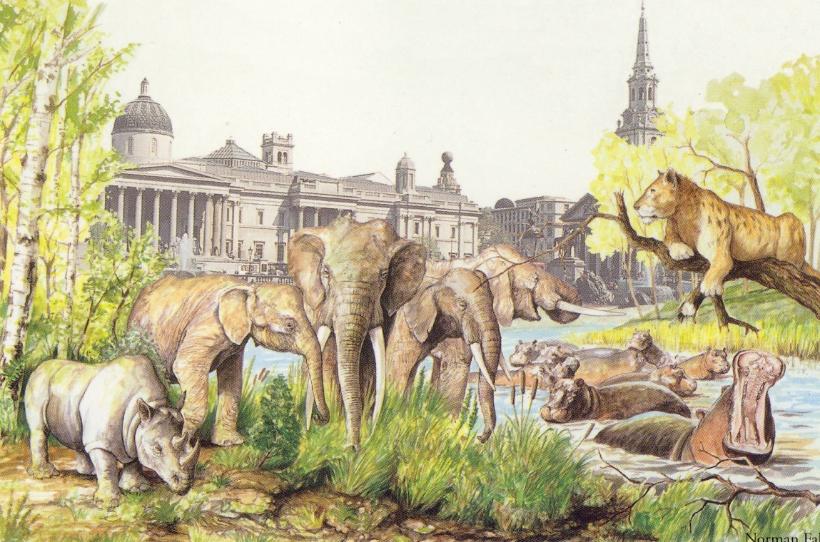
Different wildlife!
Trafalgar Square, 125,000 years ago!
Aberaeron, 15,000 years ago!

Slide 10
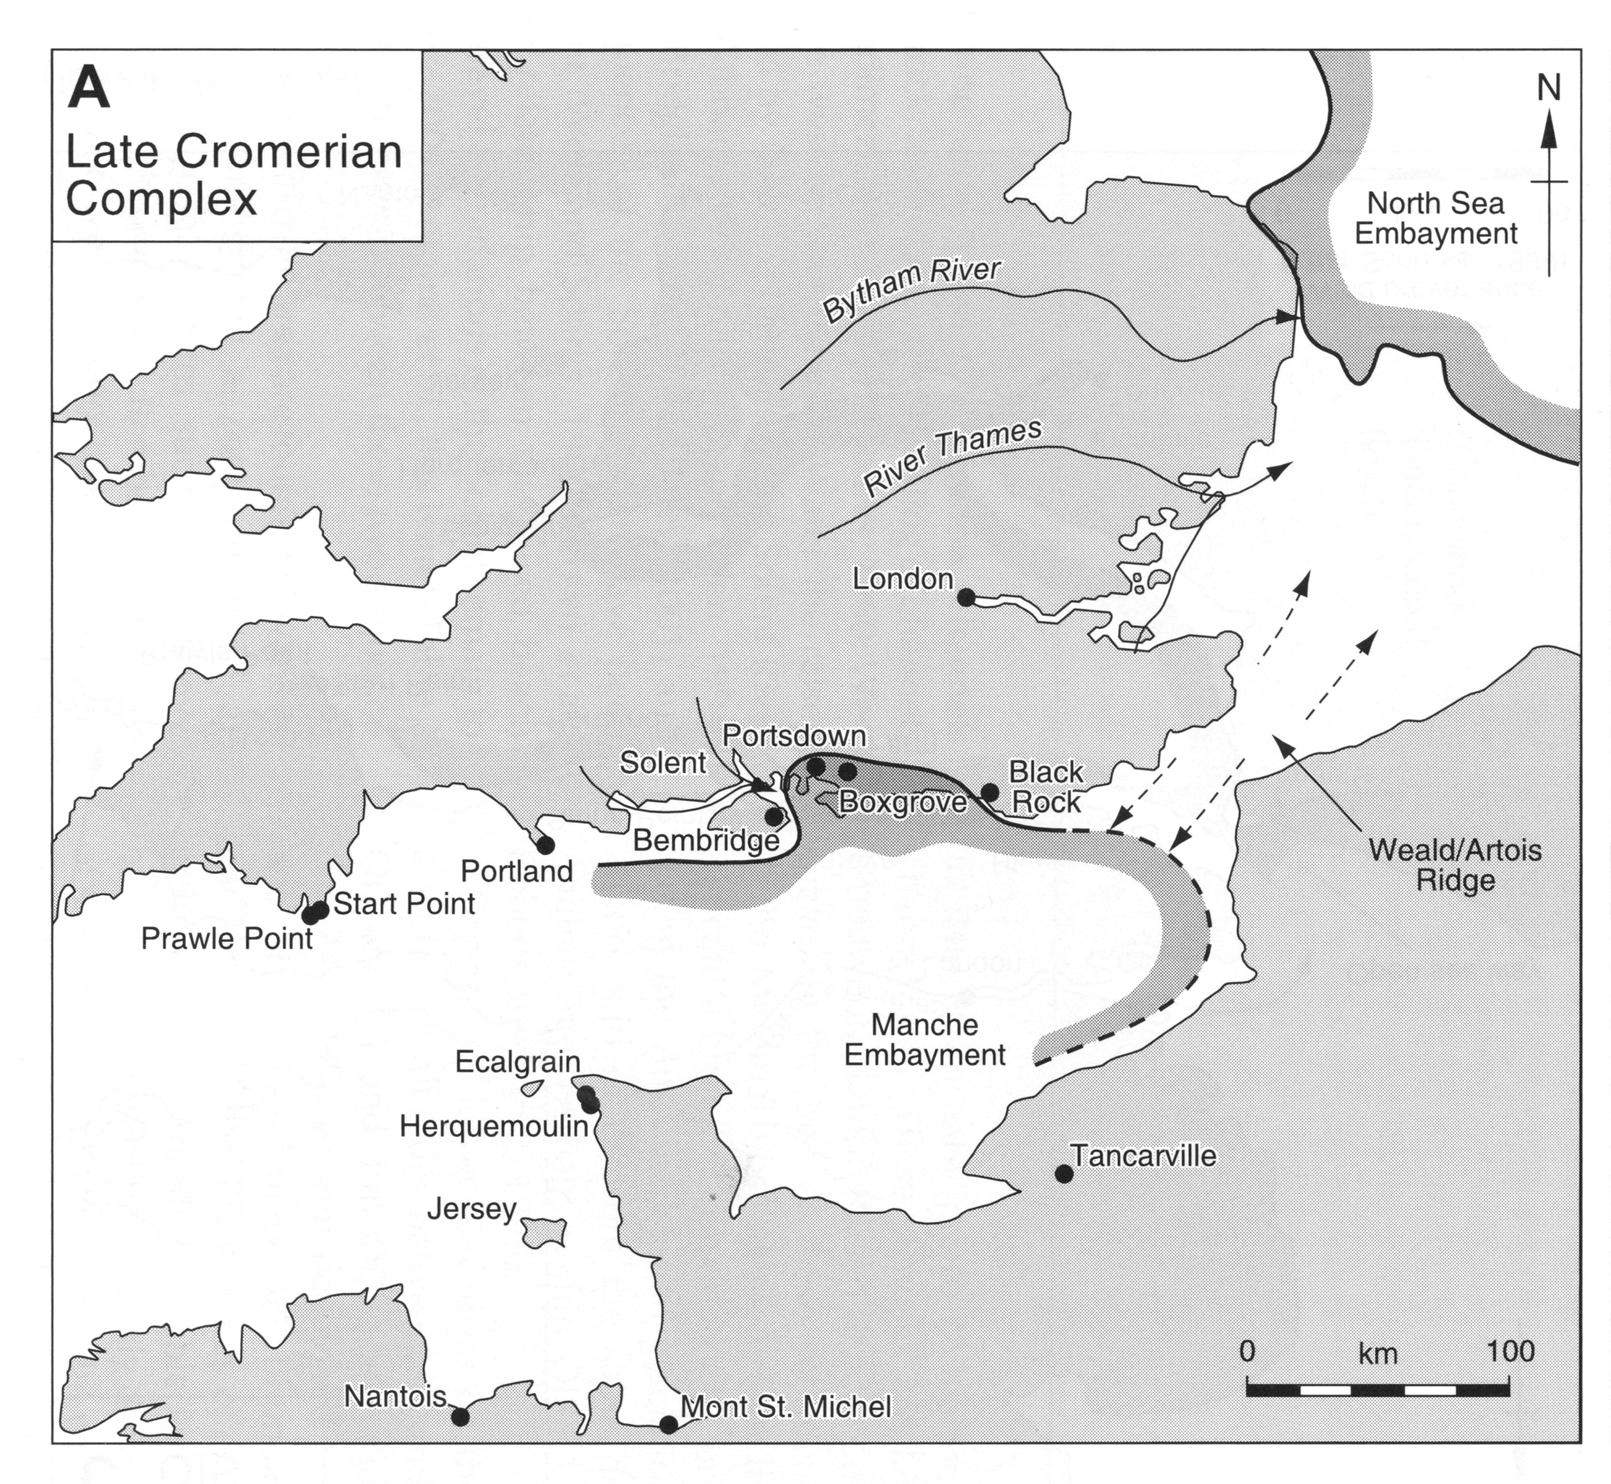
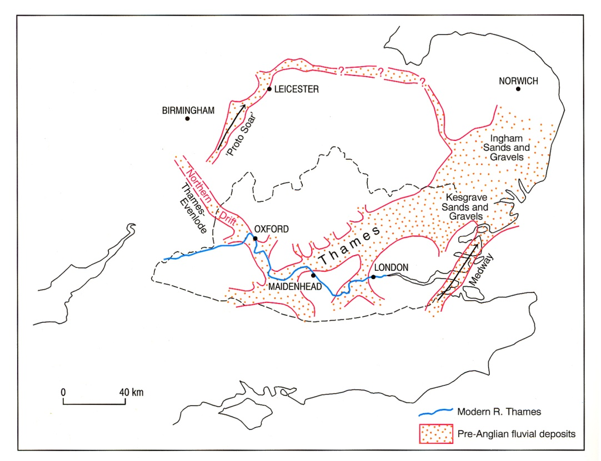
Our landscape during the Cromerian (c.500,000
years ago) was very different to that of the modern
British landscape

Slide 11
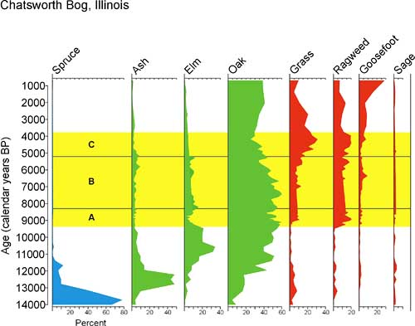

Slide 12
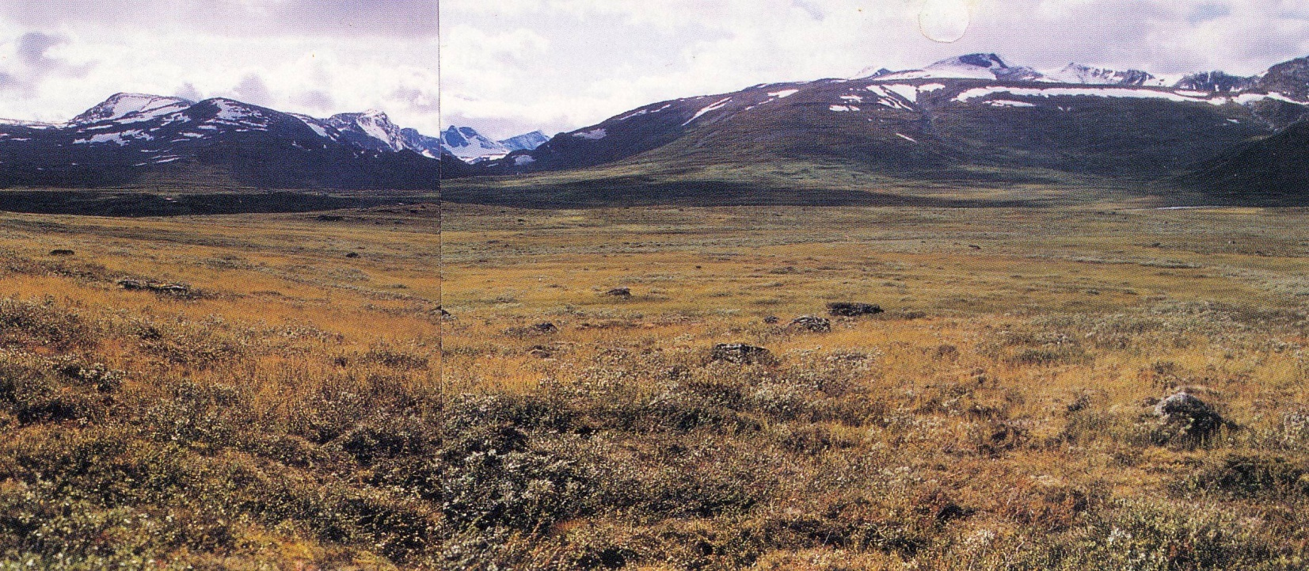
Arctic open tundra landscape

Slide 13
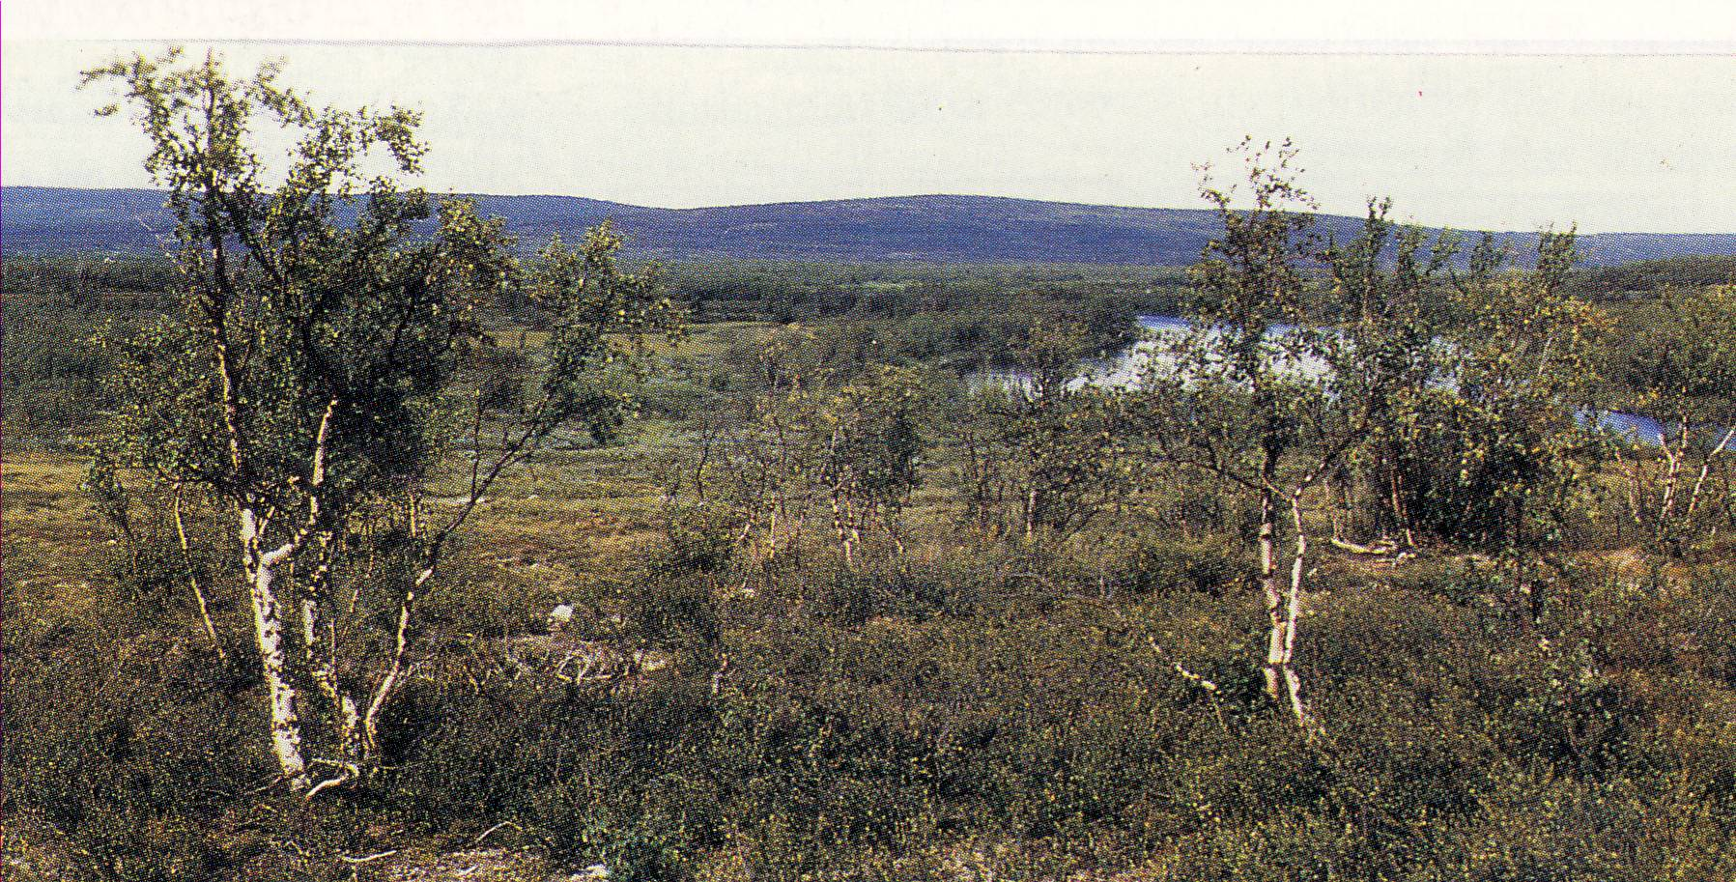
Subarctic semi-open birch forest

Slide 14
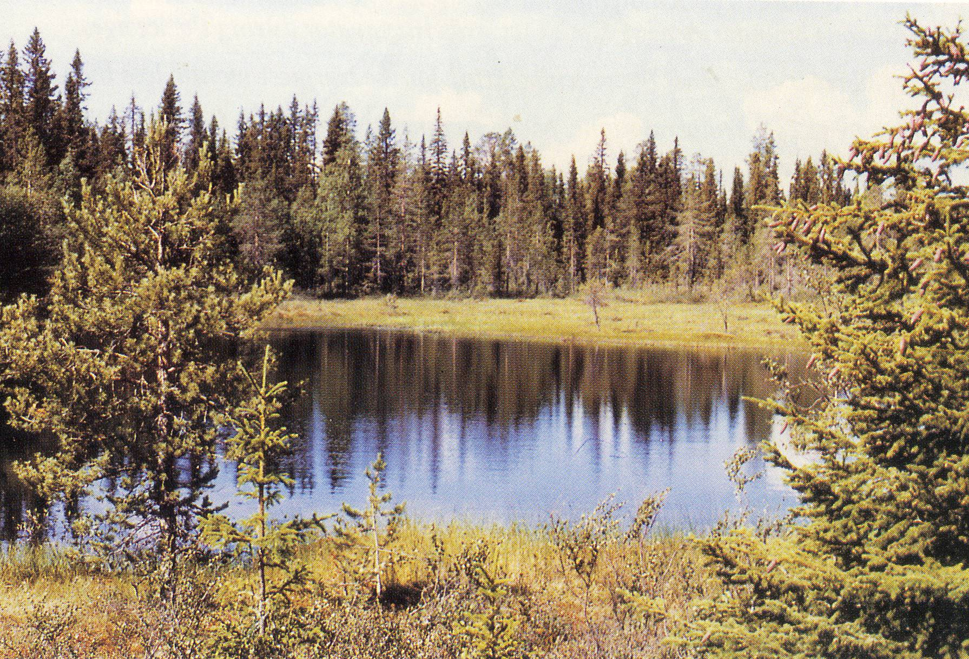
Boreal spruce/pine forest

Slide 15
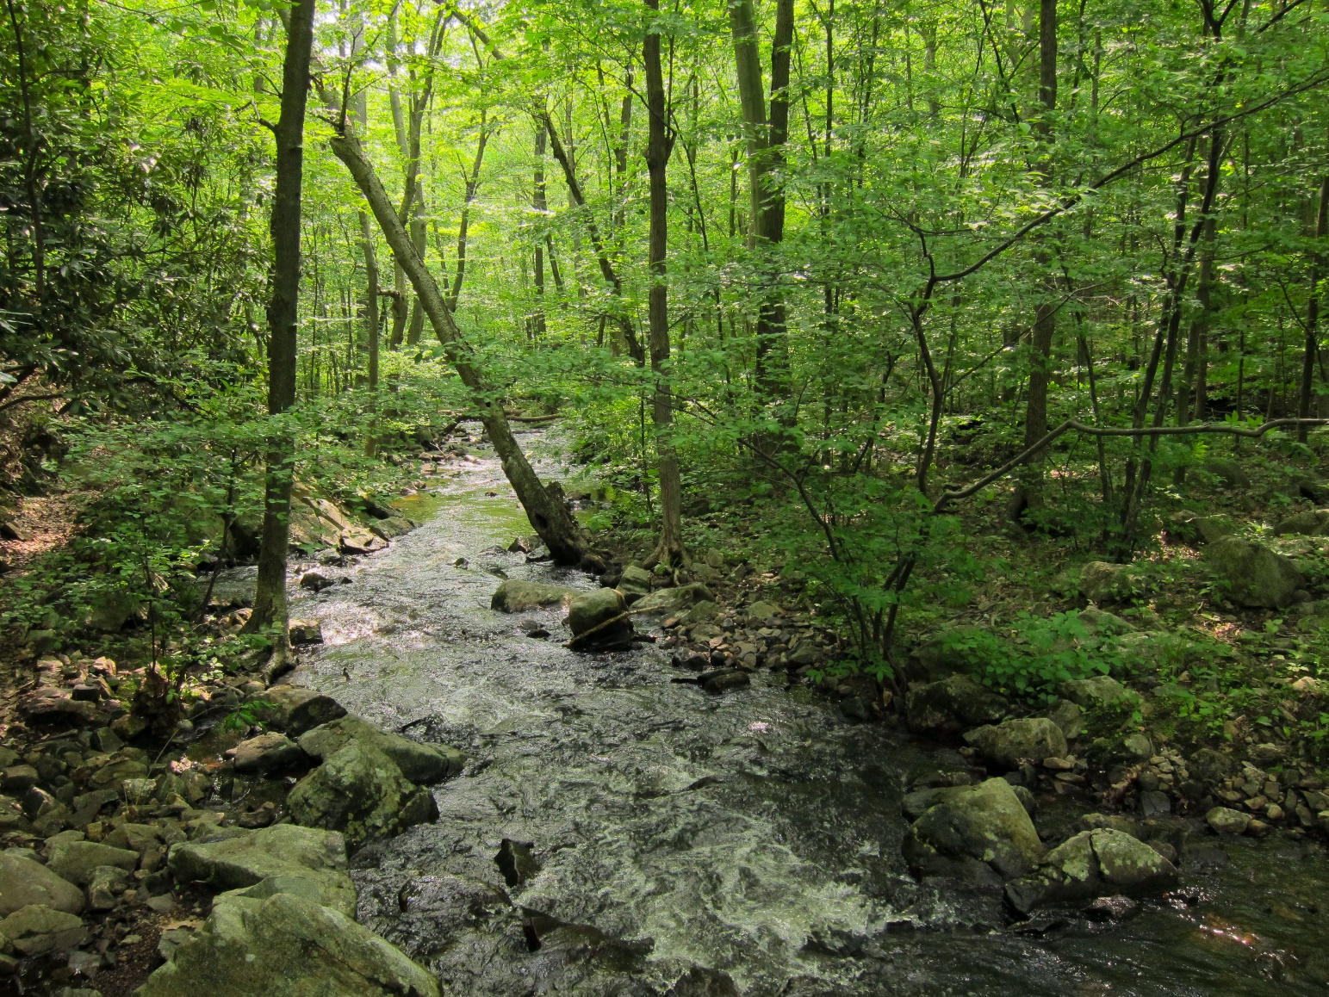
Mixed oak woodland

Slide 16
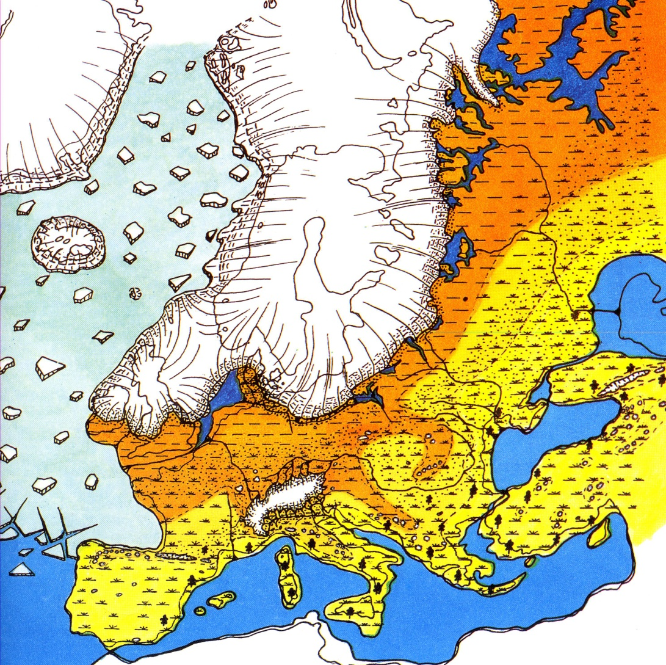
Europe 17-20ka B.P.

Slide 17
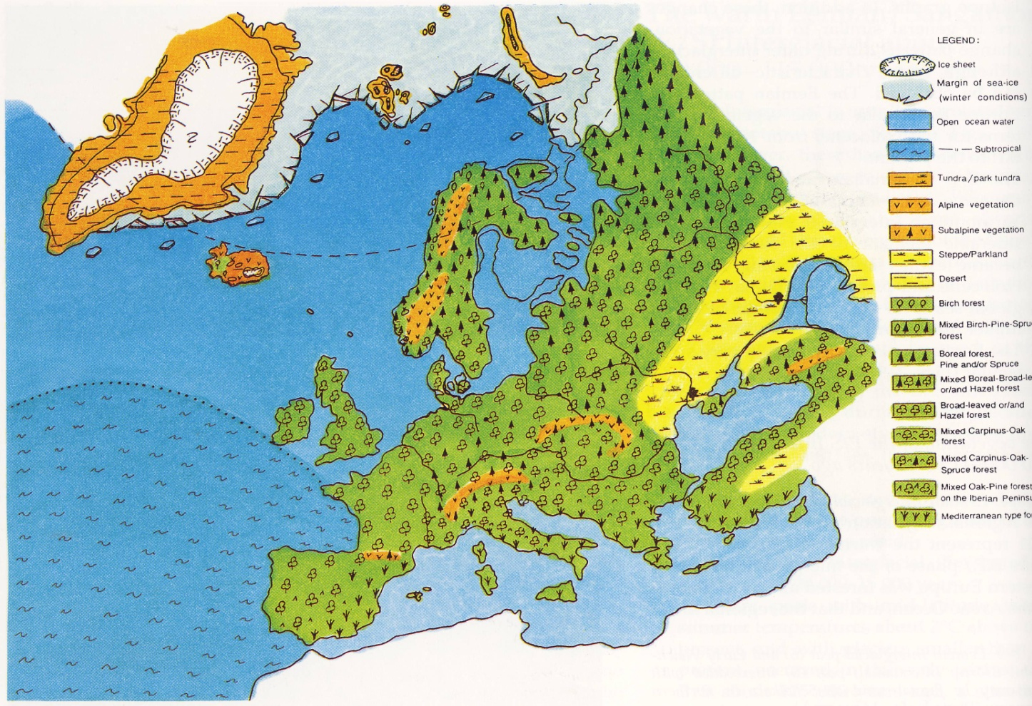
Europe during the last interglacial, 125ka B.P.

Slide 18
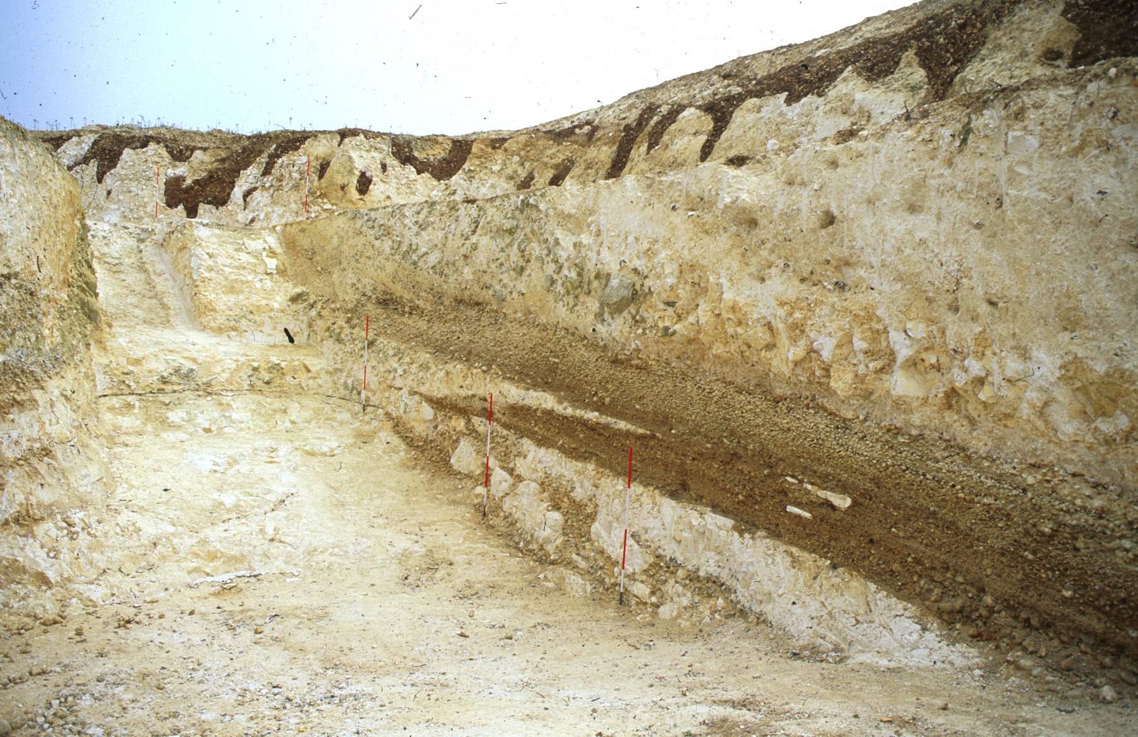
Sea levels rise and fall

Slide 19
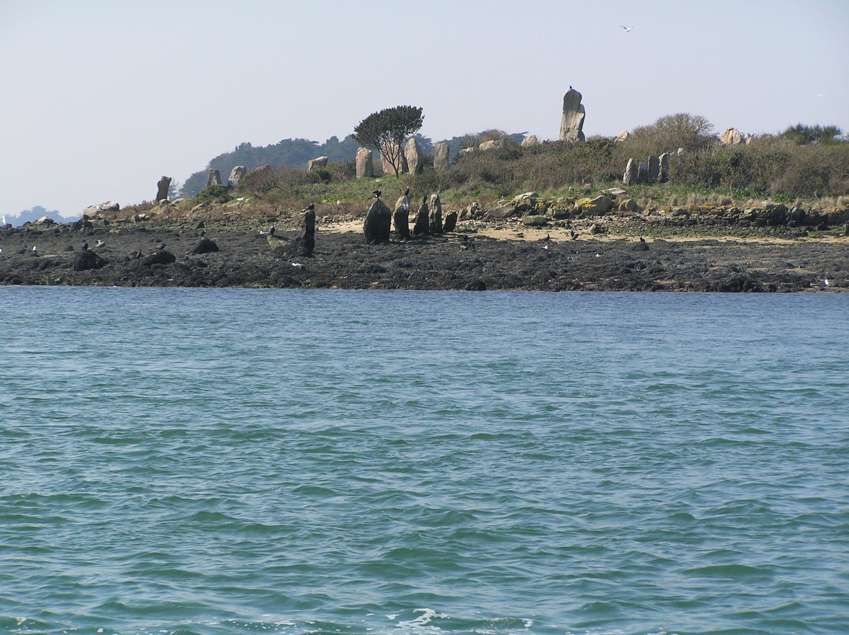
Sea level change

Slide 20
What is the evidence we use?

Slide 21
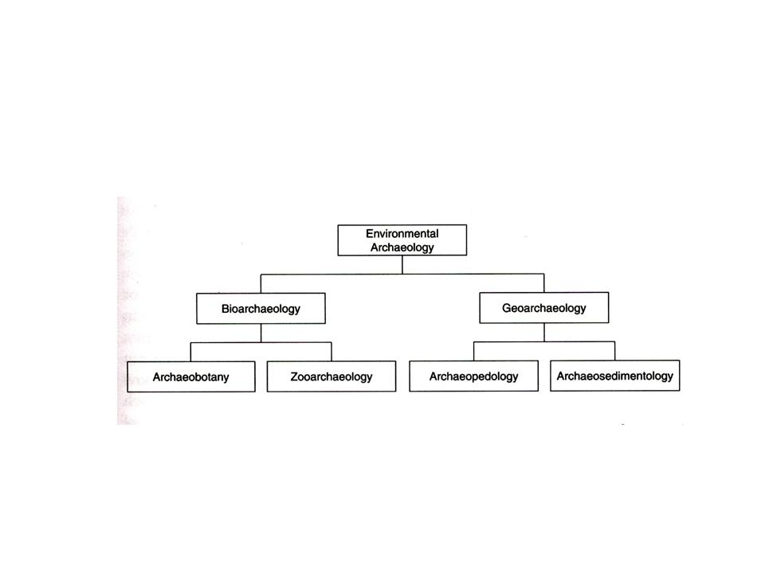
Fields of environmental archaeology

Slide 23
Types of information that can be used to reconstruct landscapes:
Physical geological data on bedrock types and underlying bedrock structures.
Physical information on superficial sediments and soil types.
Vegetation and associated animal life.
Archaeological remains.
These material information classes need to be viewed through models providing information on climate change, human subsistence, human behaviour and human beliefs.

Slide 24
Biological data
Pollen
Plant macrofossils
Diatoms
Vertebrates
Molluscs
Insects
Ostracods
Foraminifera
Insects

Slide 25
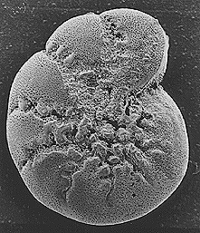

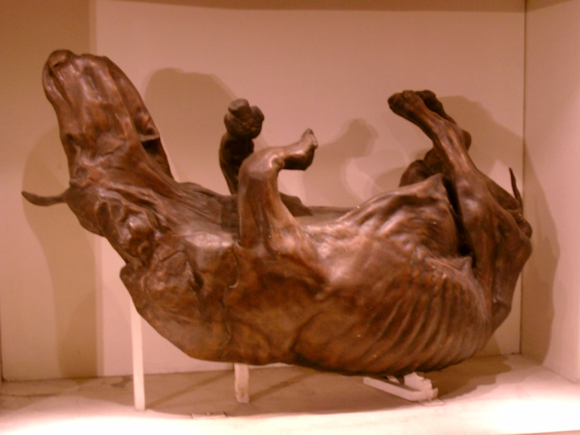
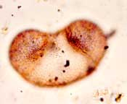
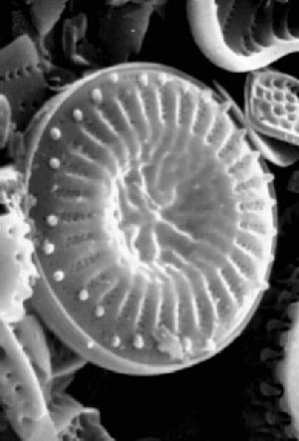
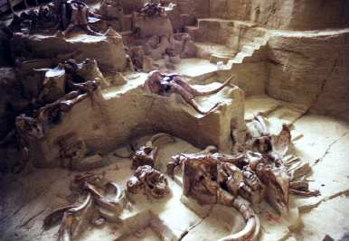
A range of different types of
biological material

Slide 26

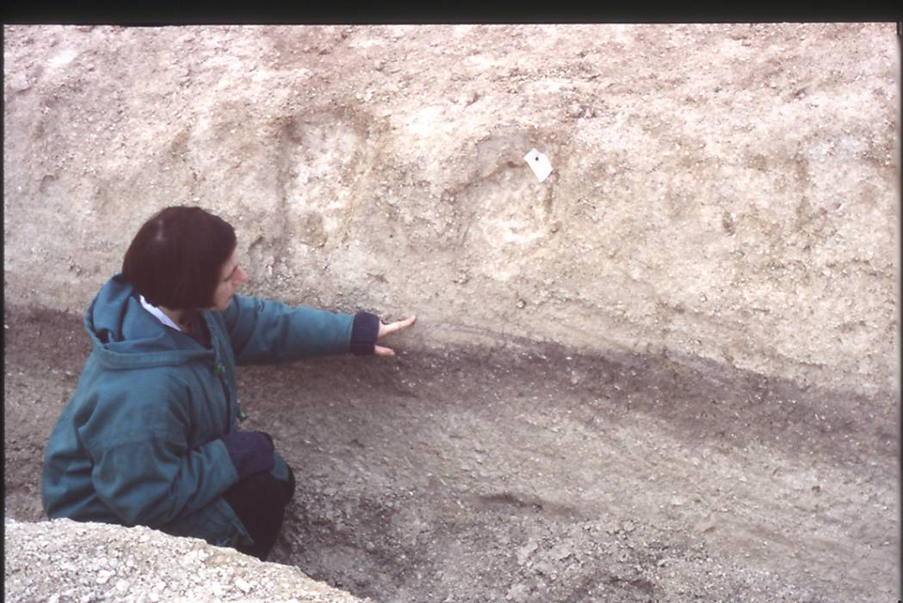
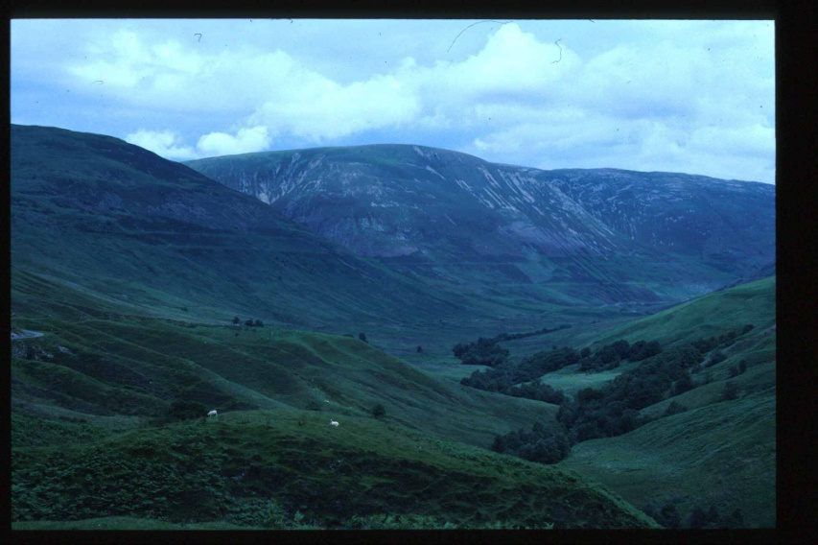
Non-biological evidence

Slide 27
A yard stick for environmental change

Slide 28
Landscapes are formed of a number of elements that interact at both the physical and the interpretative level.

Slide 29
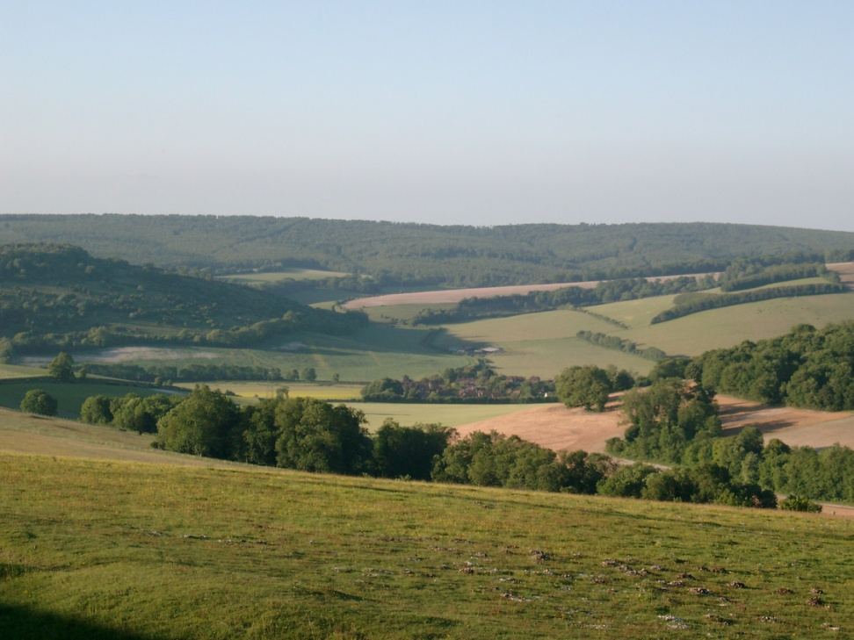
Modern landscapes are formed from the aggregate of properties derived from past processes and landscapes. In order for us to understand modern landscapes and perceive ancient landscapes we must isolate different elements to determine origin of features.
Landscapes are cumulative, they consist of a sum of their parts but are more than that because of the interaction between the sum of their parts. If this is so how can we fully understand them if we are recreating them from a part of the sum of their parts.

Slide 30
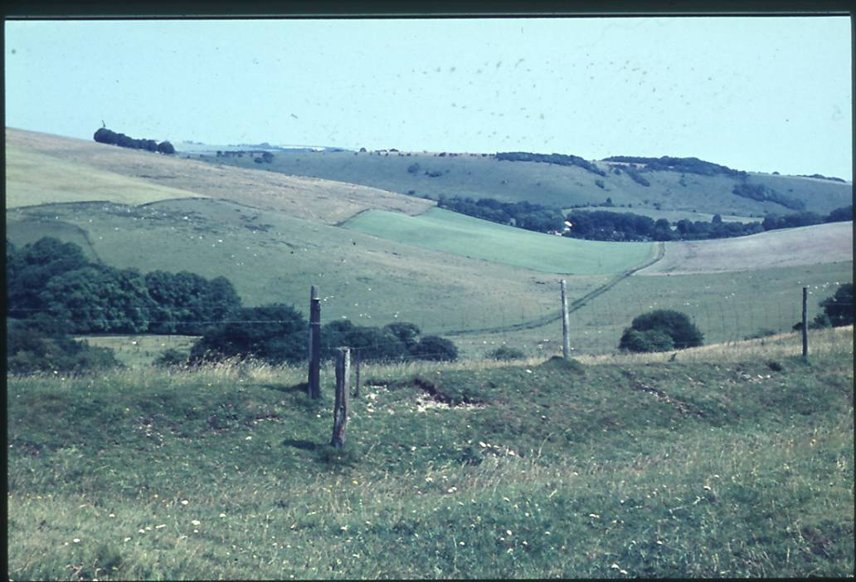
If we are to understand landscapes we must understand the different elements in the landscape.
How do we know what the ‘natural environment or landscape’ was like? What does this term mean to different people?
Part of our investigation of the past landscape is dependant on the principle of uniformitarianism i.e. ‘the present is the key to the past’. However this is only part of the investigation, others would claim that such principles cannot be applied to the human view of the past.

Slide 31
We can think about understanding past landscapes as a series of palimpsest or maps of overlays onto the base map. Each overlay maps different elements or contains information on different elements.
This is very much like how a GIS (Geographical Information System) program works.
Human activity
Rivers
Contours
Geology

Slide 32
Questions to address
What was the environment like?
How did the environment change over time?
How quickly do the environment change?
What were people using in the environment?
How were people using the environment?
What impact were the people having on the environment?
What impact did the environment have on the people of the past?

