Slide 1
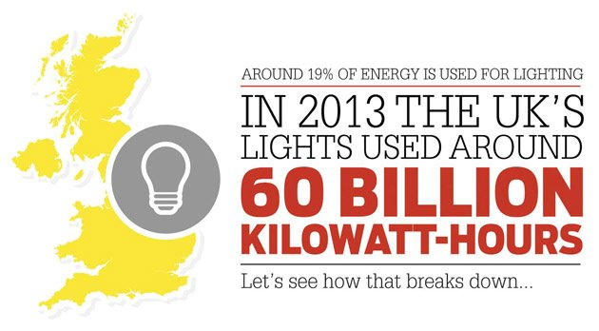
Lighting Energy Useage in UK

Slide 2
UK Lighting Useage

Slide 3
Why is Lighting Important?
It uses up nearly 1/5th of UK’s energy
Correct lighting relates directly to H and S
Correct lighting improves productivity
Smart Lighting reduces energy requirement

Slide 4
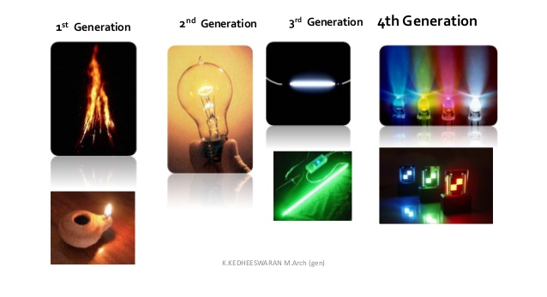
The light vision of the future

Slide 5
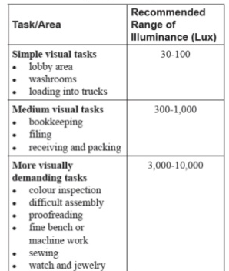
Recommended lighting Levels

Slide 6
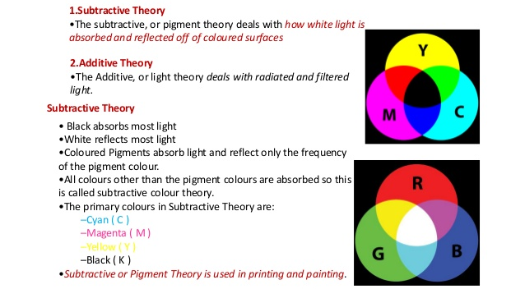
Colour Theory

Slide 7
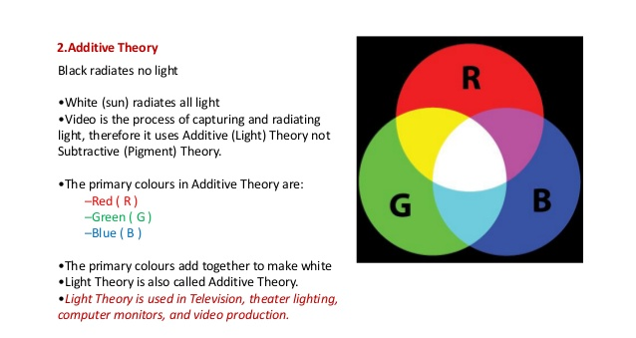
Colour Additive Theory

Slide 8
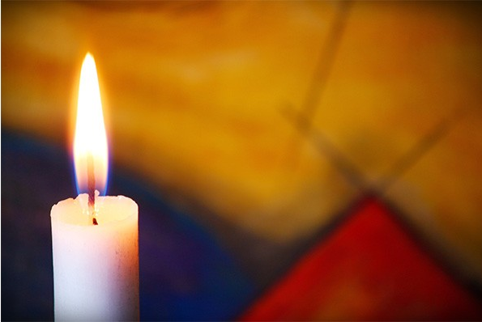
1 Candela Lighting Intensity
Notes:
The candle's lighting intensity is equal to 1 candela

Slide 9
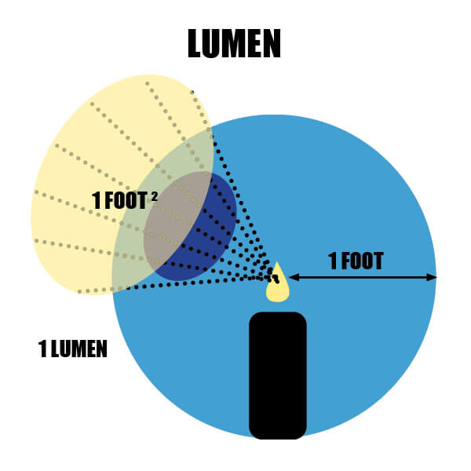
Definition of a Lumen

Slide 10
Lumens (Brightness)
Lumens (denoted by lm) are a measure of the total amount of visible light (to the human eye) from a lamp or light source. The higher the lumen rating the “brighter” the lamp will appear.

Slide 11
Definition of a Lumen
The lumen is a significant entity: it measures the total amount of visible light emitted by a given source. All other measurements are based on the lumen.
The lumen measurement originated from the basic concept of foot-candles; it might be illustrated, more or less, by the image shown next. A more scientific definition exists today, but this drawing helps visualize the lumen.
Picture a candle set in the middle of a sphere measuring 0.60 meters (2 feet) in diameter; when we cut a hole that measures 0.09 square meters (1 square foot) in the centre of this sphere, the light that shines through is what we define as a lumen.

Slide 12
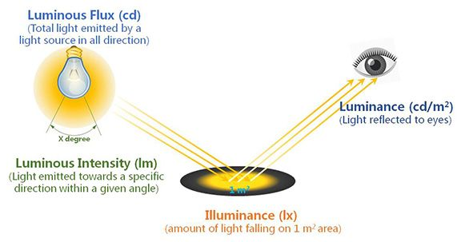
Luminous Flux and Intensity

Slide 13
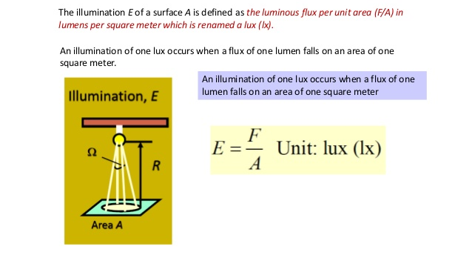
Illumination of a Surface

Slide 14
Typical Illuminance levels (lx)
Mid day the Equator (clear Sky) = 100,000 Lx
Heavily Overcast day in the open = 5,000 Lx
Artificial Light in well lit office = 800 Lx
Full Moon on a clear night = 0.25 Lx

Slide 15
Laws of Illumination
The illumination on a surface depends on:
The luminous intensity.
The distance between the source and the surface being illuminated.
The direction of the rays of light.
This is governed by the following laws:
Inverse square law
Lambert’s cosine law

Slide 16
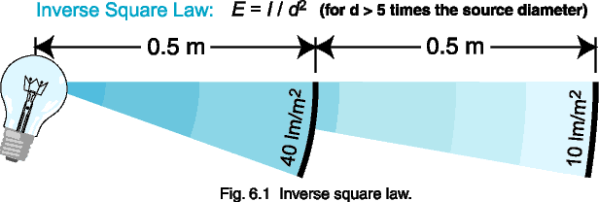
Inverse Square Relationship
E₁ d₁² = E₂ d₂²

Slide 17
Inverse square calculations
You measure 10.0 lm/m² from a light bulb at 1.0 meter. What will the flux density be at half the distance?
What will be the flux density at twice the distance?
If the flux density = 20 lm/m² what is the distance from the light source.

Slide 18
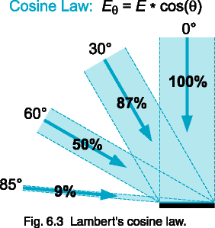
Lambert’s Cosine law
Notes:
In simple terms, the maximum amount of light reflected from a surface will occur when the light is applied perpendicularly to that surface. This reduces as the angle is made more obtuse and varies in relation to the cosine of the angle.

Slide 19
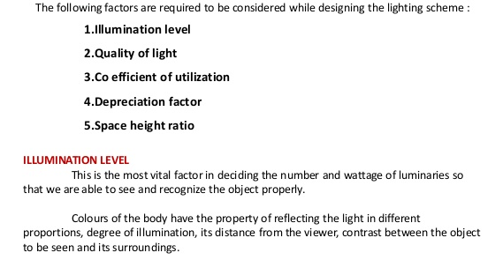
Required Lighting Scheme Factors

Slide 20
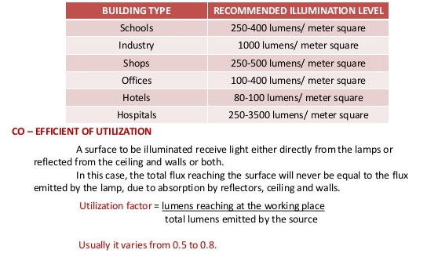
Recommended Work Illumination Levels

Slide 21
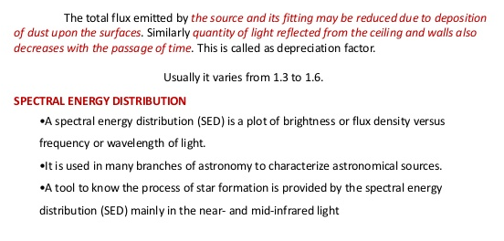
Lighting Depreciation Factor

Slide 22
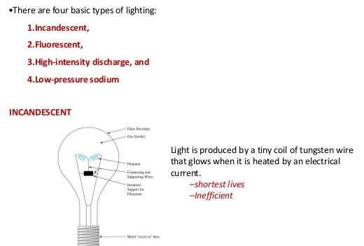
Artificial Lighting Types

Slide 23
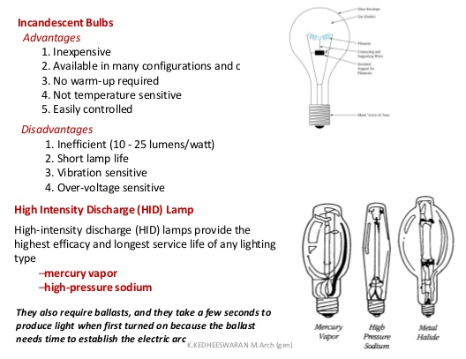
Incandescent Bulbs & HID

Slide 24
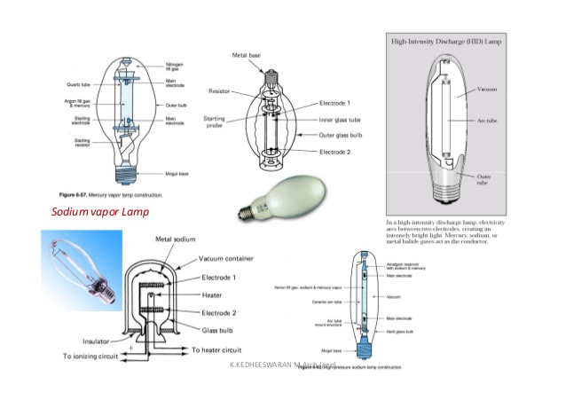
Sodium Vapour Lamps

Slide 25
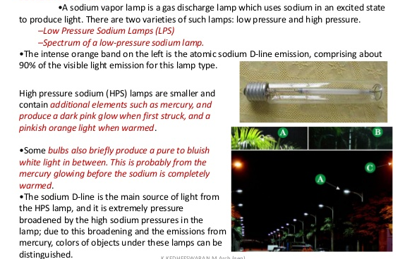
Sodium Vapor Lamps

Slide 26
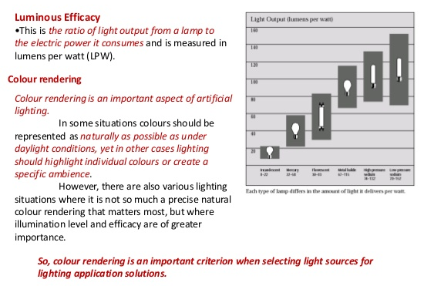
Luminous Efficiency

Slide 27
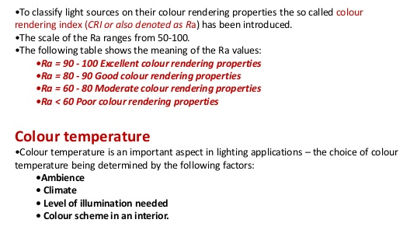
Colour Rendering

Slide 28
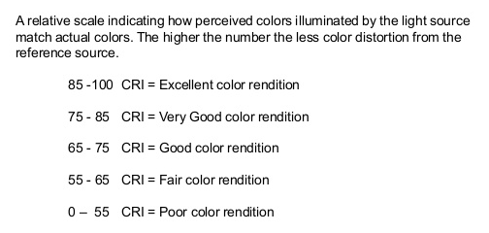
Colour Rendering Index

Slide 29
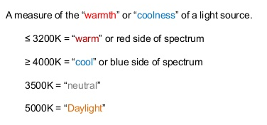
Colour Temperature (K)

Slide 30
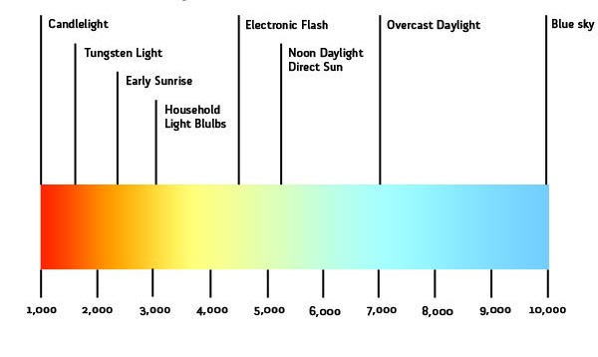
Colour Temperatures (Kelvin scale)

Slide 31
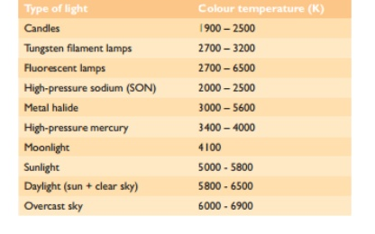
Examples of Colour Temperatures

Slide 32
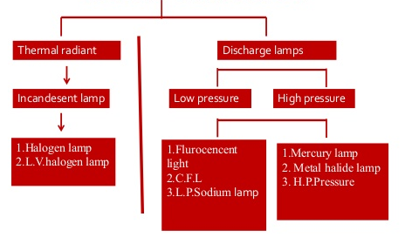
Lighting Classification

Slide 33
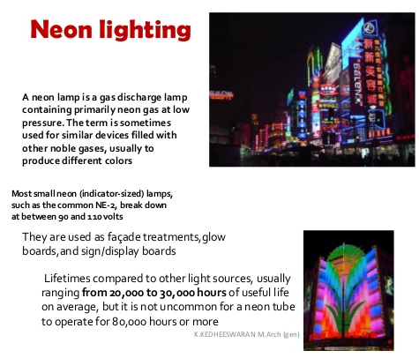
Neon Lighting

Slide 34
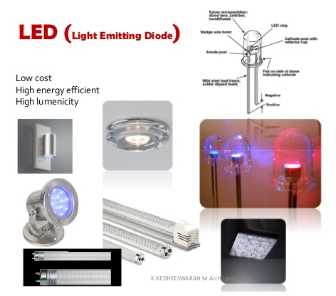
Light Emitting Diodes (LED’s)

Slide 35
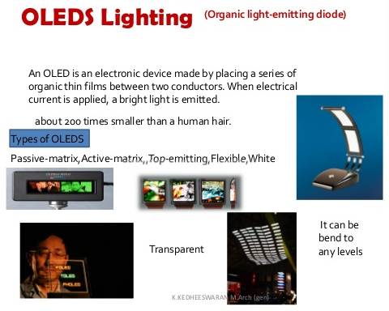
Organic light-emitting Diode(OLED’s)

Slide 36
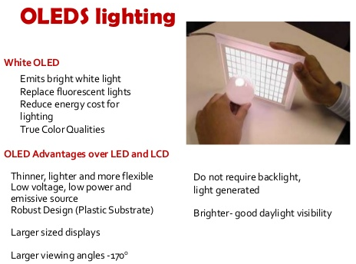
OLED’S Lighting (Advantages)

Slide 37
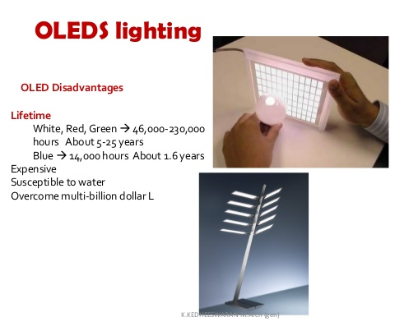
OLED’S Lighting (Disadvantages)

Slide 38
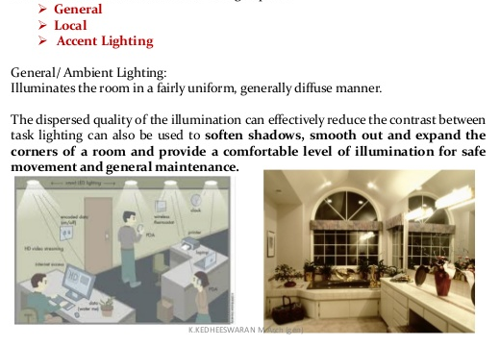
Space Illumination

Slide 39
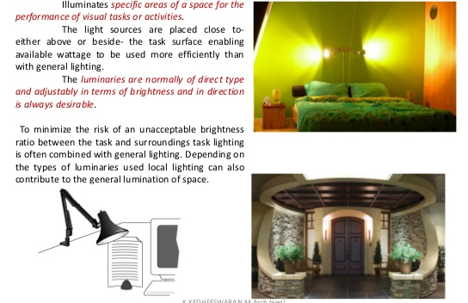
Localised (Task) Lighting

Slide 40
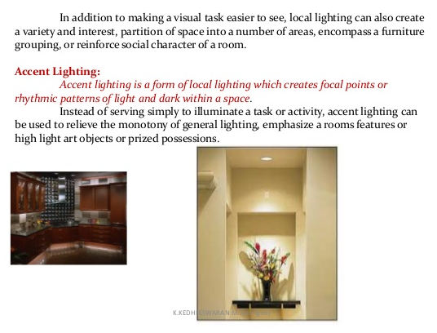
Accent Lighting

Slide 41
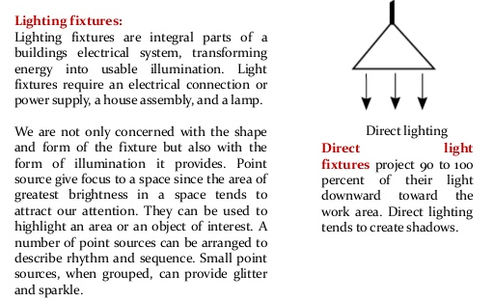
Lighting Fixtures

Slide 42
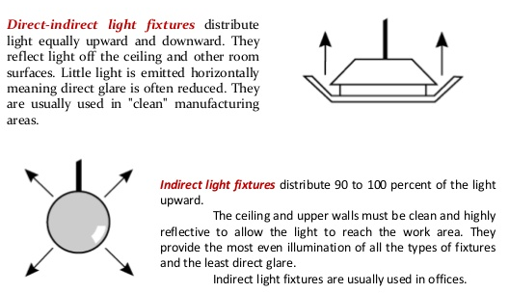
Direct & Indirect Light Fixtures

Slide 43
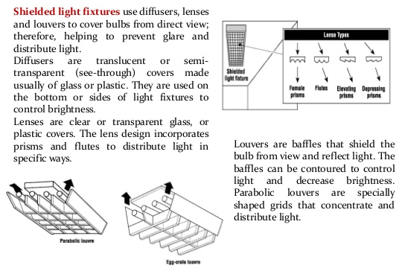
Shielded Light Fixtures

Slide 44
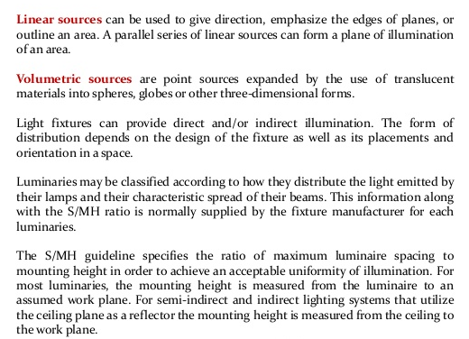
Linear & Volumetric Sources

Slide 45
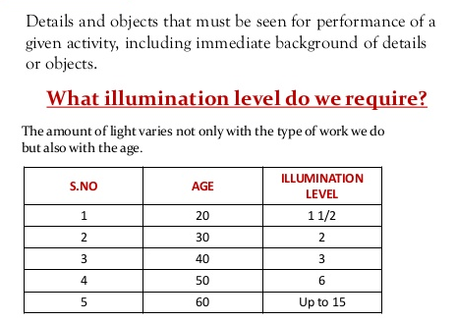
Visual Tasks Illumination Levels

Slide 46
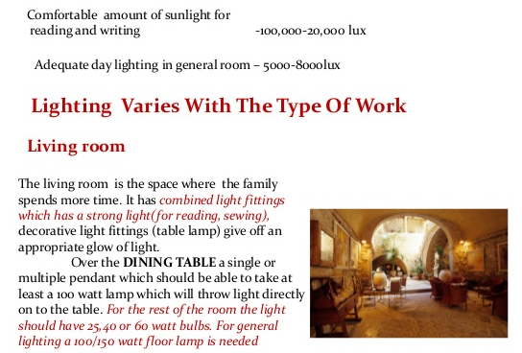
Lighting Levels

Slide 47
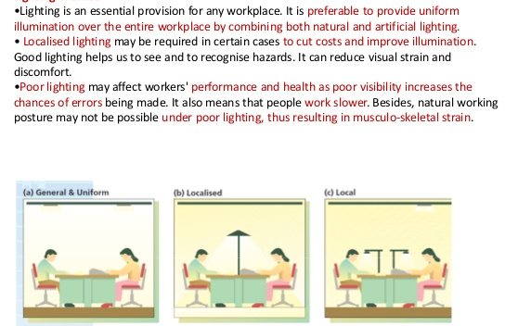
Lighting in Office

Slide 48
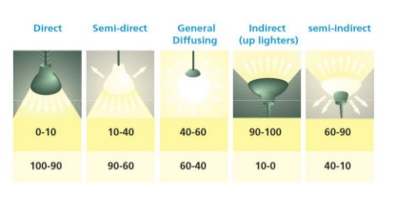
Lighting Distribution Classification

Slide 49
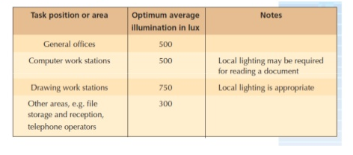
Optimum Mean Office Illuminations

Slide 50
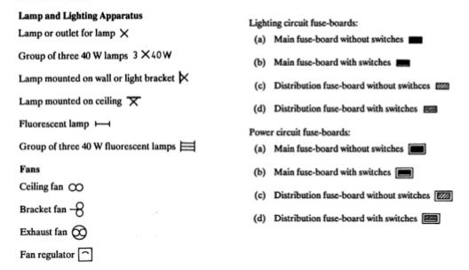
Lighting Symbols

Slide 51
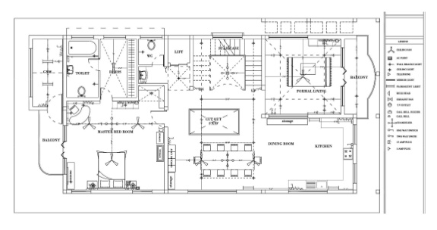
Lighting Diagrams

Slide 52
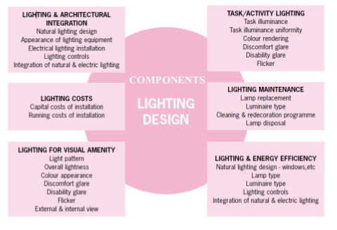
Lighting Design

Slide 53
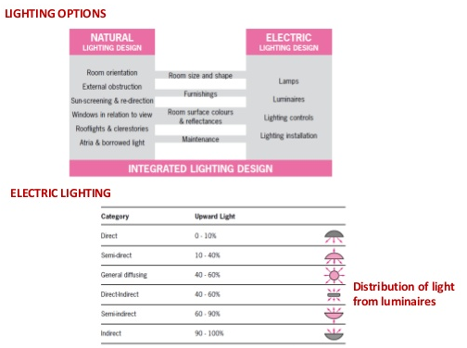
Lighting Options & Electric Lighting

Slide 54
Statistical Exercise
The life expectancy of a sample of 10 light bulbs on a stretch of M4 is
as follows:
8000, 7900, 8100, 7950, 8050, 7800, 7900, 8200, 8100, 8000 hours.
Calculate the mean, and standard deviation for this sample.
What proportion of lights have a life in excess of 8100 hours?
If you want to guarantee that 95% of the lights are on when would you
replace all the lights?
If you want to guarantee that 99% of the lights are on when
would you replace all the lights?

