Slide 1
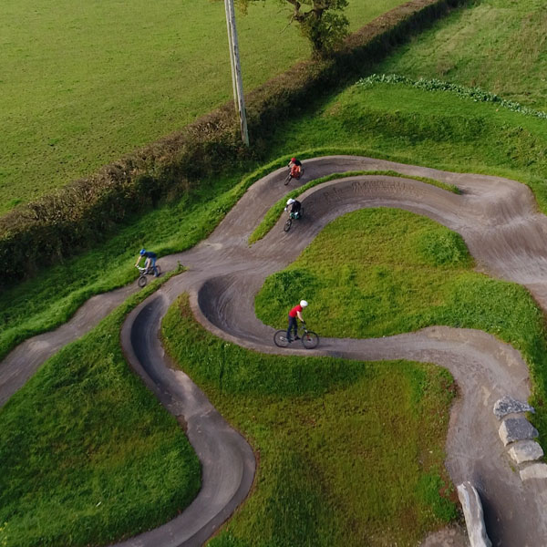
BA Addysg Antur Awyr Agored L6
BA Outdoor Adventure Education L6
Ceisiadau, ffurflenni
& CVs
Applications, forms
& CVs
Gwasanaeth Gyrfaoedd
Careers Service

Slide 2
Eitem |  | Item
Cyflwyniad | 1 | Introduction
Materion chwilio swyddi gwag | 2 | Vacancy searching issues
Egwyddorion ymgeisio | 3 | Application principles
CVu | 4 | CVs
Ffurflenni gais | 5 | Application Forms
Gwybodaeth bellach | 6 | Further information

Slide 3

1
GYRFAOEDD & CHYFLOGADWYEDD
CAREERS & EMPLOYABILITY
Darganfod mwy
Find out more
W

Slide 4
2
Archwilio'r materion chwilio swyddi gwag | 2 | Exploring vacancy searching issues
Notes:
#1 a. Who/How many started? b. One word to describe it? c. DESIRED OUTCOMES from this session

Slide 5
Progress to date?
2a
Rhy straen i feddwl
Heb feddwl amdano
Wedi meddwl amdano
Rhywfaint o weithredu
Rhai ceisiadau
Eithaf gweithredol yn y ddau
Trefnwyd
Too stressful to think
Not thought about it
Thought about it
Some action
Some applications
Quite active in both
Sorted
Notes:
2b a. Who/How many started? b. Where out of these options? c. One word to describe it? d. DESIRED OUTCOMES from this session

Slide 6

Issues faced? a) negating initial activity/motivation? b) In the actual applying?
2b
Flip Feedback
Notes:
Flipchart !!!!!!!! 2b D. PAIRS >>> Issues/Solutions 10 mins

Slide 7
3
Egwyddorion ymgeisio | 3 | Application principles

Slide 8
What could help you … a) Manage the whole thing? b) Make better applications?
3
3c
Flip Feedback
Notes:
Flipchart !!!!! 3c Pairs – same 10 mins

Slide 9
TREFNWCH
GET ORGANISED
3
?
1

Slide 10
TREFNWCH
GET ORGANISED
3
?
1

Slide 11
Strategaeth Strategy
3
Ansawdd v maint
Hyblygrwydd v dewis
Ychydig/aml v ‘1 fawr’
Trin gwrthod
Dysgu'r grefft
Dysgu Pareto
Quality v quantity
Flexibility v preference
Little/often v big bang
Handling rejection
Learning the art
Learning Pareto
2

Slide 12
Ffindio swyddi gwag Finding vacancies
3
Cymysgwch eich ffyn?
MAWR e.e. Indeed.co.uk
Proffesiwn e.e. IOL
Cyflogwyr
  ALL
  YHA
  annibynnol
Asiantaethau
Rhwydwaith, GoG, Spec
Mix your sources?
BIG e.g. Indeed.co.uk
Profession e.g. IOL
Employers
  LA’s
  YHA
  independents
Agencies
Network, WoM, Spec

Slide 13

Eich cymysgedd marchnata
3
Chi
Nhw
£ Pris
Lle
Lleoliaeth
Hyrwyddo
Cynnyrch

Slide 14
Eich cymysgedd marchnata
3
Chi
Nhw
£ Pris
Lle
Lleoliaeth
Lleoliaeth
Hyrwyddo
Cynnyrch

Slide 15
The marketing mix
3
Yours
Theirs
Positioning

Slide 16
The marketing mix
3
Yours
Theirs
Positioning
Positioning

Slide 17
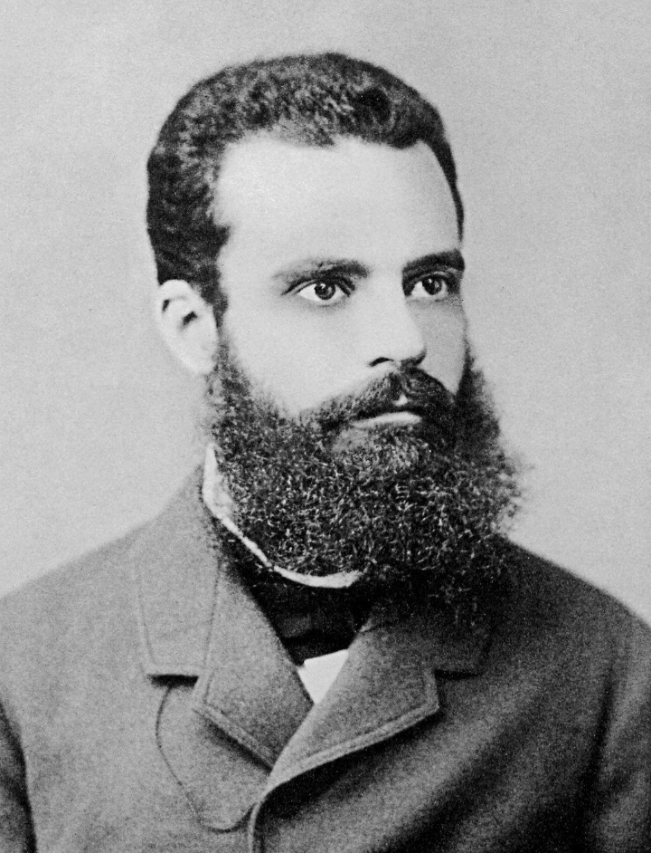
3
4

Slide 18
3
4
Pareto

Slide 19
3
80/20
4
Pareto

Slide 20
Gwrthdroi'r rôl? Roles reversed?
3
5

Slide 21
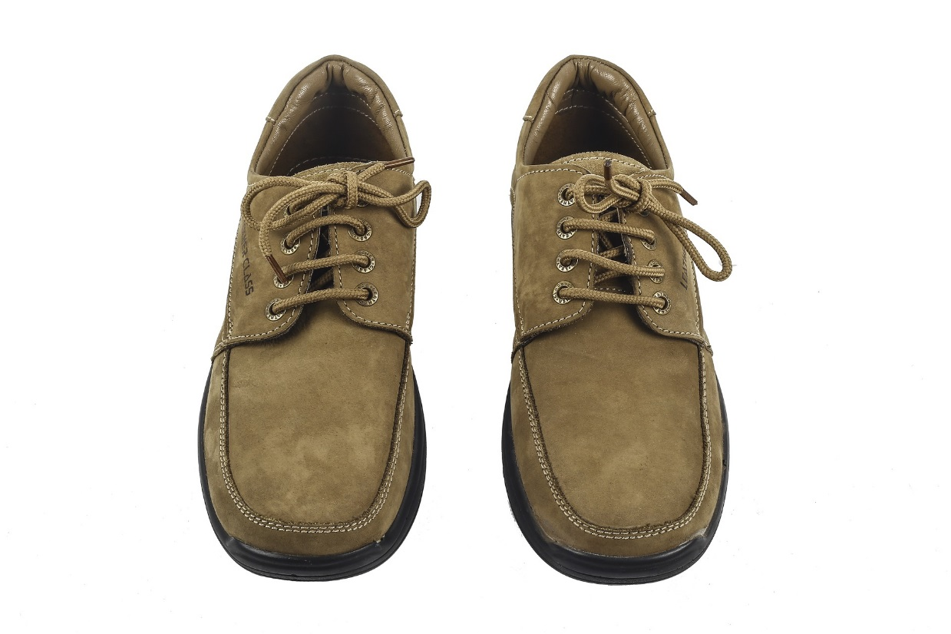
Gwrthdroi'r rôl? Roles reversed?
3
5
Image by Pashiminu, Pixabay; CC0 Public Domain

Slide 22

“Hiring the right people takes time, the right questions and a healthy dose of curiosity.
What do you think is the most important factor when building your team?
Richard Branson
3
5

Slide 23
“Hiring the right people takes time, the right questions and a healthy dose of curiosity.
What do you think is the most important factor when building your team?
For us, it’s personality.”
Richard Branson
3
5

Slide 24
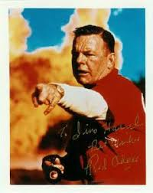
“If you think it’s expensive to hire a professional, wait until you hire an amateur.”
3
5
Red Adair

Slide 25
100%
3
6

Slide 26
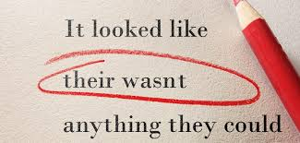
Granmar & Spelin
3
7

Slide 27
CV | 4 | CV

Slide 28
Diffiniad Definition
4
Curriculum Vitae

Slide 29
Diffiniad Definition
4
Curriculum Vitae
Latin: [the] course of [my] life
Lladin: cwrs fy mywyd

Slide 30
Cyd-destun CV CV in context
4
Pryd i ddefnyddio?
  Cais (swydd wag)
  Cais (hapfasnachol)
  Offeryn Cofnod / Myfyriol
Mathau?
Stoc a Theiliwr
Llythyr eglurhaol?
Barn yn amrywio'n fawr
When to use?
  Application (vacancy)
  Application (speculative)
  A Record / Reflective tool
Types?
Stock & Tailor
Covering letter?
Views vary greatly

Slide 31

Break the task down
4
Research & Thinking:
Job, Employer, Sector, Themes & unwritten
Establishing CRITERIA!
Writing:
Evidencing criteria
Excellent English/Welsh
STAR writing
Grammar & Spelling
Relevance
Structure & format:
On-line / Off-line
Font, Tabs,
Indent, Bold
Shape, Space allocation

Slide 32
Ysgrifennu’n gryf Writing strongly
4
GADEWCH MEINI
PRAWF GYRRU CHI
Bwledi / uniongyrchol
Gwyb. berthnasol
Berfau Power '... wyd‘
Gwyliwch orwneud ‘wnes I’
Amserau
Uchafswm ymadrodd
Cadwch gwirio m/prawf
LET CRITERIA
DRIVE YOU
Bullets / Punchy
Relevant
Power Verbs ‘…ed’
Watch overuse of ‘I’
Tenses
Active phrase maximis.
Keep checking criteria

Slide 33
Berfau pwerus Power verbs:
4
Datblygwyd
Trefnwyd
Cyflawnyd
Gychwynnwyd
Perfformiwyd
Rheolwyd
Grewyd
Developed
Organised
Achieved
Initiated
Performed
Managed
Created

Slide 34
Ffurfleni gais | 5 | Application forms

Slide 35
Rheolwyr brysur? Busy Managers?
5
“Never employ unlucky people”.
“Always start by putting half the applications in the bin”
David Brent
{BBC, The Office}

Slide 36

5
‘Passport Application’ by Ben Ward, Covent Garden via Flickr, (CC BY-NC-ND 2.0)

Slide 37
Amrywiadau Variations
5
Camau
Electronig neu Copi caled
Sail tystiolaeth
Angen tystiolaeth
Ymddangosiad
Arddull a diwylliant
Nodiadau canllaw Tystiolaeth ychwanegol
Stages
Electronic or H/C
Evidence basis
Evidence required
Appearance
Style & culture
Guidance notes
Additional evidence

Slide 38
5
Question – Source/Link – Answer structure
THEIR CRITERIA | Source | Answer frame/structure
c) Evidence of providing high quality customer service | Trek retail (Swansea) | Role; Normal CS; Over & above
d) Ability to demonstrate effective organisational skills | Volunteer Fair | Event; role; issues; examples; what you did {STAR}
n) Demonstrates self-motivation and the ability to work unsupervised | > CV > Salvation Army | CV – track record … 1#SA – role; not missed a day; I like to see things through; work on own; keen to show well …. 2#Degree .. Manage family, work etc.

Slide 39

Gwybodaeth bellach | 6 | Further information

Slide 40
4

Slide 41
UD / UK
https://www.prospects.ac.uk/jobs-and-work-experience/job-sectors/leisure-sport-and-tourism
https://www.prospects.ac.uk/job-profiles/outdoor-activities-education-manager
http://www.sportengland.org/
Look for job vacancies at …

Slide 42



6

Slide 43

Cwestiynau?
6
Questions?

Slide 44
Diwedd

Slide 45


