Slide 1

Health, Wellbeing and Sustainable Development in Modern Healthcare
(Tecnomaco, 2022)
Student Name: Tasha Young
Student Number:
Module: BMHP6030-Health, Wellbeing and Sustainable Development.
Lecturer: Dr Itse Olaoye
Date: July 2026

Slide 2
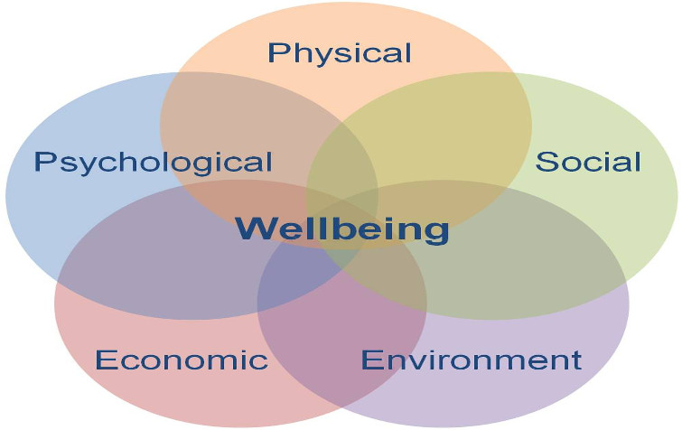
Introduction
This presentation critically explores how health, wellbeing and sustainable development are integrated across the health and social care sector. It examines why these concepts are now central to modern policy, service delivery and public health practice, and evaluates how their integration influences the quality, equity and sustainability of care.
(Bing, 2026)

Slide 3
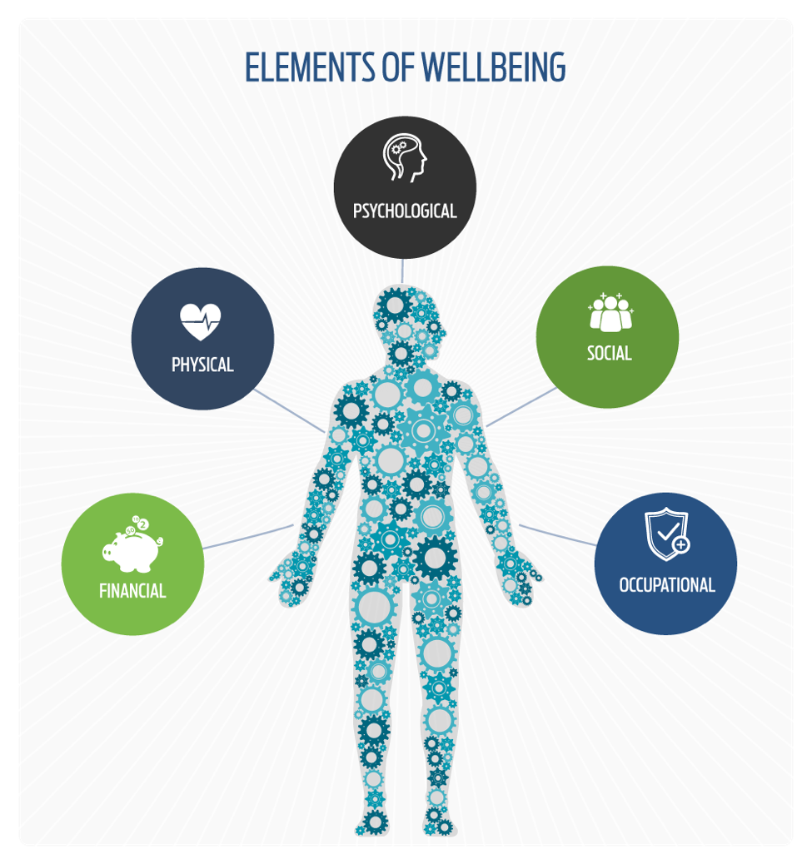
Key Concepts
. Health- Health is increasingly recognised as a holistic condition shaped by physical, mental and social factors, moving beyond the narrow idea of health as only the absence of disease. This wider definition recognises that health outcomes are shaped by biological factors, psychological resilience and social environments such as housing, income and community support (World Health Organization, 2024).
Wellbeing-Wellbeing extends the idea of health by focusing on emotional stability, life satisfaction, supportive relationships and social connection. It reflects how people feel, function and engage with their surroundings, and is increasingly used in UK policy to guide prevention, mental health support and community‑based care (NHS England, 2024).
Sustainable Development-Sustainable development links both health and wellbeing by emphasising that services must meet current population needs while protecting resources, environments and future generations. In health systems, this includes reducing inequalities, improving long‑term outcomes and ensuring that care models remain resilient and environmentally responsible (World Health Organization, 2024).
(USPM, 2024)

Slide 4

Sustainable Development
The Sustainable Development Goals (SDGs) are 17 global targets created by the United Nations to help countries improve health, reduce inequalities, protect the environment and strengthen social and economic wellbeing. They act as a shared international framework for tackling major global issues such as poverty, climate change and health disparities (United Nations, 2024).

Slide 5
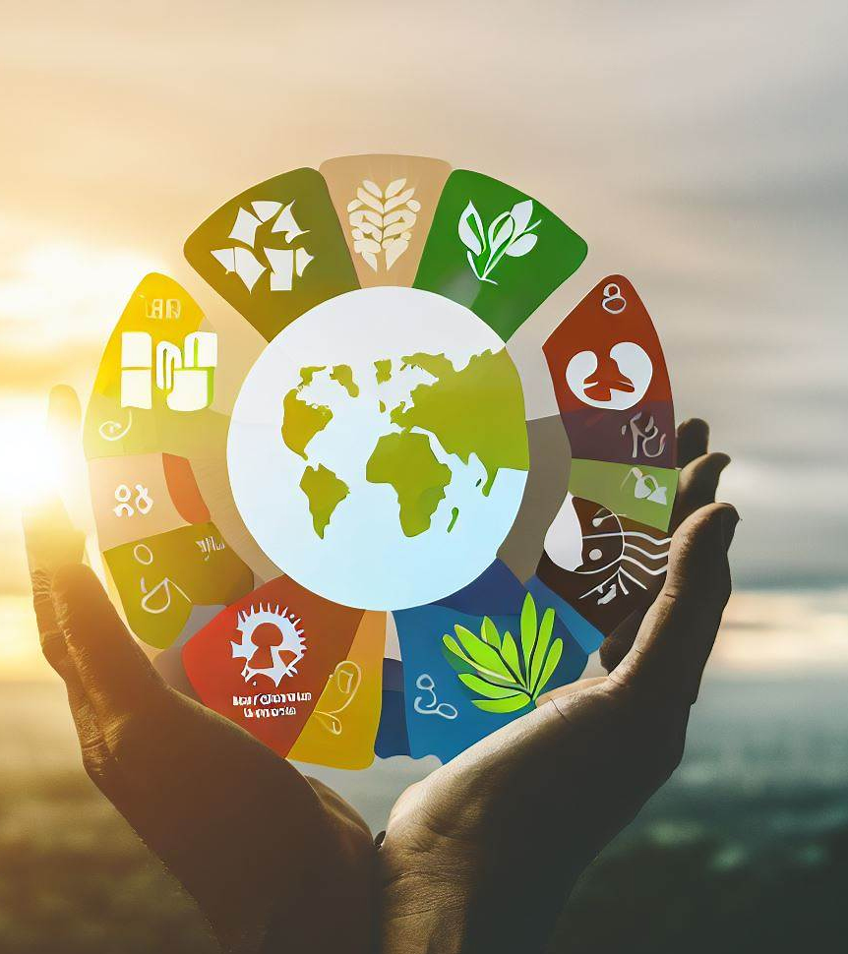
Sustainable Development Goals
Sustainable Development
Ensuring that society’s needs are met now in a way that protects the capacity of future generations to thrive. (UNDP, 2024).
Encourages long‑term planning, efficient resource use and environmentally responsible healthcare.
SDGs in Health and Social Care
Provide a global framework linking health, equity and environmental sustainability (UNEP, 2024).
Guide national policies and public health strategies.
SDG 3 – Good Health and Wellbeing
Focuses on reducing preventable illness and improving access to essential health services.
SDG 10 – Reduced Inequalities
Aims to close health gaps linked to income, geography, disability and ethnicity (UNICEF, 2024).
SDG 13 – Climate Action
Highlights climate change as a major health risk and promotes climate‑resilient healthcare systems (UN Climate Change, 2024).
(Anon, 2025)

Slide 6

Relevance in Modern Healthcare
The SDGs embed health, wellbeing and sustainability across international policy, encouraging countries to adopt long‑term, equitable and environmentally responsible health strategies (UNDP, 2024).
They guide how health systems plan services, reduce inequalities and respond to environmental pressures.
NHS Long Term Plan
The NHS Long Term Plan aims to shift the system toward prevention and community‑led support, helping to reduce the strain placed on acute healthcare settings.(NHS, 2019).
Strong emphasis on mental health expansion, personalised care and integrated local services.
Environmental Sustainability in Healthcare
Healthcare organisations are increasingly adopting “green hospital” approaches to reduce emissions, improve energy efficiency and minimise waste (Health Care Without Harm, 2024).
Climate‑resilient infrastructure is becoming essential as environmental risks directly affect population health and service demand.
(Tiga Healthcare Technologies, 2024)

Slide 7
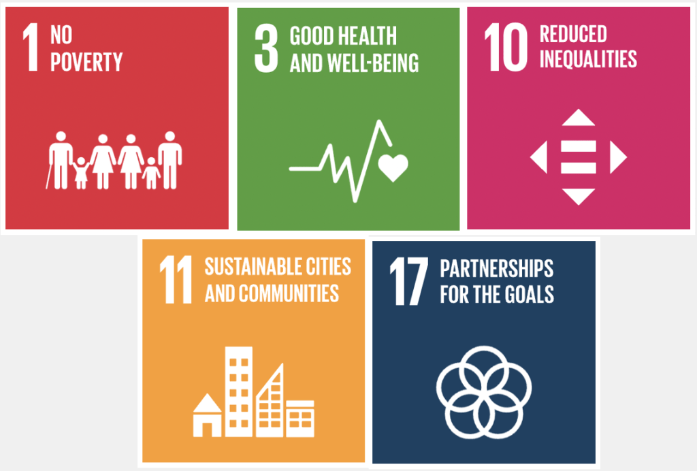
SDG‑Aligned Policies in Modern Healthcare
Policies Supporting SDG : Good Health & Wellbeing
Universal Health Coverage policies expanding access to essential services (World Bank, 2024).
National prevention programmes such as smoking cessation, obesity reduction and vaccination (Public Health England, 2021).
Community‑based care delivered through Integrated Care Systems (ICS) (NHS England, 2023).
Policies Supporting SDG : Reduced Inequalities
Targeted outreach clinics in deprived or rural areas (Public Health England, 2021).
Health equity frameworks addressing disparities linked to income, ethnicity and disability (Public Health England, 2021).
Inclusive service design such as accessible mental health and language support (NHS England, 2023).
Policies Supporting SDG : Climate Action
Net‑Zero Health Service policies reducing emissions across hospitals and transport (NHS England, 2023).
Sustainable procurement standards using low‑carbon materials and reducing waste (NHS England, 2023).
Climate‑resilient infrastructure including heatwave plans and flood‑resistant facilities (UK Health Security Agency, 2024).
(Edublogs.org, 2023)

Slide 8
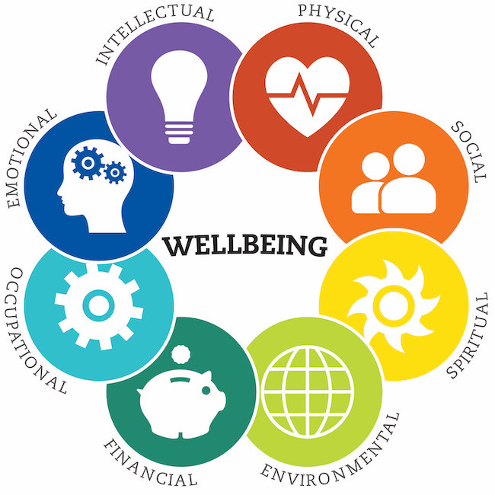
Integrating Health, Wellbeing & Sustainable Development
How They Connect
Health, wellbeing and sustainability reinforce each other: improving population health reduces pressure on services, while sustainable planning protects future resources (OECD, 2024).
Sustainable development ensures health systems can meet current needs without compromising future generations, supporting long‑term resilience (UNDP, 2024).
Wellbeing‑focused approaches strengthen prevention, mental health support and community engagement (NICE, 2023).
Environmental sustainability reduces health risks linked to climate change, air quality and extreme weather (UKHSA, 2024).
www.pdx.edu, 2026)

Slide 9
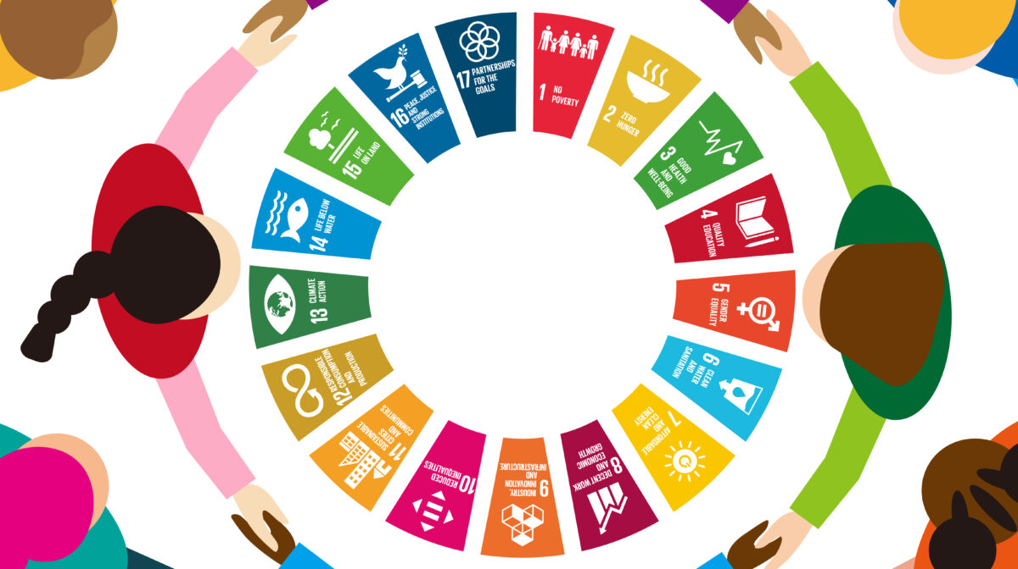
Why Integration Matters
Creates long‑term, equitable and climate‑resilient health systems
Integrated health planning brings together environmental, social and clinical priorities, allowing services to operate more fairly and sustainably. When health systems adopt policies that improve environmental conditions, they reduce exposure to hazards that drive illness and instability. WHO guidance emphasises that healthier environments lower disease risks and strengthen the long‑term functioning of health systems, helping them remain effective and equitable even as climate pressures increase (WHO, 2024).
Supports prevention‑focused care and reduces pressure on acute services
Integrated approaches place greater emphasis on prevention, early intervention and community‑level support. Evidence from well‑being economy case studies shows that when services focus on addressing issues early such as mental health needs, lifestyle risks or social determinants fewer people require emergency or hospital‑based care. This shift improves population outcomes and reduces strain on overstretched acute services (WHO Regional Office for Europe, 2025).
Aligns national health strategies with global SDGs and public health priorities
Integrated policy design helps countries meet SDG commitments by linking health equity, environmental sustainability and economic wellbeing. This alignment ensures that national strategies are not developed in isolation but contribute to wider global goals. WHO’s well‑being economy work highlights how integrated governance supports progress across multiple SDGs, particularly those focused on reducing inequalities, improving wellbeing and strengthening climate resilience (WHO Regional Office for Europe, 2025).
(UN SDG:Learn, 2023)

Slide 10
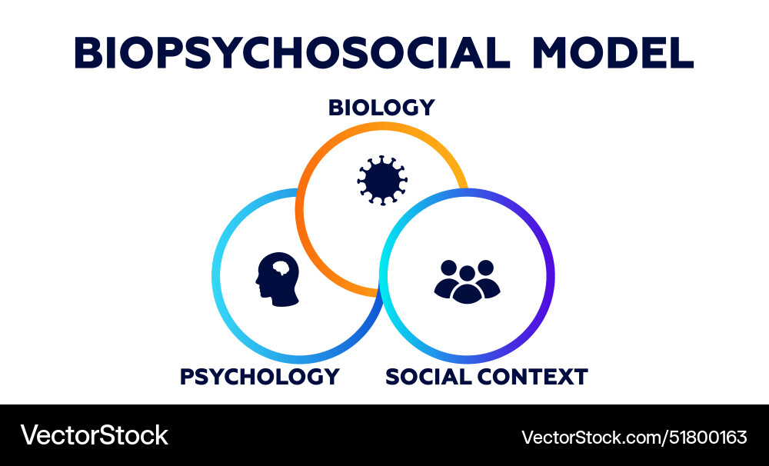
Theoretical Perspectives: Biopsychosocial Model
Understanding the Biopsychosocial Approach
The biopsychosocial approach argues that health develops through dynamic relationships between biological processes, psychological experiences and social conditions..
It moves beyond traditional medical models by recognising that illness and wellbeing are shaped by lifestyle, environment, relationships, mental health, and physical processes (Borrell‑Carrió et al., 2004).
Biological Factors
Genetics, immune function, chronic conditions, physical injury, and physiological processes all influence health outcomes.
Psychological Factors
Thoughts, emotions, coping strategies, stress, trauma, and behaviour patterns affect both physical and mental wellbeing (Adler & Stewart, 2010).
Social Factors
Social support, housing, employment, education, income, culture, and community environments shape opportunities for health and wellbeing (Marmot, 2020).
Why This Model Matters in Modern Healthcare
Encourages holistic assessment and personalised care.
Supports integrated care planning across physical, mental, and social domains.
Aligns with SDG priorities for equity, wellbeing, and sustainable development.
(Vectorstock.com, 2025)

Slide 11

Policy & Governance in Modern Healthcare
Policies Supporting Holistic Health
Preventive care policies National strategies promoting early detection, lifestyle interventions, vaccination uptake and chronic disease prevention strengthen long‑term population health (NICE, 2023).
Mental health and wellbeing initiatives Expansion of talking therapies, crisis support pathways, community mental health hubs and early intervention services reflect a shift toward whole‑person care (NHS England, 2024).
Environmental and public health policies Regulations improving air quality, reducing pollution exposure and strengthening climate‑resilient infrastructure support healthier environments and reduce disease burden (UKHSA, 2024).
Governance Challenges
Fragmented systems and regulatory barriers Misalignment between health, social care and environmental sectors can hinder integrated planning and coordinated service delivery (The King’s Fund, 2023).
Funding pressures and resource constraints Short‑term budgets, workforce shortages and rising demand limit the ability to invest in prevention, sustainability and long‑term resilience (OECD, 2024).
Variability in implementation Differences in regional capacity, leadership and infrastructure create inequalities in how holistic policies are adopted across the UK.

Slide 12

Service Delivery in Modern Healthcare
Modern Approaches to Service Delivery
Wellness and lifestyle programmes Many healthcare organisations now integrate structured wellbeing programmes such as physical activity support, nutrition counselling, stress‑management sessions and sleep‑health education to promote prevention and long‑term resilience (NICE, 2023).
Telehealth and digital care pathways Remote consultations, digital triage tools and virtual monitoring systems expand access, reduce waiting times and support continuity of care, especially for people with mobility, geographical or socioeconomic barriers (WHO, 2022).
Community‑based health initiatives Local health hubs, outreach clinics and multidisciplinary community teams provide early intervention, chronic disease management and social support closer to where people live (The King’s Fund, 2023).
Holistic Care Models in Practice
Integrated hospital pathways Hospitals increasingly adopt models that combine physical, psychological and social support such as mental health liaison teams, social prescribing link workers and family‑centred care approaches (NHS England, 2024).
Collaborative multidisciplinary teams Care is organised through collaboration between nurses, GPs, mental health providers, social workers and allied health practitioners, ensuring services are aligned and connected
(Linkedin.com, 2026)

Slide 13
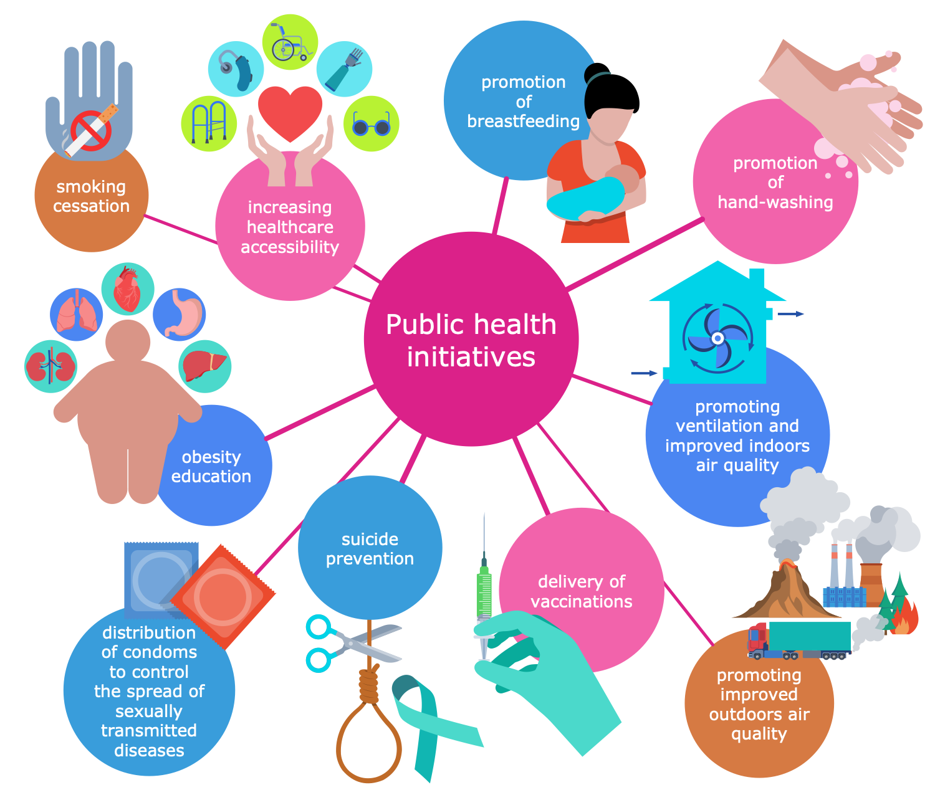
Public Health Initiatives
Promoting Healthy Lifestyles and Environments
Population‑wide behaviour change campaigns National programmes encouraging physical activity, smoking cessation, healthy eating and reduced alcohol consumption help improve long‑term wellbeing and reduce preventable disease (Public Health England, 2020).
Environmental health improvements Public health bodies work to reduce pollution, improve air quality, expand green spaces and strengthen climate‑resilient environments that support healthier communities (WHO, 2024).
Community empowerment initiatives Local authorities and health organisations deliver community‑based programmes that build resilience, support mental wellbeing and address social determinants of health (Public Health Scotland, 2023).
Impact of Public Health Campaigns
Improved population wellbeing Evidence shows that sustained public health campaigns lead to better lifestyle choices, reduced chronic disease rates and improved mental health outcomes (NHS Health Promotion, 2023).
Reduced pressure on healthcare services Prevention‑focused initiatives lower demand for acute and emergency care by addressing risks early and supporting healthier behaviours.
Stronger societal resilience Public health programmes help communities adapt to environmental, social and economic challenges, aligning with SDG priorities for health, equity and sustainability.
(Conceptdraw, 2025)

Slide 14
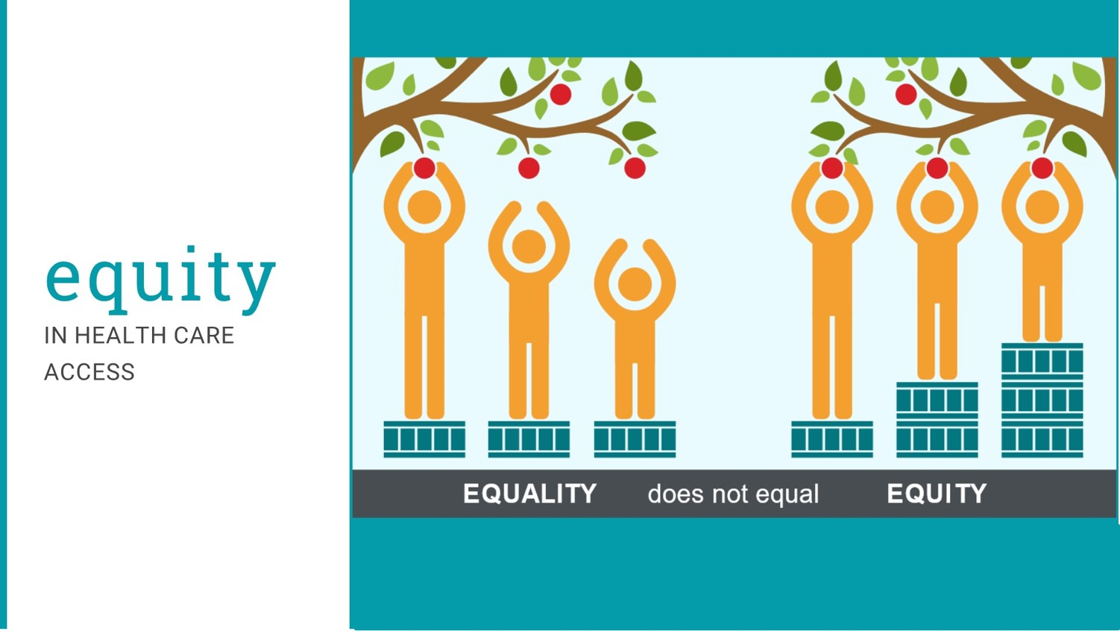
Equity & Access in Healthcare
Understanding Inequities in Healthcare
Unequal access to services Differences in income, ethnicity, disability, geography and housing conditions create barriers to timely and high‑quality healthcare (Marmot, 2020).
Variations in quality-of-care People living in deprived areas often experience poorer continuity of care, fewer preventive services and higher rates of avoidable illness (Public Health Scotland, 2023).
Structural and social determinants Education, employment, transport, discrimination and environmental conditions shape health opportunities and influence long‑term wellbeing (WHO, 2024).
Initiatives to Reduce Inequalities
Universal healthcare coverage National health systems offering free or low‑cost essential services help reduce financial barriers and improve equity (UN DESA, 2024).
Targeted interventions in high‑need communities Outreach clinics, mobile health units, culturally competent care and language support improve access for marginalised groups (NHS England, 2024).
Policies addressing social determinants of health Cross‑sector strategies focusing on housing, education, transport and environmental quality strengthen long‑term health equity (WHO Europe, 2023).
(Anon, 2025)

Slide 15
REFFERENCES
Borrell‑Carrió, F., Suchman, A.L. & Epstein, R.M. (2004) ‘The biopsychosocial model 25 years later: principles, practice, and scientific inquiry’, Annals of Family Medicine, 2(6), pp. 576–582.
Engel, G.L. (1977) ‘The need for a new medical model: a challenge for biomedicine’, Science, 196(4286), pp. 129–136.
Health Care Without Harm Europe (2024) Climate‑Resilient Healthcare Systems. Available at: https://noharm-europe.org (Accessed: 14July 2026).
Intergovernmental Panel on Climate Change (IPCC) (2023) Climate Change 2023: Impacts, Adaptation and Vulnerability. Available at: https://www.ipcc.ch (Accessed: 14 July 2026).
Marmot, M. (2020) Health Equity in England: The Marmot Review 10 Years On. Institute of Health Equity. Available at: https://www.instituteofhealthequity.org (Accessed: 15 July 2026).
National Institute for Health and Care Excellence (NICE) (2023) Preventive Health and Behaviour Change Guidance. Available at: https://www.nice.org.uk (Accessed: 17 July 2026).
NHS England (2024) Integrated Care and Health Improvement. Available at: https://www.england.nhs.uk (Accessed: 12 July 2026).

Slide 16
NHS Health Promotion (2023) Population Health and Lifestyle Improvement Programmes. Available at: https://www.nhs.uk/live-well (Accessed: 17 July 2026).
Organisation for Economic Co‑operation and Development (OECD) (2024) Health System Performance and Resilience. Available at: https://www.oecd.org/health (Accessed: 14 July 2026).
Public Health England (2020) Health Matters: Prevention and Behaviour Change. Available at: https://www.gov.uk/government/collections/health-matters (gov.uk in Bing) (Accessed: 14 July 2026).
Public Health Scotland (2023) Health Inequalities Policy Framework. Available at: https://www.publichealthscotland.scot (Accessed: 15 July 2026).
Public Health Scotland (2023) Community Wellbeing and Prevention Framework. Available at: https://www.publichealthscotland.scot (Accessed: 15July 2026).
Slavich, G.M. (2020) ‘Psychological stress and disease: the biopsychosocial model revisited’, Annual Review of Clinical Psychology, 16, pp. 265–295.
The King’s Fund (2023) Integrated Care Systems Explained. Available at: https://www.kingsfund.org.uk (Accessed: 14 July 2026).

Slide 17
The King’s Fund (2023) Community Health Services: Rethinking Place-Based Care. Available at: https://www.kingsfund.org.uk (Accessed: 6 July 2026).
UK Health Security Agency (UKHSA) (2024) Environmental Public Health: Air Quality and Climate Impacts. Available at: https://www.gov.uk/government/organisations/uk-health-security-agency (gov.uk in Bing) (Accessed: 17 July 2026).
United Nations (2015) Transforming Our World: The 2030 Agenda for Sustainable Development. Available at: https://sdgs.un.org/goals (Accessed: 6 July 2026).
United Nations Development Programme (UNDP) (2020) Human Development and Wellbeing Framework. Available at: https://www.undp.org (Accessed: 6 July 2026).
United Nations Department of Economic and Social Affairs (UN DESA) (2024) Sustainable Development Outlook. Available at: https://www.un.org/development/desa (un.org in Bing) (Accessed: 8July 2026).
Wade, D.T. & Halligan, P.W. (2017) ‘The biopsychosocial model of illness: a model whose time has come’, Clinical Rehabilitation, 31(8), pp. 995–1004.

Slide 18
World Health Organization (2015) Constitution of the WHO: Definition of Health. Available at: https://www.who.int (Accessed: 17 July 2026).
World Health Organization (2022) Telehealth: Delivering Health Services Remotely. Available at: https://www.who.int (Accessed: 17 July 2026).
World Health Organization (2024) Environmental Health: Creating Healthier Environments. Available at: https://www.who.int/health-topics/environmental-health (who.int in Bing) (Accessed: 17 July 2026).
World Health Organization Regional Office for Europe (2023) Health Equity and Social Determinants Action Plan. Available at: https://www.who.int/europe (Accessed: 15 July 2026).
Tecnomaco (2022). Health and sustainability: the EU’s global strategy - Tecnomaco. [online] Tecnomaco. Available at: https://www.tecnomaco.com/2022/11/28/health-and-sustainability-the-eus-global-strategy/ [Accessed 23 July 2026].

