Slide 1
Building Regulations, 2010
Trevor Francis MSc; MCIOB; MRICS; MBEng;
Dip. Arch. Cons.

Slide 2
Building Regulations in England and Wales (Currently). Made under the terms of the Building Act of 1984.
Please note that the following synopsis does not include the Welsh Building Regulations, powers for the making which, were granted to the Welsh Government as from the 1st of January 2012.
Introductory Text
PART 1 General
  1.Citation and commencement
  2.Interpretation
PART 2 Control of Building Work
  3.Meaning of building work
  4.Requirements relating to building work
  5.Meaning of material change of use
  6.Requirements relating to material change of use
  7.Materials and workmanship
  8.Limitation on requirements
  9.Exempt buildings and work
  10.Exemption of the Metropolitan Police Authority from procedural requirements
  11.Power to dispense with or relax requirements
Reference: http://www.legislation.gov.uk/uksi/2010/2214/contents/made , Accessed on the 14th of February, 2012.

Slide 3
Building Regulations
PART 3 Notices, Plans and Certificates
  12.Giving of a building notice or deposit of plans
  13.Particulars and plans where a building notice is given
  14.Full plans
  15.Consultation with sewerage undertaker
  16.Notice of commencement and completion of certain stages of work
  17.Completion certificates
  18.Unauthorised building work
PART 4 Supervision of Building Work Otherwise than by Local Authorities
  19.Supervision of building work otherwise than by local authorities
PART 5 Self-certification Schemes
  20.Provisions applicable to self-certification schemes

Slide 4
Building Regulations
PART 6 Energy Efficiency Requirements
  21.Application of energy efficiency requirements
  22.Requirements relating to a change to energy status
  23.Requirements relating to thermal elements
  24.Methodology of calculation and expression of energy performance
  25.Minimum energy performance requirements for new buildings
  26.CO₂ emission rates for new buildings
  27.CO₂ emission rate calculations
  28.Consequential improvements to energy performance
  29.Energy performance certificates
  30.Energy assessors
  31.Related party disclosures
  32.Duty of care
  33.Right to copy documents
  34.Application of building regulations to educational buildings and buildings of statutory undertakers
  35.Interpretation of Part 6

Slide 5
Building Regulations
PART 7 Water Efficiency
  36.Water efficiency of new dwellings
  37.Wholesome water consumption calculation
PART 8 Information to be Provided by the Person Carrying Out Work
  38.Fire safety information
  39.Information about ventilation
  40.Information about use of fuel and power
PART 9 Testing and Commissioning
  41.Sound insulation testing
  42.Mechanical ventilation air flow rate testing
  43.Pressure testing
  44.Commissioning

Slide 6
Building Regulations
PART 10 Miscellaneous
  45.Testing of building work
  46.Sampling of material
  47.Contravention of certain regulations not to be an offence
  48.Electronic service of documents
  49.Transitional provisions: interpretation
  50.Transitional provisions: work already started before 1st October
  51.Transitional provisions: work for which notification is not required
  52.Transitional provisions: notice given or plans deposited before 1st October 2010
  53.Transitional and saving provisions: earlier Building Regulations
  54.Revocations and consequential amendments
Signature

Slide 7
Building Regulations
  SCHEDULE 1
  Requirements
  SCHEDULE 2
  Exempt Buildings and Work
    CLASS 1
    CLASS 2
    CLASS 3
    CLASS 4
    CLASS 5
    CLASS 6
    CLASS 7
  SCHEDULE 3
  Self-certification Schemes and Exemptions from Requirement to Give Building Notice or Deposit Full Plans
  SCHEDULE 4
  Descriptions of Work where no Building Notice or Deposit of Full Plans Required
  SCHEDULE 5
  Revocation of Regulations
  SCHEDULE 6
  Consequential Amendments
Explanatory Note

Slide 8

Building Regulations

Slide 9
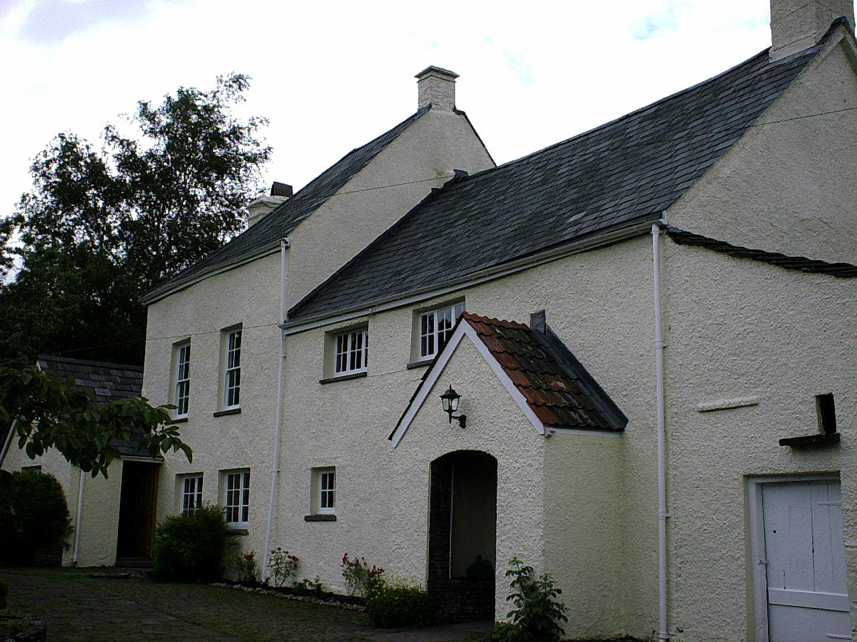
Building Regulations

Slide 10
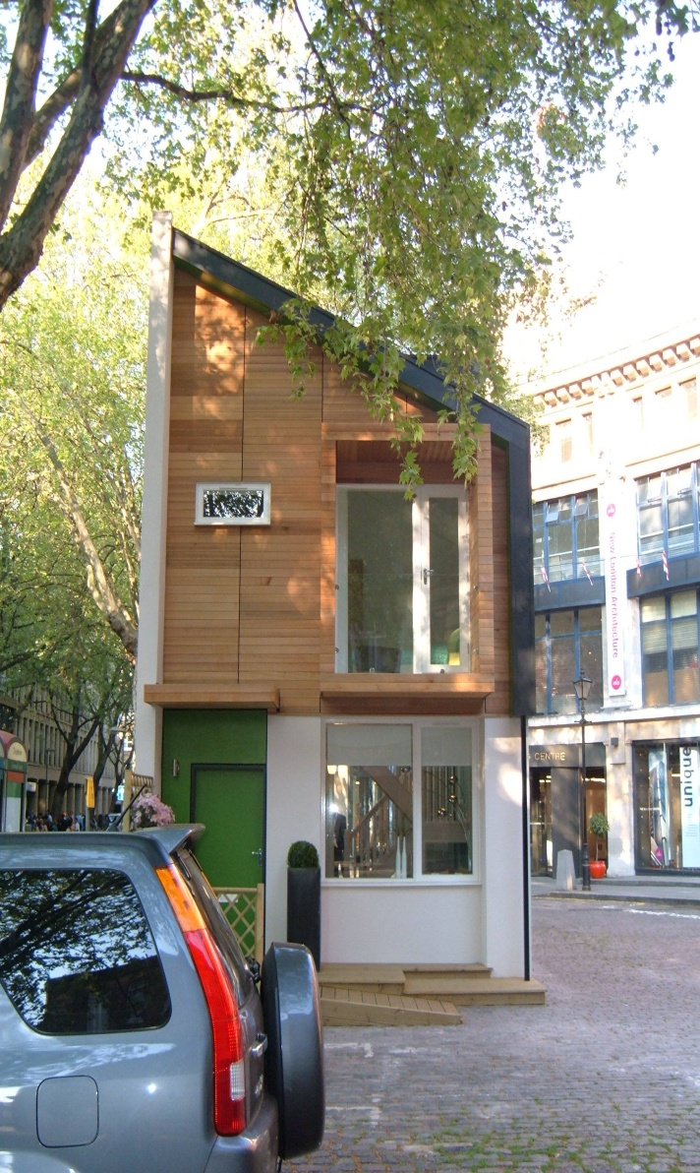
Building Regulations

Slide 11
Building Regulations

Slide 12
Building Regulations
‘The Future of Building Control’ March 2007
Department for Communities and Local Government. Website: www.communities.gov.uk1.1
Over the years, the Building Control System has helped to deliver buildings which are safe, healthy and accessible for everyone who lives and works in and around them. The quality, variety and performance of buildings in this country are a testament to the past success of the system and the people that operate it. But the world is moving on. Today we are demanding ever more from Building Control. We ask it to ensure that our buildings are not only safe but that they are sustainable and make a direct contribution to tackling climate change. And we ask it to take account of ever more complex technologies whilst remaining easy to understand and comply with.

Slide 13
Building Regulations
2.2 (Cont.)
Compliance with some parts of the regulations is low for a variety of reasons but principally a lack of understanding about what is required and a lack of resources within the building control profession to inspect everything all the time;
Most guidance is highly technical and does not do enough to meet the needs of different types of audiences. Different types of guidance are needed for different types of users and different types of jobs if compliance levels are to be raised;
Enforcement could be improved and sanctions are weak;
Future levels of resource will make achieving good levels of compliance and enforcement even harder. The building control profession is aging and not attracting the recruits that it needs while at the same time rates of development are increasing and demanding greater capacity;
There is a need to further improve performance management of the building control system, putting in place the processes needed to enable effective review and evidence based decision-making.

Slide 14
Building Regulations

Slide 15
Building Regulations

Slide 16
Building Regulations

Slide 17
Building Regulations

Slide 18
Building Regulations

Slide 19

Building Regulations
Multi-foil Insulation

Slide 20
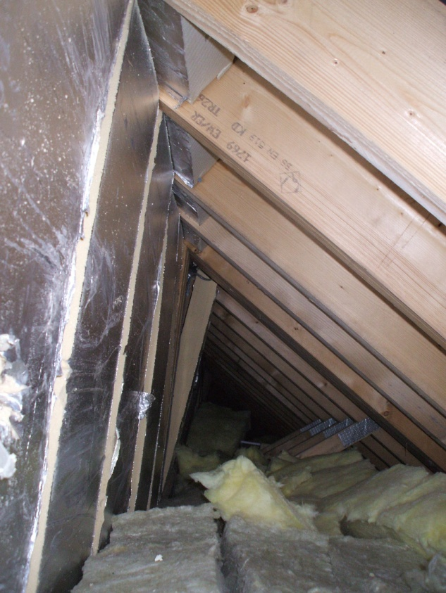
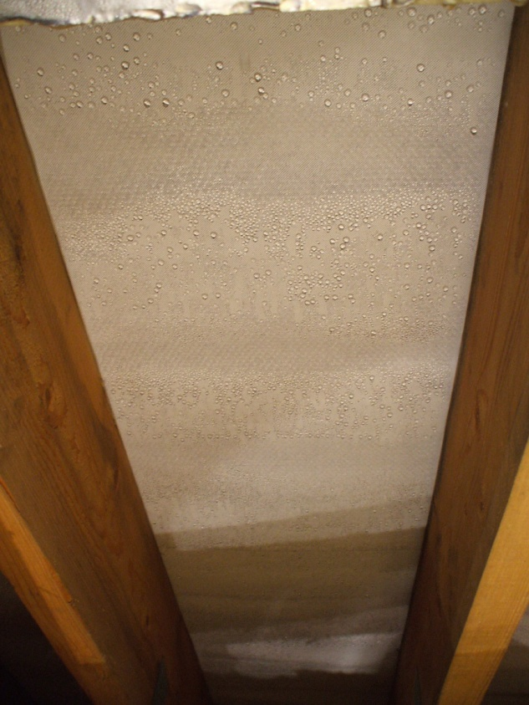
Building Regulations
20
20
20
20
20
20
20
20
20
20
20
20
20
20
20
20
20
20
20
20
20
20
20
20
20
20
20
20

Slide 21
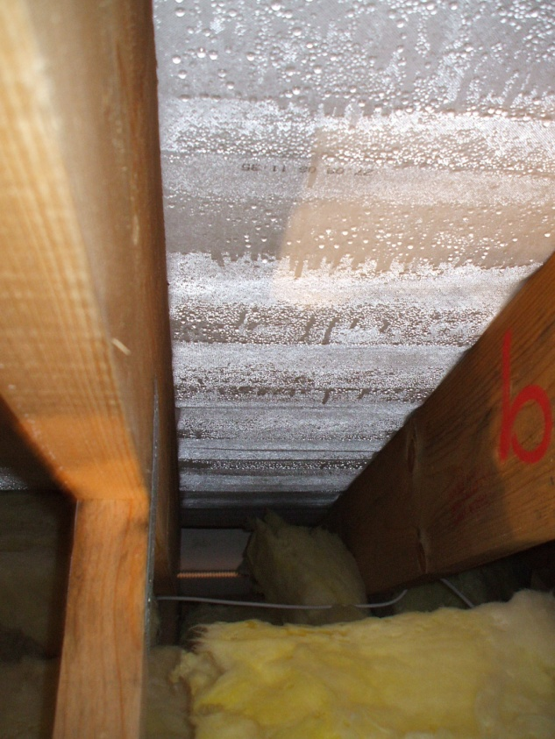
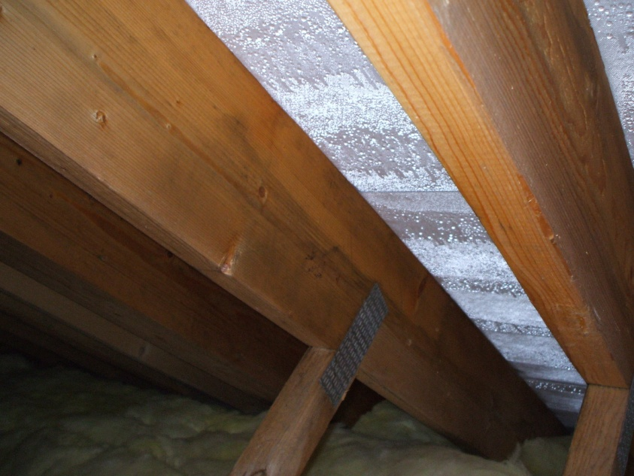
Building Regulations

Slide 22
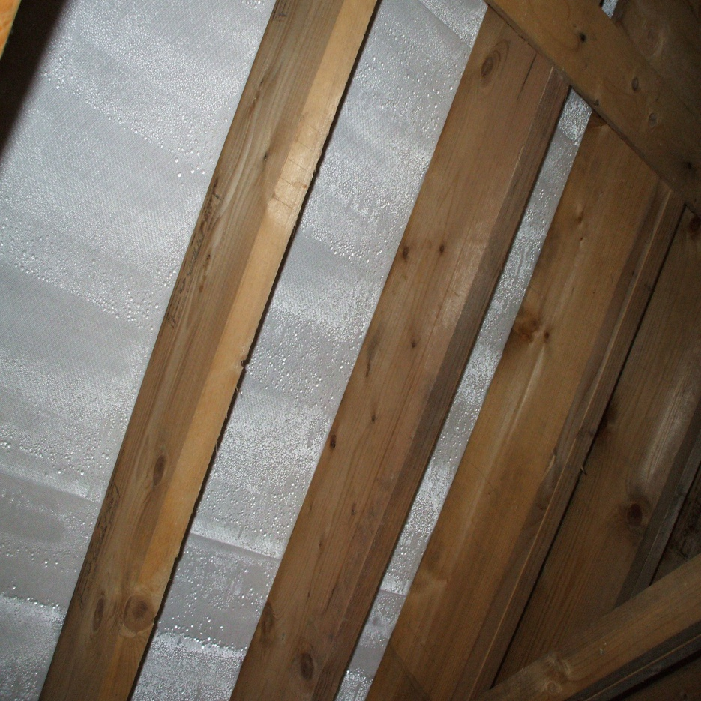
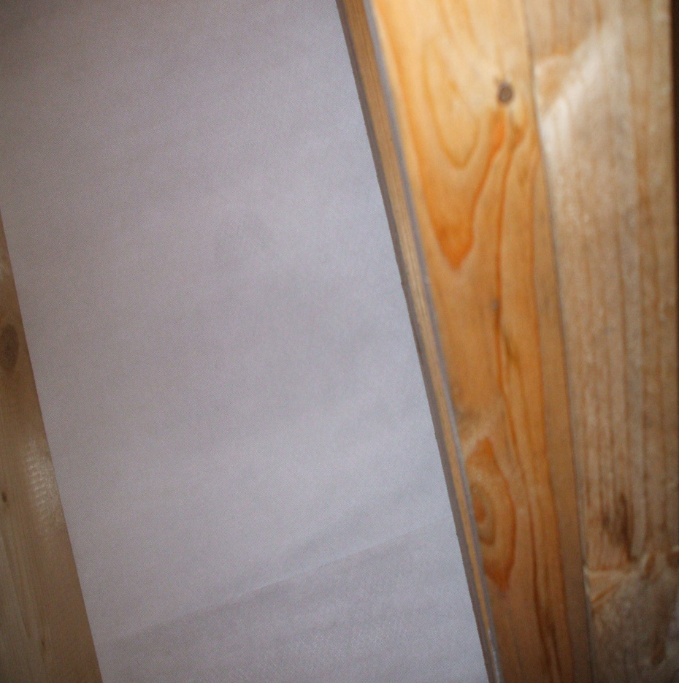
Building Regulations

Slide 23
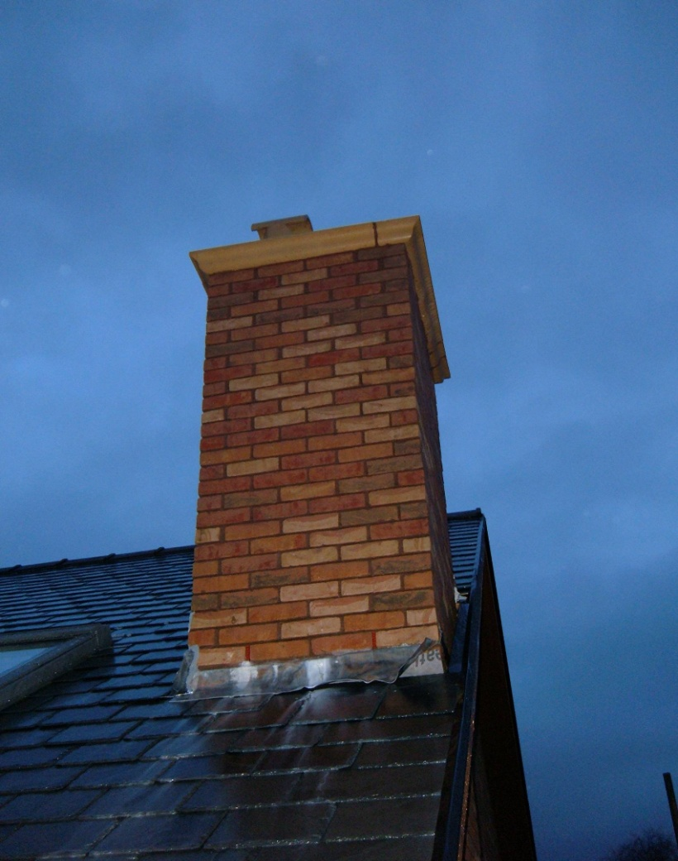
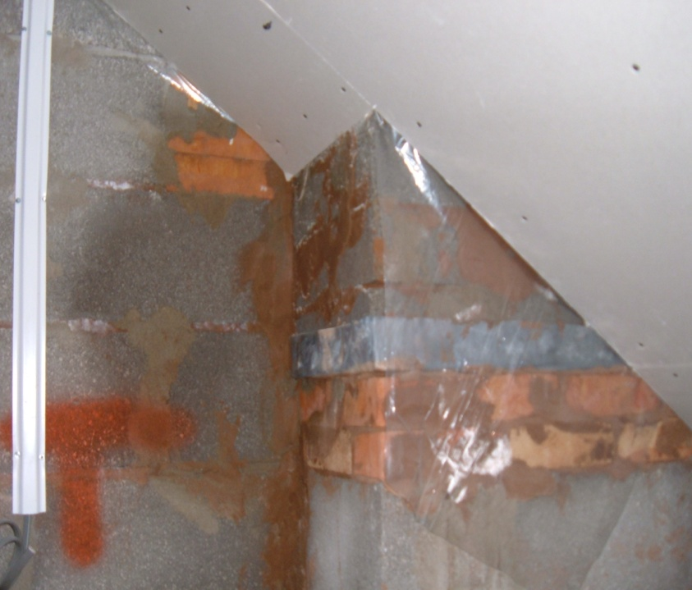
Building Regulations
23
23
23
23
23
23
23
23
23
23
23
23
23
23
23
23
23
23
23
23
23
23
23
23
23
23
23
23

Slide 24
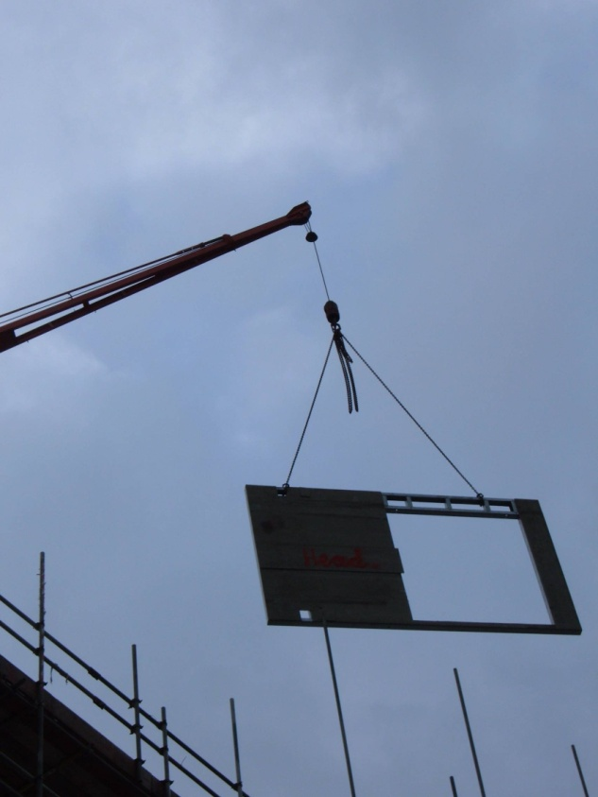
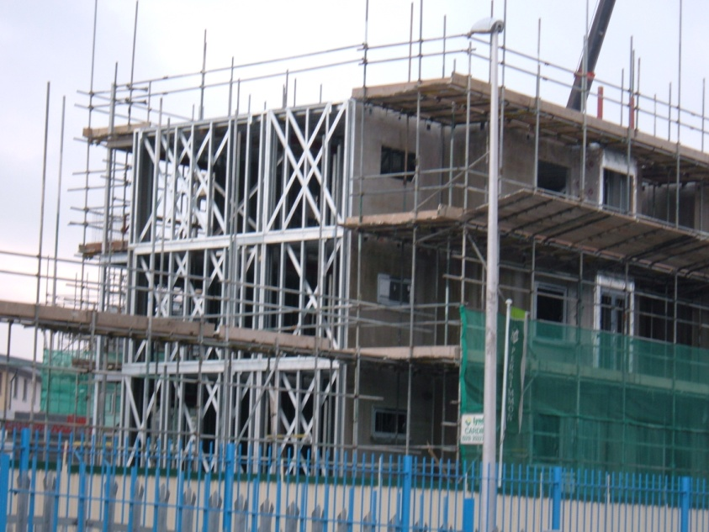
Building Regulations

Slide 25
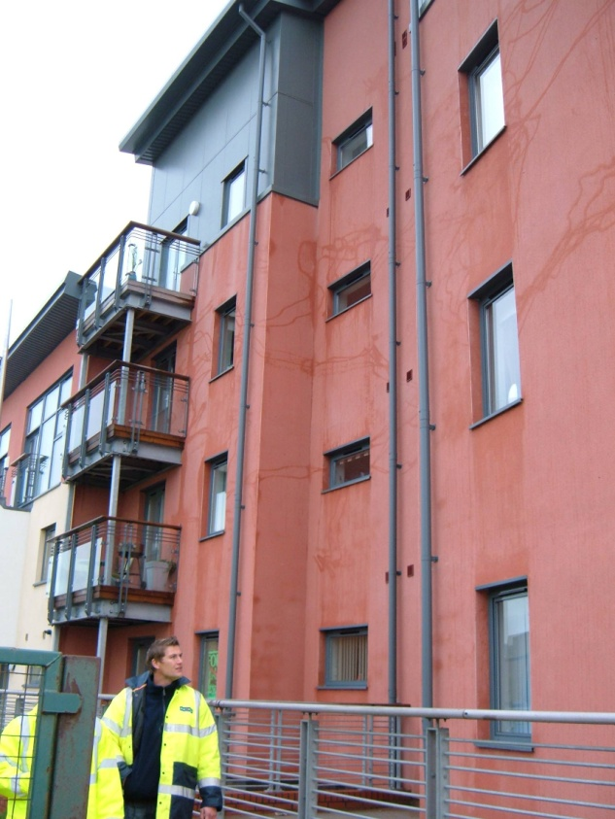
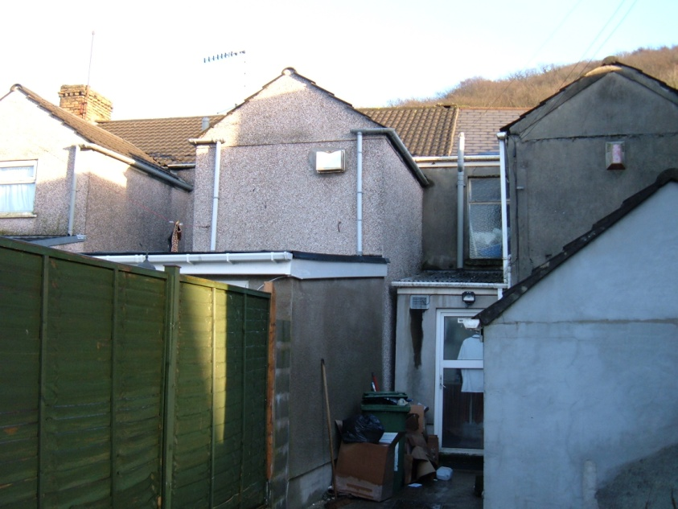
Building Regulations
What about the rest?
The One Percent?

