Slide 1

International Business Communications
BA (Hons) Business Management
Module code: LCBB6023
Component 1
Student Name: Nicoleta Carp
Student Number: 2125547

Slide 2

Introduction
International business communication is an important aspect that can build strong external relationships (Wang and Hu, 2022).
This presentation will add the concept of international business communication along with cultural components.
This will add Chinese market challenges and provide strategies to overcome them.
Notes:
The process of communication can develop not only the internal operations, but it is also a necessary factor that can be aligned with the external factors as well. Hence, it is necessary to define the relationship enhancement along with making a collaborative working culture. This is used within international communication to build strong stakeholder management along with partnership. This is a concept which can build strong external market expansion based on partnership building. This can be included as a cross-cultural relationship to enhance the cultural values. This can be used for cultural empathy enhancement based on technical implications. This can be an effective further strategy concert that can be implemented to develop cross-country-based functional operations (Wang and Hu, 2022). This presentation will elaborate on the concept of International business communication, where partnership will be elaborated. Apart from this, it will add the cultural definition along with various elements. It is something that will be further defined by implementing theories, challenges and strategies.

Slide 3




◤
Define culture and its various elements
Culture has been a key process in implementing internal behaviour and working style based on internal operations and values.
This has been deferred from other organisations based on the country, place, people’s norms and values.
The communication style incorporates language understanding, behaviour and norms which can reduce the cultural barriers (Okeke, 2025).
Additionally, the organisational hierarchy has been included to define segregated tasks based on linear and departmental structure by adding behaviours and values of leaders (Van den Hende and Riezebos, 2023).
Notes:
The culture has been defined through the internal factors, where value generation, along with behavioural contexts and communication style, has been added. This has been developed through the internal operations, where culture can be incorporated within transparency and ethical consideration. The transparent working culture has been included to develop the operations within an organisation. This has been included in the international communication structure, where language and shared values play an essential role. This has been driving the operations by constantly checking on the market where behavioural and psychological factors can play an essential role (Leonavičienė and Burinskienė, 2022).
On another approach, the cultural elements have been added to the communication style, as well as the organisational structure and hierarchy. The communication style has been incorporated within an organisational culture where language and behavioural aspects have been the main aspects. This has incorporated the structure of understanding norms and language structure based on any country context. Hence, this has been a helpful strategy that can reduce the linguistic barriers and develop strong communications (Okeke, 2025). On another approach, the concept of organisational hierarchy is also based on cultural implications. This has sometimes been linear and sometimes been departmental divisions to enhance the working culture. This is a concept which can be useful for knowing the internal culture in an organisation that can manage with a strong leadership structure and guidance (Van den Hende and Riezebos, 2023).

Slide 4
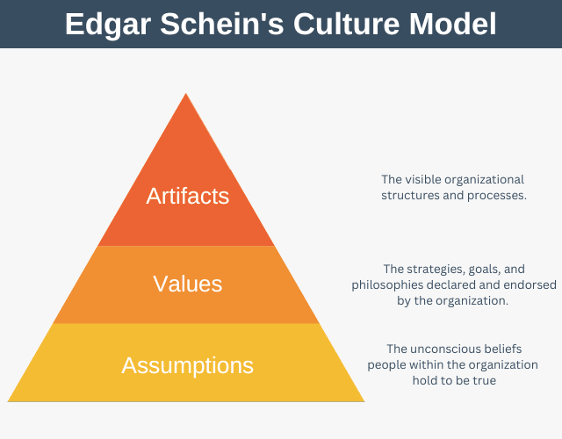
◤
Implementing Schein's Model of Organisational Culture on the impact of culture
Schein's Model of Organisational Culture has been implemented within the organisation by segregating the departments and developing strategies.
This has been useful for developing the cultural value based on three distinct.
The three components are included within this model, such as Artefacts, Espoused Values and Basic Underlying Assumptions (Makumbe and Washaya, 2022).
Notes:
The concept of Schein's Model of Organisational Culture has been underpinned by a three stage basis process where culture is broken into different segments. These factors have been accommodated within three distinct levels, such as Artefacts, Espoused Values and Basic Underlying Assumptions. These have been used to develop the structure of cultural implications by aligning the structure of visible structure, then to know the surface and implement plans. After that, the last concept has been added to the core beliefs, where the internal conflicts have been resolved by having strong plans. This model has been used as a major influential concept to enhance the structure of organisational enhancement, along with having a strong cultural impact. Here, cultural operations and behaviours have been developed with the strategic implication and segregated departments (Makumbe and Washaya, 2022).

Slide 5
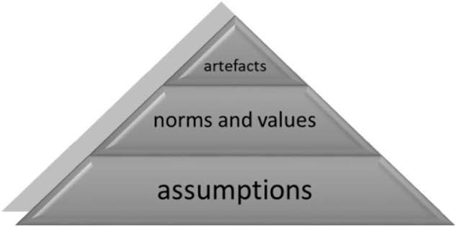
◤
Implementing Schein's Model of Organisational Culture on the impact of culture
The culture-based model has included three components where Artefacts have described the virus from the top of the pyramid.
Espoused Values determine the HR policies, psychologies and behavioural structure in an organisation.
At the last stage, the Basic Underlying Assumptions have been implemented to define conflict resolutions (Barragan et al. 2023).
Notes:
Artefacts: This has been the first segment within a triangle structure and is based on the top basis. This can be used as being visible but not impacted in a deeper way to understand and interpret.
Espoused Values: This has incorporated the internal shared values, HR policies, philosophies and vision with the missions of an organisation. This has been used to enhance the internal strategic management.
Basic Underlying Assumptions: This stage has more work as a structural pattern, where conflict resolution has been stated. Apart from this, it has included strategies for resolving any glitches and internal conflicts (Barragan et al. 2023).

Slide 6

Discuss the cultural elements based on the Chinese to overcome
Indirect Communication
  The indirect communication has been aligning within the Chinese market and organisational approach.
  Here, they have been more confused and hardly say no to other people to avoid confusion.
  This has been developed through the clear and radical written-based communicative structure (Huili et al. 2024).
Notes:
This has happened within the international communication basis as built over the UK’s organisation within the Chinese market. This can be an obstacle that can be aligned within the Chinese market, where language barriers, confusing behaviour, leads to misunderstanding, ambiguities and missed deadlines, reducing organisational opportunities. This has been impacted over the UK’s organisational operations, where indirect communication can create barriers that can disrupt the market expansions. This has been overcome through implementing a radical, clear written communication structure. This has been used as a clear written format to develop the communicative aspect for better enhancement of organisational operations (Huili et al. 2024).

Slide 7

Discuss the cultural elements based on the Chinese to overcome
Excessive Modesty
  This has been included within the Chinese market as a challenge.
  This has created the internal barriers of not promoting oneself and taking any rights to the achievements.
  This has been solved by implementing objective self-advocacy to enhance the internal operations in cultural well-being (Lagman, 2026).
Notes:
This has been an integrated concept within the Chinese market, where they have been more modest than others in hesitating to take their own rights. This can create a barrier to saying directly to the opposite person. The extreme modesty can create a barrier to not taking any credit after accommodating appreciative work. Besides that, by saying no, negotiating for salaries and promoting themselves can create a barrier. These are the barriers which can be solved by implementing objective self-advocacy to address the challenges. This has been used for self-record maintenance and enhancing the self-achievements for cultural value enhancement (Lagman, 2026).

Slide 8

Discuss Negotiation Strategies for a successful deal
Prioritise Relationship-Building
Maintaining or implementing a relationship enhancement has been a prioritised goal within a UK-based organisation.
This has been used to develop cultural norms and values based on languages.
This has solved the issue of cultural barriers by having clear communications to build strong relationships (Grant, 2024).
Notes:
This has been the segmented prioritised strategy, which can be applied to a UK-based organisation that can generally begin implementing the market in China. Here, the implication of relationship building can be developed with clear communication and well-being. This has been used to enhance cultural norms and values. This can be incorporated into the behavioural traits which can develop the cultural barrier maintaining over the Chinese market (Grant, 2024).

Slide 9
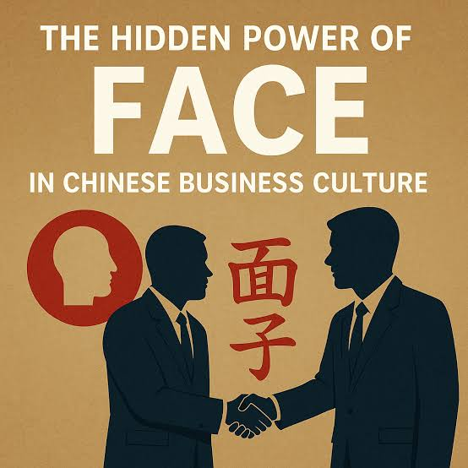
Discuss Negotiation Strategies for a successful deal
Maintain "Mianzi"
The use of the Minazi concept has been developed in the deal-making between the UK and China.
This has been used to develop the concept of reputation saving of face saving as per not accommodating any public unwanted conversations.
This has saved the deal maker by having a strong brand reputation (Zhou and Zhang, 2024).
Notes:
This has been a significant approach which can be used to develop the face-saving concept. This is used within the Chinese concept for negotiating deals with UK businesses. This has been used to develop by not publicly saying anything wrong about the organisation, instead of implementing indirect communication. This has been effective in developing a reputation for maintenance. This concept can develop the partnership maintenance (Zhou and Zhang, 2024).

Slide 10

◤
Conclusion
This presentation has been implemented, and communication is the key to developing international partnerships within a business.
This has been implementing internal hierarchy management and a clear communicative plan indulgence.
The use of clear communication and face-saving has developed international communication within a business organisation.
Notes:
The presentation has narrowed down the concept by implementing that international communication in business can have its own way to develop cultural aspects. This has been useful for developing the structure of the external market evaluation, where deal-making and partnership creation. This has been used to develop the structure of adding well-being and face-saving context. Apart from this, it has been aligning the internal hierarchy to develop the cultural aspects.

Slide 11
References
Barragan, S., Salamanca, E. and Erogul, M.S. (2023). Rethinking the transfer of the organisational culture model as a process of change. International journal of business and globalisation, 34(4), pp.462-480. https://www.inderscienceonline.com/doi/abs/10.1504/IJBG.2023.133709
Grant, O. (2024). The Influence of Cultural Differences on Supplier Relationship Management in Global E-Commerce. https://www.preprints.org/frontend/manuscript/a94b009be21e716245cc044eaf8fc118/download_pub
Huili, Z., Minna, W. and Xixi, S. (2024). Cultural Depth in Business Communication: Exploring the Interpretation of Chinese Culture-Specific Terms in Cross-Cultural Negotiations. Journal of Business Innovation, 9(1), p.1. http://www.unimel.edu.my/journal/index.php/JBI/article/view/1787
Lagman, A. (2026). The Law Has Feelings: Employing Affect, Creating Law with Shanghai's Corporate Consulting Attorneys (Doctoral dissertation). https://deepblue.lib.umich.edu/items/f3fd8076-2f6f-4261-8513-bedd70074f82
Leonavičienė, E. and Burinskienė, A., (2022). Accelerating cultural dimensions at international companies in the evidence of internationalisation. Sustainability, 14(3), p.1524. https://www.mdpi.com/2071-1050/14/3/1524
Makumbe, W. and Washaya, Y.Y.(2022). Organisational culture and innovation: testing the Schein Model at a private university in Zimbabwe. Cogent Business & Management, 9(1), p.2150120. https://www.tandfonline.com/doi/abs/10.1080/23311975.2022.2150120
Okeke, V.C. (2025). Cross-Cultural Communication Challenges in Global Business: How Cultural Differences in Communication Styles Affect International Collaboration. Traektoriâ Nauki, 11(10), pp.6001-6009. https://www.ceeol.com/search/article-detail?id=1388156
Van den Hende, F. and Riezebos, J.(2023). Academic staff on their engagement with curriculum internationalisation: an organisational change perspective. Higher Education Research & Development, 42(5), pp.1247-1266. https://www.tandfonline.com/doi/abs/10.1080/07294360.2023.2193724
Wang, G.F. and Hu, X. (2022). Research on intercultural communication in international business. Open Access Library Journal, 9(7), pp.1-7. https://www.scirp.net/pdf/oalibj_2022072816315600.pdf
Zhou, B. and Zhang, S. (2024). Exploring Mianzi consciousness congruence and its impact on unethical pro-organisational behaviour. BMC psychology, 12(1), p.436. https://link.springer.com/article/10.1186/s40359-024-01934-z

