Slide 1
Ansible

Slide 2
Ansible
What is it?
Why is it?
Alternatives? Puppet, chef, the rest of the cast of sesame street
Commands and automation
Adhoc
Playbooks
Modules
Host file / Inventory

Slide 3
What is Ansible
A tool for automation using programmed scripts
Open-Source
API Driven
  Use the keyword Ansible to activate a command
  Ansible Python API can be used to control nodes
  Plug in inventory data from external data sources
Uses SSH to connect to client (device)

Slide 4
What is Ansible
Used through the terminal or CLI
Uses scripts or files
  Written in Python and leverages Python for its modules and plugins
  Scripts written in YAML

Slide 5
Ansible Timeline
Ansible was publicly introduced by Michael DeHaan in February 2012.
Ansible, Inc. was founded in 2013.
Red Hat announced its acquisition of Ansible, Inc. in October 2015.
Ansible 2.0, a major release, was introduced in 2016. This release included several new features, improvements, and expanded module support.
Ansible became part of the Red Hat Ansible Automation Suite in 2017, which includes Ansible Tower. Ansible Tower is a web-based interface and management tool for Ansible.
Red Hat Ansible Automation Platform was launched in 2019, providing an integrated solution for enterprise-level automation. It included not only Ansible Engine (the core automation engine) but also Ansible Tower, Insights, and other components.

Slide 6
Why use Ansible
Ansible
  Ansible uses a decentralised, agentless architecture with SSH as the underlying transport protocol.
  It is typically operated in a push model, though it also supports a pull model.
  Ansible is built using Python and leverages Python for extensibility.
  Ansible supports templating using the Jinja templating language.
  Ansible originally targeted a way to run ad hoc commands on servers, but has since evolved into task orchestration using “playbooks” that perform idempotent tasks on target systems.
  Playbooks can be written in standard YAML or an Ansible derivation of YAML.
Edelman, Jason, et al. Network Programmability and Automation : Skills for the Next-Generation Network Engineer, O'Reilly Media, Incorporated, 2018. ProQuest Ebook Central, http://ebookcentral.proquest.com/lib/trinity/detail.action?docID=5261404.
Created from trinity on 2023-11-19 17:04:57.

Slide 7
Why use Ansible
It is a great tool for network automation
  Can be used for scripting to describe the desired state of a network and its configuration
  Can be used for scripting to describe the tasks to be performed
It is agentless, meaning:
  It is device agnostic
  It is software agnostic
  It is OS agnostic

Slide 8
Modules
Units of code that can control system resources or execute system commands
Ansible provides a module library that you can execute directly on remote hosts (AdHoc)or through playbooks (Scripts)
You can also write custom modules
Also known as “Task Plugins” or “Library Plugins”
From 2010 onwards, modules are hosted in Collections

Slide 9

Modules
Using modules ad-hoc through CLI
Denoted by the flag ‘-m’
Modules take arguments

Slide 10
Modules
Using modules ad-hoc through CLI
Denoted by the flag ‘-m’
Modules take arguments
These are nearly all in key-value pairs

Slide 11

Modules
Using modules from Playbooks
Scripts are written in YAML
The key-value pairs are given
Modules denoted by name
key-value pair
Pass the command as the
argument
https://www.middlewareinventory.com/blog/ansible-playbook-example/

Slide 12
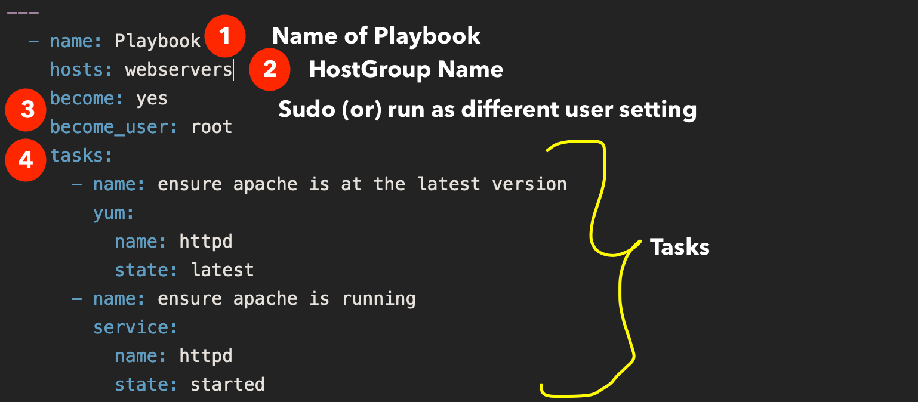
Modules
Using modules from Playbooks
Scripts are written in YAML
The key-value pairs are given
Modules denoted by name
key-value pair
Arguments can be passed as
‘Complex Args’
https://www.middlewareinventory.com/blog/ansible-playbook-example/

Slide 13
Module States
Merged - Ansible merges the on-device configuration with the provided configuration in the task.
Replaced - Ansible replaces the on-device configuration subsection with the provided configuration subsection in the task.
Overridden - Ansible overrides the on-device configuration for the resource with the provided configuration in the task. Use caution with this state as you could remove your access to the device (for example, by overriding the management interface configuration).
Deleted - Ansible deletes the on-device configuration subsection and restores any default settings.
https://www.middlewareinventory.com/blog/ansible-playbook-example/

Slide 14
Module States
Gathered - Ansible displays the resource details gathered from the network device and accessed with the gathered key in the result.
Rendered - Ansible renders the provided configuration in the task in the device-native format (for example, Cisco IOS CLI). Ansible returns this rendered configuration in the rendered key in the result. Note this state does not communicate with the network device and can be used offline.
Parsed - Ansible parses the configuration from the running_config option into Ansible structured data in the parsed key in the result. Note this does not gather the configuration from the network device so this state can be used offline
https://www.middlewareinventory.com/blog/ansible-playbook-example/

Slide 15
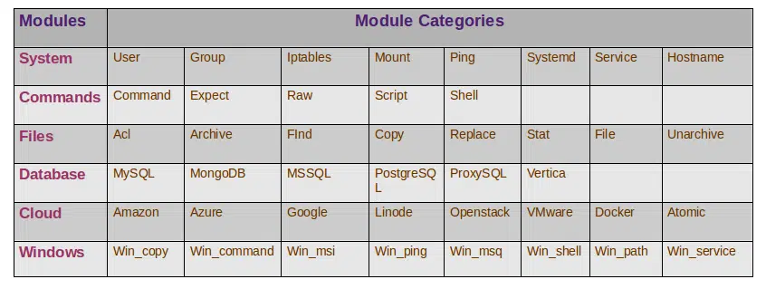
Modules
https://linuxbuz.com/linuxhowto/what-is-ansible-modules-and-how-to-use-it

Slide 16
Practical time

Slide 17
Installation
Sudo apt-get update
Sudo apt install python3
sudo apt install python3-pip
Pip install ansible / sudo apt install ansible
sudo apt install sshpass
ansible --version
mkdir ansible_quickstart && cd ansible_quickstart

Slide 18
Ansible Inventory
A file inventory that consists the managed hosts or group of managed hosts ansible tasks operates on.
The managed hosts can be specified using their IP addresses or the FQDN (Fully qualified domain name) in the ansible inventory file.
Ansible control node will operate on the managed hosts using a connection plugin and the default connection plugin for ansible is the SSH plugin.

Slide 19
Lets edit our inventory file
First make a file called inventory.ini (touch Inventory.ini)
Then lets edit it with vi (vi inventory.ini)
Lets add some fake data to test it out(press I to insert and escape to quit insert mode, then :wq to save and quit)
                [myhosts]
                192.0.2.50
                192.0.2.51
                192.0.2.52

Slide 20
Lets edit our hosts file
Now lets verify our inventory
ansible-inventory -i inventory.ini --list

Slide 21
Adhoc
One off commands that can be executed from a command line
Quick to write
For small one off jobs
Testing connections
Status checks

Slide 22
Ad-hoc commands (examples but not limited too)
ansible vm -m ping -i inventory.ini
ansible vm -m command -a uptime -i inventory.ini
ansible vm -a "free -m“-i inventory.ini
ansible all -m shell -a "cat /proc/meminfo|head -2“-i inventory.ini
ansible vm -b -m shell -a 'apt update’ -i inventory.ini
ansible vm -b -m shell -a 'sudo apt-get install docker.io -y’ -i inventory.ini
touch hello
ansible vm -m copy -a 'src=~/ansible_quickstart/hello dest=~ mode=0644’ -i inventory.ini

Slide 23
Our first adhoc command
ansible myhosts -m ping -i inventory.ini

Slide 24
Update our inventory
Lets add some real addresses to our inventory
soac-azure@ml-lab-fd636f30-93fa-4b22-9b65-13b6bfe8e9fd.uksouth.cloudapp.azure.com
ansible_port=64698
ansible_password=P@ssword!
ansible_sudo_pass=P@ssword!
(I will pop this on the moodle)

Slide 25
Make a ansible.cfg file
Touch ansible.cfg
Vi ansible.cfg
Put this code
[defaults]
host_key_checking = False
ansible_winrm_server_cert_validation = ignore

Slide 26
adhoc command
ansible vm -m ping -i inventory.ini

Slide 27

Playbook
Uses YAML
Takes ‘complex args’ in
key-value pairs
Can take a resource group or
groups to apply tasks to, from
an inventory

Slide 28
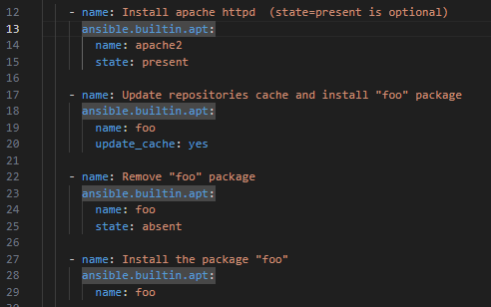
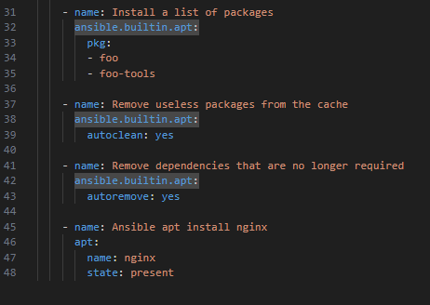
Use a module to interact with aptitude

Slide 29
Make our own playbook
Create a YAML file where we will update the virtual machine and reboot
Cold run it
ansible-playbook --check vmpb.yaml –I inventory.ini
Lint it using ansible-lint (optional additional dependency)
Ansible-lint vmpb.yaml –I inventory.ini

Slide 30
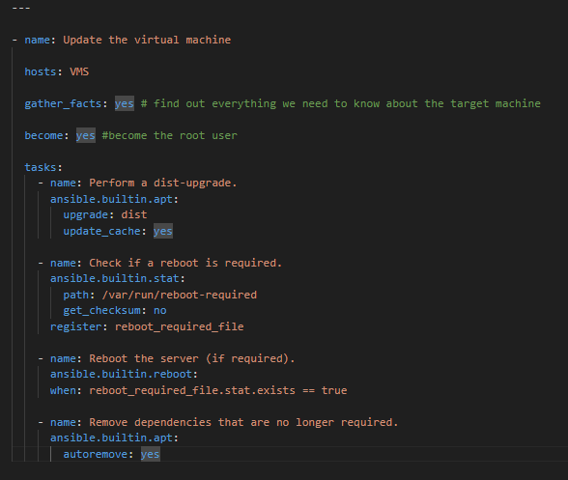
https://docs.ansible.com/ansible/latest/collections/ansible/builtin/apt_module.html
https://docs.ansible.com/ansible/latest/collections/ansible/builtin/stat_module.html
https://docs.ansible.com/ansible/latest/collections/ansible/builtin/reboot_module.html

Slide 31
Configuring a router
First we will need to add the credentials to the inventory
Then create a yaml file targeting the router group
Issue a command to set the MOTD on the router
then we can remove it by altering the state to absent

Slide 32
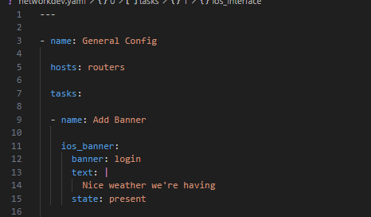

Slide 33
A more advanced example
Starts off by simply selecting the target machine/s
Declare required variables
Install docker on the remote machine
Grab the default docker image from the docker hub
Create the images
https://hub.docker.com/

Slide 34


