Slide 1
Essential Skills
Assessment Focus

Slide 2
Essential Skills: Session Descriptions
Each week, you will receive weekly, 2-hour workshop sessions which will complement your academic and professional skills.
There is no assessment attached to these sessions, they are to help develop your skills.
Study Planning
Sessions to help you manage your study time and maximise your independent study.
Digi Focus
Developing your digital skills and enhancing your digital confidence.
Assessment Focus Workshop
Workshops designing to push ahead with assessments and to plan your work effectively. .

Slide 3
Essential Skills: Session Descriptions
Present!
Develop your presentation confidence and work on your professional communication skills.
Link-In and Learn
Develop your network! Work towards developing your professional presence.
Careers Workshop
Practical sessions, exploring the career service resources and meeting advisors. .

Slide 4
Session Objectives
Assessment Focus Workshop
During this session you will:
Navigate your assessment specifications with confidence:
Understanding submission deadlines
Identifying what needs to be done
Plan your next steps
Creating an action plan for completing your work.

Slide 5
Session Schedule
Explore Assessment Specifications– 35 Mins
Identifying your next steps– 35mins
Creating an action plan– 35 mins
Reflection - 15 mins.
This session will help you with your assessment planning for your taught modules. Managing a project and planning your time will help you with your professional development.

Slide 6
Navigate your assessment specifications with confidence

Slide 7


Assessment Specifications
Do I have to read it? Can you not just tell me in class?
Where do we find our assessment specifications for each module taught?
What do you think?
What do you know already?
Notes:
Reiterate the need for students to locate their official assessment specifications rather than relying on word of mouth, highlight errors that could be made if you rely on others for info.

Slide 8
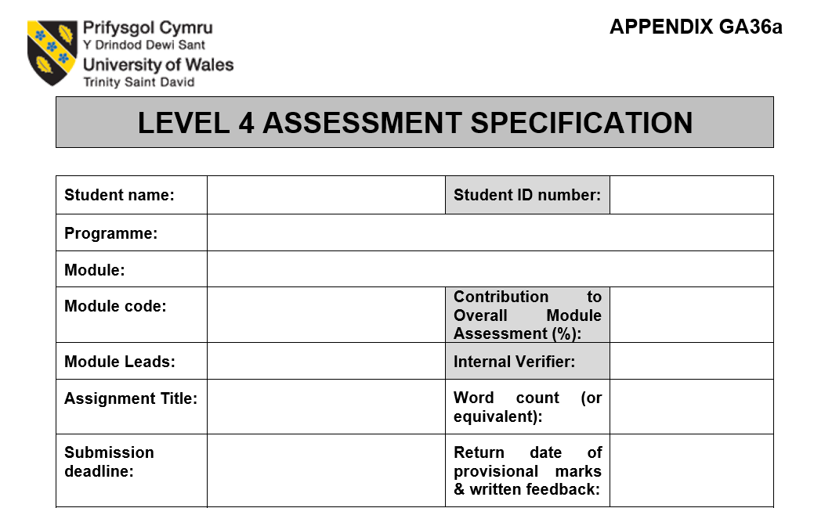
Assessment Specifications
Assessment specifications are the official source of information about your assessed assignments.
Your assessment specification looks like this.
Often you will have two of these documents for each module.
Notes:
Reiterate the need for students to locate their official assessment specifications rather than relying on word of mouth, highlight errors that could be made if you rely on others for info.

Slide 9
This tells you what type of assessment you need to complete.
This tells you how many words you should include in your written work. This might also tell you how much time you need to present for if the assessment is practical.
The submission deadline tells you when is the last opportunity to submit your work.
This date tells you when you can check your provisional marks and feedback on Turnitin.

Slide 10


Find your assessment specifications
For each of your assessed modules this term:
  Locate your assessment specifications.
  Note the type of assessment (written/presentation/exam etc)
  Note down your submission deadlines
?
?
You have 10 minutes…Go!

Slide 11
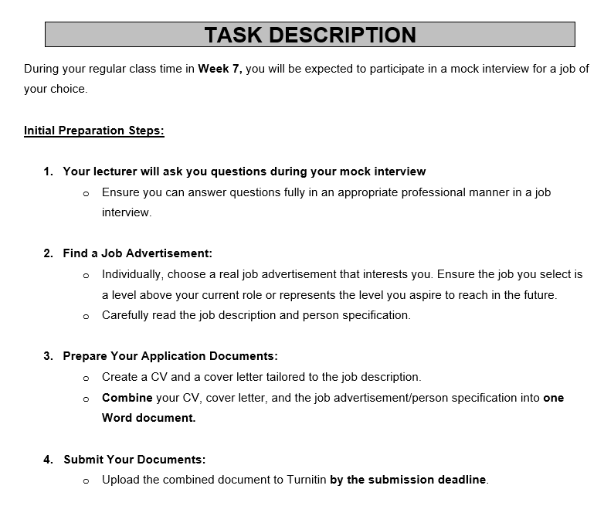
The Task Description tells you what you need to do for your assessment.
It will usually tell you:
How many tasks are involved.
Which theories or tools need to be used in your work.
What to include in your written work or presentation.
Example

Slide 12
Identify your tasks
Read your task descriptions.
Identify what you are being ask to do.
Note down any words or phrases that you do not understand.
Work in pairs for 10 minutes.
Share your thoughts with your tutor
Notes:
Students should be able to explain what they have been asked to do and produce a list of questions if anything seems unclear.

Slide 13
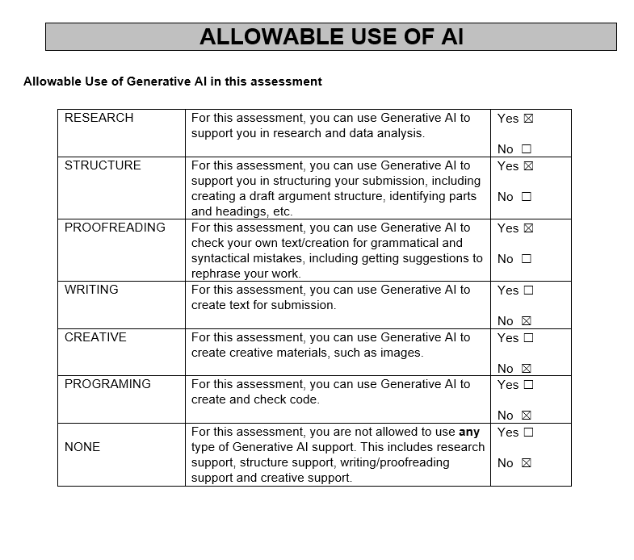
This table will tell you if Artificial Intelligence tools are allowed to be used when planning, researching and writing your work.
Your lecturer will explain what this information means in your module sessions.

Slide 14
Identifying what needs to be done

Slide 15




Identifying what needs to be done
Identify which theories, models or tools need to be included in your work.
Make a list of what you think needs to be included in your work.
Look at your module Moodle pages:
  Identify when you will discuss and learn key topics/theories/models or tools,
  Locate your module reading list and any other reading materials.

Slide 16

Reflect on your understanding
Do you know your submission deadlines for your assessments?
What do you understand about your tasks?
What are you confused or frustrated about?
Who can help you with your questions?

Slide 17
Plan your next steps

Slide 18


Thinking ahead
Watch the video together or in small groups.
Identify three tips for improving your productivity.
Reflect – How productive do you think you are?
Notes:
Video link available on Moodle labelling Productivity Explained
https://uwtsd.careercentre.me/resources/elearning/hub.aspx?id=1427&Referral=Action&Programme=Workplace%20Skills&ProgrammeID=ejNTUXl3K3lGODg5bTJUK0EySFRpQT090&TaskId=63121

Slide 19

Creating a to-do list
How do we start to prioritise university work when we have busy lives?
Watch this video and note down the key tips.
Notes:
https://uwtsd.careercentre.me/resources/elearning/hub.aspx?id=1209&Referral=Action&Programme=Workplace%20Skills&ProgrammeID=ejNTUXl3K3lGODg5bTJUK0EySFRpQT090&TaskId=63121

Slide 20
Creating an action plan for completing your work

Slide 21
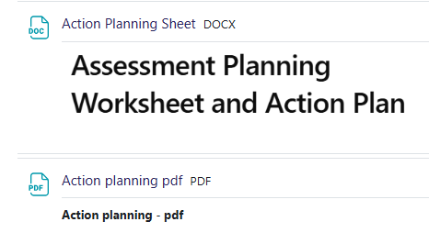
Creating an action plan for completing your work
Use the Assessment Planning Worksheet and Action Plan resource to help your break down your tasks for the next few weeks.
Take your time.
Chat to your peers
Ask for help and support if you need it,
Notes:
https://moodle.uwtsd.ac.uk/course/section.php?id=203277
Example 2 is available at the bottom of the page – click the title to view in pop up screen

Slide 22
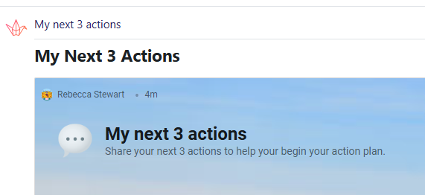
My action plan
Decide your next three steps for preparing for your assessments.
Post your ideas on the session Padlet page.
Available on the Moodle Page.
Notes:
Padlet is embedded into Moodle - https://moodle.uwtsd.ac.uk/mod/lti/view.php?id=722015

Slide 23
Development Diary
There is no assessment attached to your Essential Skills sessions. However, you should maintain a development diary.
After each week, add to your development diary (either on paper, within an online document, or journal app.)
What should you include in a development diary?
Include:
What you have done in your session.
What key points have you learned.
How you intend to apply learnings to your module assessments and onward professional development.

Slide 24


Traffic Light it
 | Where is your learning at ?
Red | I have misunderstood some of the topics. (write down 2 questions that you need help with)
Amber | I have understood most of the topics so far (write down 1 question and 1 key theme you have understood)
Green | I have understood the topics so far (write down 2 key themes from the session to show your understanding)

