Slide 1

Programme: BA (Hons) Leadership and Management Skills for the Workplace
Module: Managing Business Information
Module code: LCLM 5004
Assignment Title: Component 1- Group Presentation on Different Information Systems

Slide 2

Introduction
The presentation will analyse the role of various information systems in the conduct of business functions of Computacenter, by reflecting their essentiality for effectiveness, decision-making, and competitive benefit.
It will assess three information systems through the conduct of a comparison between their operations, advantages, and drawbacks in driving business efficiency.
Notes:
A discussion will be held regarding data privacy, security, and ethical issues faced by companies like Computacenter due to the utilisation of information systems, and recommendations will be provided to mitigate challenges obstructing the appropriate utilisation of information systems. Examples of business organisations that use information systems will be provided, highlighting the drawbacks, solutions, and ethical risks faced by them, including analysing the impact of those systems on their business performance.

Slide 3
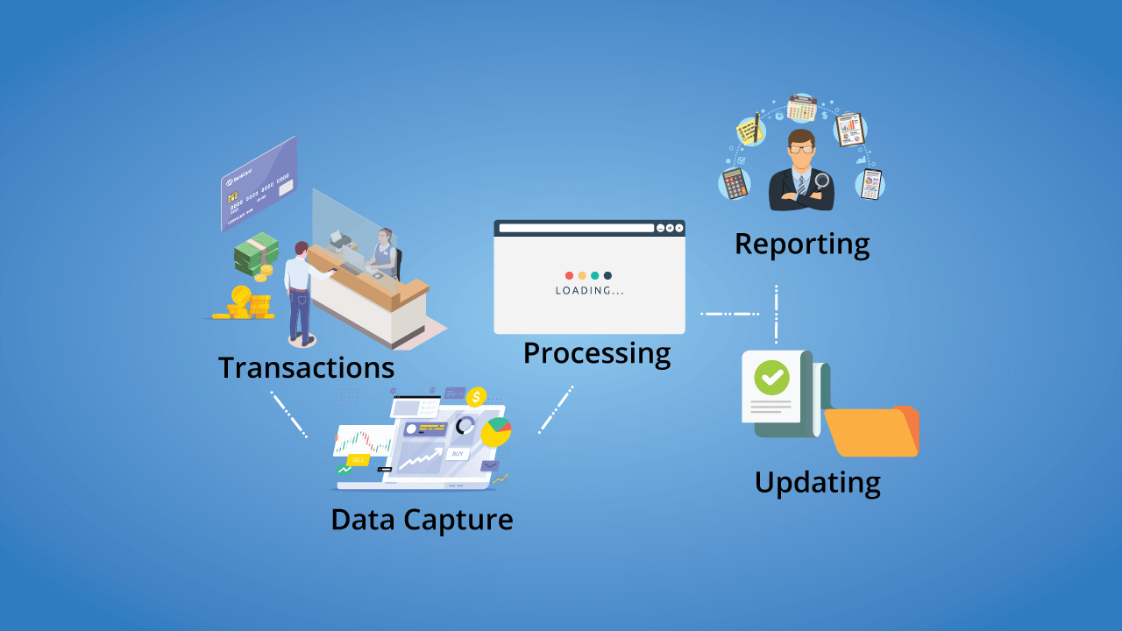
Discussion of various information systems- Transaction Processing Systems
Through the automation of manual, repetitive jobs, transaction processing systems (TPS) enable the organisational workforce to contribute their time to the execution of valuable tasks (Hvozdyk, 2025).
By effectively processing transactions and offering timely data for decision-making, TPS has served as a necessary tool to improve functional efficiency and the achievement of competitive benefits (Wahsheh et al. 2023).
Notes:
By automating manual, repetitive jobs, transaction processing systems (TPS) help the Computacenter’s organisational workforce to dedicate their time to the execution of significant tasks (Hvozdyk, 2025). Through the efficient processing of transactions and providing timely data for decision-making, TPS has served as a crucial tool to enhance functional effectiveness and the accomplishment of competitive advantages (Wahsheh et al. 2023).

Slide 4
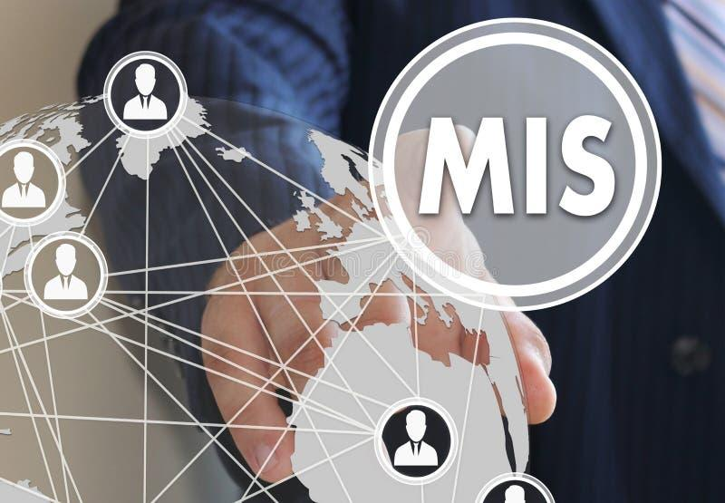
Discussion of various information systems- Management Information Systems
When a company expects to streamline the organisational workflows, it could utilise Management Information Systems (MIS) since it helps the organisation to collect and assess data effectively (Thorson, 2025).
A MIS is an effective tool implemented by companies to streamline data collaboration, enhance decision-making, and regulate organisational efficiency to function competitively in a digital-first environment (Tatli, 2024).
Notes:
When an organisation plans to streamline the organisational workflows, it could use Management Information Systems (MIS) since it enables the organisation to gather and analyse data efficiently (Thorson, 2025). A MIS is an efficient application adopted by Computacenter to streamline data integration, improve decision-making, and control organisational effectiveness to operate competitively in a digital-first environment (Tatli, 2024).

Slide 5

Discussion of various information systems- Decision Support Systems
A decision support system (DSS) enhances the pace and effectiveness of undertaking decision-making operations to gather and assess real-time information related to business (Corporate Finance Institute, 2020).
Organisational managers are regularly faced with complex decisions regarding how effectively they can run their companies to acquire a competitive edge, which can be accomplished by using a DSS (EBSCO, 2019).
Notes:
A decision support system (DSS) increases the speed and efficiency of undertaking decision-making activities to collect and analyse real-time data related to business (Corporate Finance Institute, 2020). Computacenter’s managers are faced with difficult decisions regularly regarding how efficiently they can run their companies to achieve a competitive edge, which can be accomplished by using a DSS (EBSCO, 2019).

Slide 6
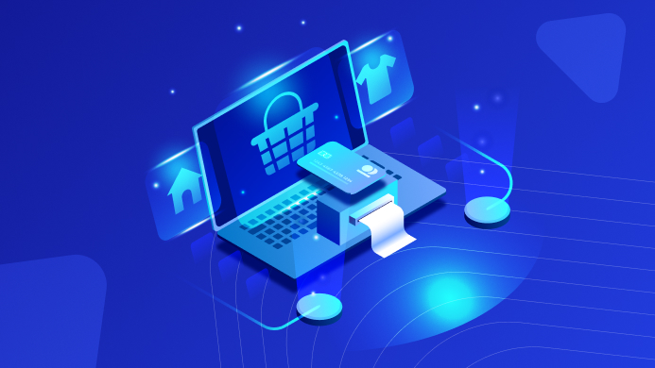
Comparison of the functions, benefits, and limitations of three information systems- Transaction Processing Systems
A transaction processing system (TPS) is a kind of information system in which information related to business transactions is preserved, altered, and retrieved, where the transactions are conducted by front-line employees who directly communicate with customers (Reke et al. 2022).
Through the utilisation of TPS, the organisational workforce enhances its productivity, and the customers can acquire more faith and satisfaction in the organisation (Reke et al. 2022).
Very often, a huge number of transactions takes place on the TPS, which results in slowing down the system or halting its functioning (Reke et al. 2022).
Notes:
A TPS is used for storing information regarding business transactions in Computacenter, and it could be used by the employees to improve their productivity. A large number of transactions occurring on the TPS slows down the system and stops its operations (Reke et al. 2022).

Slide 7
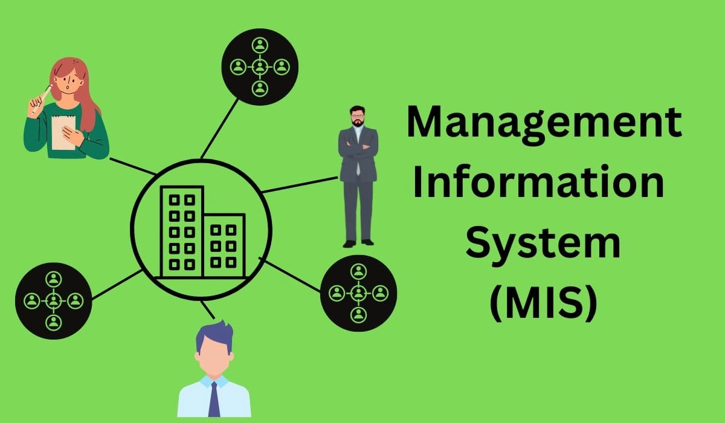
Comparison of the functions, benefits, and limitations of three information systems- Management Information Systems
A Management Information System (MIS) is a software solution that gathers, arranges, and assesses data to provide assistance to business functions and decision-making (Tatli, 2024).
MIS merges information from a wide range of sources into an individual repository, which removes data silos and ensures that all sectors, like marketing, finance, HR, or sales, have access to the same information (Tatli, 2024).
When the company workers have to explore a wide range of MIS with disintegrated workflows, their work productivity gets hampered (Tatli, 2024).
Notes:
A MIS collects, organises, and evaluates data to support business operations and decision-making at Computacenter, and it helps to integrate data from a broad group of sources into a single repository. The work productivity of employees gets hindered due to the navigation of a broad group of MIS (Tatli, 2024).

Slide 8
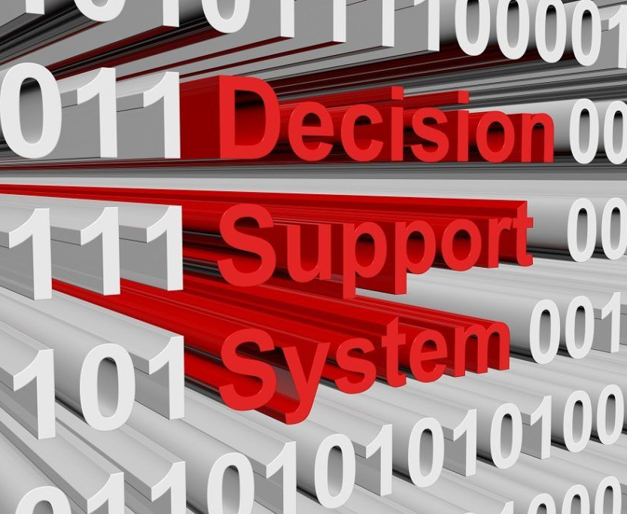
Comparison of the functions, benefits, and limitations of three information systems- Decision Support Systems
For making informed decisions, business organisations depend on decision support systems (DSS) that offer significant insights regarding the preparation of decisions through the assessment of data (Zaplatynskyj, 2023).
Through progressive analytical applications and data collaboration, DSS enables decision-makers to analyse various contexts, detect trends, and evaluate potential results appropriately (Zaplatynskyj, 2023).
The acquisition of improper or unfinished information could hinder the transparency of perceptions produced by DSS, since the efficiency of these systems hugely depends on the quality and collaboration of data from different sources (Zaplatynskyj, 2023).
Notes:
Companies like Computacenter rely on decision support systems (DSS) to prepare informed decisions that provide significant perceptions regarding decision-making through data analysis. This information system also possesses few advantages and drawbacks (Zaplatynskyj, 2023).

Slide 9
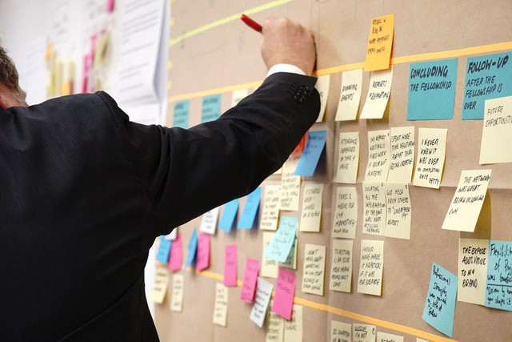
Ethical Considerations- Ethical Issues faced due to the use of information systems
The workers functioning remotely compared to hybrid workers frequently access company systems through the utilisation of poor information systems, such as personal devices and insecure networks, which bear a high tendency to conduct data breaches (TrustArc, 2026).
Remote employees depend on cloud-based collaboration applications like Slack, Microsoft Teams, and Zoom for work purposes, and when these tools are not regulated accurately, it could result in data leakage or unauthorised access by third parties (TrustArc, 2026).
Notes:
In Computacenter, the employees working remotely, compared to hybrid employees, often access organisational systems through the application of ineffective information systems, such as personal devices and insecure networks, which bear a high tendency to face data breaches. Remote workers rely on cloud-based collaboration tools like Slack, Microsoft Teams, and Zoom for work purposes, and when these tools are not operated accurately, it could lead to data leakage or unauthorised access by third parties (TrustArc, 2026).

Slide 10

Ethical Considerations- Recommendations to mitigate the ethical problems
Companies that implement and utilise information systems could set up specific guidelines for the maintenance of ethical standards related to data privacy, safety, and transparency while utilising them (LinkedIn, 2023).
Business organisations could function towards the generation of an ethical culture by emphasising values that motivate the ethical application of technology, by providing training to their workforce on fostering transparency (LinkedIn, 2023).
Notes:
Computacenter can adopts and uses information systems, which could establish particular guidelines for the maintenance of ethical standards regarding data privacy, safety, and transparency while using them. Companies could operate towards the creation of an ethical culture by emphasising values that encourage the ethical use of technology, through offering training to their employees on the promotion of transparency (LinkedIn, 2023).

Slide 11
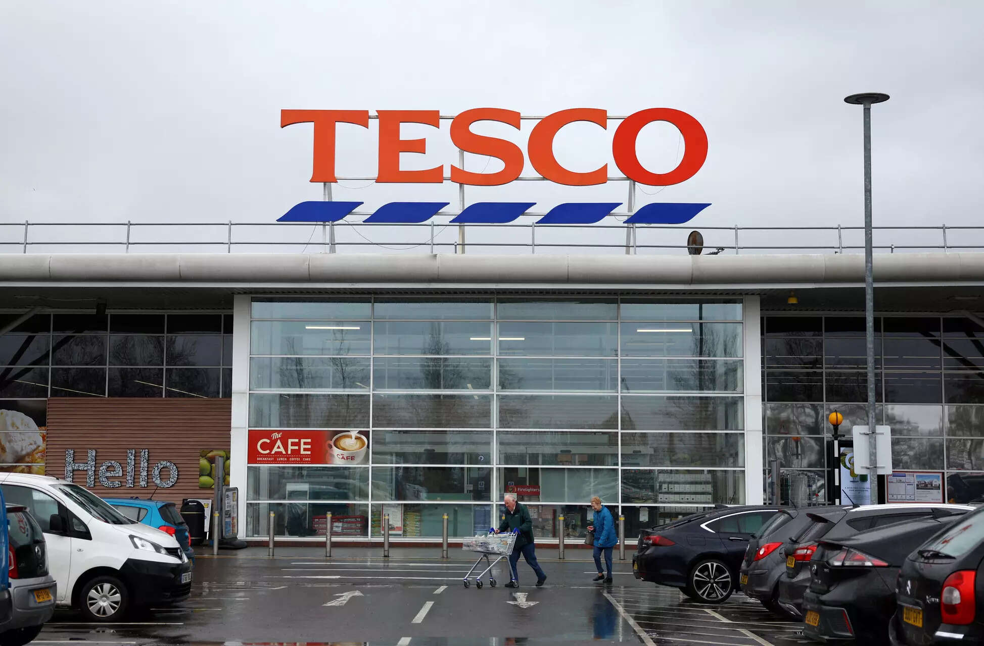

Real-Life Case Examples
Tesco depends on a large amount of hardware, which provides the physical base of its information system, without which the retail store could not gather data, process transactions, regulate stock, or conduct business functions (Future Learn, 2026).
Sainsbury’s has declared it has selected NCR Voyix, an international leader in digital commerce solutions, to enable the transition of its marketing experience and assist the adoption of its Next Level Sainsbury’s business policy (Sainsburys, 2024).
Notes:
Tesco relies on a huge amount of hardware, which offers the physical foundation of its information system, without which the retail store could not collect data, process transactions, regulate stock, or conduct business operations (Future Learn, 2026). Sainsbury’s has announced it has chosen NCR Voyix, a global leader in digital commerce solutions, to allow the transformation of its marketing experience and support the implementation of its Next Level Sainsbury’s business policy (Sainsburys, 2024).

Slide 12
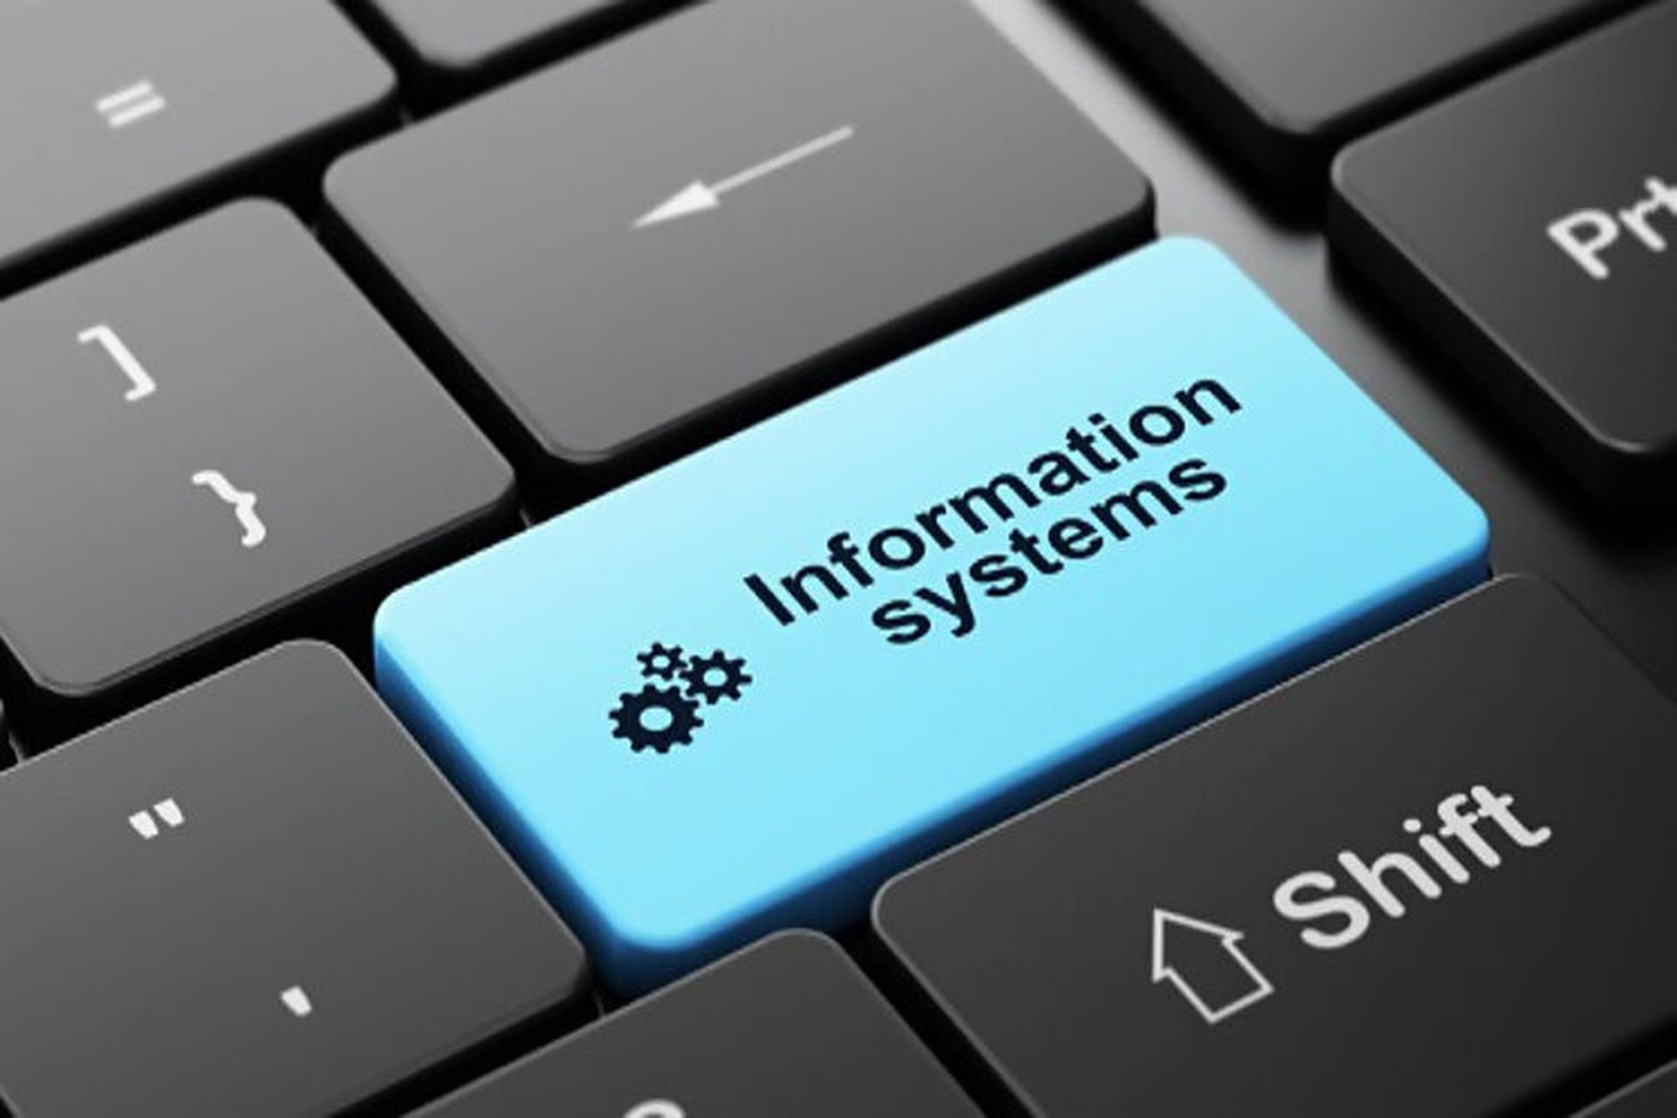
Conclusion
This presentation assessed the role of different information systems in the conduct of business operations by highlighting their importance for efficiency, decision-making, and competitive advantage.
It conducted discussions about three information systems through the conduct of a comparison between their functions, benefits, and limitations in driving business effectiveness.
Notes:
A discussion was conducted regarding data privacy, security, and ethical risks faced by Computacenter because of the utilisation of information systems, and recommendations were offered to mitigate problems obstructing the proper utilisation of information systems. Examples of companies that utilise information systems were provided, reflecting the drawbacks, solutions, and ethical issues faced by them, including assessing the impact of those systems on their business performance.

Slide 13
References
Corporate Finance Institute (2020), Decision Support System (DSS), Available at: https://corporatefinanceinstitute.com/resources/management/decision-support-system-dss/ (Accessed: 04 June 2026).
EBSCO (2019), Decision Support Systems, Available at: https://www.ebsco.com/research-starters/business-and-management/decision-support-systems (Accessed: 04 June 2026).
Future Learn (2026), Case Study: Tesco in today’s retail market, Available at: https://www.futurelearn.com/info/courses/the-data-driven-business-analyst/0/steps/456492 (Accessed: 04 June 2026).
Hvozdyk, I. (2025). What is a transaction processing system [types and benefits], Kindgeek. Available at: https://www.kindgeek.com/blog/what-is-transaction-process-system (Accessed: 04 June 2026).
LinkedIn (2023), Ethical Issues in Technology & Ways to Manage Them, Available at: https://www.linkedin.com/pulse/ethical-issues-technology-ways-manage-them-teamleasedigital (Accessed: 04 June 2026).
Reke, E., Powell, D. and Mogos, M.F., (2022). Applying the fundamentals of TPS to realize a resilient and responsive manufacturing system. Procedia CIRP, 107, pp.1221-1225. https://www.sciencedirect.com/science/article/pii/S221282712200419X/pdf?md5=29c7ea1ad5d6c50a36ae1cc08c245b4c&pid=1-s2.0-S221282712200419X-main.pdf
Sainsburys (2024), Sainsbury’s Partners with NCR Voyix for Exceptional Customer Experience, Available at: https://corporate.sainsburys.co.uk/news/press-releases/sainsbury-s-partners-with-ncr-voyix-for-exceptional-customer-experience/ (Accessed: 04 June 2026).
Tatli, Z. (2024). The role of Management Information Systems (MIS) in solving data integration, CloudOffix. Available at: https://www.cloudoffix.com/blog/the-role-of-management-information-systems-mis-in-solving-data-integration (Accessed: 04 June 2026).
Thorson, T. (2025). What are MIS? The role of Management Information Systems, Orderful. Available at: https://www.orderful.com/blog/what-is-mis (Accessed: 04 June 2026).
TrustArc (2026), Employee Data Privacy: Balancing Monitoring and Trust, Available at: https://trustarc.com/resource/employee-data-privacy-balancing-monitoring-and-trust/ (Accessed: 04 June 2026).
Wahsheh, F.R., Marie, Z., Farea, M.M., Al-Haithami, W.A., Mohamad, F.S. and Bisht, N., (2023), October. Operational Level System: Transaction Processing System and Decision Making. In 2023 International Conference on Computer Science and Emerging Technologies (CSET) (pp. 1-7). IEEE. https://www.researchgate.net/profile/Mazen-Farea/publication/376673600_Operational_Level_System_Transaction_Processing_System_and_Decision_Making/links/658a769d2468df72d3d90ee3/Operational-Level-System-Transaction-Processing-System-and-Decision-Making.pdf
Zaplatynskyj, C. (2023). Advantages and disadvantages of Decision Support Systems, InterDynamics. Available at: https://www.interdynamics.com/2023/06/14/advantages-and-disadvantages-of-decision-support-systems/ (Accessed: 04 June 2026).

