Slide 1


Empowering Cultural Holders: Exploring Participatory Documentaries for Intergenerational Transmission of Intangible Cultural Heritage
Hanwen Zhang

Slide 2
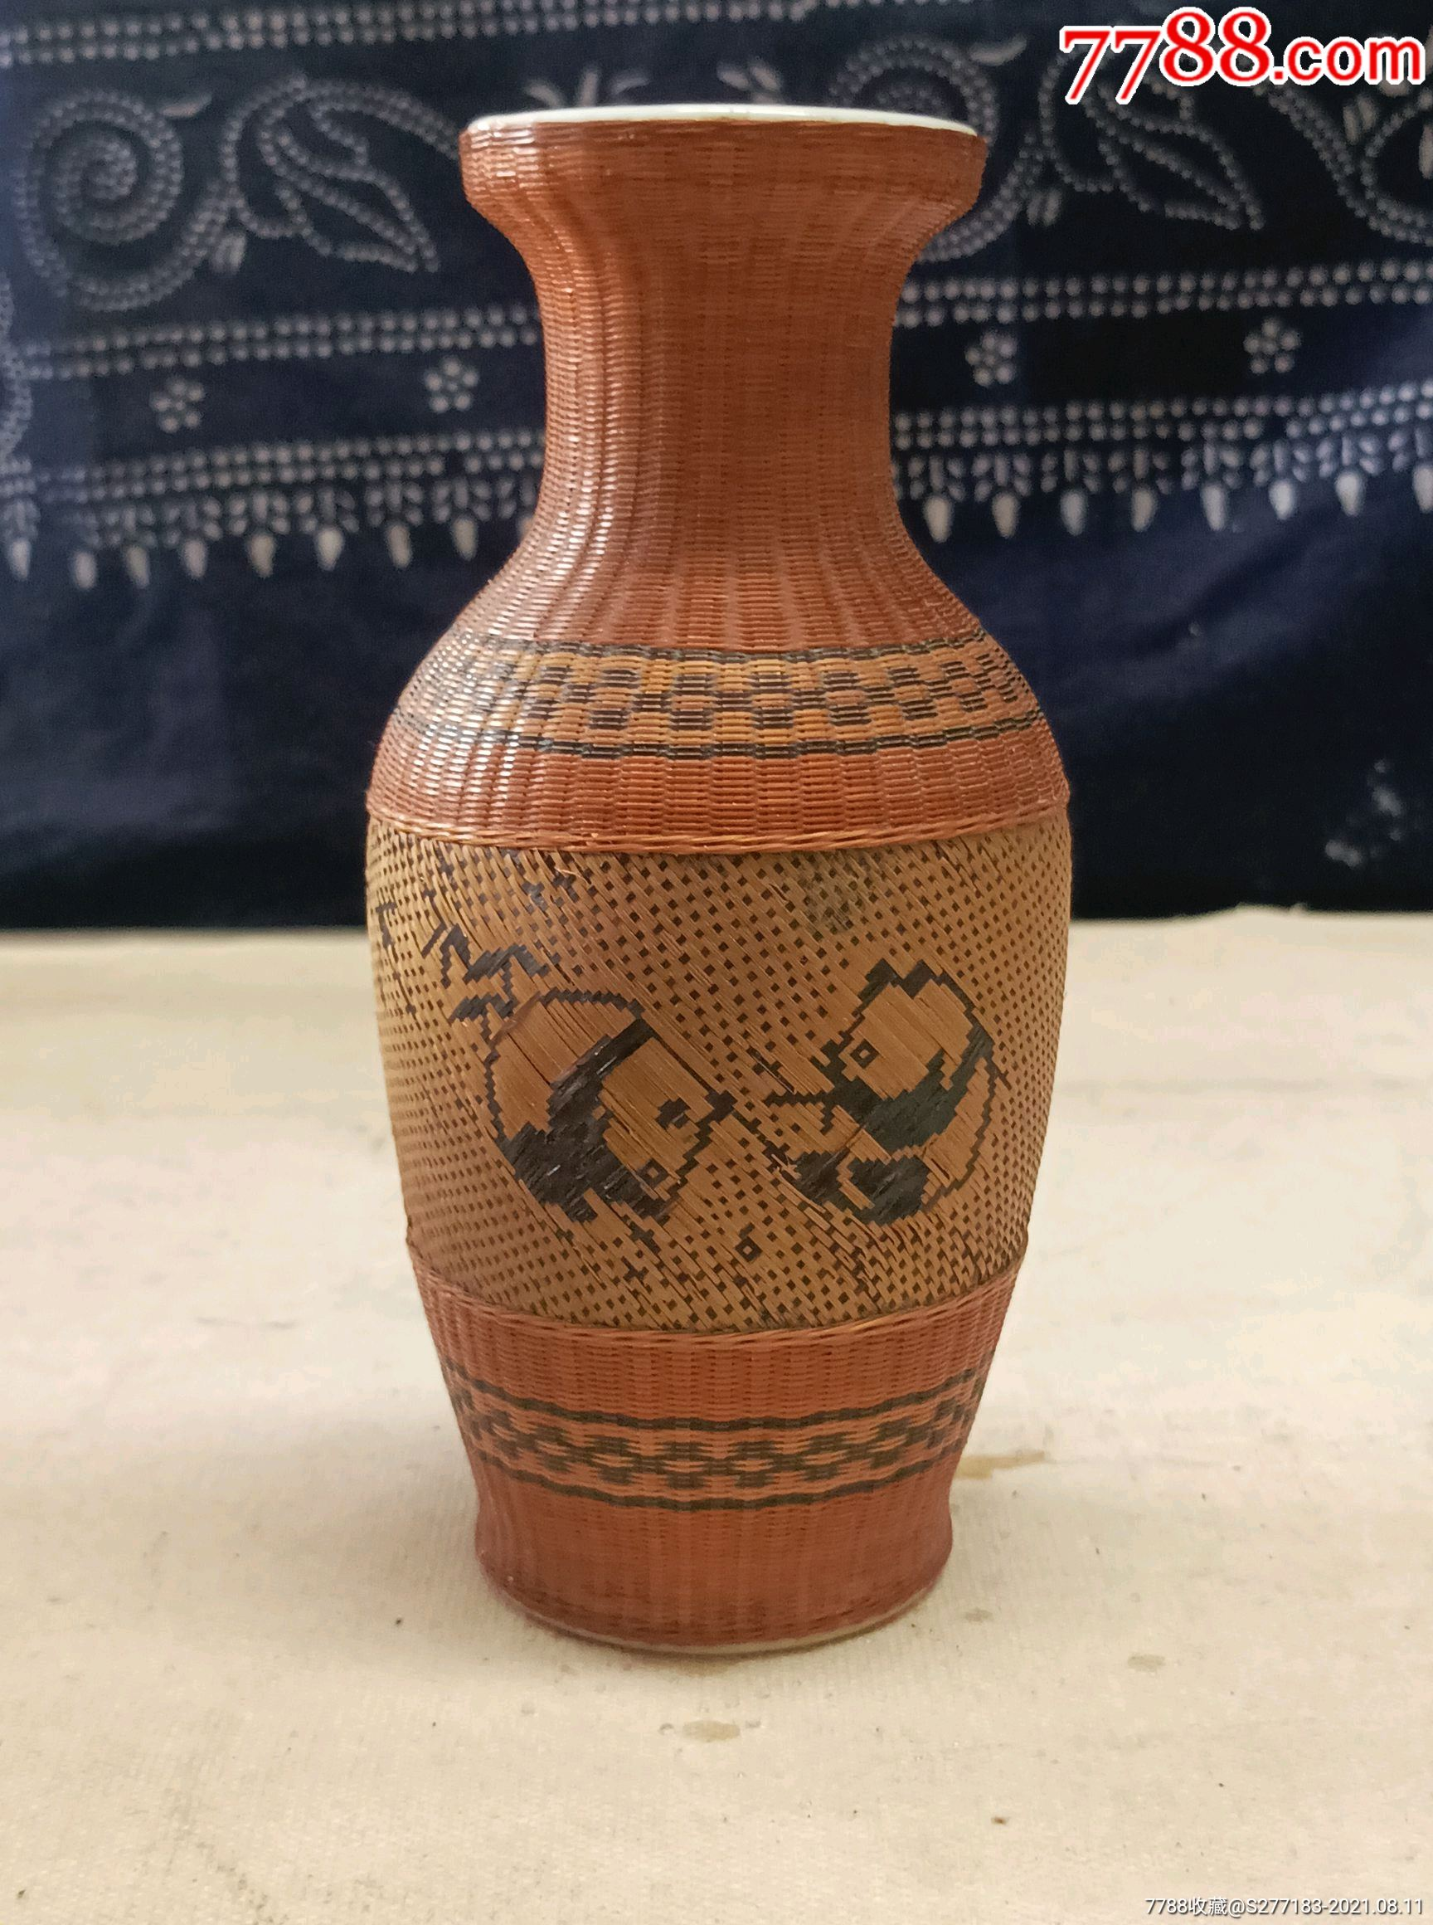
01.
Intrucotion
02.
Contemporary Challenges and Research Purpose
CONTENS
03.
Contemporary Value of the Research
04.
Practice-Driven Contemporary Theoretical Validation
05.
Conclusion

Slide 3

PART ONE
Introduction
Participatory documentaries empower cultural holders to reclaim narrative control, addressing intergenerational transmission challenges caused by globalization and the dominance of mainstream media in cultural storytelling.

Slide 4

PART TWO
Contemporary Challenges
Research Purpose

Slide 5

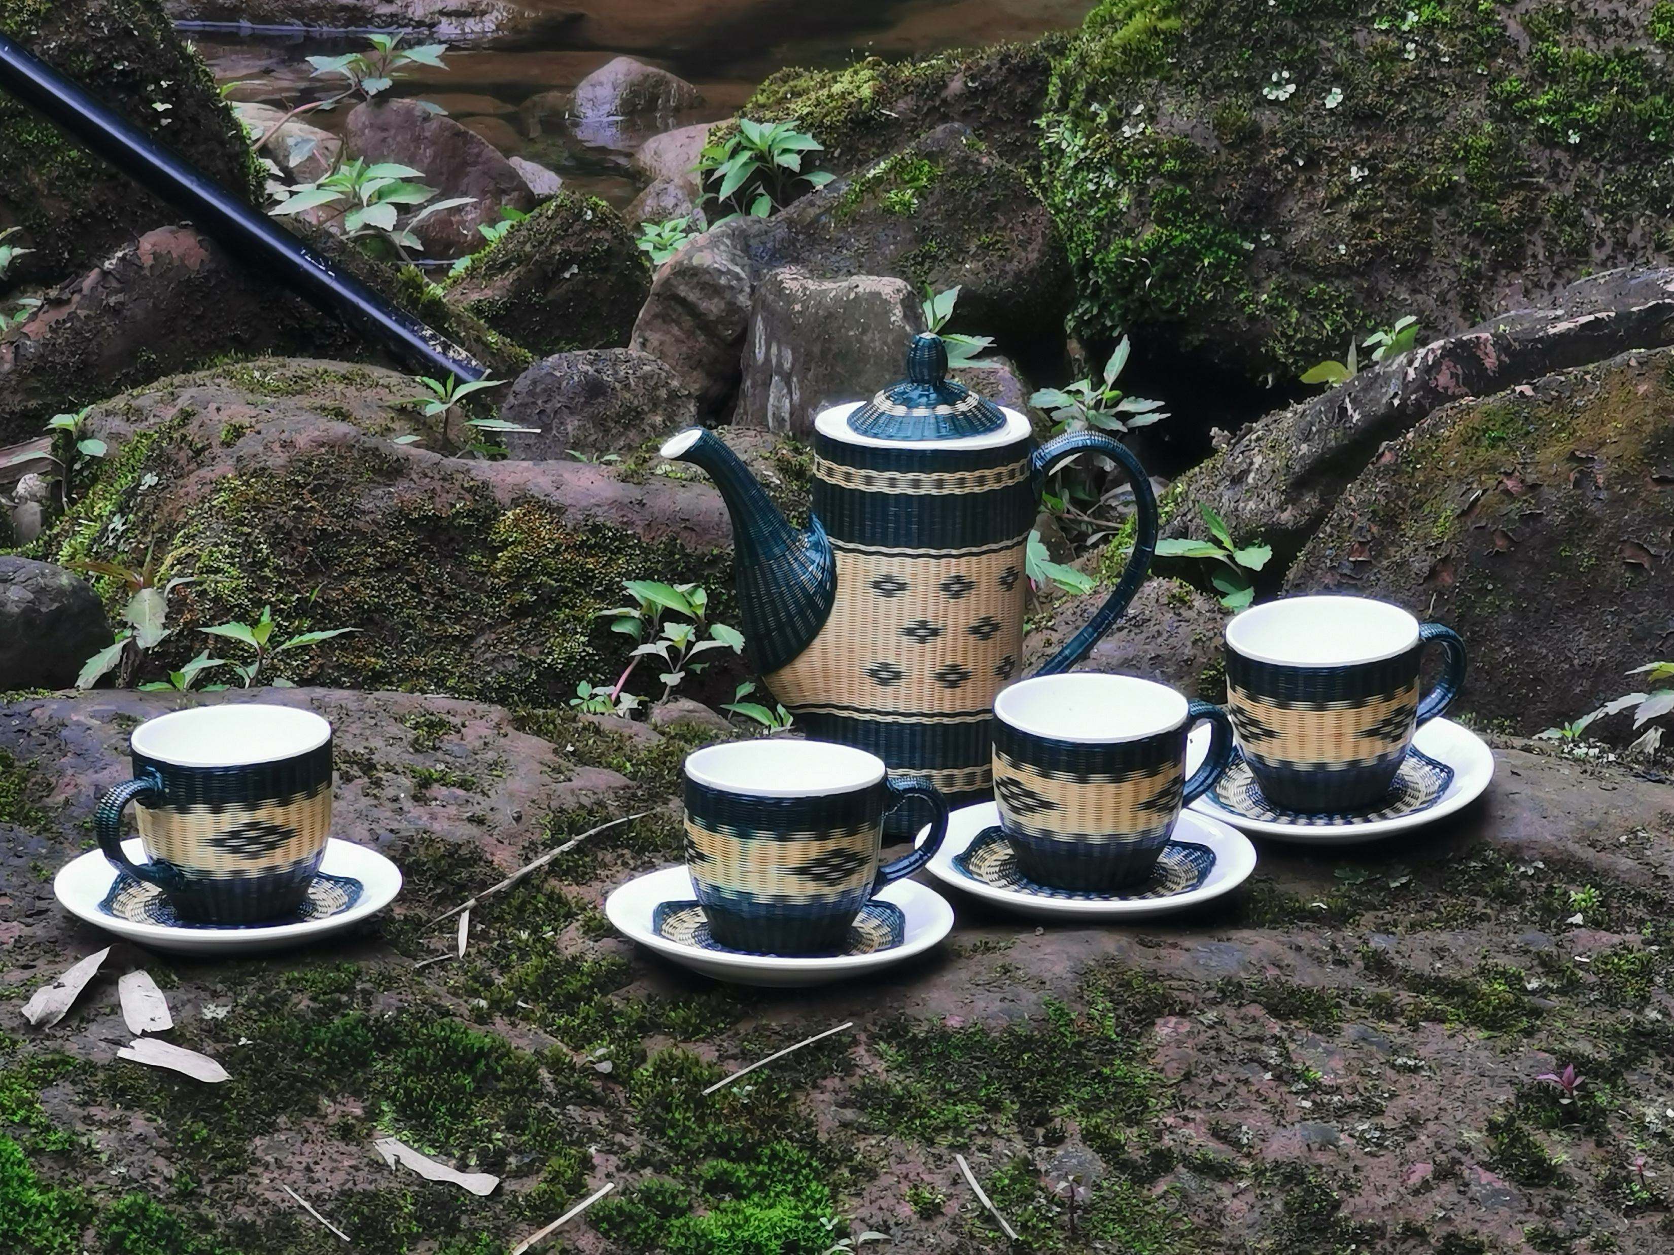
Contemporary Challenges
Adopting participatory documentary practices provides a pathway to empower cultural holders and counteract these issues, restoring narrative control to the communities themselves.
The current landscape of cultural studies reveals several pressing issues:
A decline in cultural inheritors due to socio-economic pressures, leading to reluctance in assuming responsibilities for cultural transmission.
Misunderstandings within cultural identity, often driven by external forces controlling cultural narratives, weakening cultural holders' agency.

Slide 6

Research Purpose
This study aims to address intergenerational transmission challenges within the context of globalization and contemporary policies. It seeks to assist cultural industries in their development while enhancing the cultural self-expression capacities of cultural holders through audiovisual practices.

Slide 7

PART THREE
Contemporary Value of The Research

Slide 8
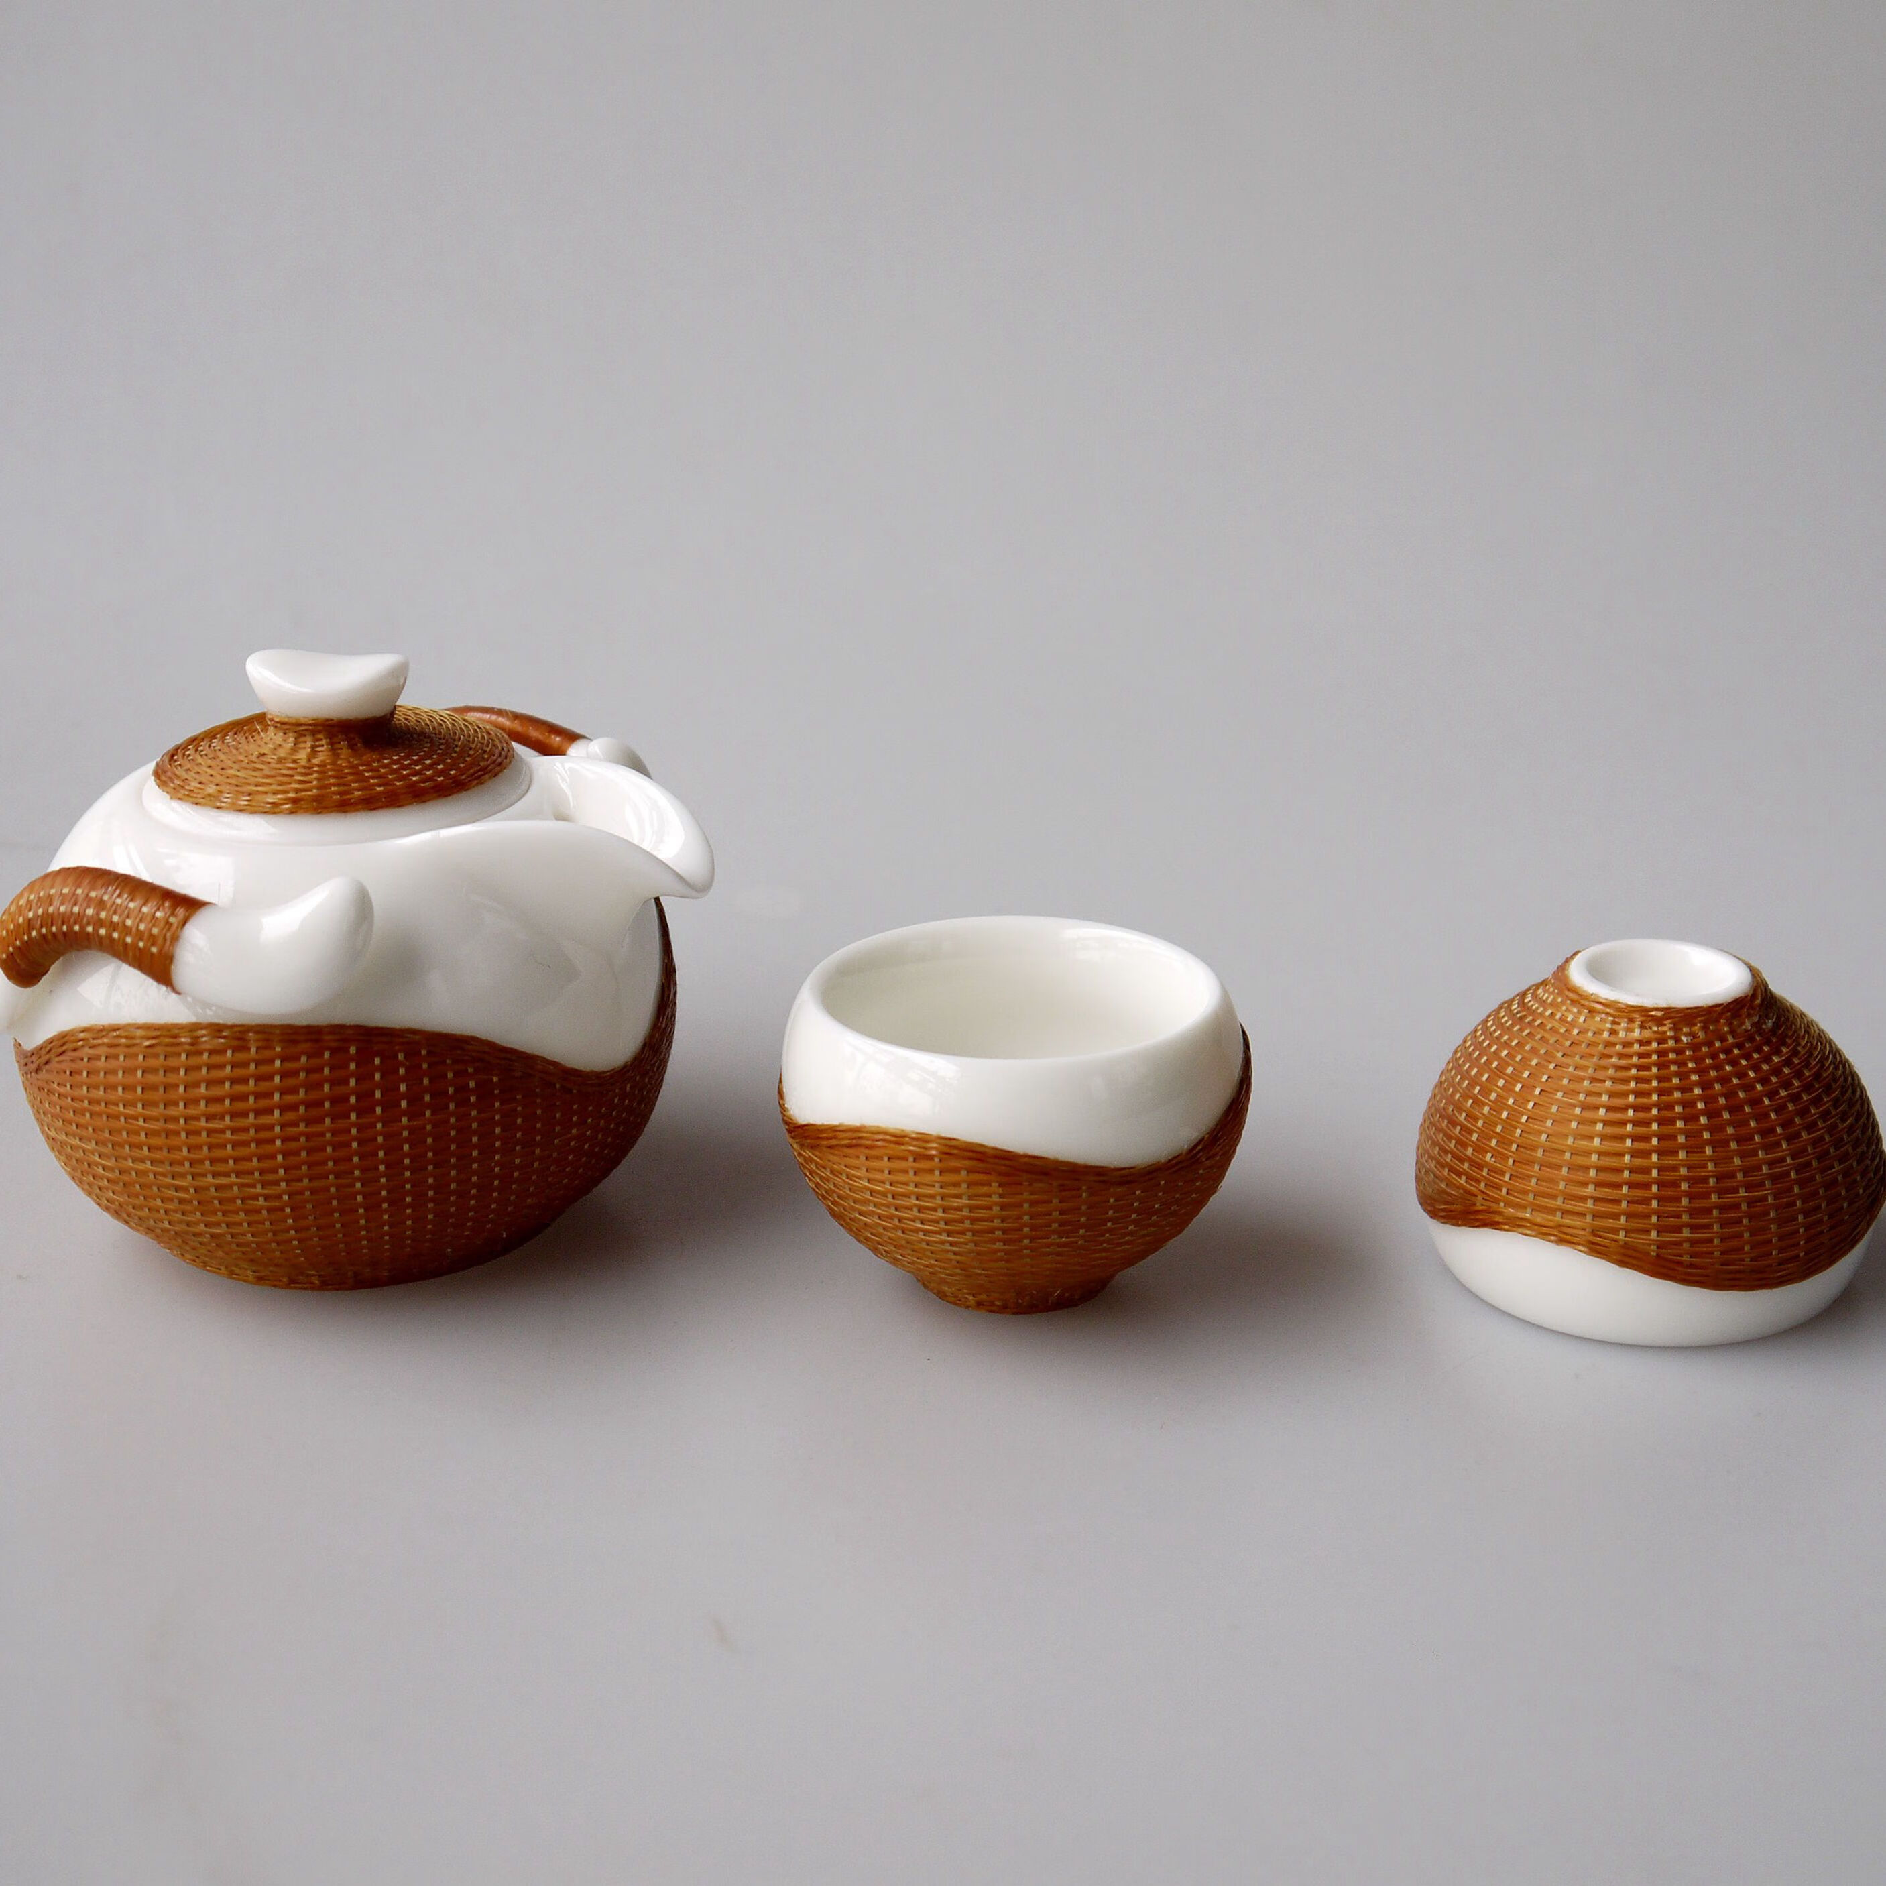
Domestic Needs and Contemporary Value
For cultural holders, participatory documentary offers a tool for self-expression and empowerment, breaking away from China's current trend of commercially driven, interview-based ICH documentaries. It equips cultural holders with a medium to communicate their traditions and ensures tools for intergenerational expression.

Slide 9

Global Context and Contemporary Value
In a world where cultural diversity is paramount, participatory documentaries provide new possibilities for showcasing and disseminating ICH. They foster cultural understanding and inclusivity, reducing conflicts and offering valuable references for cultural scholars. Furthermore, these documentaries contribute new perspectives and documentation to academic research.

Slide 10
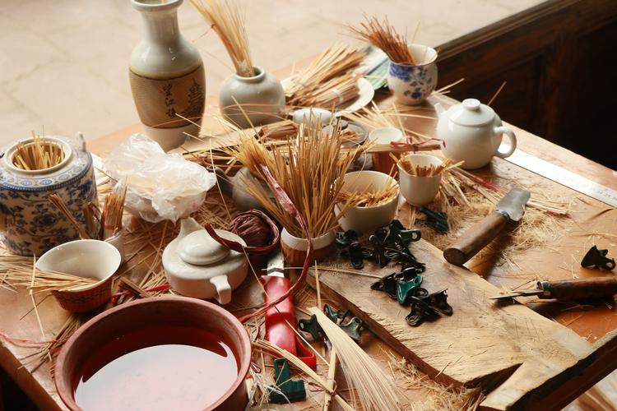
PART THREE
Practice- Driven Contemporary Theoretical Validation

Slide 11
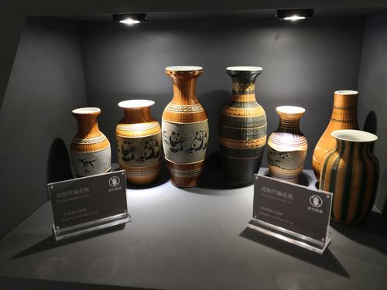
This research validates contemporary theories through practice:
Empowerment Theory
Cultural Transmission Theory
Technological Empowerment
By making cultural holders the creators of narratives, participatory documentaries challenge traditional documentary norms and enhance cultural identity and representation.
Advancements in digital technology empower cultural holders with accessible filming tools, increasing interaction with global audiences.
These documentaries enable both local and global dissemination of cultural practices, promoting cross-cultural understanding through digital platforms.

Slide 12
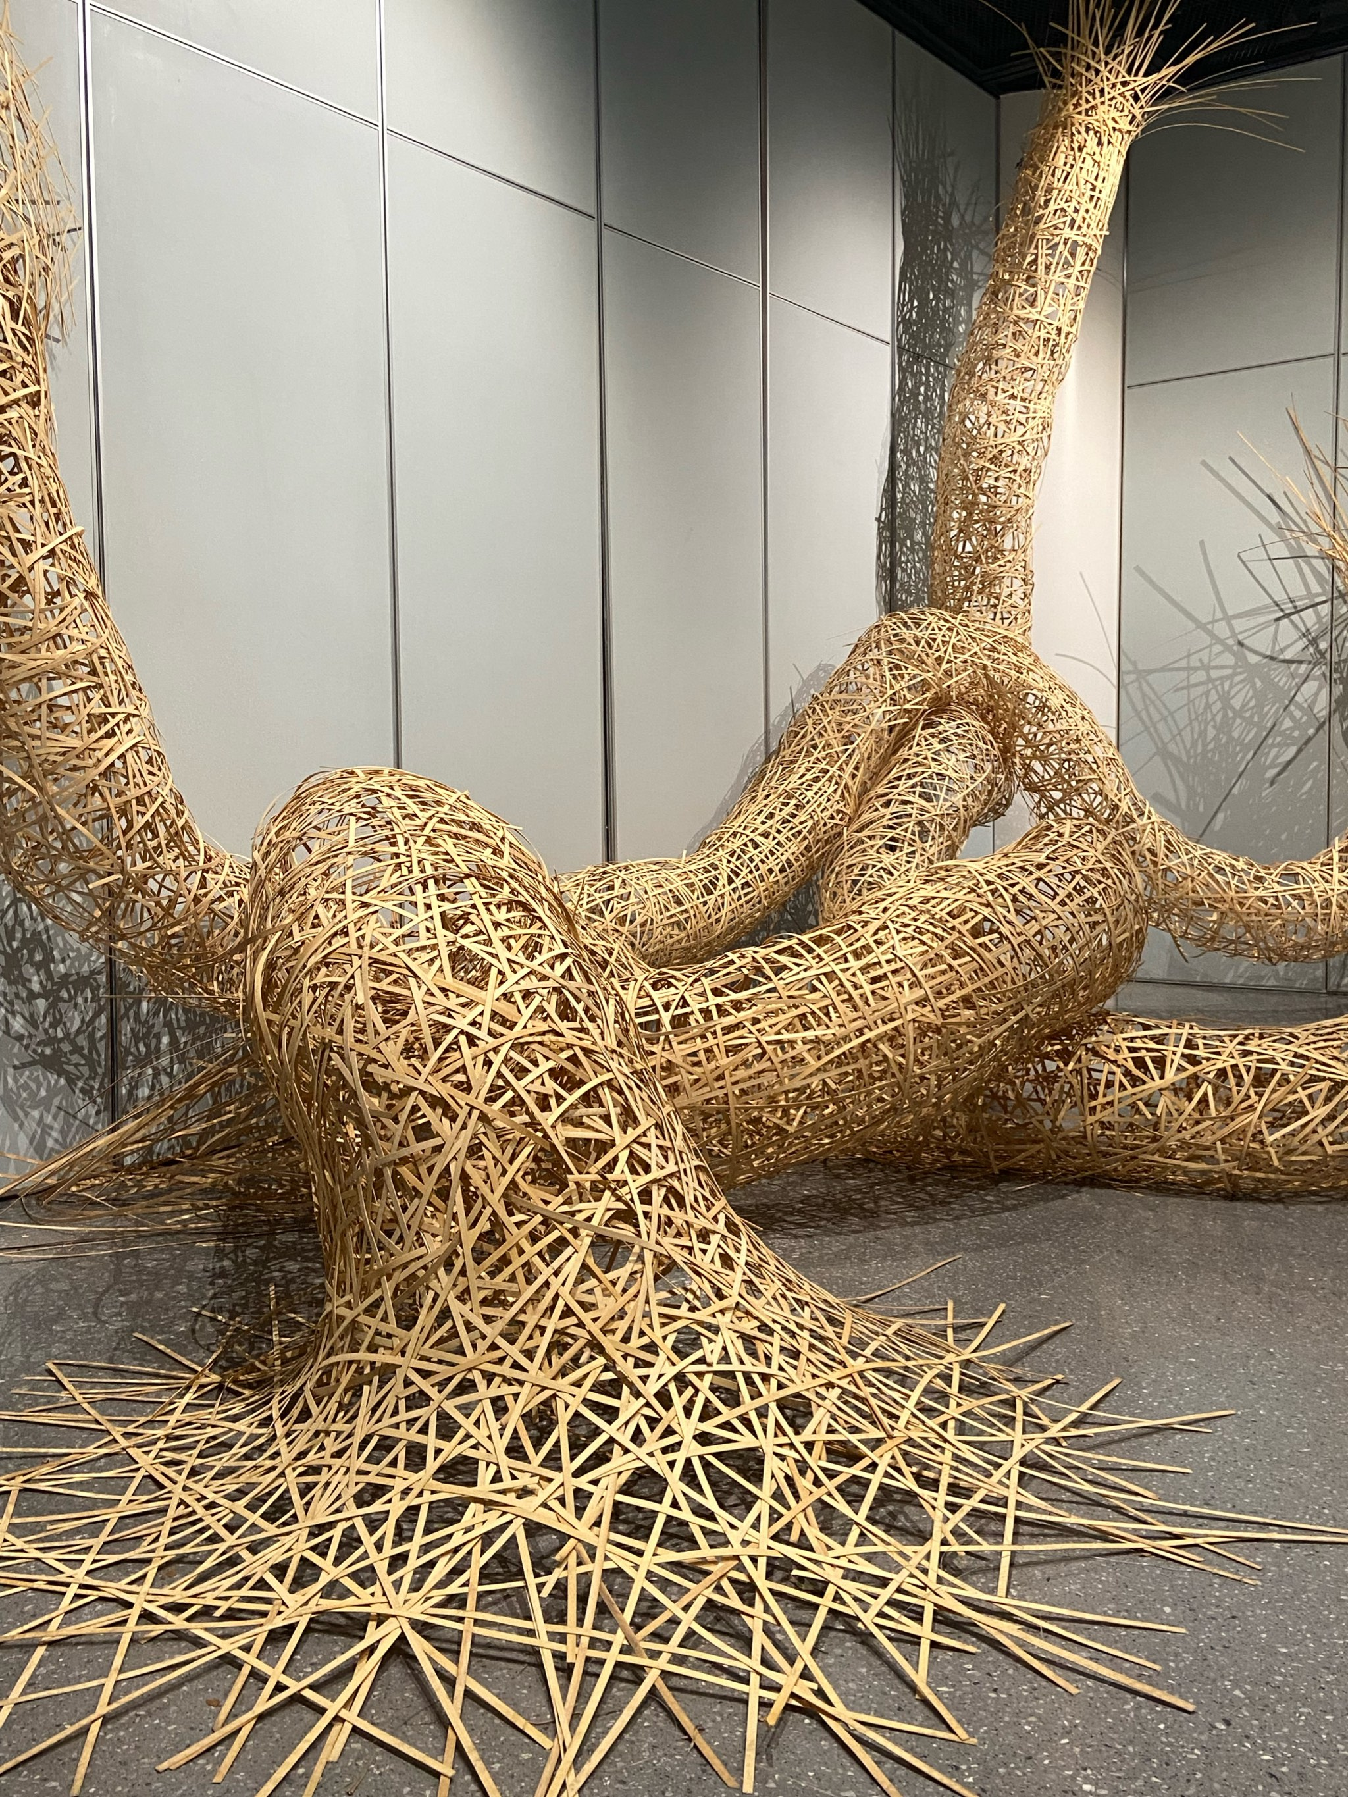
PART FOUR
Conclusion
This research offers a new path for participatory documentaries to address cultural transmission challenges. It empowers cultural holders to engage in documentary practices, fostering stronger cultural identity and paving the way for the intergenerational preservation of ICH.

Slide 13
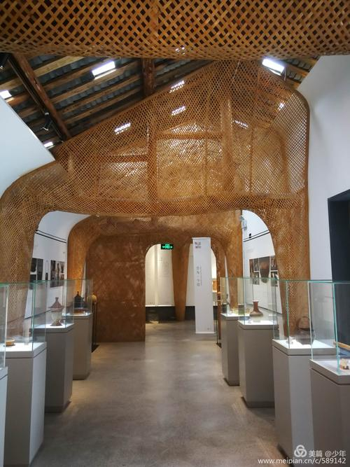
THANKS

