Slide 1
We will be introducing to you about team working and all the different aspects in this field. The topics being discussed will be:
Benefits of team working
Stages of team development
Team Roles
Successful team development
Managing conflict
TITANS TEAMWORKING CONSULTATIONS LTD

Slide 2
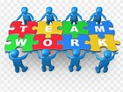
Presentation
Fizza Chohan 1807415 (Team Leader)
Sunu Miah 1807439
Jahura begum 1807431
Nakita Gall 1810215
Sabina khanam 1713883
Group 3

Slide 3
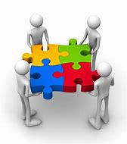
TEAM ROLES
Name: FIZZA CHOHAN
Student No: 1807415

Slide 4
What is Team Roles and why is it Important
A team is a congregation of individual's all with different job roles and titles
Each team has a mix of different team roles depending on the goal the team are trying to achieve
All members in a team will have different specific strengths
Team roles is important for achieving objectives and overall goals
Working within a team you can accomplish much more than working individually
Having different roles in a team leads to having a effective team that runs efficiently, that brings together different ranges of skills and talents

Slide 5
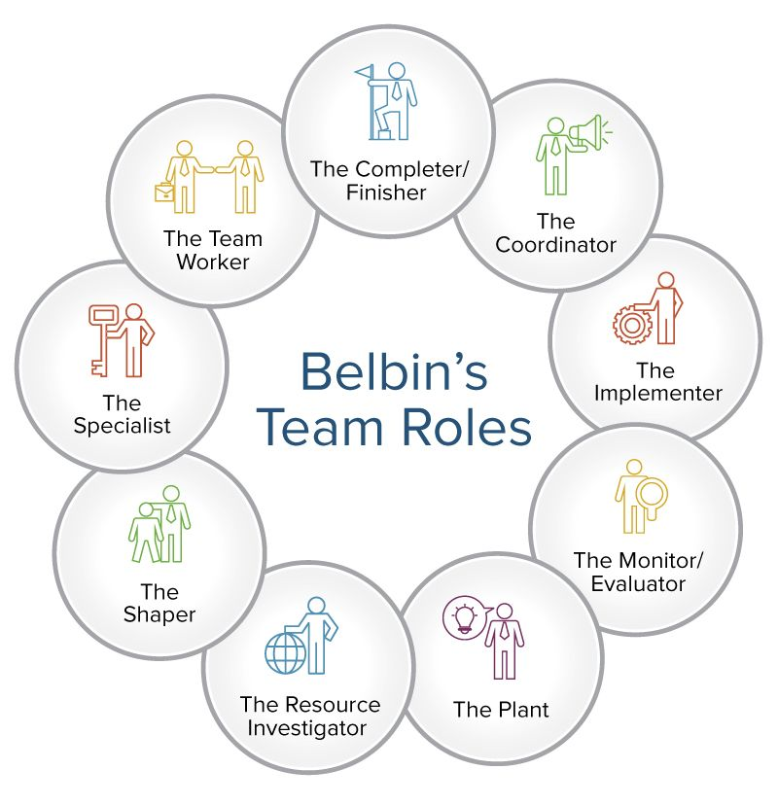
Belbin and his team discovered that there are 9 clusters of behavior.
Using Belbin individuals have a better understanding of their own strength's and weakness.
This then leads to greater communication between team members and colleagues and managers.
Helps the team to understand ways to improve
helps the individual to understand where they fit into the team
Belbin Associates (2019)

Slide 6
Belbin’s Team Role
Belbin's team roles come with both strength's and weakness. Below are some examples of Belbin's team role
Role | Description | Strengths | Weakness
Co- Ordinator | Delegates work Draw out team members Focuses on teams goals | Confident Clarifies goals Mature | Can come across as arrogant and manipulative
Implementer | Plans a workable strategy Carry's this out as affectively and efficiently as possible | Reliable Efficient Practical Turns ideas into actions | Can be slow to respond to new possibilities Can be inflexible
Mindtool ltd (1996-2019)

Slide 7
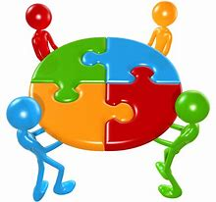
My own experience within a Team Role
I previously worked in a retail company called next. For the store to run efficiently all members of staff had to work within a team. My job role was a sales assistant. My job consisted of helping customers with parcel pick ups, purchasing items and browsing the next website. Each morning a supervisor or a store manger would delicate our jobs which had to be completed for the day. Once complete we then had to report back to senior member of staff to say the job had been completed.
Each member of the team had different job roles relating to their own individual strength’s. We all had the same overall goal and that was customer satisfaction and making profit for the company. Therefore without our specific job roles and working as a team this would not be possible.

Slide 8
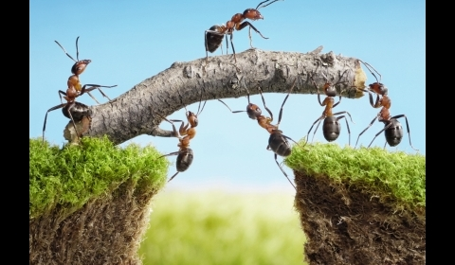
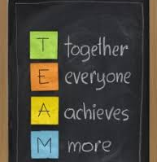
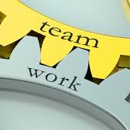


Benefits of team working
By Sunu Miah
Student No: 1807439

Slide 9
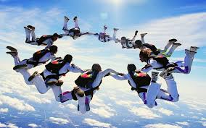
Defining teamwork
I am going to be looking at the importance and the benefits of teamworking, also linking it in with how vital teamwork is in the modern organization. To do this I will be looking into the main theorists and their guidelines for a team to work well and to be efficient.
Teamwork is a group/ team of people working together to achieve a common goal or vision and have the ability to direct individual accomplishments towards organizational objectives.
Working in a team could prove to be an incredible learning experience when there is a readiness among the members to share information with one another.
(kimberly leonard, chron, 2018)

Slide 10
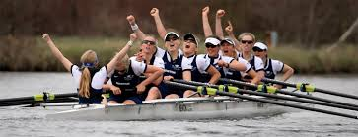
Problem solving
Participation in planning
Effective decision making
Work on performance evaluation and improvement
Developing strategies
What is the purpose of a team
Problem solving
Participation in planning
Effective decision making
Work on performance evaluation and improvement
Developing strategies
The main ingredient of an effective team is the people If the team is to function effectively, all the necessary skills and experience should be present
An effective team has interdependent members Its productivity and efficiency are influenced by the level of coordination and interaction amongst and between its members effective team helps its members work together rather than alone. (luman, 2018)
Some of the traits are,

Slide 11
Teamwork and collaboration Benefits
The benefits of teamwork are that it utilizes everyone's strengths. Each person will have different areas of expertise, allowing each person to contribute their part to create the best possible outcome. As well as this, it relieves pressure as the responsibilities is shared across the team. (paul goodman, toughnickel, 2019)
Greater Risk Taking
Decisions Understood
Faster Resolutions
More Involvement with New Ideas
Greater Motivation and Morale
Greater Aptitude for Complex Problems
Maximizes Involvement
Shared Information
Problem Solving
Shared Goals
Improved Outcomes
Sense of Ownership

Slide 12
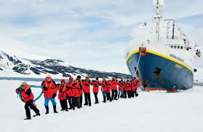
•Teamwork motivates unity in the workplace
•Teamwork offers differing perspectives and feedback
•Teamwork provides improved efficiency and productivity
•Teamwork provides great learning opportunities
•Teamwork promotes workplace synergy
5 reasons why teamwork matters
•Teamwork is increasingly gaining importance. Teamwork is necessary to develop and maintain the group commitment focus and strength. Main principle of teamwork is based on shared values that can make team members work together to achieve common goal.
•It provides an opportunity to come together and establish a common ground for fulfilment of specific goals Understanding, appreciation, and encouragement are main elements of effective teamwork. (shada wehbe, potential, 2017)

Slide 13
What Makes a Team Successful?
Successful teamwork relies upon synergism existing between all team members creating an environment where they are all willing to contribute and participate in order to promote and nurture a positive, effective team environment.
Team members must be flexible enough to adapt to cooperative working environments where goals are achieved through collaboration and social interdependence rather than individualized, competitive goals. (deakinco, 2016)
Clear understanding of team’s mission
Commitment towards the goals
Pre-defined roles and responsibilities
Proper decision-making process
Agreed upon ground rules
Productive group working process

Slide 14
Stages of Team development
By Jahura Begum
Student No: 1807431

Slide 15
STAGES OF TEAM DEVELOMENT
In society now, whether its at a workplace or a study place most people operate together in teams or groups to come and work together to reach the same end goal. Here I will be looking at the main 5 development stages process and go through the breakdown stages of them.

Slide 16
5 stages of team development
Forming- A team of people come together.
Storming- The team come together and learn ways to work together and find ways to approach the problem or assignment.
Norming- The team has become consciously or unconsciously working together and is becoming functional at working together.
Performing- At this stage the real work of the team is progressing and team members provides input when needed.
Adjourning- The team has completed its mission or purpose and it is time for team members to pursue other goals or projects.
According to “The balance Careers” There are 5 stages of steam development with each stage presenting its own challenges.
(The Balance Careers 2019)

Slide 17
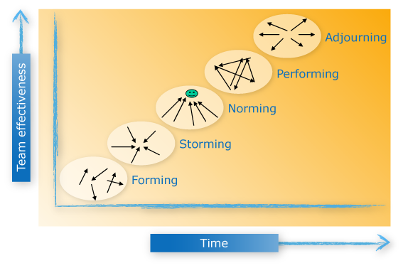
STAGES OF TEAM DEVELOPMENT
Looking at the 5 stages of the development process it is clear that if we follow that process it will be easier for us to communicate together and reach the goal as we have the foundation of steps of which we need to follow in order to assist us.
(Alchemy 2019)

Slide 18
CREATING A SUCCESSFUL TEAM
Name: Nakita Gall
Student No: 1810215

Slide 19
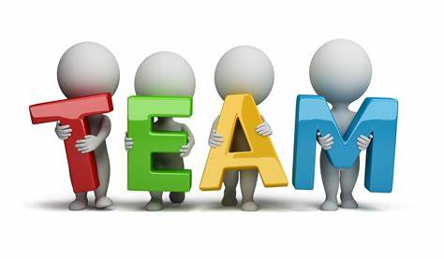
Successful Team development
A successful Team is what helps make a working environments become so successful, working together and communicating effectively and listening is all key core factors to help build a strong team. It is group of people that want to achieve the best and respect each others opinions and know how to work along side each other and work effectively.
Successful team development is Important as it increases positive working environment and relationships within the team, also improves work sales and also has massive impact on how people feel, working within a good positive team brings out the best in people.

Slide 20
Successful team development
Trust
Team members need to be able to trust one another and also the environment they are in
Constructive criticism
Being able to talk openly about any issues arising, or take of any advice from team members and having healthy debates, is important as having conflict can cause negative situation
Accountability
Being able to own you own performance and what you can improve on is a good thing, also highlighting other peoples performance’s can help build successful team as you can all help each other to improve what other people may lack in.
Commitment
Making sure everyone knows what role they play within the team and committing to their rea to complete and achieve the goal.

Slide 21
Example
Team work can be help back by problems, such negative energy within the team, conflict or people may lack in areas. But by doing tam building exercises and group activities can build relationships within the team, also help tackle weakness areas for people within the team.
Team meetings
Team activities such has;
Build a bridge
Bowling
Obstacle courses.

Slide 22
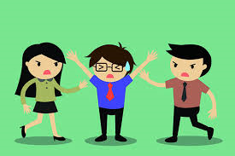
Managing Conflict
Name: Sabina Khanam
Student No: 1713883
Recognising and dealing with disputes in a rational, balanced and effective way. (Sharpe and Johnson, 2002)

Slide 23


Managing Conflict
ADVANTAGES
EFFECTIVE MEASURES TO PREVENT
Development of team work: Helps with working through problems and disagreements
Communication / Appraisal Meetings
Workplace changes: Reorganise the workplace
Sharing ideas: Helps important topics being discussed
Training Staff: Enough recourses to fulfil roles and help work with other people
Effective communication: Helps respect and understanding
Stronger Relationships: Builds on conflict resolution skills
Conflict Resolution Policy: Encourages employees to report concerns, and establishes a zero tolerance policy

Slide 24
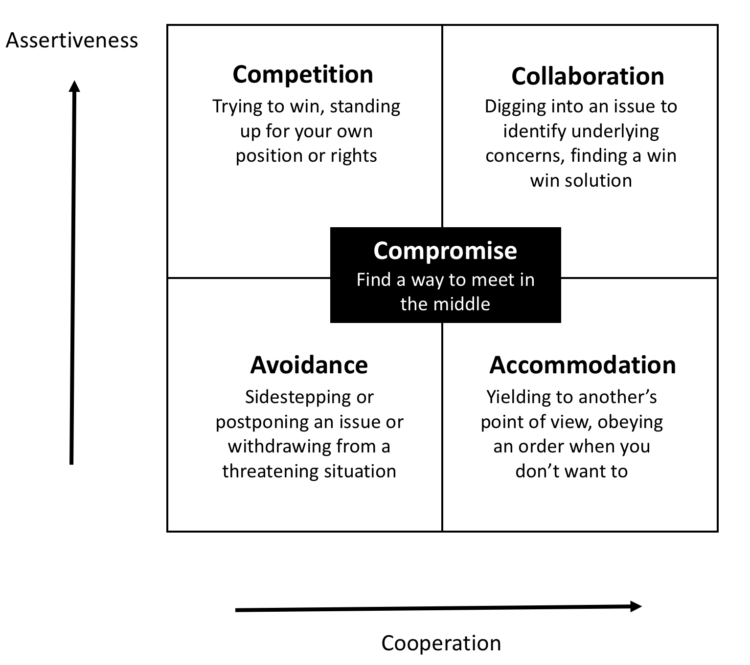
Thomas – Kilmann: Conflict Resolution Strategies
Strategy 1: Avoiding
Strategy 2: Competing
Strategy 3: Accommodating
Strategy 4: Collaborating
Strategy 5: Compromising
(Ivanova and Bikmetova, 2017)

Slide 25
Thomas – Kilmann: Conflict Resolution Strategies
Strategy 1: Avoiding
Strategy 4: Collaborating
When people ignore or withdraw from conflict.
When people are both assertive and cooperative
Strategy 2: Competing
Strategy 5: Compromising
When people who go into conflict plan to win.
Where participants are partially assertive and cooperative.
Strategy 3: Accommodating
When one side gives into the wishes or demands from another.
“DON’T FEAR CONFLICT – JUST EMBRACE IT – ITS NATURAL”

Slide 26
Summary
As a group we have summarised the topics we have talked about
Team roles defines each individuals strengths and weakness within their team. Great teams can be put together, and each individual will feel they are making a significance difference to help achieve the teams goals.
Teamwork in the workplace is not only effective but pivotal studies confirm teamwork improves innovation, enhances problem solving and boost productivity by using collaboration and effective communication a team would be able to ensure ideas and instructions are executed on effectively and timely.
The reason why stages of development is so important is because different people have different capacities. These capacities influence how they communicate, make decisions and evaluate the information.
Managing conflict increases personal growth, enhancing communication, and producing better outcomes, if not effectively managed, by understanding the dynamics of conflict resolution we will all be able establish an environment in which goals can be accomplished.
Successful team development includes trust, accountability, commitment and communication. With all those you can build a strong team who value each other.

Slide 27
REFERENCES
Alchemy 2019- Available at - https://www.alchemyformanagers.co.uk/topics/r64ZCZGCF8evQ5Wf.html
Deakins, 2016. https://www.deakinco.com/media-centre/news/the-five-elements-of-successful-teamwork
Invanova, N., Bikmetova, K., 2017. Identity as a factor of conflict behaviour in organizations. 3(1), p.35-42. [online] Available at: https://search-proquest-com.ezproxy.uwtsd.ac.uk/docview/2068859108/fulltextPDF/888C3A97510742CEPQ/1?accountid=130472
Kimberly leonard, chron, 2018. Available at: https://smallbusiness.chron.com/definition-teamwork-workplace-36105.html
Luman, 2018. Available at: https://courses.lumenlearning.com/boundless-management/chapter/defining-teams-and-teamwork/
Paul goodman, toughnickle, 2019. Available at: https://toughnickel.com/business/15-Advantages-of-teamwork-in-the-workplace

Slide 28
REFERENCES
Sharpe, D., Johnson, E., 2002. Managing conflict with your boss [e-book] Greensboro, NC: Centre of creative leadership. Available at: https://web-b-ebscohost-com.ezproxy.uwtsd.ac.uk/ehost/pdfviewer/pdfviewer?vid=2&sid=7e4fb0f4-bc7c-4c75-8d82-f8519f02a24b%40sessionmgr120
The Balance Careers 2019. Available at - https://www.thebalancecareers.com/what-are-the-stages-of-team-development-1919224
https://smallbusiness.chron.com/good-examples-team-development-workplace-11881.html
https://www.belbin.com/about/belbin-team-roles/ (2019)
https://www.mindtools.com/pages/article/newLDR_83.htm (1996- 2019)

