Slide 1
How do we use technology to collaborate at UWTSD?
Student Name: Elvis Liviu Nassiri Basti
Lecturer Name Seyed Navid Nasirpourosgoei
Student Number: 2112789
BMSW4003_BIRMINGHAM
Digital Skills and Research Methods.

Slide 2
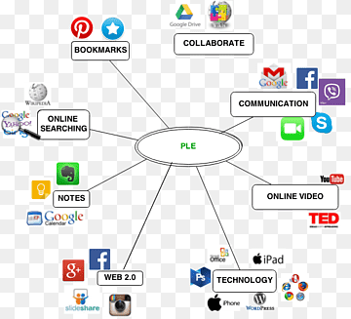
Collaboration
What is collaboration
What is a collaborative technology
“mutual engagement of participants in a coordinated effort to solve a problem
together.”(Lai, 2011)

Slide 3

Collaborative technologies futures
List tasks and allocate them to team members
Add documents and share them with the team
Chat facilities
Plan schedules setting key dates as deadlines

Slide 4

Benefits of collaborative technologies
Global and multicultural workplace
Inclusivity
Team flexibility

Slide 5

Collaboration tools in UWTSD
Microsoft team
WhatsApp
Instagram
GoToMeeting
Skype

Slide 6
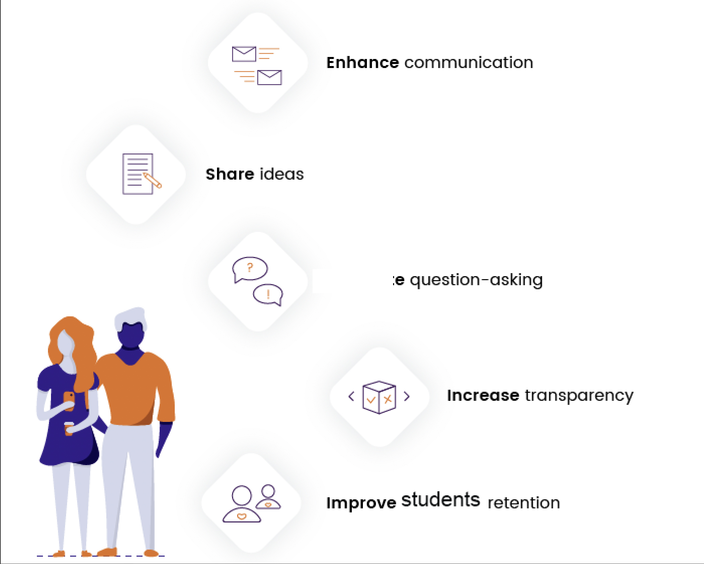
Benefits of collaboration software to manage teams
Storing and managing work
in files in a single location
Ensuring the file you working on
is the up to date
Archiving previous versions of a file
Communicate with the whole team
simultaneously
Providing group support and saving
discussions

Slide 7
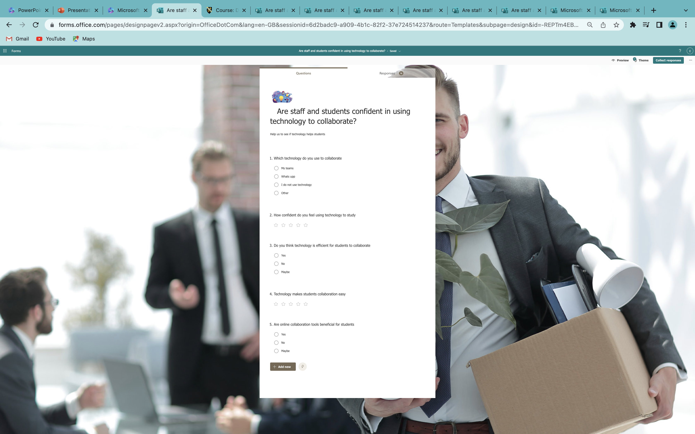
Collaboration Questionnaire
“The questionnaire can be a cost-effective research tool for use in data collection.”(Jack, 1998)

Slide 8
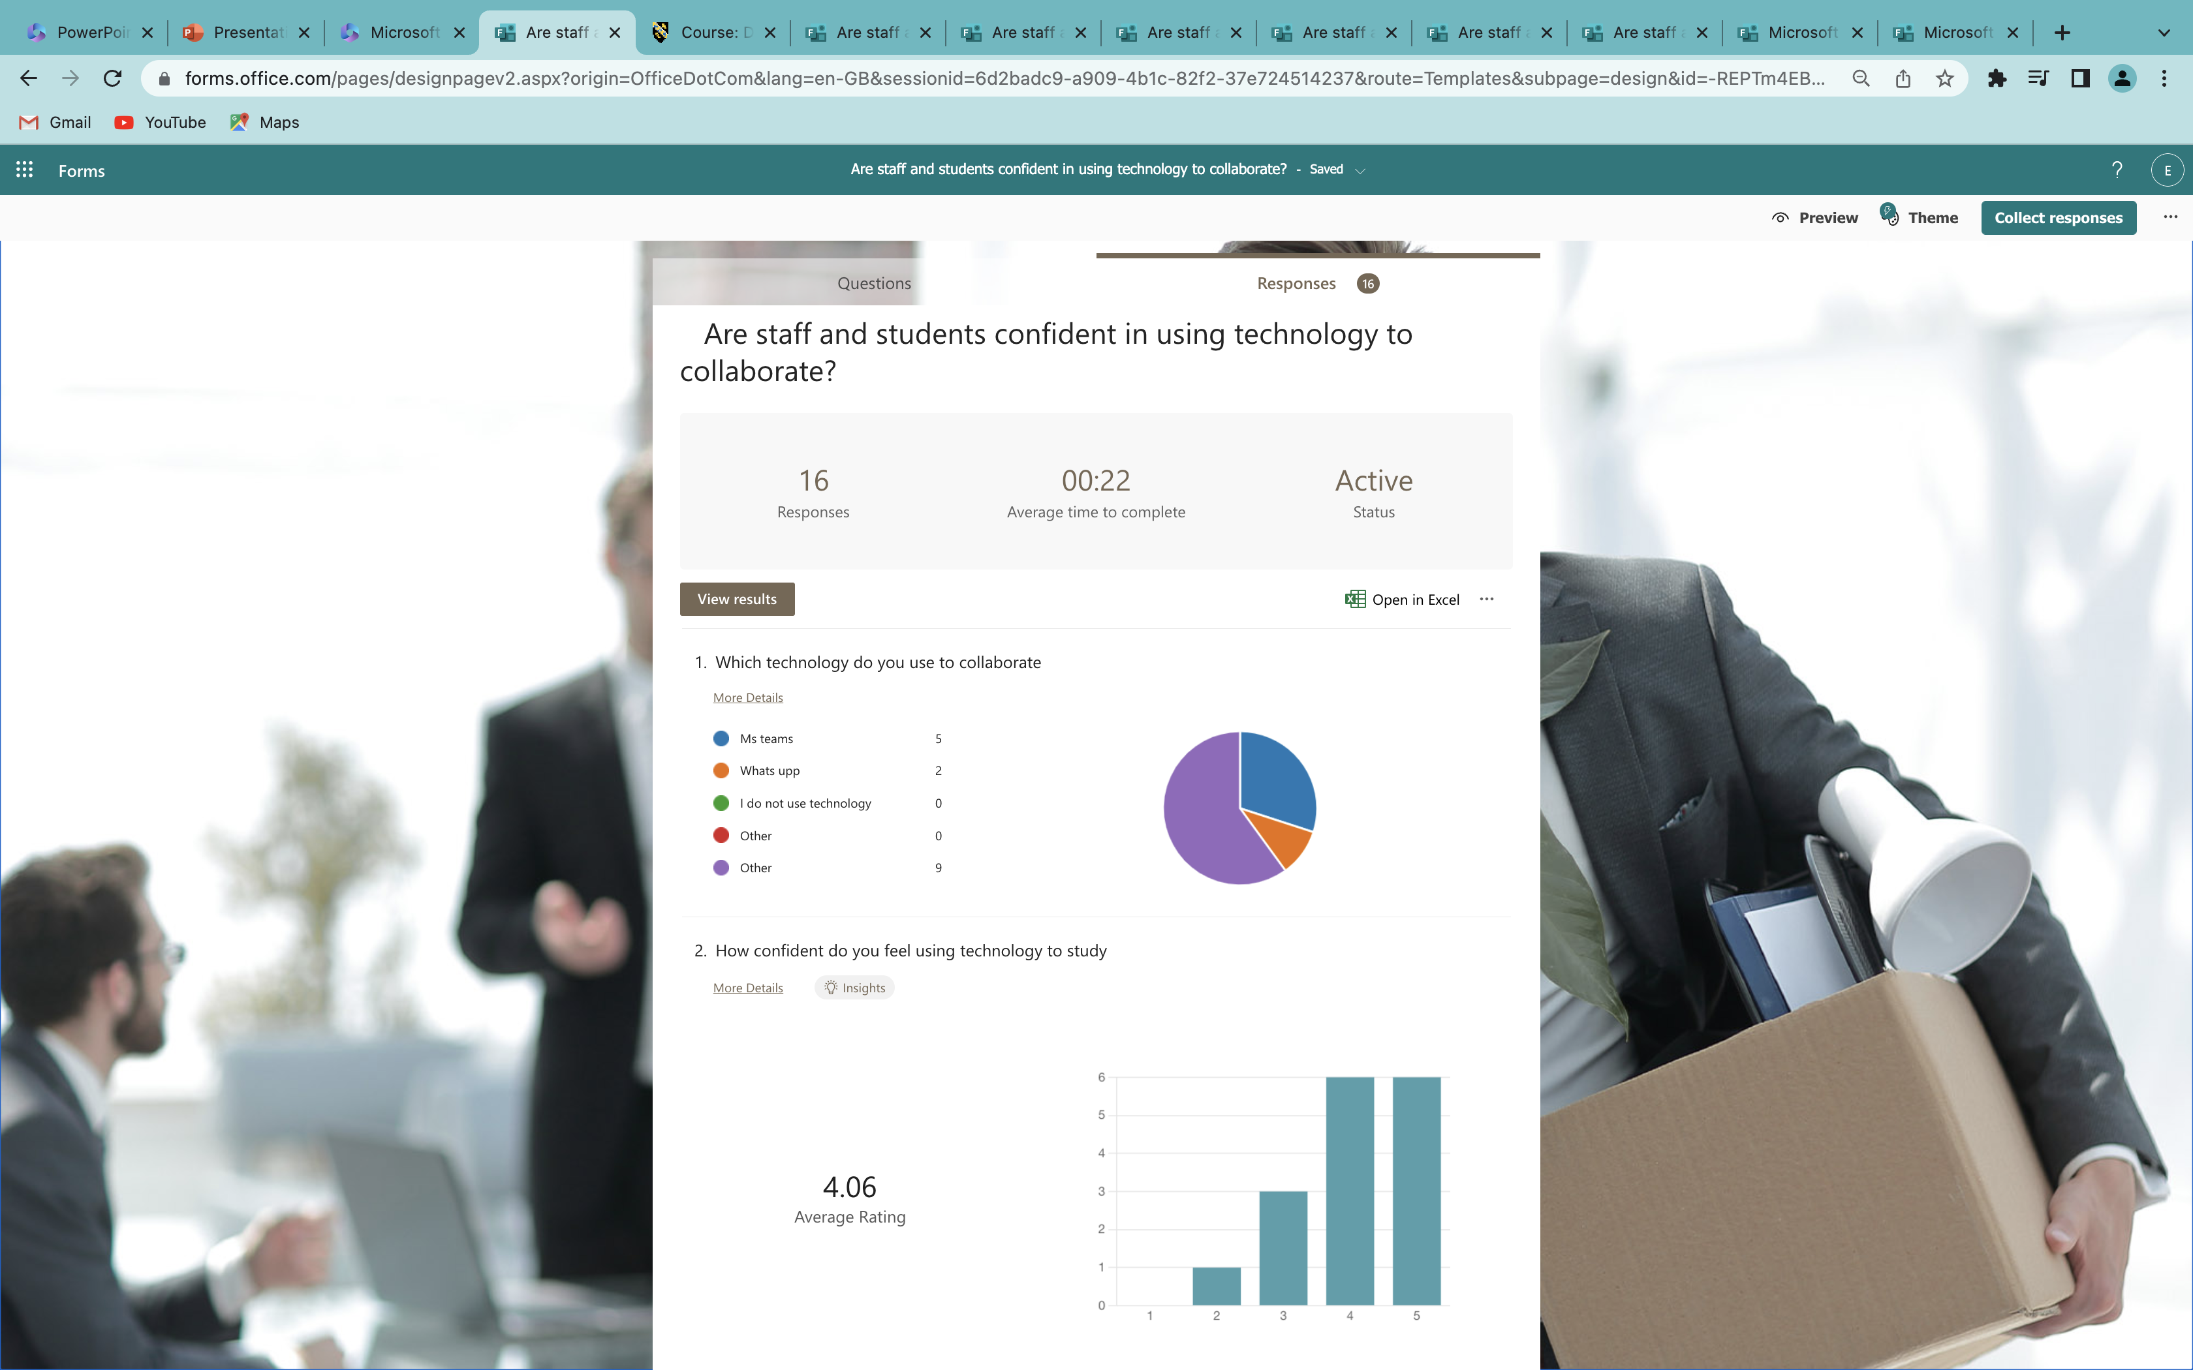
Questionnaire Explained

Slide 9
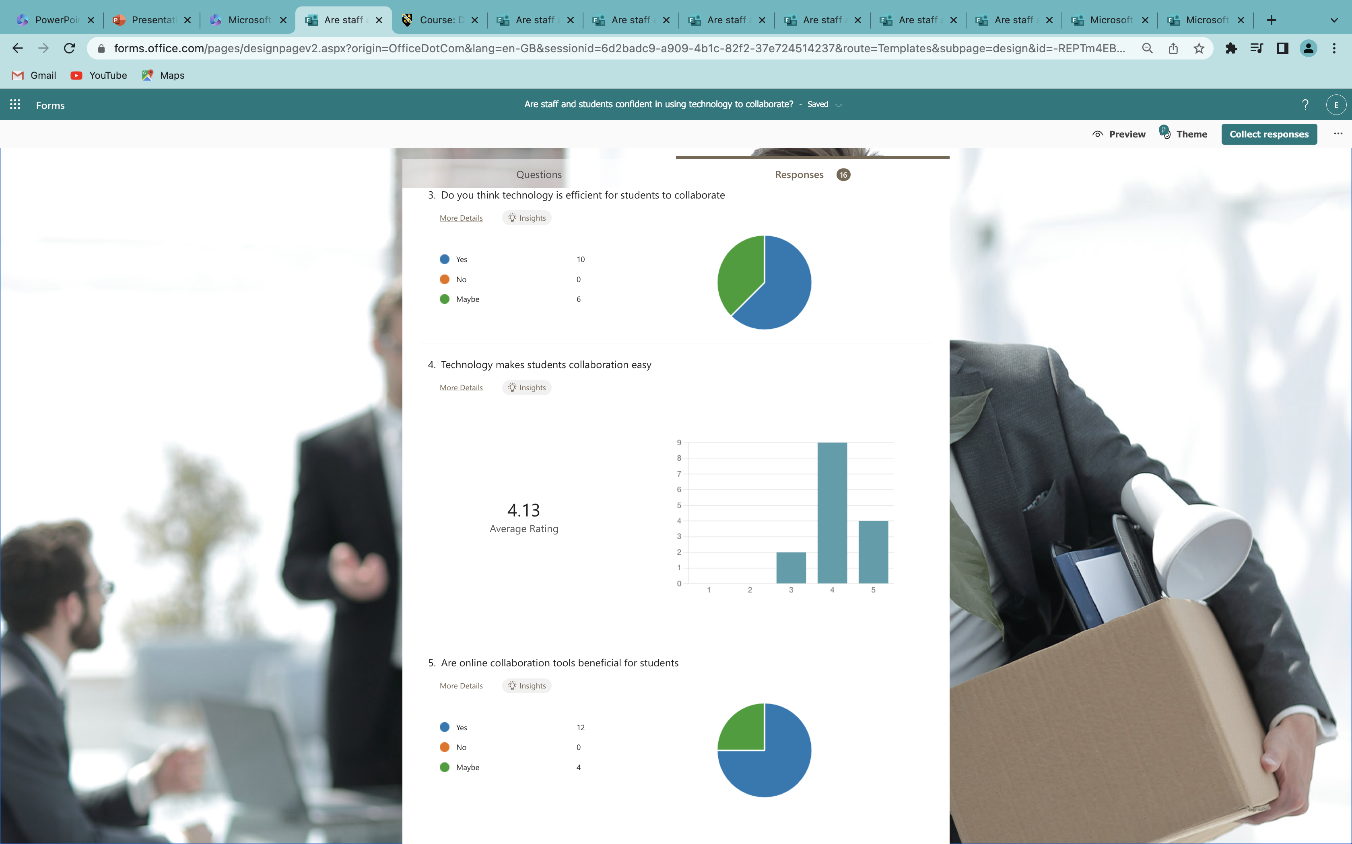
Questionnaire Explained

Slide 10
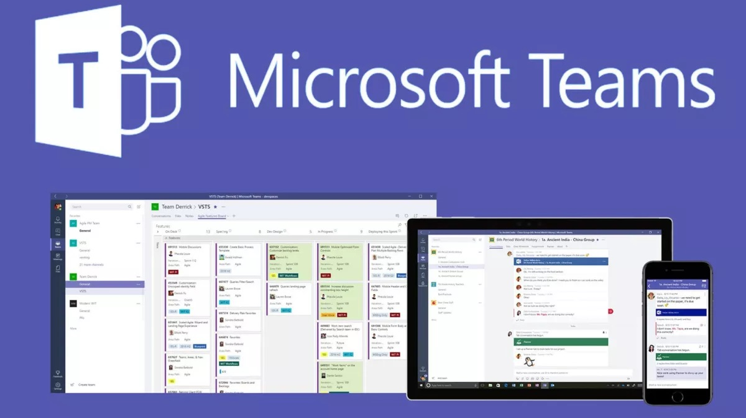
Microsoft Teams
“learning via Microsoft Teams is categorized as something new for the students but this interaction and learning environment motivated students in participating online learning”(Rojabi, 2020)

Slide 11
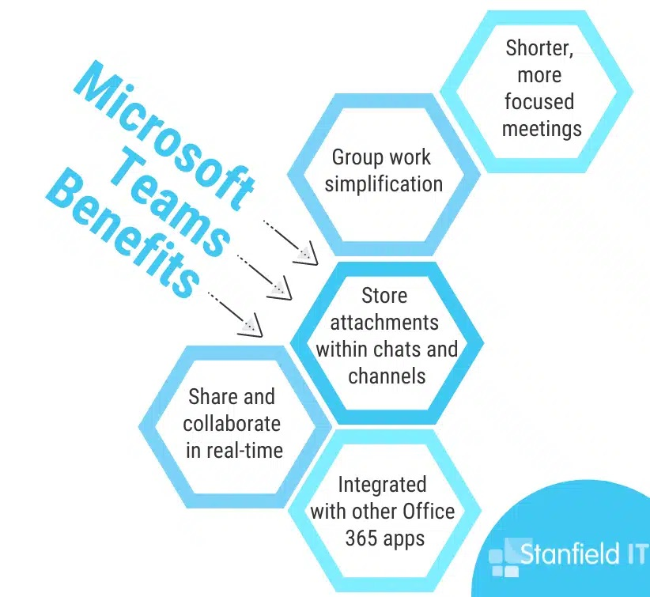
Benefits of Microsoft Teams
Instant messaging, calls
meetings
A central hub to connect all your content and collaboration
Teams mobile is flexible
For on-the-go collaboration
Increase workplace transparency and improve teamwork

Slide 12

Microsoft Teams Features
Instant chats
Conversation channels
Reduced emails
Collaborate live in Realtime
Direct access to skype, email, one drive, and share point
Access across all your devices
Collaborate internally and externally secure
Fast searching for information
Cyber security
Use grid view

Slide 13

Conclusion

Slide 14

Questions

Slide 15


Slide 16

Lai, E.R., 2011. Collaboration: A literature review. Pearson Publisher. Retrieved November, 11, p.2016.
Jack, B. and Clarke, A.M., 1998. The purpose and use of questionnaires in research. Professional nurse (London, England), 14(3), pp.176-179.
Rojabi, A.R., 2020. Exploring EFL Students' Perception of Online Learning via Microsoft Teams: University Level in Indonesia. English Language Teaching Educational Journal, 3(2), pp.163-173.

