Slide 1
Faculty of Education and Communities Research & Ethics Committee
Guidance on submitting forms
DECEMBER 2017

Slide 2
Overview of process
The ethical approval process is a means by which the University seeks to ensure that all researchers consider carefully the ethical implications of their research activity.
There is an expectation that research design and methodology will have been approved for all research project proposals through School/Faculty processes BEFORE ethical approval is sought.
Each School should establish a procedure to ensure the processes below are followed.
All ethical approval applications are completed on the form PG2-E1.

Slide 3
FACULTY ETHICS COMMITTEE
Submission deadlines –10.00 am of the last Thursday of every month;
Ethics committee meets first Wednesday afternoon of every month (unless otherwise indicated due to the University Board commitments), with 10 days for ethical review and responses to be returned to the Module leader/supervisor via the committee secretary.
It is the Supervisor/Module leader’s responsibility to disseminate outcomes to their students.
Incomplete/weak forms will not be considered and will need to be resubmitted at the next meeting.
Any particularly sensitive projects will be referred to University Ethics Committee for advice.

Slide 4
What the committee should and should not do
It should…
  meet regularly (monthly)
  focus on ethical implications of each stage of the proposed research
  give clear, timely and concise feedback on the form submitted
  usually only consider taught postgraduate and research forms and only those undergraduate forms with specific ethical requirements
It should not…
  accept late submissions
  comment on methodology unless there are ethical implications

Slide 5
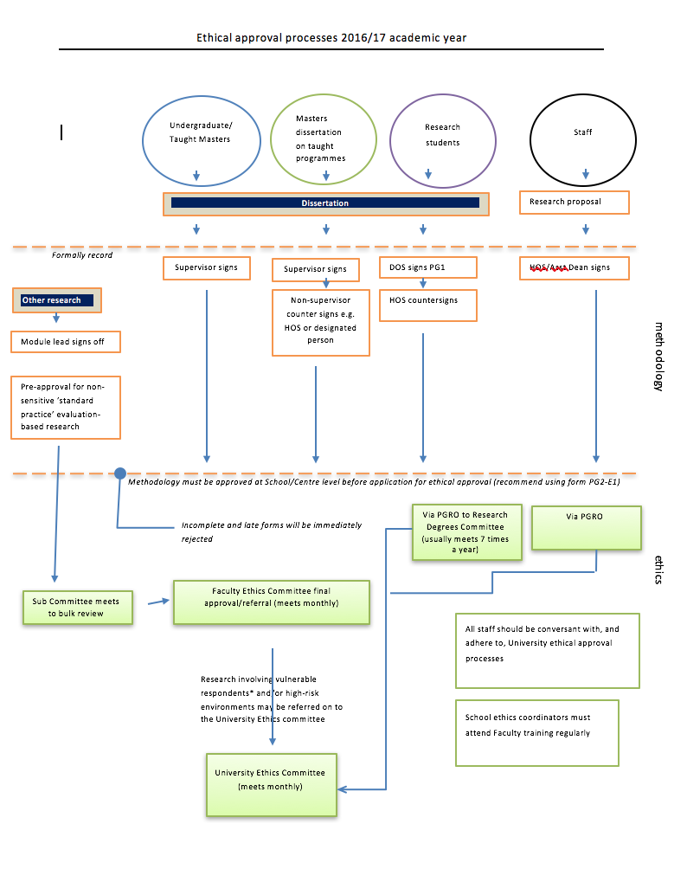
The process for seeking ethical approval

Slide 6
Naming of files
You should adopt the following convention for naming the electronic form submitted: SURNAME_NAME _PROGRAMME_DATE
  SMITH PPGCE 4 April 2017
  JONES SPGCE 4 APRIL 2017
  SMITH BA SS 17 April 2017
  WILLIAMS MSocStud 23 May 2017

Slide 7
resubmissions
Ensure that any alterations are highlighted in RED
  Just change font colour
  Do NOT use Track Changes
The Ethics Committee will only focus on the changes

Slide 8
10 common shortcomings
Section B:
  Omitting date
Section B:
  Omitting name of the staff member and their designated role
Section C:
  Omitting University Code of Ethics
Section D:
  Indicating ‘Yes’ when ‘No’ may be more appropriate.
    This does not normally apply to university placement experiences which are part of the students’ programme of study e.g. schools, youth organisations, observational placements
    In these cases you would indicate ‘No’

Slide 9
10 common shortcomings
Section E:
  Ensure that the proposed start date is after the Committee Ethics meeting
Section F:
  Any boxes ticked should be commented upon in the methodology (section E)
Section G:
  Give number of participants and say how you will identify participants
Section H:
  All research carries risk
    Ensure that risks are identified
    Do not put ‘Not Applicable’
Section K:
  Include signatures of supervisor
  These can be either electronic or handwritten
Section K:
  Include date of signature and tick relevant boxes on checklist.

Slide 10
Further general observations
Section C and E:
  Reference should be made to ethics guidance outside the UK
Section E:
  Under ‘location of research activity’ it is up to the discretion of the supervisor in conversation with the student as to whether the name of an organisation is included
  It is advisory to use bullet points for
    Research Aims
    Research Objectives
    Research Questions
Section G:
  Ensure that you tick one the boxes either ‘YES’, ‘NO’ or N/A

Slide 11
Further general observations
Section H:
  ‘Adverse outcomes’ should link to risks in preceding boxes
Section I:
  Make explicit reference to how informed consent, confidentiality and anonymity will be achieved
Section J:
  Electronic transfer of data means communicating data between electronic devices e.g. one database to another. This does not mean saving work to a USB stick.
  Under ‘list all who have access to the data generated by the research activity..’ this applies to raw data and you should consider carefully who should access this. Normally this would be the researcher and supervisor and in placement contexts, a leader or designated person.
  Ensure that you provide details if boxes are ticked
At the end of the form, do not include the Application Process or any appendices

Slide 12
Section b
Include Name of Staff Member and their Designated Role
Put in Date

Slide 13
Section c
Include UWTSD Code of Ethics plus Discipline-Specific Codes of Ethical research
If you are undertaking your work outside of the UK include the relevant Ethical Guidance

Slide 14
Section d
Ticking ‘Yes’ when ‘No’ may be more appropriate. This does not normally apply to university placement experiences which are part of the students’ programme of study e.g. schools, youth organisations, observational placements.
In these cases you would tick ‘No’.

Slide 15
Section E
Ensure that the proposed start date is AFTER
the Committee Ethics meeting
It is advisory to use
Bullet Points for research aims, objectives and questions

Slide 16
Section e
It is up to the discretion of the Supervisor in conversation with the student as to whether the name of an organisation is included.

Slide 17
Section f
Any boxes ticked YES should be commented upon in the Methodology (Section E)

Slide 18
Section g
Give number of participants and
say HOW you will identify participants

Slide 19
Section h
All research carries risk if it involves participants
ensure that risks are identified
Do not put ‘Not applicable’
All research carries risk, ensure that risks are identified.
Do not put ‘Not applicable’
All research carries risk, ensure that risks are identified.
Do not put ‘Not applicable’
Any Risk identified in the section above
needs mitigation explained here

Slide 20
Section i
Researchers are required to indicate in the ethics form that they will follow the Ethical policy within their place of work/placement, to provide a letter which demonstrates the organizations support for the research, in addition consent forms given to all participants and if this work involves minors (under 18 in line with UWTSD) that parents/guardians are also asked for their consent.
Make explicit reference to HOW informed consent, confidentiality and anonymity will be achieved
Make explicit reference to HOW informed consent, confidentiality and anonymity will be achieved
Demonstrate the difference between anonymity and confidentiality
How will participants withdraw from a study?

Slide 21
Section J
Personal data are data which relate to a living individual who can be identified from that data or from that data and other information which is in the possession of, or is likely to come into the possession of, the data controller and includes any expression of opinion about the individual and any indication of the intentions of the data controller. This includes any other person in respect of the individual (Data Protection Act 1998).
Sensitive Personal Data are defined in the Data Protection Act 1998 as data pertaining to a person's race, ethnic origin, political opinion, religious or similar beliefs, trade union membership, physical or mental health or condition, sexual life, commission or alleged commission of an offence, proceedings for an offence (alleged to have been) committed, disposal of such proceedings or the sentence of any court in such proceedings.

Slide 22
Section J
Electronic transfer of data means communicating data between electronic devices e.g. one database to another.
This does NOT mean saving work to a USB stick

Slide 23
Section J
This ONLY applies to RAW DATA and you should consider carefully who should have access
Normally this would be the researcher and supervisor but in placement contexts, this could also be a leader or designated person
Under normal circumstances, raw data should be destroyed at the first opportunity e.g. after transcription. Exceptions might include circumstances where raw data is needed in the preparation of publications or re-submission of assignments. Researchers should seek advice from supervisors if in any doubt. The key principle for researchers to consider is protecting the anonymity of participants.

Slide 24
Section K
Remember to include the Date
Include signature of
your supervisor
These can be either electronic or handwritten
Remember to include the Date

Slide 25
General Issues
Remember . . .
Ensure that you
Indicate either
‘YES’, ‘NO’ or N/A
For all that require
a cross

Slide 26
Finally . . .
This box is often marked in error

Slide 27
Remember!
delete the instructions
from the bottom of the form
before sending to your supervisor

Slide 28
Research data management policy 27/01/2016
http://www.uwtsd.ac.uk/media/uwtsd-website/content-assets/documents/strategies-policies/Research-Data-Management-Policy-27.01.16.pdf

