Slide 1

Digital Competence Models & The Future Modelau Cymhwysedd Digidol Y Dyfodol
Addysg y Dyfodol

Slide 2
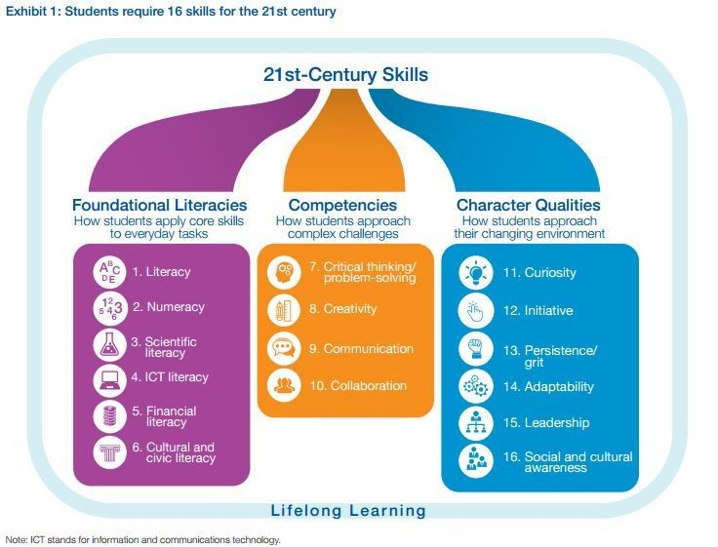

https://www.weforum.org/agenda/2016/03/21st-century-skills-future-jobs-students

Slide 3
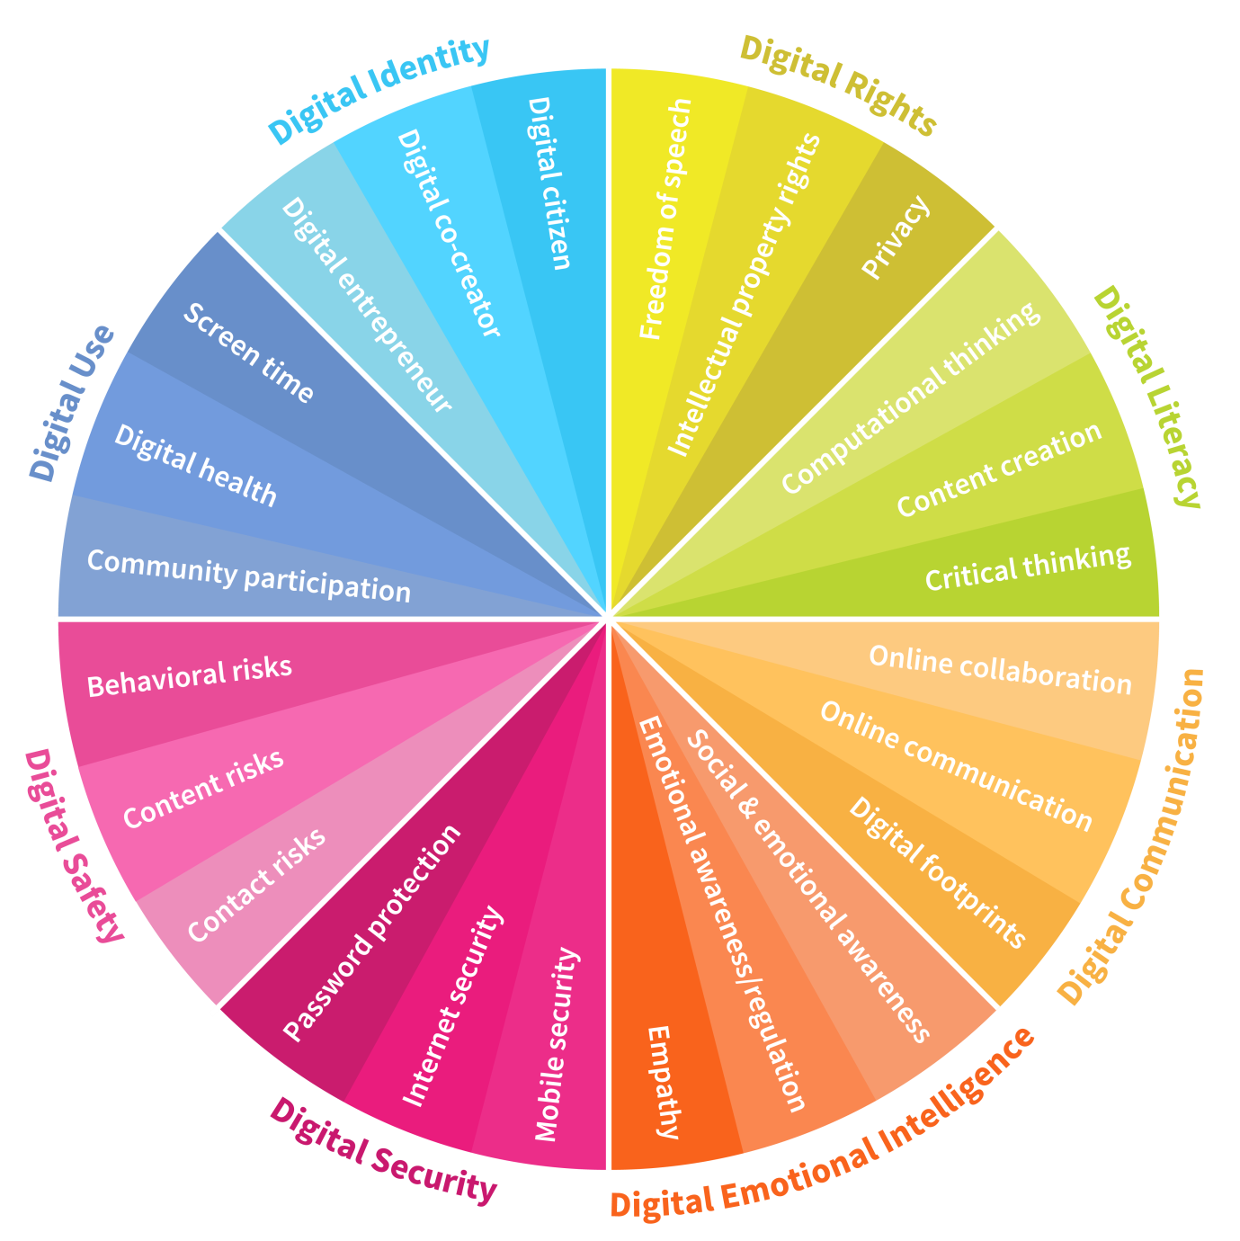
https://www.weforum.org/agenda/2016/06/8-digital-skills-we-must-teach-our-children/

Slide 4
Y Fframwaith /
The Framework
Dinasyddiaeth.
Rhyngweithio a chydweithio.
Cynhyrchu.
Data a meddwl cyfri adurol.
Citizenship.
Interacting and collaborating.
Producing.
Data and
Computational
thinking.

Slide 5
Dinasyddiaeth Citizenship | Rhyngweithio a chydweithio Interacting and collaborating | Cynhyrchu Producing | Data a meddwl cyfri adurol Data and computational thinking
1) Hunaniaeth, delwedd ac enw da / Identity, image and reputation 2) Iechyd a lles / Health and well-being 3) Hawliau digidol, trwyddedu a pherchnogaeth / Digital rights licensing and ownership 4) Ymddygiad ar-lein a Seiberfwlio / Online behaviour and cyberbullying | 1) Cyfathrebu / Communication 2) Cydweithio / Collaboration 3) Storio a rhannu / Storing and sharing | 1) Cynllunio, cyrchu a chwilio / Planning, sourcing and searching 2) Creu / Creating 3) Gwerthuso a gwella / Evaluating and improving | 1) Datrys problemau a modelu / Problem solving and modelling 2) Llythrennedd gwybodaeth a data / Data and information literacy

Slide 6
Y Dyfodol
The Future

Slide 7
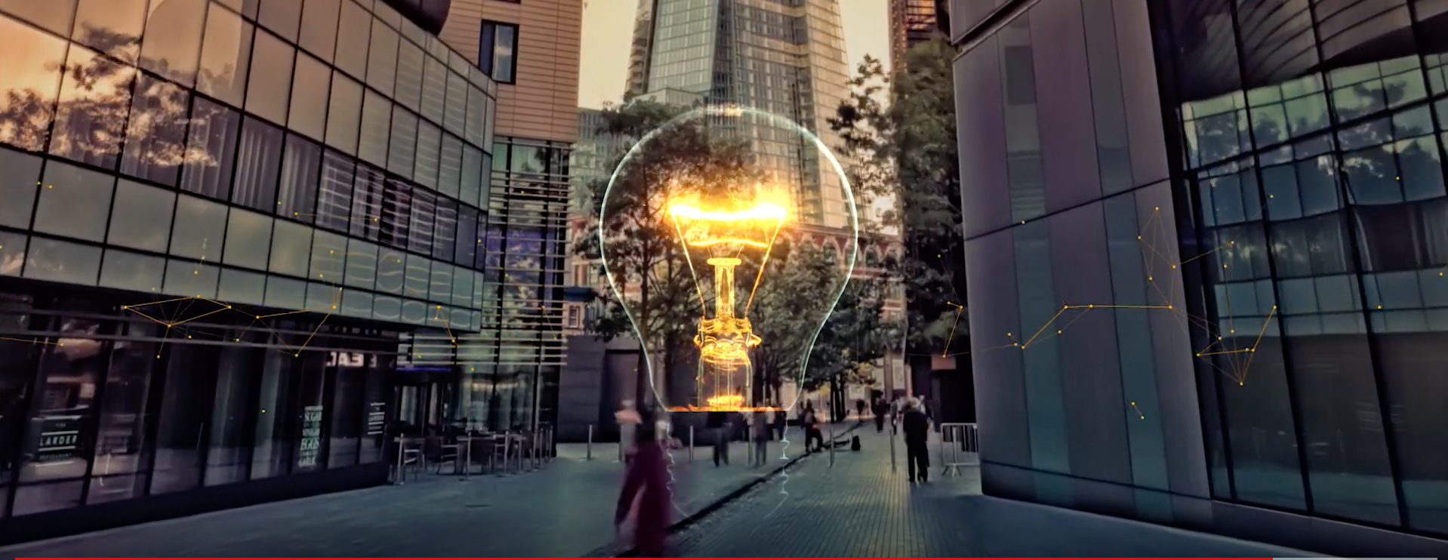
Education 4.0 – transforming the future of education (through advanced technology)
https://www.youtube.com/watch?v=aVWHp8FsV1w

Slide 8
Let’s see the future… Dewch i ni weld y Dyfodol

Slide 9
https://www.youtube.com/watch?v=d2LuPY5DupI
Dubai wants to 3D print a quarter of every new building by 2025

Slide 10
https://www.youtube.com/watch?v=FP4HAl_6614
Technology Pioneers

Slide 11
Draw i chi …. ! Over to you on …!

Slide 12
https://www.youtube.com/watch?v=SVz_Zp3lf88
Future Learners

Slide 13
https://www.youtube.com/watch?v=ibAi7CGnUhg
Future of Education

Slide 14
The Future of Education
(Learning and Teaching)
https://www.youtube.com/watch?v=9DwQDL6K3ws

Slide 15
Syniadau?Thoughts?

Slide 16
Y Fframwaith /
The Framework
Dinasyddiaeth.
Rhyngweithio a chydweithio.
Cynhyrchu.
Data a meddwl cyfri adurol.
Citizenship.
Interacting and collaborating.
Producing.
Data and
Computational
thinking.

Slide 17
Dinasyddiaeth Citizenship | Rhyngweithio a chydweithio Interacting and collaborating | Cynhyrchu Producing | Data a meddwl cyfri adurol Data and computational thinking
1) Hunaniaeth, delwedd ac enw da / Identity, image and reputation 2) Iechyd a lles / Health and well-being 3) Hawliau digidol, trwyddedu a pherchnogaeth / Digital rights licensing and ownership 4) Ymddygiad ar-lein a Seiberfwlio / Online behaviour and cyberbullying | 1) Cyfathrebu / Communication 2) Cydweithio / Collaboration 3) Storio a rhannu / Storing and sharing | 1) Cynllunio, cyrchu a chwilio / Planning, sourcing and searching 2) Creu / Creating 3) Gwerthuso a gwella / Evaluating and improving | 1) Datrys problemau a modelu / Problem solving and modelling 2) Llythrennedd gwybodaeth a data / Data and information literacy

Slide 18
Modelau arall …. Other Models

Slide 19
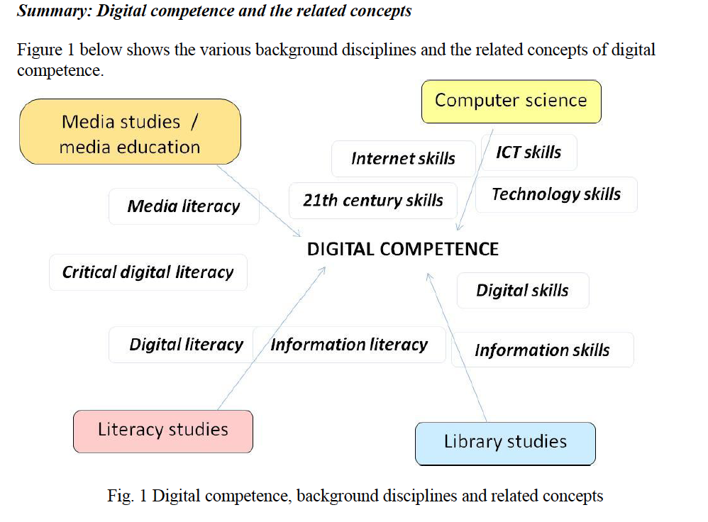
Ilomäki, L., Kantosalo, A., & Lakkala, M. (2011). What is digital competence?
In Linked portal. Brussels: European Schoolnet. http://linked.eun.org/web/guest/in-depth3

Slide 20
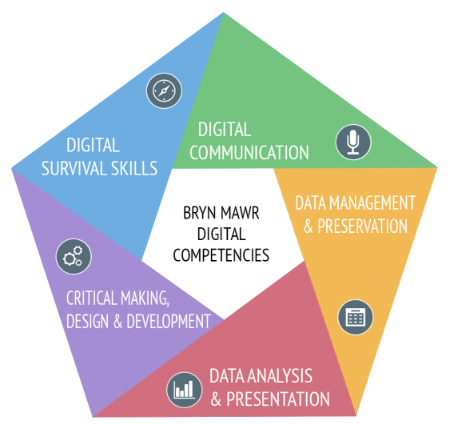
Bryn Mawr Digital Competencies

Slide 21
DIGCOMP

Slide 22
Hunan werthusiad – Self Evaluation
What about your digital competence?
Beth am eich Cymhwysedd Digidol?
https://hwb.gov.wales/dcf

Slide 23
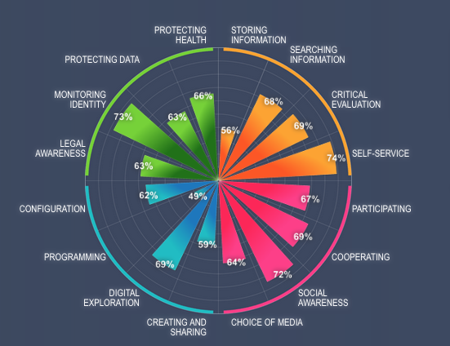
https://digital-competence.eu/
What about your digital competence?
Beth am eich Cymhwysedd Digidol?

Slide 24
Dewch i ni edrych ar beth sydd gan Estyn i ddweud
Let’s have a look at what Estyn have to say

Slide 25
Estyn recommendations (2018)
Schools should:
R1 Involve all stakeholders in developing a clear vision for the DCF
R2 Appoint a digital lead, secure the full support of senior leaders, and monitor developments regularly
R3 Audit teachers’ professional learning needs and use this information to plan training, support and guidance over a realistic timeframe
R4 Map the DCF across the curriculum and ensure that there are no gaps in provision and sufficient progression and continuity
R5 Carry out hardware and network infrastructure audits
R6 Ensure that staff collaborate with others to share good practice
https://www.estyn.gov.wales/thematic-reports/preparing-digital-competence-framework-dcf

Slide 26
Argymhellion Estyn (2018)
Dylai ysgolion:
A1 Gynnwys pob rhanddeiliad mewn datblygu gweledigaeth glir ar gyfer y Fframwaith
A2 Penodi arweinydd digidol, sicrhau cefnogaeth lwyr uwch arweinwyr a monitro datblygiadau’n rheolaidd
A3 Archwilio anghenion dysgu proffesiynol athrawon a defnyddio’r wybodaeth hon i gynllunio hyfforddiant, cymorth ac arweiniad dros gyfnod realistig
A4 Mapio’r Fframwaith ar draws y cwricwlwm a sicrhau nad oes bylchau yn y ddarpariaeth a bod digon o barhad a dilyniant
A5 Cynnal archwiliadau caledwedd a seilwaith y rhwydwaith
A6 Sicrhau bod staff yn cydweithredu â staff eraill i rannu arfer dda
https://www.estyn.gov.wales/thematic-reports/preparing-digital-competence-framework-dcf

Slide 27
Primary Mapping Tool
Offer Mapio Cynradd
English
https://www.erw.wales/media/2687/171019-curriculum-mapping-tool-primary-en.xlsx
Cymraeg
https://www.erw.cymru/media/2688/171019-curriculum-mapping-tool-primary-cy.xlsx

Slide 28
List of Schools visited – Rhestr Ysgolion ymwelwyd
Bassaleg School, Newport
Blackwood Comprehensive School, Caerphilly
Bodringallt Primary School, Rhondda Cynon Taf
Cornist Park School, Flint
Malpas Court Primary School
Portfield School, Pembrokeshire
Presteigne Primary School, Powys
Radyr Comprehensive School, Cardiff
Sofrydd Primary School, Blaenau Gwent
St Nicholas Church in Wales Primary School, Vale of Glamorgan
Whitestone Primary School, Swansea
Ynysowen Community Primary School, Rhondda Cynon Taf
Ysgol Gynradd Bethel, Gwynedd
Ysgol Bro Pedr, Ceredigion
Ysgol Bryn Elian, Conwy
Ysgol Comins Coch, Ceredigion
Ysgol Dolafon, Powys
Ysgol Gymraeg y Fenni, Monmouthshire
Ysgol Hafod Lon, Gwynedd
Ysgol Penmaes, Powys
Ysgol Pennant, Powys
Ysgol Gyfun Rhydywaun, Rhondda Cynon Taf
Ysgol Syr Hugh Owen, Gwynedd

