Slide 1
MODULE NAME :Problem Solving and Decision Making(CERTHE Business Skills for the Workplace)
MODULE CODE :LCLM4004_LON
STUDENT NAME :Florin Alexandru Merian
STUDENT ID :2511418
LECTURER: Mohammad Rahman
Assignment 1: Presentation GREEN HAVEN FLORISTS

Slide 2

Presentation Overview Green Haven Florists
CONTEXT
Who Green Haven Florists are and what they are facing .
NATURE&SCOPE
The key issues impacting their in-store sales
5W2H MODEL
A structured breakdown of the core problem
KEY FINDINGS
What this all means where the strengths lie .
THIS Presentation covers six areas ,starting with the business background and finishing with my key findings.
FISHBONE DIAGRAM
Root causes behind the 30%sales decline .
PESTEL ANALYSIS
External forces shaping the business environment

Slide 3






WHO ARE GREEN HAVEN FLORISTA?
LOCATION
NORWICH,UK- independent high street florist
FOUNDED
By Liam and Priya Patel
Customers
Walk-ins, corporate clients and weddings
THE PROBLEM
30% drop in ,in-store
Known for
Bespoke arrangements and eco-friendly packing
Rising costs squeezing margins
Competition from online & local rivals
Outdated digital presence
Struggling to stay profitable

Slide 4
NATURE & SCOPE OF THE ISSUES
30%
Drop in in-store sales
Foot Traffic
Hight street closures and a shift to online shopping have cut walk-ins significantly
Rising costs
Import flowers price and eco-packing have risen sharply due to supply chain pressures
Week Digital
The website is outdated and social media is inconstant ,leaving customers hard to reach.
New Competition
A boutique Instagram florists and a national chain with same-day delivery are in the local market.
Green Haven Florists

Slide 5
5W2H –What ,Who, Where, When ,Why ,How , How much
ANALYSIS
What?:In –store sales have dropped 30%over the past 12 month .
Who?: Liam and Priya Patel and their long-standing costumers base.
Where?:The physical shop on the hight street in Norwich,UK
When?:Progressively over the last 12 month
Why?:Rising costs, weaker footfall, pool digital tools stronger competitors
How?:Customers are moving to online retailers and new local competitors
How much?: 30%sales drop ,higher supply costs and unsustainable overheads .

Slide 6


PESTLE ANALYSIS: Green Haven Florists part 1
POLITICAL
Post-Brexit import rules have raised the cost and complexity of sourcing European flowers like orchids and tulips.
ECONOMIC
The cost- of- living crisis is cutting consumer spending on non-essentials.
Flowers are often the first thing people cut from their budget.
SOCIAL
Customers increasingly prefer online shopping and same –day delivery over visiting physical store-and this shift is long-term.
Sources: ons(2024); u.k. gov Brexit trade report(2023)

Slide 7

PESTLE ANALYSIS: Green Haven Florists part 2
TECHNOLOGICAL
Competitors with strong e-commerce sites and active social media are winning customers that Green Haven Florists cannot reach digitally.
LEGAL
Employment law, GDPR for online orders ,and health and safety rules all and compliance responsibilities to a small team.
ENVIRONMENTAL
Green havens sustainable ethos resonates with eco-conscious buyers –a genuine strength .But biodegradable materials cost more
“Looking at the external environment ,Green Haven Florists is being hit by post-Brexit import costs pushing up flowers price ,the cost –of- living crisis's reducing what people spending on non-enssentials ,and a long-term shift in how people shop”
Source Statista U.K. Floral Market (2024);IGO GDPR Guidance(2023).

Slide 8
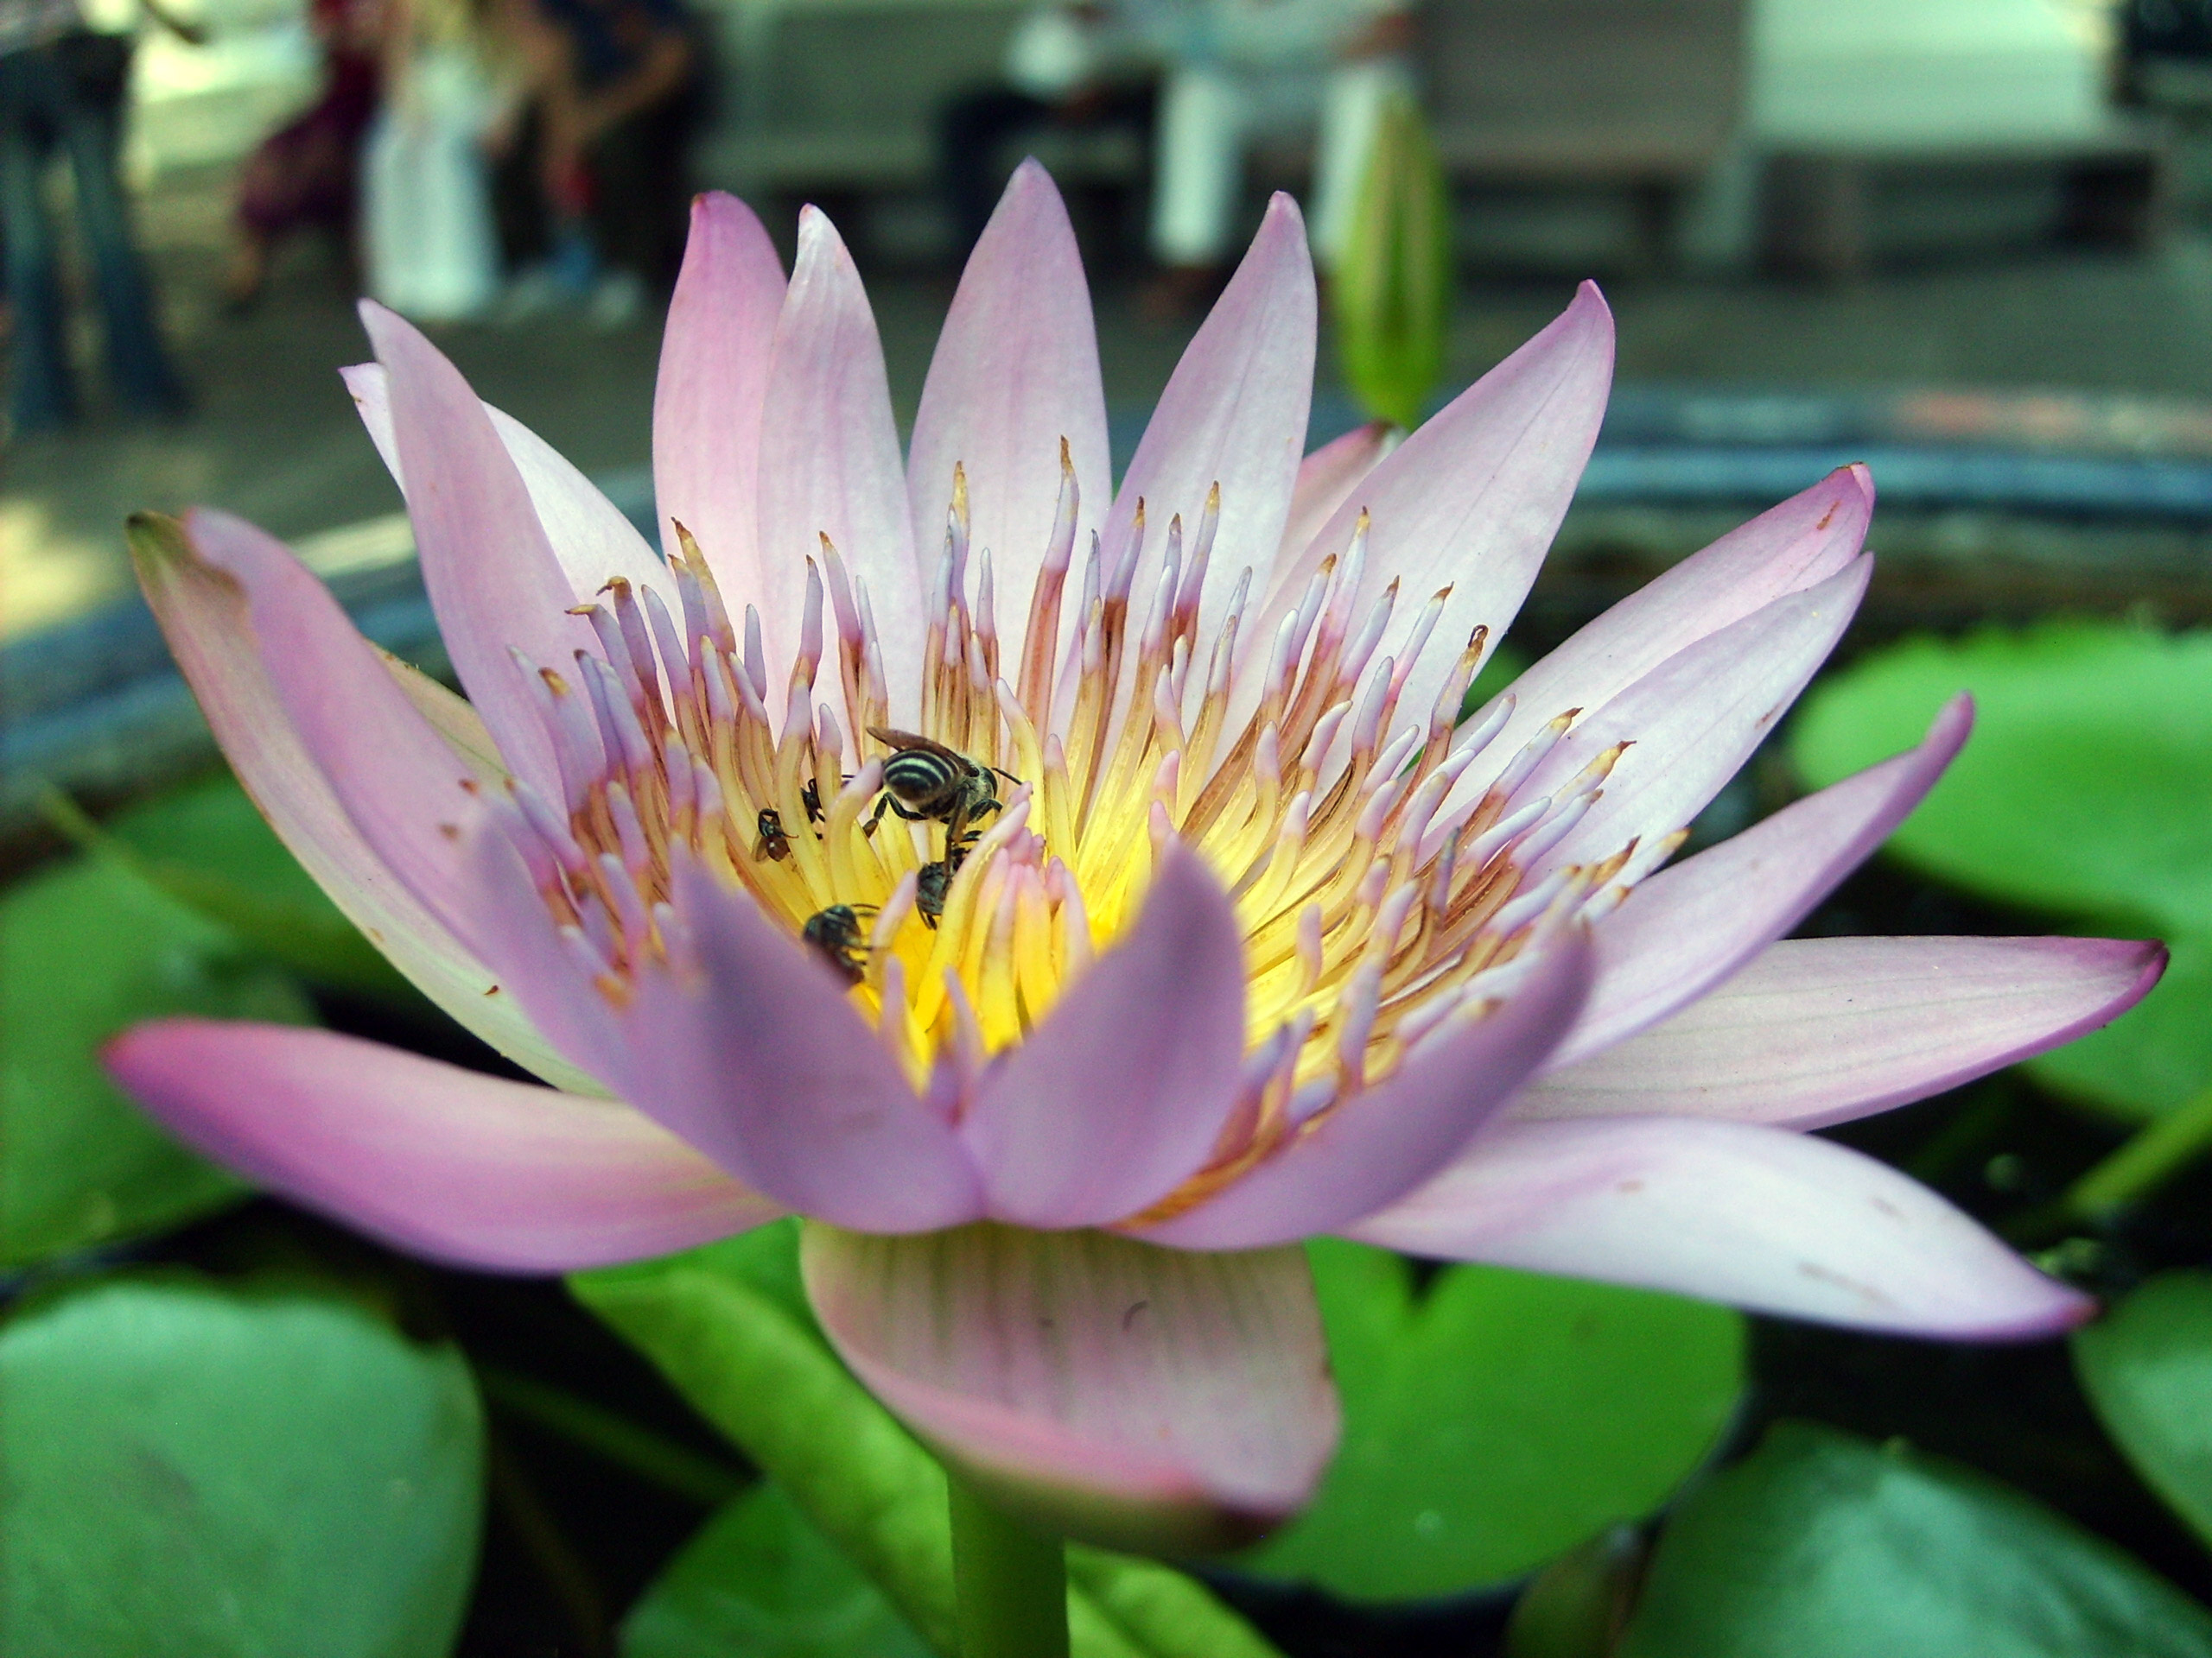




Cause and effect analysis: Fishbone diagram
Competition
Instagram boutique florist
National chain pricing
Digital Gap
Website is outdated
Minimal social media
Location
Nearby shops closed
Reduced footfall
Rising Costs
Supply chain inflation
Eco packaging costs
Customer Habits
Prefer online convenience
Seeking discounts
Operations
No delivery options
No subscription offend
30% Drop
in Sales

Slide 9



Conclusion
REBUILD THE WEBSITE ---Make it easy to browser, order and book- this single most urgent fix
get active on social media ---regular posts showing arrangements and the story behind the shop will build a loyal following
introduce delivery ---even local same –day delivery would directly address what competitors are wining on
lean into sustainability ---turn the eco-ethos into a clear marketing message –it genuinely matters to customers today

Slide 10
References
5 sources
1) Green Haven Florists Case Study — UWTSD Module Brief (provided course material)
2) Office for National Statistics (ONS) (2024) Retail Sales in Great Britain. Available at: www.ons.gov.uk [Accessed: March 2026]
3) Statista (2024) Floral and gardening market in the United Kingdom. Available at: www.statista.com [Accessed: March 2026]
4) UK Government (2023) UK Trade Post-Brexit: Horticulture and Fresh Produce. Available at: www.gov.uk [Accessed: March 2026]
5) Ishikawa, K. (1990) Introduction to Quality Control. 3rd ed. Tokyo: 3A Corporation
6) ICO (2023) Guide to the UK GDPR. Available at: www.ico.org.uk [Accessed: March 2026]
7) Mind Tools (2024) The 5W2H Framework for Problem Analysis. Available at: www.mindtools.com [Accessed:01 March 2026.

Slide 11

Sincerely Florin Alexandru Merian

