Slide 1
Understanding and Engaging in the Customer Experience
BMSK5003
Evening Session 1

Slide 2
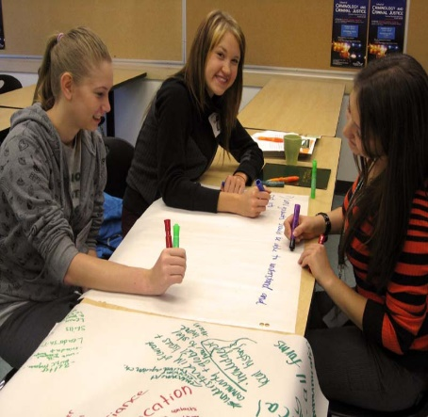
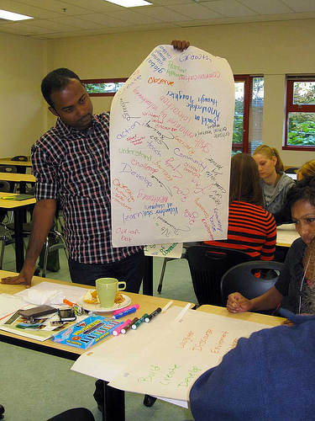
Aim & Learning Outcomes
AIM(S)
  To instil a critical understanding of quality systems and controls for customers.
LEARNING OUTCOMES
Upon the successful completion of this module, the student should be able to demonstrate the ability to:
  evidence a critical understanding of quality process in the workplace;
  analyse the customers’ experience of an organisation;
  critically evaluate the benefits and challenges of developing and maintaining good customer relationships.
INDICATIVE CONTENT
  Quality modules and standards.
  Customer service.
  Customer centrality.
  Value and purpose of customer relationship management (CRM).
  Buyer seller relationships.
  Managing customer expectations.
  Buying decision making process: ethical considerations such as fair-trade, sustainable resources.
  Appreciation of the importance of quality control.
  Customer value.

Slide 3
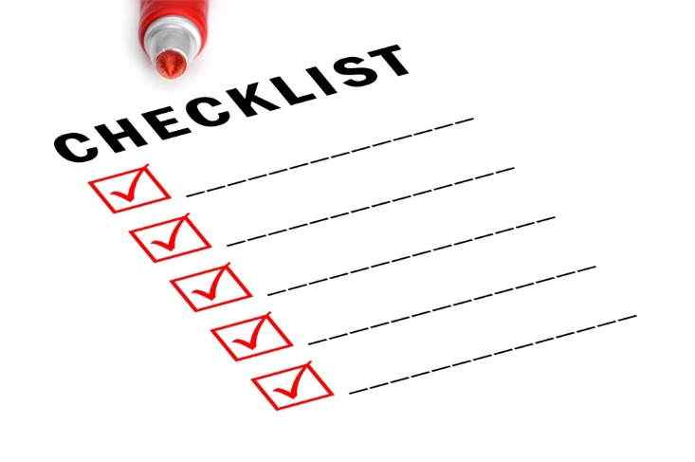
Review
Complete Learning Log
Watch P&O Get hot on service for discussion at the next session, looking at the what, where, why, who, how, etc.
Discuss your “feelings” about the customer service of your organisation.

Slide 4

P&O Get Hot
Exercise: As a group, identify the key learning points from the case study.
Record on flipchart for
discussion
10 mins.

Slide 5

Understanding and Engaging in the Customer Experience
Assessment Criteria
Critically analyse the factors that impact upon your organisation’s ability to maximise customer value
Demonstrate a critical understanding of your organisation’s quality processes and its effectiveness in meeting customer requirements
Notes:
How can an organisation maximise customer value? Value to the customer and value from the customer. What can impact on either of these? Critically analyse your organisation’s ability to do this? Best practice? Worst practice? Your practice? What could you do better?
Demonstrate a critical understanding - you show what’s good, or otherwise, in regard to your organisation’s quality processes. What are quality processes? What do they do? Meeting customer requirements……or even going beyond this to excite and generate loyalty!

Slide 6
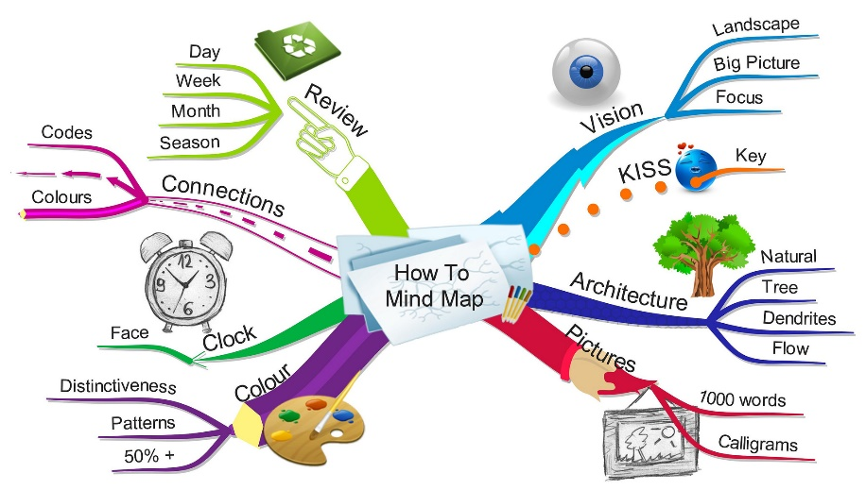
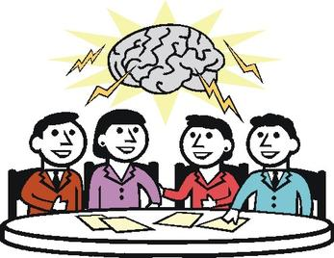
Mind Map - Revisited
Review your Mind Map in light of the last session and what you have learnt so far….

Slide 7

Quality
Customers are looking for quality to be more than a thin veneer; they are looking for it to be the wood from which the whole organisation is cut
“Quality is not an act, it is a habit” (Aristotle)
  Take 5 minutes to think these statements through and then we will discuss.

Slide 8

Philosophies
All about Culture Change
    Total Quality Management
    Six Sigma
    Lean
National Recognition
    Deming Award
    Baldrige Award
    EFQM Award

Slide 9

Total Quality Organisations
Four Key Elements
TQM companies focus on customers and on satisfying their needs. Therefore, they must be able to react fast to changing customer needs and to focus their limited resources on activities that satisfy customers
TQM companies seek continuous improvement of the processes that lead to higher quality products and services. Continuous improvement involves using a scientific approach to make improvements (analyse facts, base actions on facts, test results empirically), doing step-by-step improvements to get to market fast and acquire real experience and doing iterative improvement to reach ever-higher levels of quality.
TQM companies seek total participation of their people. All capabilities of all company members must be used if companies are to make continuous improvement and to seek customer satisfaction
TQM companies must participate in societal learning (that is, shared learning with other companies and organisations) to avoid reinvention of methods, to implement quality practices more quickly and to create a quality culture in which to do business
Source: Shiba. S., et al., 1993. A New American TQM: Four Practical Revolutions In Management. Portland, USA: Productivity Press

Slide 10
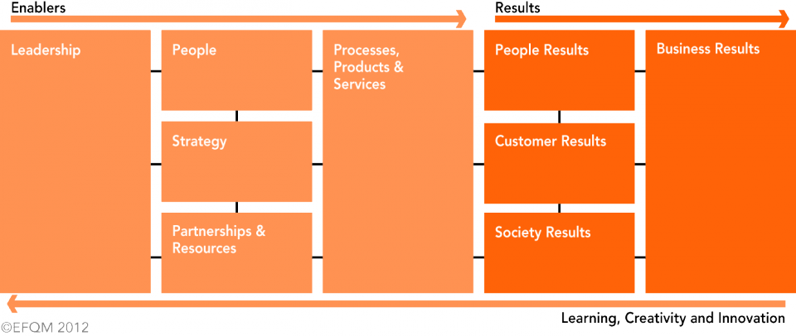
EFQM Excellence Model

Slide 11

EFQM Excellence Model
Key elements: -
    Holistic
    Leadership
    Strategy
    People
    Partnerships
    Processes
    Results – Reflective and Predictive
      Business
      Customer
      People

Slide 12

Customer Focus
Quality Policy
  Meeting Customer Requirements
  Customer Satisfaction
  “To meet the needs and exceed the expectations of our customers”
  Customer Delight
  Customer Loyalty

Slide 13
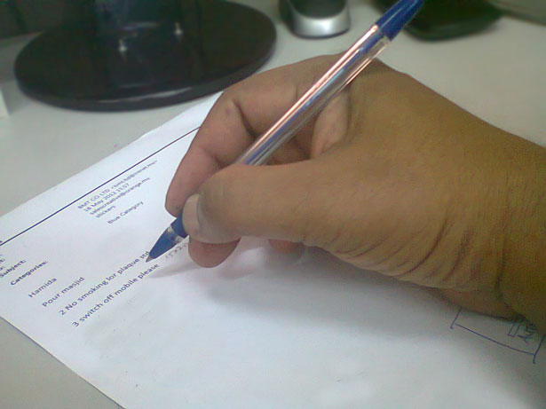
Exercise
Individually, write down….
  2 Basic features (things you expect to be present)
  2 Performance features (things you might ask for)
  2 Excitement features (these would really ‘wow’ you)
  for a new car that you are thinking of buying.

Slide 14
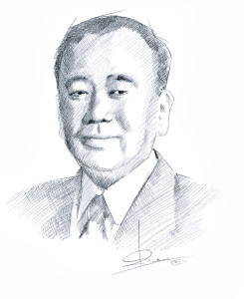
Kano Model

Slide 15
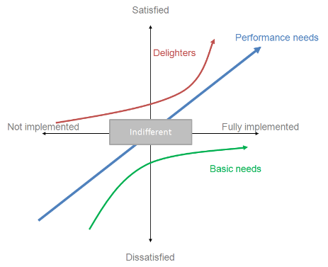
Kano Model
Dr. Noriaki Kano developed this very powerful model relating customer satisfaction to a company’s degree of achievement in meeting customers’ requirements.
The key lessons to be learnt from this model are as follows: -
Achieving basic features means a customer is not dissatisfied, but it doesn’t make him or her satisfied! However, not achieving basic features gives strong dissatisfaction. The customer takes Basic features for granted.
Achieving Performance features in a product or service provides the foundation for customer satisfaction.
Once Basic and Performance features are achieved we can delight a customer if we provide unexpected excitement features.
Customers’ expectations are always changing. Something that is an excitement feature today, will be a Performance feature tomorrow and a Basic feature in the near future...and this process is speeding up!
Dr. Noriaki Kano developed this very powerful model relating customer satisfaction to a company’s degree of achievement in meeting customers’ requirements.
The key lessons to be learnt from this model are as follows: -
Achieving basic features means a customer is not dissatisfied, but it doesn’t make him or her satisfied! However, not achieving basic features gives strong dissatisfaction. The customer takes Basic features for granted.
Achieving Performance features in a product or service provides the foundation for customer satisfaction.
Once Basic and Performance features are achieved we can delight a customer if we provide unexpected excitement features.
Customers’ expectations are always changing. Something that is an excitement feature today, will be a Performance feature tomorrow and a Basic feature in the near future...and this process is speeding up!

Slide 16
Taguchi
CUSTOMER DRIVEN QUALITY
We must ensure that we understand our customers’ requirements, their needs and expectations, if we are to have any chance of satisfying them, because it is the customer who ultimately decides whether or not we are delivering a quality product or service.
EXAMPLE
A drinks vending machine supplier ensures that all his machines deliver hot drinks within a specific temperature range. He quality audits his machines on site to ensure that no drinks are delivered too hot or too cold. As long as this is the case, the vending machine could be said to be conforming to requirements. The vending machine supplier could believe he is delivering a quality product and service. Within the range allowed, the supplier will aim for a target or ideal temperature. If the machine delivers drinks at this temperature then the supplier will be even more confident of the quality he provides. The supplier could believe his customers will show the following satisfaction profile:-

Slide 17
Taguchi
Let us consider whether the drinks machine supplier is correct to think as he does by considering a similar situation.

Slide 18
Taguchi
Conforming to our own requirements in the drinks example will give a mixed level of customer satisfaction. Customers using the vending machine for the hot drinks are likely to show the following satisfaction profile: -

Slide 19
Taguchi
A similar profile will be found for customers of many organisations, which equate quality with conforming to their own requirements. The above diagram is known as the Taguchi “Quality Loss” model. Taguchi suggests that quality cannot truly be measured by inspection by the supplier or manufacturer. Quality can only truly be measured by customer satisfaction. Quality Loss is the cost associated with customer dissatisfaction.
If the vending machine supplies drinks that are always at the target temperature, then so long as the target temperature was researched adequately there is a chance of gaining high customer satisfaction. Nevertheless, this target is supplier generated rather than generated by individual customers. If 100% of the drinks are served at the target temperature, there will still be a percentage of dissatisfied customers who find their drinks to be too hot or too cold.
For each of these there will be associated quality loss - the cost to the customer of replacing the drink, warming it up or waiting for it to cool, and a cost to the supplier of losing customers and dealing with the various customer complaints. Quality loss is a price of non-conformance. We may conform to our own requirements, but unless we also conform to the customers’ needs costs will be incurred. To prevent Quality Loss we must ensure that we consult with and listen to the customer as closely as possible.

Slide 20
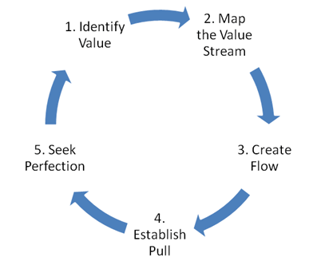
Lean
Identify Customers and Specify Value
Identify and Map the Value Stream
Create Flow by Eliminating Waste
Respond to Customer Pull
Pursue Perfection

Slide 21
Lean
There are FIVE overriding principles to Lean.
Identify Customers and Specify Value - The starting point is to recognise that only a small fraction of the total time and effort in any organisation actually adds value for the end customer. By clearly defining Value for a specific product or service from the end customer’s perspective, all the non value activities - or waste - can be targeted for removal.
Identify and Map the Value Stream – The Value Stream is the entire set of activities across all parts of the organisation involved in jointly delivering the product or service. This represents the end-to-end process that delivers the value to the customer. Once you understand what your customer wants the next step is to identify how you are delivering (or not) that to them.
Create Flow by Eliminating Waste – Typically when you first map the Value Stream you will find that only 5% of activities add value, this can rise to 45% in a service environment. Eliminating this waste ensures that your product or service “flows” to the customer without any interruption, detour or waiting.
Respond to Customer Pull – This is about understanding the customer demand on your service and then creating your process to respond to this. Such that you produce only what the customer wants when the customer wants it.
Pursue Perfection - Creating flow and pull starts with radically reorganising individual process steps, but the gains become truly significant as all the steps link together. As this happens more and more layers of waste become visible and the process continues towards the theoretical end point of perfection, where every asset and every action adds value for the end customer.
In following these five principles of Lean you will implement a philosophy that will become “just the way things are done”. You are ensuring that you are driving towards the overall organisational strategy by constant review of your processes to ensure that they are constantly and consistently delivering value to your customer. This allows the organisation to maintain its high level of service whilst being able to grow and flex with a changing environment and it does this through implementing sustainable change.
Source: http://www.cardiff.ac.uk/lean/principles/
Take a look at “Time: The next dimension of Quality” on YouTube.com

Slide 22

Some interesting facts
Price is not the main reason for customer churn: churn occurs due to overall poor quality of customer service
A customer is four times more likely to defect to a competitor if the problem is service related than price related
The probability of selling to an existing customer is 60-70%. The probability of selling to a new prospect is 5-20%
For every customer complaint, there are 26 other unhappy customers who have remained silent.
A 2% increase in customer retention has the same effect as decreasing costs by 10%

Slide 23
Some interesting facts (cont.)
96% of unhappy customers don’t complain. However, 91% of them will leave and never come back
A dissatisfied customer will tell between 9 and 15 people about their experience. Around 13% of dissatisfied customers tell more than 20 people
Happy customers that get their issue resolved tell about four to six people about their experience
70% of buying experiences are based on how the customer feels they are being treated
55% of customers would pay extra to guarantee a better service

Slide 24
Some interesting facts (cont.)
Customers who rate you five on a scale from one to five are six times more likely to buy from you again, compared to ‘only’ giving you a score of 4.8
It takes 12 positive experiences to make up for one unresolved negative experience
A 5% reduction in the customer defection rate can increase profits by 5 to 95%
It costs six to seven times more to acquire a new customer than retain an existing one
eCommerce spending for new customers is on average $24.50 compared to $52.50 for repeat customers
Shaw, C. and Hamilton, R. 2016 The Intuitive Customer: 7 Imperatives For Moving Your Customer Experience To The Next Level. UK: Palgrave MacMillan

Slide 25

Questions

Slide 26

Reflection
Take 5 minutes to reflect upon what we have discussed and identify key learning points

