Slide 1
Tsvetelina Valchova - 2026418
Zhivko Panev - 2109289
Vasil Stoev - 2113007
Aleksandar Petrov - 2112978

Slide 2



Slide 3
Amazon started at 1994
The largest e-commerce company
Physical retail stores, subscription and web services

Slide 4
Online sales for Amazon have increase
Third-party sellers risen
Web services business has sales rise
Amazon Prime Video

Slide 5
Increased count of employees
Market capitalization
Amazon shares

Slide 6

COVID 19 IMPACT

Slide 7


Working safely during coronavirus (COVID-19)​
Wash your hands for stop spreading the virus.
Protect yourself and others by wearing a face cover.
Keep social distance.
Testing regularly and broadly to help identify, people who have contracted the coronavirus.

Slide 8

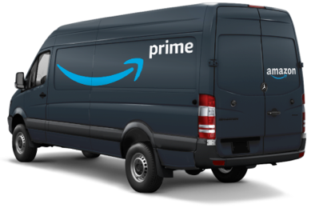
Deliveries due Covid19-Pandemic
New rules and conditions for delivery workers
Drivers required due to high volume of orders
Prime customers experienced changes for their subscriptions
Focus on the most in-demand essential items
Unpredictable deliveries and delays

Slide 9
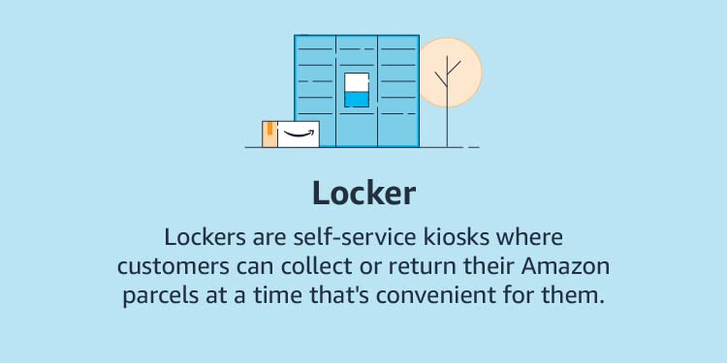
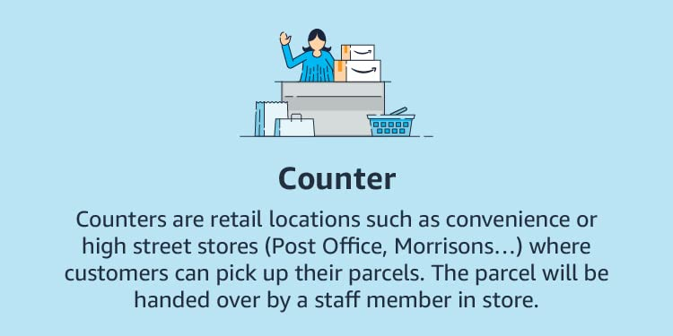
CLICK AND COLLECT OR PICK UP POINTS
Collect your items at your convenience
Collect your items with your essential shopping
Discuss issues with staff members in stores

Slide 10


New Vouchers and Promotions
Amazon coupons or vouchers
Discounts and free delivery
Help to improve sales
Amazon gift card
Promotions for clients
Suitable present for everyone

Slide 11
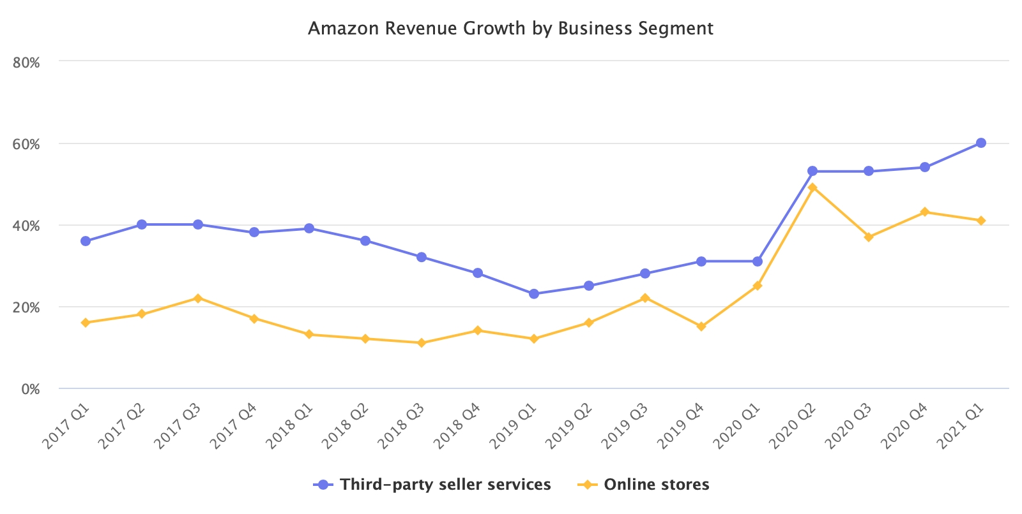
During COVID-19 online sales for Amazon have increase with 57%
Amazon sales from third-party sellers risen by 80%

Slide 12
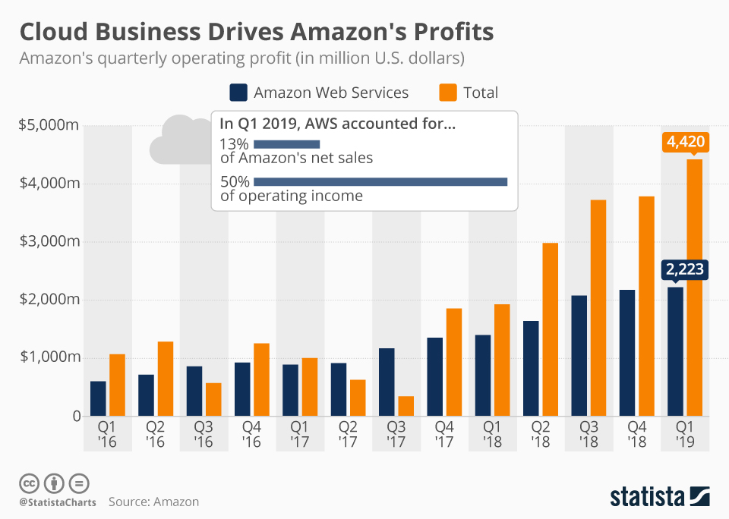
Amazon web services business has sales rise more than 50%​
Amazon Prime Video has become the second-fastest growing streaming service with 37% growth in subscribing

Slide 13
Amazon increased count of employees from 750 000 before pandemic to 1.3 million in June 2021 and plans additional 185 00 new positions
As of October 2021, Amazon market capitalization is 1.67 trillion

Slide 14
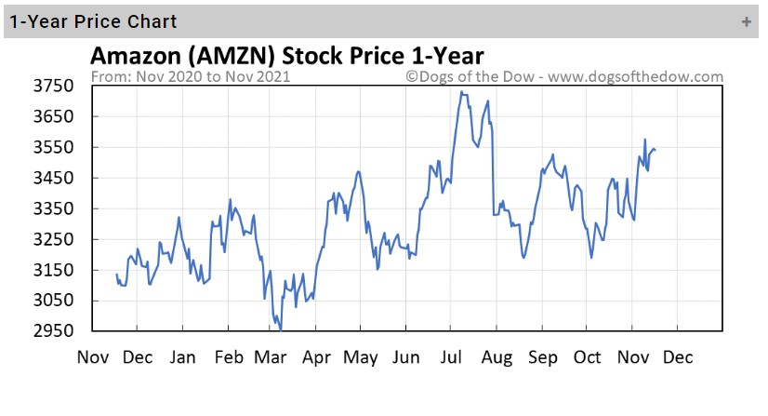
Amazon shares are currently trading price is 3.300$ with 94% increase from beginning of the pandemic
Source: Dogs of the dow

Slide 15
Online sales for Amazon have increase
Third-party sellers risen
Web services business has sales rise
Amazon Prime Video

Slide 16
Right strategy
Increased count of employees
Marketing

Slide 17
Financial position on the market
Amazon shares

Slide 18
MarketplacePulse (30th April 2021) Amazon posts record marketplace growth in Q1 2021. . Available from:
https://www.marketplacepulse.com/articles/amazon-posts-record-marketplace-growth-in-q1-2021 [Accessed 20th November 2021]
Statista (Apr 26, 2019) Cloud business drives Amazon's profits. Available from:
https://www.statista.com/chart/9174/amazon-operating-profit [Accessed 20th November 2021]
Dogs of the dow (n.d.) AMZN stock price today. Available from:
https://www.dogsofthedow.com/stock/amzn.htm [Accessed 20th November 2021].

