Slide 1
“How I can use the DIKW and CRAAP frameworks to confirm or refute my collected
Academic GRIT test result (Primary Data) compared to the UWTSD GRIT Result
(secondary Data) based on the work of Angela Duckworth TED Talk lecture”.

Slide 2
CRAAP TEST
A CRAAP test is one of the test which used to evaluate the Authenticity and relevancy of an information. It help the researcher by providing questions list which are scaling from one to five through which a researcher can find the relevant information.
CRAAP test is considered in five steps:
Currency: Information published timelines.
Relevancy: The information is important as we need it.
Authority: Which source an information getting from
Accuracy: A truthfulness and reliability of a content.
Purpose: information existing reason

Slide 3
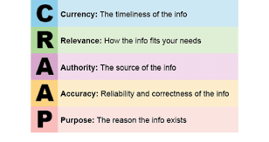
CRAAP Test and Duckworth
CRAAP test , is demonstrating the trustworthiness, accuracy, reliability
of the content.
This Test is used by Duckworth in her research by using the Grit scale , and design a self-reported questionnaire of school children's ,then evaluate it on the basis scaling it from one to five.

Slide 4
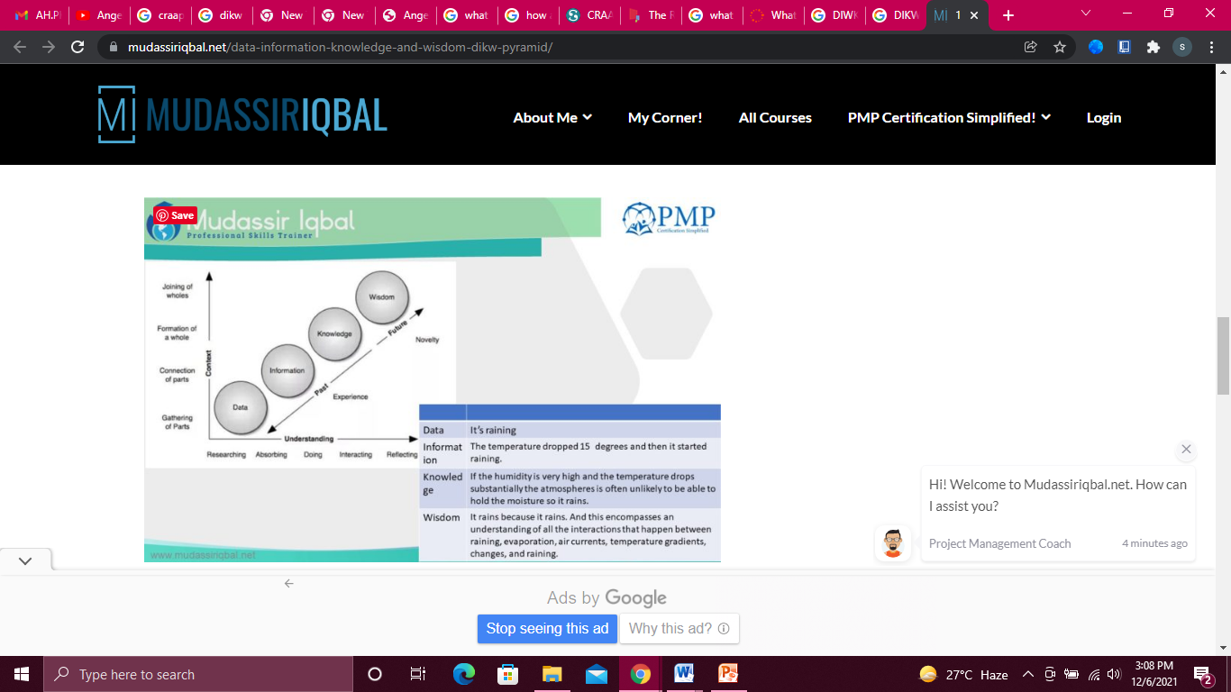
DIWK Framework:
The DIKW model is one of the pyramid method which are based on management of knowledge and describe the ways in which the data move towards information ,then knowledge and at last wisdom which is an essential and fourth part of DIWK.This all happen for the purpose of taking decision and relevant actions.

Slide 5
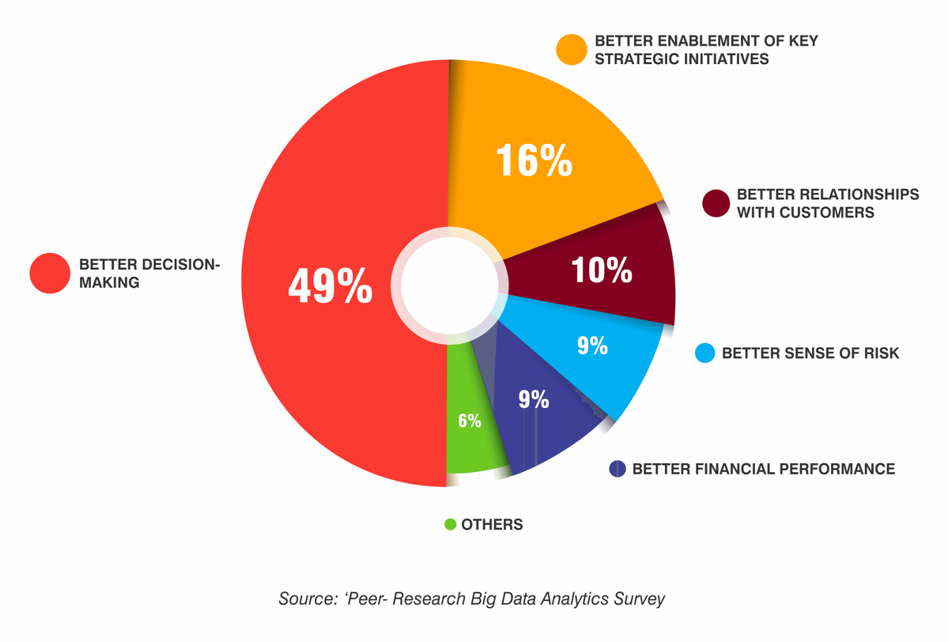
DATA
Data : It is observed and collected and in a form of signals and symbols etc.

Slide 6
INFORMATION
Information is the second steps of the DIKW pyramid. This data is more clearer and are more easy to proceed .It is easier to measure as compare to data.It is useful for analyzing it for a specific purpose.
For example:
We analyze a data of DOW JONES Index performance and creating a graph which have mentioned certain timelines on the basis of data which is closed on each day.

Slide 7
Knowledge
Knowledge: It is relevant and purposeful .
For example:
This knowledge is uncover the relatiponship and we get deeper to understand the relevancy with our desired objectives.

Slide 8
WISDOM
Wisdom is the last step and top most of the DIKW pyramid .It answer the questions like why something was happen and what the consequences in near future.
Example:
Wisdom is something like what we do at present and what we want to achieve in near future. It is affiliated with goals.

Slide 9
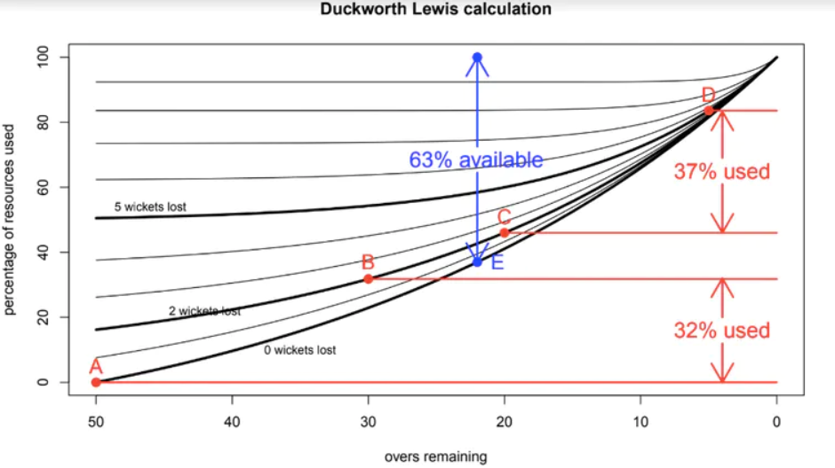
Trends Chart
The image demonstrates that the team had just 69 percent of an uninterrupted innings since the first hitting session used 32% of the resources and the second batting session consumed 37%. When the rain ceases, the team batting second starts from point E in the diagram (in blue). They have 63% of their innings left, thus their target is 150 x 63% / 69% = 137 runs in 22 overs.The curve helps balance out any advantage obtained by the team batting second, which knows exactly how many runs it needs to achieve and can set out to do so with ten wickets in hand. The team batting first would have imagined it had 50 overs to set a target and would have accordingly prepared its innings.

Slide 10
Conclusion:
Grit is a method which are non-cognative in Nature.
It also help to improve the the academic performance of Students.
As Grit is something which indicate the successful outcome with the entrance of consistent effort in their work.
It help to learn the consistency and perseverance in their life.

Slide 11
Reference:
Data, Information, Knowledge and Wisdom - DIKW Pyramid - Mudassir Iqbal (2019). Available at: https://mudassiriqbal.net/data-information-knowledge-and-wisdom-dikw-pyramid/ (Accessed: 6 December 2021).
What is the Data, Information, Knowledge, Wisdom (DIKW) Pyramid? (2021). Available at: https://www.ontotext.com/knowledgehub/fundamentals/dikw-pyramid/ (Accessed: 6 December 2021).
Anderson, K. and Francisco, A. (2019) The Research Behind the TED Talk: Angela Duckworth on Grit, Digital Promise. Available at: https://digitalpromise.org/2019/03/06/research-behind-ted-talk-angela-duckworth-grit/ (Accessed: 6 December 2021).
Research Guides: Evaluating Sources: The CRAAP Test (2021). Available at: https://researchguides.ben.edu/source-evaluation (Accessed: 6 December 2021).

