Slide 1
Carl Von Clausewitz
(1780-1831)
Presented by
Claire Mann
HPHI 4008
17 December 2018

Slide 2
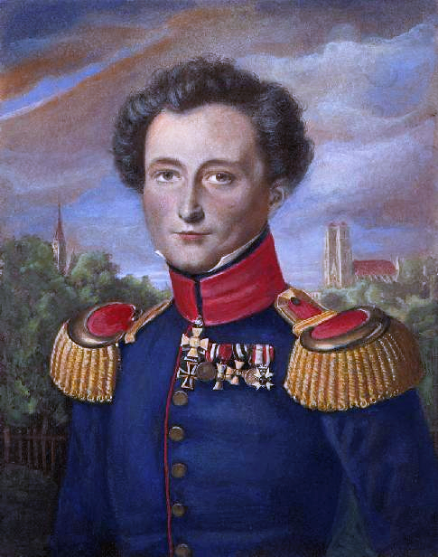
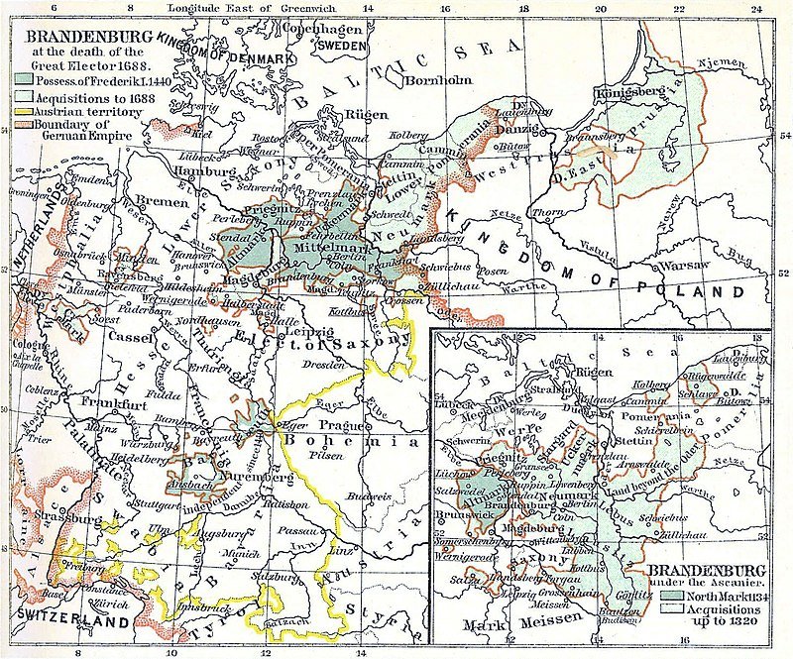
This presentation will be a brief introduction to Carl von Clausewitz (1780-1831)
We will look at his background, childhood, family and military career.

Slide 3
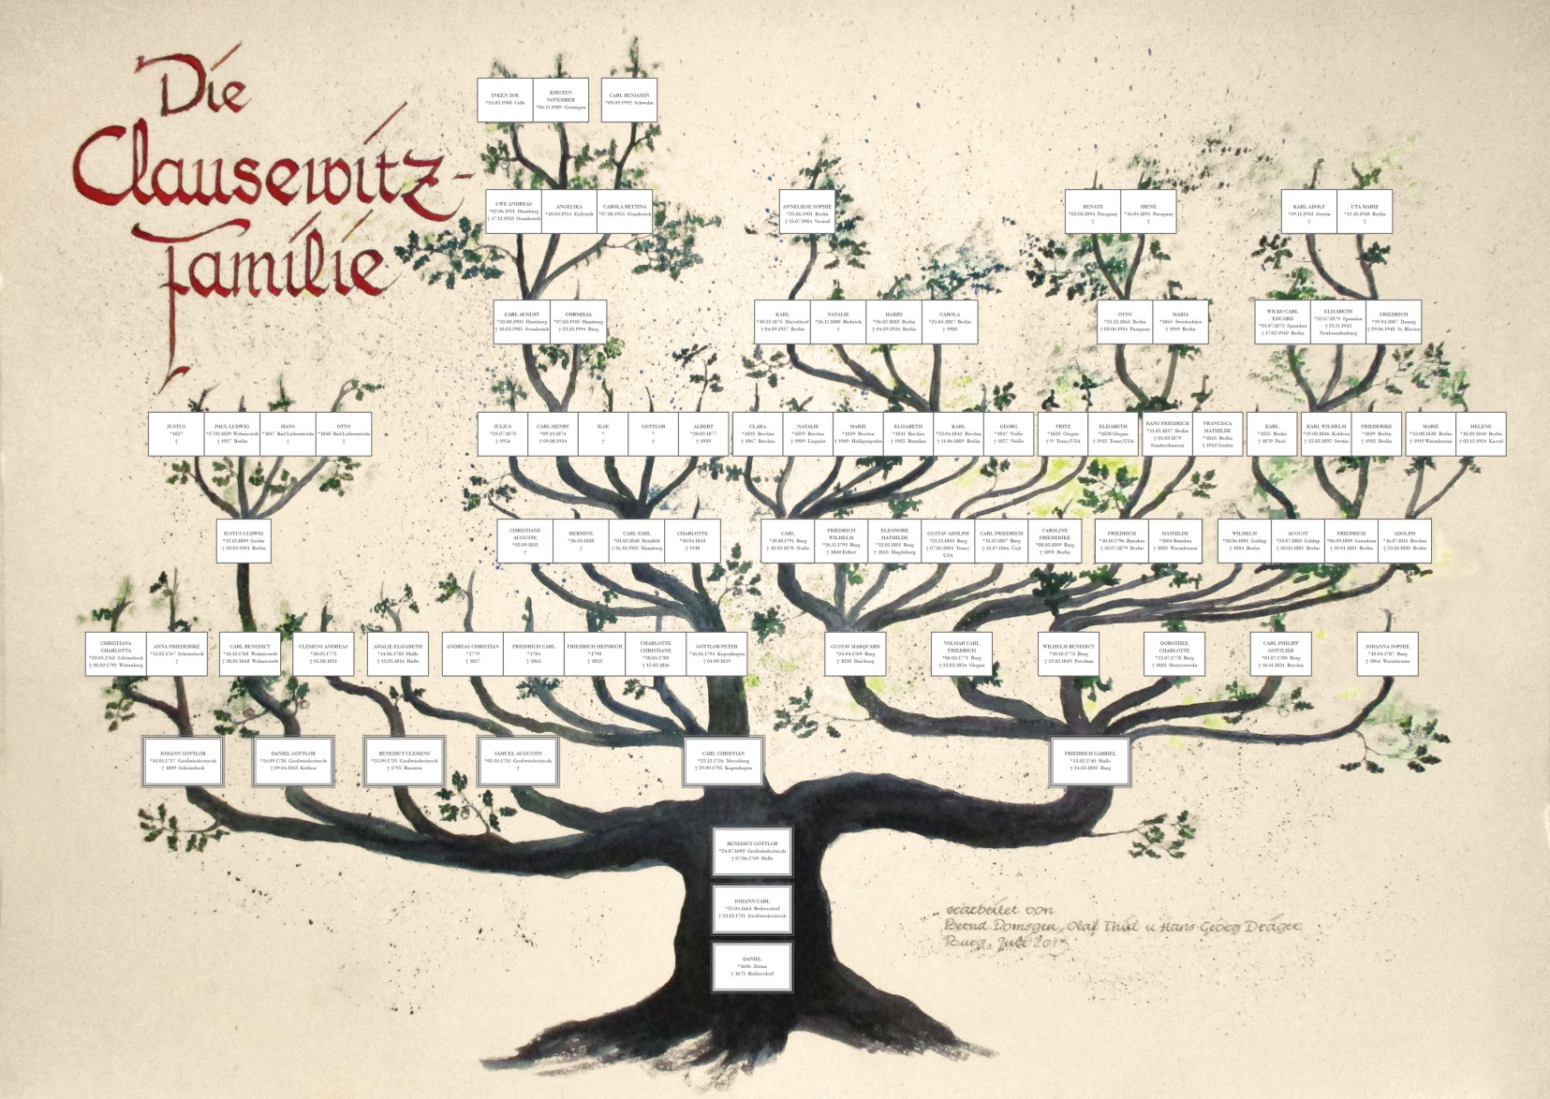
Bernd Domsgen and Olaf Thiel from the Clausewitz Society (Freundeskreis Clausewitz) in Carl’s hometown Burg
have been researching Carl von Clausewitz’s life for a long time. Last year they finally recreated his family tree.

Slide 4
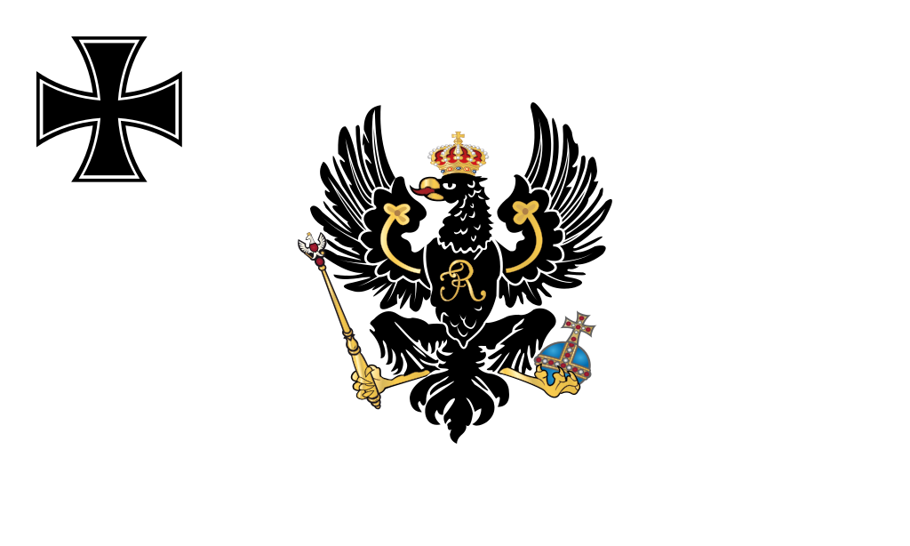
The Prussian Army (1701-1919)

Slide 5
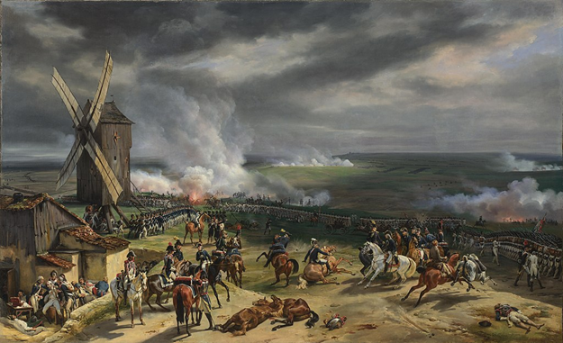
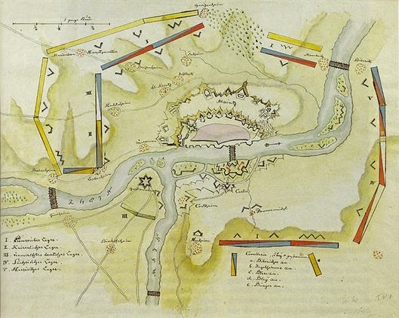
Battle of Valmy
Siege of Mainz
Clausewitz served in the Rhine campaigns (1793-1794) including the siege of Mainz when the Prussian army invaded France.
His active career spanned the course of the Revolutionary and Napoleonic wars between 1792 and 1815.

Slide 6
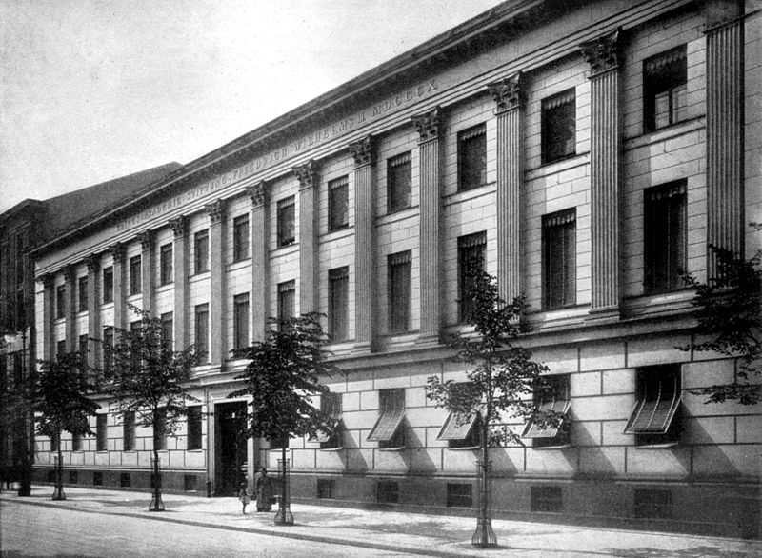
‘Kriegsakademie’
‘War College Berlin’

Slide 7
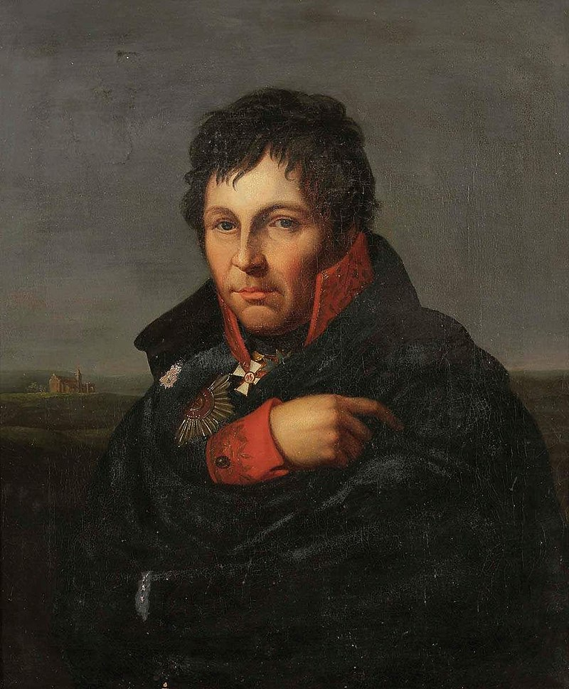
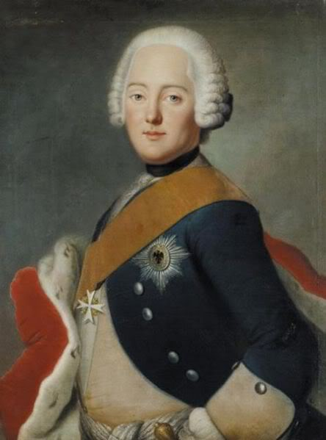
General Gerhard von Scharnhorst (1755-1813).
Prince Augustus Ferdinand
(1730-1813)

Slide 8
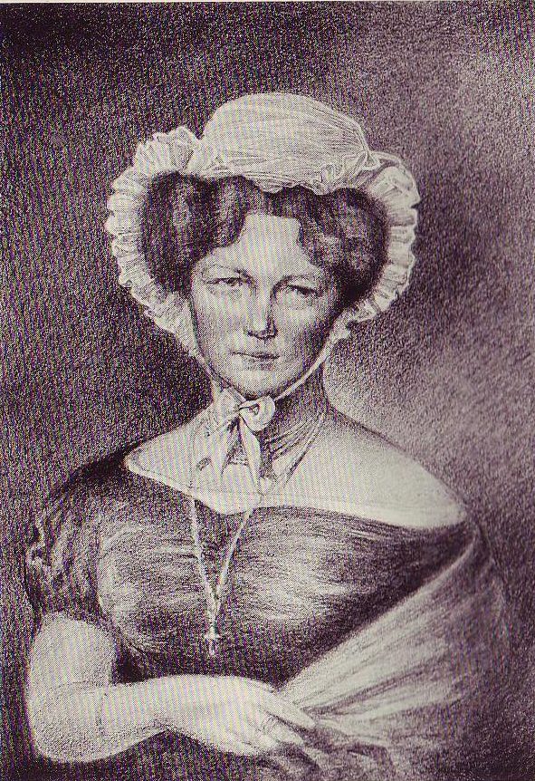
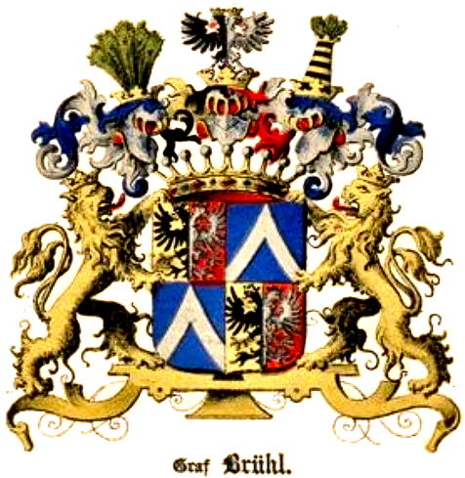
Marie von Brühl (1779-1836)
Arms of the Counts of Brühl

Slide 9
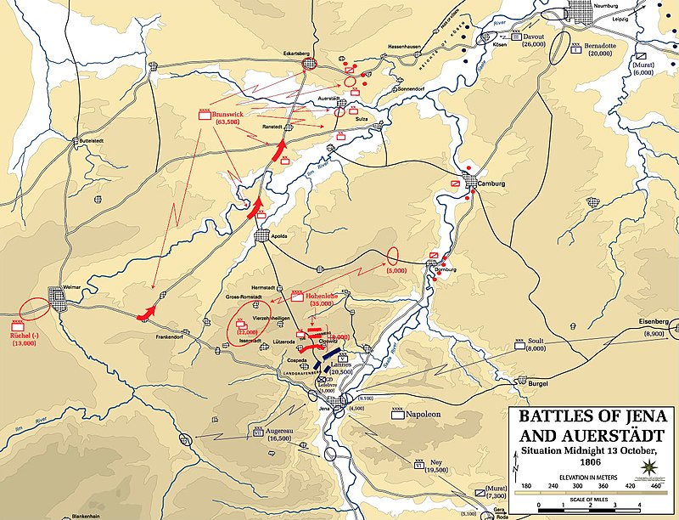
Battle of Jena and Auerstadt 1806

Slide 10
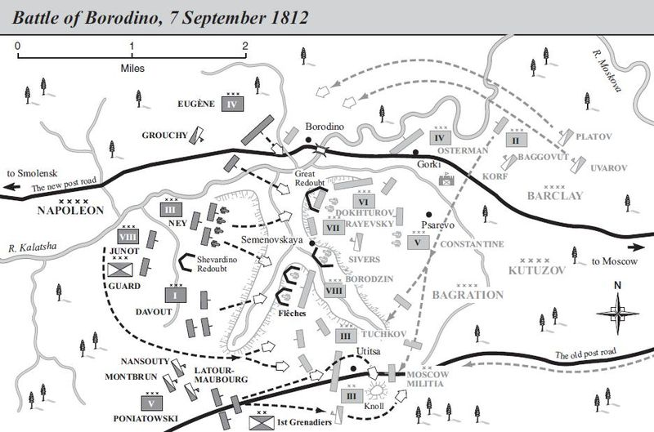

Slide 11
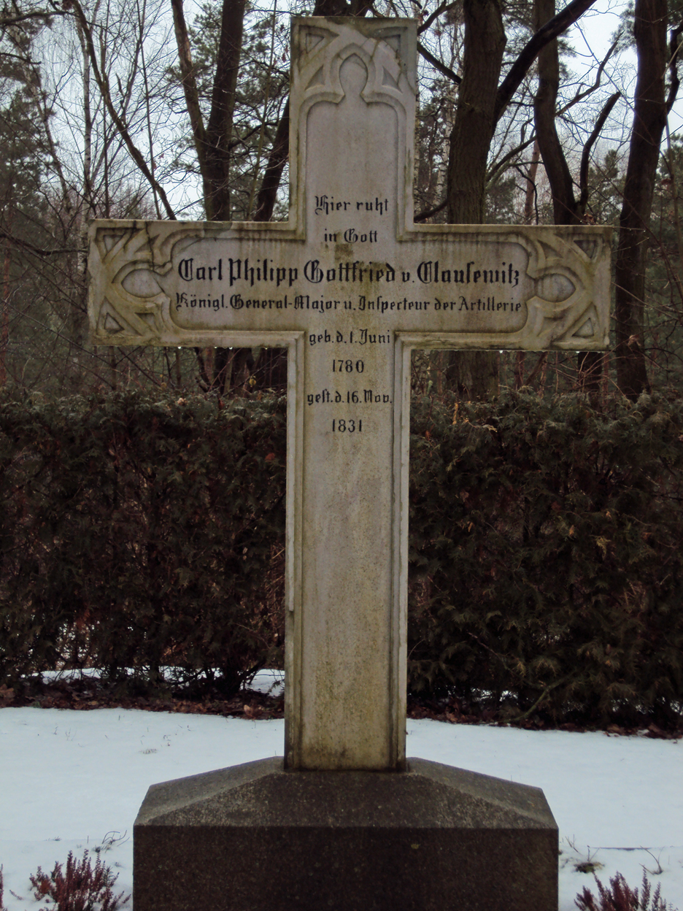

Slide 12
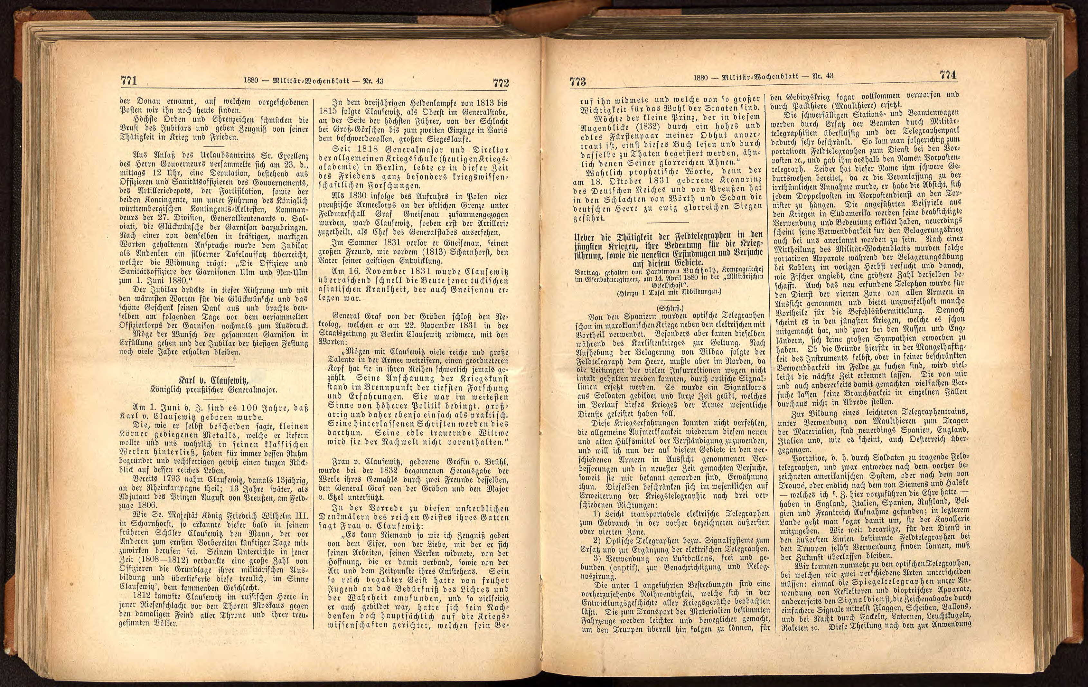

Slide 13
1880 Military Weekly Gazette – Issue 43
Carl von Clausewitz
Royal Prussian Major General
1st June of this year will mark the centenary of the birth of Carl von Clausewitz.
As Clausewitz himself modestly said, he had merely wanted to pass on some small nuggets – and these indeed he left behind in his classic works, assuring him of everlasting fame and certainly justifying a brief retrospective of his eventful life.
By 1793 Clausewitz was already taking part in the Rhine Campaign as a 13-year-old; and just 13 years later, he was serving as an adjutant to Prince August of Prussia in the 1806 campaign.
Just as he had seen in Scharnhorst, King Friedrich Wilhelm III quickly recognised in Scharnhorst’s former pupil Clausewitz the man who, before all others, was capable of contributing to the serious preparations needed for the coming days. It was his guidance during that period (1808-1812) which, for many officers, formed the basis of their military training, and which those officers in turn, true to Clausewitz, passed on to the coming generation.
In 1812 Clausewitz fought in the Russian Army in a momentous battle before the gates of Moscow against what was then the enemy of all thrones and their loyal peoples.
In the three-year heroic fight between 1813 and 1815, Clausewitz, acting as colonel on the general staff and on the side of the supreme leader, negotiated a tricky but ultimately successful path to victory, from the Battle of Gross-Görschen to the second entry into Paris.
From 1818 Clausewitz served as Major General and Director of the German War School (now the Military Academy) in Berlin, and during this peaceful period was most particularly engaged in military research.
When in 1830, as a result of the uprising in Poland, four Prussian army corps on the eastern border were combined under Field Marshall Count von Gneisenau, Clausewitz was, as the first in the artillery to be granted this honour, appointed Chief of the General Staff.
In the summer of 1831 Clausewitz lost his great friend von Gneisenau, just as before (in 1813) he had lost Scharnhorst, the inspiration behind his intellectual development.
On 16 November 1831 Clausewitz was fatally felled with surprising speed by the same Asian disease that had previously also claimed von Gneisenau.
[text ends here]

Slide 14
Bibliography
Books
Clauswitz, On War (England: Penguin Books , 1908).
Lawrence Freedman, War (Oxford: Oxford University Press, 1994).
Michael Howard, Clausewitz (Oxford: Oxford University Press, 1983), p. 1-21.
John Keegan, A History of Warfare (London: Pimlico, 1994), p. 15.
Stephen Morillo, What is Military History, 2nd Edition edn (Cambridge: Polity Press, 2013), p. 33-4 50-1 63.
Websites
Clausewitz () <www.clausewitz.com> [accessed 8 December 2018].
Ancestry, Ancestry () <Ancestry.co.uk> [accessed 5 December 2018].
Emerson Kent, History for the relaxed Historian (2018) <http://www.emersonkent.com/> [accessed 12 December 2018].
Translation
Bruce Hanworth.

